Slide 1
Towards an automatic real-time seismic monitoring system for the city of Oslo
EGU 2022 - Geo-infrastructure monitoring: complex data analysis and instrument application
Erik Myklebust, Andreas Köhler, Anna Maria Dichiarante
erik.myklebust@norsar.no
andreas.kohler@norsar.no

Slide 2
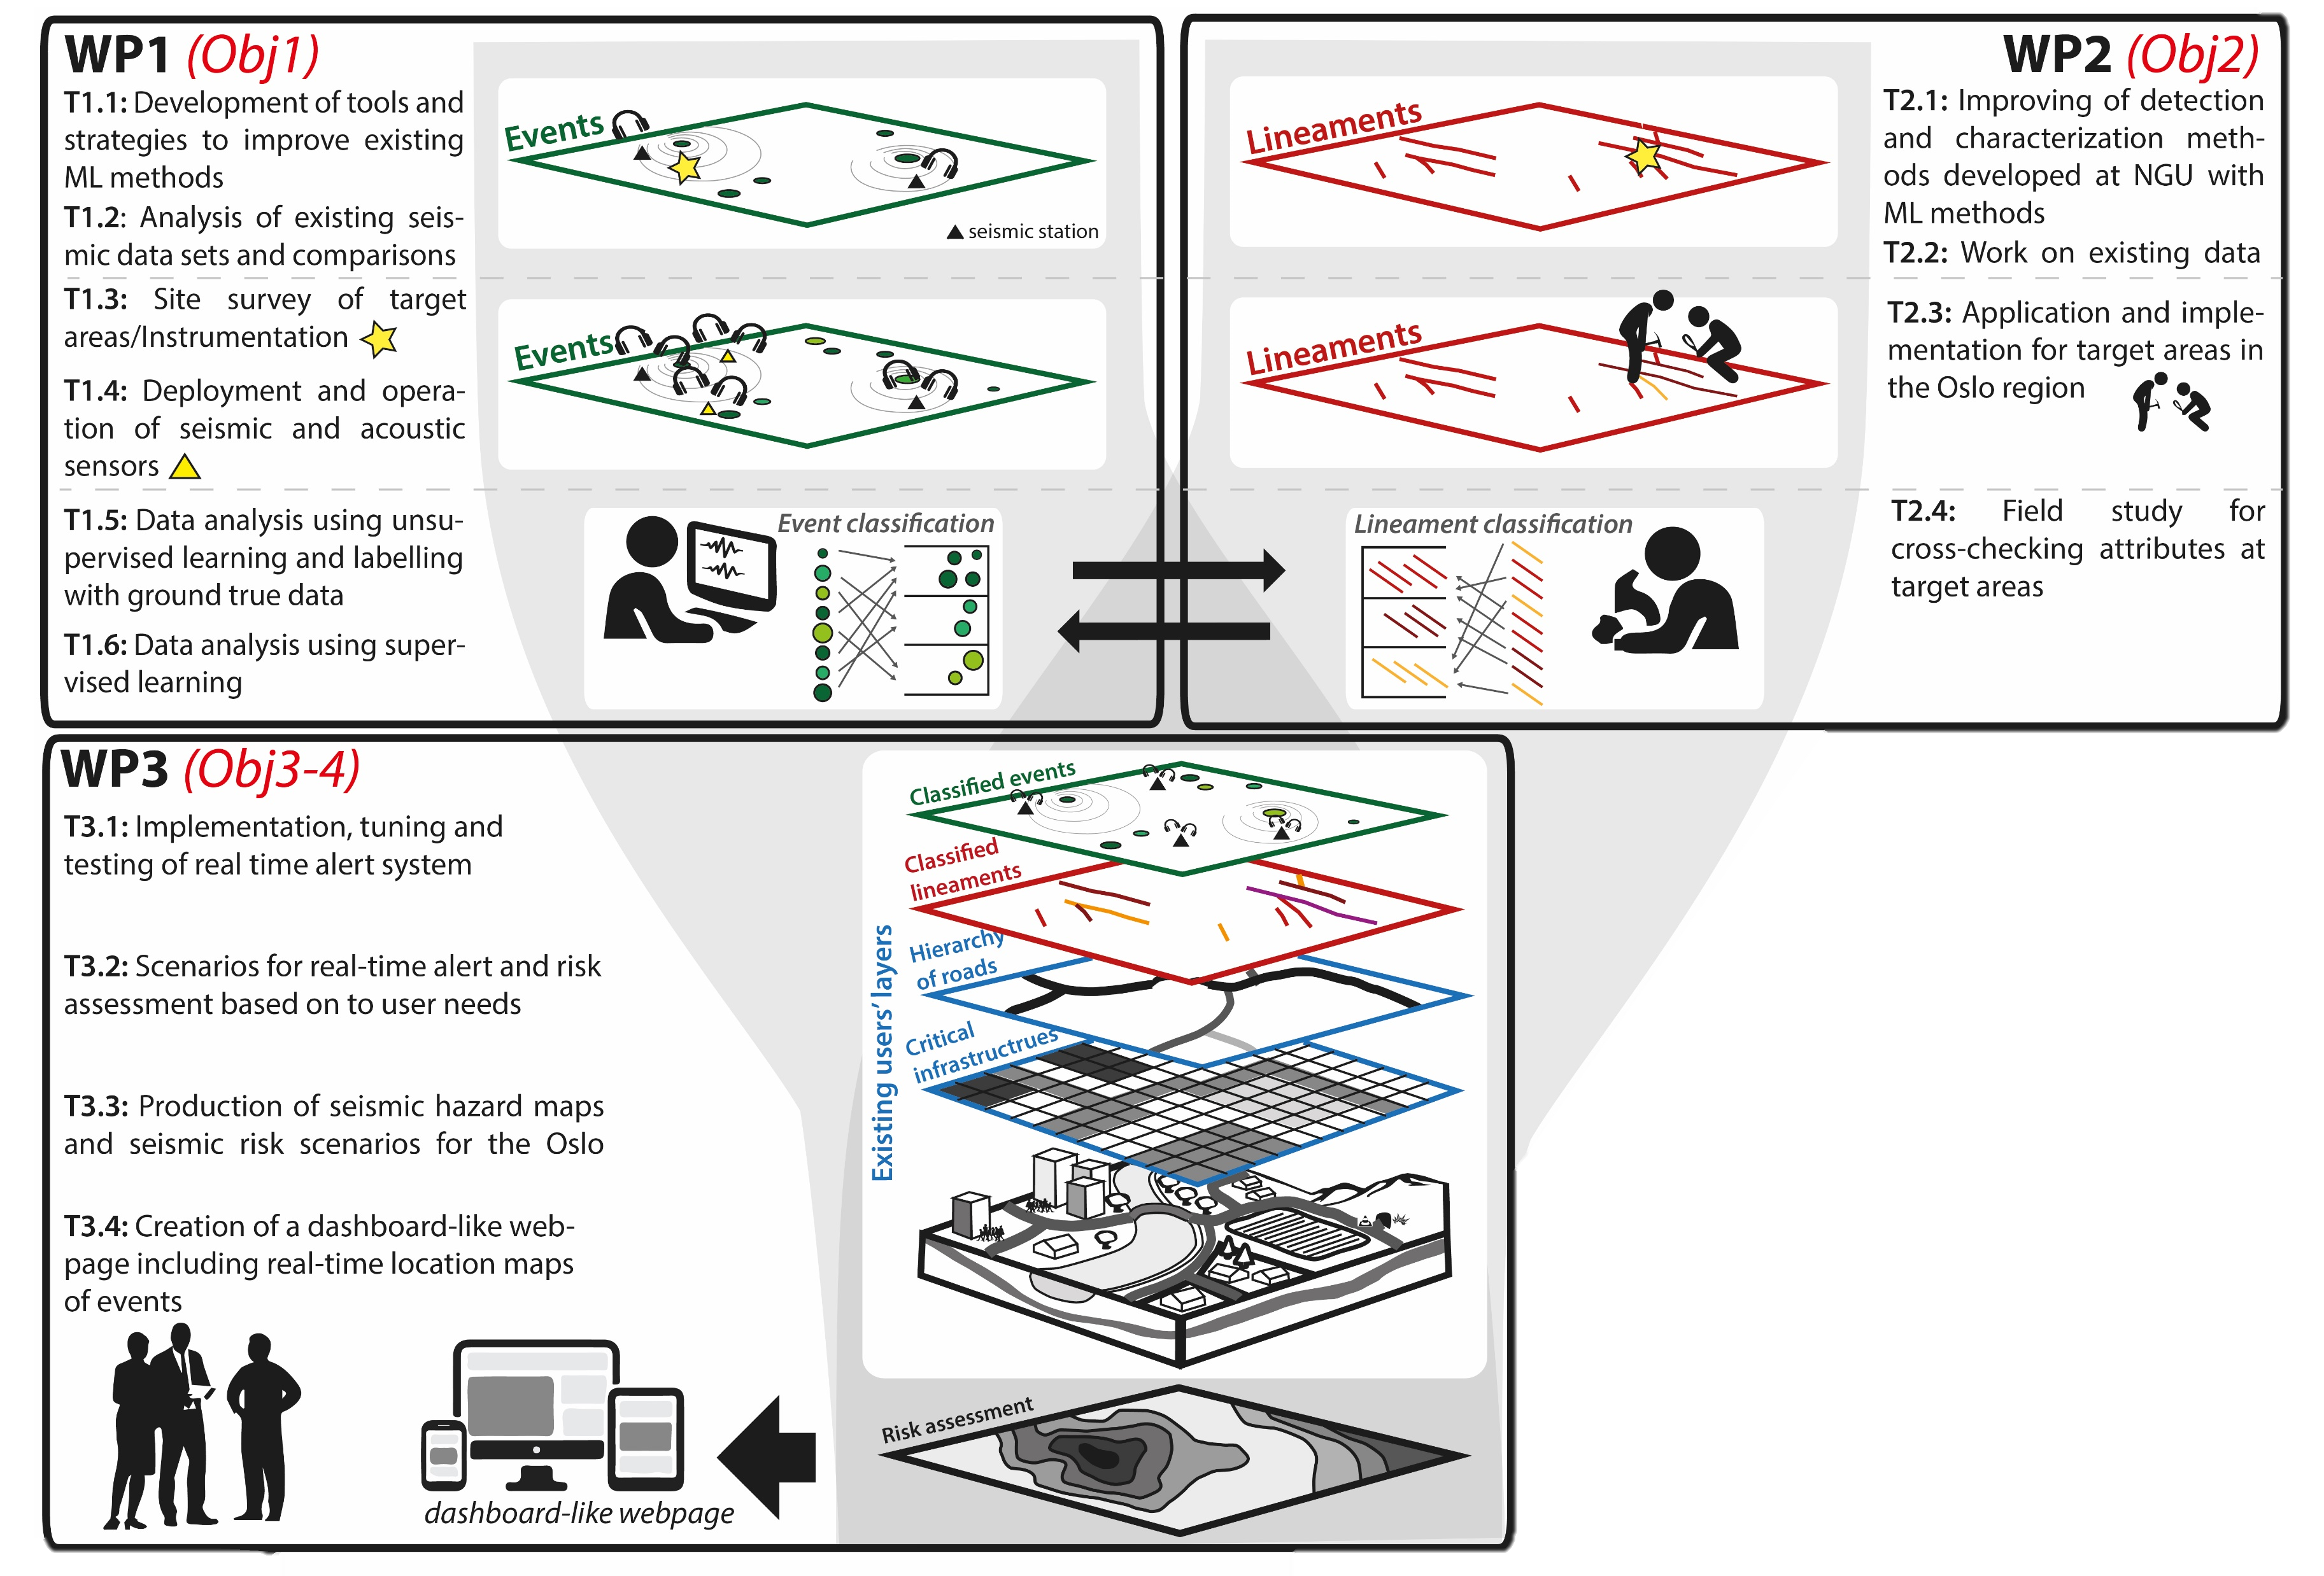




The project
Real-time alert system and seismic hazard assessment for the city of Oslo (Norway)
WP1 Seismic monitoring:
Detecting ‘unusual’ or ‘critical’ events of interest for city managers & authorities
Monitoring infrastructure and subsurface

Slide 3
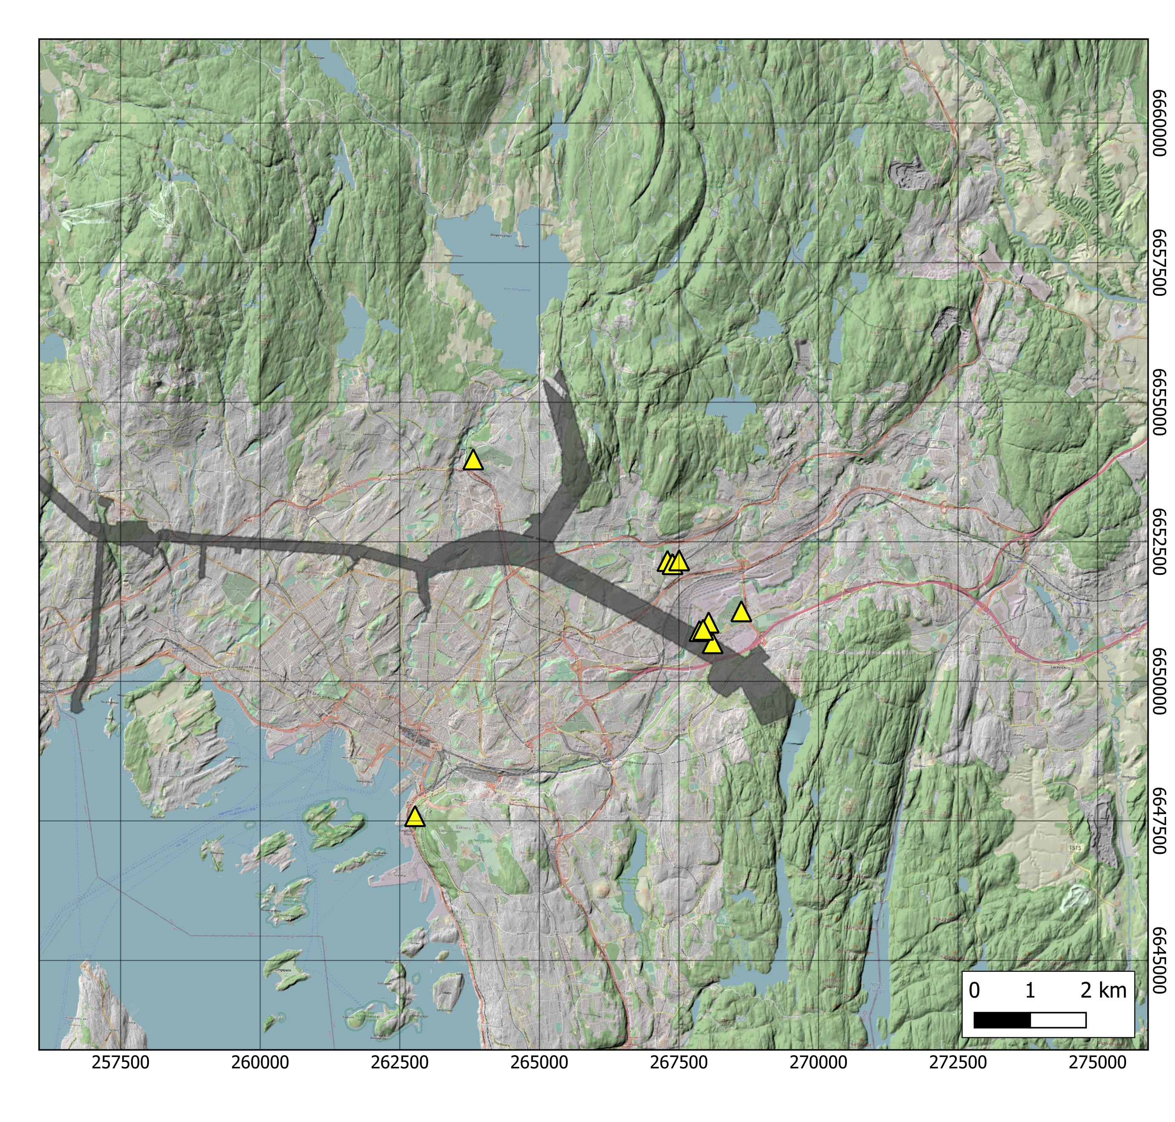

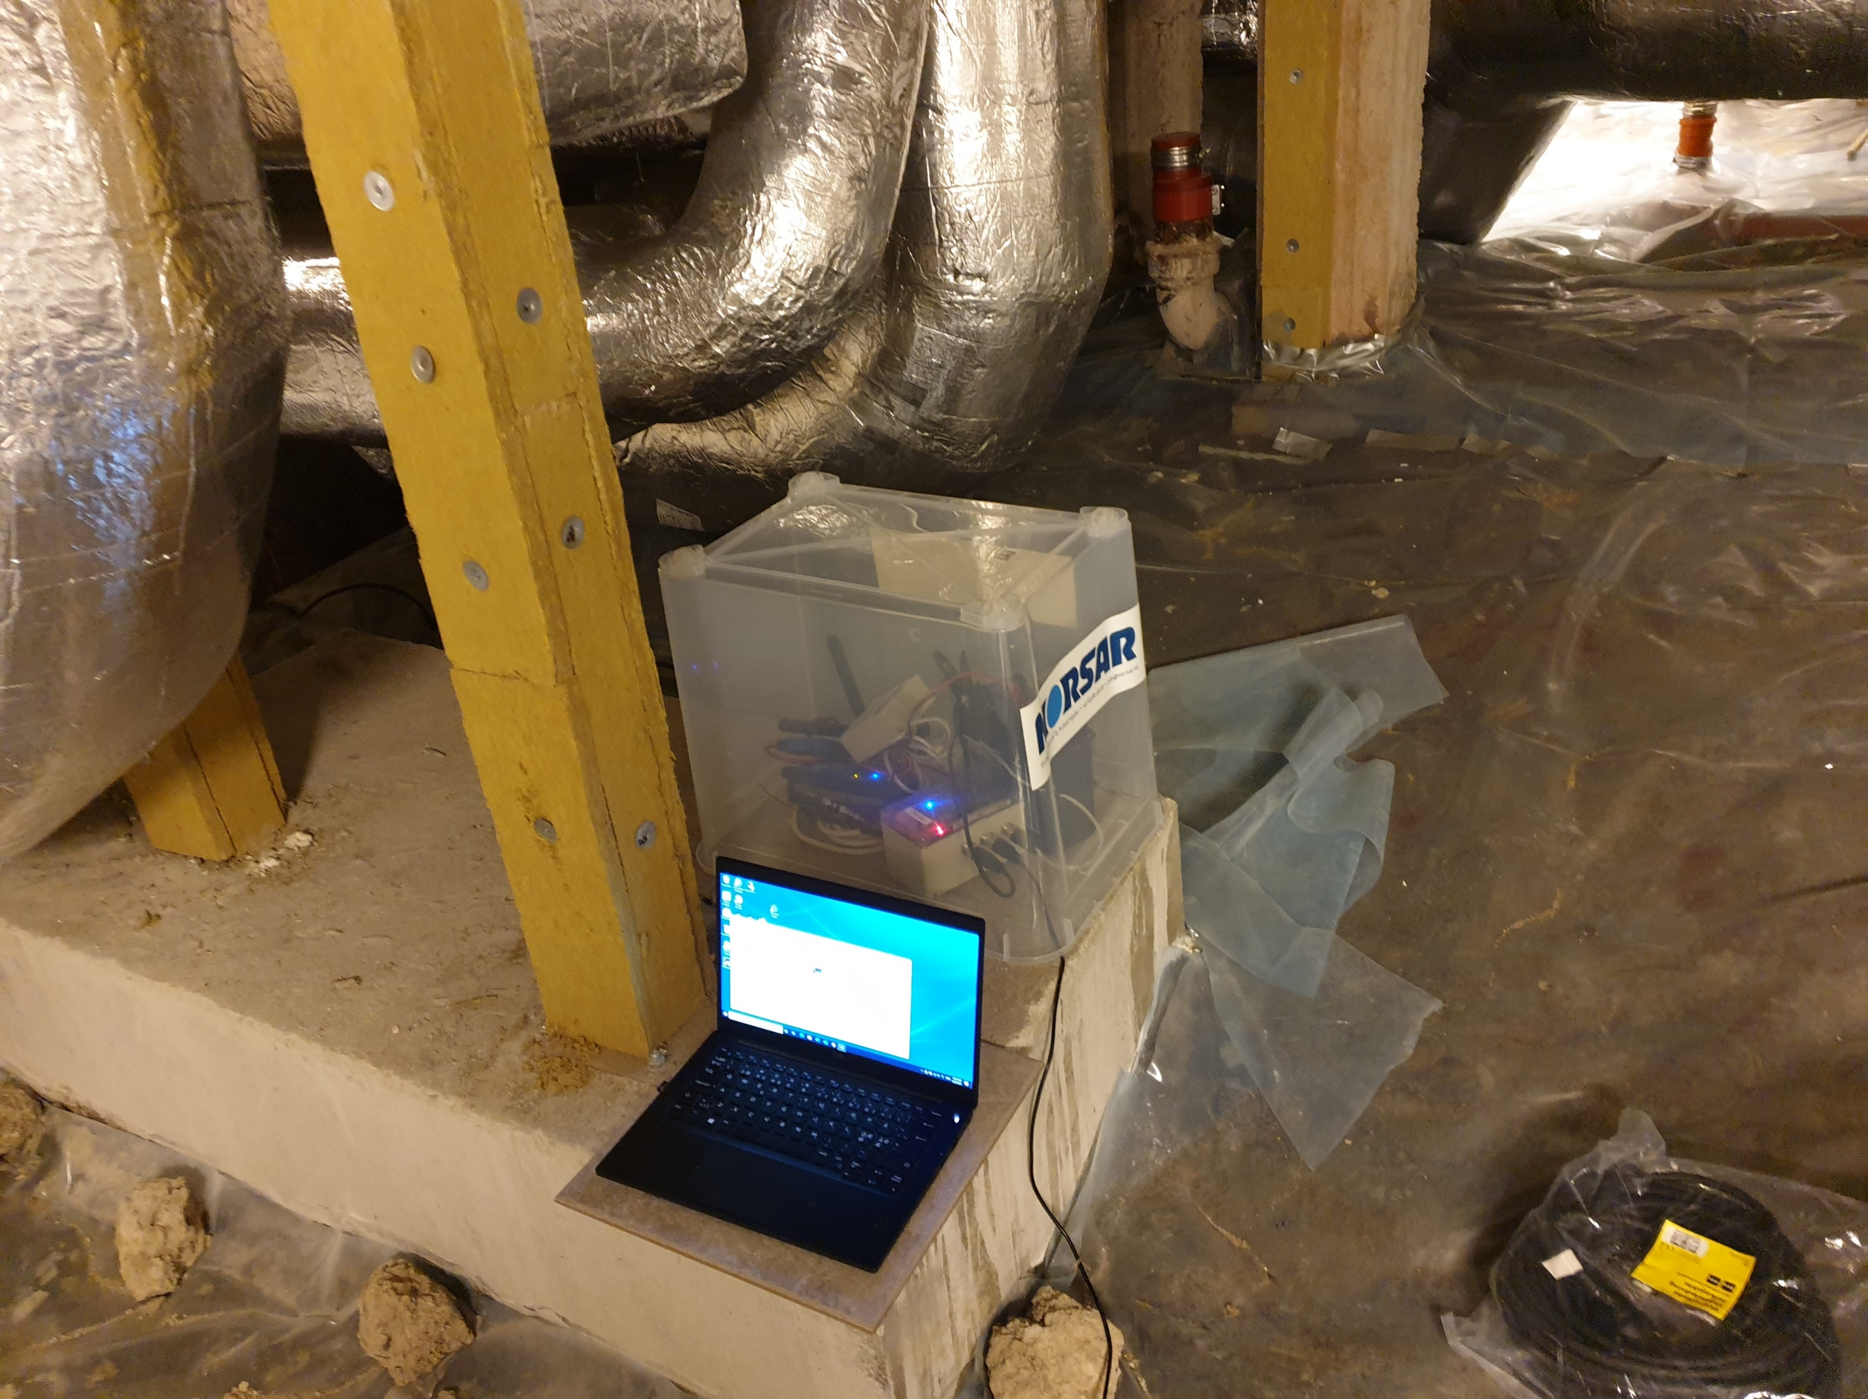
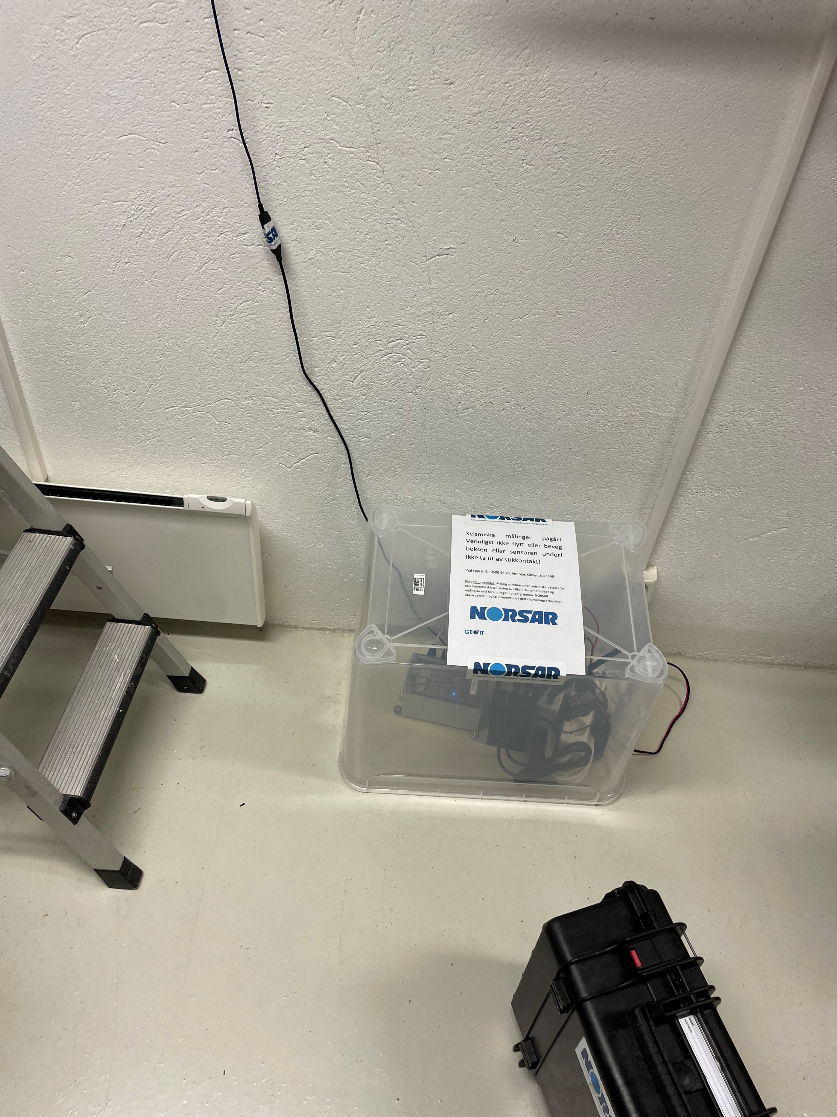
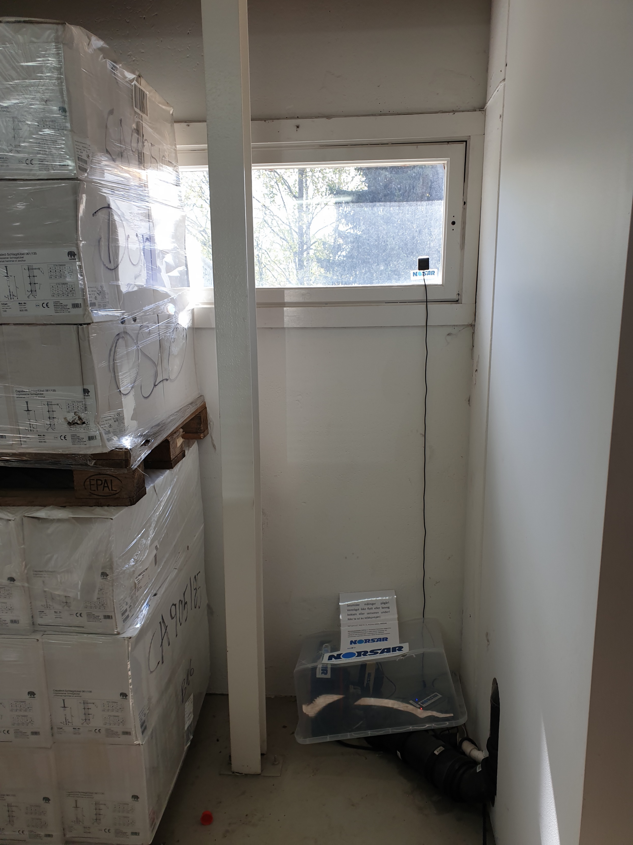
Urban seismic network in Oslo
Pilot study with 10 Raspberry Shake sensors deployed in municipality and private buildings
Targets for monitoring:
Construction of new water supply tunnels
Important infrastructure (harbor, cargo terminal)

Slide 4
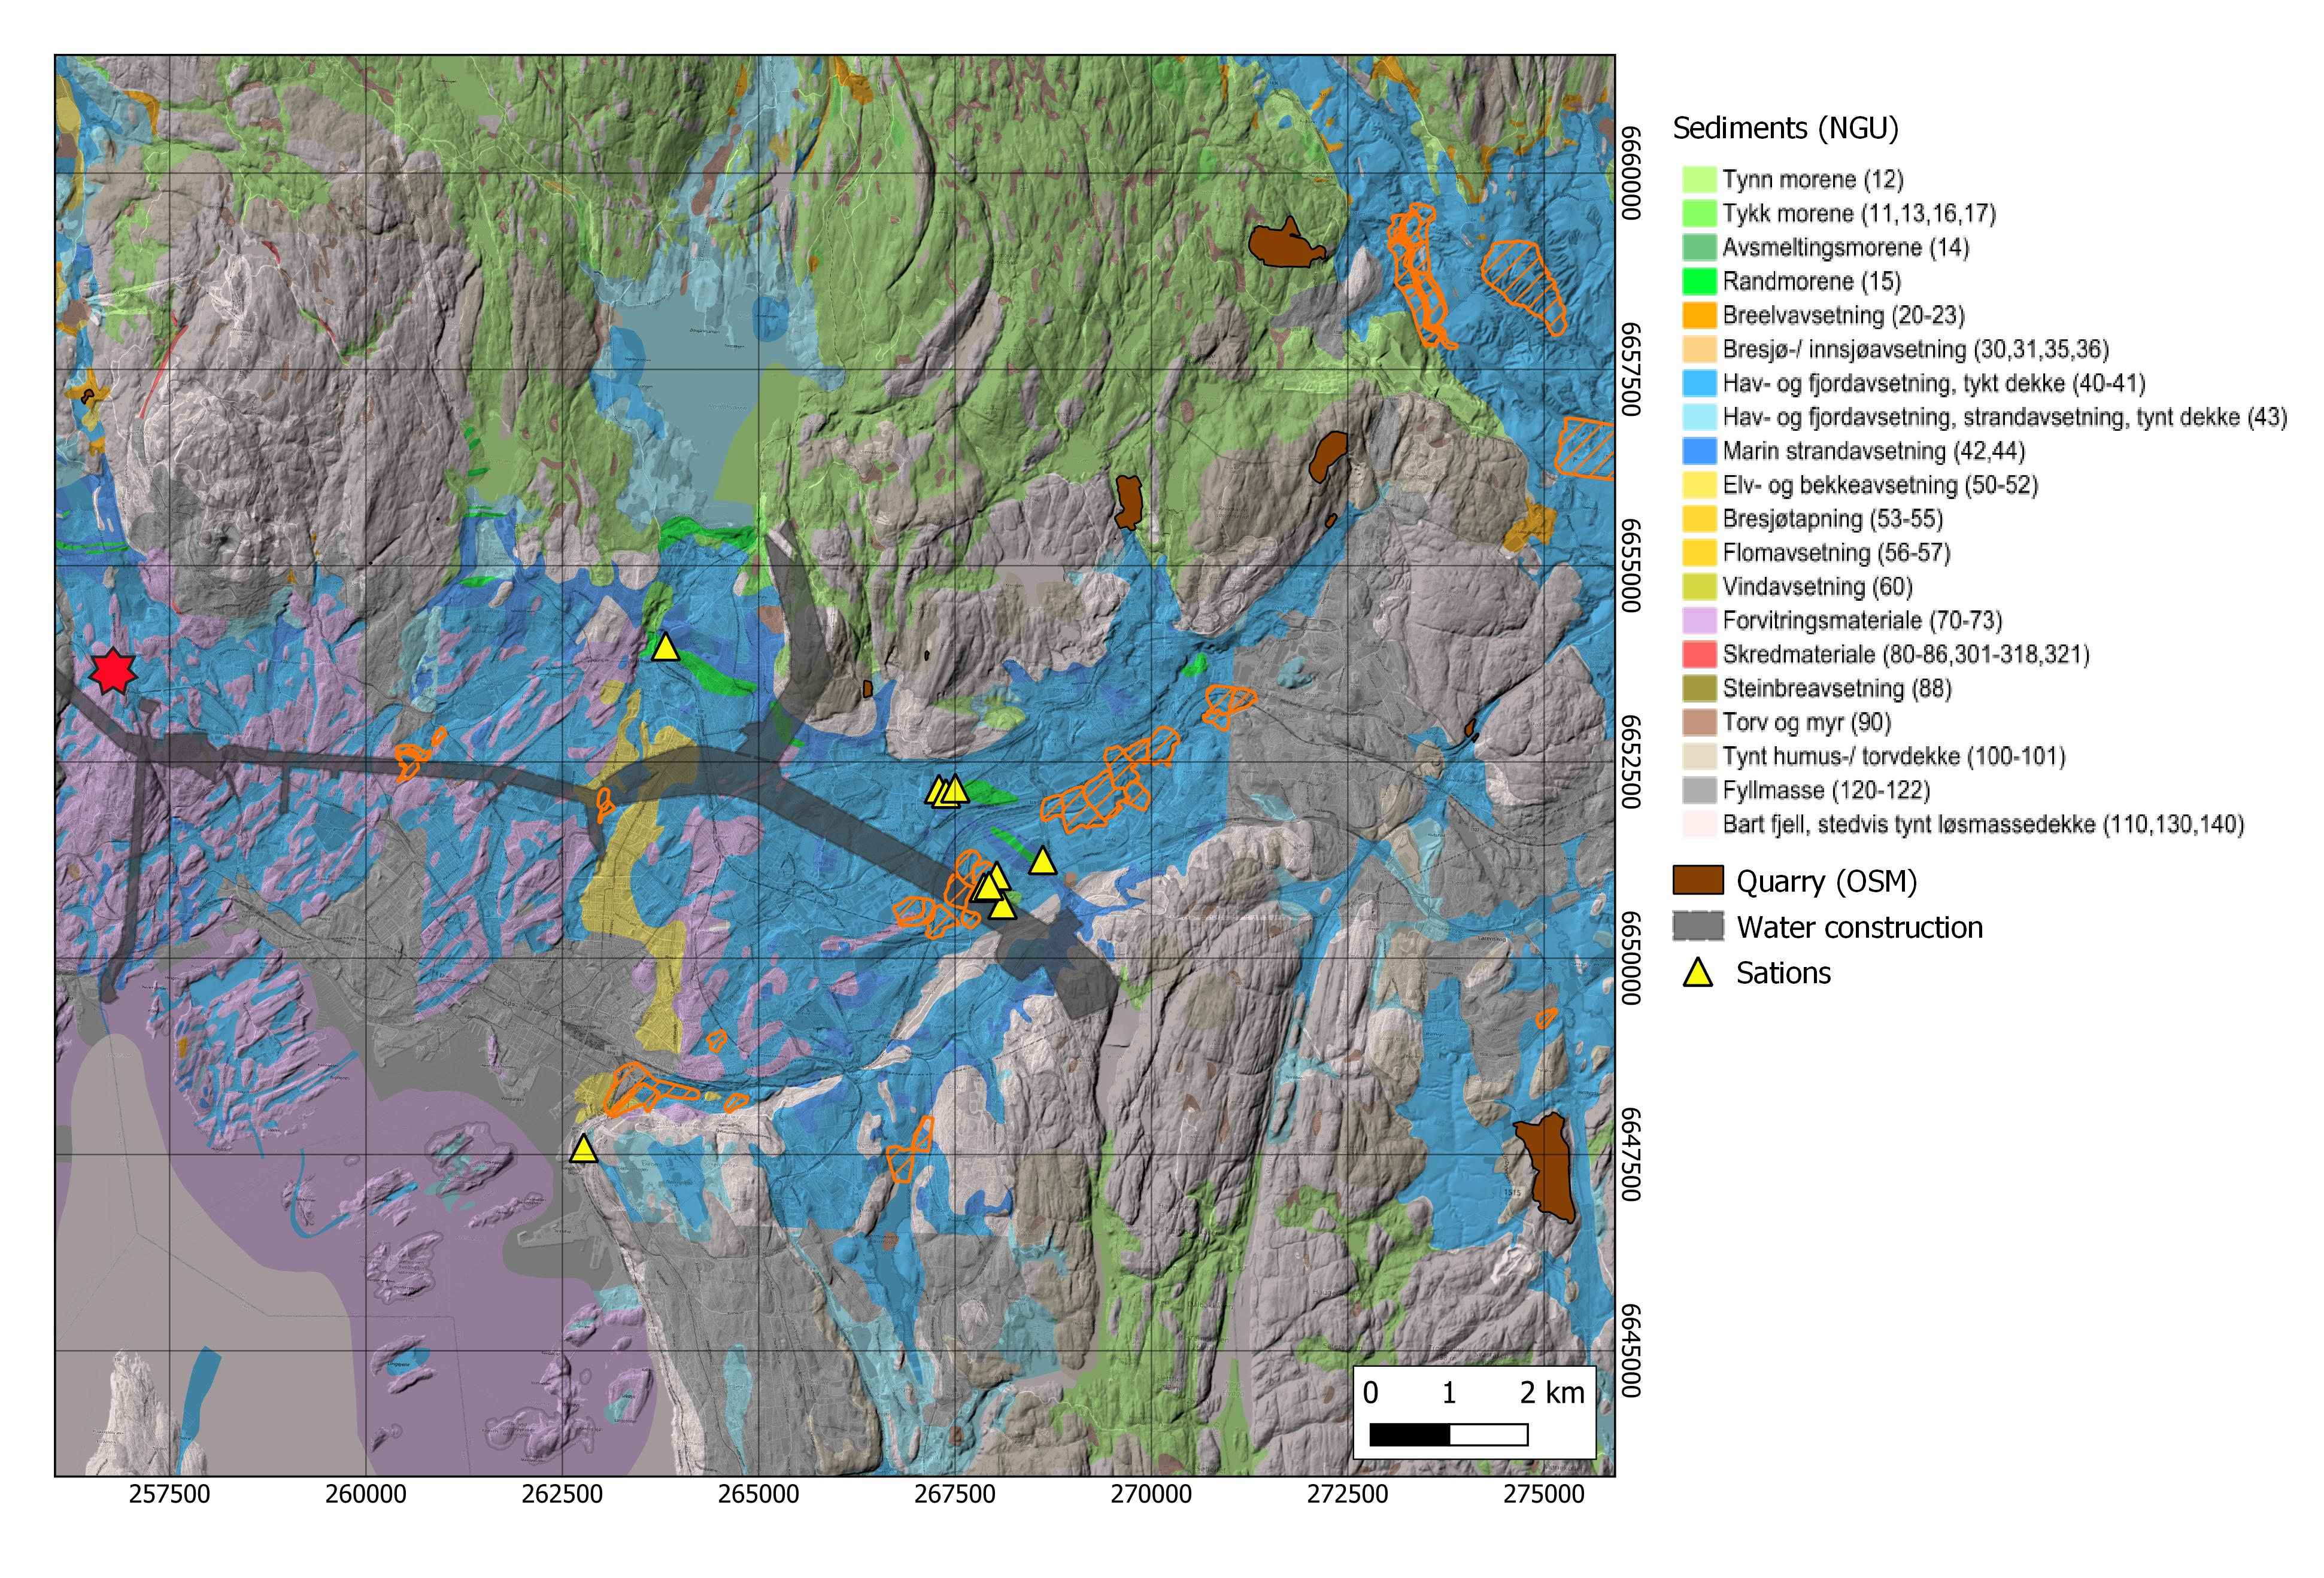

Urban seismic network in Oslo
Pilot study with 10 Raspberry shake sensors deployed in municipality and private buildings
Targets for monitoring:
Construction of new water supply tunnels
Important infrastructure (harbor, cargo terminal)
Quarries (as test cases)
Areas with quick clay in sub-surface

Slide 5
Making us of urban seismic data - Overview
Complex seismic records in urban environment: multitude of signals and high noise level
Use ambient noise for sub-surface monitoring
  Case study 1: Noise interferometry applied in busy urban area with quick clay
Automatic detection of rare or repeating events of interest
  Detect all transient signals (classic STA/LTA) but only a small part is of interest: development and test of machine learning tools
  Case study 2: Supervised classifier for repeating signals (traffic monitoring, metro trains)
  Case study 3: Unsupervised learning for:
    Event clustering to identify repeating events (not suitable for rare events)
    Detection of rare events with autoencoder trained on continuous data and assignment of badly reconstructed signals as outliers to be screened

Slide 6
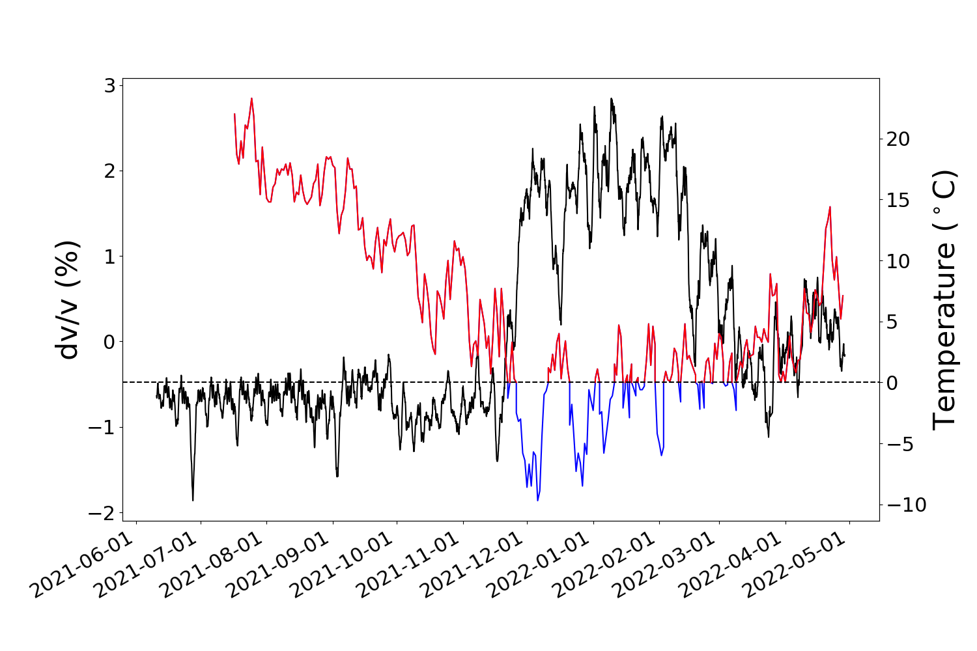
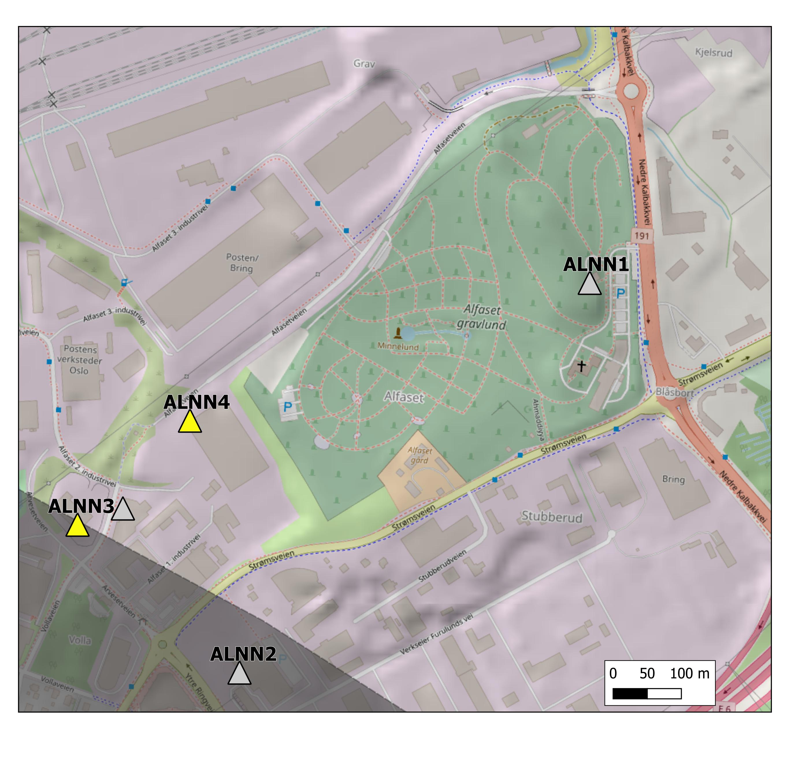
(1) Seismic noise interferometry
Relative sub-surface seismic velocity variations (dv/v) can be measured between two seismic sensors using ambient noise.
Frequency range: 3-4 Hz
Cross-correlation of one year of data
Distance between sensors: 220 m
> 0℃
< 0℃
Strong velocity variation observed during winter 2021/2022 anti-correlated with air temperature
Most likely due to ground freezing (frozen layer of less than 5 cm thickness can cause apparent velocity increases above 2%, Steinmann et al, 2021)
Potential method to observe velocity variations due to changes in quick clay

Slide 7
Machine learning toolbox for seismic data analysis
    Urban seismic records are rich in unknown signals
    Visual screening of all waveforms is a laborious job
    Detecting all events with STA/LTA can reduce workload, but still requires time-consuming event screening
    Use of unsupervised learning, clustering and intuitive data visualization can help to explore the seismic record
    Use of supervised learning once repeating signals of interest have been identified
Supervised learning
Learn from labelled examples
Unsupervised learning
Search for structures in data (e.g., clustering)

Slide 8
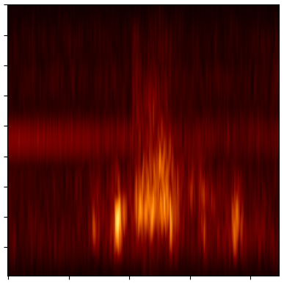
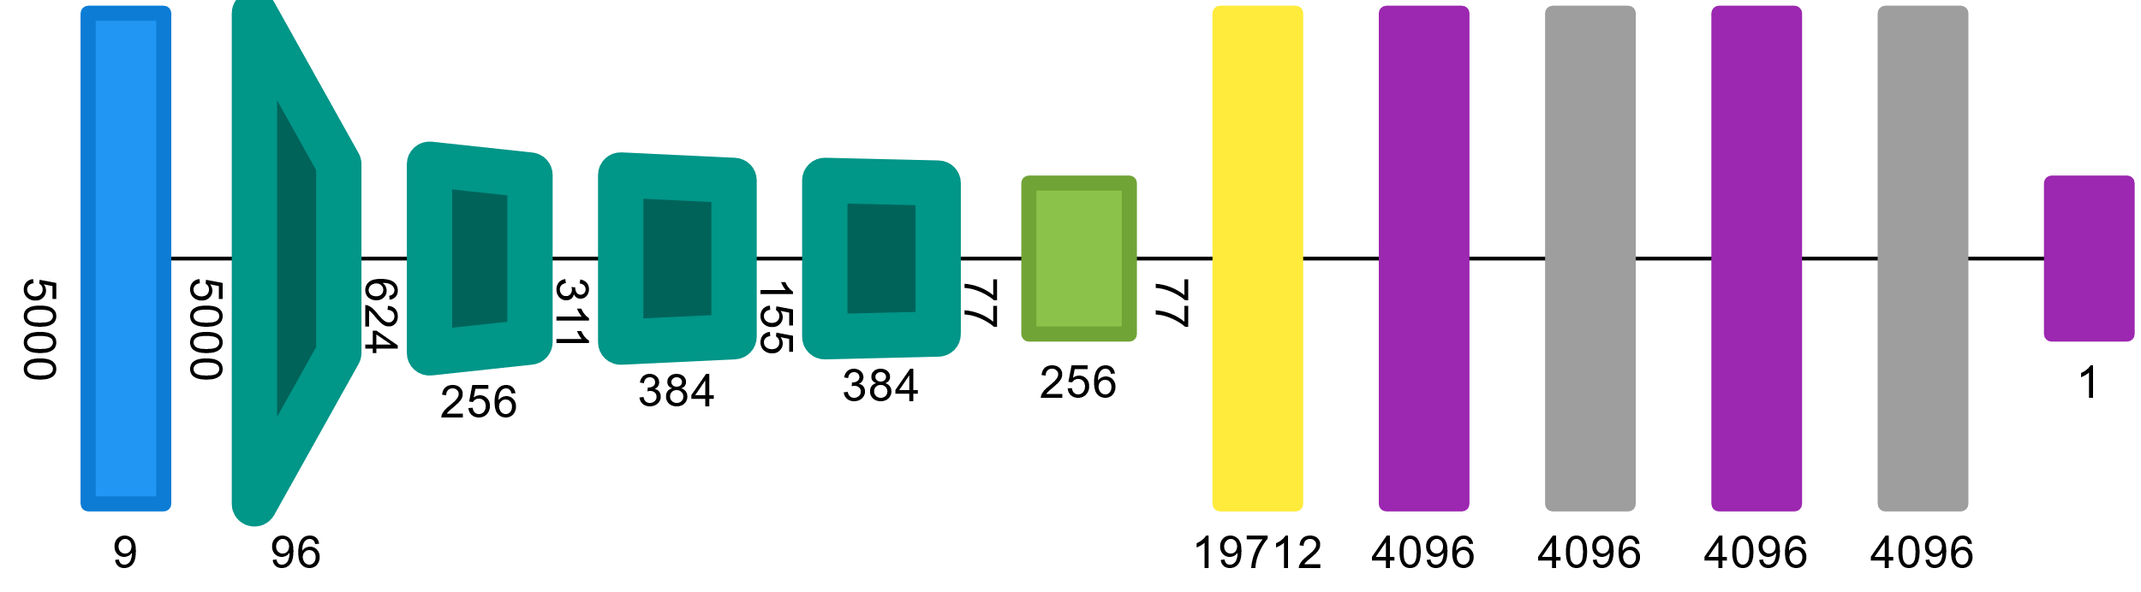
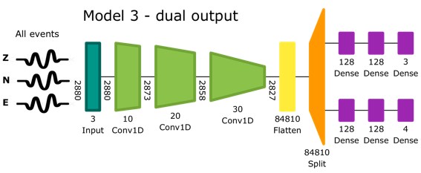
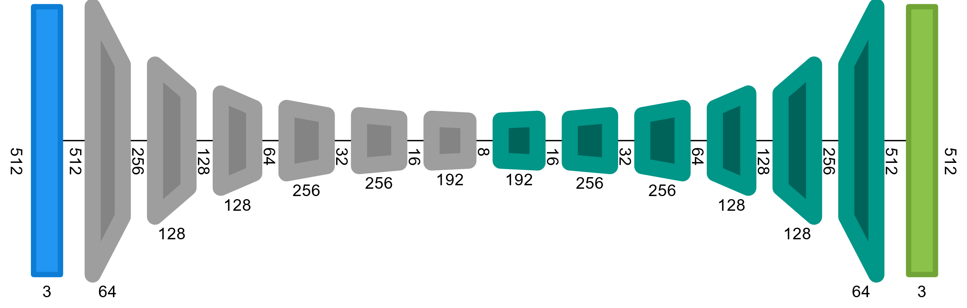
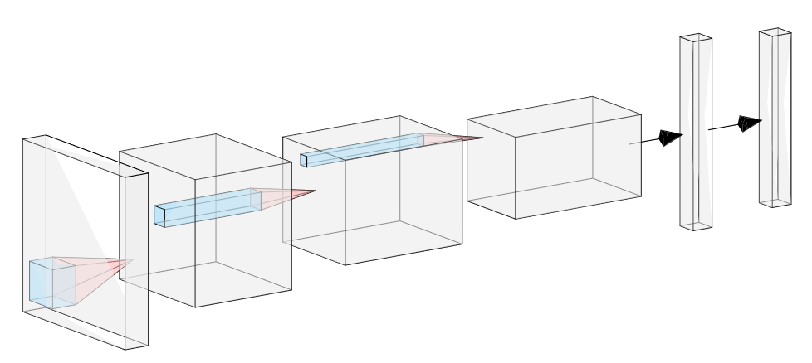

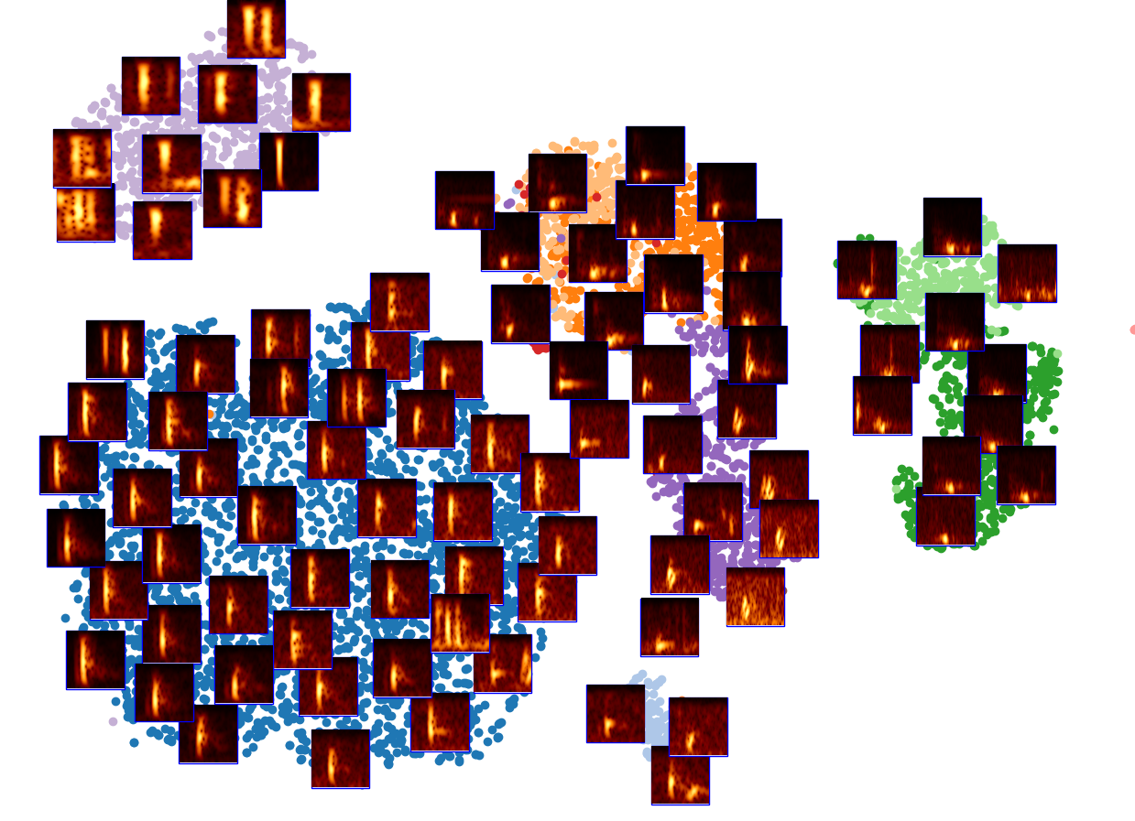
Machine learning toolbox for seismic data analysis
Unsupervised signal clustering
Supervised signal classification
Outlier signal detection
Seismic 3c data of triggered events
Spectrogram images
Manually select repeating events and train CNN
Learn to reconstruct signals using a lower number of features
Extract features with pretrained image recognition CNNs
Application to continuous data to detect more of those events
Model trained on classes of repeating signals and background noise
Application to continuous or pre-triggered data (STA/LTA) to detect events not well-reconstructed
Metric: correlation between input and output seismic signal
Use combination of methods depending on seismic record composition and monitoring purpose
Identify groups of seismic event classes by visualization in 2D embedding space

Slide 9
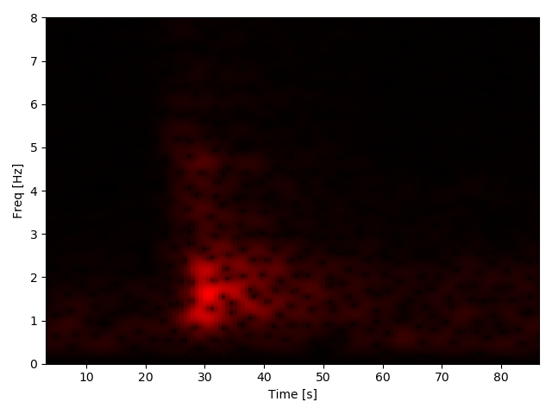
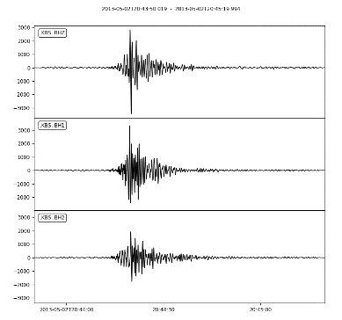
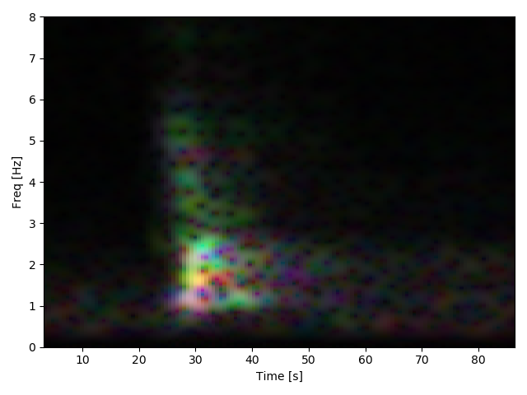
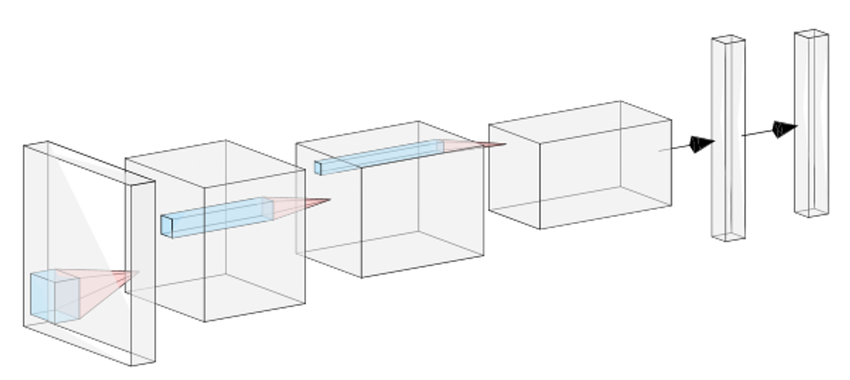
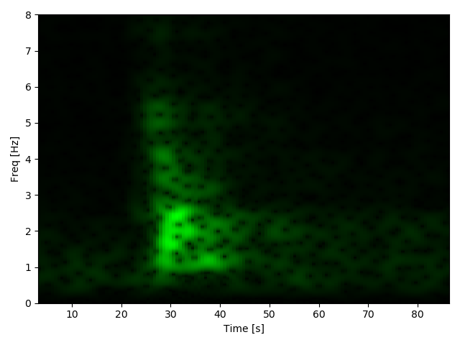
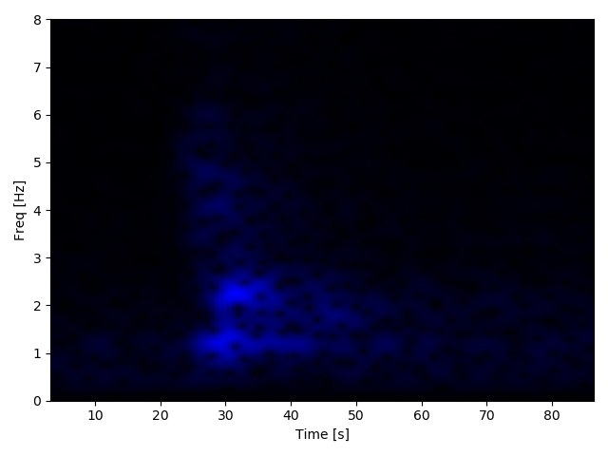
Machine learning toolbox: Unsupervised signal clustering
    Compute spectrograms of three-component seismic data, combined as RGB images and directly apply state-of-the-art models like ResNet, InceptionNet *, for feature extraction
    Classification step is removed and replaced by a dimension reduction and clustering algorithm
Z
R
Pre-trained base model: spectrogram features become invariant to translation in time
Classification
Three-component RGB images
N
G
E
B
Or flattened spectrogram:
We loose invariance to translation & dilatation in time!
Clustering and intuitive 2D visualization
Or mono-chromatic image by averaging ZNE components
[*] Szegedy, Christian, et al. "Going deeper with convolutions." Proceedings of the IEEE conference on computer vision and pattern recognition. 2015.

Slide 10
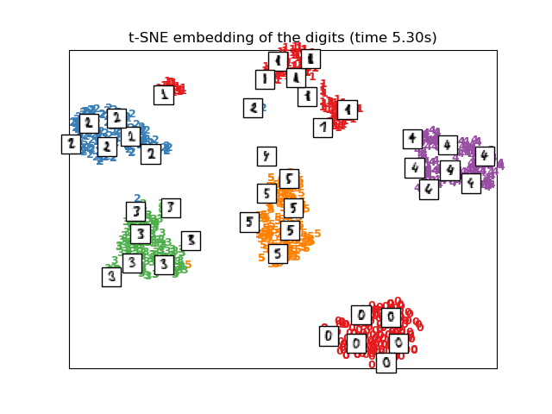
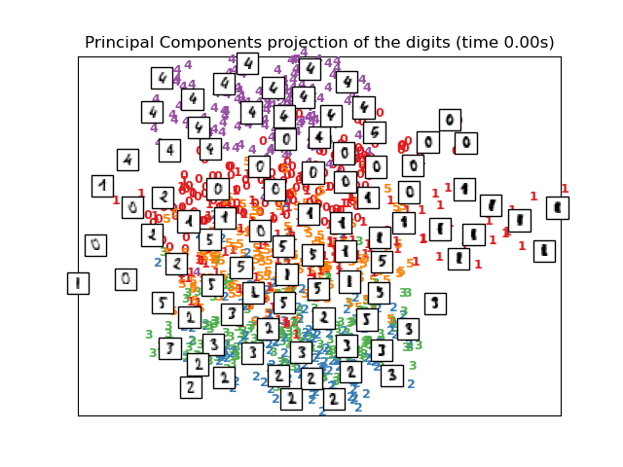
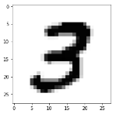
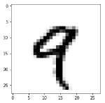
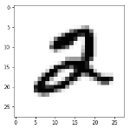
Machine learning toolbox: Unsupervised signal clustering
    CNN output is visualised in two dimensions (reduced from 2048): here t-SNE (manifold learning)
    t-SNE converts pairwise similarities of data points to probabilities in the original (Gaussian) and output space (t-distribution). The similarity of probabilities (Kullback-Leibler divergence) in the original space and the embedded space is minimized to achieve best visualization.
Pre-trained base model
Classification
Select 50 PCA components
t-SNE: The labels (colors) are not used
2 PCA components without t-SNE
Intuitive visualization through dimensionality reduction
In this example the images are handwritten digits (not spectrograms) – but the idea is the same
https://scikit-learn.org/stable/modules/manifold.html#t-distributed-stochastic-neighbor-embedding-t-sne

Slide 11
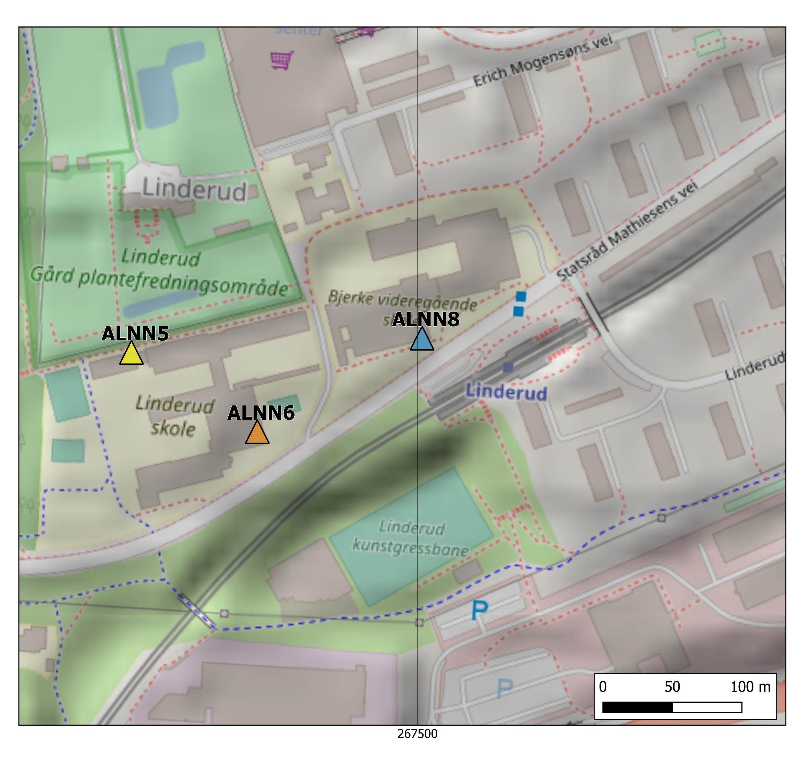
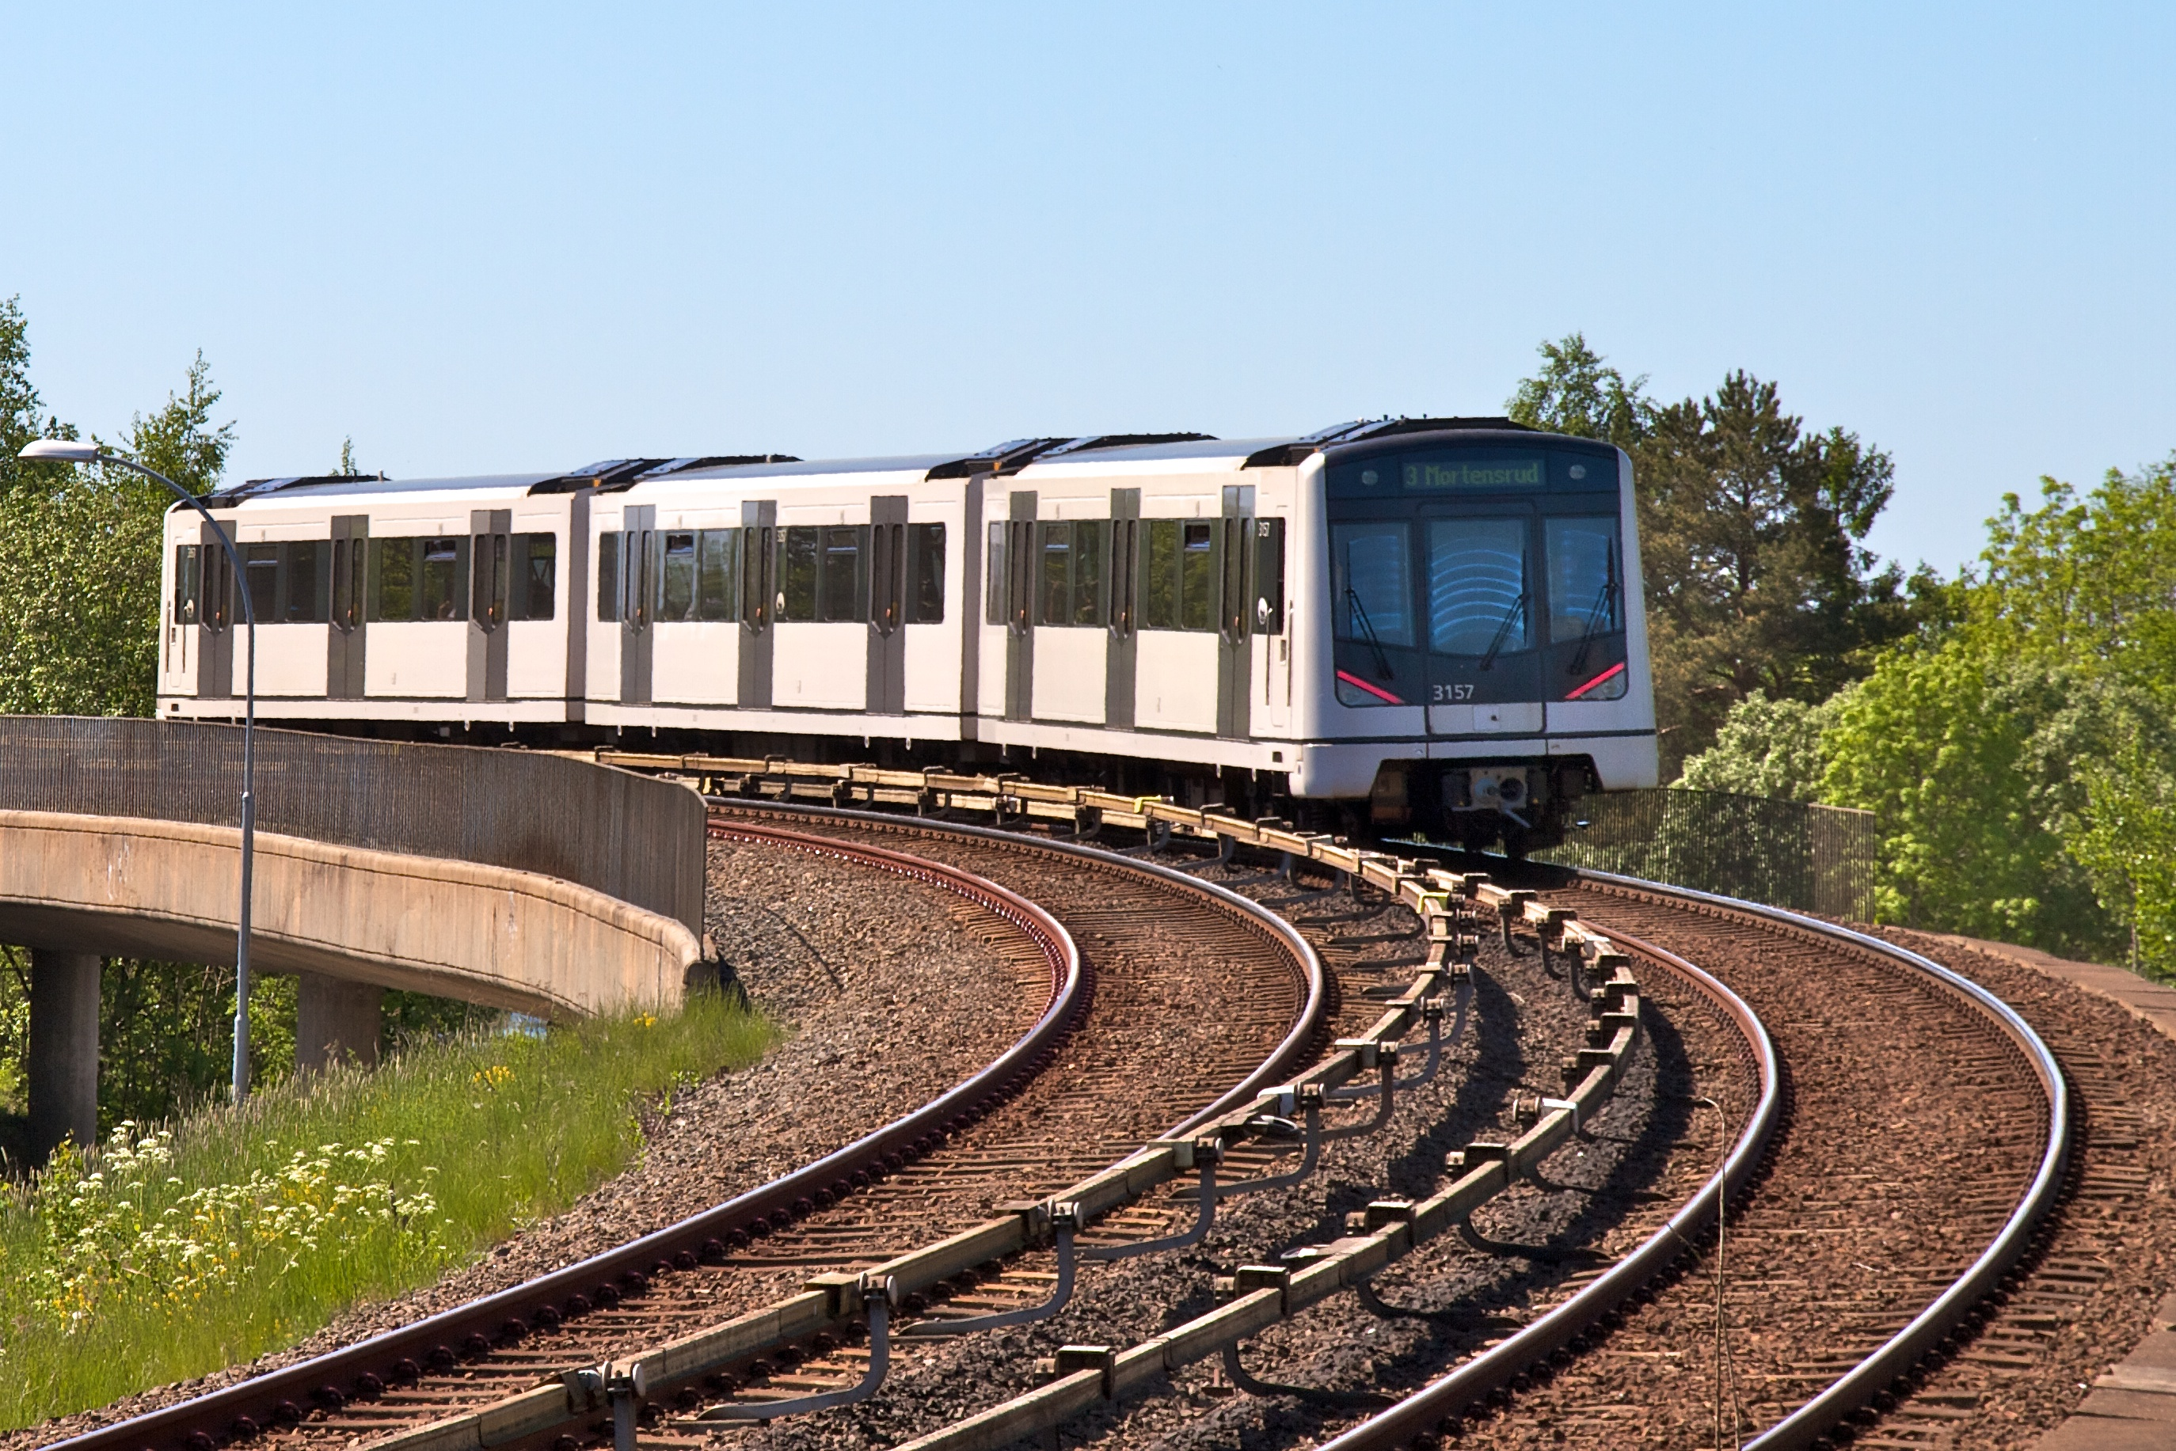
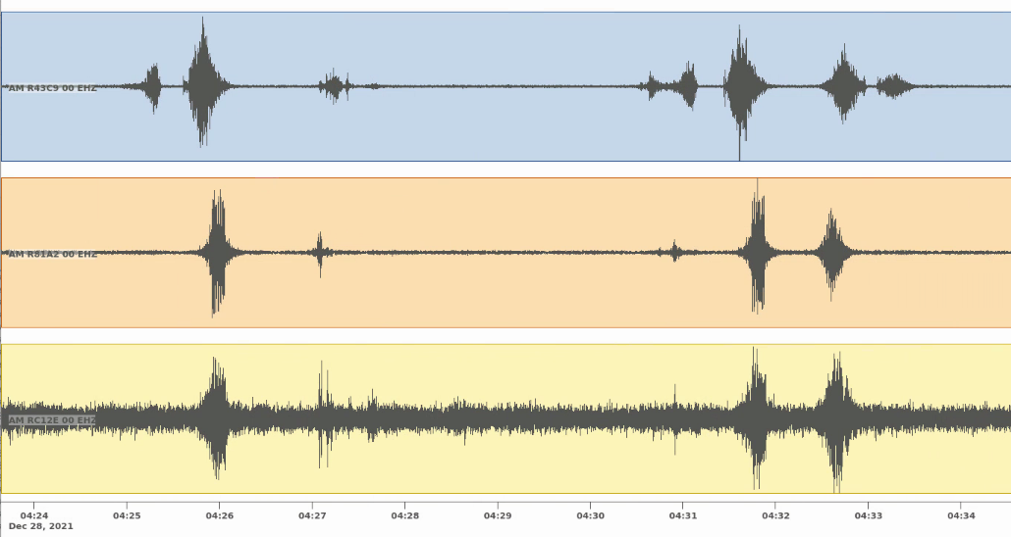
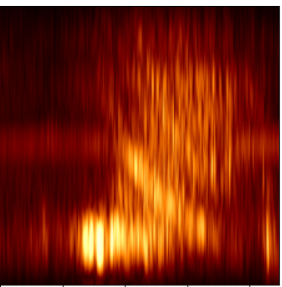
(2) Metro train detection
A Case study for detection of repeating signals in noisy environments
Good noise conditions
Passes the other sensors a bit later
Leaves station and passes first sensor
Trains arrives at station
Stop at Station
ALNN8
Spectrogram image
ALNN6
Metro station
ALNN5
Metro track
Metro track
Westbound trains
Eastbound train

Slide 12
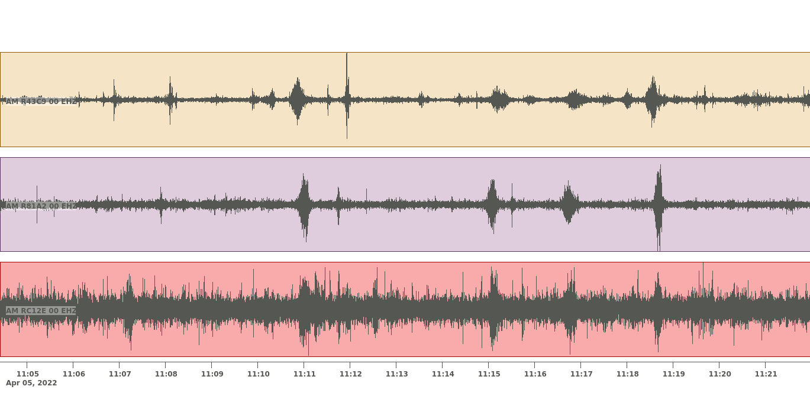
(2) Metro train detection
A Case study for detection of repeating signals in noisy environments
Bad noise conditions (rush hours)
Trains
ALNN8
ALNN6
Metro station
ALNN5
Metro track

Slide 13
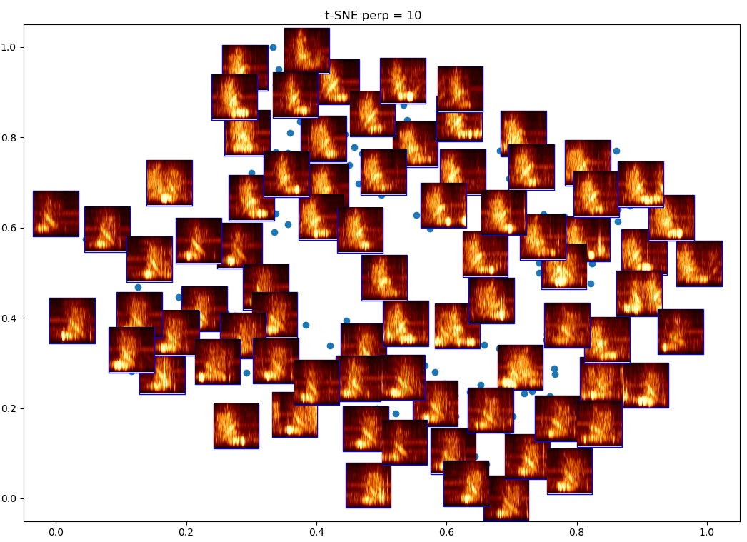
(2) Metro train detection
Westbound
Visualization of spectrogram image similarity in embedding space of manually picked metro train signals
Difference between east- and westbound trains clearly visible (acceleration and deacceleration of trains)
Eastbound

Slide 14
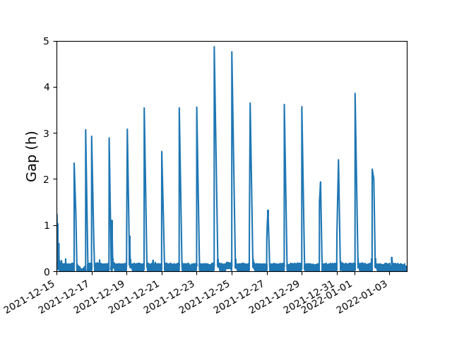
(2) Metro train detection
Input
Output
Supervised training of convolutional neural networks with visually identified train signals on 3 stations along track
Performance on test data: 99% accuracy for train vs. noise and 95% accuracy for train direction
Application to continuous data:
  99% of manually picked detected
  13% false detections
  63% directions correctly classified
  Potential applications:
    Sort out to find rare events
    Disruptions in train schedule
    Use for noise interferometry
3 stations = 6 channels
Metro train or not (super-class)
ALNN8
1
ALNN6
Run this model if train detected:
ALNN5
Eastbound trains
Westbound trains
Mixed or unclear (sub-classes)
3
Time gap between train detections

Slide 15
(3) Outlier detection
Train convolutional autoencoder on background noise and repeating signals
To detect events, evaluate correlation between observed and re-constructed signal
Correlation coefficient
Application to:
  Continuous data (would also captures changes in background noise)
  Here: Pre-triggered events (only transient event outliers)

Slide 16
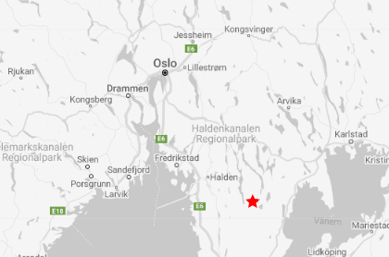
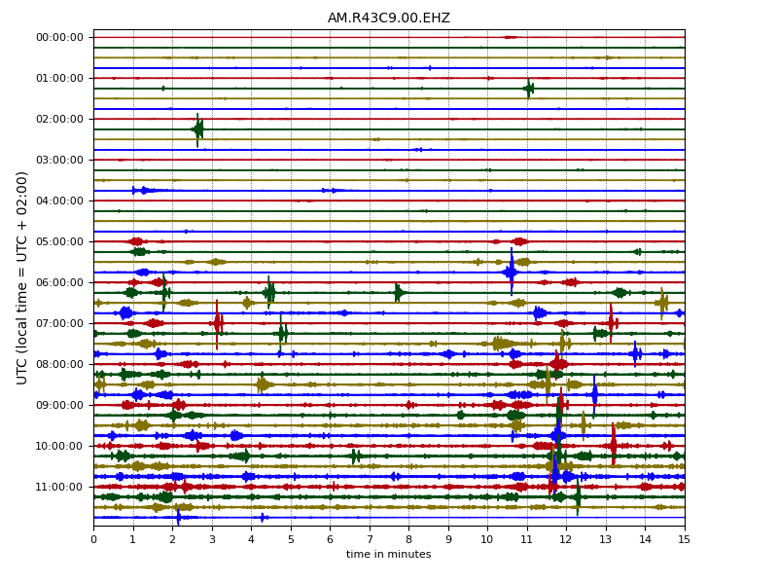
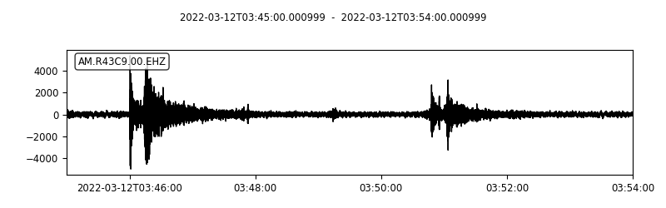
(3) Outlier detection: Example 1
Two local earthquakes (distance to Oslo 110 km): should be detected
Metro trains: should not be detected

Slide 17
(3) Outlier detection: Example 1
Autoencoder method applied to STA/LTA detections (one day)
 | Earthquakes | Metro trains | Total Detections
STA/LTA (threshold=11) | 2 | 4 | 6
+ outlier detection | 2 | - | 2
STA/LTA (threshold=5) | 2 | 180 | 299
+ outlier detection | 2 | 1 | 10
Frequent metro train detections are sorted out and earthquakes are kept
Less detections for further event screening

Slide 18
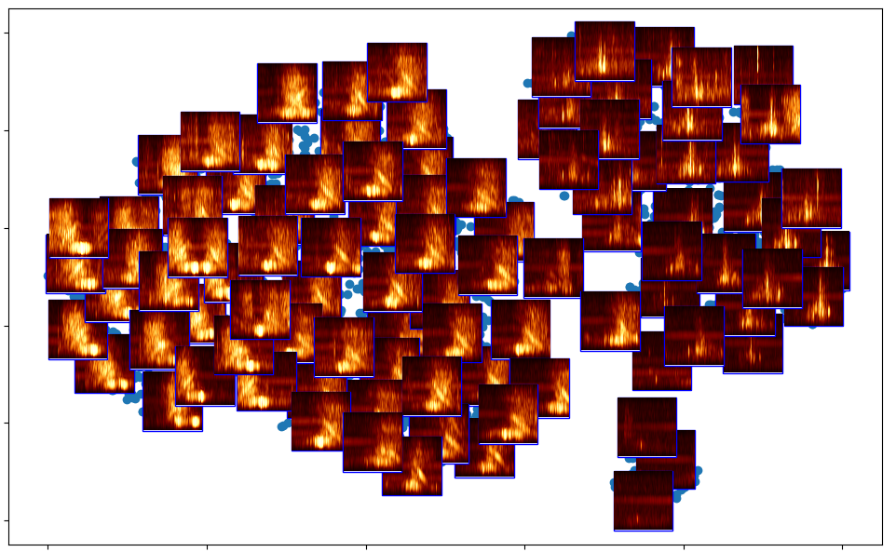
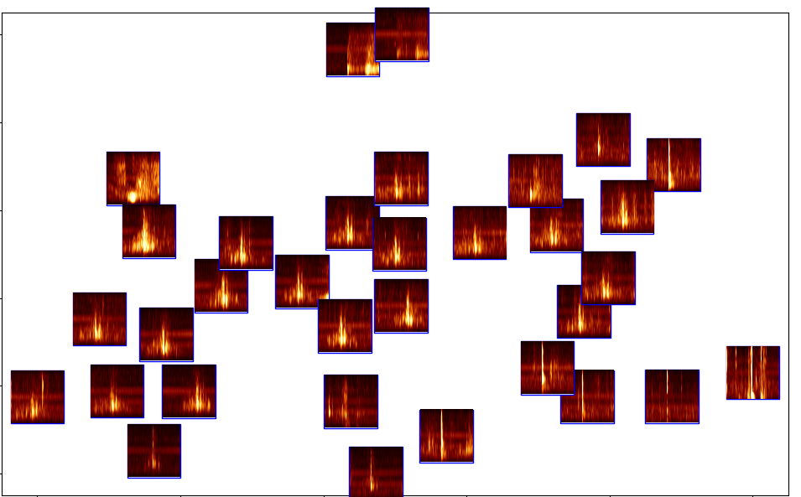
(3) Outlier detection: Example 1
Outliers after applying autoencoder method to STA/LTA detections
Spectrograms of STA/LTA detections in 14 days
Earthquakes are easier to identify
Metro trains
Other signals
Where are the earthquakes?

Slide 19
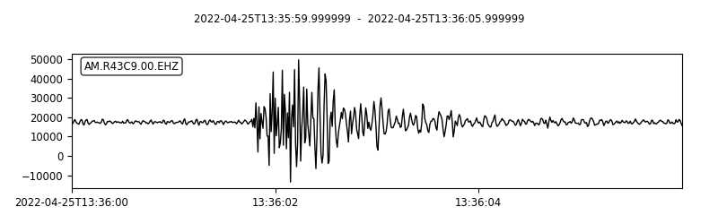
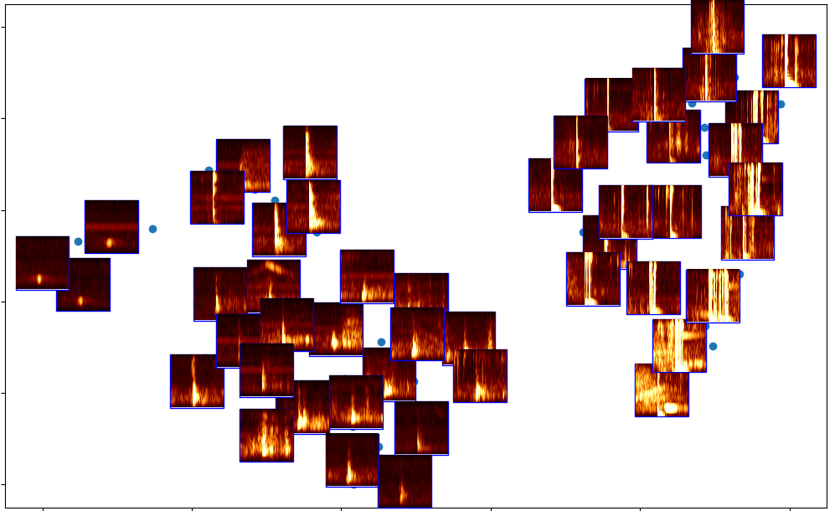
(3) Outlier detection: Example 1
Outliers after applying autoencoder method to STA/LTA detections (threshold=11) in 6 months
Local (construction?) blasts
Mostly disturbances close to sensor (people)

Slide 20
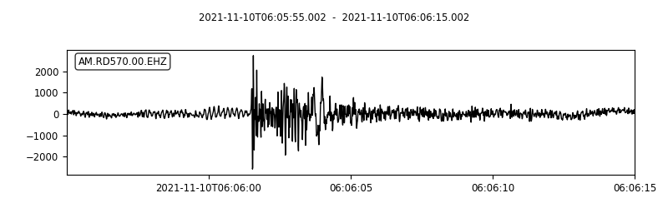
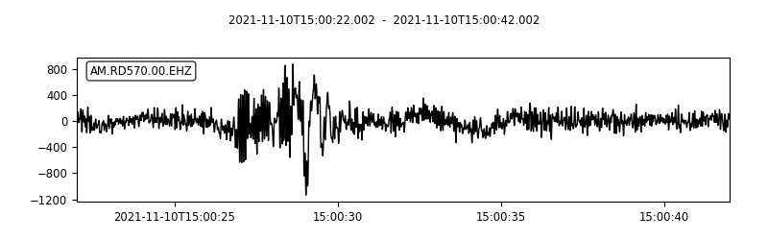
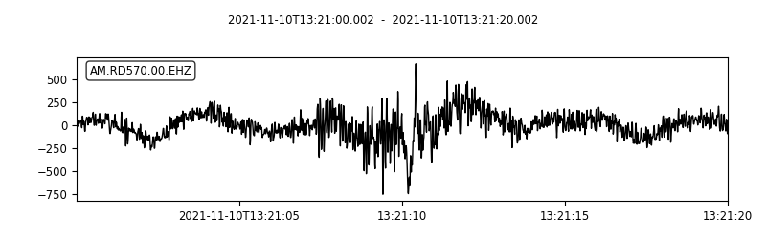
(3) Outlier detection: Example 2
  Blasts related to construction of new water supply system and quarry blasts

Slide 21
(3) Outlier detection: Example 2
Autoencoder method applied to STA/LTA detections (15 days in November 2021)
Comparison with blast signals confirmed by visually screening
 | Blasts | Total Detections
STA/LTA (threshold=4) | 17 | 141
+ outlier detection | 16 | 33
Except for one event the outlier detection method keeps the blasts and sorts out other transient signals not of interest
Less detections for further screening

Slide 22
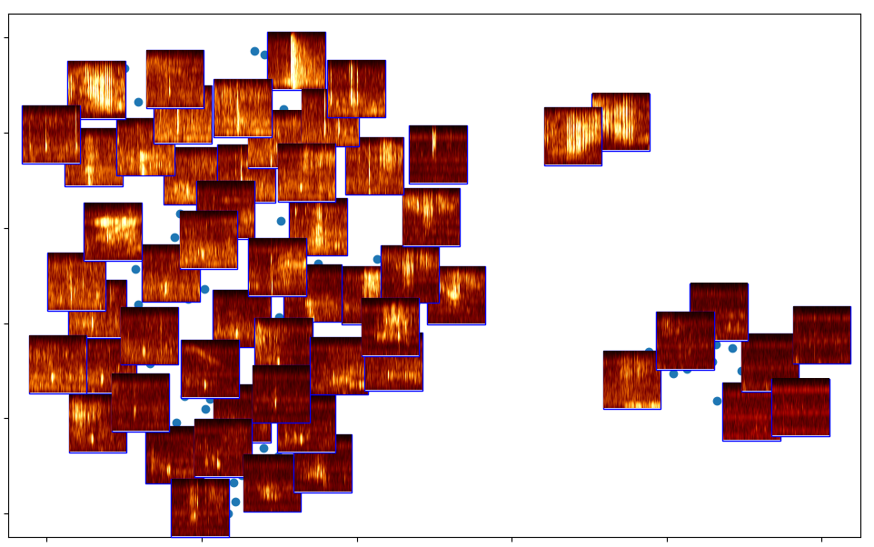
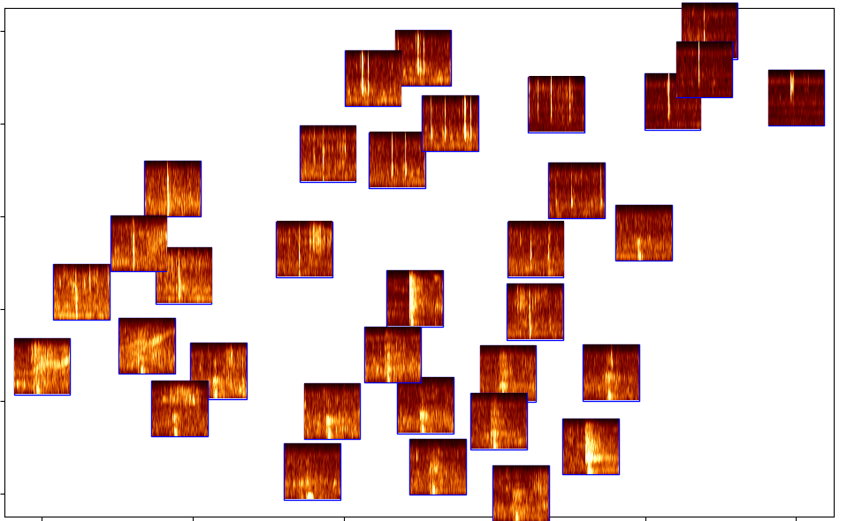
(3) Outlier detection: Example 2
Outliers after applying autoencoder method to STA/LTA detections
Spectrograms of STA/LTA detections in 15 days
Rare blasts are easier to identify
Where are the blasts?

Slide 23
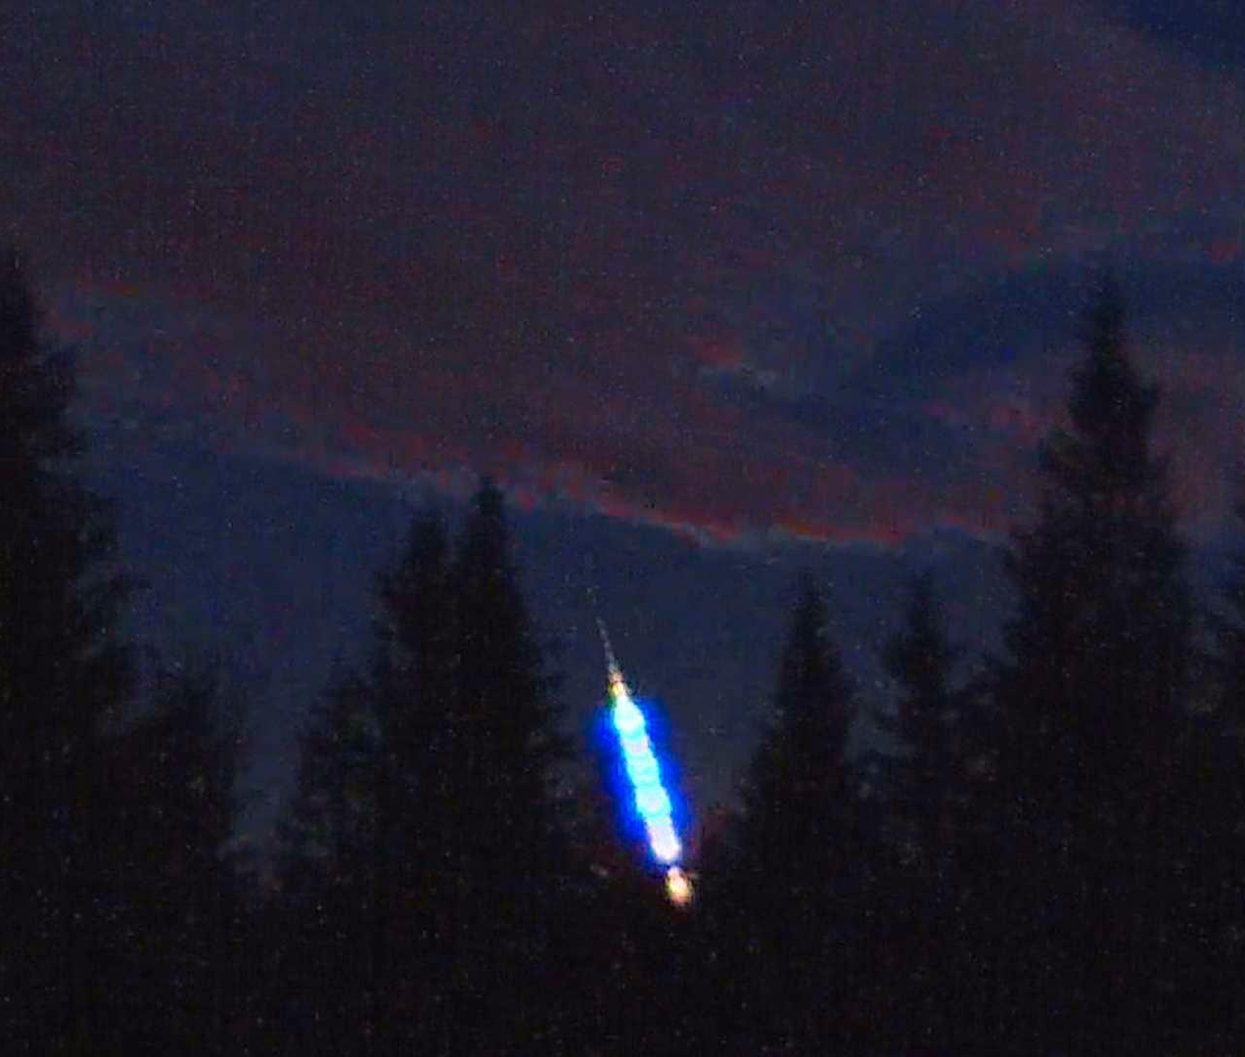
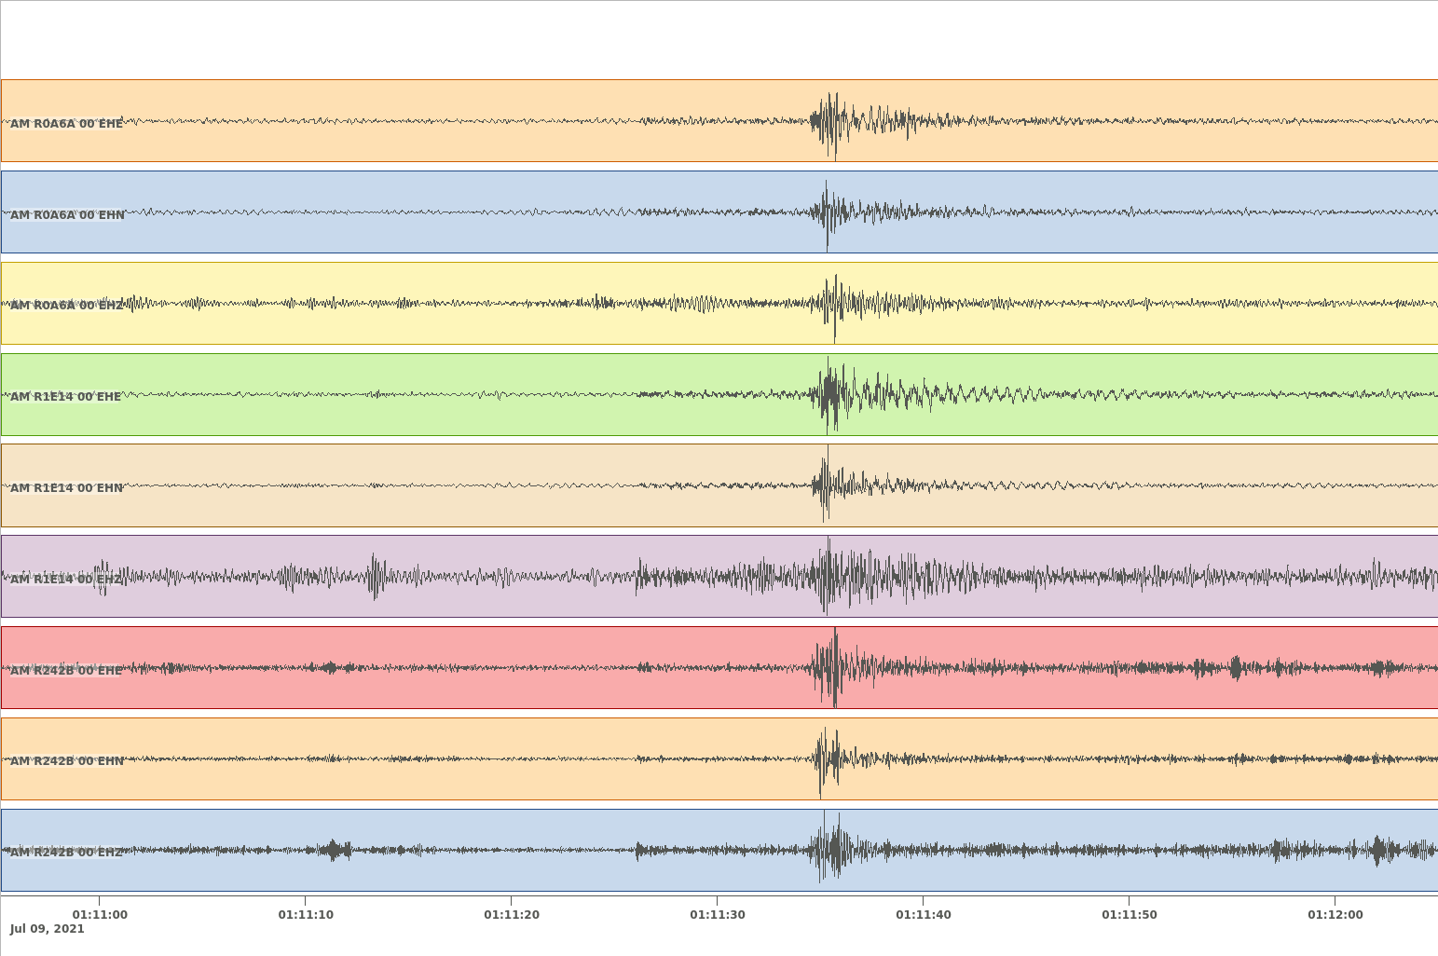
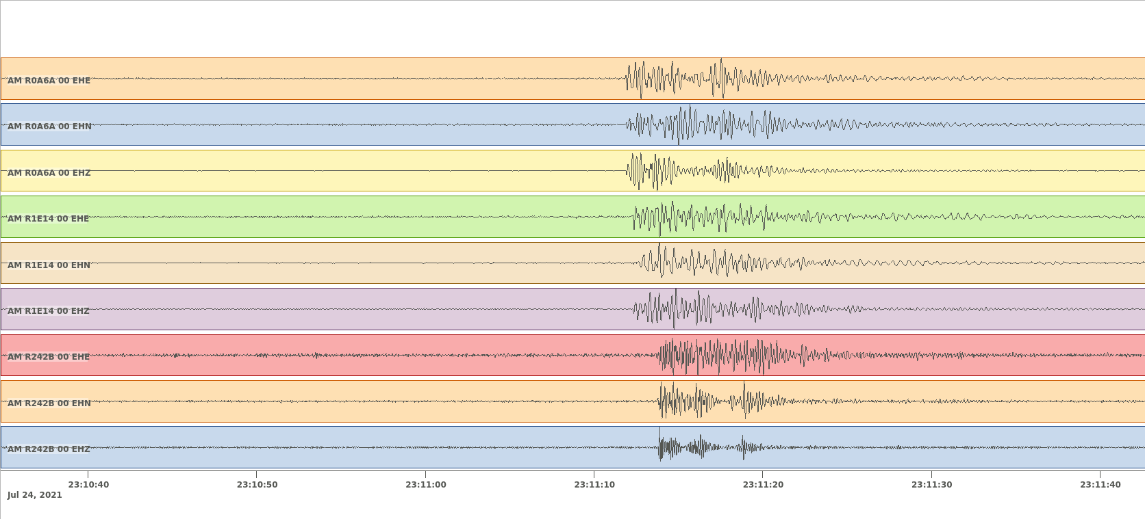
Other observations of events of interest
Foto: Norsk meteornettverk
  Earthquake north of Oslo 9.7.2021
  Meteor over Oslo 24.7.2021

Slide 24
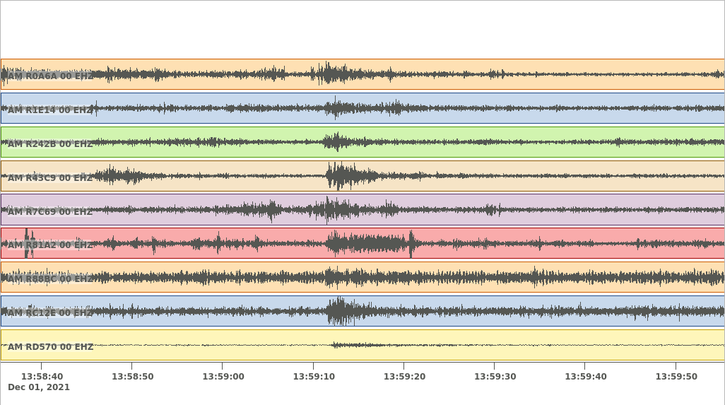
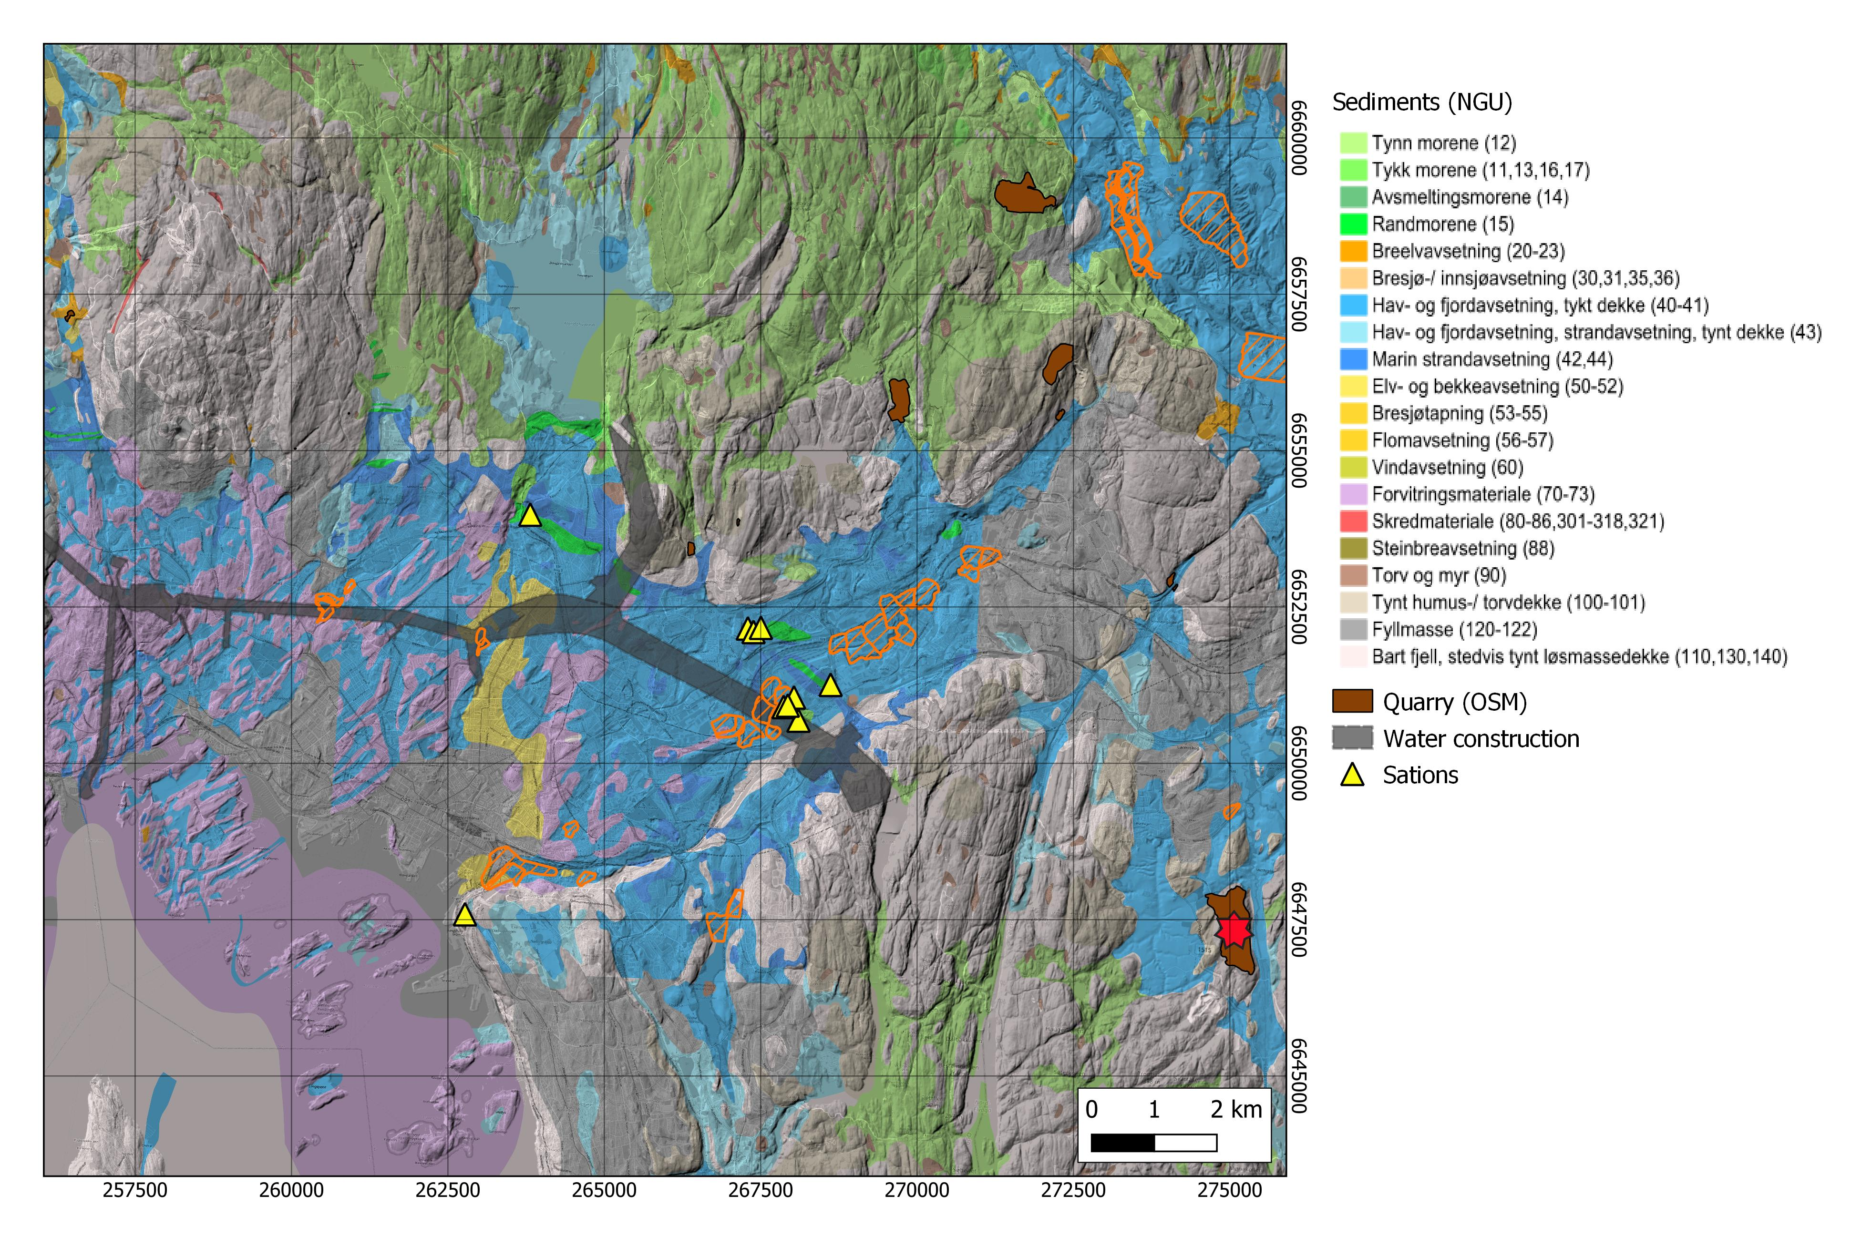
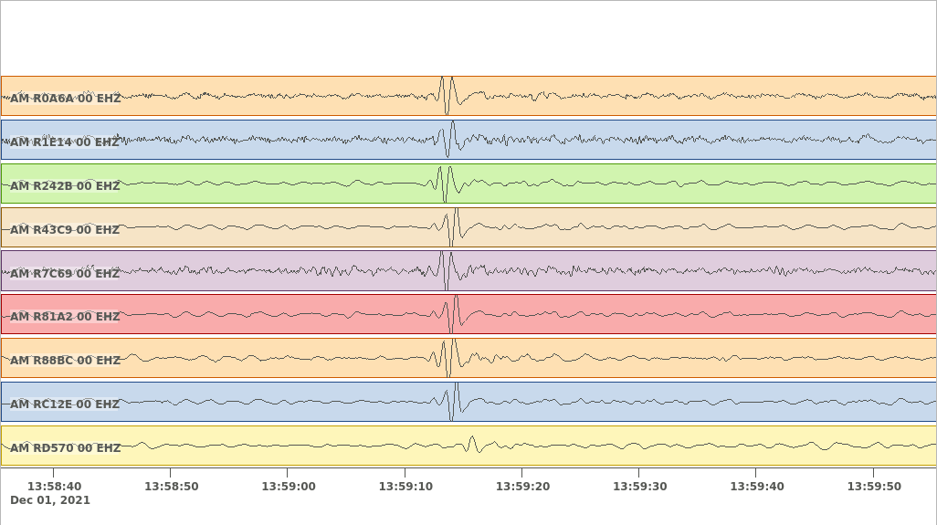
Other observations of events of interest
  Losby quarry blast 1.12.2021
  Unfiltered
  Low-pass filter: RG

Slide 25
Conclusions and Outlook
We can make use of urban seismic data for monitoring purposes in Oslo
Sub-surface monitoring: noise interferometry reveals seasonal velocity changes and could potentially be used to identify changes before quick clay failure
  What velocity changes do we expect?
Identifying repeating signals: unsupervised embedding and clustering tools allow intuitive visualization of seismic signal similarly using spectrogram images
Detection of repeating signals: supervised classifier can detect metro trains
  Use of these signals for “controlled source” subsurface monitoring?
  Indicator for traffic disruptions?
Detection of rare events with autoencoders: successful application to identify earthquakes and blasts in noisy environment
  Still needs final screening. Can this be further automated?
  So far only single stations: Include whole network for outlier detection

