Slide 1





EGU General Assembly
23 - 27 May 2022
Meteorological and agricultural drought indices in semiarid grasslands monitoring
Andrés F. Almeida-Ñauñay^{1,2}, Ernesto Sanz^{1,2}, María Villeta¹, Miguel Quemada¹ and Ana M. Tarquis^{1,2}.
¹ Centro de Estudios e Investigación para la Gestión de Riesgos Agrarios y Medioambientales, CEIGRAM, Universidad Politécnica de Madrid (UPM)
² Complex Systems Group, UPM
24th of May, 2022
Austria, Viena.

Slide 2
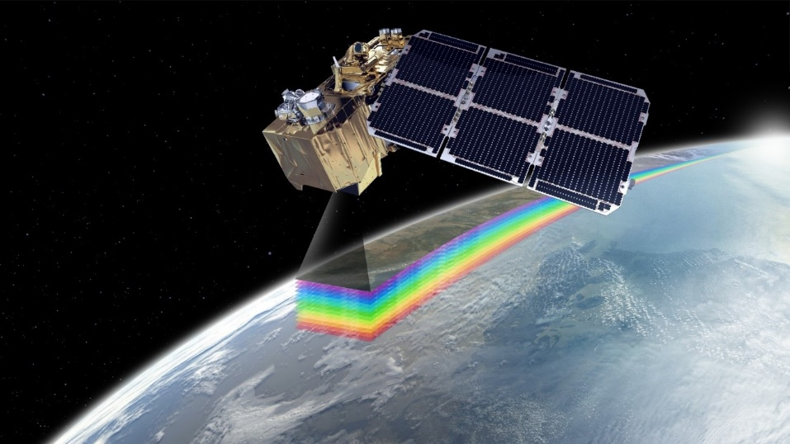
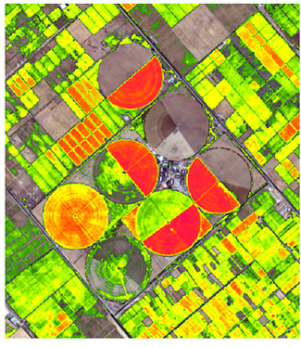
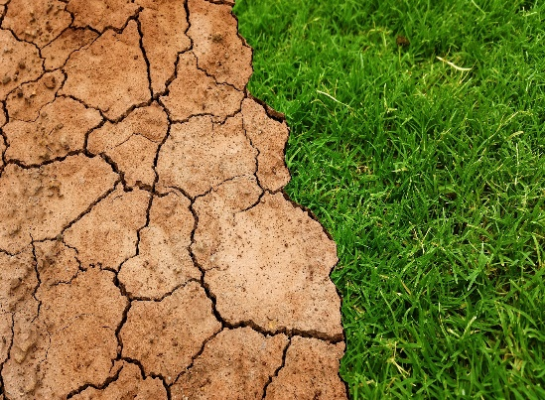
INTRODUCTION
Meteorological drought
Agricultural drought:
Drought is an important driving force in grassland dynamics.
Feunte: https://www.ecoticias.com/energias-renovables/133686/Sentinel-2-ya-vigila-el-Medio-Ambiente-desde-el-espacio
Objective
Evaluate the relationship between agricultural drought indices (VHI and SVHI) and climate drought indices (SPI and SPEI) at different time scales during 20 years.
Fuente: httpwww.satimagingcorp.com/applications/natural-resources/agricultures:///
2

Slide 3
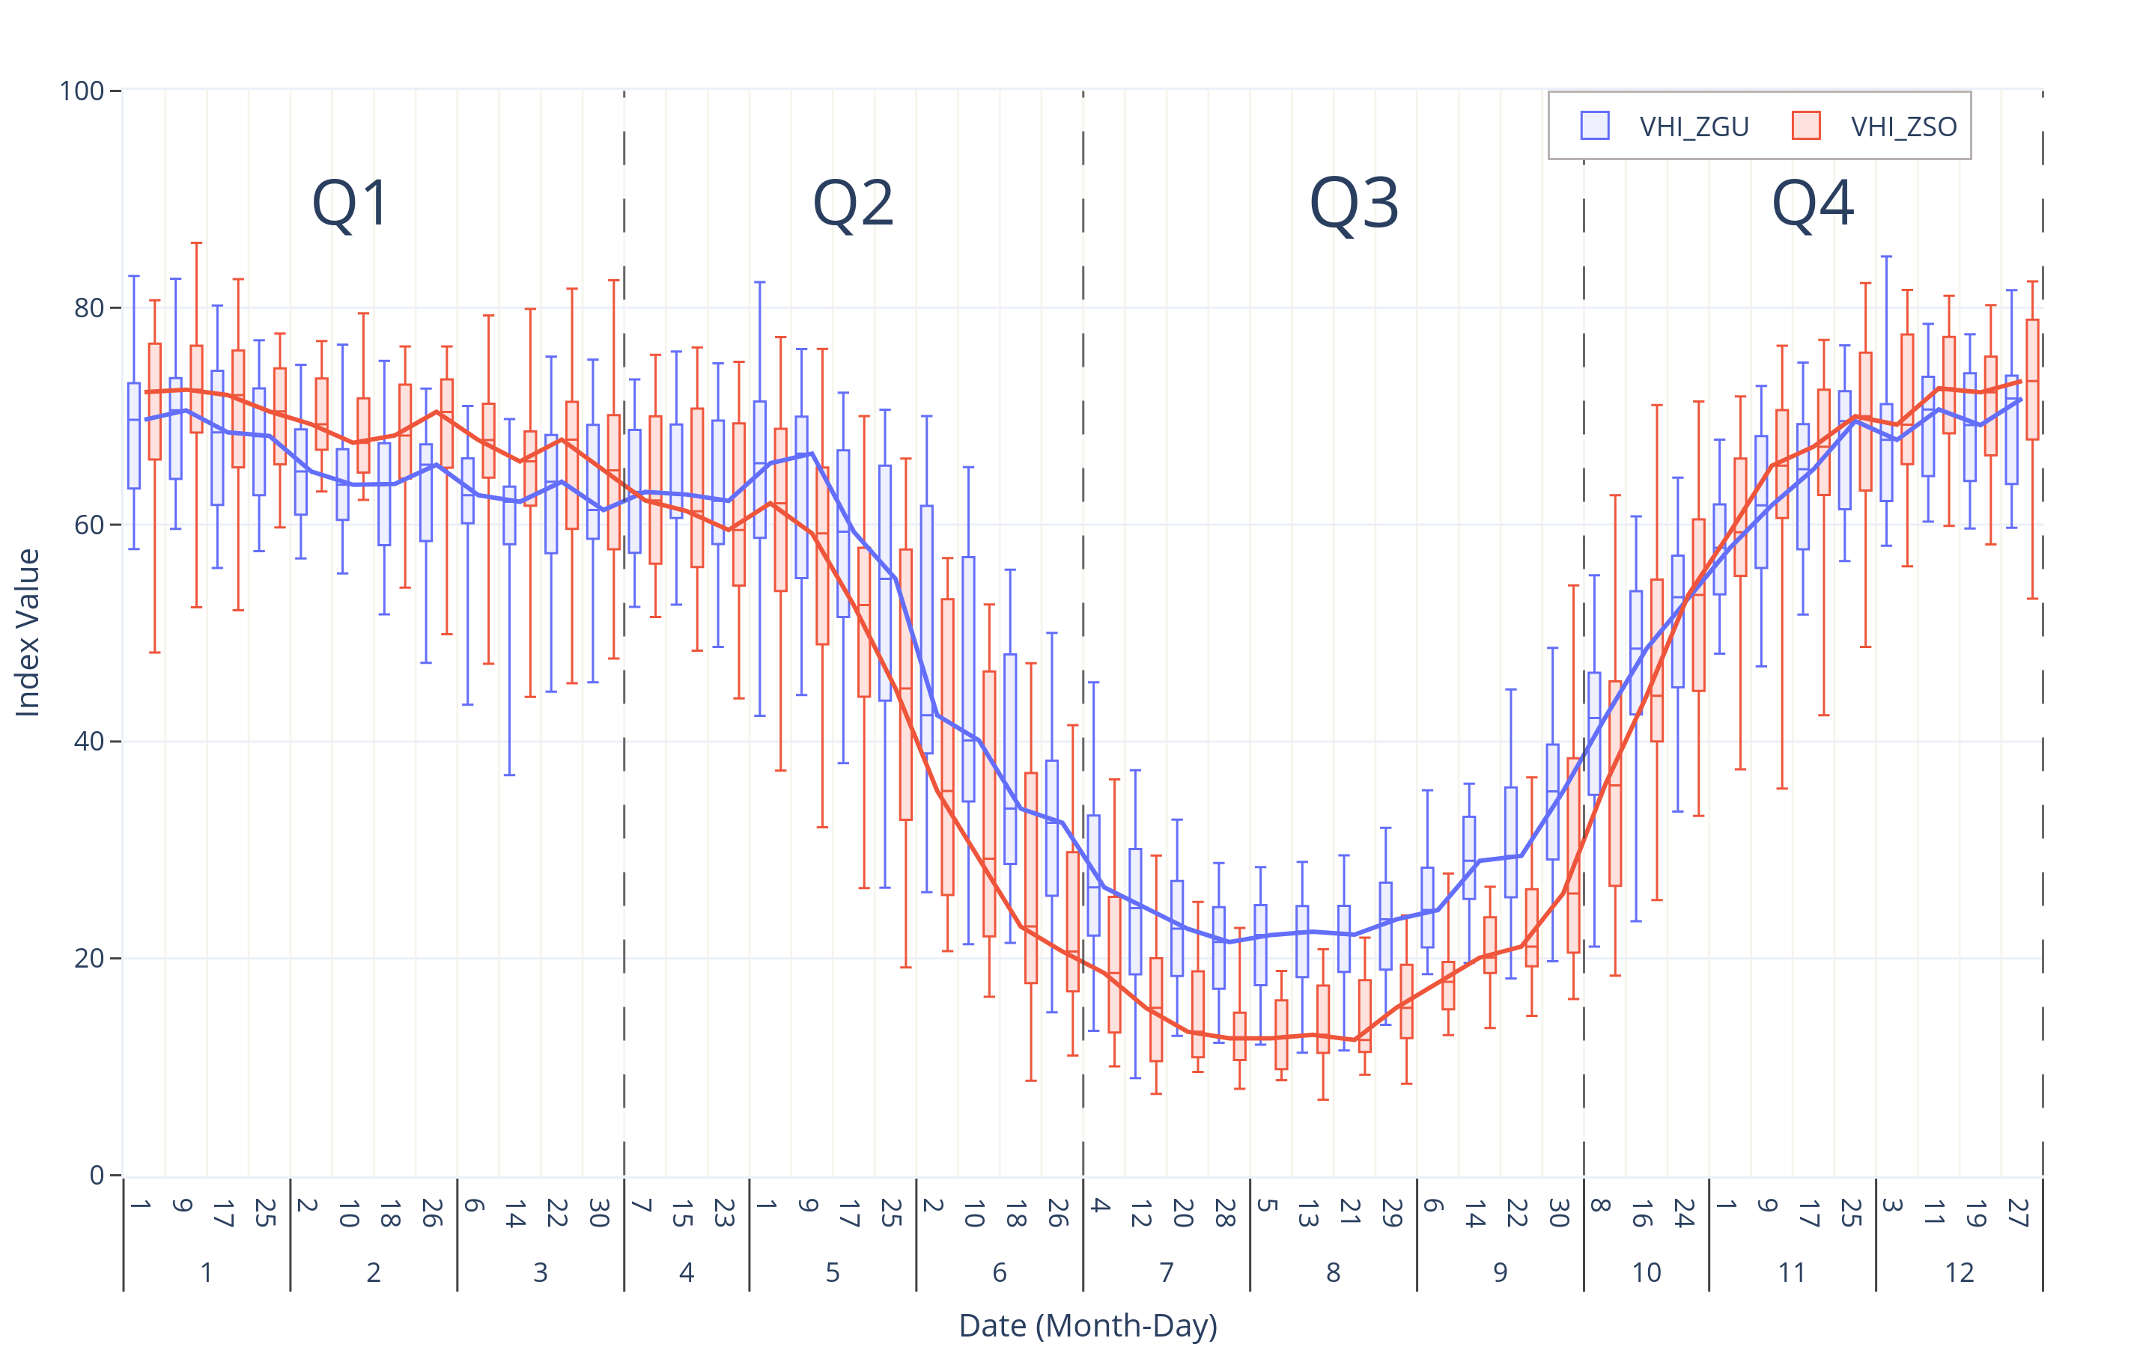
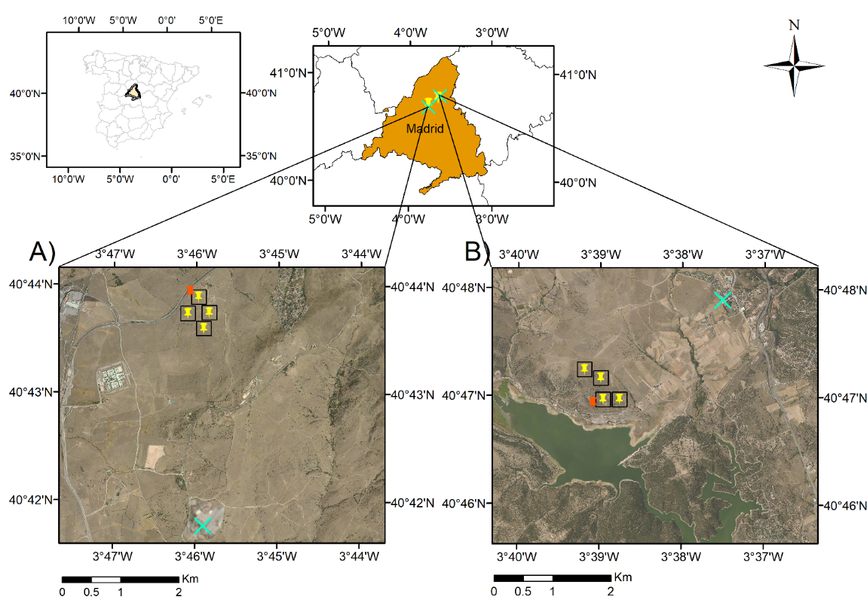
Material and methods
$$VHI=\left(α∗VCI\right)+\left(1−α\right)∗TCI$$
VCI: Vegetation Condition index
TCI: Temperature Condition index
𝛼 coefficient
A) ZGU and B) ZSO
3

Slide 4
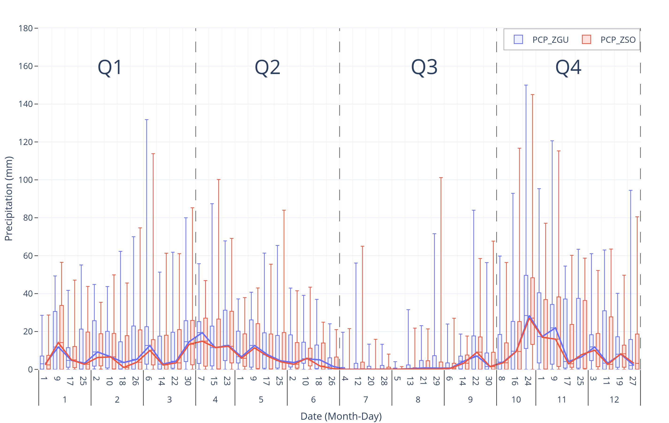
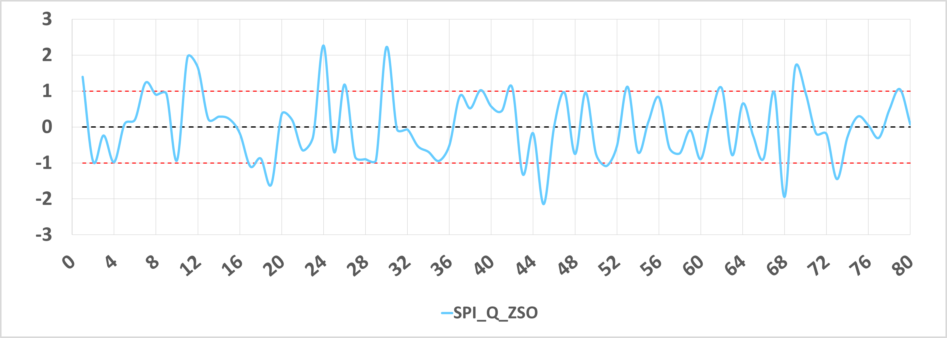
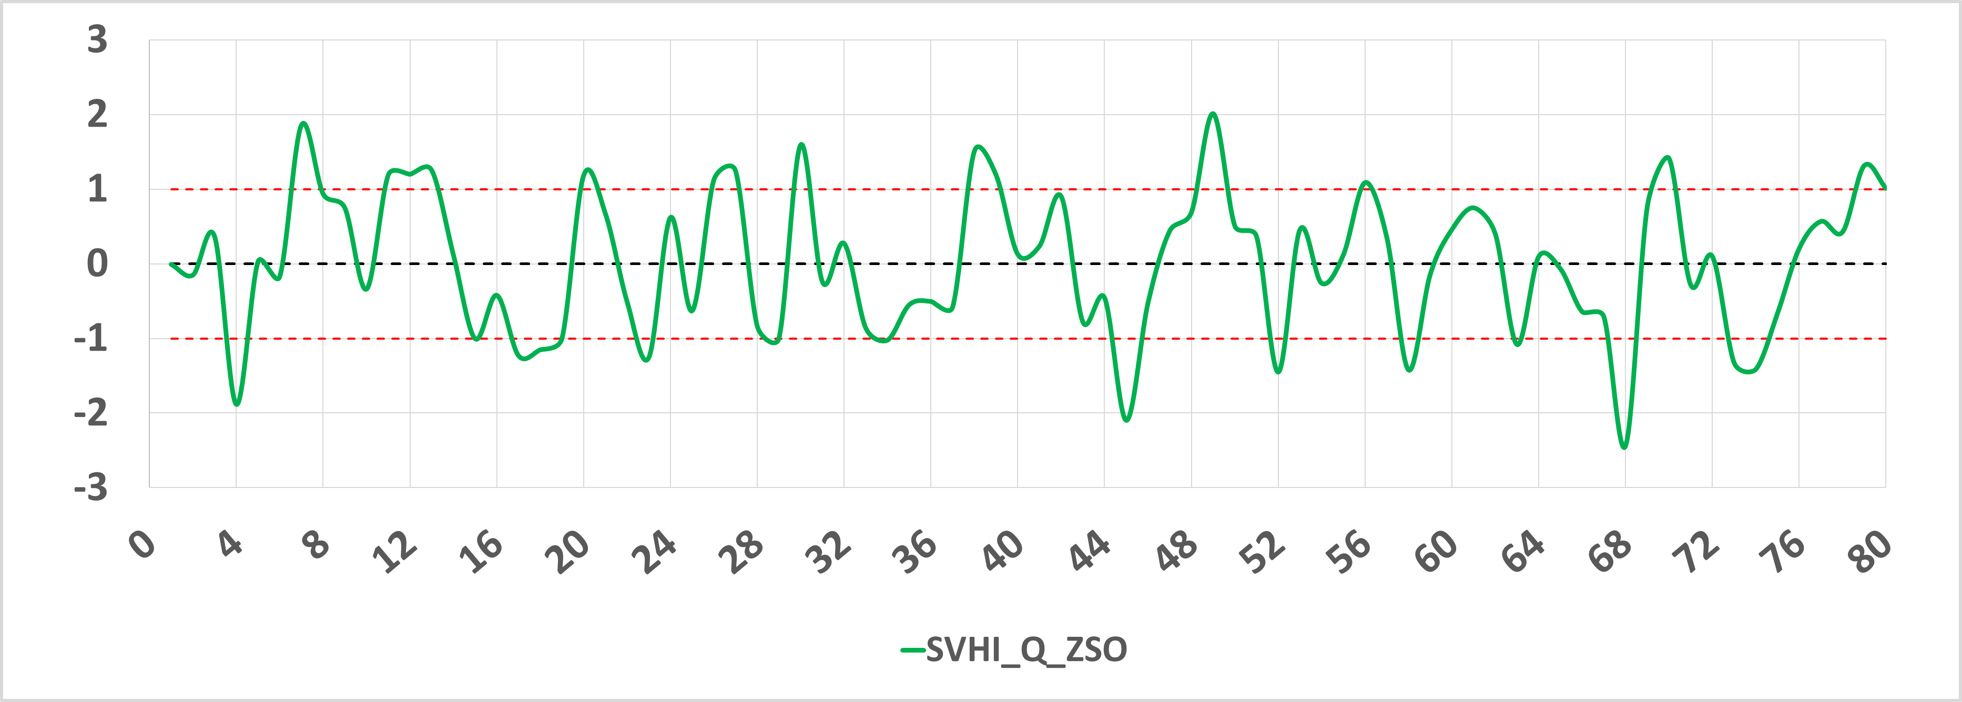
Material and methods
Refer to: from: Loukas et al. (2003)
4

Slide 5
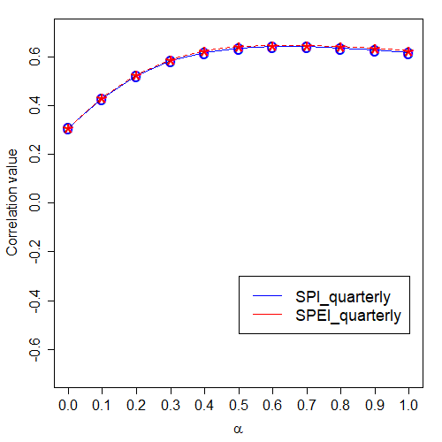
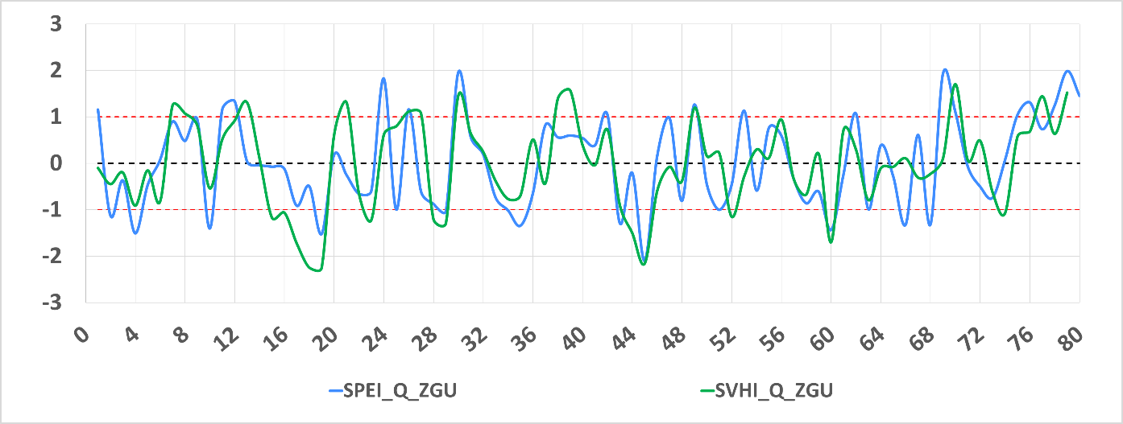
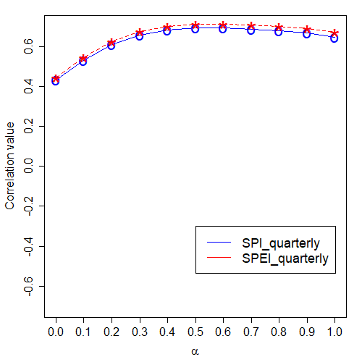
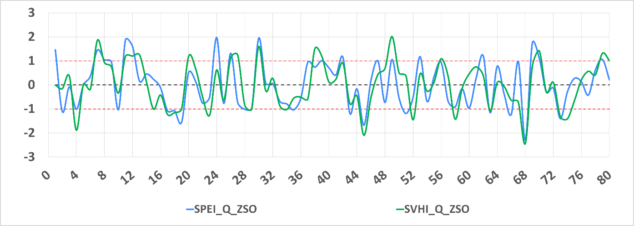
results
5

Slide 6
Conclusions and further research
Optimisation of α and standardization of climate and vegetation indices (SPEI and SVHI) improves the correlation between climate and vegetation.
Time scale is a determinant factor. The quarterly scale seems to be the most appropriate in semiarid grasslands.
Future research should take into account the phenological phases of the vegetation cover.
The authors acknowledge the support from Project No. PGC2018-093854-B-I00 of the Spanish Ministerio de Ciencia Innovación y Universidades of Spain, the funding from the Comunidad de Madrid (Spain), the Structural Funds 2014-2020 512 (ERDF and ESF), through project AGRISOST-CM S2018/BAA-4330 and the support of the grant from Agencia Estatal de Investigación (PID2019-106433GB-I00 / AEI / 10.13039/501100011033) of Spain, are highly appreciated
6

Slide 7
rEFERENCES
Almeida-Ñauñay, A.F., Villeta, M., Quemada, M., Tarquis, A.M., 2022. Assessment of Drought Indexes on Different Time Scales: A Case in Semiarid Mediterranean Grasslands. Remote Sens. 14, 565. doi:10.3390/rs14030565
Loukas, a, Vasiliades, L., Dalezios, N.R., 2003. Intercomparison of Meteorological Drought Indices for Drought Assessment and Monitoring in Greece. 8th Int. Conf. Environ. Sci. Technol. 8, 484–491.
Rivas-Tabares, D.A., Saa-Requejo, A., Martín-Sotoca, J.J., Tarquis, A.M., 2021. Multiscaling NDVI Series Analysis of Rainfed Cereal in Central Spain. Remote Sens. 13, 568. https://doi.org/10.3390/rs13040568
Sanz, E., Saa-Requejo, A., Díaz-Ambrona, C.H., Ruiz-Ramos, M., Rodríguez, A., Iglesias, E., Esteve, P., Soriano, B., Tarquis, A.M., 2021. Normalized Difference Vegetation Index Temporal Responses to Temperature and Precipitation in Arid Rangelands. Remote Sens. 13, 840. https://doi.org/10.3390/rs13050840
Vicente-Serrano, S.M., Beguería, S., López-Moreno, J.I., 2010. A Multiscalar Drought Index Sensitive to Global Warming: The Standardized Precipitation Evapotranspiration Index. J. Clim. 23, 1696–1718. https://doi.org/10.1175/2009JCLI2909.1
Zhao, A., Zhang, A., Cao, S., Liu, X., Liu, J., Cheng, D., 2018. Responses of vegetation productivity to multi-scale drought in Loess Plateau, China. Catena 163, 165–171. https://doi.org/10.1016/j.catena.2017.12.016

Slide 8
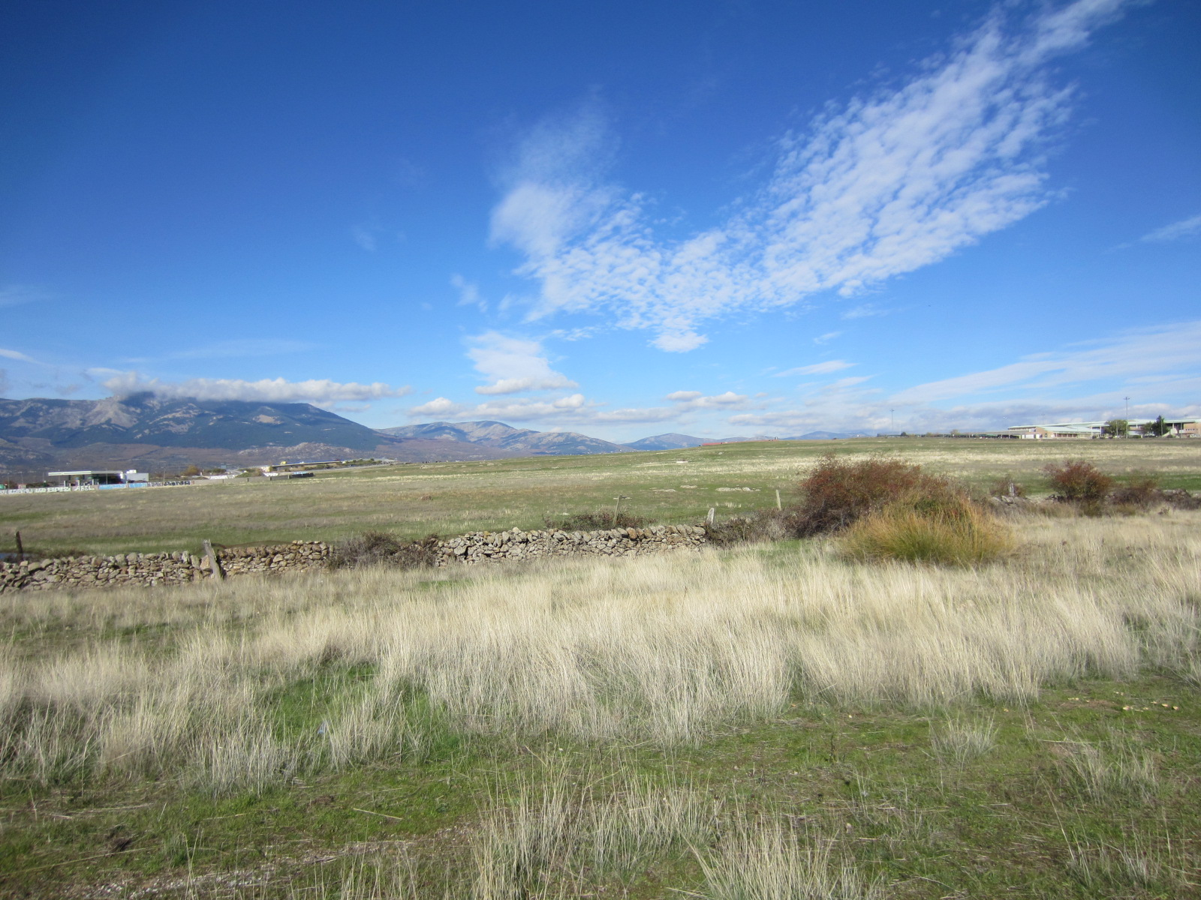
Thank you very much for your attention
8
af.almeida@upm.es

