Slide 1
Mechanism of frictional discharge plasma at fault asperities
EGU General Assembly 2022 Session NH4.1 – Short-term Earthquakes Forecast (StEF) and multi-parametric time-Dependent Assessment of Seismic Hazard (t-DASH)
(EGU22-3610)
Kiriha Tanaka*, Jun Muto, Hirouyuki Nagahama
Department of Earth Science, Graduate School of Science, Tohoku University, Japan
Place and Date: room M2 on Friday, 27th May 2022, 08:33ｰ08:40 CEST
Notes:
I’m Kiriha Tanaka and PhD student in Tohoku University. I’ll talk about the mechanism of frictional discharge plasma at fault asperities.

Slide 2
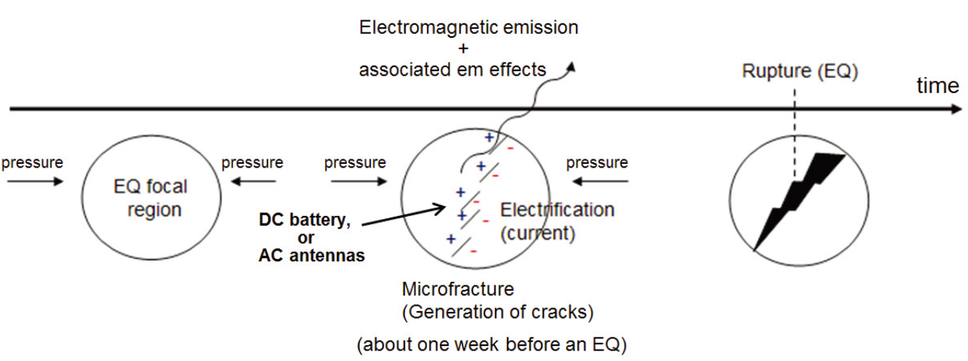
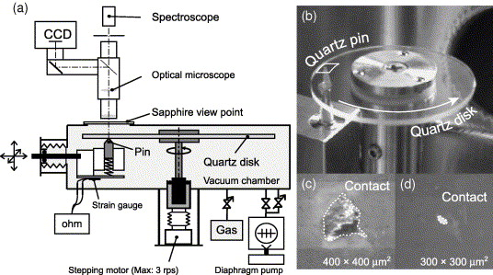
What is a source of seismo-electromagnetic phenomena?
Seismo-electromagnetic phenomena: expected as precursors of a short-term earthquake prediction
3. Seismo-electromagnetic phenomena
Possible generation mechanism related to:
Piezoelectricity (e.g., Finkelstein et al., 1973;; Wang, 2021)
Fluids (e.g. Mizutani et al., 1976; Uyeda et al., 2009)
Exo-electron (e.g., Brady and Rowell, 1986; Enomoto et al., 2021)
Positive charge carriers (e.g., Freund, 2002; Freund et al., 2009)
Frictional or contact electrification (e.g., Takeuchi and Nagahama, 2002; Muto et al., 2008; Tanaka et al., 2022)
1. Pressure
1. Pressure
2. Electrification Electric current
1. Microcracking
4. Earthquake
(Hayakawa, 2016)
etc…
Spatial distributions and spectroscopic characteristics of photon emissions
What inspired that study?
Charge densities of frictional or fracturing surfaces were estimated from potential difference or current:
10⁻⁴ｰ10⁻² C/m² > 10⁻⁵ C/m² → cause an electric discharge by dielectric breakdown of air
(Takeuchi and Nagahama, 2002)
Scheme of a pin-on-disk friction apparatus (Muto et al., 2006)
Investigated by performing pin-on-disk friction experiments
Notes:
Seismo-electromagnetic phenomena occur due to electrification or electric current on and/or near a fault which is generated by mechanical effect like stress, Microcracking, slow slip, etc. However, these generation mechanism is still discussed yet.
Some possible mechanisms have been proposed in the past, however, the which mechanism is plausible remain unknown.
Previous studies estimated the charge densities ... and the value satisfied the condition to cause ... air.
Hence, it is possible for electric discharge to occur by a fault slip before an earthquake. From this viewpoint, we performed pin-on-disk friction experiments to investigate whether electric discharge occur at contacts on a fault, namely, fault asperities.

Slide 3
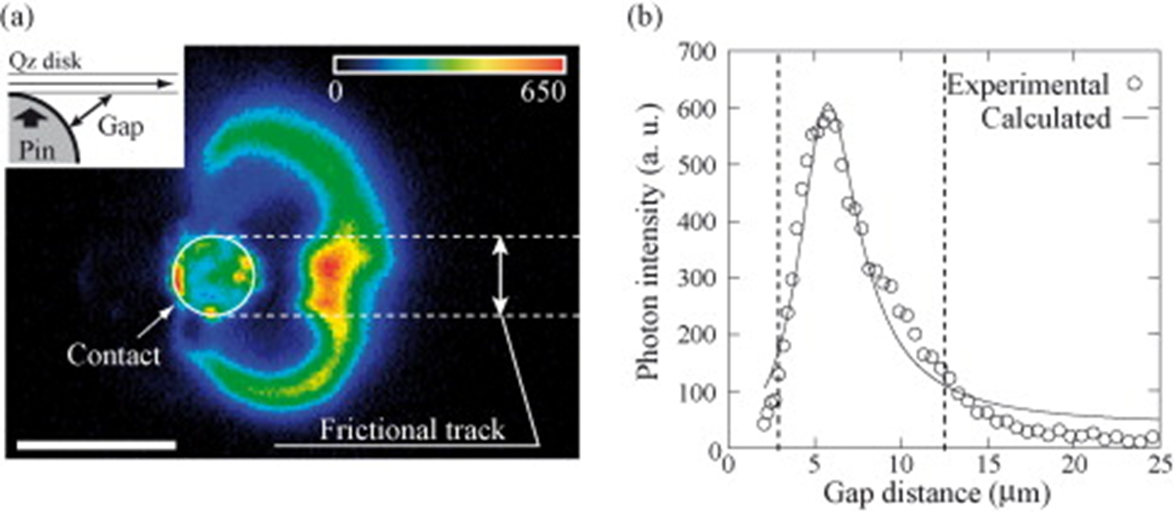
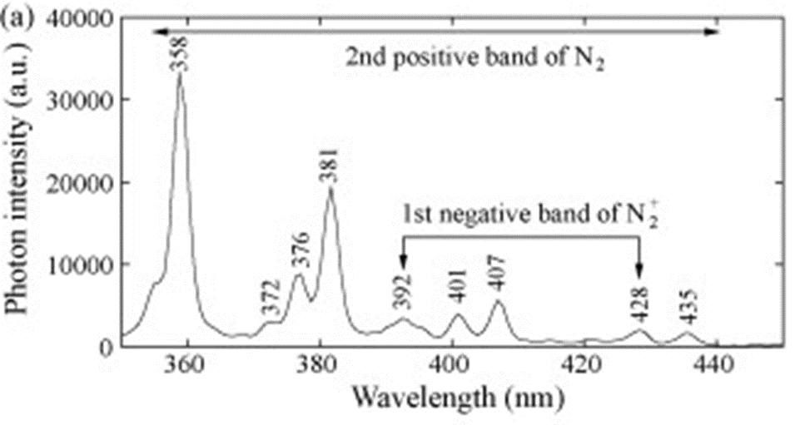
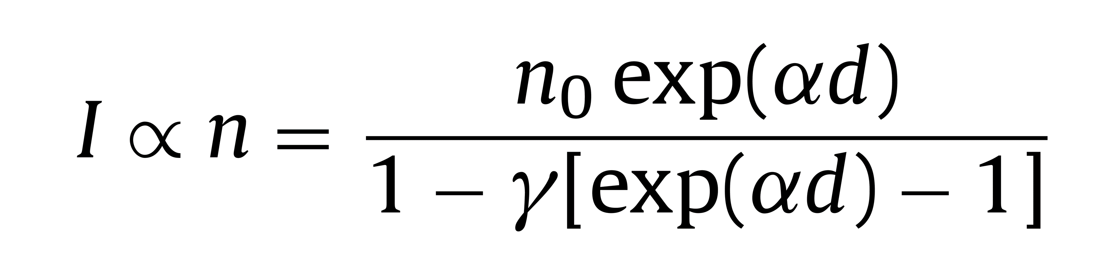
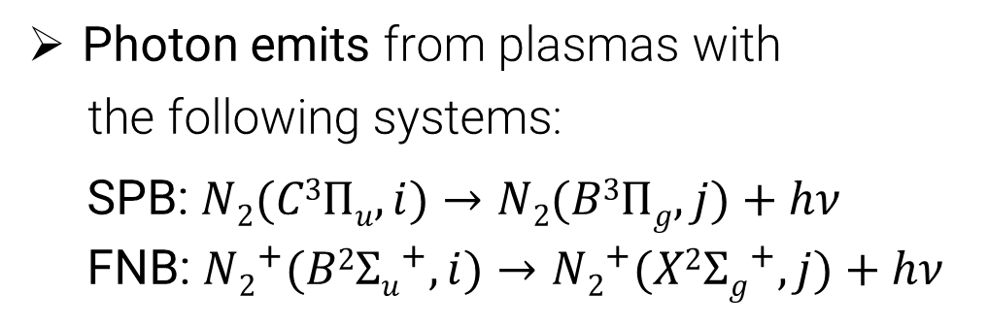

Previous results of a pin-on-disk friction experiment
(Muto et al., 2008)
Quartz disk
Only during friction
Diamond pin
(von Engel, 1965)
Fitting
$$α=pAexp⁡\left(−\frac{pBd}{φ}\right)$$
I: current, n: the number of electrons multiplied by electron impacts, α and γ: the first and second ionization coefficients, A: 9.0 m⁻¹Pa⁻¹, B: 257 Vm⁻¹Pa⁻¹, d: gap, φ: potential difference
100 μm
Normal stress σ = 13–20 MPa, sliding speed v = 1.0×10⁻² m/s, N₂ gas pressure p = 2.4×10⁴ Pa
σ = 13–20MPa, v = 1.0×10⁻² m/s, p = 2.4×10⁴ Pa
The potential difference was estimated to be 34 V
The secondary electron emission from the frictional surfaces due to the incidence of ionized particles onto the surfaces
The photon emission is caused by de-excitation of the gas-discharge plasma due to an electron impact ionization of gas molecules
Photon emits from plasmas with
the following systems:
SPB: $N2(C3Πu, i)→N2(B3Πg, j)+hν$ FNB: ${N2}^{+}(B2{Σu}^{+}, i)→{N2}^{+}(X2{Σg}^{+}, j)+hν$
➡ Photon can be emitted by discharge plasma due to gas dielectric breakdown by frictional electrification
≈ source of seismo-electromagnetic phenomena
However, detailed electronic transition and its state during plasma generation remain unclear
Notes:
These are one of the results of previous work (Muto et al., 2008).
The left figure shows that the photon emission observed by CCD camera during the friction. These emission observed only during the friction.
The photon emission at a gap from center of a curvature circle of a pin to a quartz disk was measured and their relationship was fitted by this equation considering the theory of electric breakdown of gases. From this fitting, the potential difference was estimated. Moreover, the good correlation of this fitting indicates the secondary ... surfaces, and the photon emission is caused ... gas molecules.
Right figure shows a spectra of photon emission during the friction. It presents us the plasma discharge was occur through the SPB and FNB systems.
These results indicated that photon ... Electrification and discharge plasma can be a source of ... . However, ... .

Slide 4
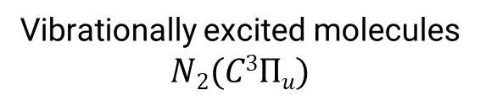
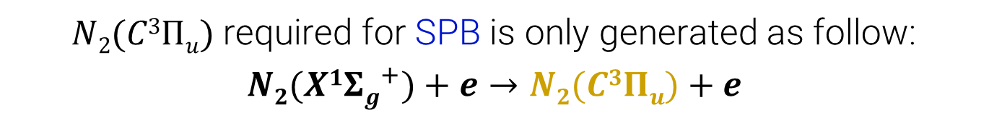
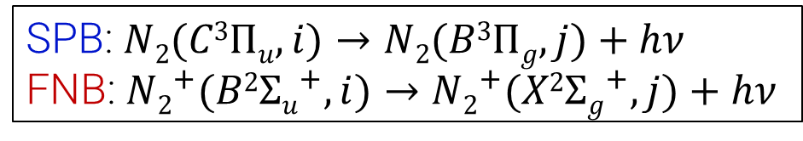
Plasma occurs by de-excitation of neutral/ionized nitrogen molecules
4.3×10⁴ Pa
1.2×10⁴ Pa
FNB
Vibrationally excited molecules
$$N2(C3Πu)$$
SPB
p = 2.4×10⁴ Pa
SPB: $N2(C3Πu, i)→N2(B3Πg, j)+hν$ FNB:${ N2}^{+}(B2{Σu}^{+}, i)→{N2}^{+}(X2{Σg}^{+}, j)+hν$
Photon emission observed during the friction at σ = 13–20 MPa, v = 1.0×10⁻² m/s, and different gas pressures (Muto et al., 2006, 2007)
An energy level diagram of a nitrogen molecule
As gas pressure decreases, plasma is wider and stronger
➡ Why was this pattern change observed?
$N2(C3Πu)$required for SPB is only generated as follow:
$$N2(X1{Σg}^{+})+e→N2(C3Πu)+e$$
Pin-on-disk friction experiments (Muto et al., 2007)
Notes:
Left images show the photon emission generated during the friction with different gas pressures. As gas pressure decreases, plasma is wider and stronger. Why ... .
As you see, the plasma occurs through the SPB and FNB systems. Vibrational excited molecules of nitrogen $N2(C3Πu, i)$ which is precursors of the SPB system is generated only this reaction. Hence, we discuss the pattern change focusing on the vibrational excited molecules.

Slide 5





Electronic transition of plasma depending on gas pressure
The state of $N2(C3Πu)$ depends on gas pressures in gaps
From Boltzmann distribution, the concentration of $N2(C3Πu)$:
$nv = n0exp⁡(–Ev/Tv)$ (1) n_{v} is given by the increase in the relative population by electron impact:
$nv = nengkv$ (2) ➡ With decreasing gas pressure ≈ collision frequency, $Tv$(C³Π_{u}) and $nv$(C³Π_{u}) increase and $ne$ in the plasma increases
The increase in a free path of excited molecules as gas pressure decreases can result in widening of the photon emission patterns
$$Tv$$
σ = 13–20 MPa, v = 1.0×10⁻² m/s
p = 2.4×10⁴ Pa
increase
increase
p = 2.4×10⁴ Pa
(Muto et al., 2008)
increase
increase
Photon intensity ratio of FNB to SPB
=
$$IFNB=AFNBn_{ν\left(FNB\right)}$$
$$ISPB=ASPBn_{ν\left(SPB\right)}$$
σ = 13–20 MPa, v = 1.0×10⁻² m/s
p = 1.2×10⁴ Pa
p = 4.3×10⁴ Pa
$p$
widening
Pin-on-disk friction experiments (Miura et al., 2004)
Pin-on-disk friction experiments (Muto et al., 2007)
Notes:
The state of the excited molecules depend on gas pressure in gaps.
As gas pressure decreases, the vibrational temperature increases. From the equation based on Boltzman distribution, the concentration of the molecules also increases. The increase in the molecules depends on electron density in the plasma, hence the plasma electron increase.
The second left graph shows photon emission intensity ratio of FNB and SPB increase with decreasing gas pressure. It means that when the intensity of SPB increases with decreasing gas pressure, the FNB also increases.
It indicates that The increase in a free path of excited molecules as gas pressure decreases can result in widening of the photon emission patterns
.

Slide 6
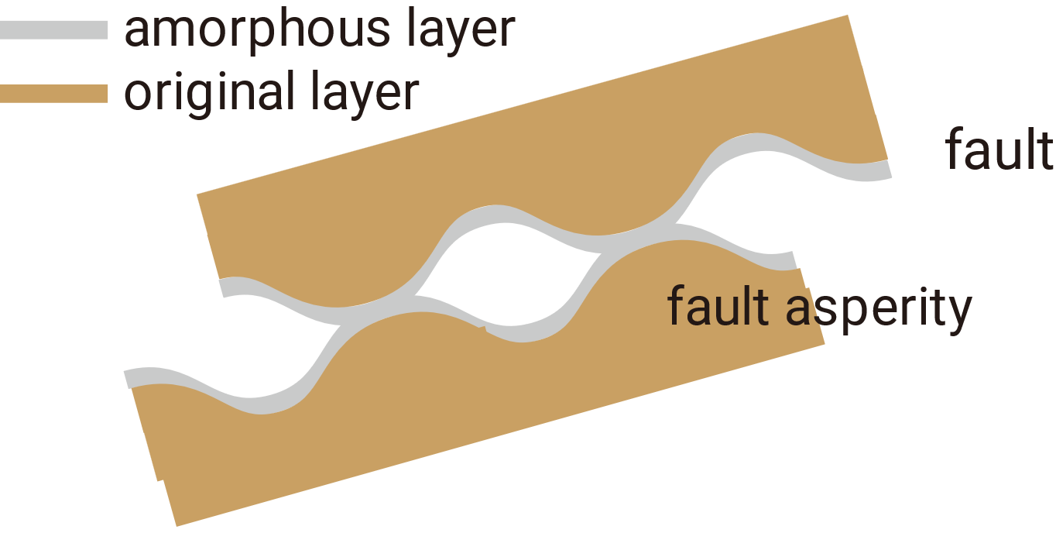
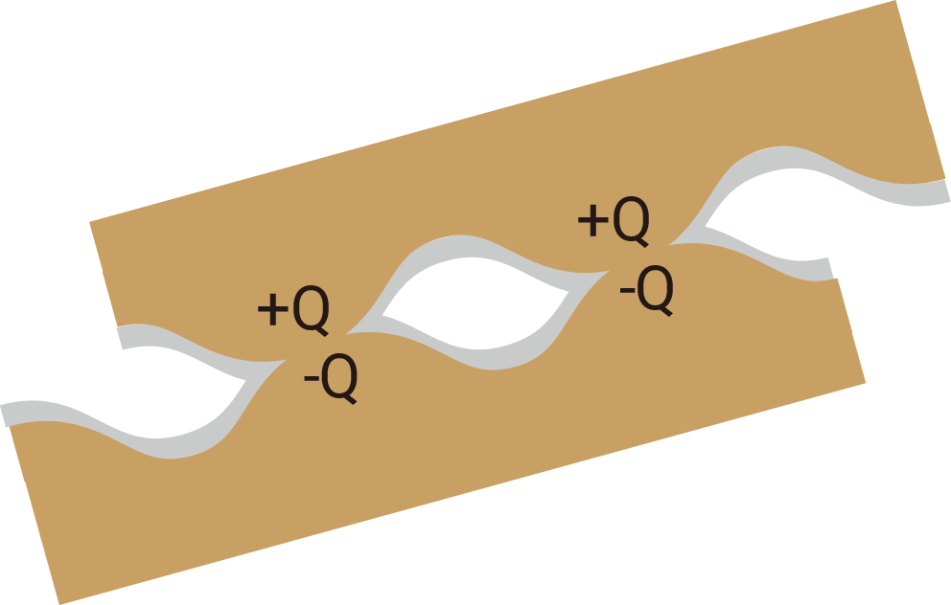

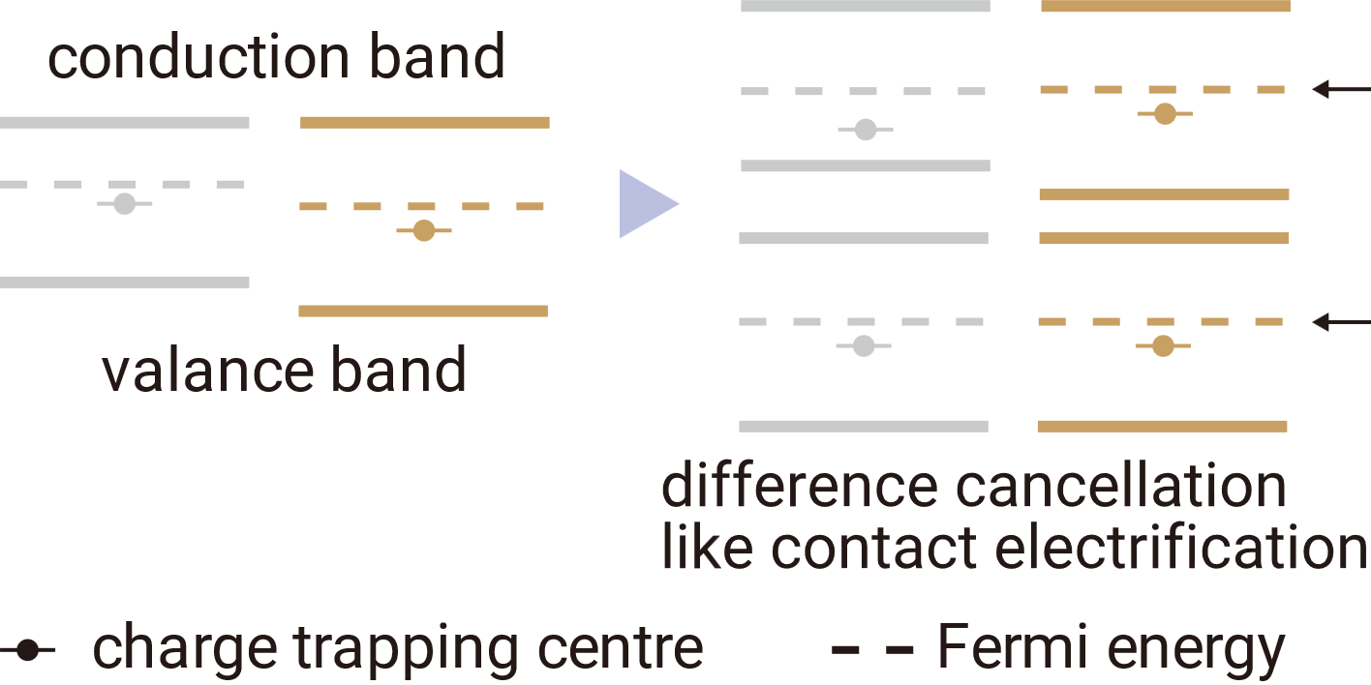
Sources of frictional electrification
Surface charging mechanism (Takeuchi and Nagahama, 2002, 2004)
Production of charge trapping centres in amorphous surface layers of a fault.
Difference cancellation of Fermi energies between in amorphized and original layers (~ contact electrification)
Surface layer separation at the layer boundary causes electrification
3
1
2
3
1
2
Findings from laboratory experiments
Pin-on-disk friction could produce amorphous layers at frictional surfaces
Charge trapping centres can exist in quartz grains produced by fracturing and friction
(Nakamura et al., 2012)
(e.g., Yund et al., 1990; Tanaka et al., 2021)
Plasma discharge has an origin in charge trapping centres?
Notes:
Move on to the next slide about a source of frictional electrification. Takeuchi and Nagahama (2002) proposed the surface charging mechanism. This mechanism is explained as follows,
First, charge trapping centers can be produced in amorphous layers of a fault by friction or fracturing.
It creates a difference between the Fermi energies possessed surface layer and original inside layer. and charge trapping center behave to cancel the difference.
Then, the fault slips more, the surface layer is separated at the layer boundary, finally, it causes electrification. (like contact electrification)
From the previous studies, charge trapping centers can be generated in the amorphous surface layers at fault asperities. We guess that plasma discharge can originate from charge trapping centres through this charging mechanism.

Slide 7
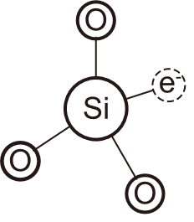
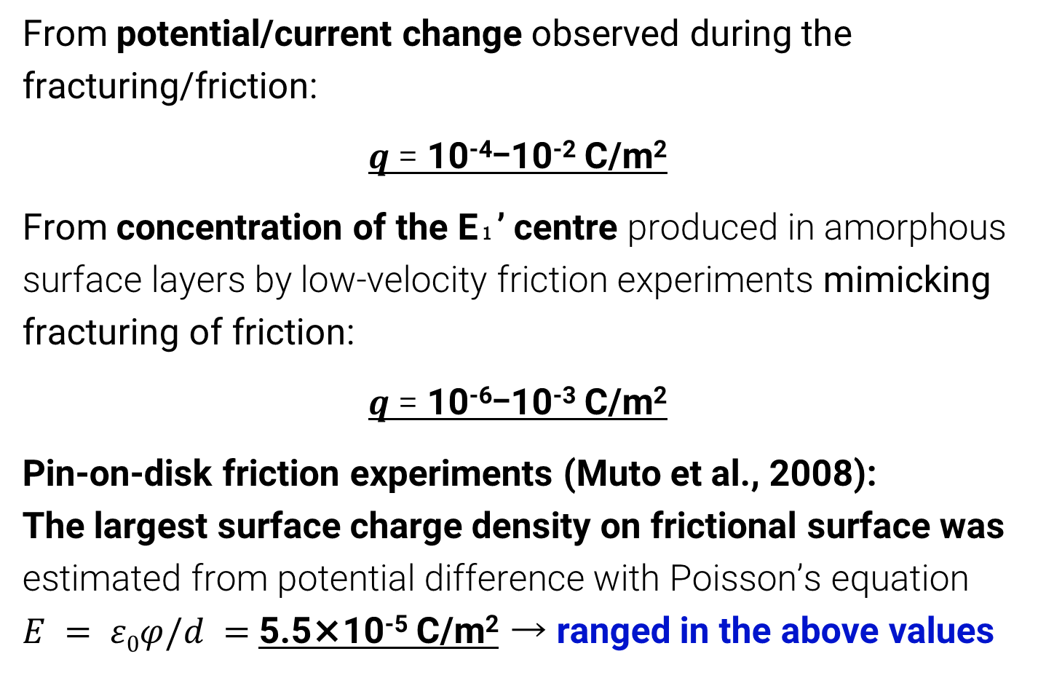
Photon emission by electrification due to charge trapping centre
Surface charge density of friction/fracturing quartz, $q$
From potential/current change observed during the fracturing/friction:
$q$= 10⁻⁴ｰ10⁻² C/m²
From concentration of the E₁’ centre produced in amorphous surface layers by low-velocity friction experiments mimicking fracturing of friction:
$q$= 10⁻⁶ｰ10⁻³ C/m²
Pin-on-disk friction experiments (Muto et al., 2008): The largest surface charge density on frictional surface was estimated from potential difference with Poisson’s equation $E = ε0φ/d =$ 5.5×10⁻⁵ C/m² → ranged in the above values
Experimental conditions
Normal stress = 1 MPa
Slip rate = 7.7×10⁻⁴ m/s
Shear displacement = 0.28ｰ1.4 m
(Iwamatsu, 1986; Takeuchi and Nagahama, 2004)
quartz grains
Electron spin resonance (ESR)
(Tanaka et al., 2022)
Low-velocity friction experiments (Tanaka et al., 2021)
Standard material: Mn²⁺/MgO
E₁’ centre
g = 2.032
g = 2.001
g = 1.981
ESR spectra
E₁’ centre
Charge trapping centres (e.g., E₁’ centre) in friction-induced amorphous surface layers can originate in photon emission
Results of ESR measurements (Tanaka et al., 2022)
Notes:
The surface charge densities estimated from potential difference or current measured during the rock friction or fracturing experiments is ten to the minus fourth power to second power.
The surface charge densities also calculated from the concentration of a charge trapping centre (the E₁’ centre) is ten to the minus sixth power to third power.
The charge density estimated from the strongest potential difference was 5.5 ten to the minus fifth power. The value is ranged in the above values. It indicates that the E₁’ center can be ... .

Slide 8
Conclusions
Frictional discharge plasma between minerals in nitrogen gas can be glow discharge
The plasma during the friction is caused by de-excitation of neutral or ionized nitrogen molecules (SPB and FNB)
The plasma is spatiotemporally non-thermally equilibrated state
Charge trapping centers can be the charging source of the plasma
* After this presentation, I will upload this file as a display material. If you have any questions and comments, please contact: kiriha.tanaka.s8@dc.tohoku.ac.jp

Slide 9
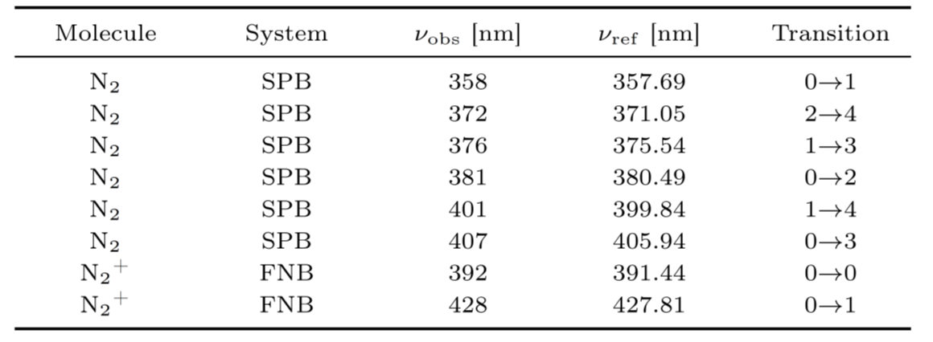
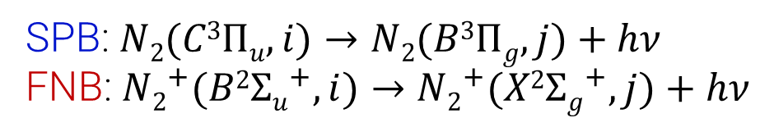

System of Electronic Transition Observed during the Friction
FNB
SPB
$$N2(X1{Σg}^{+})+e→N2(C3Πu)+e$$
SPB: $N2(C3Πu, i)→N2(B3Πg, j)+hν$ FNB:${ N2}^{+}(B2{Σu}^{+}, i)→{N2}^{+}(X2{Σg}^{+}, j)+hν$
An energy level diagram of a nitrogen molecule
The SPB system is a transition of electrons in $π3σ$ orbital of neutral nitrogen molecules The FNB system is a transition of electrons in $π2σ$ orbital of positively charged nitrogen molecules

