Slide 1
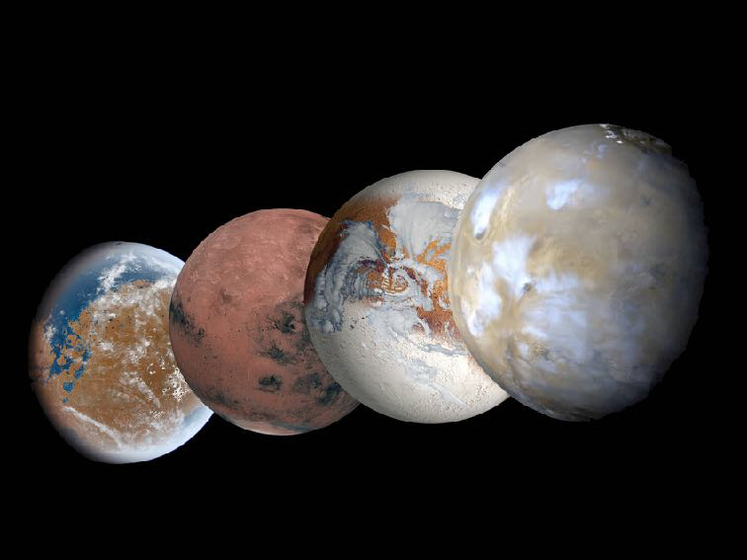



Long Term Climate Variation
Planetary Evolution Model
R.Vandemeulebrouck, F. Forget, L.Lange, E.Millour, A.Delavois, J.Naar, A.Spiga, A.Bierjon
Laboratoire de Météorologie Dynamique, CNRS, Paris
romain.vandemeulebrouck@lmd.ipsl.fr

Slide 2
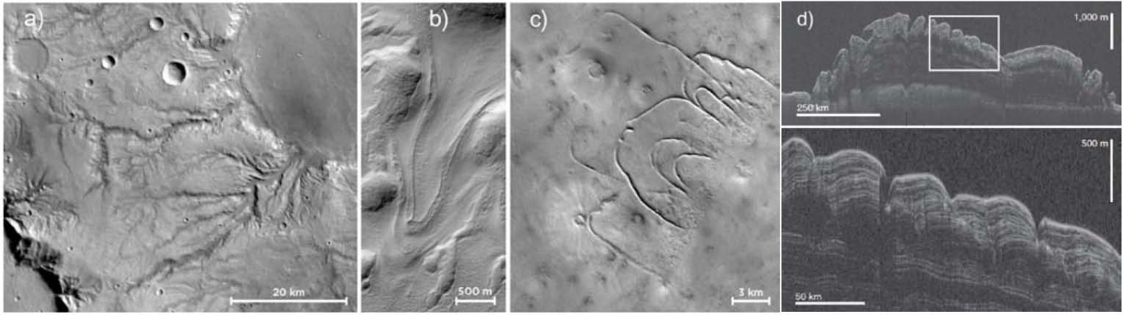
Past of Mars
Mars has not always been the desert planet of today.
Geological Observation:
Goal : Understand and modelize these formations
Ancient Terrains, Fluvial Valley
CO2 Glaciers
Ice Glacier Moraines
Northern Polar Deposits (Radar)

Slide 3
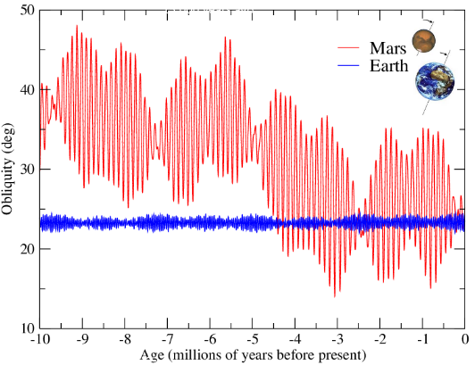
Problem
Geological Formations = Long Term Variation
Very different timescale ⇒ GCM not appropriated
GCM : ~ 2 hours/year. Few years ok
Needed : Hundred of Thousands / Millions of Years

Slide 4
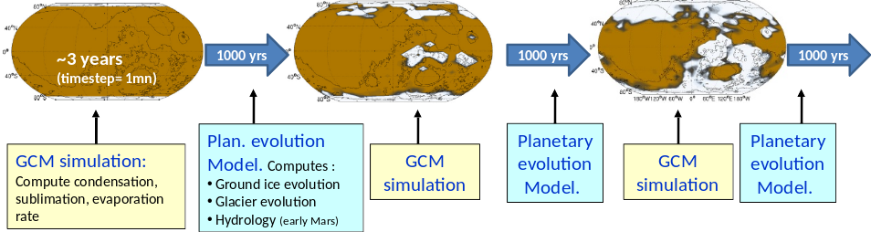
Planetary Evolution Model (PEM)
Asynchronous model and extrapolation
Objective: simulate the climate and the fate of volatiles for thousand to millions of years.

Slide 5
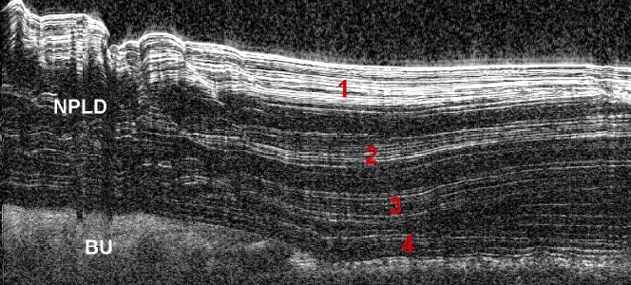
Physical Processes to Reproduce
Ice accumulation, lag deposit, stratification

Slide 6
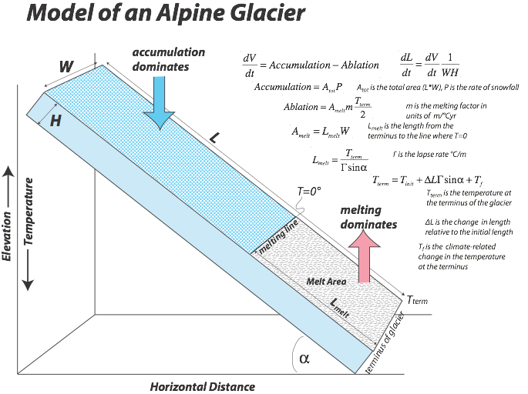
Physical Processes to Reproduce
Ice accumulation, lag deposit, stratification
Glacier flow, slope
(See following talk of L. Lange)

Slide 7
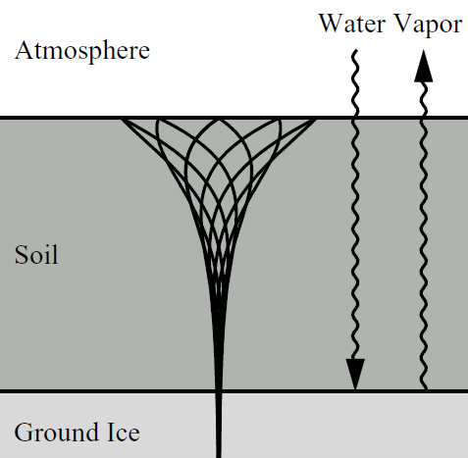
Physical Processes to Reproduce
Ice accumulation, lag deposit, stratification
Glacier flow, slope
Subsurface Ground Ice, Long Period Variation of Thermal Inertia, Ice-Table

Slide 8
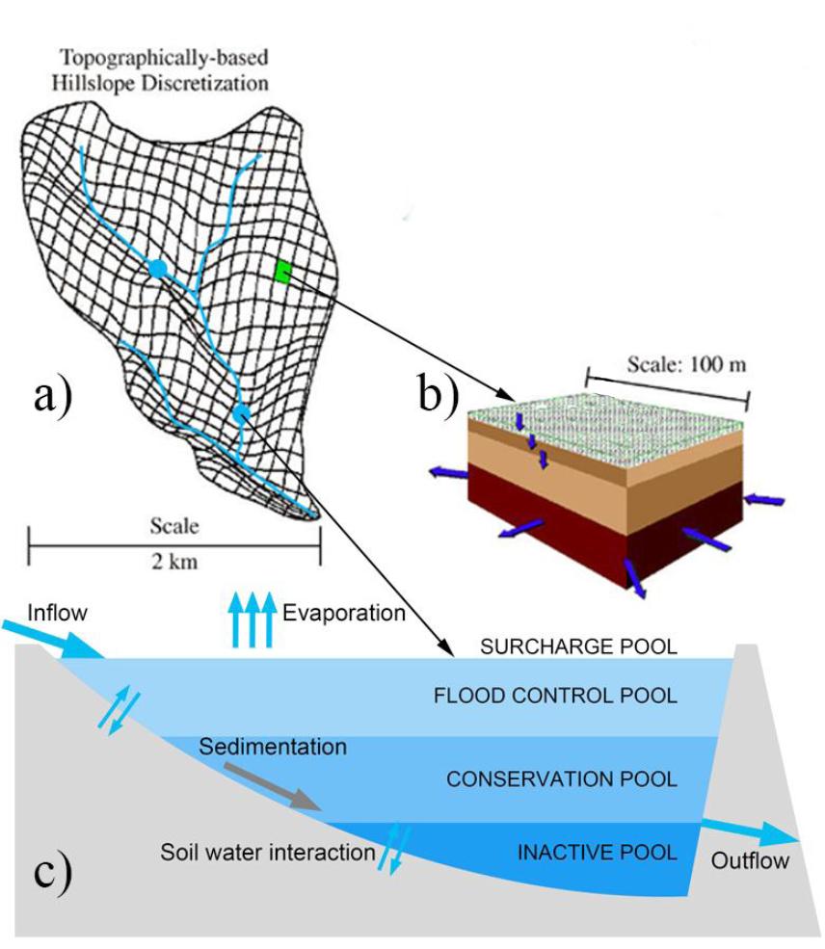
Physical Processes to Reproduce
Ice accumulation, lag deposit, stratification
Glacier flow, slope
Subsurface Ground Ice, Long Period Variation of Thermal Inertia, Ice-Table
Hydrology : Lake, River, Ocean
(see A. Delavois talk later)
Etc…

Slide 9
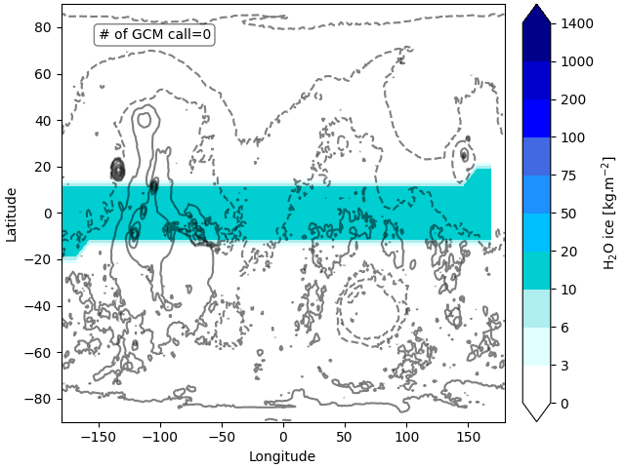
Two purposes
Find a steady state for a given external forcing (e.g. where do water reservoirs stabilise for a given climate?)
Realistic simulation of climate and fate of volatiles over thousands of years
Preliminary validation and example of 1. :
Perineal Ice Reservoir at a given obliquity (present day 25°)

Slide 10
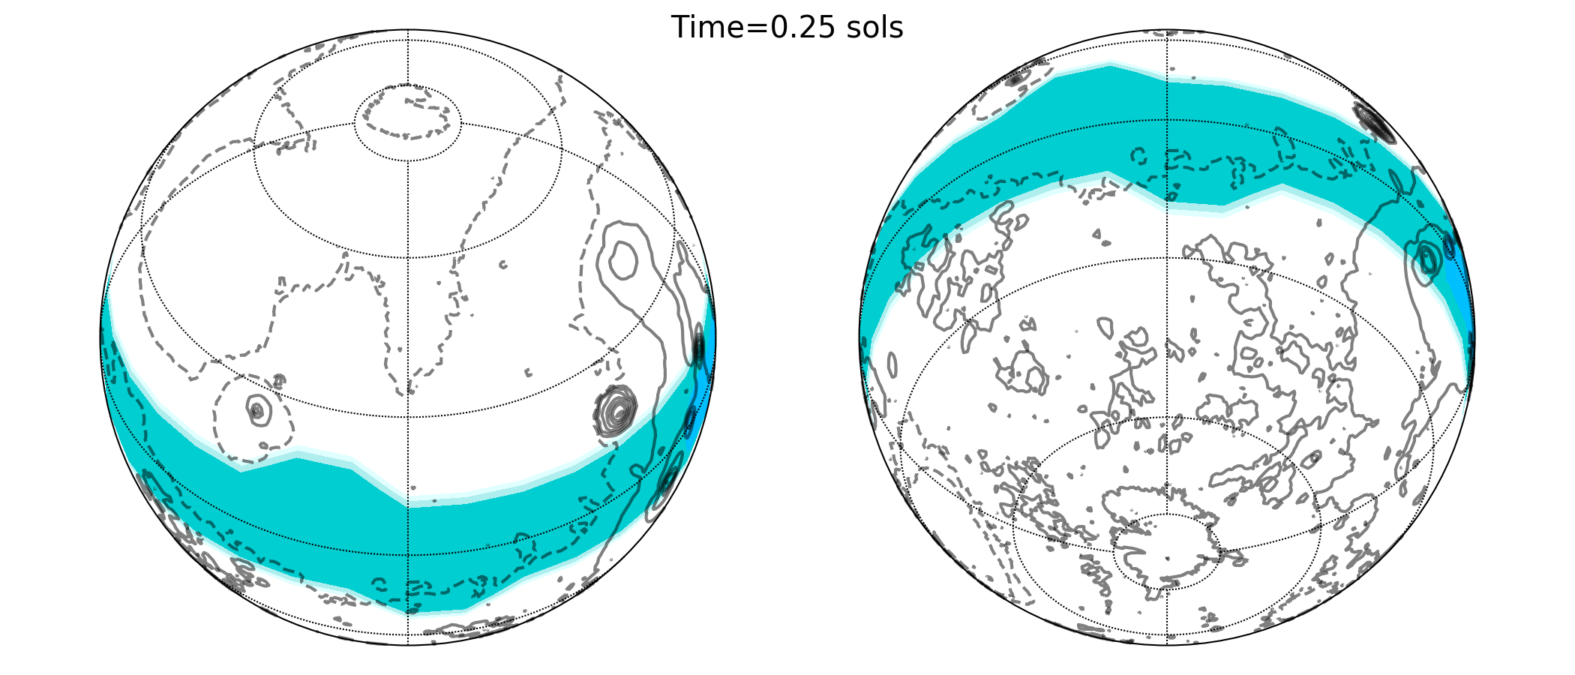
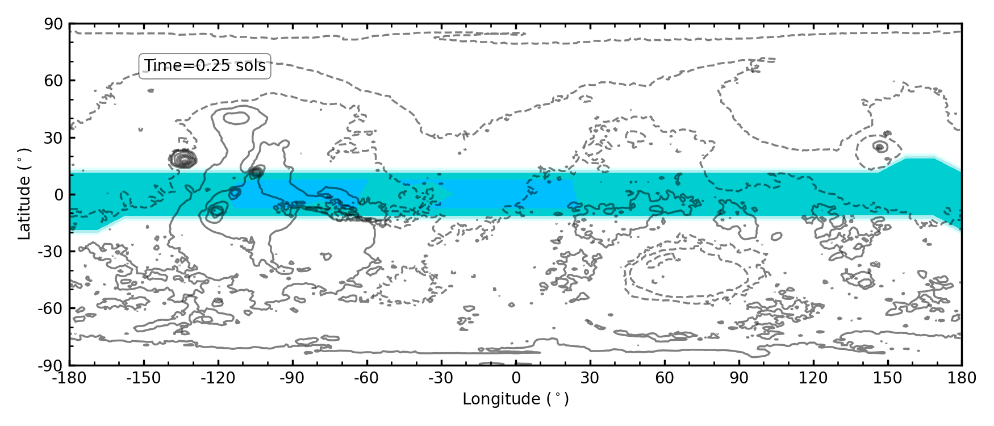

Slide 11
Take Home Message
Long Term Climate Variation not reproducible with GCM
Solution : PLANETARY EVOLUTION MODEL (PEM : Asynchronous model and extrapolation)
Two purposes:
Find a steady state for a given external forcing.
Realistic simulation of climate and fate of volatiles over thousands of years.
References:
Laskar et al. 2004, 10.1051/0004-6361:2004133
Forget et al, 1999
Contact : romain.vandemeulebrouck@lmd.ipsl.fr

