Slide 1
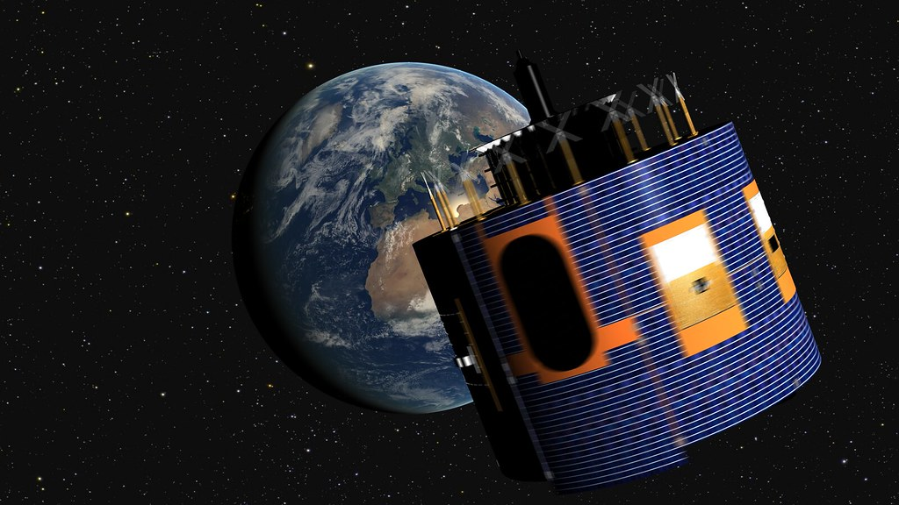




Deep learning for improved bias correction of satellite-derived SSR maps
Carpentieri, A.^{1,2}, M. Wild², D. Folini², A. Meyer¹
1 Bern University of Applied Sciences, Quellgasse 21, 2501 Biel, Switzerland
2 ETH Zurich, Universitaetstrasse 16, 8006 Zurich, Switzerland
Corresponding author: alberto.carpentieri@bfh.ch
Notes:
Good evening and thank you for letting me present our project.
The project I am presenting today is about the study and the correction of the bias related to satellite surface solar radiation maps. To correct the bias, we trained a spatio temporal neural network able to learn the bias distribution and then correct it. The first results are promising, leading to up to 30% RMSD reduction.

Slide 2
Notes:
So, the solar radiation maps are retrieved by a geostationary satellite as shown in the picture, in our case the METEOSAT 2nd generation. It scans the same part of the surface of the earth every 15 minutes.

Slide 3
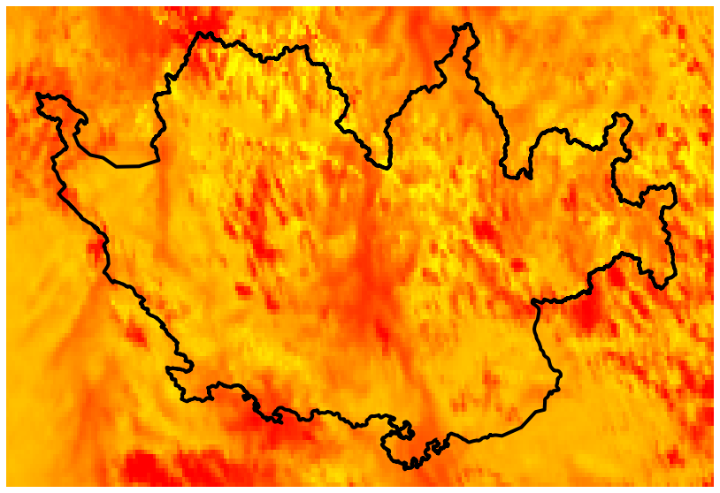
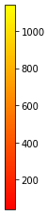
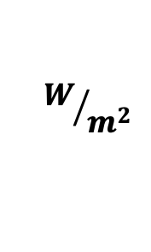
$$W/{m^{2}}$$
3
Notes:
The satellite scans are then processed to derive the surface radiation. Here an exemple, in our project we will focus on the Swiss area (bounded in black). Since the global radiation maps are computed by radiative transfer algorithms, we will analyze and discuss HelioSat SARAH2 and HelioMont, there can be some systematic bias on the maps. To find and solve this problem we make use of meteorological stations of the swiss national weather service

Slide 4
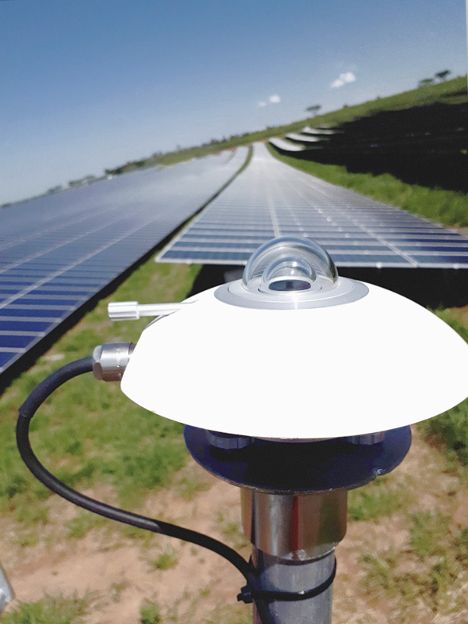
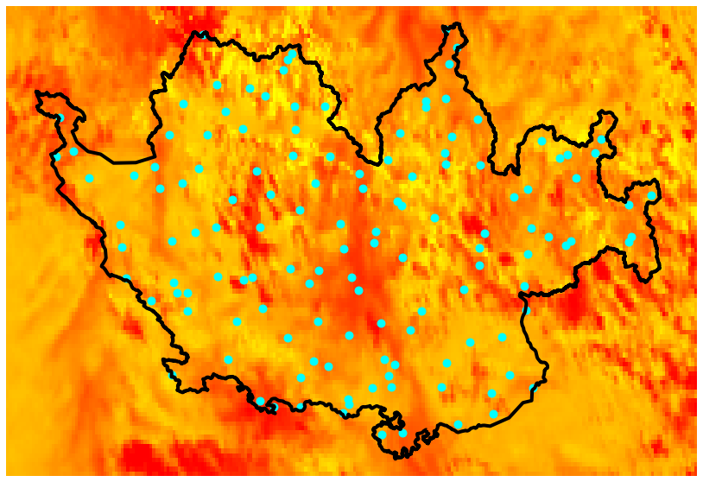
Ground
Stations
$$W/{m^{2}}$$
4
Notes:
The satellite measurements are so compared to ground measurements. Meteorological stations have pyranometers (right side picture) which measure the amount of radiation. They are more accurate wrt to the satellite, so we use the ground measurements as ground truth for our study. So the satellite measurement are compared with the station pixel by pixel. The aim is to model the problem in order to correct the bias on pixels not having a ground station.

Slide 5

Bias
$$bias_{lon,lat,t}=SSR_{lon,lat,t}^{sat }−SSR_{lon,lat,t}^{ground}$$
Notes:
Let’s formailize it.
The bias is inteded to be the difference between the satellite and the pyranometers measurements.

Slide 6

Bias
$$bias_{lon,lat,t}=SSR_{lon,lat,t}^{sat }−SSR_{lon,lat,t}^{ground}$$
$\left(lon,lat,t\right)$: point in space-time, $\left(lon,lat\right)∈S,t∈T$
$SSR^{sat}$ : satellite-derived SSR measurement
$SSR^{ground}$ : ground station SSR measurement
Notes:
The space is modeled using longitude latitude and altitude. The time ,instead ,is modeled using synusoidal time encoding features. The aim is to capture daily and yearly seasonalities in the bias distribution.

Slide 7
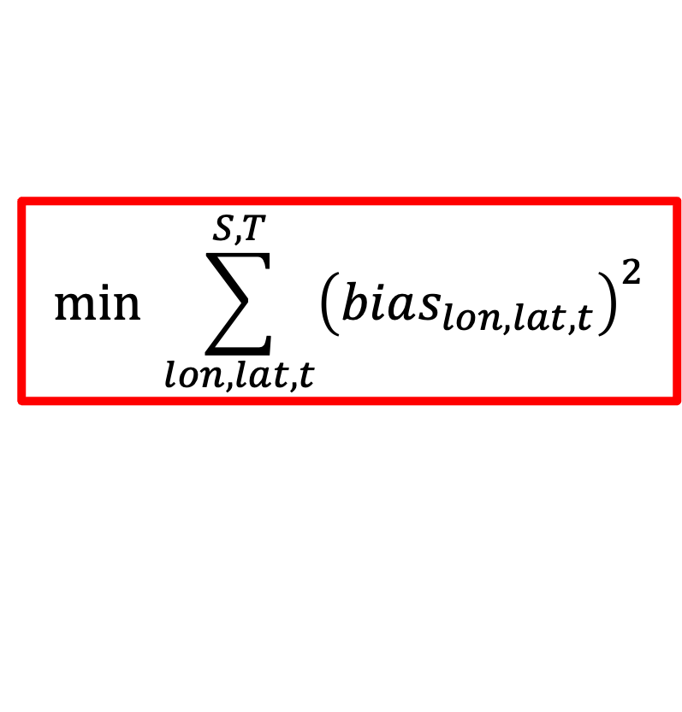
Bias
$$bias_{lon,lat,t}=SSR_{lon,lat,t}^{sat }−SSR_{lon,lat,t}^{ground}$$
$\left(lon,lat,t\right)$: point in space-time, $\left(lon,lat\right)∈S,t∈T$
$SSR^{sat}$ : satellite-derived SSR measurement
$SSR^{ground}$ : ground station SSR measurement
GOAL
$$min \sum_{lon,lat,t}^{S,T}{{\left(bias_{lon,lat,t}\right)}^{2}}$$
Notes:
The final goal is the minimization of the sum of squared biases.

Slide 8
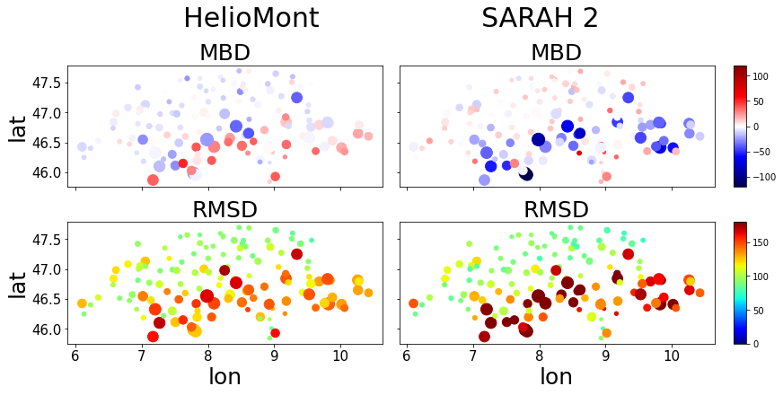
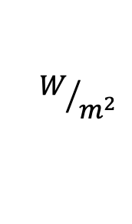
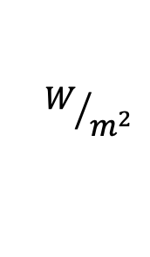
Bias
HelioMont
HelioSat SARAH-2
$$W/{m^{2}}$$
$$W/{m^{2}}$$
RMSD vs altitude $R^{2}:$ 0.77 0.84
Notes:
Now we can see the Mean Bias Deviation and the Root Mean Squared Deviation of the bias for all the 133 ground stations of the SMN for two satellite datasets. The bigger the dots the higher are the ground stations located. Clearly there is an increase of the bias magnitude (RMSD) with the increase of the altude represented by dot size. The values showed are averaged over all timestamps available for 2018 and nighttime values are not considered. In general, HelioMont performs better in higher locations as described in the paper of Castelli et al., 2014. In fact the Pearson correlation for HelioMont is lower.
the bias strongly increases ith altitude
large errors, note the magnitude,

Slide 9

Regression Models
HelioMont BC Model
$${bias}_{t,lon,lat}=SS{R^{sat}}_{t,lon,lat}−{S{SR}^{ground}}_{t,lon,lat}$$
$\sim SS{R^{sat}}_{t,lon,lat}+SZA_{t,lon,lat}+KI_{t,lon,lat}+TE_{t}+lon+lat+alt_{lon,lat}$
Notes:
This is our general modelization of the problem. We intend to predict the bias value given a set of features. The predicted bias is then subtracted from the maps to solve the minimization probelm.
The features are:
- the satellite measurement
- solar zenith angle
- clear-sky index

Slide 10
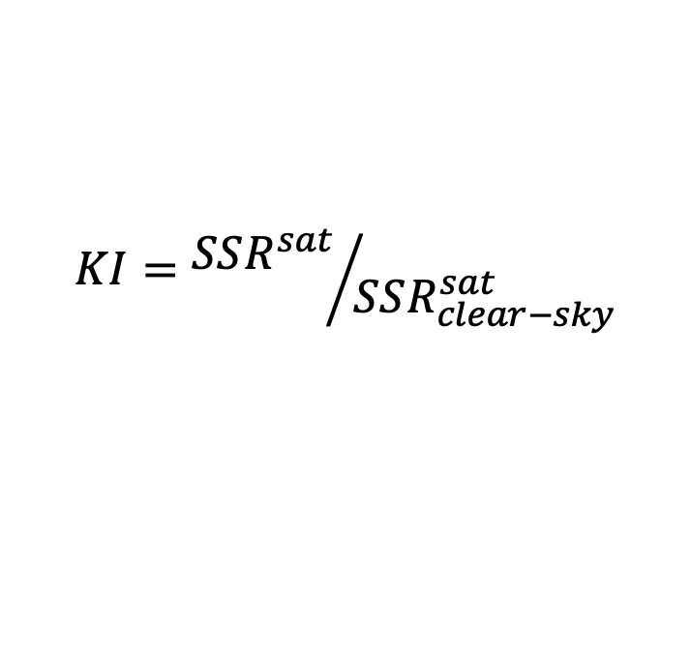
Regression Models
$$KI={SSR^{sat}}/{SSR_{clear−sky}^{sat}}$$
HelioMont BC Model
$${bias}_{t,lon,lat}=SS{R^{sat}}_{t,lon,lat}−{S{SR}^{ground}}_{t,lon,lat}$$
$\sim SS{R^{sat}}_{t,lon,lat}+SZA_{t,lon,lat}+KI_{t,lon,lat}+TE_{t}+lon+lat+alt_{lon,lat}$
Notes:
whihc is defined as the ratio of the satellite measurement and the clear sky radiation
Plus the three spatial features (lon, lat and alt) and 4 time encoding features.

Slide 11

Regression Models
HelioMont BC Model
$${bias}_{t,lon,lat}=SS{R^{sat}}_{t,lon,lat}−{S{SR}^{ground}}_{t,lon,lat}$$
$\sim SS{R^{sat}}_{t,lon,lat}+SZA_{t,lon,lat}+KI_{t,lon,lat}+TE_{t}+lon+lat+alt_{lon,lat}$
SARAH-2 BC Model
$${bias}_{t,lon,lat}=SS{R^{sat}}_{t,lon,lat}−{S{SR}^{ground}}_{t,lon,lat}$$
$\sim SS{R^{sat}}_{t,lon,lat}+SZA_{t,lon,lat}+TE_{t}+lon+lat+alt_{lon,lat}$
Notes:
The modelization of the regression problem for the two datasets is almost the same, the only difference is that we do not have the KI for SARAH-2 at the moment.

Slide 12
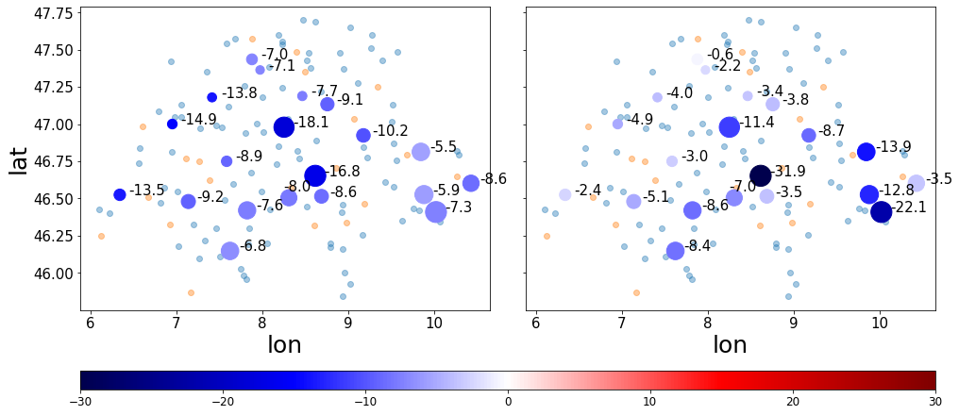
Results
HelioMont
HelioSat SARAH-2
% RMSD Improvement
Notes:
Now some results, in this map we can see all the ground stations, the small blue dots are the staion used as training set. The orange ones used for the validation and the bigger dots represent the test set. Train, validation and test sets are all represented by different time periods. For the test set we can see the percentages of rmsd reduction, the results are satisfactory, in fact the model can learn the spatio-temporal distribution of the bias and reduce it by up to more than 30% and 18 % for HelioSat and HelioMont respectively

Slide 13
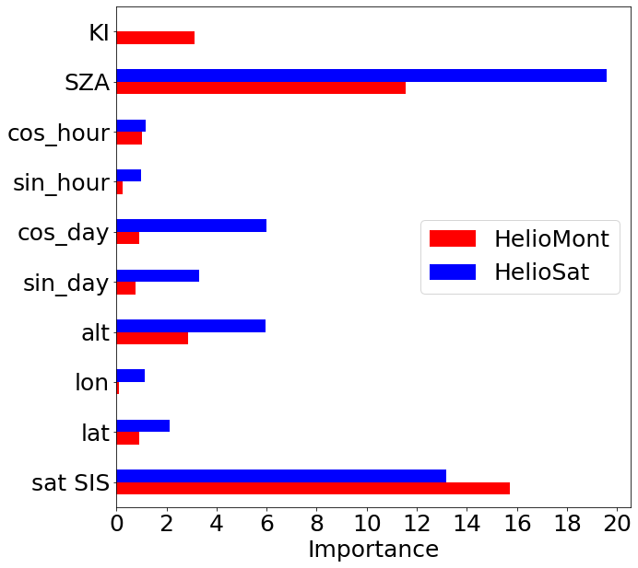
Features Importance
Permutation algorithm based on Fisher et al., 2018
Notes:
We also analyzed the importance of the different features. For both datasets the most important features are the satellite radiation value, the solar zenith angle and the altitude.
explain a bit what a feature importance is (use regressors)

Slide 14
Thank you!
Strong altitude-bias correlation
Post-processing techique with no need of real time in situ meaurements
Up to 31% RMSD reduction
Contacts: alberto.carpentieri@bfh.ch
Notes:
Thank you for your attention.
NOTES:
- geostationary satellite of METEOSAT 2nd GENERATION satellites.
- radiative transfer algorithms that converts the satellite images
- change radiative transfer with algorithm that changes the

Slide 15
Appendix - Key Points
Altitude-bias correlation is studied for HelioSat SARAH-2 and HelioMont datasets
The presented spatio-temporal bias correction (BC) approach can be applied as a post-processing techique with no need of real time in situ meaurements
Spatio-temporal Multi-Layer Perceptron (MLP) decreases the satellite RMSE by up to 18% for HelioMont and 31% for HelioSat on unseen locations and timestamps
Notes:
The main results of this project are the followings. First, a study on the bias of the satellite intra-hourly measurements of the satellite maps indicate a strong relationship between the altitude of the considered location and the magnitude of the bias. In order to reduce the magnitude of the satellite-derived maps bias we present a spatio-temporal modelization of the problem where a deep-learning regressor model is used to predict the bias for unseen locations and timestamps. This modelization permits to use our model as a post-processing technique directly on the satellite-based maps which differ from what was mostly done in literature. The results of the proposed approach are promising, leading to up to 30% RMSD reduction for the HelioSat algorithm and up to 18% for HelioMont algorithm.
Don’t write key points, just use map of switzerland with instruments used. Show instruments.
More time on the set up (no text)
SMN run by swiss weather service
Reduce the info in the slide (no time encoding, just few words on feature importance)
Last slide: name and contact details
Speak slower on the results

Slide 16
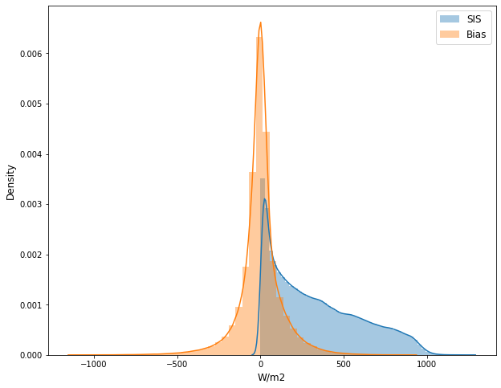
Appendix - Bias
From the results of D’agostino Pearson test on normality, both HelioSat and HelioMont biases show normality with a confidence of 99%
Predicting the bias instead of the ground measurements showed an improvement on the performances

Slide 17
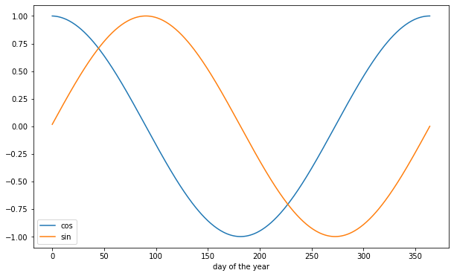
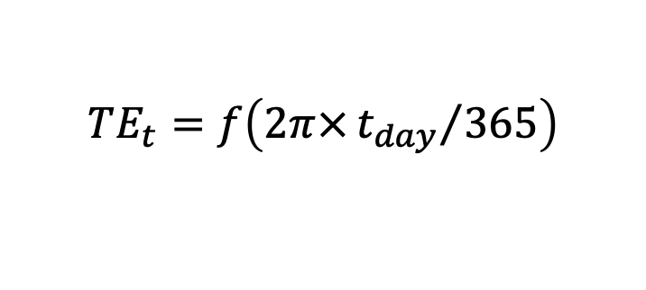
Appendix - Regression Models
HelioMont BC Model
$${bias}_{t,lon,lat}=SS{R^{sat}}_{t,lon,lat}−{S{SR}^{ground}}_{t,lon,lat}$$
$\sim SS{R^{sat}}_{t,lon,lat}+SZA_{t,lon,lat}+KI_{t,lon,lat}+TE_{t}+lon+lat+alt_{lon,lat}$
$$TE_{t}=f\left(2π×{t_{day}}/{365}\right)$$
Notes:
Plus sinusoidal time encoding features, inspired by the positional encoding procedure. sin and cosine functions are used to model the yearly and daily seasonalities. Moreover, we used three spatial features, which are the topografical coordinates and altitude

Slide 18
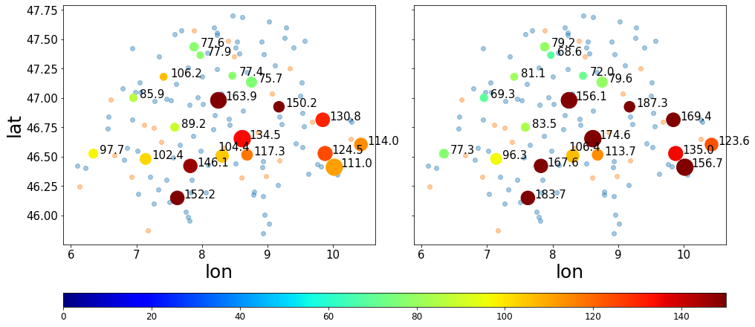
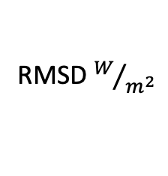
Appendix - Test Set
HelioMont
HelioSat SARAH-2
RMSD $W/{m^{2}}$
Notes:
Now some results, here we can see the RMSD of the test set: 20 stations are randomly sampled. As test periods we chose 6 weeks comprehending the cloudiest and sunniest days of 2018.
We can see again that the bias magnitude is higher for higher located stations.

Slide 19

Appendix - Test Set
HelioMont
HelioSat SARAH-2
RMSD $W/{m^{2}}$
Notes:
And now the bias values after the correction.

