Slide 1
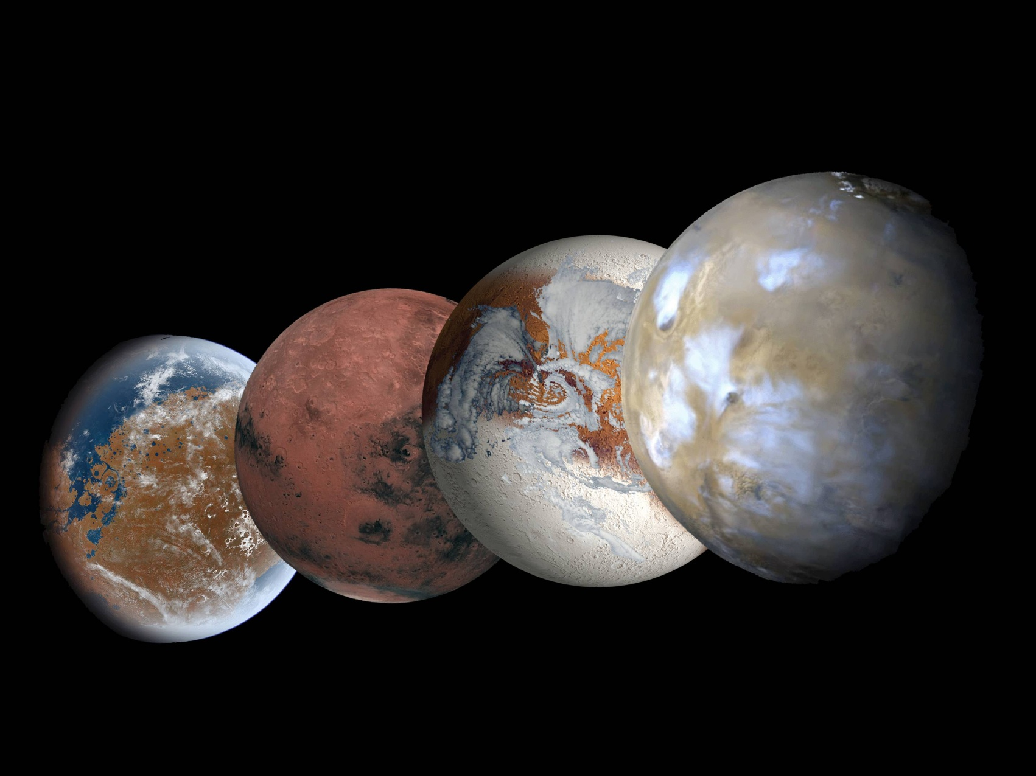



Climate Simulations of Mars at Low Obliquity
L.Lange, F. Forget, R.Vandemeulebrouck, E.Millour, A.Delavois, J.Naar, A.Spiga, A.Bierjon, E.Dupont
Laboratoire de Météorologie Dynamique, CNRS, Paris lucas.lange@lmd.ipsl.fr

Slide 2
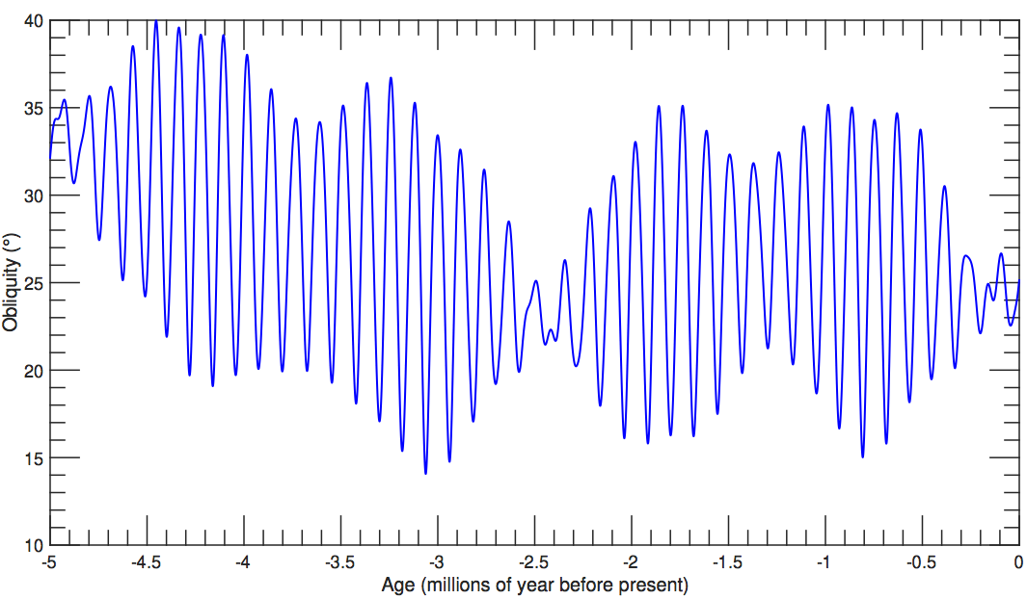
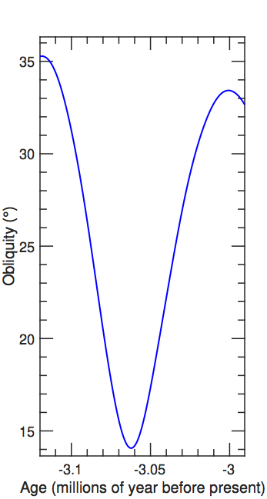
Evolution of the Martian Obliquity
~100 000 years
~30 000 years
The obliquity of Mars reached values ~15° in its recent past, probably less than a few degrees during the Amazonian era (Laskar et al. 2004)

Slide 3
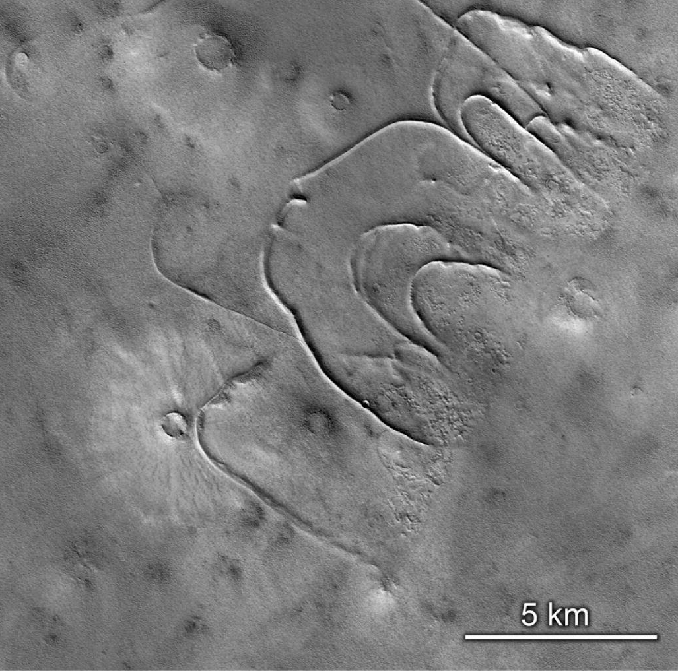
Evolution of the Martian Obliquity
The poles receive lower insolation and are thus cold traps. One may expect:
An atmospheric collapse, with the formation of massive permanent ice caps at the poles ? (Kreslavsky and Head 2005)
A residual atmosphere of Ar/N2, 20 times less dense than today (Kreslavsky and Head 2005)
Formation of CO2 glaciers flowing on the surface of Mars ? (Kreslavsky and Head 2011)
1D models !
Evidence of CO2 glacier moraines ? (Kreslavsky and Head 2011)

Slide 4
Model set-up
We use the Planetary Evolution Model
We run the model with only CO2 and Ar/N2 in the atmosphere, and dust opacity is set constant.
Obliquity is set to 5°, initial state is today’s martian climate

Slide 5
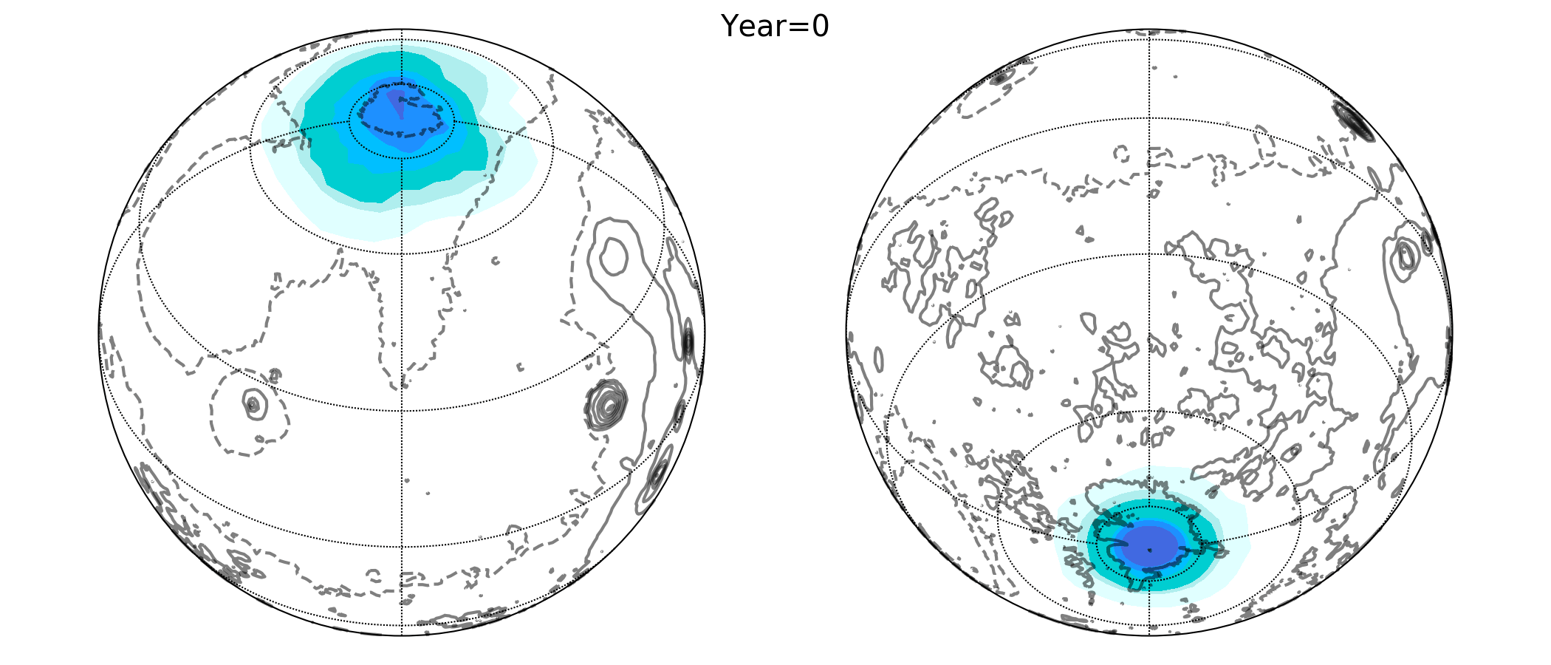
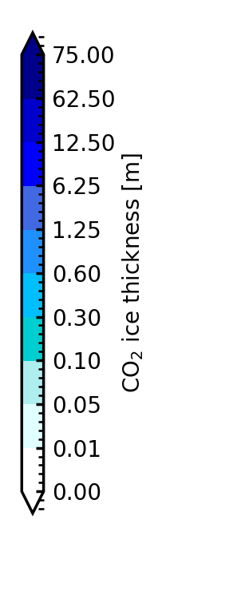
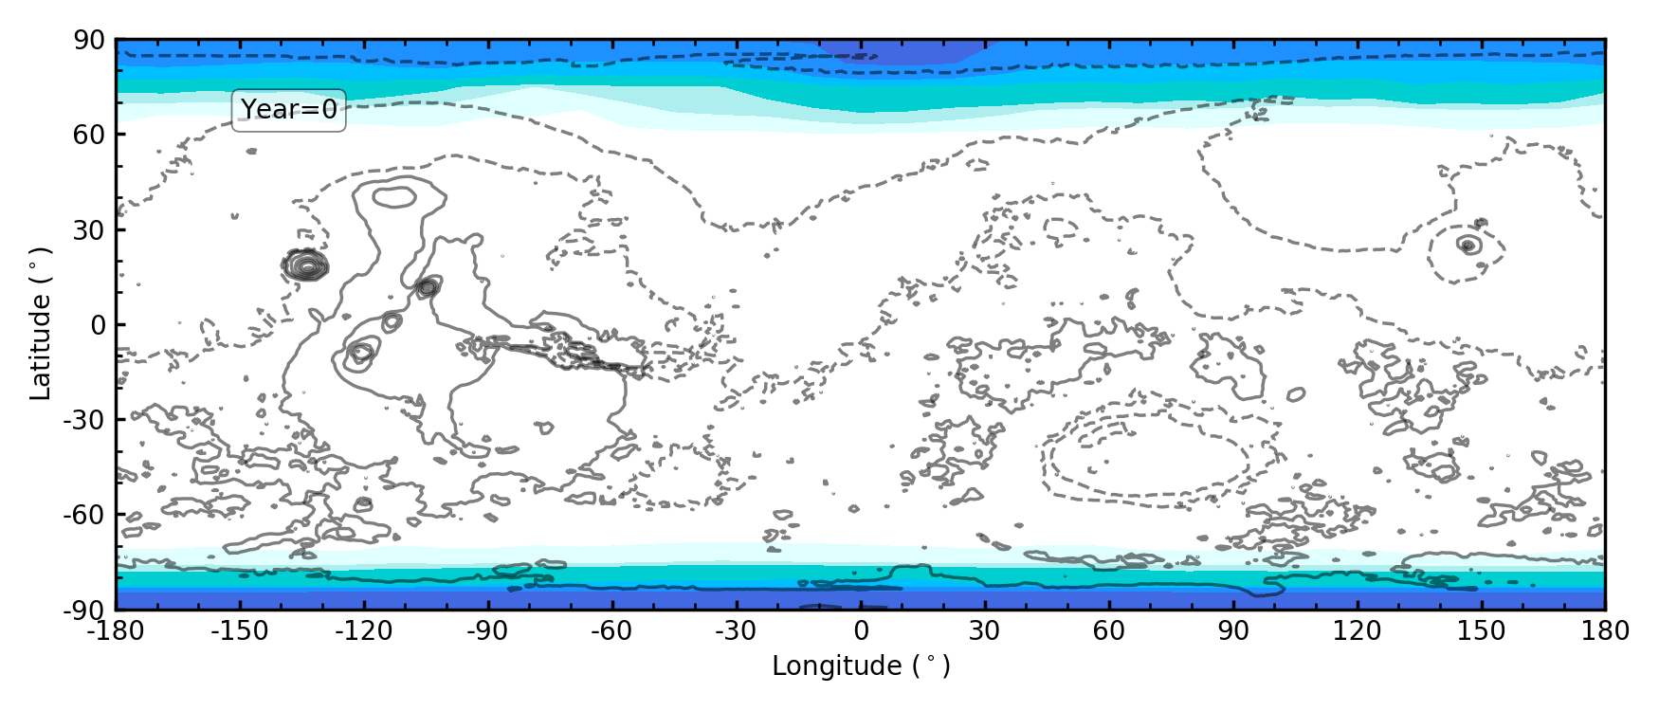
Results no slope
5￼

Slide 6
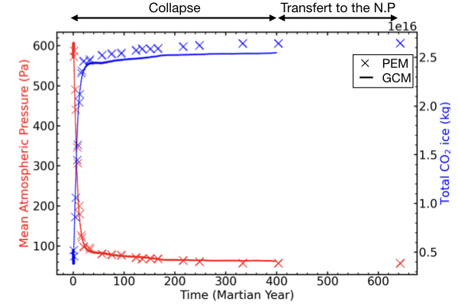
Results
The residual atmosphere has a 10 times lower mass than today

Slide 7
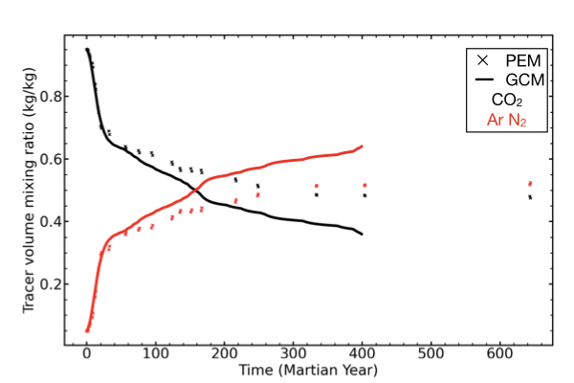
Results
The residual atmosphere is mainly composed of Ar N2

Slide 8
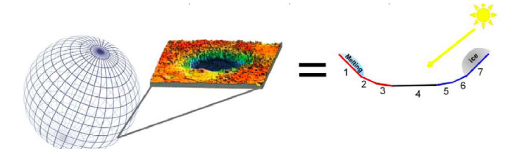
CO2 glacier flows
We introduce a slope parametrization in each mesh of the model to simulate the formation and evolution of glaciers
Nsidc.org

Slide 9
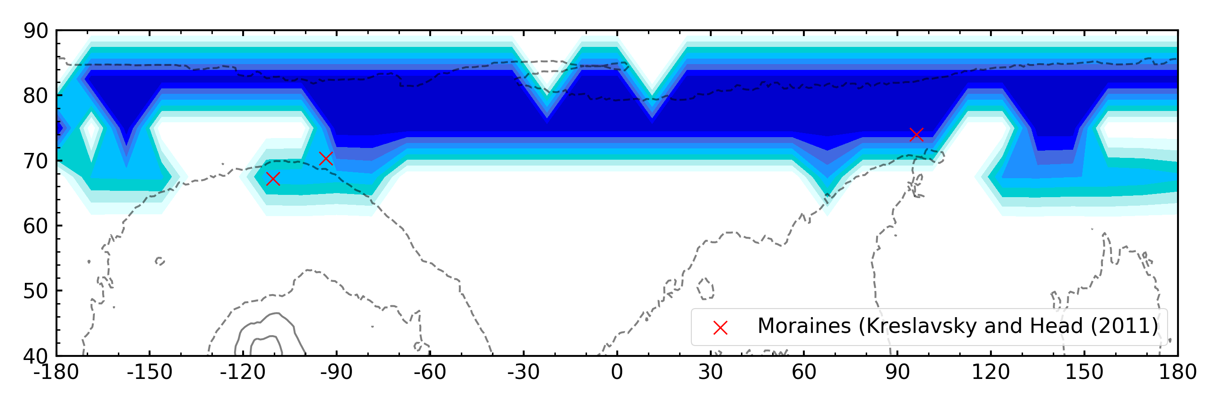
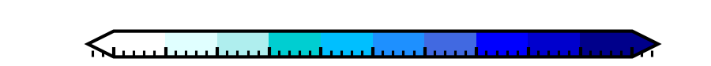
CO2 glacier flows
Results after 25 years of simulations
0
1
2
3
4
5
6
7
8
9
Glacier flows
CO2 ice thickness on 30° North facing slopes [m]
The location of some moraines are consistent with a possible CO2 glacier flows on steep slopes.
Longer simulations are however needed.

Slide 10
Take-Home Messages:
The Planetary Evolution Model enables the simulation of low-obliquity climates
Atmospheric collapse at low obliquity can quickly occur, forming a perennial ice caps at the North Pole, leaving a residual atmosphere of Ar and N2
CO2 glaciers are expected to flow where moraines have been found in the Northern hemisphere
Future works:
Make longer simulations with slopes and water
Simulate a complete descent from 25° to 15° following the curves of Laskar et al., 2004
Include the ground response to atmospheric collapse: a possible warming of the subsurface ? (Woods & Griffiths, 2009)
References:
Contact:
Laskar et al. 2004, 10.1051/0004-6361:2004133
lucas.lange@lmd.ipsl.fr
Kreslavsky and Head, 2005 10.1029/2005GL022645
Kreslavsky and Head, 2011, 10.1016/j.icarus.2011.08.020
Wood and Griffiths, LPSC 2009

