Slide 1


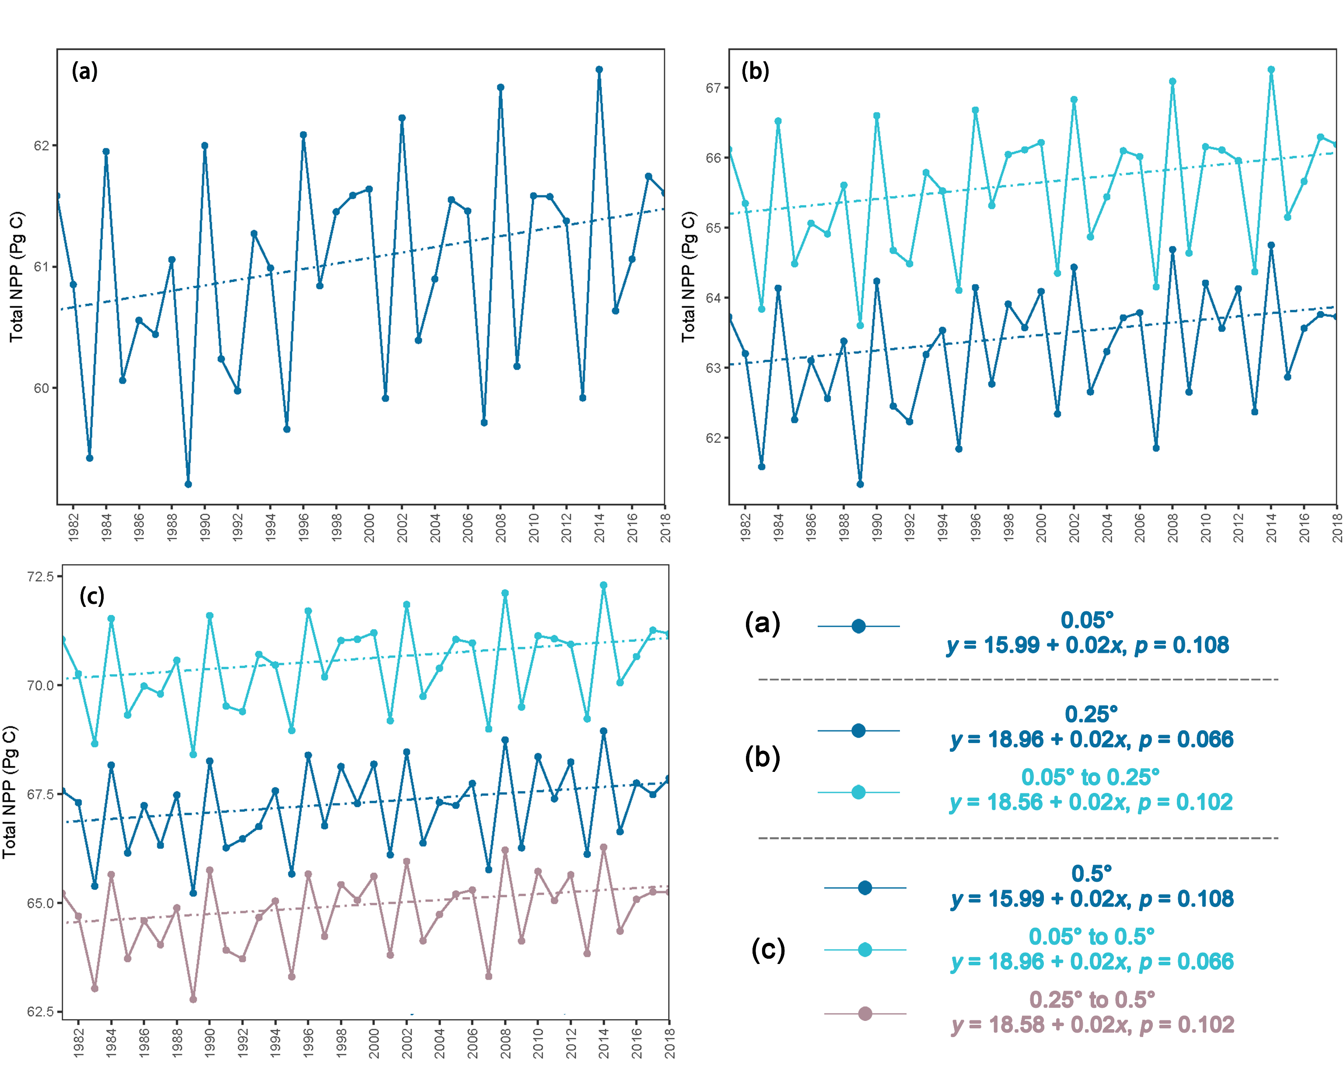
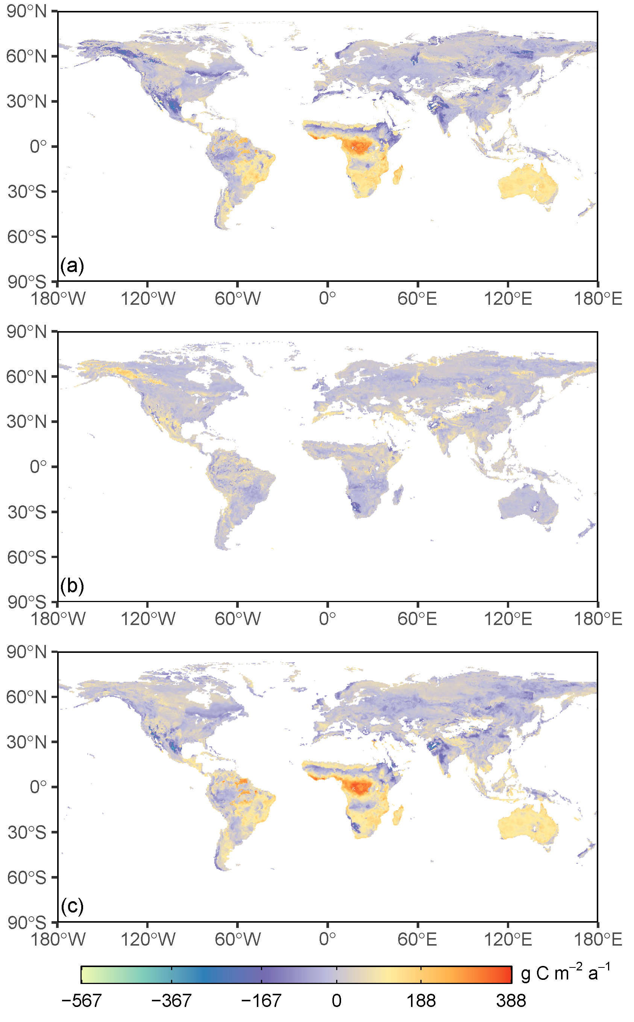
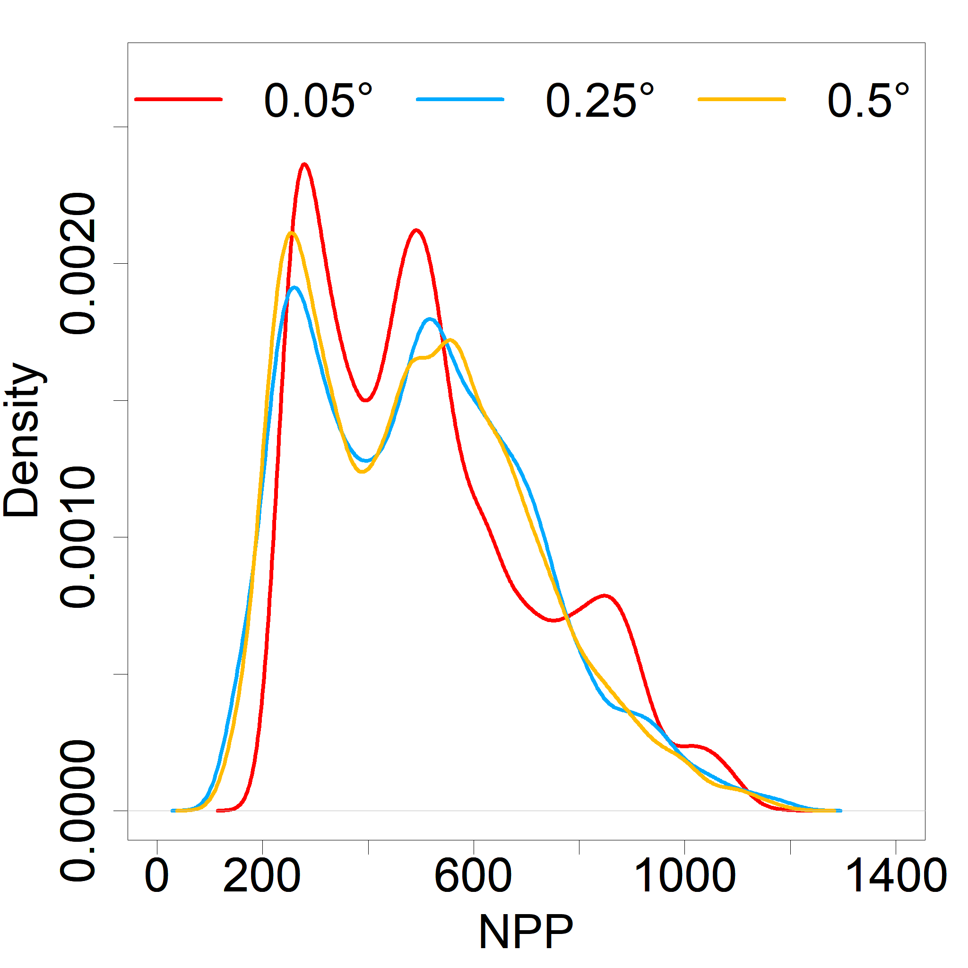
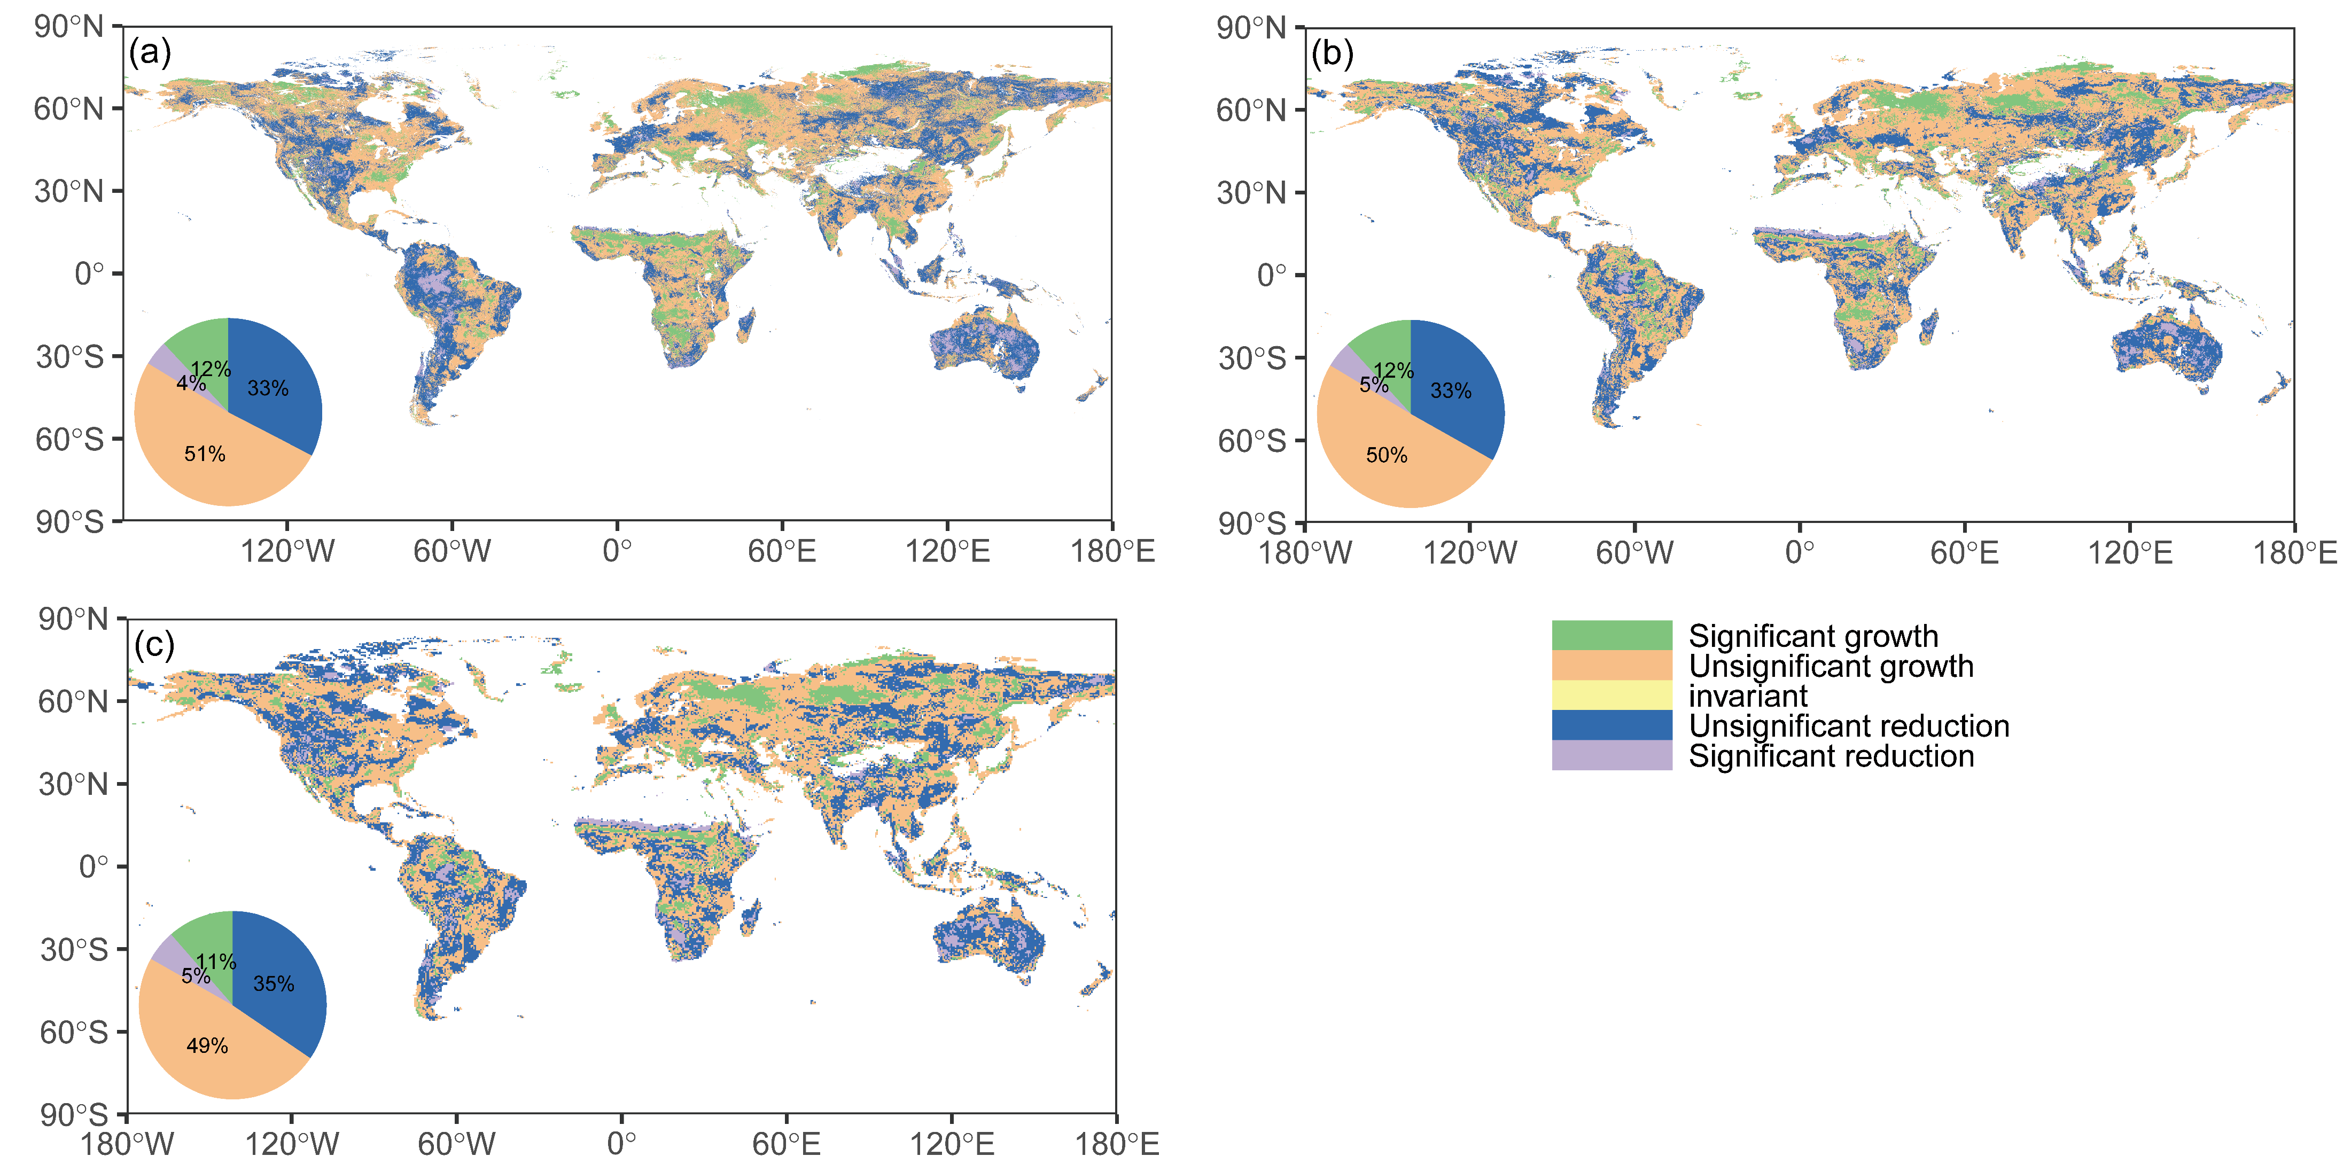
Comparing the spatio-temporal differences of global NPP simulation data with different resolutions
Tao Zhou¹, Xiaolu Tang ^{2, 3,*}, Zhihan Yang¹, Xinrui Luo¹, Ke Luo¹, Yunsen Lai¹, Peng Yu¹, Runying Zhao²
2022
1 College of Earth Science, Chengdu University of Technology, Chengdu, China
2 College of Ecology and Environment, Chengdu University of Technology, Chengdu, China
3 State Environmental Protection Key Laboratory of Synergetic Control and Joint Remediation for Soil & Water Pollution, Chengdu University of Technology, Chengdu , China
Introduction
Net primary productivity (NPP) is a key parameter to characterize terrestrial ecological processes. Fast and accurate estimation of global NPP can provide help for climate warming, ecological protection, policy designation, etc. However, research of impact of the changing data resolution on simulate NPP is still uncertain.
Results
Conclusion
(ⅰ) The three-resolution NPP models was reliable (R²: 0.55, 0.53, 0.54), resolution change had little effect on model;
(ⅱ) The annual average total NPP were about 61, 63 and 67 Pg C for 0.05°, 0.25°, 0.5°, respectively. the total NPP showed a non-significant positive trend.
(ⅲ) The change in the resolution of the variables and the global NPP caused differences in the spatio-temporal characteristics of the NPP database.
(1) Among the 0.05°, 0.25°, and 0.5° models, the model constructed with the 0.05° variable had the highest accuracy (R² = 0.55; RMSE = 213), and the annual average total NPP estimate of 61 Pg C.
(2) Density plots shown some differences of different resolution NPP in the range of 300-1000 g C m⁻² a⁻¹. the spatial difference value revealed that the largest difference distribution in Africa.
Figure 1 Accuracy evaluation results of the 0.05° model based on (a) 10-fold cross-validation, (b) leave-one-site cross-validation, (c) leave-one-year cross-validation.
(3) From 1981 to 2018, the annual total NPP for different resolutions shown a positive trend (0.02 Pg C a⁻¹), and the annual total NPP increased with increasing resolution.
Method
(ⅰ) Three cross-validations, for evaluating different resolution random forest models; (ⅱ) Density curves, Spatial difference values, for analyzing the spatial difference of different resolution; (ⅲ) Theil-Sen linear regression and Mann-Kendall (MK) test, for analyzing the spatio-temporal differences of different resolutions.
(d)
Figure 3 Mann-Kendall (MK) trends in total annual NPP for (a) 0.05°, (b) 0.25°, and (c) 0.5°.
Figure 2 Spatial patterns of (a) annual mean NPP (0.05°) minus annual mean NPP (0.25°), (b) annual mean NPP (0.25°) minus annual mean NPP (0.5°), (c) annual mean NPP (0.05°) minus annual mean NPP (0.5°), (d) density distribution of three-resolution NPP.
(4) The percentage of significant changes was approximately the same for different resolution NPP data, but the significant change regions were not consistent at different resolutions.
Corresponding author at:
State Environmental Protection Key Laboratory of Synergetic Control and Joint Remediation for Soil & Water Pollution, Chengdu University of Technology, Chengdu 610059, China
E-mail address: lxtt2010@163.com (X. Tang)
Figure 4 Spatial Patterns of NPP significant change for (a) 0.05°, (b) 0.25°, and (c) 0.5°; The fan chart is the percentage of change types.

