Slide 1


Mercury and methylmercury in the benthic organisms of Admiralty Bay (Antarctica).
Małgorzata Jarzynowska¹*, Dominika Saniewska¹, Michał Saniewski², Piotr Bałazy³
University of Gdansk, Faculty of Oceanography and Geography, Department of Marine Chemistry and Environmental Protection, Al. Marszałka Piłsudskiego 46, 81-378 Gdynia, Poland
Institute of Meteorology and Water Management – National Research Institute, Waszyngtona 42, Gdynia, Poland
Institute of Oceanology, Polish Academy of Sciences, Powstańców Warszawy 55, Sopot, Poland
* Master student; malgorzata.jarzynowska@gmail.com
Notes:
Hello, my name is Małgorzata Jarzynowska and I am a student of the first year of master studies in Oceanography at the University of Gdańsk. The topic of my presentation is Mercury in the benthic organisms of the Admiralty Bay (Antarctica), in which I would like to present the results that are part of my bachelor thesis.

Slide 2
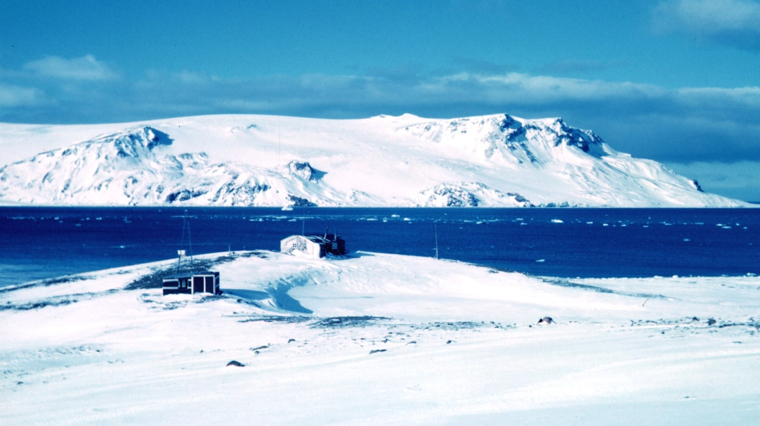
AIMS
Recognise the concentration of total mercury and methylmercury in organisms inhabiting the Antarctic coastal zone.
Determine of mercury accumulation and biomagnification potential in the food web depending on the trophic level and the size of the organism.
Notes:
The aim of this study was determination of the mercury accumulation and biomagnification potential in the food web depending on the trophic level and the size of the organism.

Slide 3
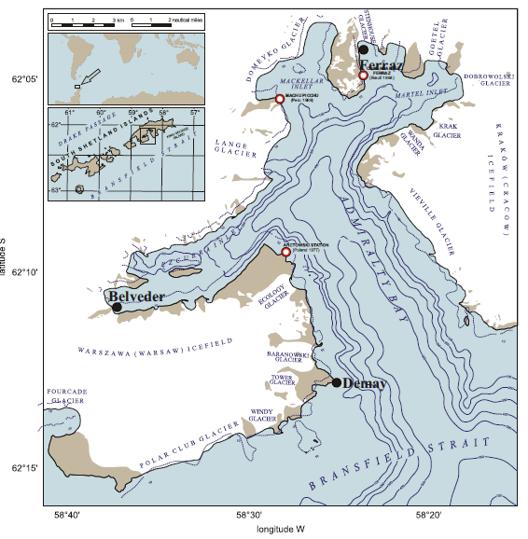
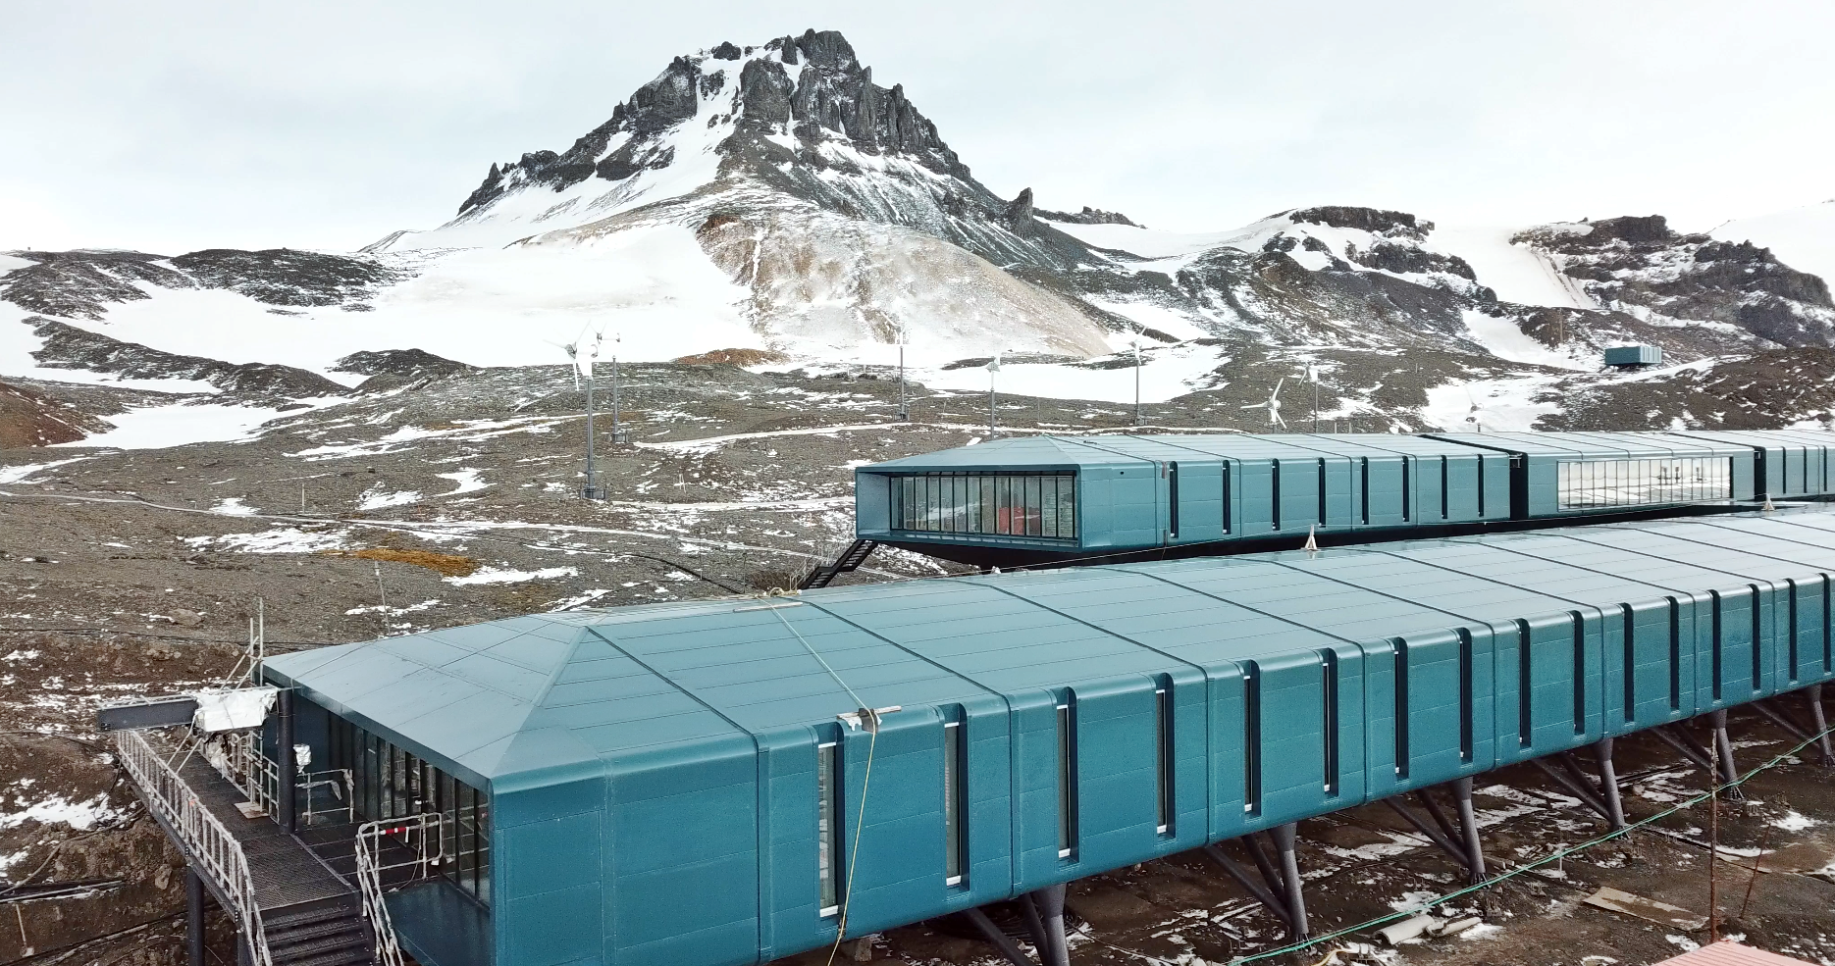
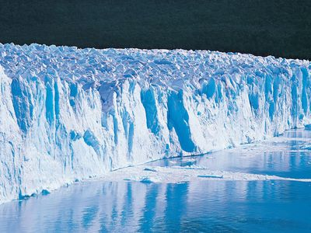
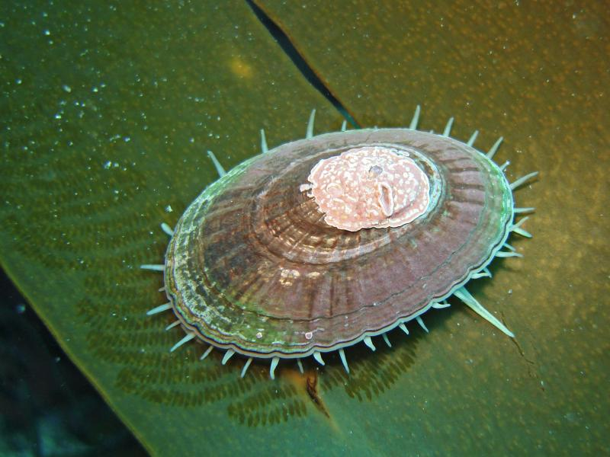
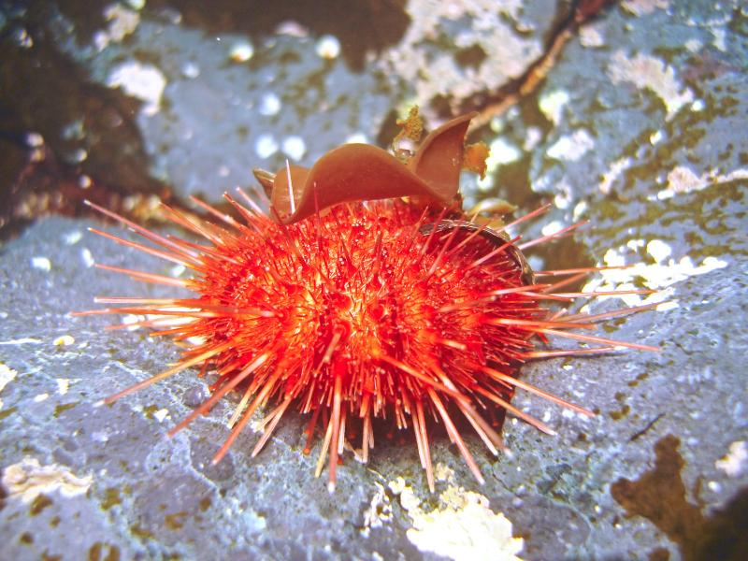
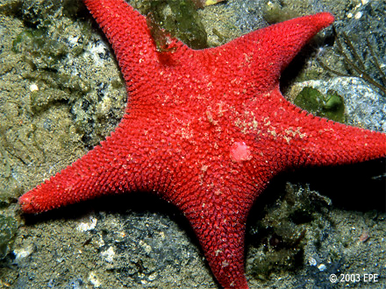
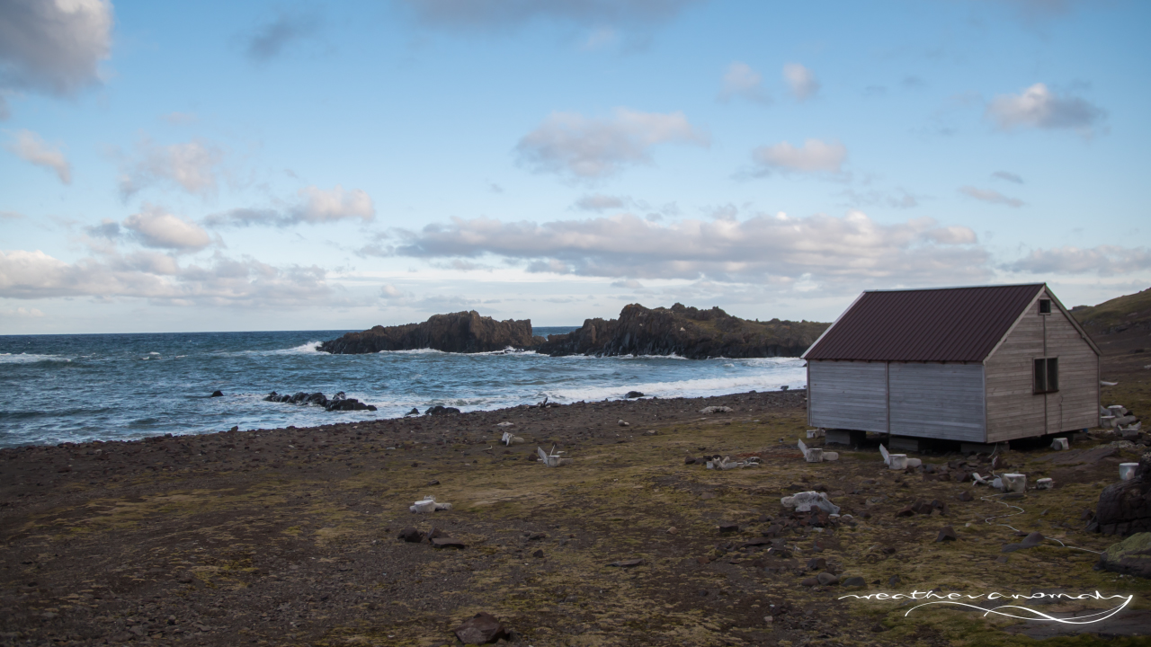
Area of research
Admiralty Bay
Fragile ecosystem
„Mercury ice storage”
Climate change
Samples – zoobenthos
www.oikonos.org
www.alchetron.com
www.divephotoguide.com
n=10
n=11
n=15
Bioaccumulation and biomagnification
Long-lived and slow metabolism
Indicators of the environment
D. Saniewska
Notes:
Why is this research focused on the mercury content in organisms? Mercury is a heavy metal and it is toxic to both marine and terrestrial animals, including humans. Histopathological changes have already been noticed, for example in the polar bears and whales, which are the organisms at the end of the trophic chain. Also the properties of mercury are important, including the ability to biomagnify. Biomagnification is based on the fact that the concentration of mercury accumulated in the soft tissue increases with the trophic level - hence the organisms at the end of the trophic chain, including humans, are most exposed to the risk of mercury poisoning and mercury concetration ih their soft tissue can be even hundred thousand times higher than the mercury contentration in the water around them.
Both the Arctic and the Antarctic are far away from anthropogenic sources of mercury, so perhaps the metal should be studied closer to big cities or mines. However, it is not the proximity to the source that is crucial, but the biogeochemical cycle of mercury as well as the characteristics of the polar regions. The concentration of mercury in water, ice, snow and animals are relatively high in polar regions and scientists are still searching for the answer why. Due to its properties, mercury can be transported long distances and then deposited in water or on the surface of ice. Assuming that mercury can accumulate in the polar ice, the Arctic and the Antarctic are often referred to as "mercury ice storage". Additionally, due to global warming, mercury, which has been deposited in ice for many years, gets into the water as a result of melting glaciers.
Mercury accumulates and biomagnifies in polar organisms, so it is particularly important to study animals inhabiting cold polar waters, as they can be seriously endangered. These organisms are long-lived, have a slow metabolism, can become large, and accumulate mercury during their lifetime. Hence, the concentration of mercury in individuals of the local fauna can be very high, especially at the highest trophic level. Research on benthic organisms is especially valuable, because due to their limitations in movement, they can be good environmental indicators.

Slide 4

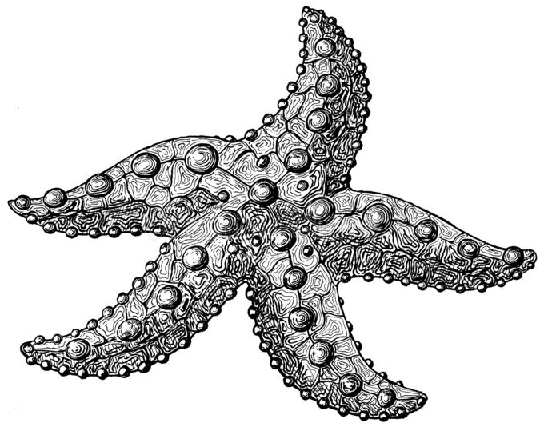

RESULTS
Fig. 1 Average concentration of total mercury of the organisms [ng/g].
Fig. 2 The percentage of THg in the hard tissue and in the soft tissue.
The highest THg concentration is in starfish.
Sea urchin has the greatest ability to „purify”.
Notes:
On the graph we can see the average concentrations of total mercury of the organisms - as can be seen, Sea snail had the lowest concentration, then we had sea urchin. In turn, the starfish had the highest concentration - the difference in concentration between the first and the last two species is very large. The explanation for this difference may be the biomagnification process. Sea snail is a typical herbivorous, when sea urchin is omnivorous - largely feeds on diatoms and other algae. It also consumes foraminiferans, amphipods, bryozoans and also seal faeces when available. Whereas, starfish is an omnivorous scavenger and consumes anything it finds including carrion, detritus and the faeces of seals.

Slide 5
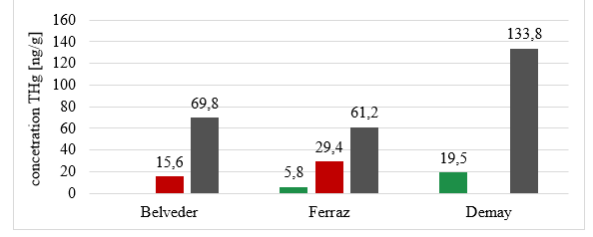
RESULTS
The highest concetrations in Demay point.
No tendency in Belveder and Ferraz points.
No data
No data
No data
Fig. 3 Average concentration of total mercury in tested organisms at individual stations [ng/g].
Notes:
Not all tested species were collected from all three points, but still it can be noticed that the highest total mercury concentration were observed in animals from the Demay station ​​- both the concentrations in the starfish and the sea snail clearly differ from the others. However, in the case of Ferraz and Belveder - these results do not show a specific tendency - it means that despite the fact that starfish has a higher concentration, at the Belveder station, the sea urchin has a higher concentration at the Ferraz station. Why are these concentrations so high at the Demay station? Melting glaciers transport to the sea a large load of mercury but this mercury is less bioavailable and it is not so strongly absorbed and accumulated by living organisms – hence the high results at the Demay station, where the suspension was mainly organic one, for example plankton. These conclusions have yet to be confirmed by the 13C carbon isotope research, which will allow us to discuss the source of the matter.

Slide 6
RESULTS
Large mass of individuals
Mostly inorganic mercury in soft tissue.
MeHg constitute majority of THg in hard tissue in sea snail and in starfish.
Fig. 4 Average amount of total mercury in tested organisms in soft and hard tissue with the division into methylmercury and inorganic mercury [ng/g].

Slide 7
This study has been performed within the framework of a National Science Center projects No. 2019/33/B/ST10/00290 and No. 2017/27/N/ST10/02230.
Notes:
This research was performed within the framework of two projects funded by National Science Center.

Slide 8

Mercury and methylmercury in the benthic organisms of Admiralty Bay (Antarctica).
Małgorzata Jarzynowska¹*, Dominika Saniewska¹, Michał Saniewski², Piotr Bałazy³
University of Gdansk, Faculty of Oceanography and Geography, Department of Marine Chemistry and Environmental Protection, Al. Marszałka Piłsudskiego 46, 81-378 Gdynia, Poland
Institute of Meteorology and Water Management – National Research Institute, Waszyngtona 42, Gdynia, Poland
Institute of Oceanology, Polish Academy of Sciences, Powstańców Warszawy 55, Sopot, Poland
* Master student; malgorzata.jarzynowska@gmail.com
Notes:
Hello, my name is Małgorzata Jarzynowska and I am a student of the first year of master studies in Oceanography at the University of Gdańsk. The topic of my presentation is Mercury in the benthic organisms of the Admiralty Bay (Antarctica), in which I would like to present the results that are part of my bachelor thesis.

