Slide 1
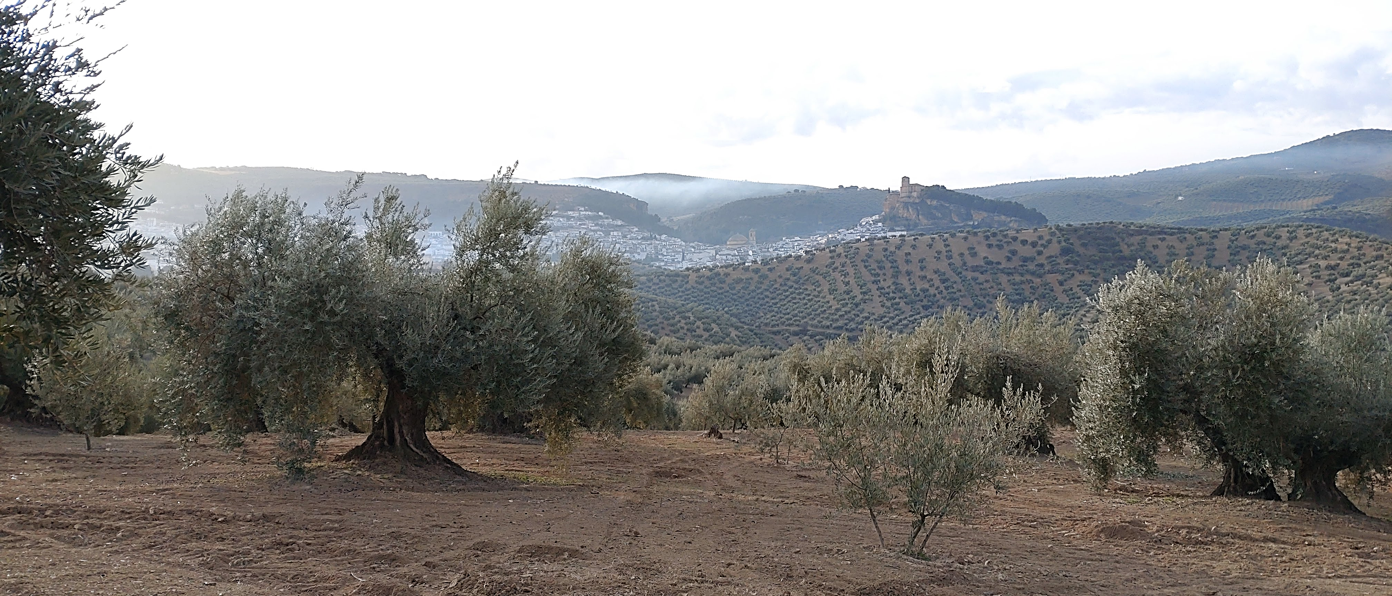




A robust evaluation of a revised version of the MMF-TWI soil erosion model
Andrés Peñuela, Vanesa García-Gamero and Tom Vanwalleghem
EGU General Assembly 2022
Tue, 24 May 2022
apenuela@uco.es

Slide 2



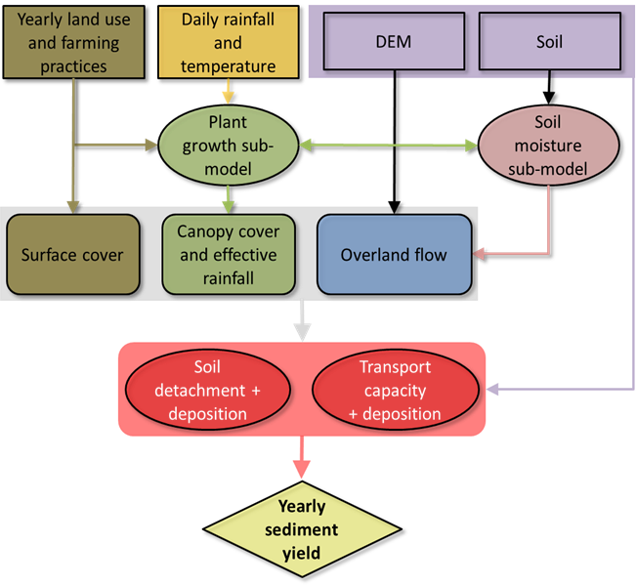
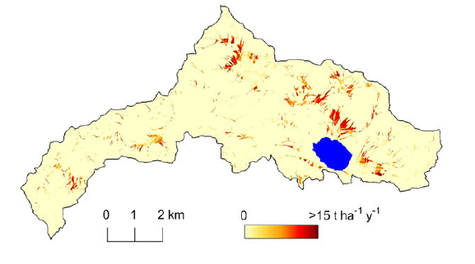
A robust evaluation of a revised version of the MMF-TWI soil erosion model
The MMF-TWI model (Peñuela et al., 2018)
Support agricultural soil management
Parsimonious / conceptual model
Long-term simulation (multi-decadal)
Identify vulnerable areas and vulnerable periods
Results
Good performance in simulating soil erosion in humid landscapes at a centennial timescale
Smith et al. (2018)
Notes:
The MMF-TWI is based on the MMF model and the TWI. It is meant to Support agricultural soil management and is a parsimonious model that explicitly represents the soil moisture, plant growth, runoff and soil erosión processes and their seasonal changes. It can run long-term simulations and can identify both vulnerable áreas in the catchment and vulnerable periods.
Previous results have show a good performance in simulating the effect of farming practices over the last century on sediment yields of 4 lake catchments in the UK.

Slide 3

A robust evaluation of a revised version of the MMF-TWI soil erosion model
A revised version
Why?
MMF-TWI only for humid environments
Apply on drier areas, e.g. Mediterranean
How?
Implementing infiltration excess runoff mechanism (PESERA approach)
Can we trust the model results?
Robust evaluation of the model
Can the model simulate past soil loss rates?
Centennial scale
Spatially
Is the model behaviour plausible?
Notes:
Why a revised version? For the moment, the model is only suitable for humid environments and we would like to use to support agricultural management also in drier areas like the Mediterranean. For this purpose we have implemented the infiltration excess runoff mechanism based on the PESERA model approach. But now we would like to evaluate it in a robust way, so we and land managers can trust the model results and we would like to answer these questions: Can the model simulate the past in the long-term, at a centennial scale, and spatially across the catchment? And moreover, is the model behaviour plausible?
However, the Hortonian (infiltration excess) overland flow (HOF) mechanism is not considered in MMF-TWI and needs to be implemented before it can be applied to areas where the Hortonian overland flow mechanism is predominant, such as the Mediterranean.
Models aiming to predict the future impacts of changes in land management and climate in soil erosion need first to demonstrate a good performance in simulating observed past changes and their corresponding measured/estimated impacts over time scales that encompass at least several decades.
, to gain confidence in the model and in its ability to perform its intended task, we need to test the plausibility of the model behaviour, i.e. whether the ‘right’ parameters control the model response, by means of Global Sensitivity Analysis (GSA)

Slide 4
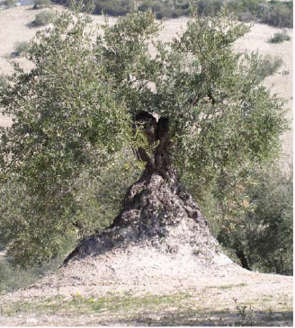
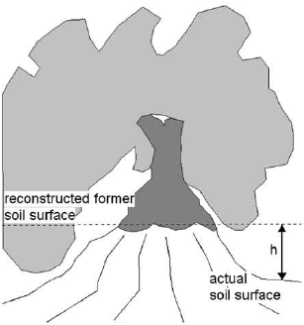



A robust evaluation of a revised version of the MMF-TWI soil erosion model
Can the model simulate past soil loss rates?
Comparison with spatially distributed estimations of past (30 - 250 years) soil loss rates:
Fallout radionuclide (FRN) tracers
Height of olive tree mounds
Vanwalleghem et al. (2010)
²³⁹⁺²⁴⁰Pu
EGU22-4173: Quantifying the impact of soil erosion on soil security by using alternative fallout radionuclides
Notes:
Olive orchards catchment in South Spain.
Spatially distributed soil loss rates will also be estimated by a simple and inexpensive methodology developed by the host institution supervisor. This methodology provides soil loss estimates in olive orchards over decadal and centennial time scales (depending on the tree age) by measuring the height of the mounds that form around trees.

Slide 5
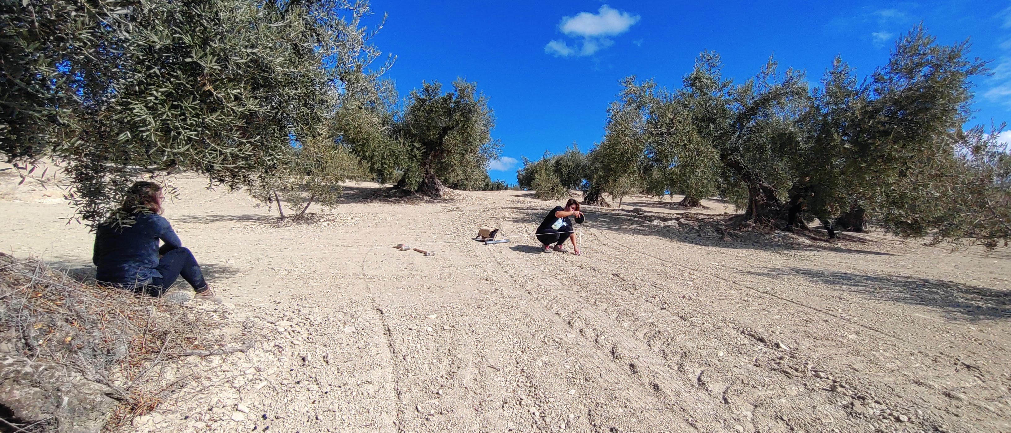
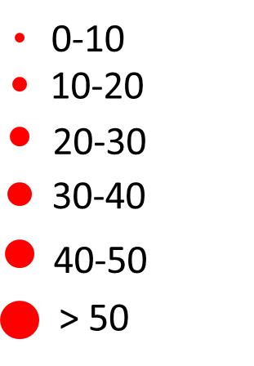
A robust evaluation of a revised version of the MMF-TWI soil erosion model
Estimations of past soil loss rates from measurements of the height of olive tree mounds
Original soil surface
Soil loss depth
(t ha⁻¹ y⁻¹)

Slide 6
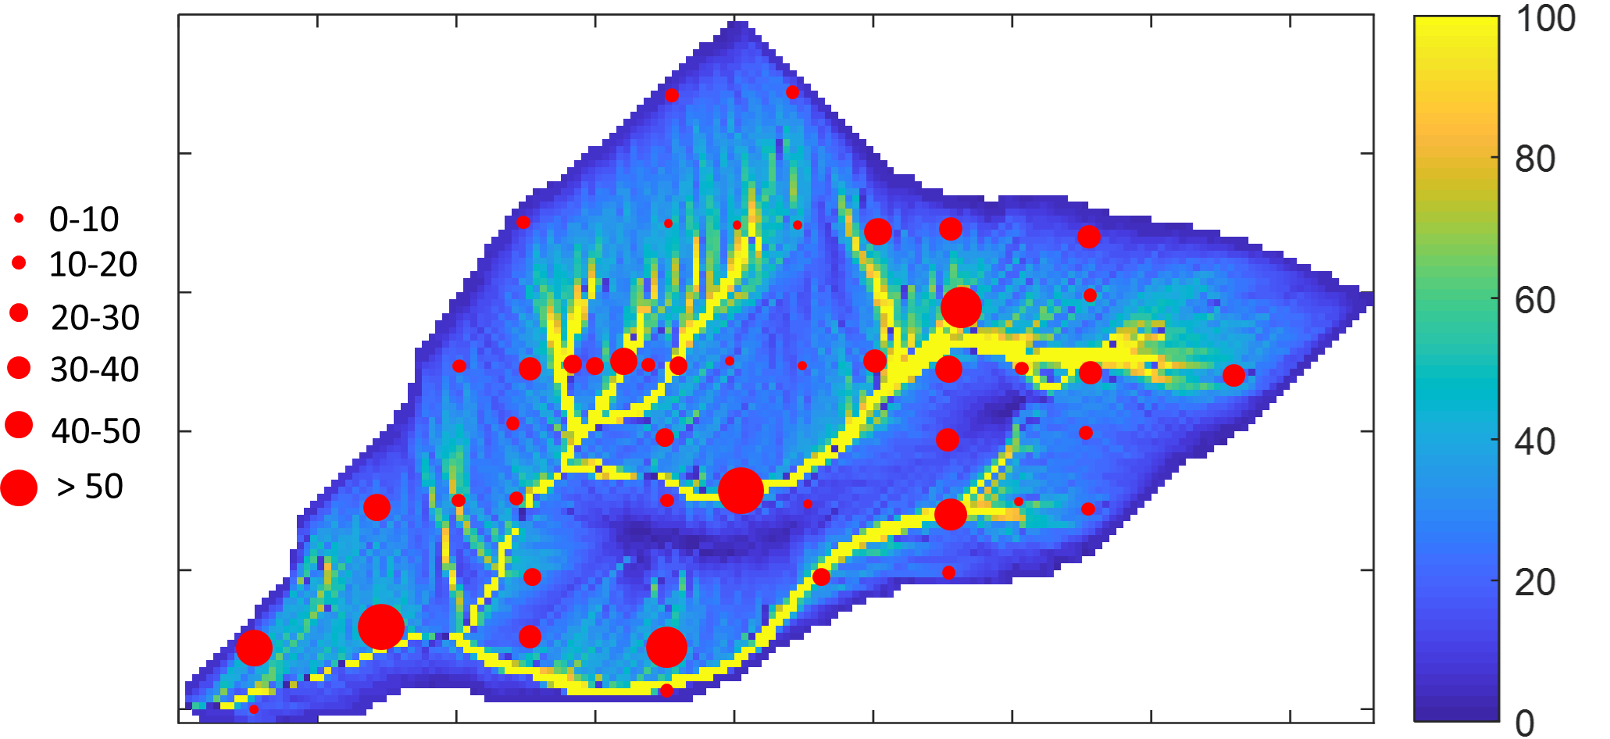
A robust evaluation of a revised version of the MMF-TWI soil erosion model
Preliminary results show a good correaltion between measurements and simulations
Estimations from tree mound measurements vs Model simulations
Only simulation of water erosion
Model simulation
Soil loss rate
Tree mounds
R² = 0.56
Simulated soil los rate (t ha⁻¹ y⁻¹)
(t ha⁻¹ y⁻¹)
(t ha⁻¹ y⁻¹)
Estimated soil loss rate from tree mound measurements (t ha⁻¹ y⁻¹)

Slide 7
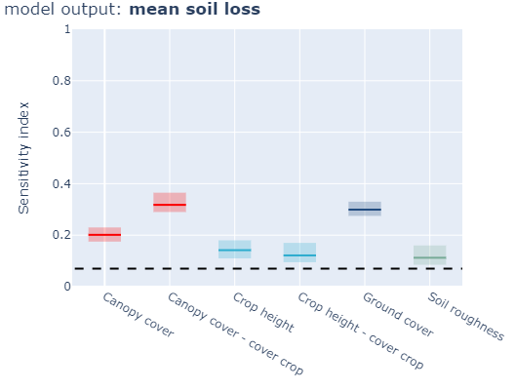
A robust evaluation of a revised version of the MMF-TWI soil erosion model
Is the model behaviour plausible?
Global Sensitivity Analysis
SAFE Toolbox (Pianosi et al., 2015)
Identify the model parameters that most influence model outputs
Are these results consistent with our expectations and empirical evidence?
Most influential factors under similar conditions (Francia et al. 2006; Gomez et al. 2009; Taguas et al. 2010; Lima-Cueto et al. 2018)
Tillage or its absence
Cover crops
most influential
No influence
Thanks! Any questions?
This project is financially supported by the Spanish Ministry of Science and Innovation, the Spanish State Research Agency, through the Severo Ochoa and María de Maeztu Program for Centers and Units of Excellence in R&D (Ref. CEX2019-000968-M) and the project SOLITAIRE (Ref. PID2019-109924RB-I00).
apenuela@uco.es

