Slide 1
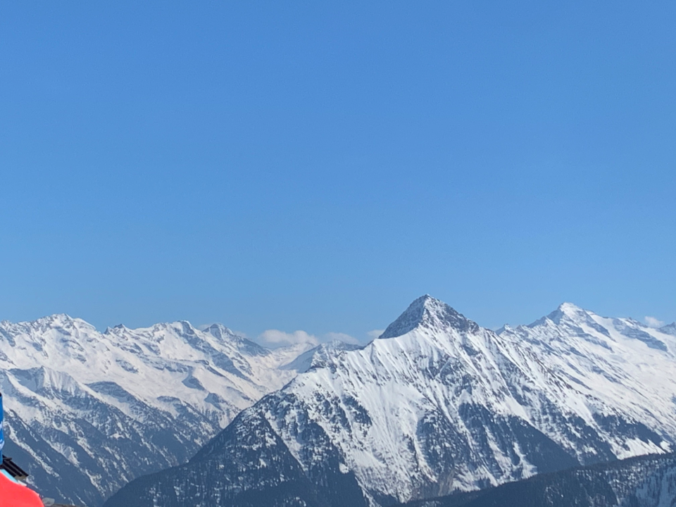

A station-based evaluation of south foehn forecasting with COSMO-1
Yue Tian, Juerg Schmidli, Julian Quimbayo-Duarte
Institute for Atmospheric and Environmental Sciences (IAU), Goethe University Frankfurt, Germany
Wed 25.05.2022, EGU 2022, Vienna
Contact: yue.tian@iau.uni-frankfurt.de

Slide 2
Motivation
What is foehn? A warm, dry, and gusty wind on the lee side of a mountain
How is it forecasted? In MeteoSwiss, COSMO at 1 km horizontal resolution (COSMO-1)
Anecdotal evidence of systematic biases in COSMO-1: (from MeteoSwiss, AGF, Wilhelm 2012, Sandner 2020)
  Cold bias in 2-m temperature and moist bias in relative humidity (RH) during foehn
  ……
Research questions:
  Q1: What biases does COSMO-1 have? Are they systematic?
  Q2: What could be the possible causes?
Case study + 5-year climatology
Pseudo profile + Sensitivity experiments

Slide 3
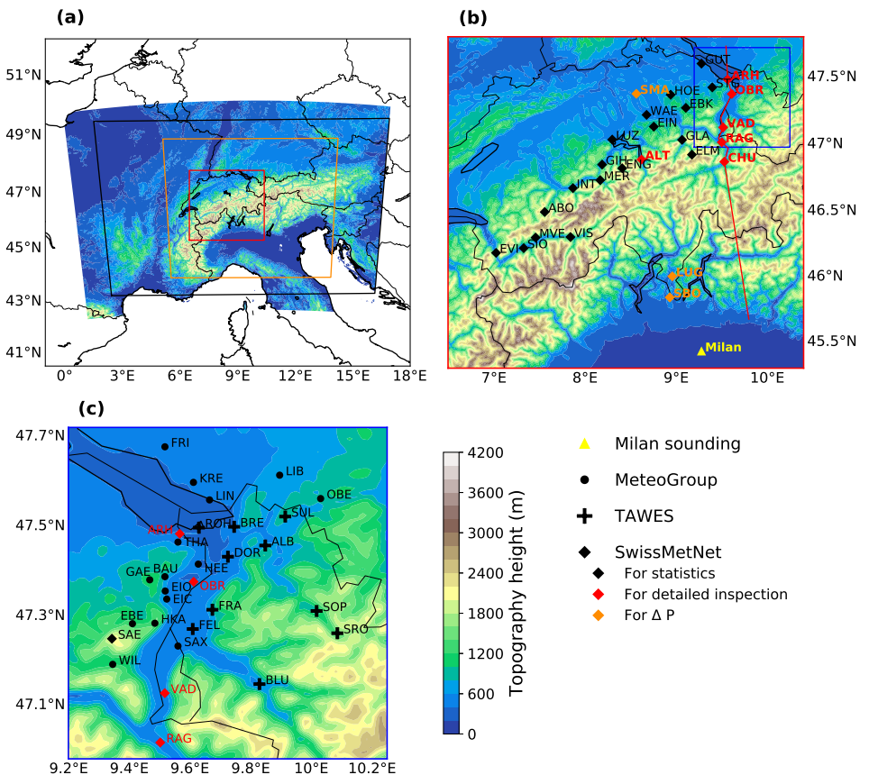
Data and methods
Observations:
  Surface observations from SwissMetNet, ZAMG, MeteoGroup for the period of foehn cases and 5-year climatology
5-year COSMO-1 analysis:
  29 Oct 2015 — 29 Oct 2020
  Produced with observation nudging technique
  Only dew point temperature and pressure from surface
  stations are assimilated
COSMO-1 model:
  Close to MeteoSwiss operational setup
The Rhine Valley

Slide 4
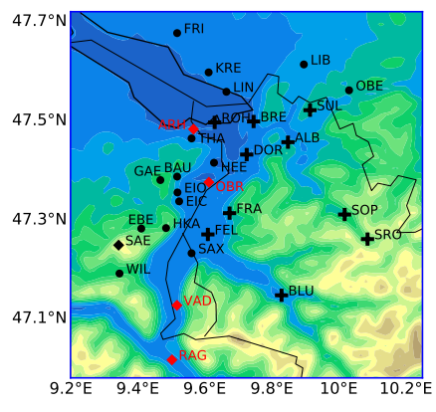
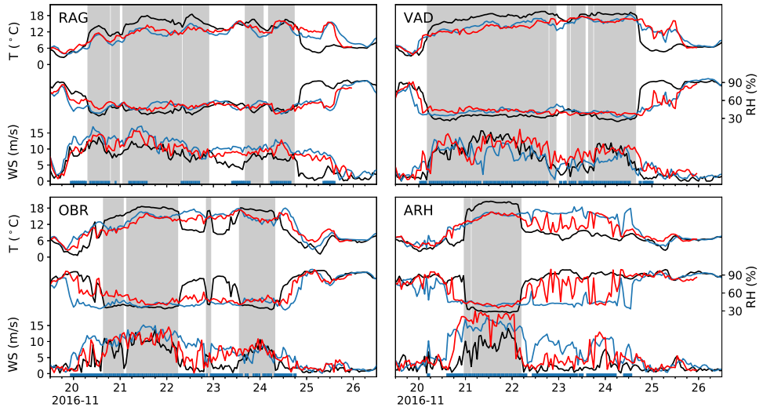
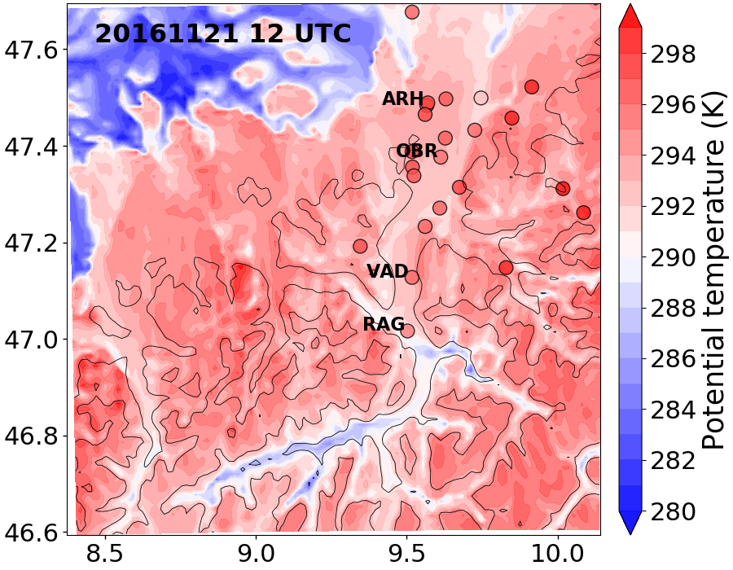
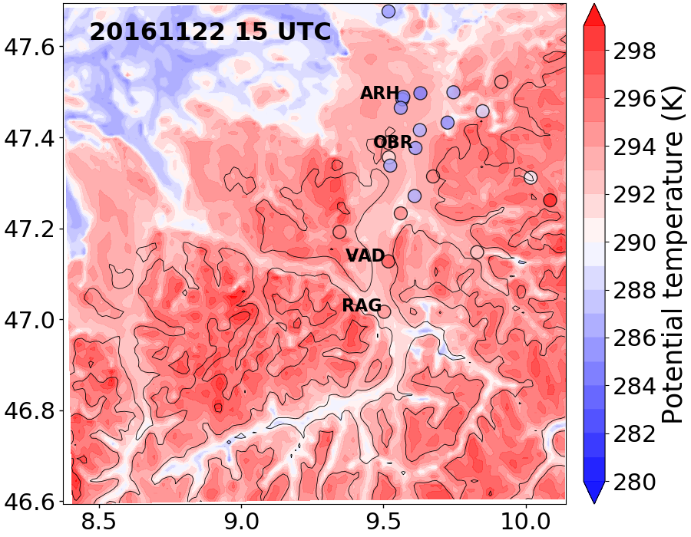
Near-surface model biases — Case study (Nov 2016)
OBS：observation
REF：COSMO-1 simulation
ANA: COSMO-1 analysis

Slide 5
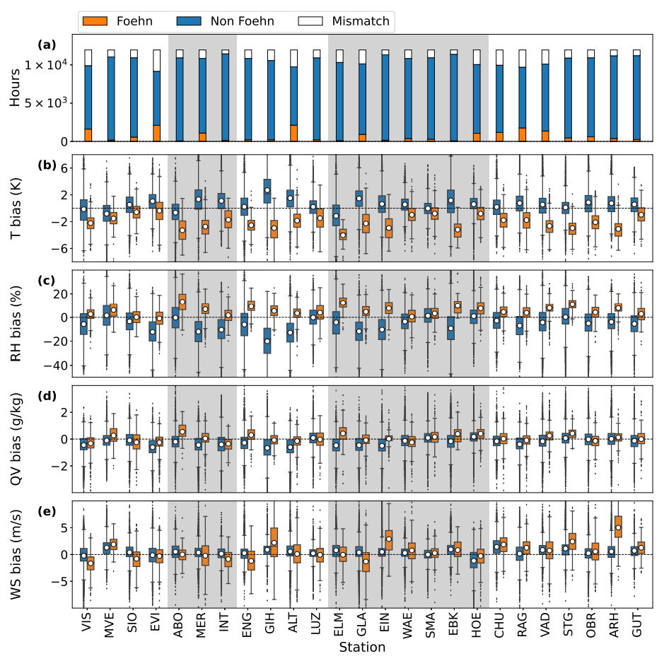
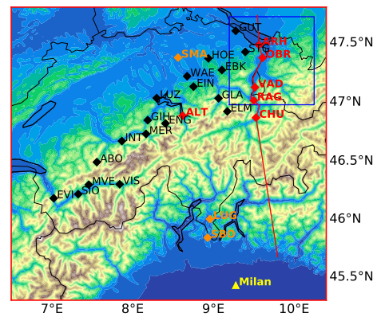
Near-surface model biases — 5-year COSMO-1 analysis
25 stations in 5 major Alpine valleys
No cold bias during non-foehn
Cold bias
during foehn
No strong bias in specific humidity (QV), moist bias in RH is mainly due to cold temperature bias

Slide 6
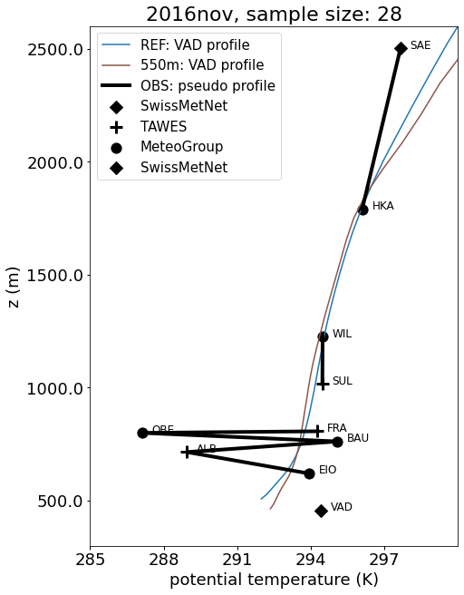
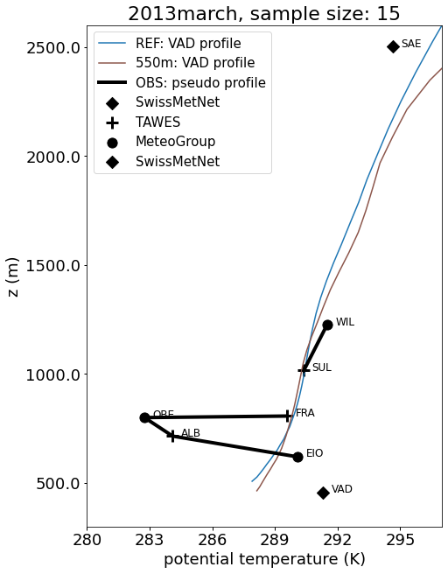
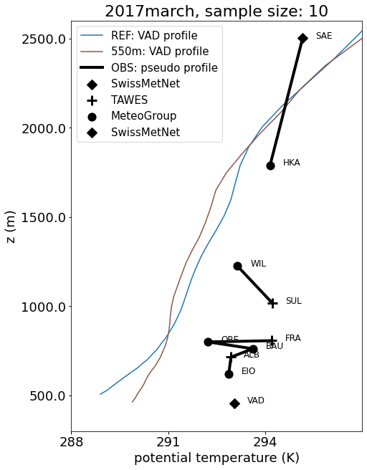
What may cause the cold bias? — Ave. pseudo profile
Three foehn cases (Nov 2016, Mar 2013, and Mar 2017)
OBS Pseudo profile: constructed with surface stations at different altitudes during foehn hours at VAD
VAD profile in COSMO-1: the closest grid point to VAD in COSMO-1 during foehn hours at VAD
Despite local fluctuations in OBS pseudo profile, insufficient vertical mixing in COSMO-1

Slide 7
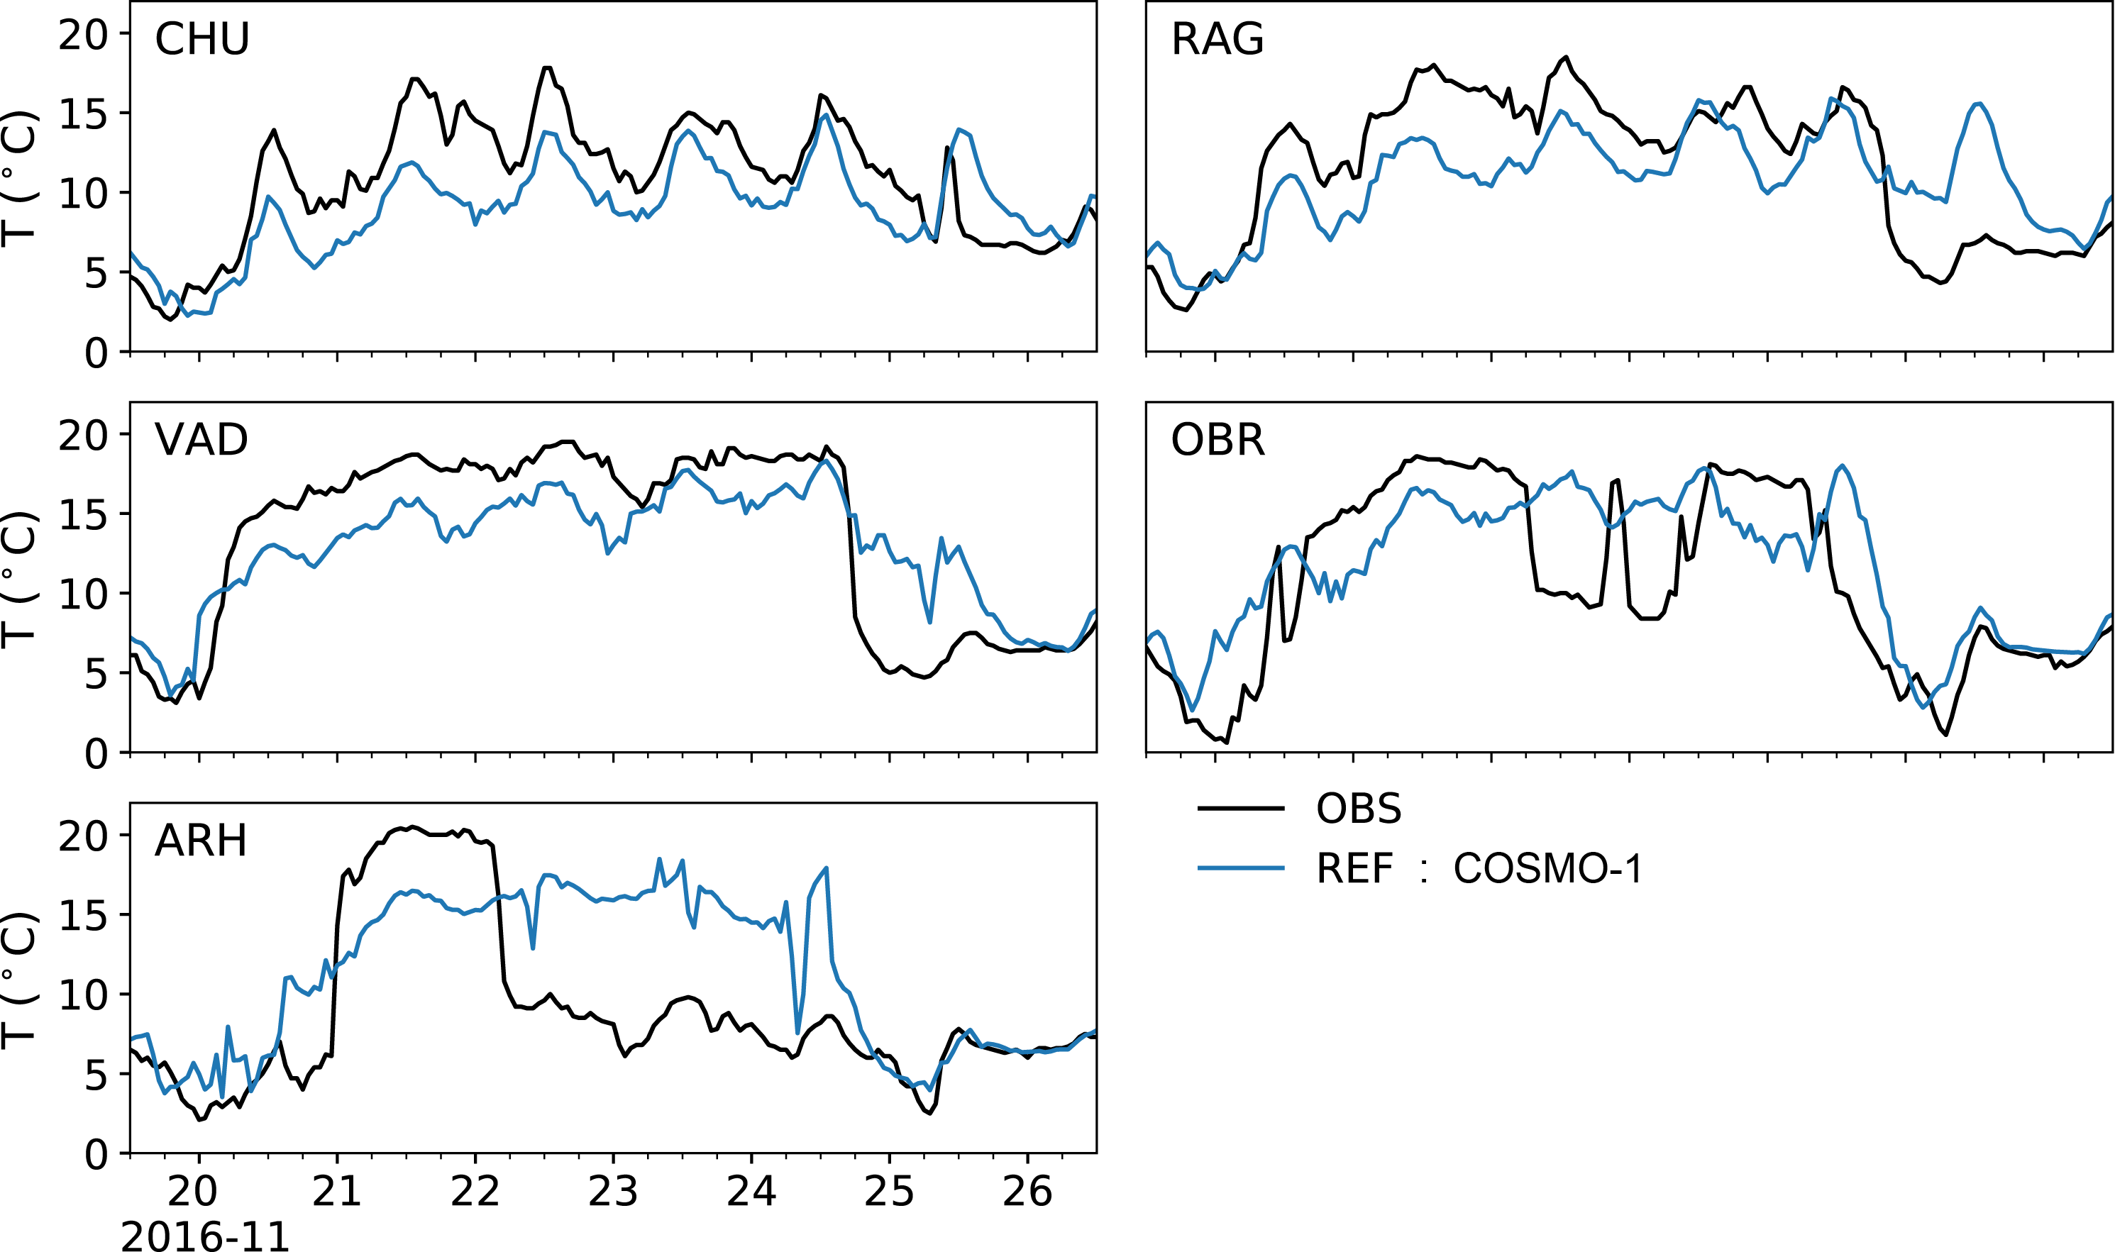
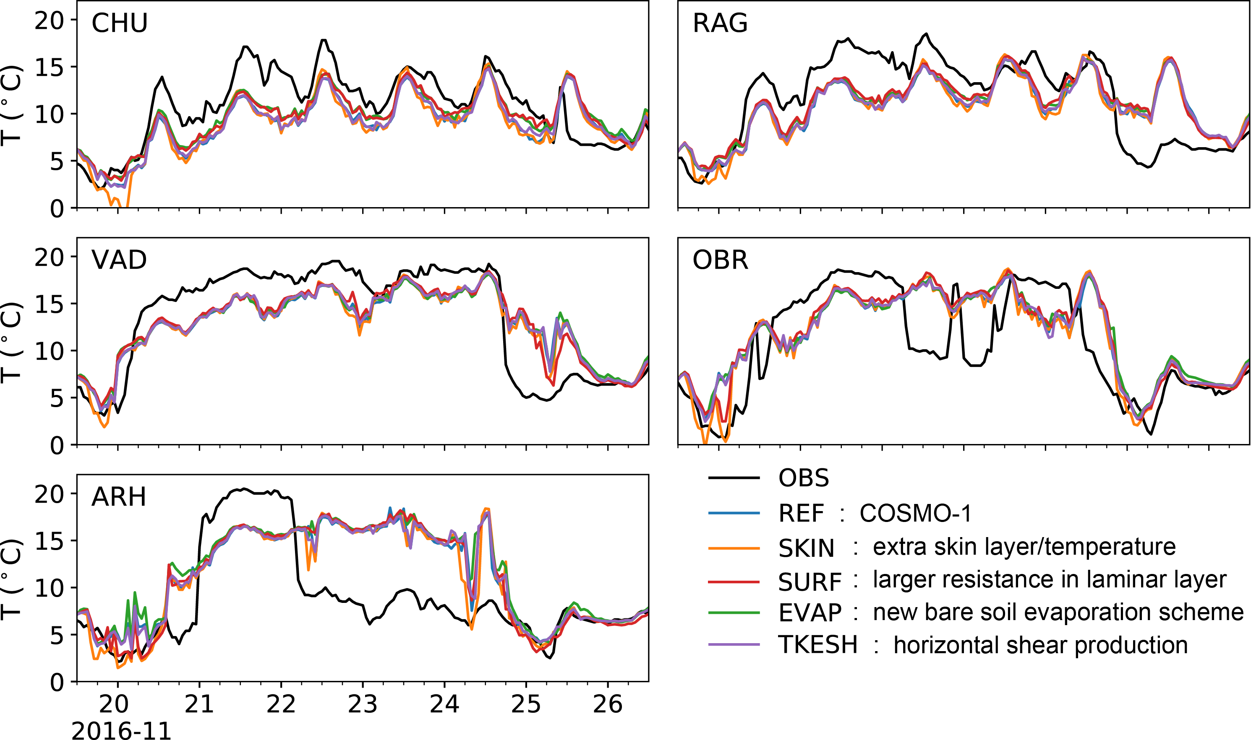
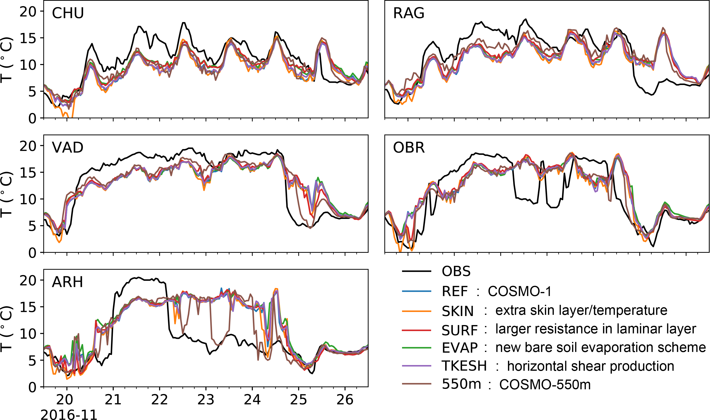
What may cause the cold bias? — Sensitivity exps.
Foehn case in Nov 2016
?
Land-surface interaction

Slide 8
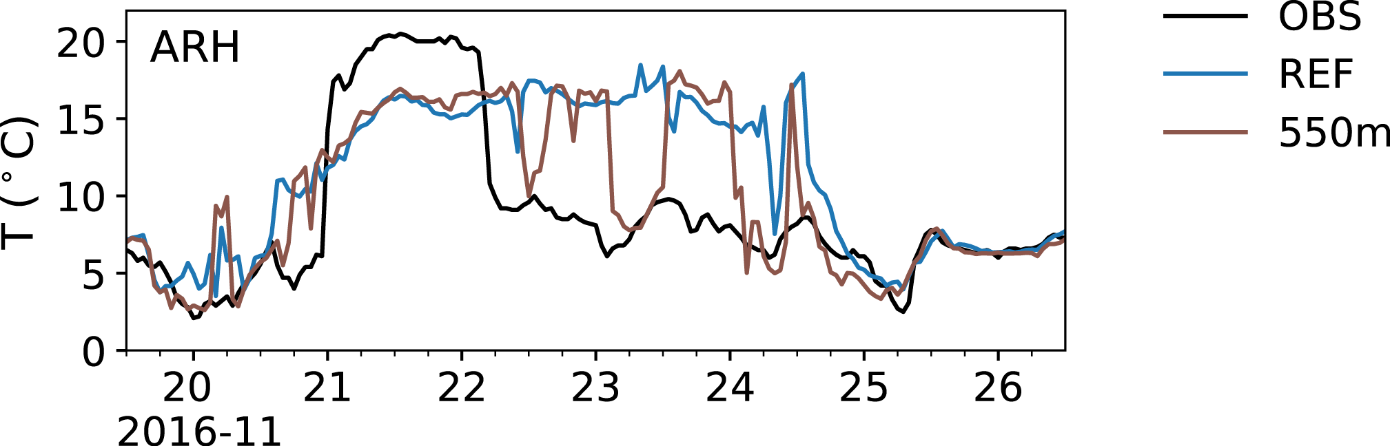

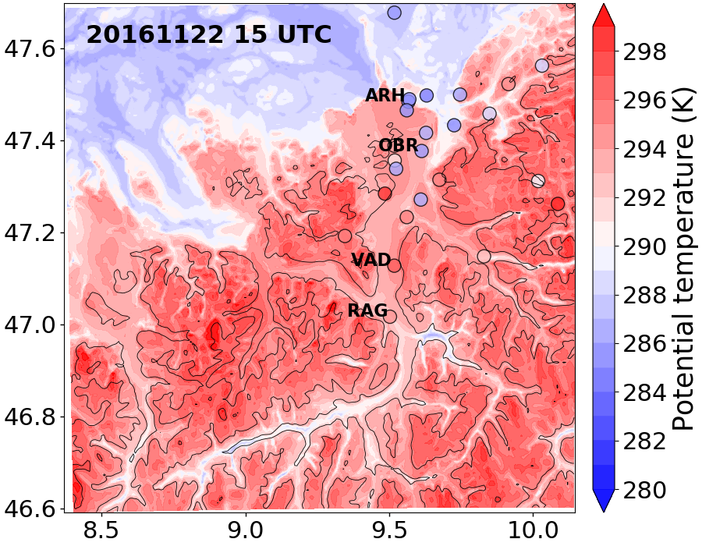
Improvements in COSMO-550m — Downstream
Foehn case in Nov 2016
COSMO-1
COSMO-550m

Slide 9
Improvements in COSMO-550m — Pseudo profile
Three foehn cases (Nov 2016, Mar 2013, and Mar 2017)
COSMO-1
COSMO-550m
More vertical mixing at lower levels in COSMO-550m

Slide 10
Conclusions
Systematic cold bias are found near the surface in COSMO-1 in both case and climatology studies
Foehn flow extends too far downstream in COSMO-1 in the case 2016nov
The cold bias can be partly due to weak vertical mixing in COSMO-1
Most sensitivity experiments do not have significant impacts on the cold bias, whereas…
COSMO-550m reduces the too-far extent of the foehn flow and the near-surface cold bias by introducing more vertical mixing at lower model levels.
Thank you for your attention :D
Any questions or suggestions please contact: yue.tian@iau.uni-frankfurt.de

