Slide 1
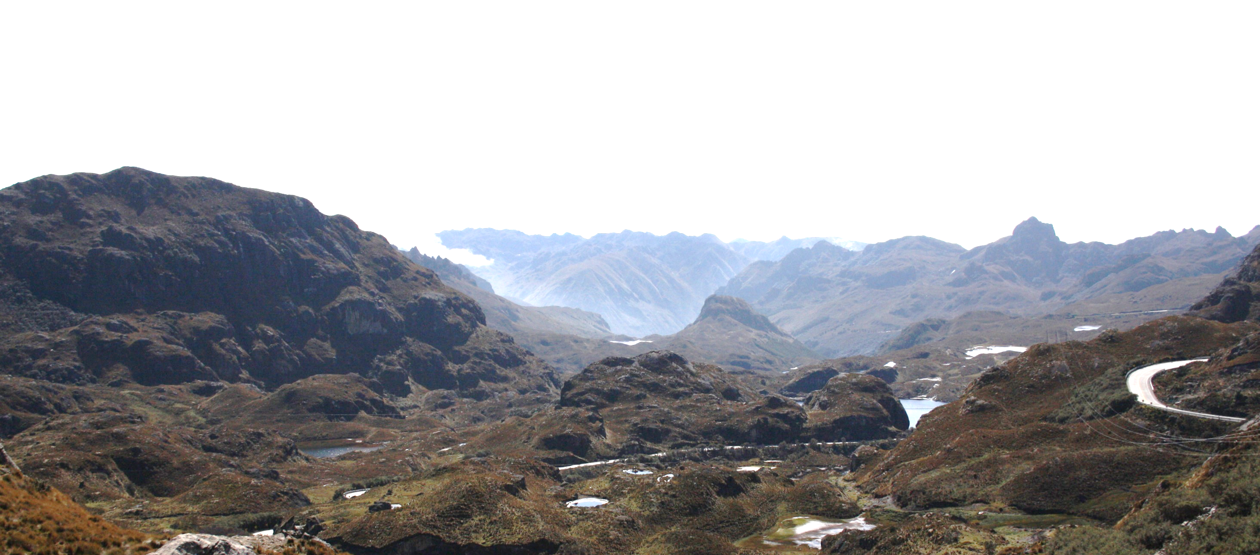




EGU – Vienna, Austria & Online | 23–27 May 2022
Significance of the northern Andean Block extrusion and genesis of the Interandean Valley: Paleomagnetic evidence from the “Ecuadorian Orocline”
Siravo G., Speranza F., Mulas M., Costanzo-Alvarez, V.

Slide 2
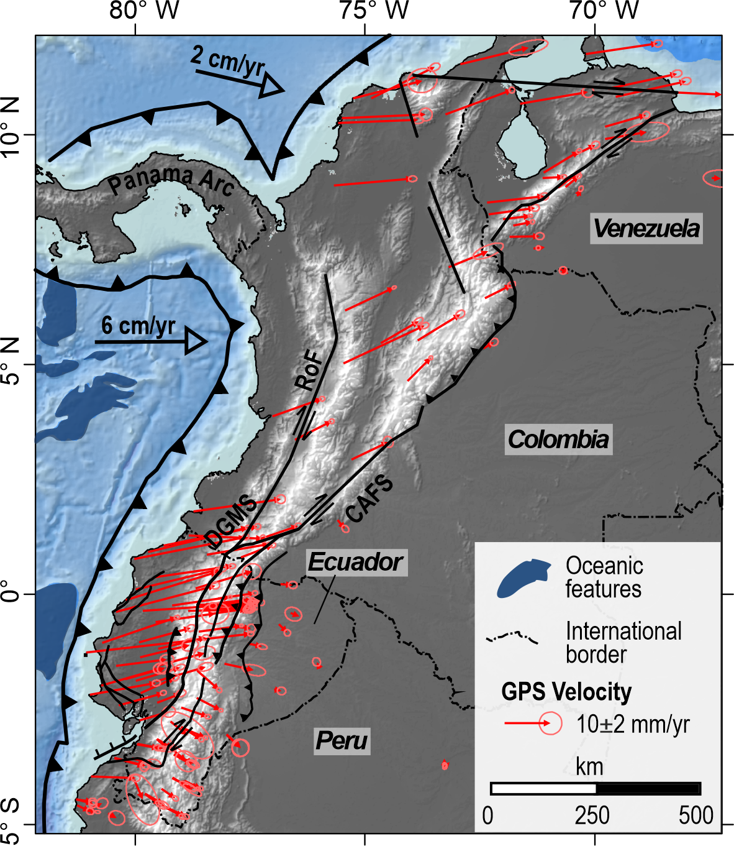
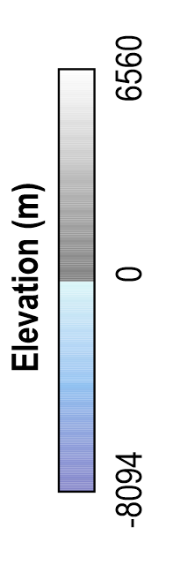
EGU – Vienna, Austria & Online | 23–27 May 2022
Significance of the northern Andean Block extrusion and genesis of the Interandean Valley: Paleomagnetic evidence from the “Ecuadorian Orocline”
GPS data:
Trenkamp et al. (2002)
Alvarado et al. (2014)
Nocquet et al. (2014)
Perez et al. (2018)

Slide 3
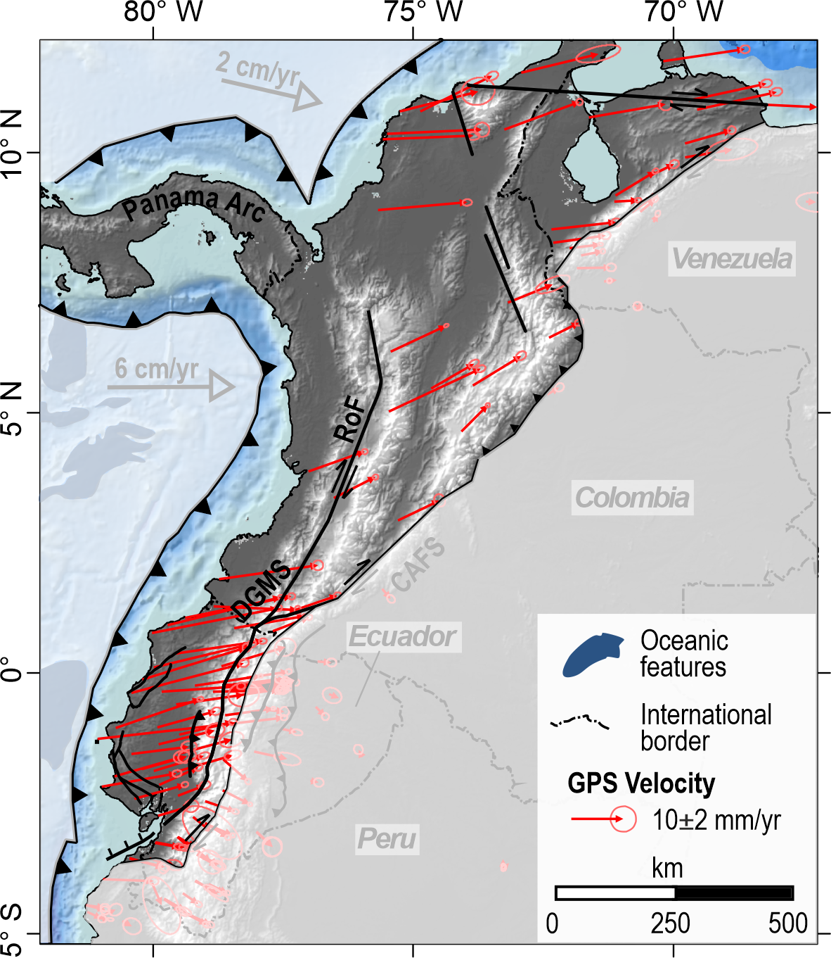
EGU – Vienna, Austria & Online | 23–27 May 2022
Significance of the northern Andean Block extrusion and genesis of the Interandean Valley: Paleomagnetic evidence from the “Ecuadorian Orocline”
GPS data:
Trenkamp et al. (2002)
Alvarado et al. (2014)
Nocquet et al. (2014)
Perez et al. (2018)
Northern Andean Block
6 ±2 cm/a
Pallatanga F.
Peltectec F.

Slide 4
EGU – Vienna, Austria & Online | 23–27 May 2022
Significance of the northern Andean Block extrusion and genesis of the Interandean Valley: Paleomagnetic evidence from the “Ecuadorian Orocline”
Quaternary slip-rate
Giegengack et al. (1976)
Schubert et al. (1983)
Schubert (1980)
Soulas (1986)
Chrowicz et al. (1996)
Ego et al. (1996)
Singer and Beltran (1996)
Audemard (1997)
Winter and Lavenu (1989)
Winter et al. (1993)
Audemard et al. (1999)
Tibaldi et al. (2007)
Witt and Burgois (2010)
Carcaillet et al. (2013)
Doumont et al. (2005a)
Doumont et al. (2005b)
Diederix et al. (2009)
Wesnousky et al. (2012)
Egbue et al. (2014)
Baize et al. (2015)
Jimenez et al. (2015)
Pousse-Beltran et al. (2017)
Northern Andean Block
Pleistocene
Pousse-Beltran et al., 2017
Notes:
However, as uncertainties of Quaternary slip rates are wide and as geodetic data are sparse, it only can be stated that the North Andean Block escape is
localized along the main dextral faults and remains constant at first order since Middle Pleistocene until nowadays.
Queste faglie che adesso bordano il NAB Sono anche il limite dei blocchi oceanici accreti al sud America
Questi blocchi hanno affinità con la placca caraibica
Quindi conoscerli e studiarli ci permette di fare inferenze anche su Caraibi

Slide 5
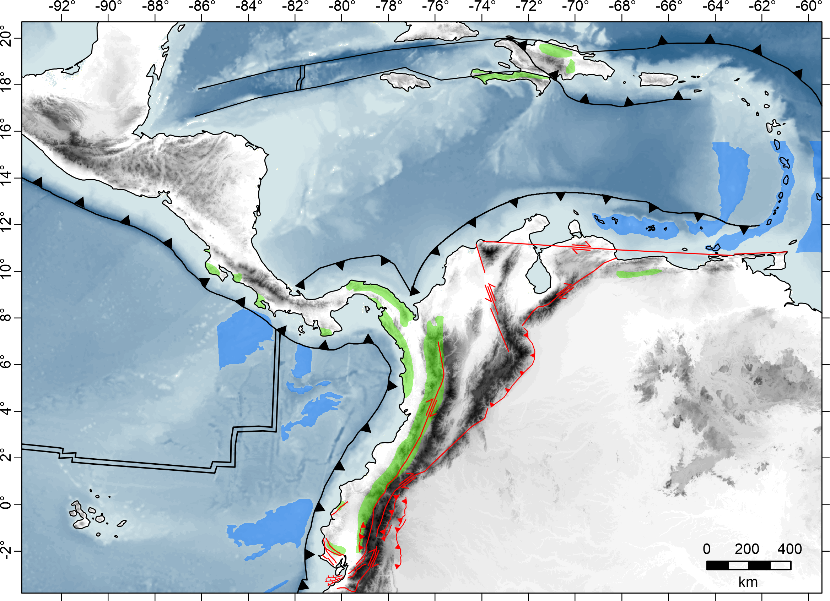
EGU – Vienna, Austria & Online | 23–27 May 2022
Significance of the northern Andean Block extrusion and genesis of the Interandean Valley: Paleomagnetic evidence from the “Ecuadorian Orocline”
Caribbean Plate
2 cm/a
CC
Cocos Plate
WC
EC
Oceanic terranes
GPS data:
Trenkamp et al. (2002)
RC
South American Plate
WC
Nazca Plate
6 cm/a
Notes:
Queste faglie che adesso bordano il NAB Sono anche il limite dei blocchi oceanici accreti al sud America
Where active in late cretaceous during the accretion of the oceanic terranes to south america, sincrono to 40-50 ° rotation

Slide 6
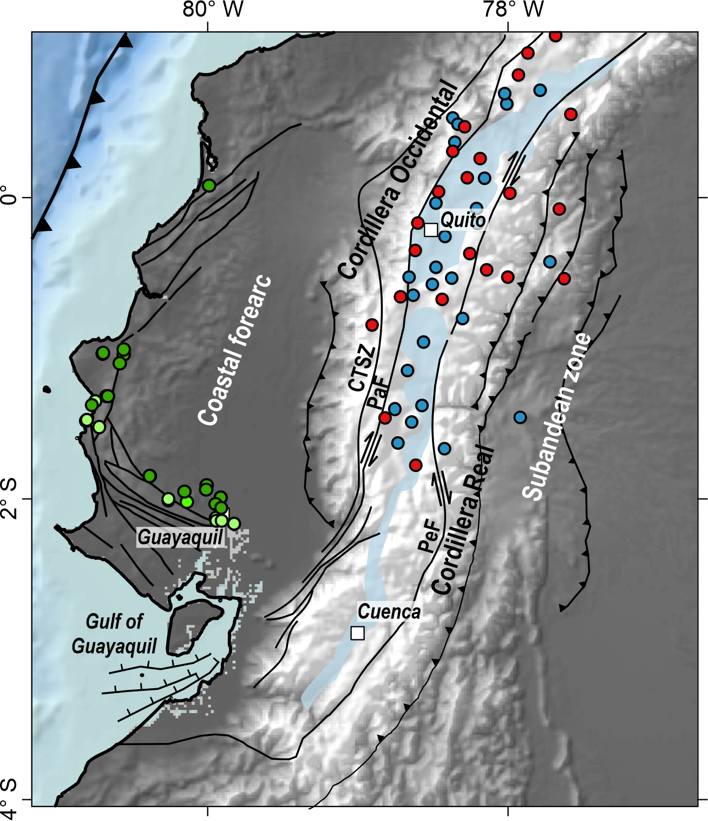
EGU – Vienna, Austria & Online | 23–27 May 2022
Significance of the northern Andean Block extrusion and genesis of the Interandean Valley: Paleomagnetic evidence from the “Ecuadorian Orocline”
Paleomagnetic data and vertical-axis rotation
clockwise (CW) rotation of 40-50°
PALEOMAG DATA
Roperch et al. (1987)
Luzieux et al. (2006)
Notes:
Queste faglie che adesso bordano il NAB Sono anche il limite dei blocchi oceanici accreti al sud America
Where active in late cretaceous during the accretion of the oceanic terranes to south america, sincrono to 40-50 ° rotation

Slide 7
EGU – Vienna, Austria & Online | 23–27 May 2022
Significance of the northern Andean Block extrusion and genesis of the Interandean Valley: Paleomagnetic evidence from the “Ecuadorian Orocline”
(a) did the Northern Andean Block kept drifting northward during the Cenozoic?
b) Was such drift accommodated by individual faults or did it involve the
northern Andes as a whole?
(c) How significant was strike-slip tectonics when compared to thrust tectonics during Cenozoic times?
Caribbean Plate
Cocos Plate
South American Plate
Nazca Plate

Slide 8
EGU – Vienna, Austria & Online | 23–27 May 2022
Significance of the northern Andean Block extrusion and genesis of the Interandean Valley: Paleomagnetic evidence from the “Ecuadorian Orocline”
Caribbean Plate
2 cm/a
CC
Cocos Plate
WC
EC
Oceanic terranes
GPS data:
Trenkamp et al. (2002)
RC
South American Plate
WC
Nazca Plate
6 cm/a
Notes:
Queste faglie che adesso bordano il NAB Sono anche il limite dei blocchi oceanici accreti al sud America
Where active in late cretaceous during the accretion of the oceanic terranes to south america, sincrono to 40-50 ° rotation

Slide 9

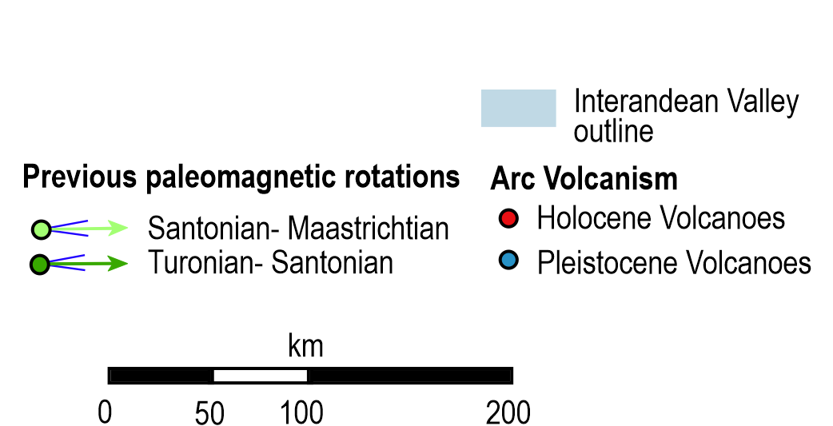
EGU – Vienna, Austria & Online | 23–27 May 2022
Significance of the northern Andean Block extrusion and genesis of the Interandean Valley: Paleomagnetic evidence from the “Ecuadorian Orocline”
proposed tectonic regime | authors
inverted extensional | Villagomez (2003)
transtensional | Tibaldi & Ferrari (1992)
transpressive | Winkler et al. (2005)
strike-slip | Noblet & Marocco (1989)
compressional | Hungerbuhler et al. (2002) Lavenu et al. (1995) Steinmann et al. (1999)

Slide 10
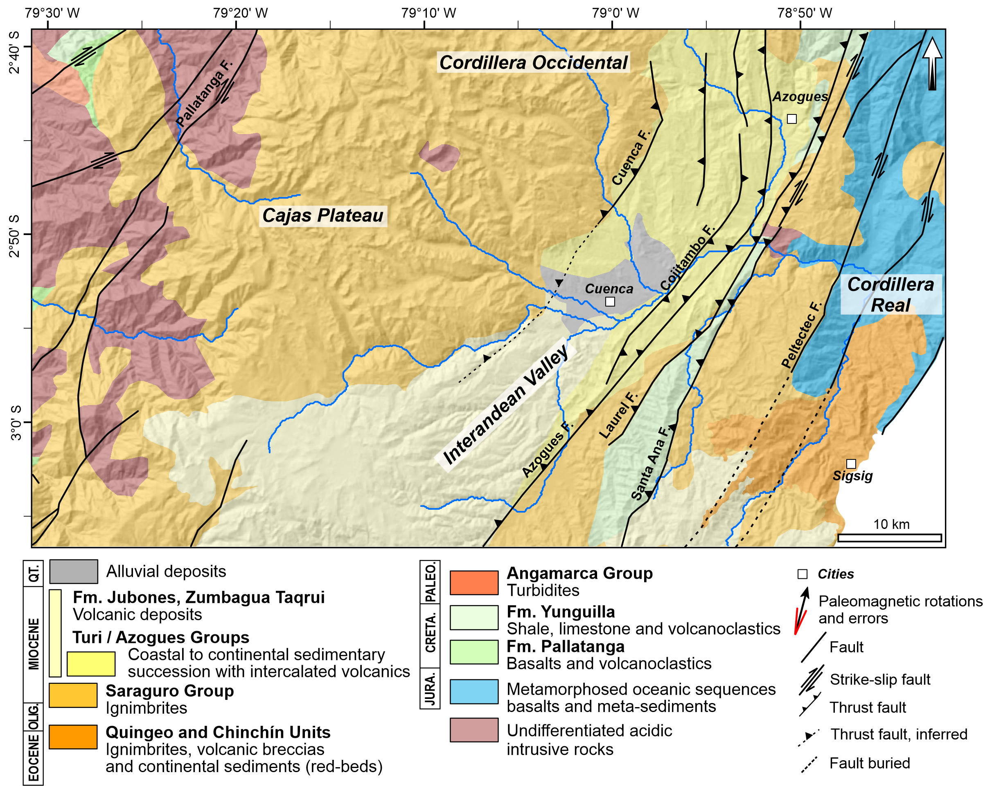
EGU – Vienna, Austria & Online | 23–27 May 2022
Significance of the northern Andean Block extrusion and genesis of the Interandean Valley: Paleomagnetic evidence from the “Ecuadorian Orocline”

Slide 11
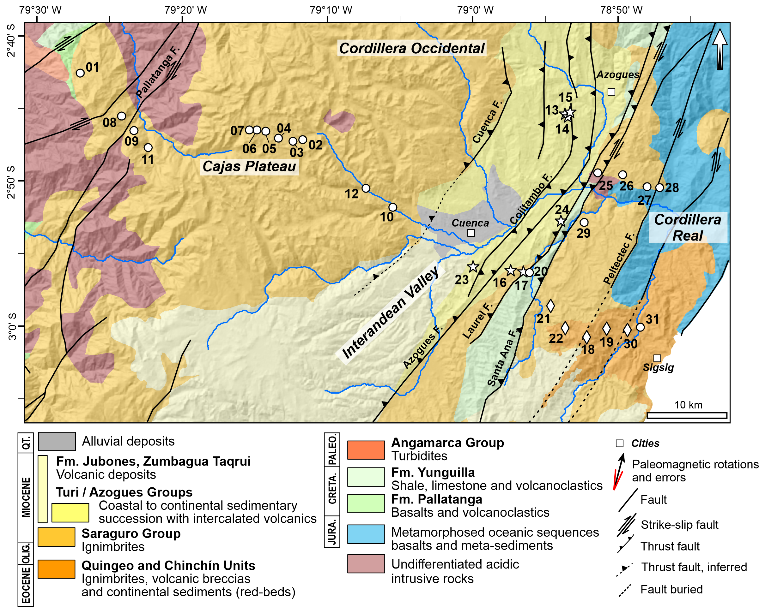
EGU – Vienna, Austria & Online | 23–27 May 2022
Significance of the northern Andean Block extrusion and genesis of the Interandean Valley: Paleomagnetic evidence from the “Ecuadorian Orocline”

Slide 12
EGU – Vienna, Austria & Online | 23–27 May 2022
Significance of the northern Andean Block extrusion and genesis of the Interandean Valley: Paleomagnetic evidence from the “Ecuadorian Orocline”

Slide 13
EGU – Vienna, Austria & Online | 23–27 May 2022
Significance of the northern Andean Block extrusion and genesis of the Interandean Valley: Paleomagnetic evidence from the “Ecuadorian Orocline”

Slide 14
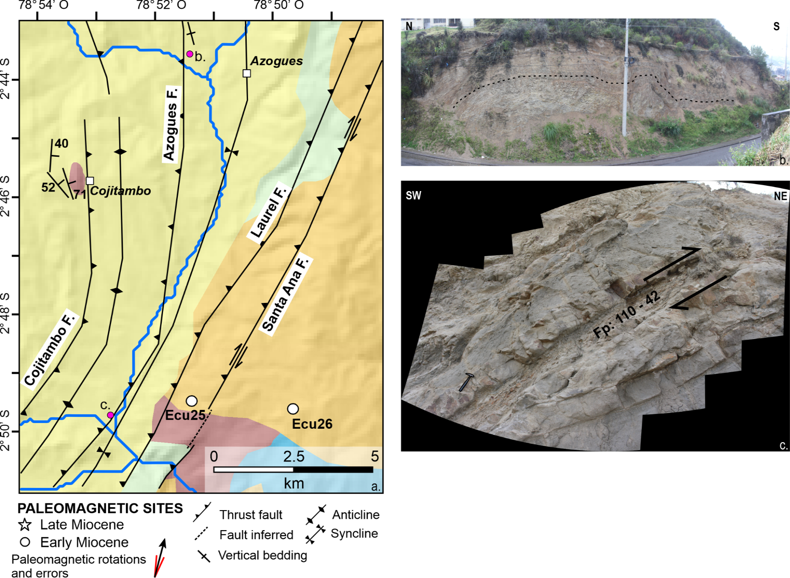
EGU – Vienna, Austria & Online | 23–27 May 2022
Significance of the northern Andean Block extrusion and genesis of the Interandean Valley: Paleomagnetic evidence from the “Ecuadorian Orocline”

Slide 15
EGU – Vienna, Austria & Online | 23–27 May 2022
Significance of the northern Andean Block extrusion and genesis of the Interandean Valley: Paleomagnetic evidence from the “Ecuadorian Orocline”

Slide 16
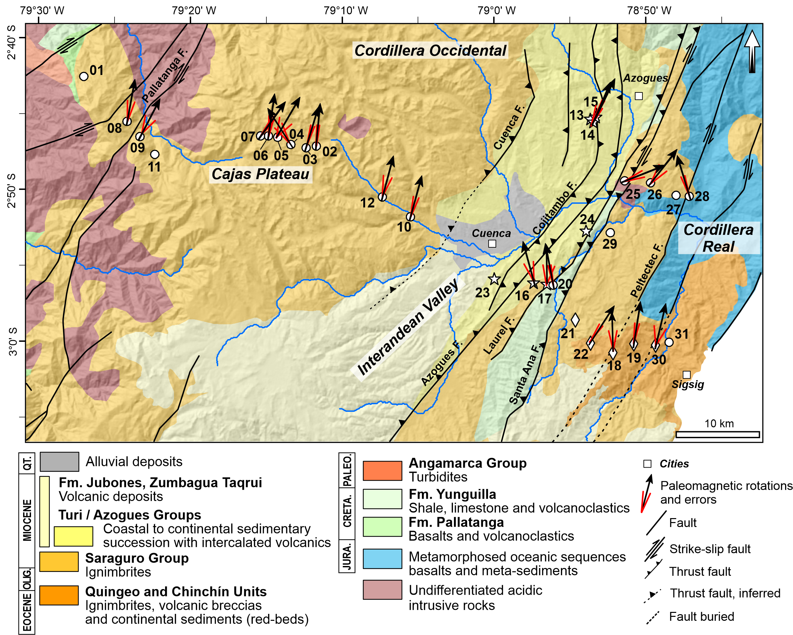
EGU – Vienna, Austria & Online | 23–27 May 2022
Significance of the northern Andean Block extrusion and genesis of the Interandean Valley: Paleomagnetic evidence from the “Ecuadorian Orocline”
vertical-axis rotation with respect to South America using updated paleopoles
(Torsvik et al., 2012)

Slide 17
EGU – Vienna, Austria & Online | 23–27 May 2022
Significance of the northern Andean Block extrusion and genesis of the Interandean Valley: Paleomagnetic evidence from the “Ecuadorian Orocline”
vertical-axis rotation with respect to South America using updated paleopoles
(Torsvik et al., 2012)

Slide 18
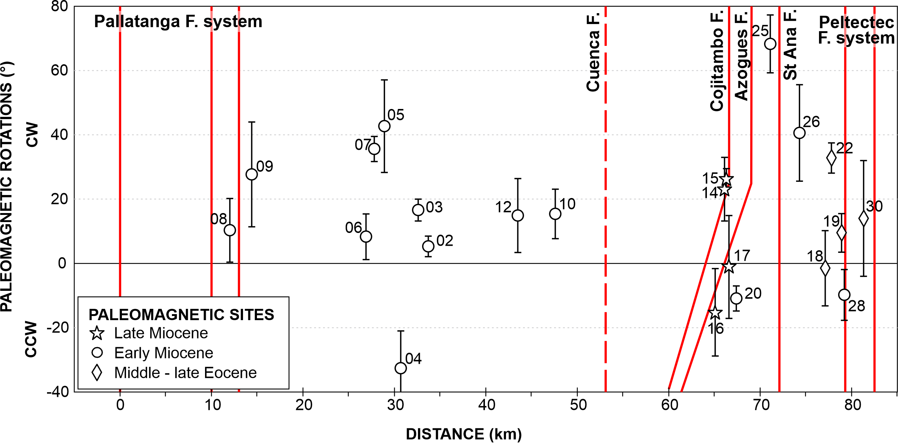
EGU – Vienna, Austria & Online | 23–27 May 2022
Significance of the northern Andean Block extrusion and genesis of the Interandean Valley: Paleomagnetic evidence from the “Ecuadorian Orocline”
inter Andean Valley
Cordillera Occidental
Cordillera Real
24±10°
NO ROT
SCATTER
-11±20°

Slide 19
EGU – Vienna, Austria & Online | 23–27 May 2022
Significance of the northern Andean Block extrusion and genesis of the Interandean Valley: Paleomagnetic evidence from the “Ecuadorian Orocline”
Rotational thrust emplacement
Allerton (1998)

Slide 20
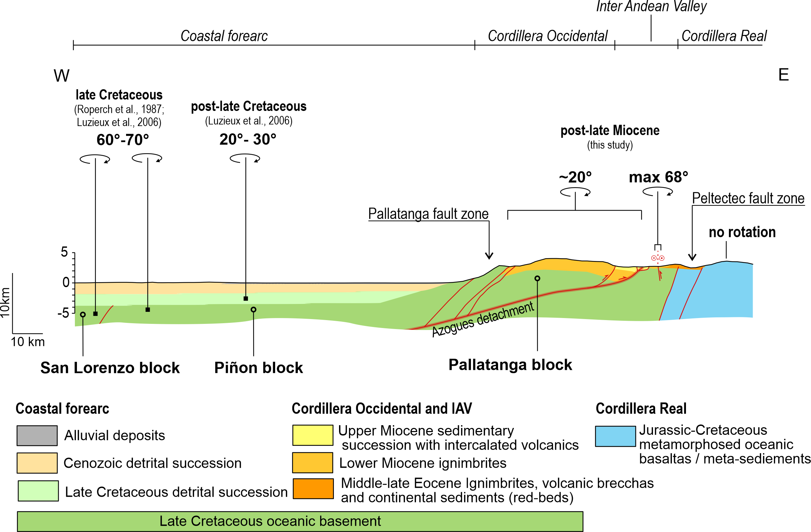
EGU – Vienna, Austria & Online | 23–27 May 2022
Significance of the northern Andean Block extrusion and genesis of the Interandean Valley: Paleomagnetic evidence from the “Ecuadorian Orocline”
50°-60°

Slide 21
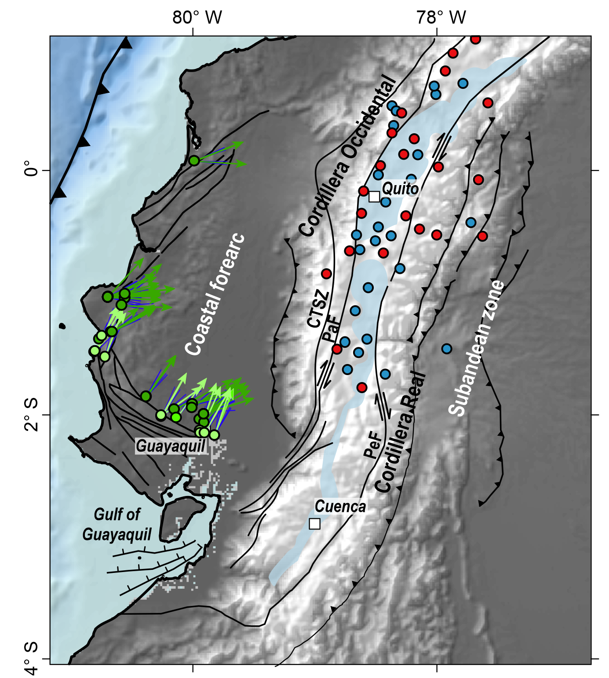
EGU – Vienna, Austria & Online | 23–27 May 2022
Significance of the northern Andean Block extrusion and genesis of the Interandean Valley: Paleomagnetic evidence from the “Ecuadorian Orocline”
PALEOMAG DATA
Roperch et al. (1987)
Luzieux et al. (2006)
Santoniano-Maastrichtiano
vertical-axis rotation with respect to South America using updated paleopoles
(Torsvik et al., 2012)
66 ± 17°
28 ± 9°
Coniaciano
Santoniano
Turoniano
Coniaciano
Santoniano
Maastrichtiano
40-50°
20-30°
Coniaciano
Santoniano
Turoniano
Coniaciano
Luzieux et al. (2006)

Slide 22
EGU – Vienna, Austria & Online | 23–27 May 2022
Significance of the northern Andean Block extrusion and genesis of the Interandean Valley: Paleomagnetic evidence from the “Ecuadorian Orocline”
Conclusions
40°-50°

Slide 23
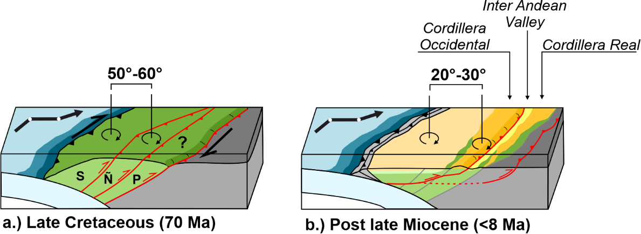
EGU – Vienna, Austria & Online | 23–27 May 2022
Significance of the northern Andean Block extrusion and genesis of the Interandean Valley: Paleomagnetic evidence from the “Ecuadorian Orocline”
Conclusions
40°-50°

Slide 24
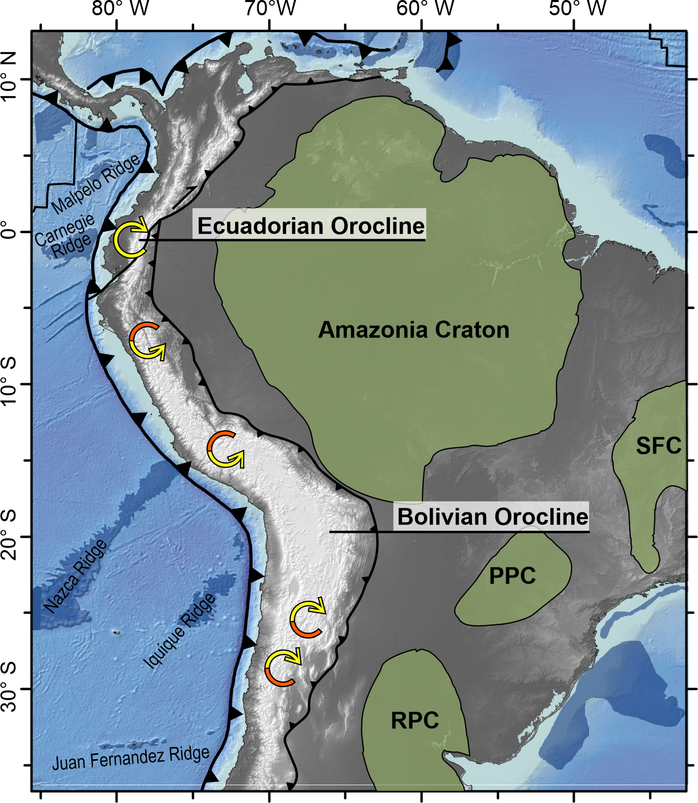
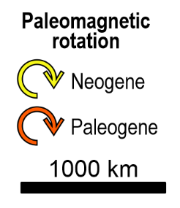
EGU – Vienna, Austria & Online | 23–27 May 2022
Significance of the northern Andean Block extrusion and genesis of the Interandean Valley: Paleomagnetic evidence from the “Ecuadorian Orocline”
Conclusions
Cratons
Archean - Paleoproterozoic
Notes:
We suggest that the Andes of Ecuador and Peru form the “Ecuadorian Orocline”, formed by opposing orogenic rotations around the Amazonian craton indenter.

Slide 25
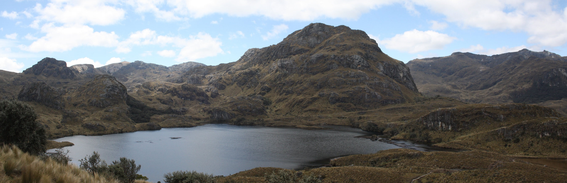
Thanks for your attention
gaia.siravo@ingv.it
Siravo et al., 2021

