Slide 1






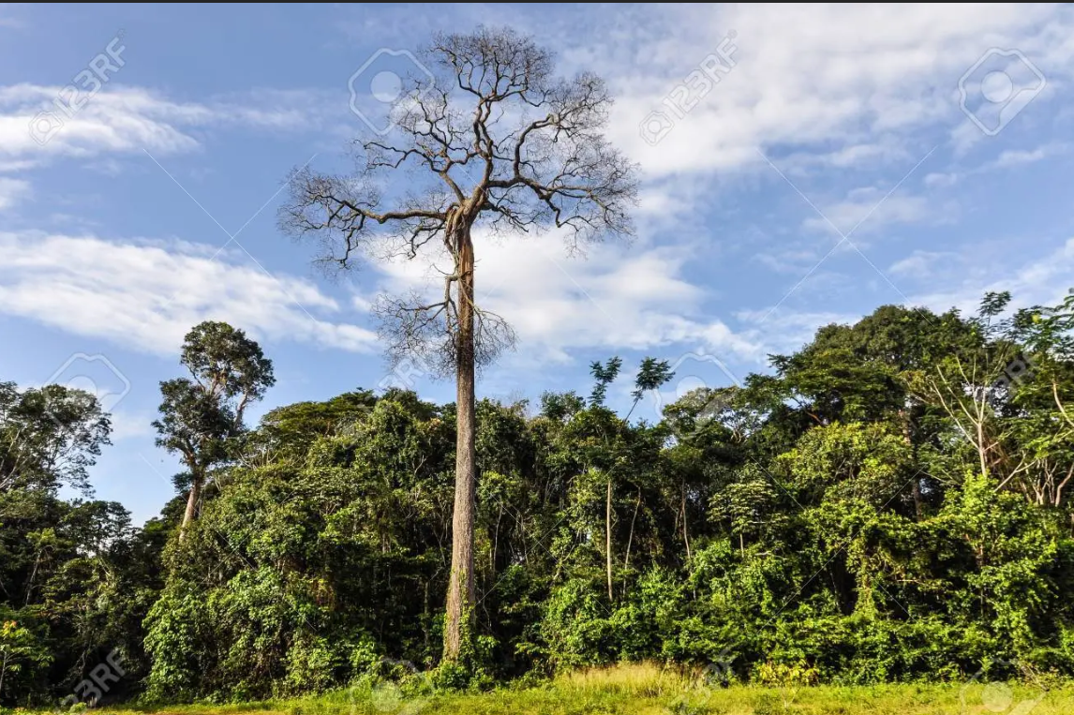
How drought events during the last Century have impacted biomass carbon in Amazonian rainforests
Yitong Yao, Philippe Ciais, Nicolas Viovy, Emilie Joetzjer, Jerome Chave
23 May 2022, Vienna, Austria

Slide 2
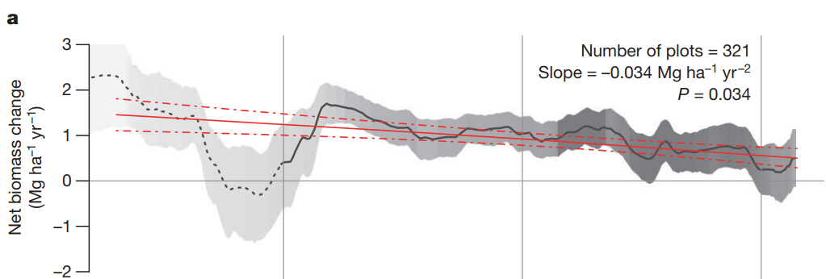
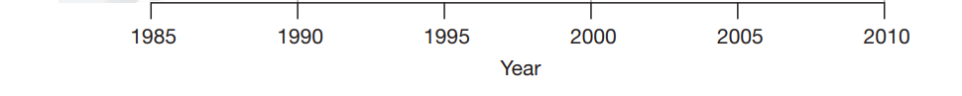
Background
Slowdown of net carbon sink in Amazon rainforest from inventory data
Net biomass change
(MgC ha⁻¹ yr⁻¹)
[Brienen et al., 2015]

Slide 3
From plant hydraulics to tree mortality
Hydraulic architecture
Transpiration
C_{leaf}
Ψleaf=-1.8MPa
R_{leaf}
Ψleaf=-2.2MPa
A simple empirical model calibrated on field data (two parameters):
drought mortality exposure threshold
(in ‘risky’ days)
mortality => fraction of trees killed each time in each size class
(in % of all trees that would die).
C_{stem}
R_{stem}
=f(Ψ_{stem})
Ψstem=-1.3MPa
C_{root}
R_{root}
R_{soil-root}
Ψroot=-0.8MPa
soil
Ψroot=-0.8MPa
Ψsoil=-0.5MPa
Ψsoil=-0.5MPa

Slide 4
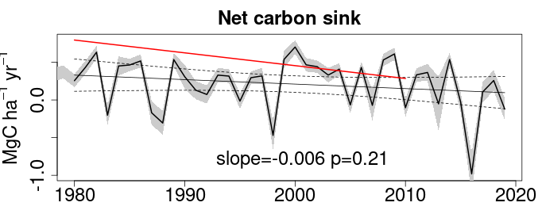
Long-term decelerating net forest carbon sink trend is captured!
Inventory: slope=-0.017
Trend (MgC ha⁻¹ yr⁻²) | Inventory | Model
Growth | 0.015 | 0.008
Mortality | 0.025 | 0.014

Slide 5
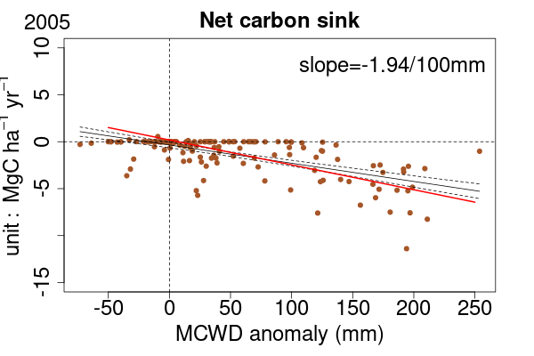
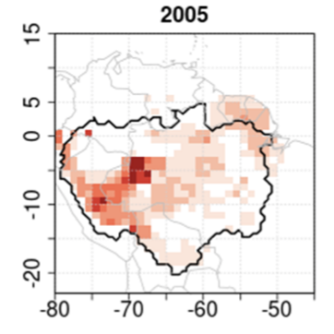

Evaluation of drought sensitivity of biomass carbon sink over the Amazon basin
2005 drought : epicenter in Western Amazon - dry season drought
Inventory: 2.65 MgC ha⁻¹ per 100mm MCWD
More severe water stress

Slide 6
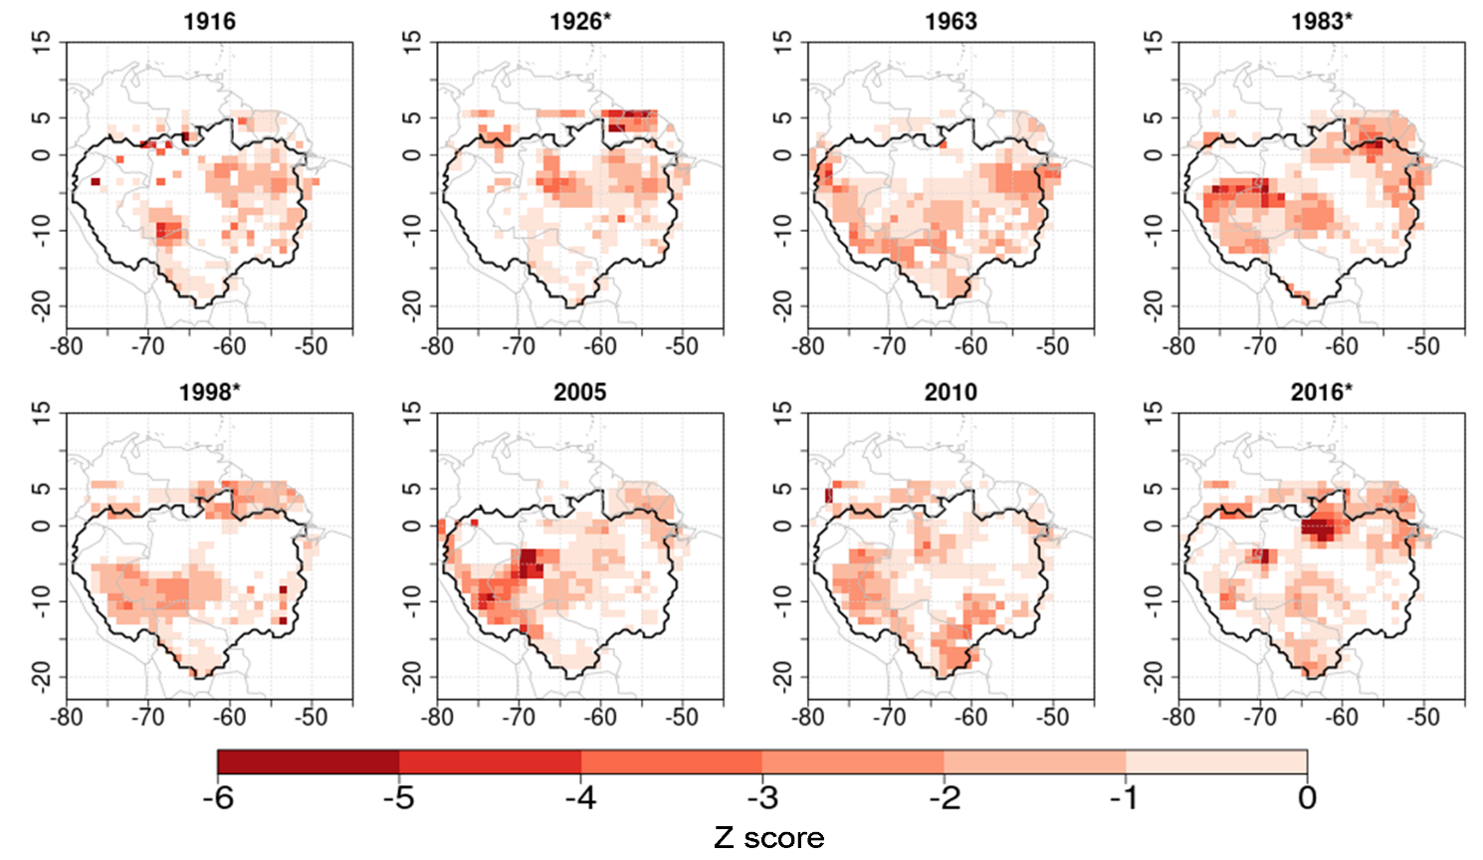
2015/16 is the most severe drought event since 1901
El Nino drought:
1926, 1983, 1998, 2015/16
Non El Nino drought:
1916, 1963, 2005, 2010

Slide 7
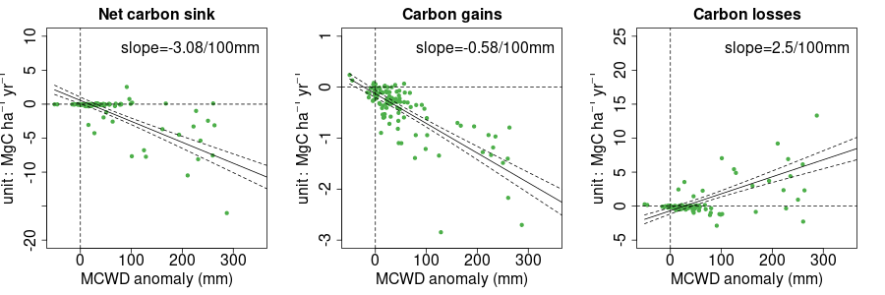
Part 2: Regional simulation of drought impacts over Amazon rainforest
2015-16 : epicenter in East-central Amazon - wet season drought (big El Niño)
+
More severe water stress
2005: -1.94 MgC ha⁻¹ per 100 mm increase in MCWD in Southwest Amazon
2010: -1.66 MgC ha⁻¹ per 100 mm increase in MCWD in Brazilian Amazon
2015/16: -3.08 MgC ha⁻¹ per 100 mm increase in MCWD in East-central Amazon

Slide 8
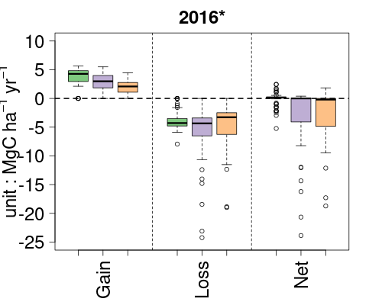
Climate change has a negative effect on growth and mortality
Elevated CO₂ improves growth and slightly reduces mortality loss
Part 2: Regional simulation of drought impacts over Amazon rainforest
Climate change and elevated CO₂ effects on AGB dynamics
S1 vs. S2: -> climate change effect
S2 vs. S3: -> elevated CO₂ effect
S1: CO₂ only
S2: CO₂ & Climate
S3: Climate only

Slide 9
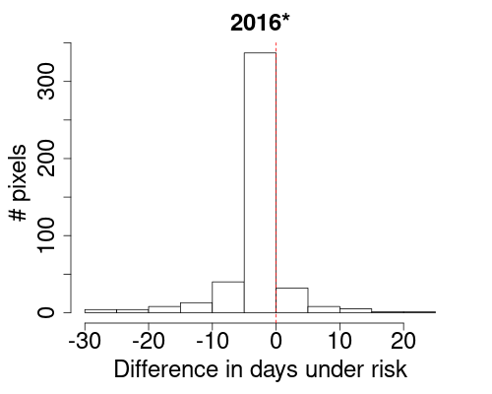
Part 2: Regional simulation of drought impacts over Amazon rainforest
Climate change and elevated CO₂ effects on AGB dynamics
During a drought :
Elevated CO₂ reduces transpiration, increases soil moisture which allows to reduce the tree mortality risk.
Elevated CO₂ -> transpiration decrease -> SMC increase -> tree mortality risk decrease
Number of days under mortality risk difference between S2 and S3 = effect of CO₂

Slide 10
Take-home message
Part 2: Regional simulation of drought impacts over Amazon rainforest
Regional-scale long-term decreasing trend of net biomass carbon sink is captured
The decelerating carbon sink can be explained by increasing drought severity and frequency, especially last 20 years
Alleviation of water stress & mortality during drought from elevated CO₂.

Slide 11
Thanks for your attention!
Yitong Yao
yitong.yao@lsce.ipsl.fr

