Slide 1


Bedding-parallel, fibrous veins record overpressure during hydrocarbon generation in laminated source rocks
Miao Wang, Yong Chen, Wyatt M. Bain, Keyu Liu,
Guoqi Song, Zhenzhu Zhou, Matthew Steele-MacInnis
School of Geosciences, China University of Petroleum (East China), Qingdao, Shandong, 266580, China
Dept. of Earth & Atmospheric Sciences, University of Alberta, Edmonton, Alberta, T6G2E3, Canada

Slide 2
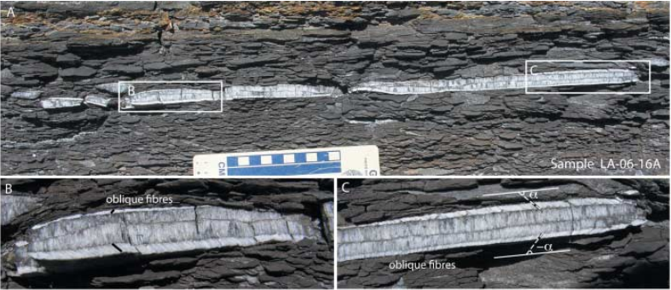
Introduction
Overpressure vs. force of overburden
Compaction
Tectonic compression
Thermal expansion
Dehydration reactions
Hydrocarbon generation
Rodrigues et al., 2009
Bedding-parallel veins of fibrous crystals (referred to as beefs) are a fairly common and widespread feature in sedimentary basins, particularly in low-permeability source rocks.
These veins has attracted much attention and debate, as an example of a relatively rare crystal morphology.
Horizontal
hydraulic fracturing

Slide 3
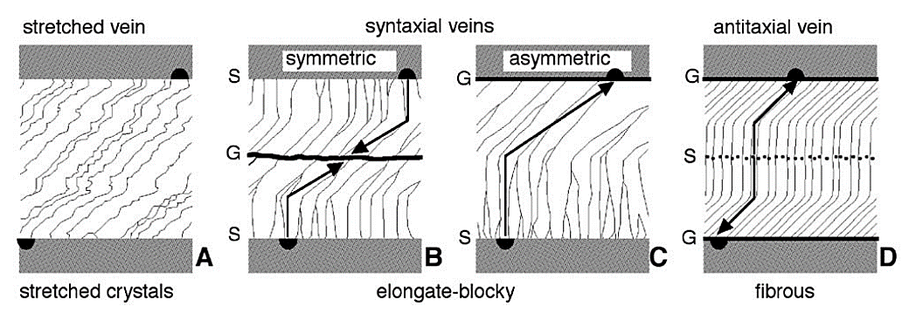
Introduction
Bons and Montenari., 2005
A growth mechanism (horizontal fracture opening and dilation) is essential for understanding the diagenesis and fluid migration of source rocks based on the detailed petrographic observation, as these veins contain much information about the fluids present during hydrocarbon generation.

Slide 4
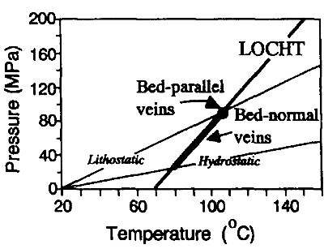
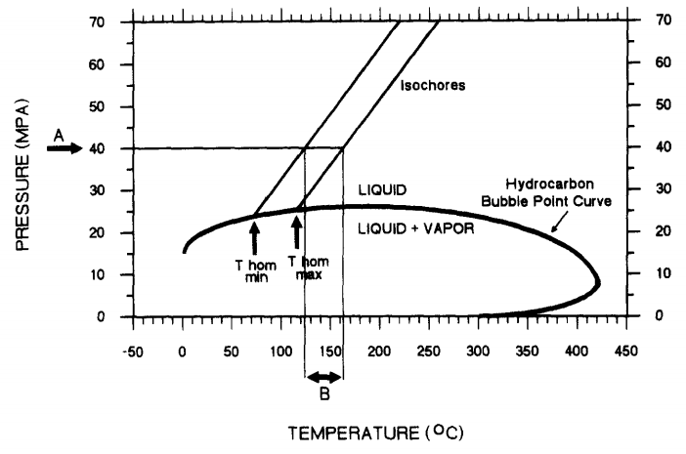
Introduction
Formation of these veins is related to the hydrocarbon generation and expulsion from laminated source rocks, so determination of fluid conditions – temperatures, pressures and compositions is crucial. Also helpful to understand the unconventional hydrocarbon formation mechanism.
Foreman and Dunne, 1991
Jochum et al., 1995
Based on vein formation and fluid inclusions studies, we present direct evidence for overpressure during hydrocarbon generation and primary migration, and calculate pressure ranges.

Slide 5
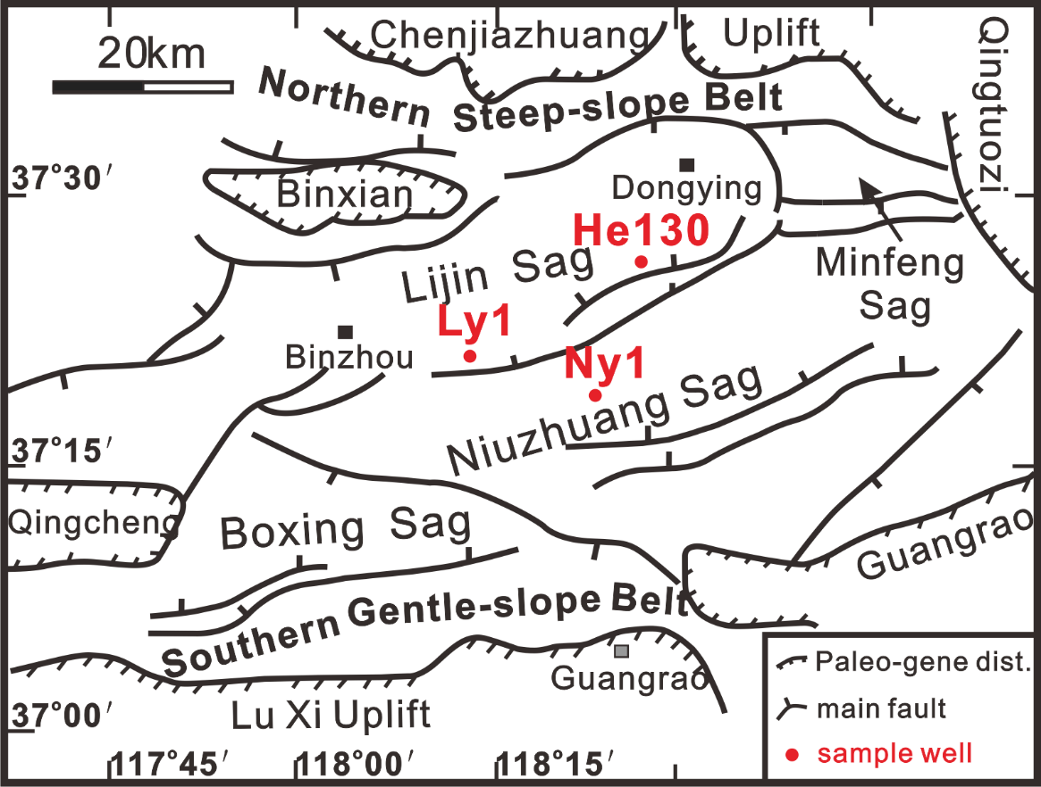
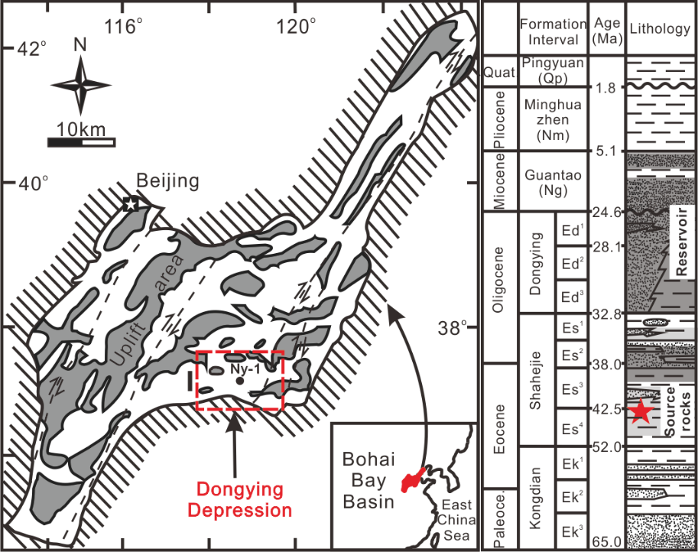
Study area
Bedding-parallel, fibrous calcite veins (commonly referred to as “beefs”) are widely developed within Eocene (4th member of the Shahejie Formation and 3rd member of the Shahejie formation) lacustrine, laminated organic-rich source rocks in the Dongying Depression, Bohai Bay Basin, East China.

Slide 6
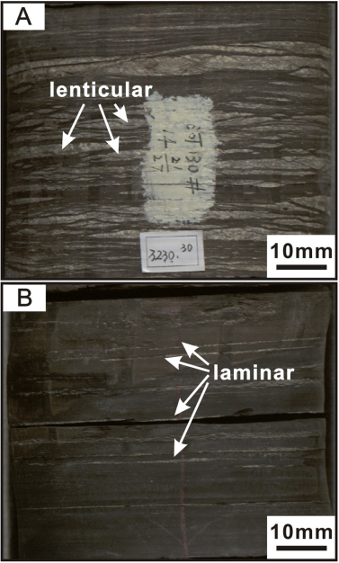
Vein distribution
The veins do not cut across the laminae, and the interfaces between vein and their adjacent wall-rocks are invariably sharp and abrupt.
The laminar calcite veins are comparatively elongated in the lateral direction. The lenticular veins are hosted between two adjacent laminae, with sharp tips in lateral extremes.
In the section of mudstones and shales above 3000 m buried depth, no such calcite veins were found, which indicates that vein formation is associated with diagenesis and burial depth.

Slide 7
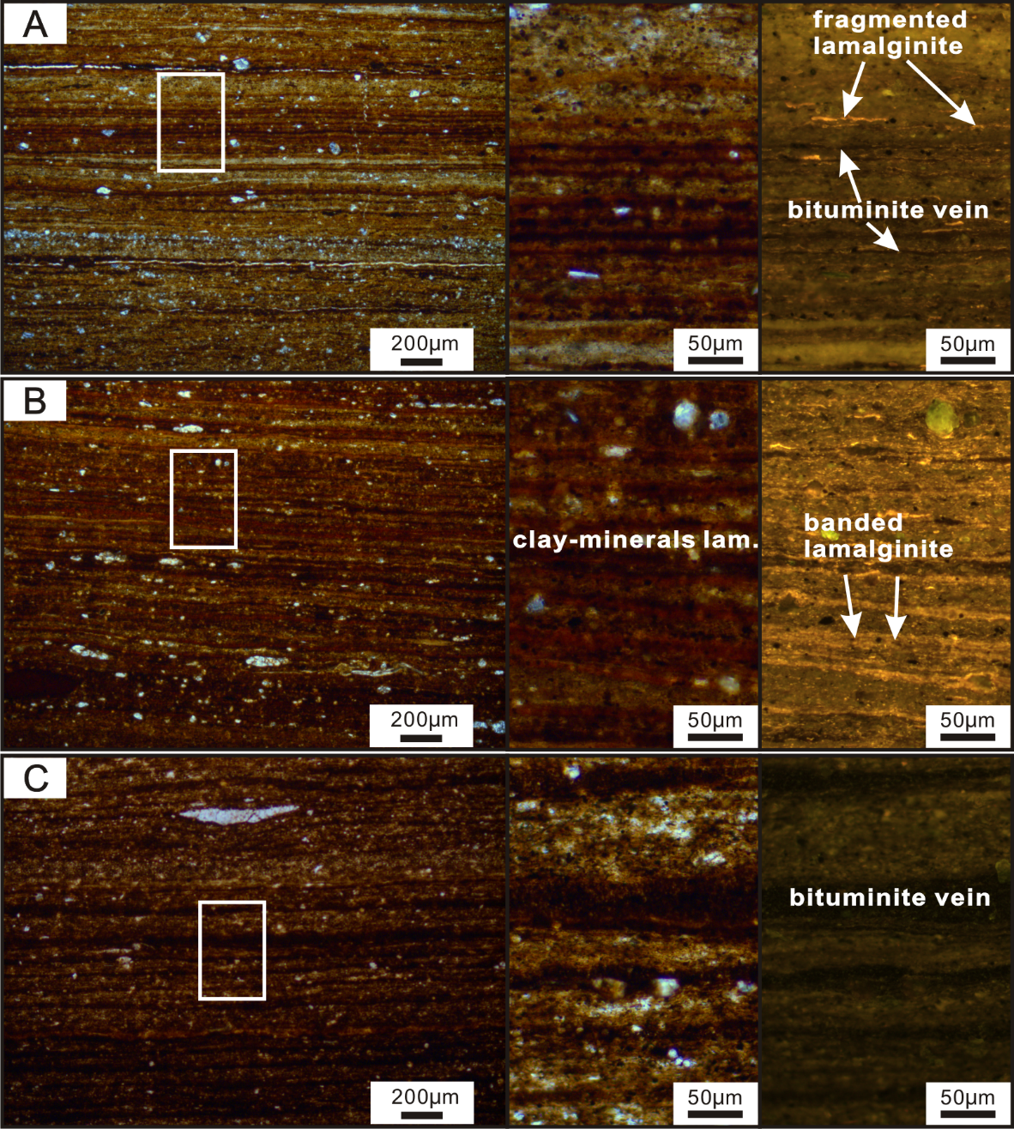
Wall rock
clay-mineral lam.
Laminated source rocks are characterized by discrete laminae of fine grain sizes.
clay-mineral laminae
carbonate-rich lam.
carbonate-rich laminae
  cryptocrystalline
  microcrystalline
  sparry carbonate
OM (organic matter)-rich laminae
discrete and fragmented OM
banded and continuous OM
OM-rich lam.

Slide 8
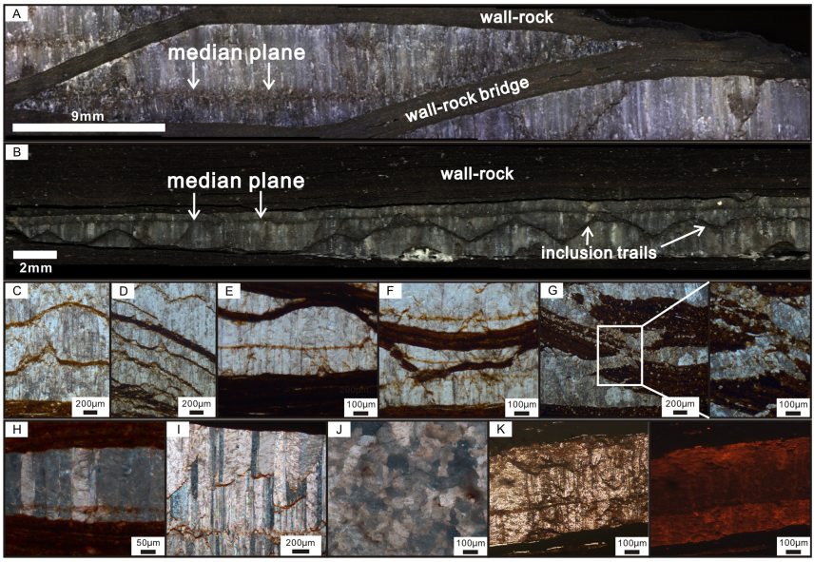
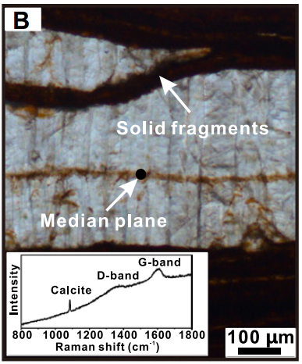
Petrography of fibrous veins
Fibers
All the veins are parallel to the bedding and the fibres are generally vertical and straight, uniform and normal to the bedding. The fibrous nature of veins is attributed to the high length/width ratio, smooth boundaries and parallel to each other with no growth competition.
Median Plane: Calcite stained by bedding-parallel bitumen.
Solid fragment: Recording episodic disruption of wall rock during antitaxial growth

Slide 9
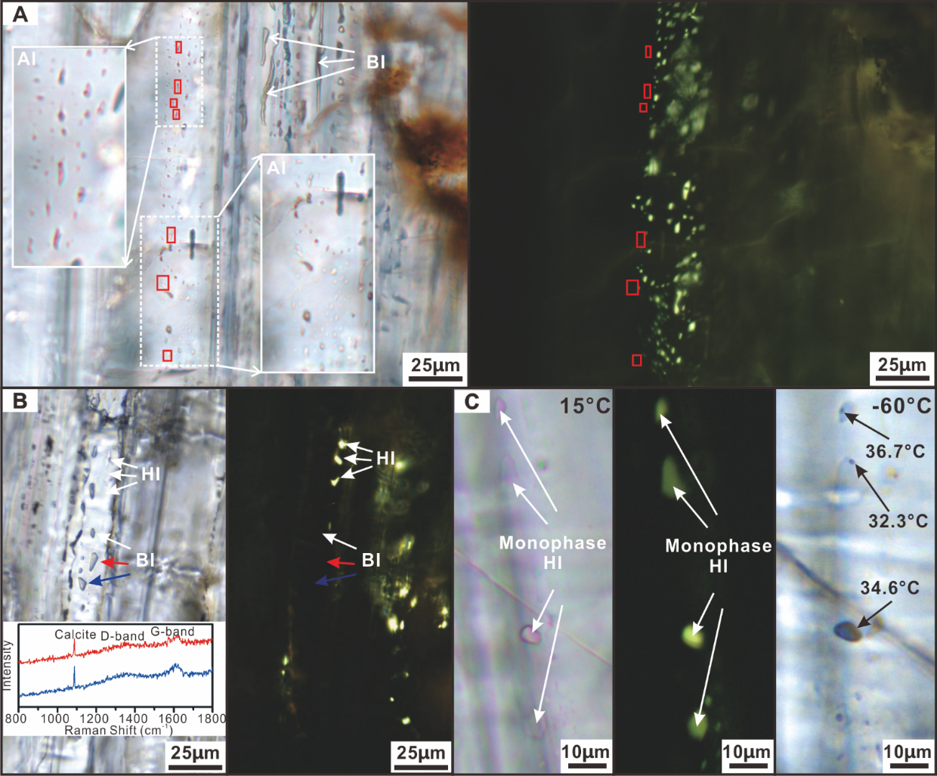
Fluid inclusions
Petrography
FIA (fluid inclusion assemblage)
FIA (fluid inclusion assemblage)
two-phase hydrocarbon inclusions
fibers
elongation
direction
mono-phase bitumen inclusions
two-phase aqueous inclusions
Primary nature
Immiscible + multi-phase
fluid mixture
Only liquid petroleum
Vein formation is concurrent with hydrocarbon generation and primary migration.

Slide 10
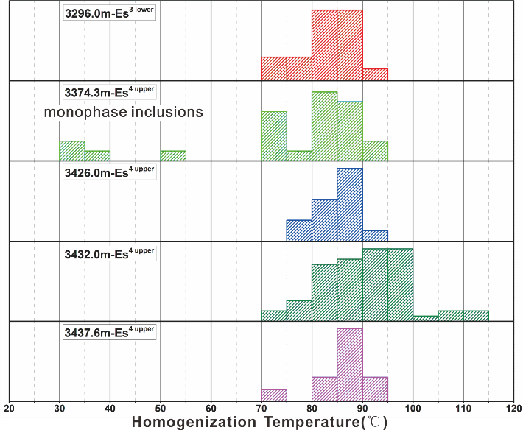
Fluid inclusions
Microthermometry
The T_{h} of hydrocarbon inclusions in
5 different burial samples show the similar range, from 70-110 °C.
During cooling, all monophase inclusions nucleated a gas bubble at about -60 °C. After nucleation, the inclusions were re-heated, resulting in consistent T_{h} around 32-37
°C (average ~35 °C)

Slide 11
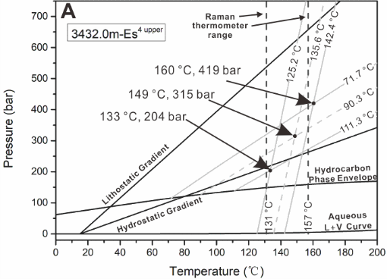
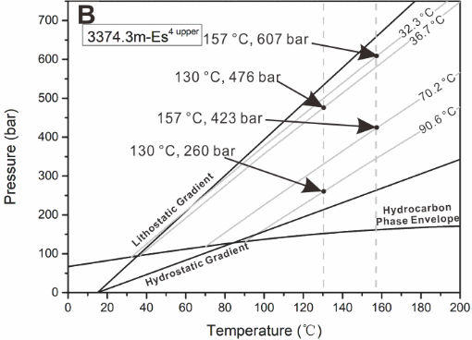
Growth mechanism
Horizontal fracture dilation
entrapment conditions during hydrocarbon generation and expulsion
The highest degrees of overpressure in the veins are recorded by the monophase petroleum inclusions. And these high density inclusions correspond to isochores that overlap with the lithostatic gradient.
Lithostatic pressures were not always present and not a requirement for horizontal vein vertical dilation.

Slide 12
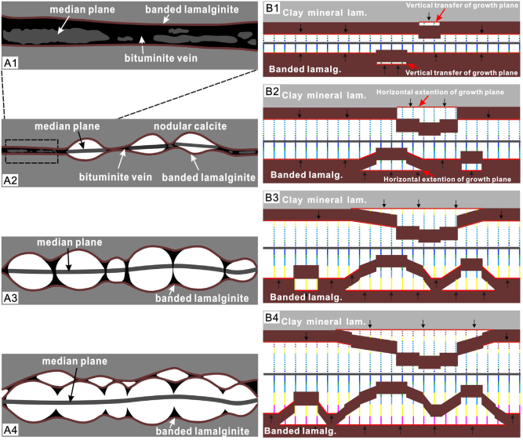
Conclusions
The antitaxial growth direction.
Continuous growth and limited growth space.
Crystal boundaries track trajectory of dilation.
Occurred in direct response to fluid overpressure due to hydrocarbon generation.
Assist to the primary lateral migration of petroleum from source rocks outward.
Variable degrees of overpressure during vein dilation, ranging from only modestly in excess of hydrostatic, to approaching and perhaps exceeding lithostatic value.
Commonly persisted at values of ~0.5-0.6x lithostatic during "normal," gradual vein dilation.

Slide 13



Acknowledgments
Funding
A graduate fellowship from the China Scholarship Council (CSC)
National Natural Science Foundation of China (No. 41703060, U1762108 and 41873070)
NSERC through a Discovery Grant to MS-M
Samples and collaboration
Shengli oilfield company, SINOPEC
Yury Klyukin for the suggestions on revision, and presentation practices
Email: fiwater@sina.com

