Slide 1



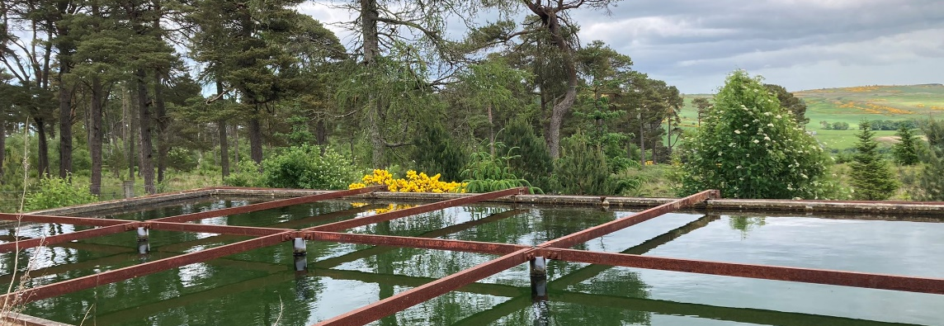
What does the future hold?
Sayali Pawar
Supervisory team: Dr Miriam Glendell , Dr Sarah Halliday ,Dr Paola Ovando Pol , Dr Lisa Avery

Slide 2
Using Drought Indices To Future-Proof Scotland’s Water
Sayali Pawar
Supervisory team: Dr Miriam Glendell , Dr Sarah Halliday ,Dr Paola Ovando Pol , Dr Lisa Avery

Slide 3
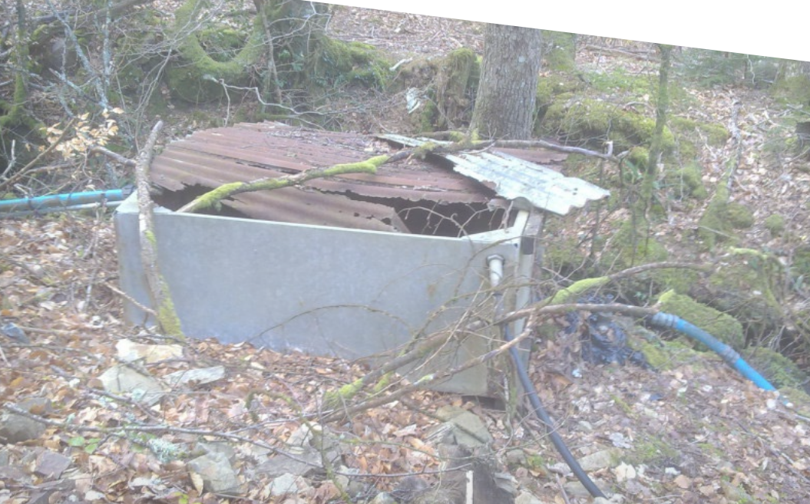
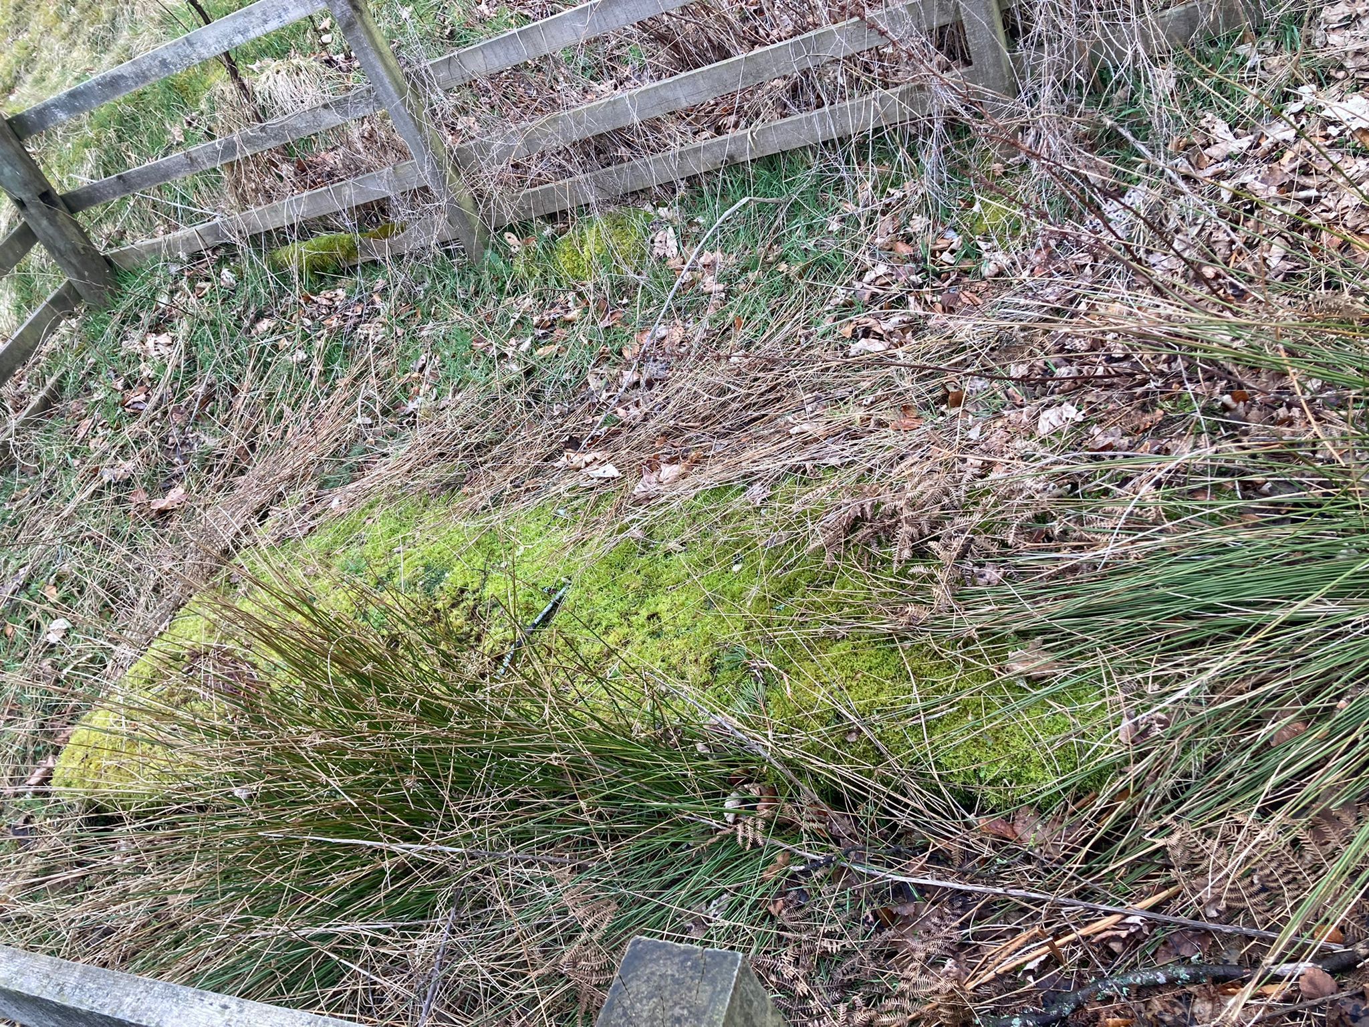
Drought affecting Scotland’s Private Water Supplies
Scottish Private Water supplies

Slide 4
Drought affecting Scotland’s Private Water Supplies
*Private water supplies are those that are not provided by Scottish Water
Scottish Private Water supplies

Slide 5
Drought affecting Scotland’s Private Water Supplies
*Private water supplies are those that are not provided by Scottish Water
Scotland’s private water supplies are estimated to be within areas of increased vulnerability until 2050
Scottish Private Water supplies

Slide 6
Drought affecting Scotland’s Private Water Supplies
*Private water supplies are those that are not provided by Scottish Water
Scotland’s private water supplies are estimated to be within areas of increased vulnerability until 2050
220,000 people, could have their drinking water supply impacted in the coming decades
Scottish Private Water supplies

Slide 7
Drought affecting Scotland’s Private Water Supplies
*Private water supplies are those that are not provided by Scottish Water
Scotland’s private water supplies are estimated to be within areas of increased vulnerability until 2050
220,000 people, could have their drinking water supply impacted in the coming decades
Northeast Scotland is forecast to experience the largest increase in water shortages, which is home to the highest density of private water supplies.
Scottish Private Water supplies

Slide 8
Drought affecting Scotland’s Private Water Supplies
*Private water supplies are those that are not provided by Scottish Water
Scotland’s private water supplies are estimated to be within areas of increased vulnerability until 2050
220,000 people, could have their drinking water supply impacted in the coming decades
Northeast Scotland is forecast to experience the largest increase in water shortages, which is home to the highest density of private water supplies.
500 supply owners contacted their local authorities to seek emergency assistance when their supplies ran dry in 2018⁴
Scottish Private Water supplies

Slide 9
Research Aims

Slide 10
Research Aims
What is the likelihood of extreme drought events in Scotland between 2041-2080 and which areas are at high risk of experiencing drought?

Slide 11
Research Aims
What is the likelihood of extreme drought events in Scotland between 2041-2080 and which areas are at high risk of experiencing drought?
What is the amount of change in the frequency, duration, severity, and intensity of drought events compared to the baseline?

Slide 12
Research Aims
What is the likelihood of extreme drought events in Scotland between 2041-2080 and which areas are at high risk of experiencing drought?
What is the amount of change in the frequency, duration, severity, and intensity of drought events compared to the baseline?
What are the uncertainties related to model variability while predicting drought?

Slide 13
Research Aims
What is the likelihood of extreme drought events in Scotland between 2041-2080 and which areas are at high risk of experiencing drought?
What is the amount of change in the frequency, duration, severity, and intensity of drought events compared to the baseline?
What are the uncertainties related to model variability while predicting drought?
Calculate the number of drought months for the longer term (2041-2080) in comparison with the baseline period 1981-2020.

Slide 14
Research Aims
What is the likelihood of extreme drought events in Scotland between 2041-2080 and which areas are at high risk of experiencing drought?
What is the amount of change in the frequency, duration, severity, and intensity of drought events compared to the baseline?
What are the uncertainties related to model variability while predicting drought?
Calculate the number of drought months for the longer term (2041-2080) in comparison with the baseline period 1981-2020 using SPEI.
Using UKCP 18 climate projections, calculate drought metrics.

Slide 15
Research Aims
What is the likelihood of extreme drought events in Scotland between 2041-2080 and which areas are at high risk of experiencing drought?
What is the amount of change in the frequency, duration, severity, and intensity of drought events compared to the baseline?
What are the uncertainties related to model variability while predicting drought?
Calculate the number of drought months for the longer term (2041-2080) in comparison with the baseline period 1981-2020.
Using UKCP 18 climate projections, calculate drought metrics.
Compare model variability to understand the spatial variability and drought simulation differences between ensemble members using underlying UKCP18 climate change data.

Slide 16
Drought metrics

Slide 17
Drought metrics
Drought Frequency- Number of drought events in a given period

Slide 18
Drought metrics
Drought Frequency- Number of drought events in a given period
Drought severity- Strength of drought (sum of SPEI in an event)

Slide 19
Drought metrics
Drought Frequency- Number of drought events in a given period
Drought severity- Strength of drought (sum of SPEI in an event)
Drought intensity- The lowest value of SPEI in a given drought event

Slide 20
Drought metrics
Drought Frequency- Number of drought events in a given period
Drought severity- Strength of drought (sum of SPEI in an event)
Drought intensity- The lowest value of SPEI in a given drought event
Drought duration- Number of consecutive months where SPEI <0

Slide 21
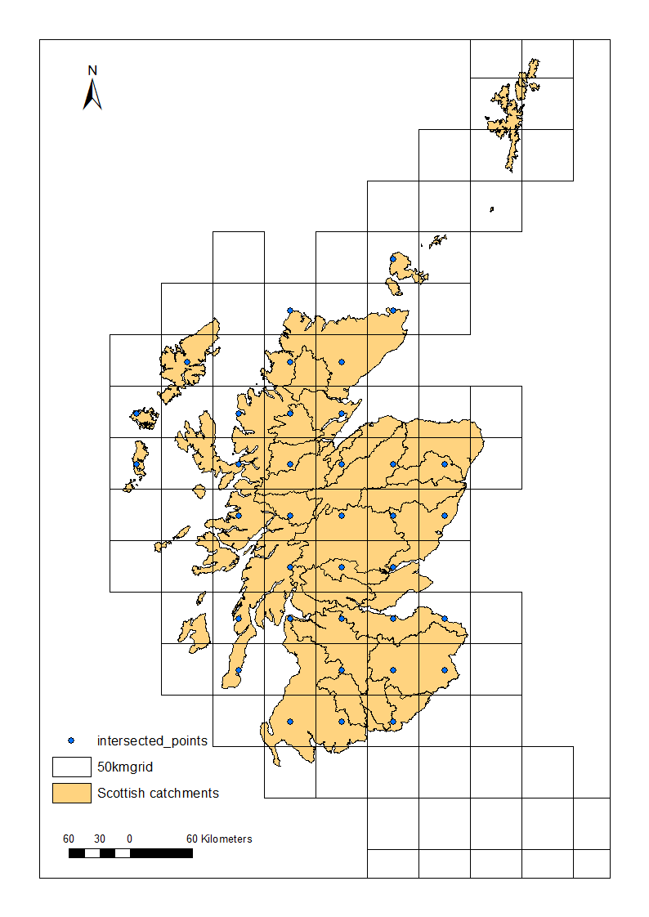
Regional Analysis
Sites

Slide 22
Regional Analysis
36 sites located used as part of our pilot case study to test the use of SPEI to project future drought scenarios for the long term (2041-2080)
Sites

Slide 23
Regional Analysis
36 sites located used as part of our pilot case study to test the use of SPEI to project future drought scenarios for the long term (2041-2080)
The bias-corrected UKCP18 regional data for 1981-2020 (baseline) and 2041-2080 (future)
Sites

Slide 24
Regional Analysis
36 sites located used as part of our pilot case study to test the use of SPEI to project future drought scenarios for the long term (2041-2080)
The bias-corrected UKCP18 regional data for 1981-2020 (baseline) and 2041-2080 (future)
SPEI (Standardised Precipitation and Evapotranspiration Index): 6 month timestep was calculated for all 36 sites; drought months calculated for 36 sites where SPEI ≤ -2 for any month classified as extreme drought month
Sites

Slide 25
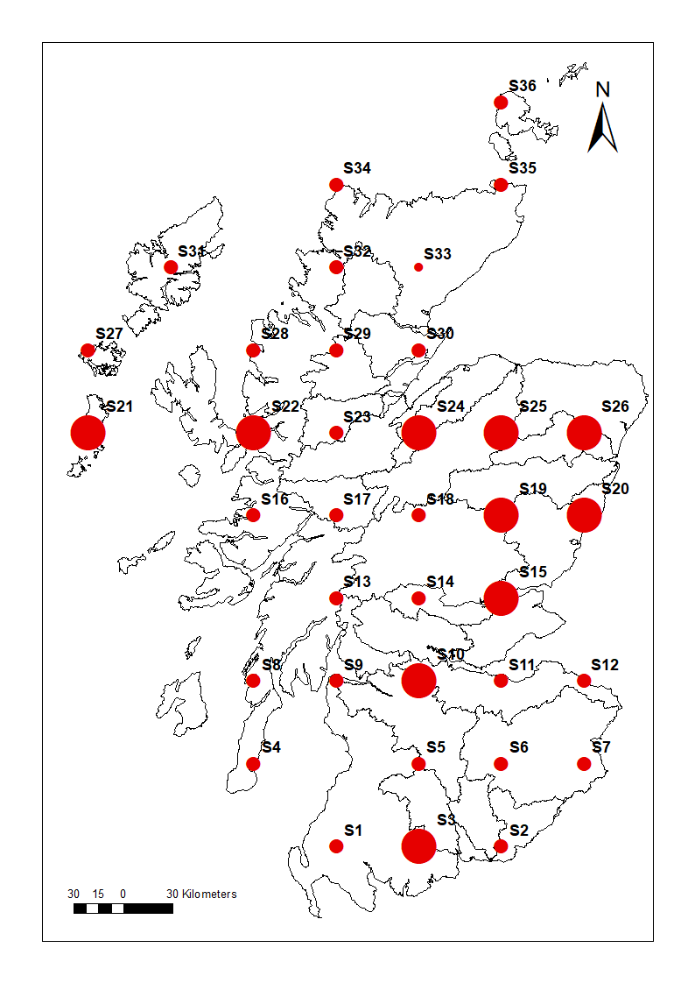
Spatial distribution
No. of drought months

Slide 26
Spatial distribution
Increased occurrences of drought months were simulated in the south and northeast of Scotland for the future period (2041-2080)
No. of drought months

Slide 27
Spatial distribution
Increased occurrences of drought months were simulated in the south and northeast of Scotland for the future period (2041-2080)
Site 26 and Site 15, both located on the east coast of Scotland showed the highest number of extreme drought months compared to other locations in Scotland
No. of drought months

Slide 28
Spatial distribution
Increased occurrences of drought months were simulated in the south and northeast of Scotland for the future period (2041-2080)
Site 26 and Site 15, both located on the east coast of Scotland showed the highest number of extreme drought months compared to other locations in Scotland
All other sites showed between 1-4 number of extreme drought months for the future period 2041-2080
No. of drought months

Slide 29
Model comparison

Slide 30
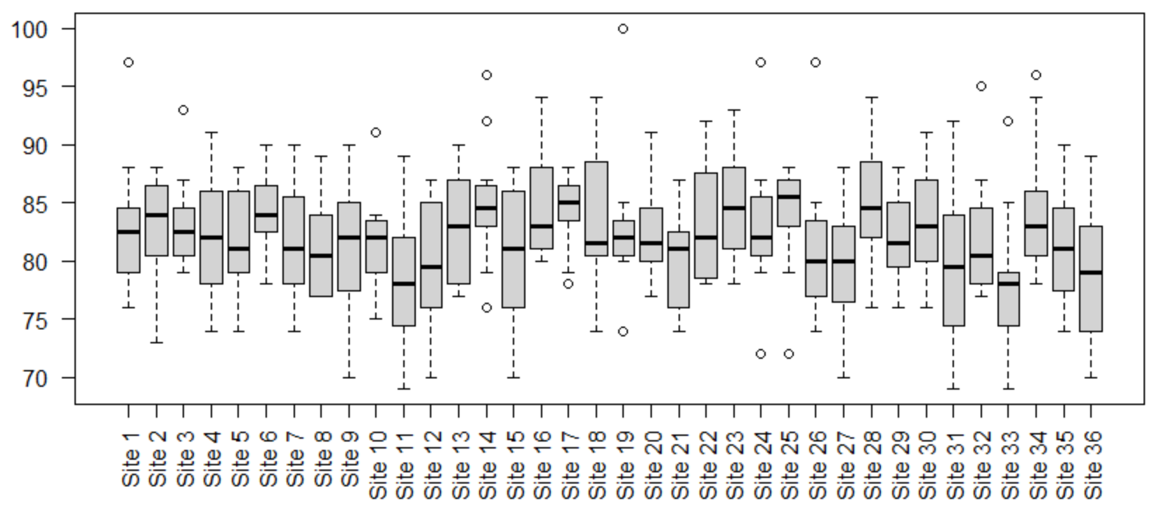
Distribution of SPEI data showing the number of months where SPEI <-1 from 2040-2080
Number of months (SPEI<-1)

Slide 31
Frequency of drought events (2021-2040)
Site 1
Site 2
Number of drought events
Site 3
Site 4
Climate model

Slide 32
Mean severity of a drought event (2021-2040)
Climate model
Site 1
Site 2
Mean Severity
Site 3
Site 4

Slide 33
Mean drought duration(2021-2040)
Site 1
Site 2
Mean drought duration in months
Site 3
Site 4
Climate model

Slide 34
Takeaway points

Slide 35
Takeaway points
Scotland and mainly its northeast counterparts are experiencing situations of water scarcity and affecting water quality in the areas

Slide 36
Takeaway points
Scotland and mainly its northeast counterparts are experiencing situations of water scarcity and affecting water quality in the areas
There is an upward trajectory in the severity of impacts which will be exacerbated due to a warming climate.

Slide 37
Takeaway points
Scotland and mainly its northeast counterparts are experiencing situations of water scarcity and affecting water quality in the areas
There is an upward trajectory in the severity of impacts which will be exacerbated due to a warming climate.
Spatial variability exists in model ensemble, however, the magnitude of change is small

Slide 38
Takeaway points
Scotland and mainly its northeast counterparts are experiencing situations of water scarcity and affecting water quality in the areas
There is an upward trajectory in the severity of impacts which will be exacerbated due to a warming climate.
Spatial variability exists in model ensemble, however, the magnitude of change is small
Next steps: Conduct drought analysis for all PWS sites across Scotland

Slide 39
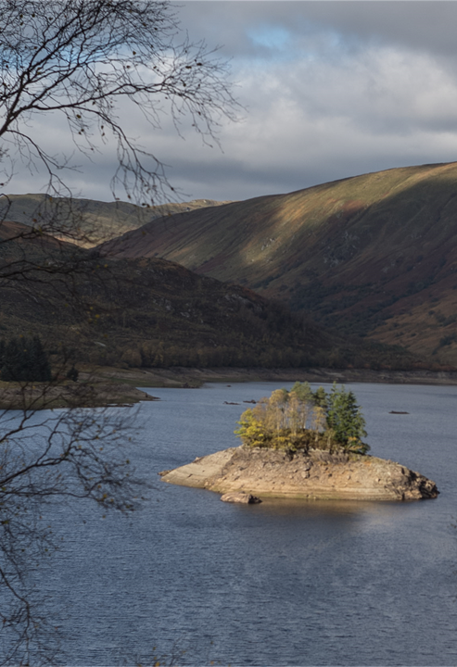

Twitter-@pawarsayali20
Email-sayali.pawar@hutton.ac.uk
Trossachs National park, 2020

