Slide 1
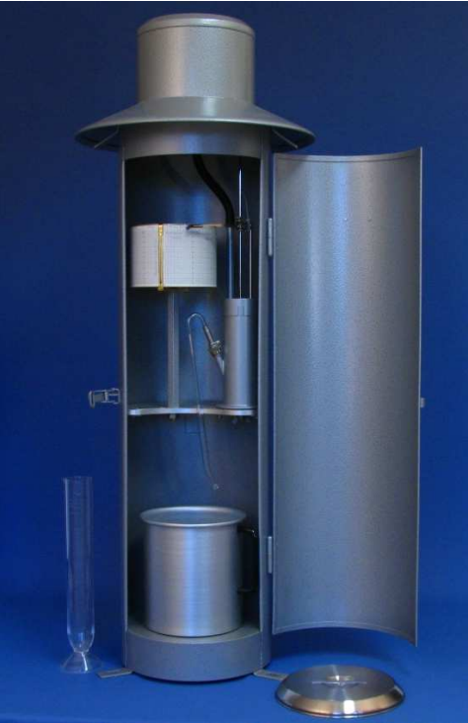
Correction of siphoning error in processed historical rainfall intensity data, a case study of data measured by Hellmann-Fuess type rainfall recorder
EGU General Assembly 2022
Session CL5.1.5 – Downscaling: methods, applications and added value
Rácz Tibor MSc water eng.
Photo: Dr. Alfred Müller Catalogue

Slide 2
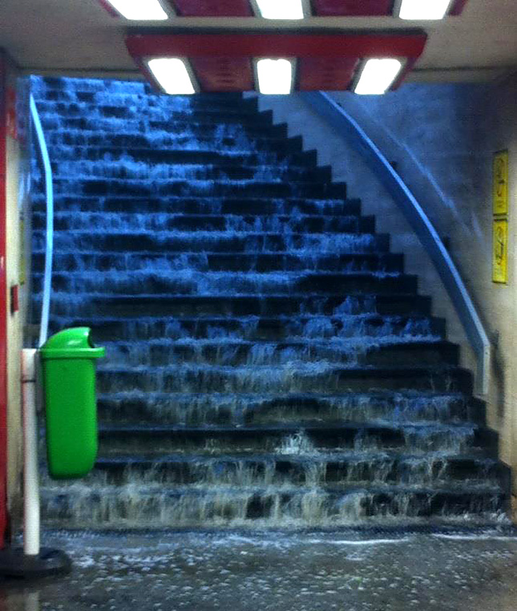
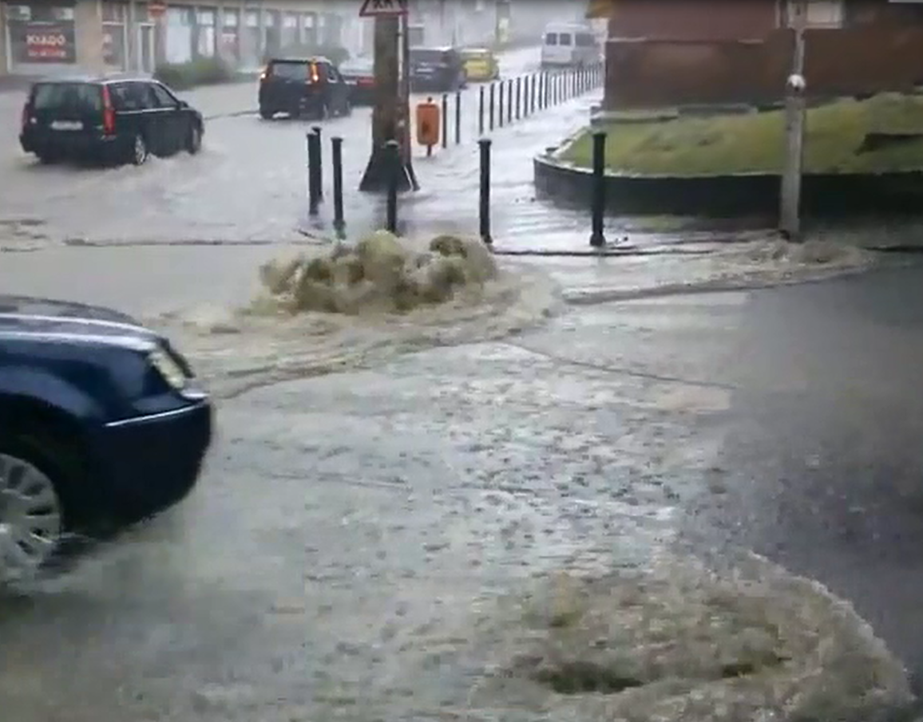
Importance of the issue
Significant damage capacity of heavy rainfall caused floods.
Heaviest damage potential: short duration intensive rainfall.
Climate change issue: are the reference data accurate enough?

Slide 3
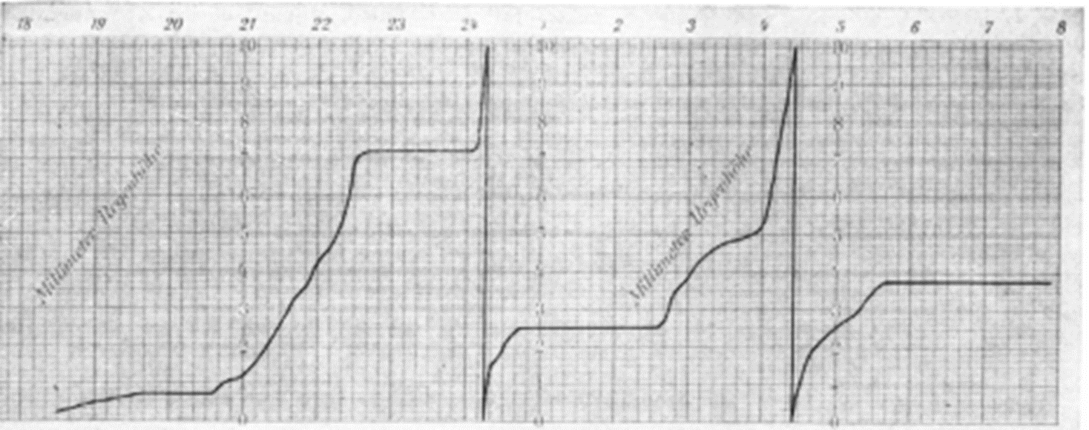
Specific systematic error of siphoned rainfall recorders
Undermeasurement during siphonage
Reason: The emtying of the device takes time (10-30 s);
During the siphoning the rainfall recording is pending
But: The time of siphonage depends on the actual rainfall intensity
Correction: method of Luyckx and Berlamont, in the possession of registration banner
LUYCKX G., BERLAMONT J. (2002): Accuracy of siphoning rain gauges. In: Global Solutions for Urban Drainage. 2002. p. 1-12. https://doi.org/10.1061/40644(2002)251

Slide 4
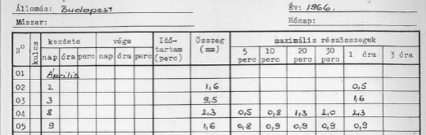
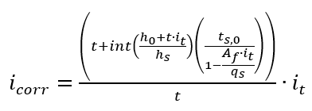
Correction of extracted rainfall intensity data
Extracted data: The highest sums (intensities) of a class of duration were collected during the processing of data
Correction: modified method of Luyckx and Berlamont
i_{t} Measured t minute intensity
i_{corr} Adjusted t minute intensity
t Duration
t_{s,0} Siphonage time (no rain supply)
h_{o} Initial water level
h_{s} Measurable raindepth of the ribbon
A_{f} Surface of collecting area
q_{s} Drainage discharge of the device

Slide 5
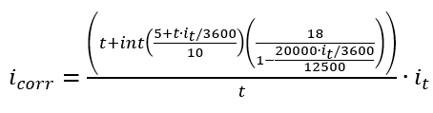
Correction of extracted data of Hellmann-Fuess recorder
Parameters of the device:
h_{s} measurement capacity, width of the tape 10 mm
A_{f} collection area of the device 20000 mm²
q_{s} drainage discharge of the device 12500 mm³/s
t_{s,0} siphonage time (no rain supply) 18 s
Initial water level issue:
The initial water level in the measurement tank is a random variable
The waterlevel is somewhere between 0-10 mm, randomly.
h_{o} can be estimated as expected value of a uniform distribution (E=h_{s}/2=5 mm)

Slide 6
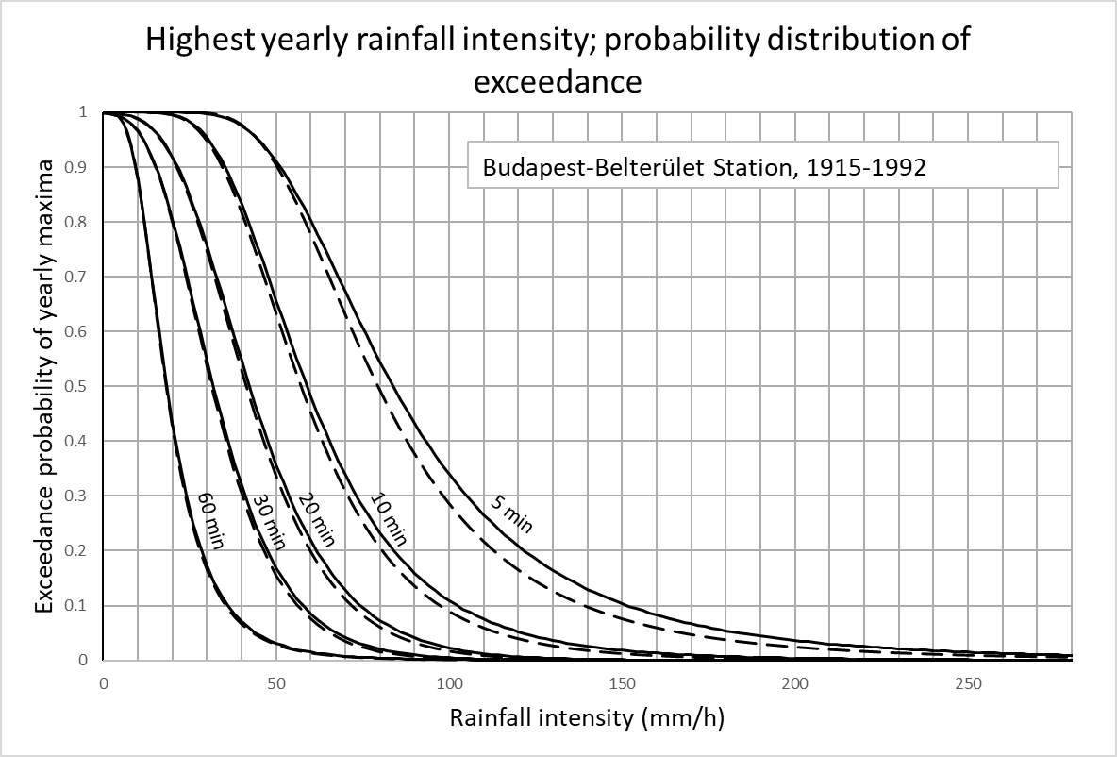
Effect of correction on the rainfall’s PDF and IDF data
General Extreme Value PDF curves on raw and adjusted data
Highest corrections:
in the range of shorther duration than 30 min.
Data: Hungarian Meteorological Service
Percentual differences between raw and adjusted IDF data
Adjusted data / Raw data, %
Average recurrency (years) | Exceedance Probability (%) | 5 min | 10 min | 20 min | 30 min | 60 min
1 | 99 | -2,3 | 3,7 | 0,0 | 1,9 | 0,0
2 | 50 | 5,4 | 3,0 | 2,2 | 1,3 | 1,1
10 | 10 | 9,0 | 5,1 | 3,6 | 2,7 | 1,7
50 | 2 | 11,1 | 7,4 | 4,9 | 3,9 | 2,4
100 | 1 | 11,9 | 8,6 | 5,4 | 4,3 | 2,7
Significant corrections:
over 10 ys recurrency

Slide 7
Summary and Conclusion
Correction of systematic errors is possible for the extracted data on a statistical basis.
The magnitude of the correction on short durations and rare intenisties is higher than 5%.
The effect of the correction is significant.
The improvement may affect the evaluation of climate change by refining the precipitation intensity reference data.
The repair will allow a reassessment of the suitability of existing drainage facilities.
Further information about the method:
https://www.researchgate.net/publication/354586738_On_the_correction_of_processed_historical_rainfall_data_of_siphoned_rainfall_recorders
https://www.researchgate.net/publication/351917435_Application_of_Correction_Procedures_for_Some_Systematic_Measurement_Errors_to_Rainfall_Intensity_Data_of_a_Rain_Gauge_in_Budapest

Slide 8

Thank YOU for the kind attention!

