Slide 1



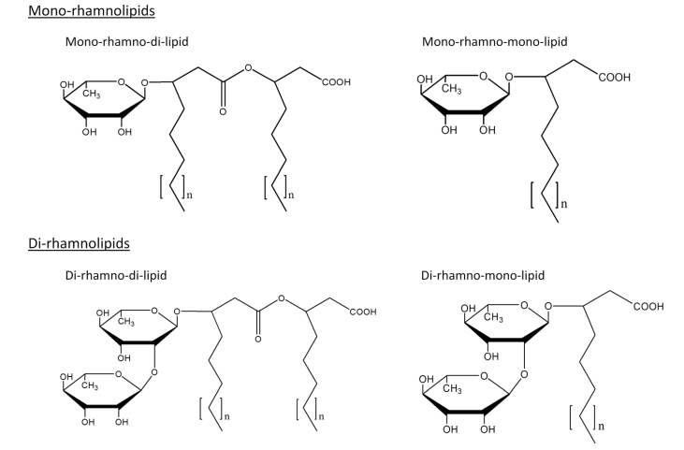
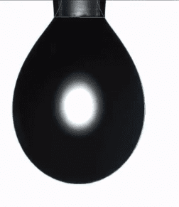
Dynamic and equilibrium surface tension of Rhamnolipid:
Effect of real-time temperature
Thuc Nguyen and Gilboa Arye
(nguyan@post.bgu.ac.il, aryeg@bgu.ac.il)
French Associates Institute for Agriculture and Biotechnology for Drylands, Jacob Blaustein Institutes for Desert Research,
Ben Gurion University of the Negev, Israel
With high biodegradability, bio-surfactants are considered as an eco-friendly alternative to synthetic surfactants. In conjunction with the changing soil temperature under effects of climate change, knowledge about temperature-dependent surface activities of bio-surfactants is essential. In this study, dynamic and equilibrium surface tension of Rhamnolipid (RLP) was investigated as functions of concentration and temperature.
Control chamber:
T (°C) = constant
H (%) = constant
RLP solution
Air
Figure 1. Chemical structures of mono and di-rhamnolipid
(Wittgens et al., 2017)
Figure 2. Pendant drop method for surface tension measurement
Figure 3. Surface tension as a function of time (γ_{t})

Slide 2
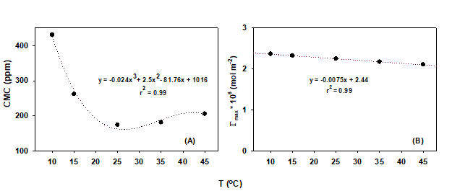
Equilibrium surface tension as a function of temperature
CMC
Figure 5. Critical micelle concentration (CMC) as a function of temperature
With increasing temperature, the reduction in hydration of hydrophilic groups favors micellization → decreased CMC.
With further increased temperature, the breakdown of the structured water surrounding disfavors micellization → increased CMC
Figure 4. Equilibrium surface tension (γ_{eq}) as a function of concentration.
γ_{eq} decreased due to adsorption of surfactant at water/air interface.
As adsorption reached saturation, γ_{eq} remained unchanged.
Figure 6. Equilibrium surface tension as a function of temperature
γ_{eq} at pre-CMC decreased more significantly with increasing temperature than γ_{eq} at post-CMC, most likely because micelles are more stable with heat than monomers.
2

Slide 3
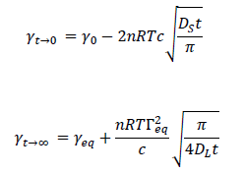
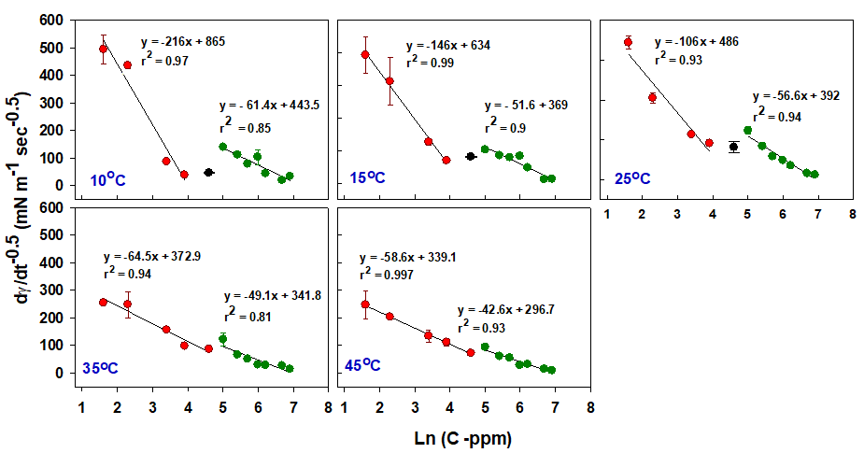

Dynamic surface tension under effects of temperature
Figure 7. Surface tension of 30 ppm and 400 ppm RLP as a function of time (γ_{t} )
Asymptotic solution of Ward and Tordai equation
Figure 8. dγ/dt^{-0.5} as a function of concentration
dγ/dt^{-0.5} decreased with increasing concentration
→ DL increased with increasing concentration.
dγ/dt^{-0.5} vs ln(C) created two linear regressions with two distinctive slopes, representing pre-CMC and post-CMC. Temperature affected the slopes at pre-CMC more than at post-CMC.
→ Temperature affected diffusion at pre-CMC more than at post-CMC.
$$\sqrt{\frac{1}{D_{L}}}$$
=
∼
The diffusion coefficient at long term (DL) was estimated from the slope dγ/dt^{-0.5} by fitting γ_{t} (t^{-0.5} ) to the asymptotic equation.
DL is inversely proportional to dγ/dt^{-0.5} .
Conclusions:
Equilibrium surface tension decreased with increasing temperature.
The diffusion of surfactant molecules increased with increasing temperature.
At both equilibrium and dynamic surface tension, the pre-CMC concentrations were affected more significantly than the post-CMC concentrations.
3

