Slide 1

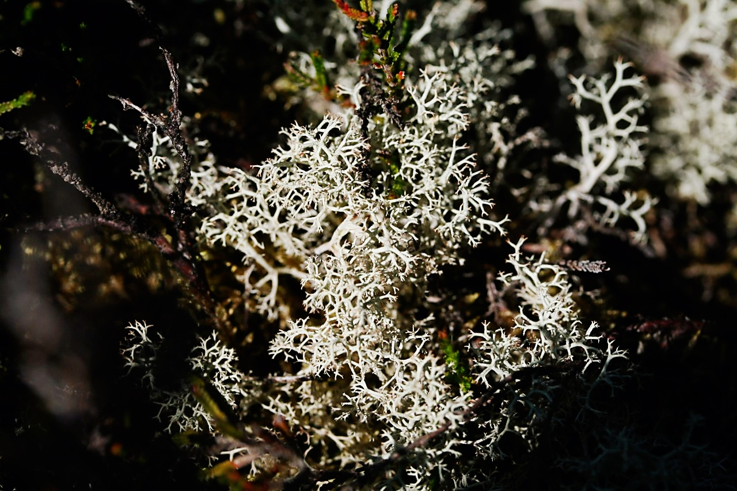
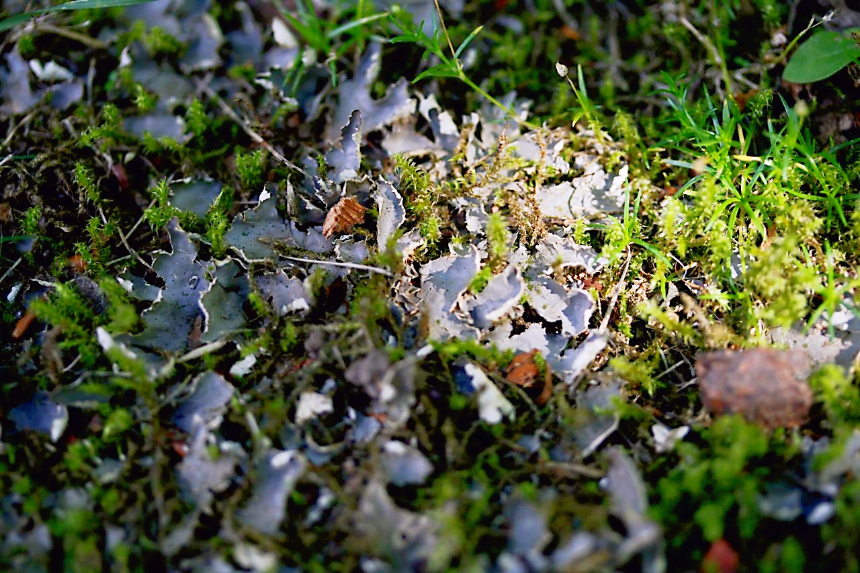
Yunyao Ma, Bettina Weber, Claudia Colesie, José Raggio Quílez, Maik Veste, Maaike Bader, Philipp Porada
Determining key drivers of the annual carbon budget of biocrusts in different climatic zones

Slide 2
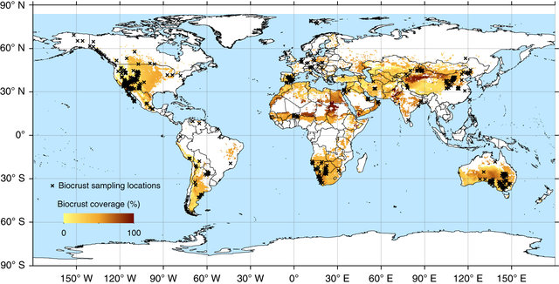
Motivation
Widely distributed
Provide critical ecological functions
Growth quantified by annual carbon balance (C balance)
(Rodriguez-Caballero, E. et al., 2018)
How do environmental drivers affect annual C balance along climatic gradients?
What is the role of seasonal acclimation of traits?
2
Notes:
3

Slide 3
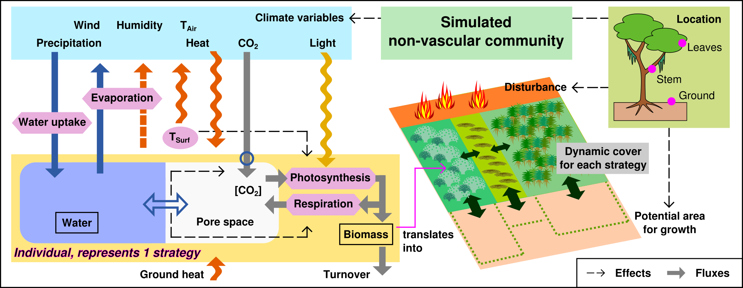
Methods
Dryland
Temperate
Alpine
Mechanistic data-driven model – part of LiBry model
3
Notes:
3

Slide 4
Results
Key environmental factors for carbon balance
Climate change could largely affect global C balances of biocrusts.
A=alpine, D=dryland, T=temperate
3

Slide 5
Results
C balance estimated by data-driven model - Negative
Annual C budget of each collected biocrust type in all sites, estimated by the data-driven model.
Site | Lichen (g C m⁻² a⁻¹) | Moss (g C m⁻² a⁻¹) | Cyanocrust (g C m⁻² a⁻¹)
D1 | 3.8 | 3.2
D2 | 0.7 | 6.3 | -2.0
T1 | -27.3 | -28.6
T2 | -96.0 | -63.9
T3 | 7.1 | 13.3
A1 | -11.4 | 6.2
Climatic gradient
Dead!
3

Slide 6
Results
Including seasonal acclimation of physiological traits shows a large improve of carbon:
Seasonal acclimation of traits is an important process in models.
Season of collecting samples matters.
3
Notes:
3

Slide 7

Take-home messages
Environmental drivers for annual carbon balance
  Light intensity, CO₂ concentration, Relative humidity, and Air Temperature at all climate zones.
  Amount of precipitation in drylands.
  Climate change will likely affect global long-term C balances of biocrusts.
Seasonal acclimation of physiological traits in temperate regions
Suggestion for modelers: Missing from the model might cause bias in annual carbon balance estimation.
Suggestion for experimental investigators: Season and timing of collecting samples for the CO₂-exchange measurements are important.
yunyao.ma@uni-hamburg.de
3
Notes:
3

