Slide 1
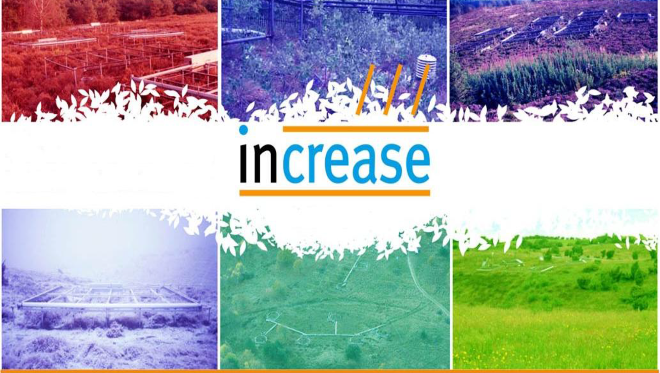

Effects of drought and warming treatments on CO₂ fluxes in shrubland ecosystems across European environmental gradients
PhD fellow: Qiaoyan Li (University of Copenhagen)
Co-authors: Albert Tietema, Sabine Reinsch, Gabriele Guidolotti, Inger Kappel Schmidt, Giovanbattista de Dato, Bridget Emmett, Eszter Lellei-Kovács, and Klaus Steenberg Larsen
PhD fellow: Qiaoyan Li E-mail:qli@ign.ku.dk

Slide 2
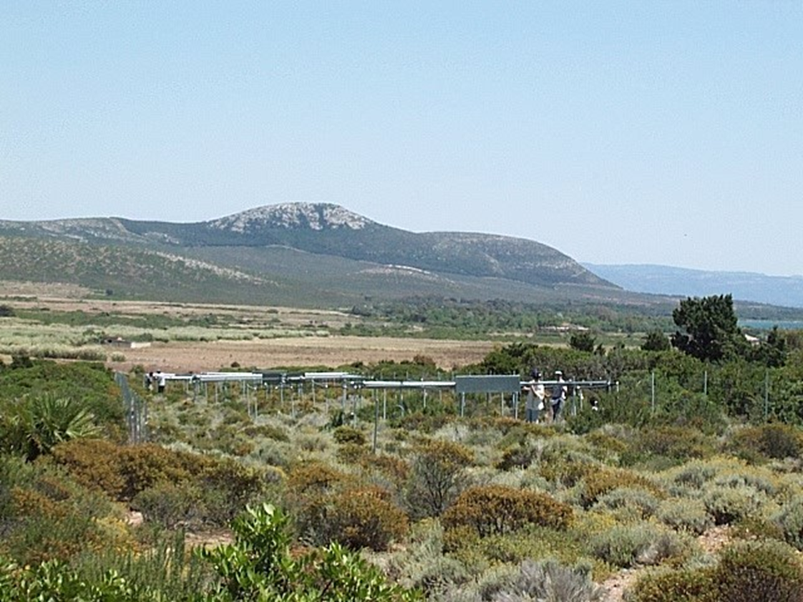
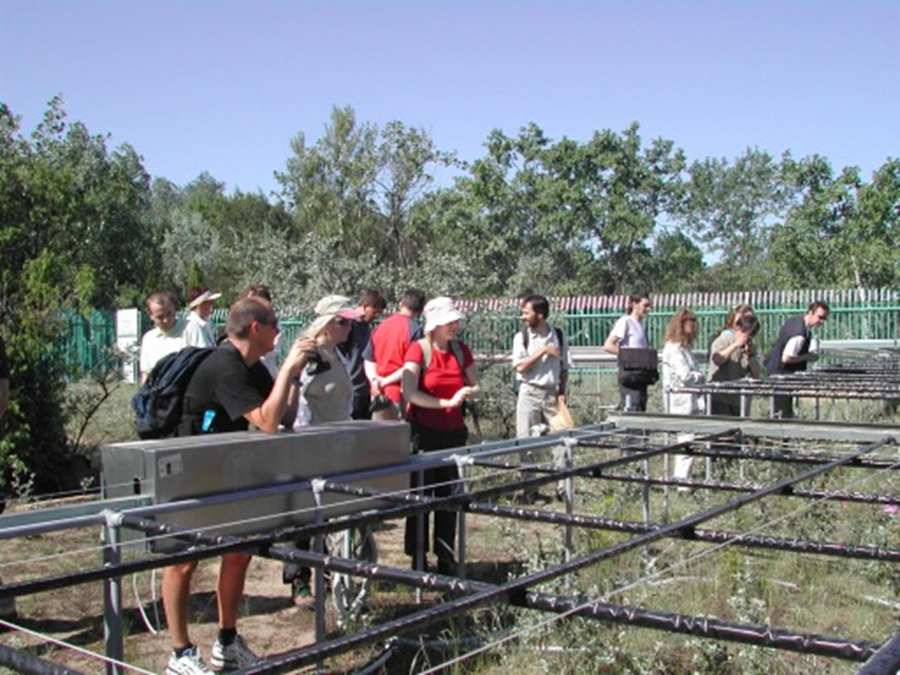
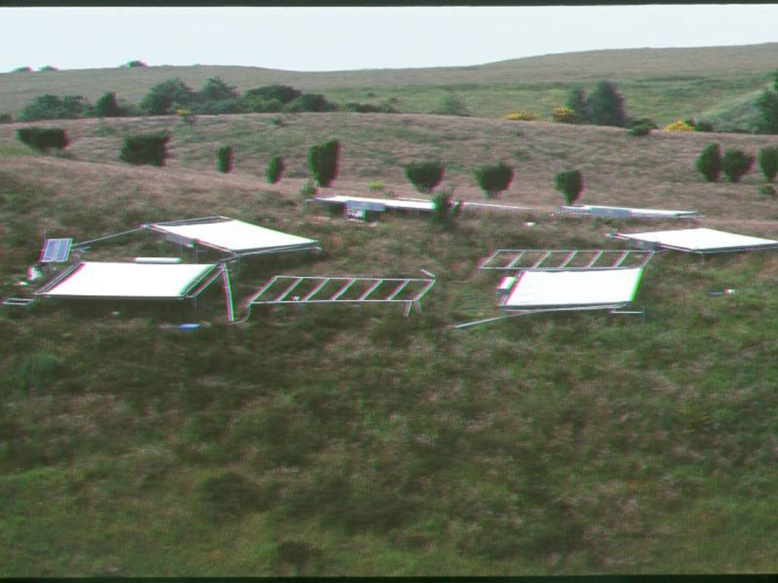
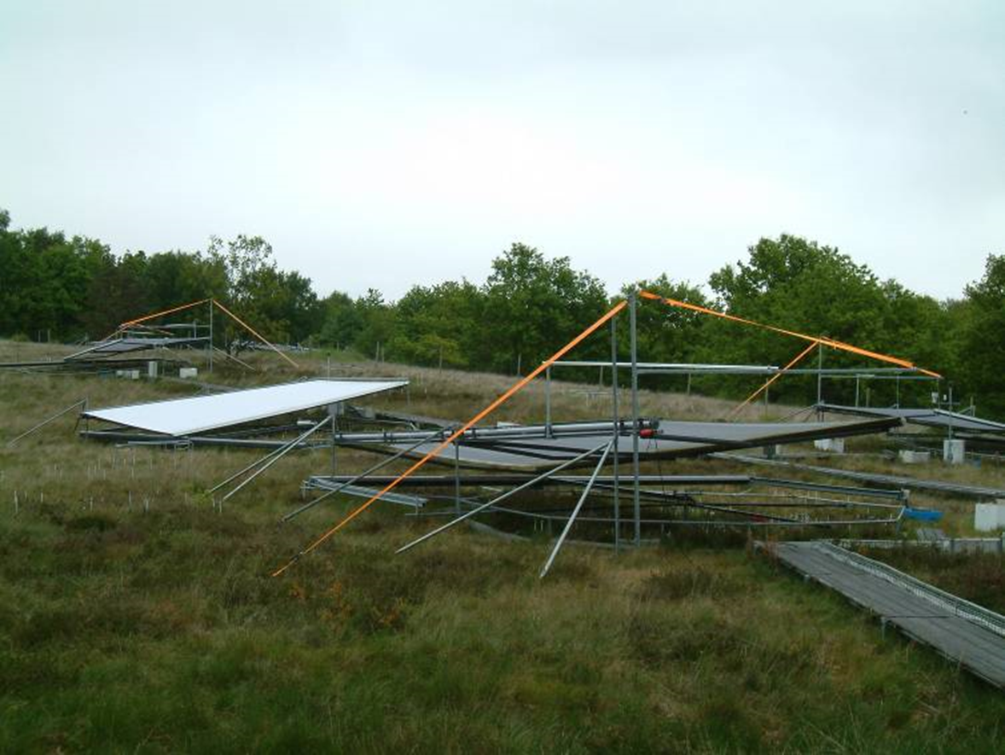
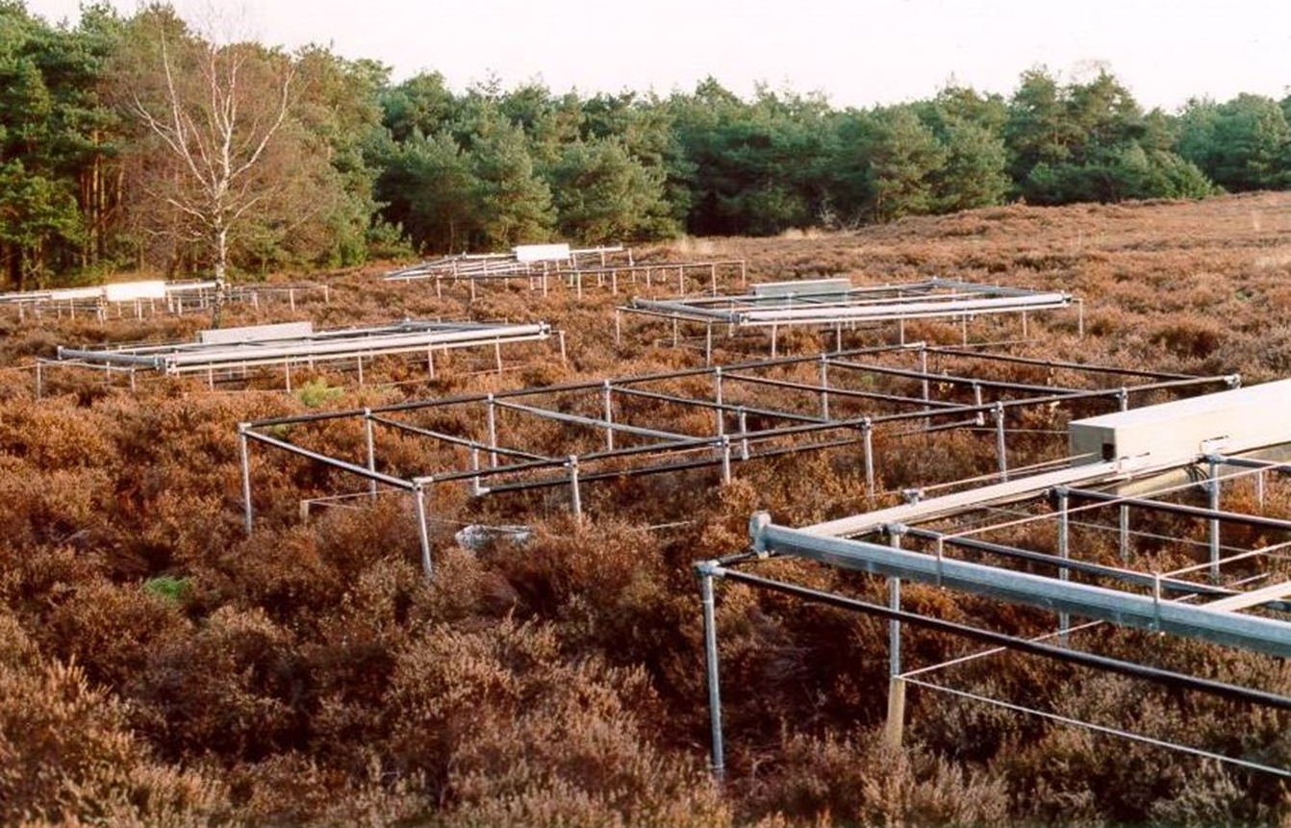
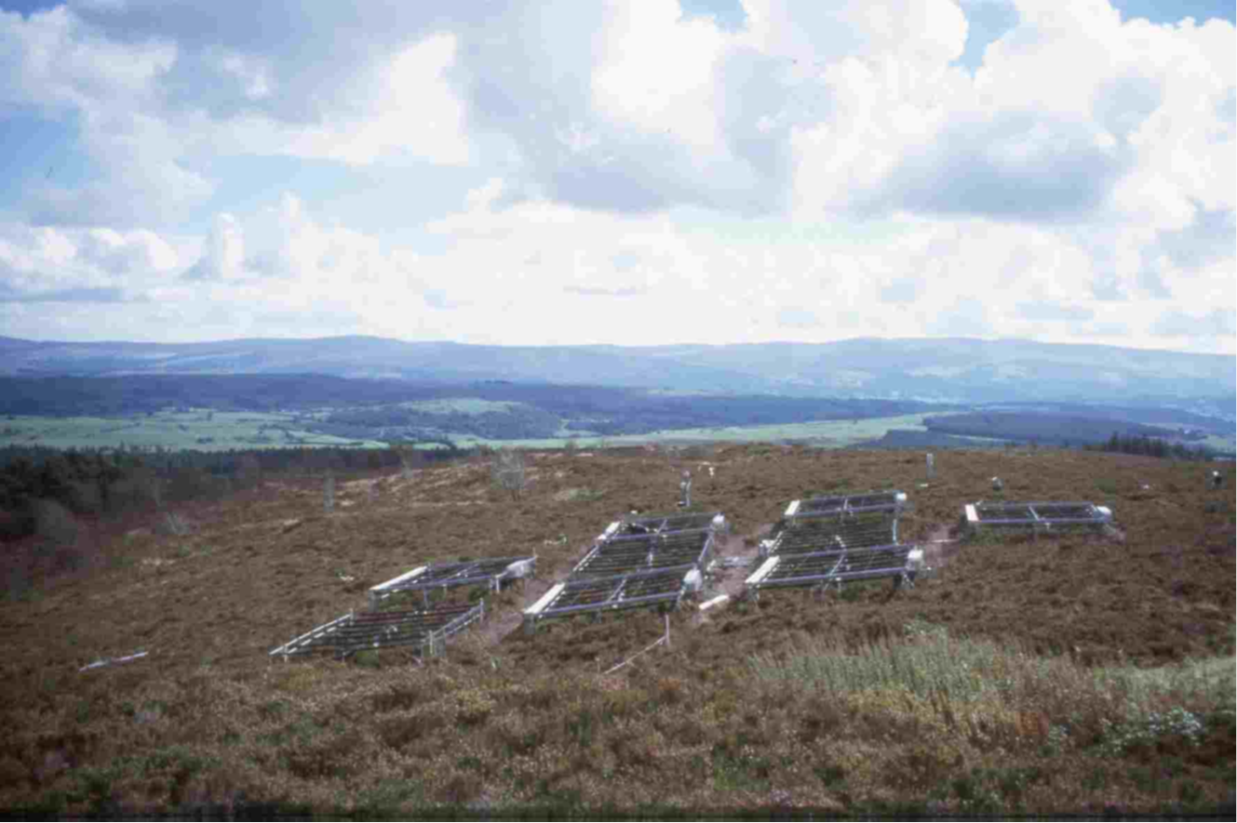
IT
HU
DK_M
DK_B
NL
UK

Slide 3
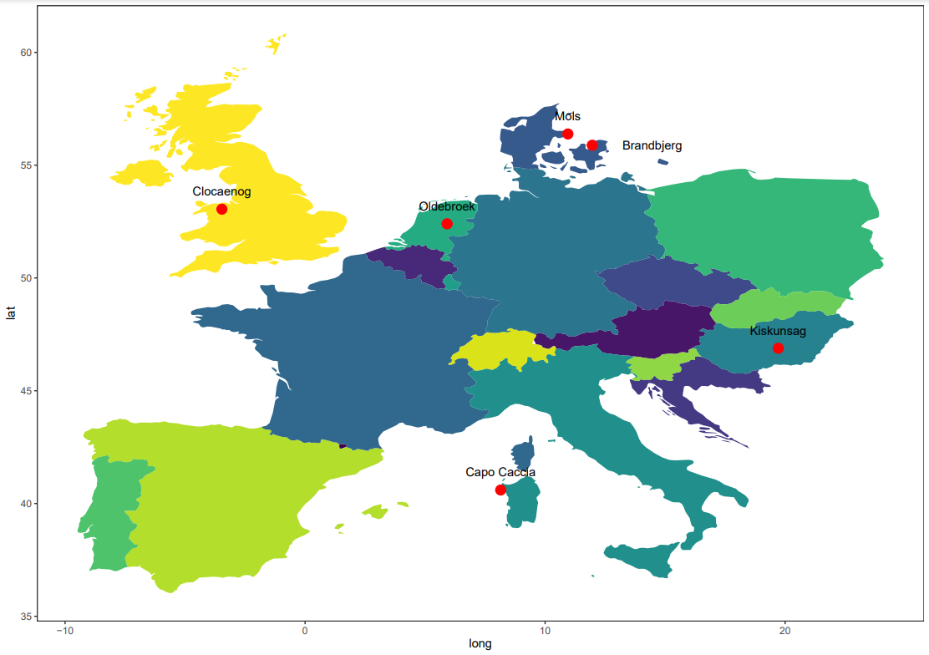
Clocaenog, UK
MAP 1263 (mm)
MAT 7.4 (℃)
25% 0.2℃
Mols, DK
MAP 669 (mm)
MAT 8.7 (℃)
18% 0.9℃
Brandbjerg, DK
MAP 757 (mm)
MAT 9.4 (℃)
8% 0.2℃
Oldebroek, NL
MAP 1005 (mm)
MAT 19 (℃)
8.9% 0.3℃
Kiskunsag, HU
MAP 558 (mm)
MAT 10.5 (℃)
22% 0.4℃
Porto Conte, IT
MAP 544 (mm)
MAT 16.1 (℃)
16% 0.4℃
PhD fellow: Qiaoyan Li E-mail:qli@ign.ku.dk

Slide 4
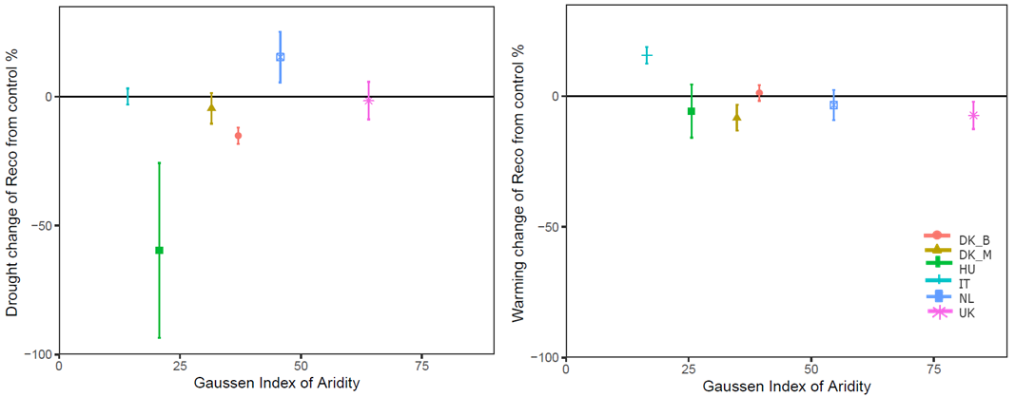
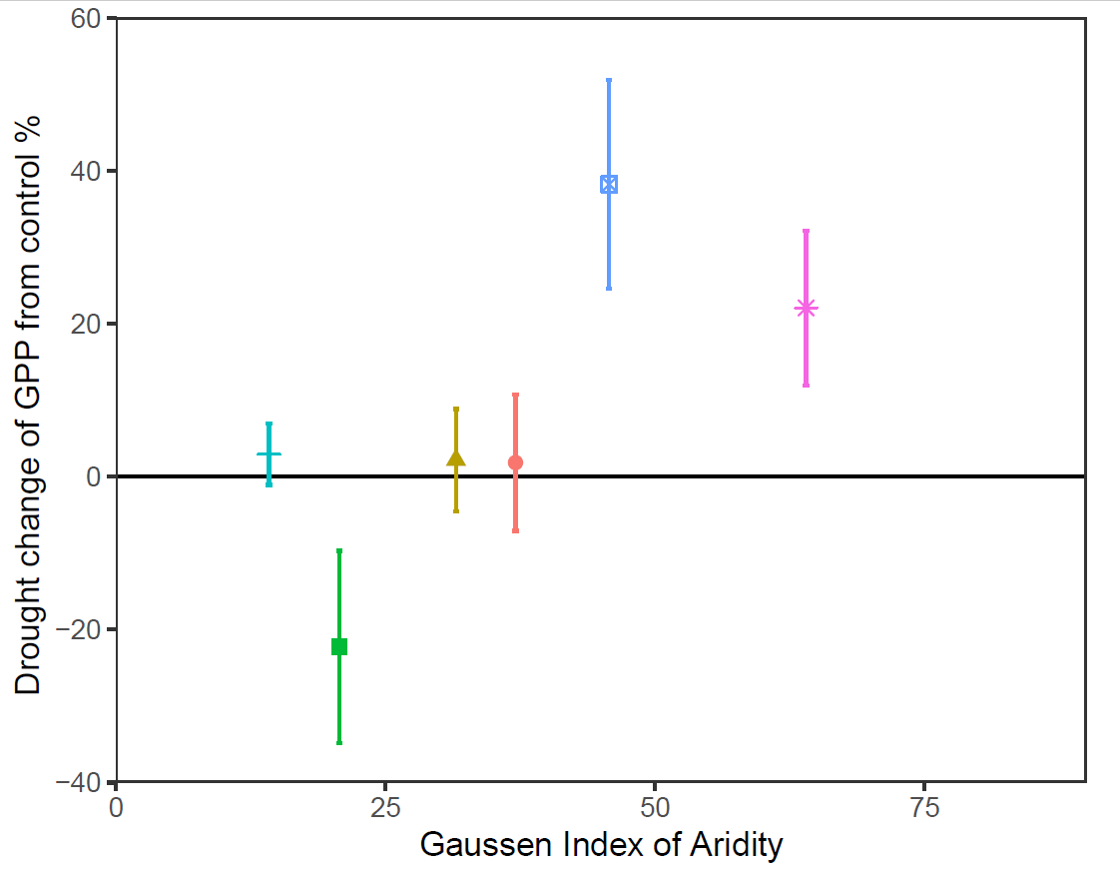
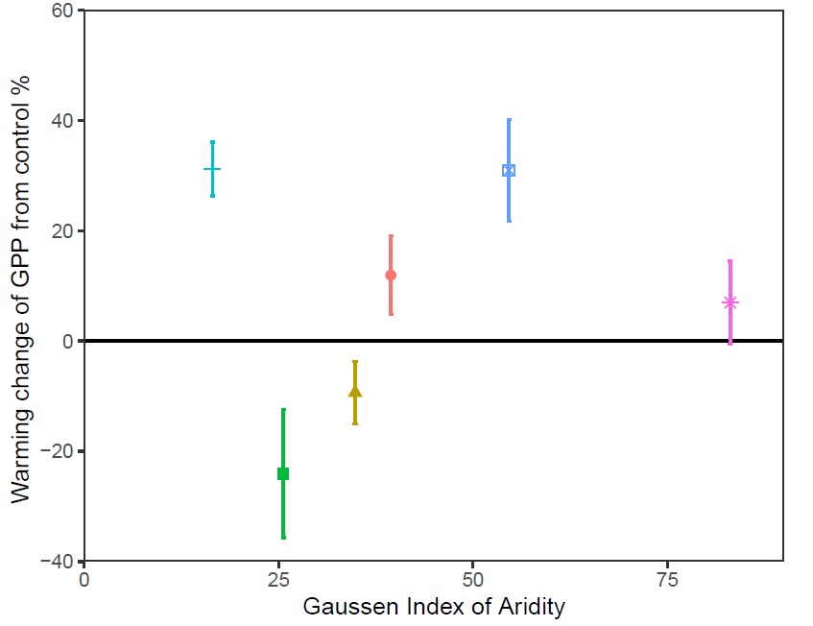
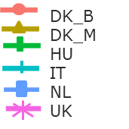
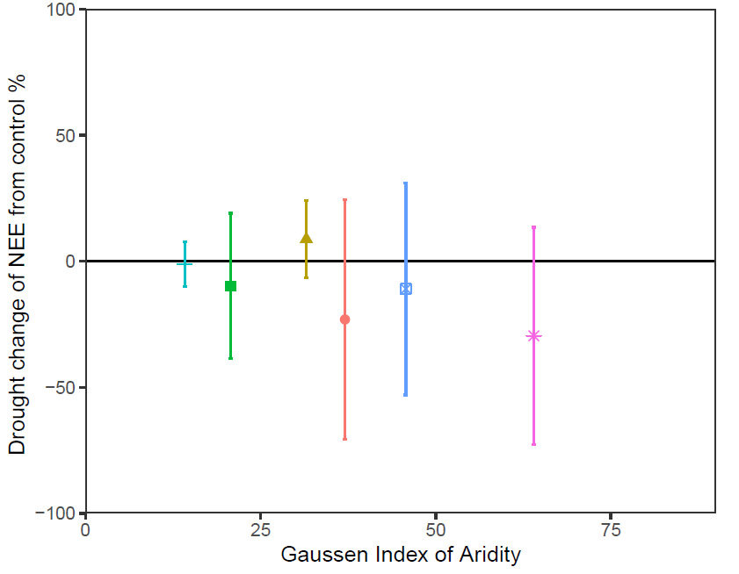
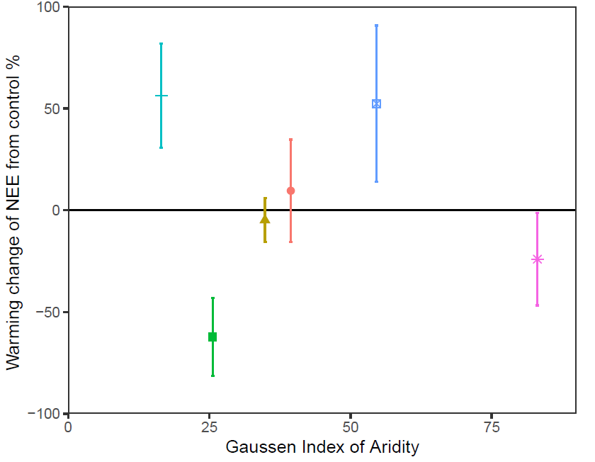
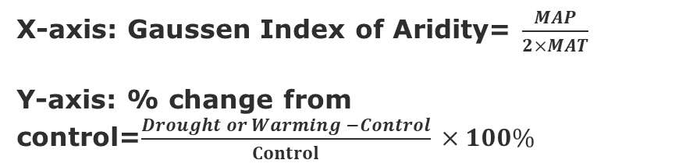
Drought
Warming
X-axis: Gaussen Index of Aridity= $\frac{MAP}{2×MAT}$
Y-axis: % change from control=$\frac{Drought or Warming −Control}{Control}$ $×100\%$
Drought
Warming
Reco
Drought
Warming
GPP
Site range: IT, HU, DK_M, DK_B, NL, UK
NEE

Slide 5


high
a)
b) IT & UK
Conceptual framework
DK_B
DK_M
GPP – CO₂ uptake
Effects of soil moisture (dark grey) and warming (light grey) on gross primary production (GPP) and ecosystem respiration (Reco)
HU
NL
IT
low
low
high
low
high
high
c)
d) IT
e) UK
Warming induced stagnation of Reco at DK_B, DK_M, HU, NL sites
Warming induced increase of Reco
Warming induced slightly decrease of Reco
Reco – ecosystem C loss
IT
UK
DK-B
DK-M
NL
HU
low
low
Soil moisture content
high
low
Soil moisture content
high
low
Soil moisture content
high
PhD fellow: Qiaoyan Li E-mail:qli@ign.ku.dk

Slide 6
Take home message
Reco is more sensitive to drought than warming, while NEE is relatively more sensitive to warming than drought.
The site-specific variations like plant species, soil texture and nutrient conditions are deeply coupled with drought and warming, which leading to the prolonged different influences on the ecosystem carbon balances.
Compare to our previous Rs results, we could infer that plant dominated the ecosystem-related fluxes and has more complicated responses to climate change.
PhD fellow: Qiaoyan Li E-mail:qli@ign.ku.dk

Slide 7
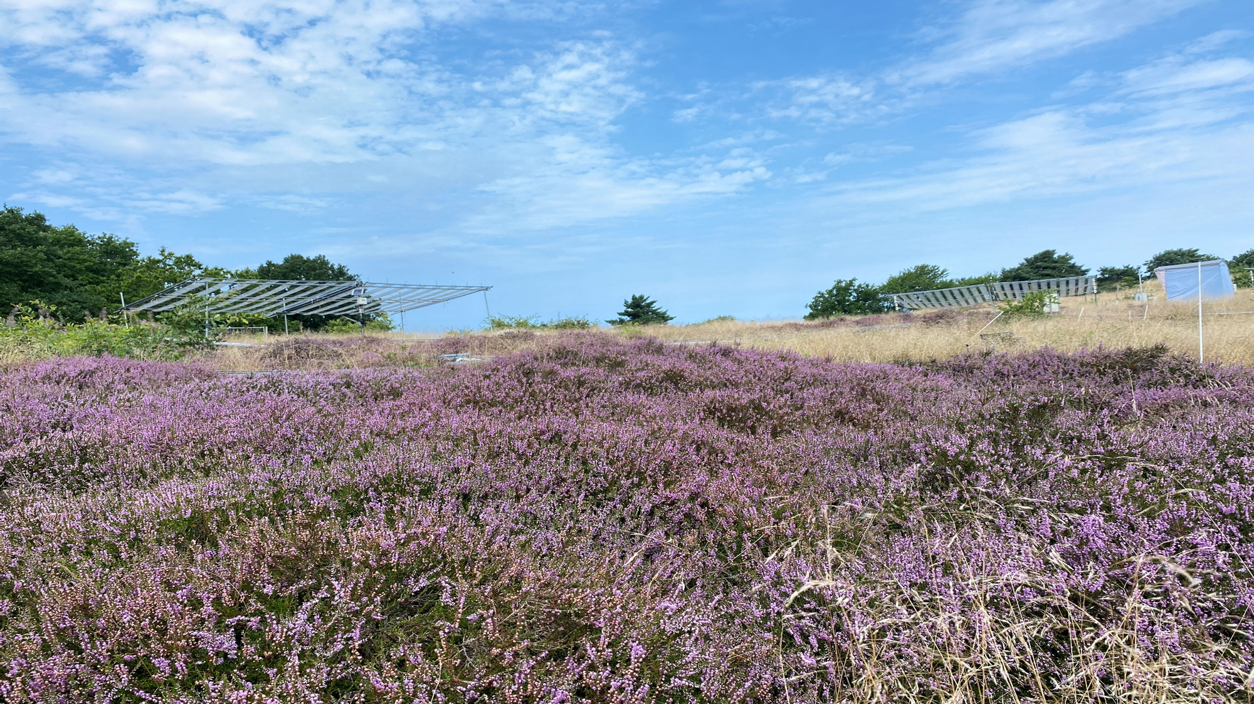


Scan & give more feedback
(OSPP)
Thanks!
Contact me if you are interested in more details:
E-mail:qli@ign.ku.dk

