Slide 1




Experimental measurement of P-wave velocities across the α→β quartz at lower continental crust pressure and temperature conditions
Arefeh Moarefvand¹, Julien Gasc¹, Damien Deldicque ¹, Loic Labrousse², Alexandre Schubnel¹
1) Laboratoire de Géologie, Ecole Normale Supérieure, PSL Resarch University, Paris France
2) ISTEP, Sorbonne Université, Paris France

Slide 2
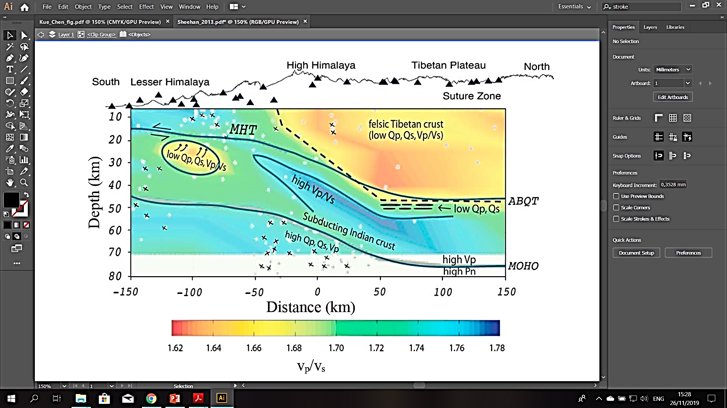

Introduction | Methods | Results | Discussion | Conclusions
α→β Transition quartz : Geophysical thermometer
Temperature(°C)
Modified from [Kuo-Chen et al. (2012)]
[Sheehan et al. (2013)]
Quartz α - β transition from $V_{p}/V_{s}$ imaging could be a powerful indicator for temperature conditions in the crust. That is the main reason for what we realized an experimental research to understand better this transition.

Slide 3
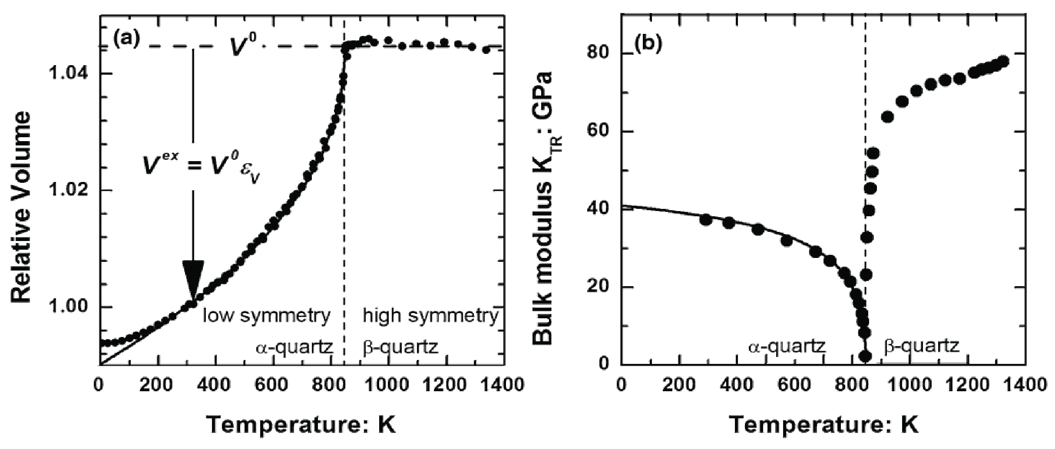

Introduction | Methods | Results | Discussion | Conclusions
Quartz α→β transition is a displacive phase transition by reorientation of tetrahedral α -phase, to the hexagonal β-phase, which has greater crystal symmetry.
The α → β phase transition in quartz drastically modifies the physical properties of quartz-bearing rocks.

Slide 4
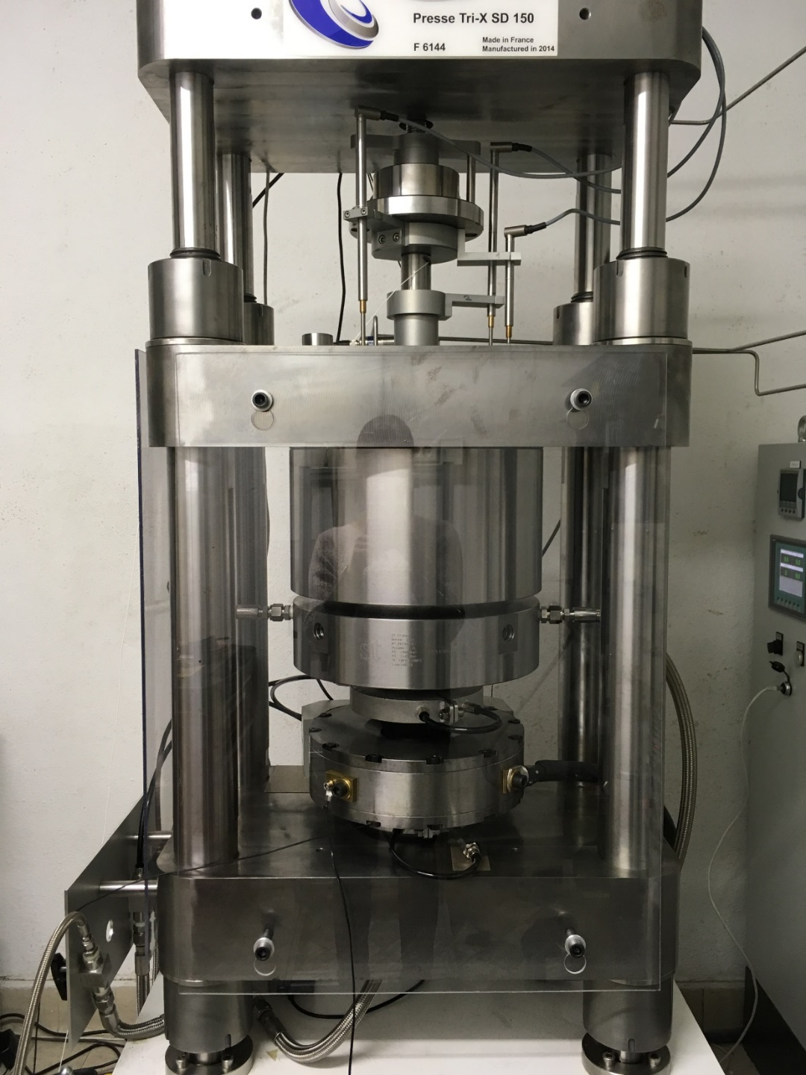
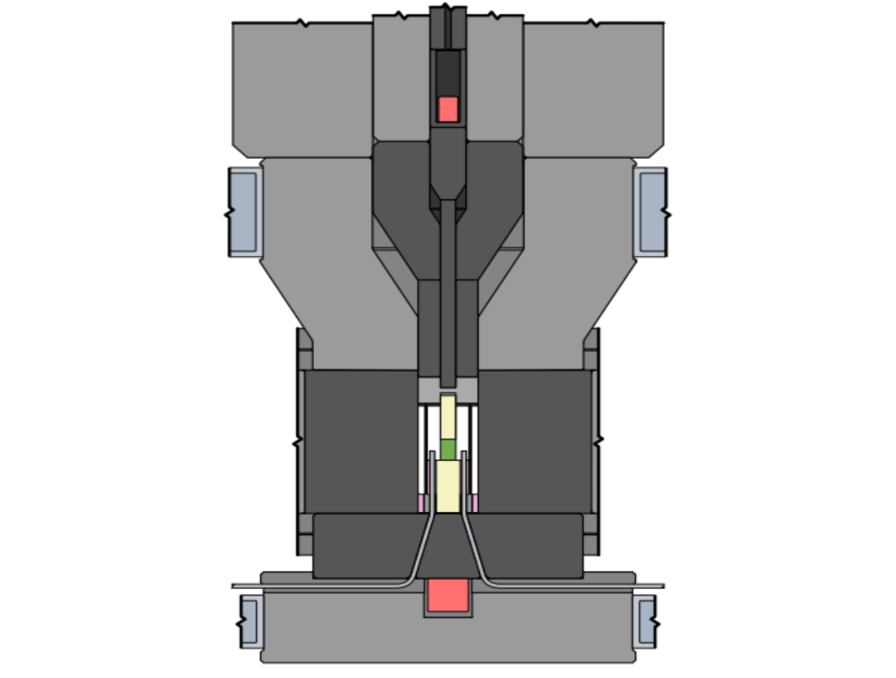
Our apparatus :
Introduction | Methods | Results | Discussion | Conclusions
Top
ultrasonic
transducer
Deformation
piston
Confining
piston
Sample
Assembly
Bottom
ultrasonic
transducer
Griggs apparatus at ENS witch is equipped by 2 ultrasonic transducers (shown in red).
With this apparatus we can go up to 5 GPa and 1000 °C which allows us to carry out experiments under realistic subduction zone conditions.
Notes:
Une photo

Slide 5
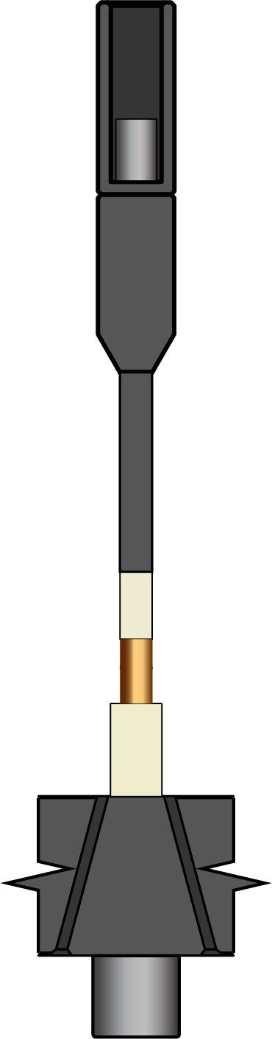
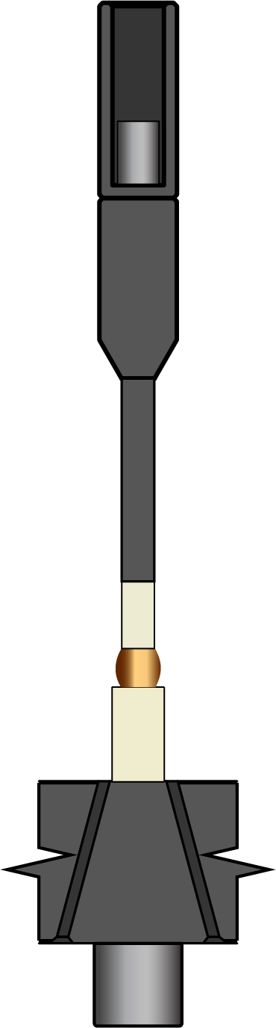

Our apparatus :
Introduction | Methods | Results | Discussion | Conclusions
Top
ultrasonic
transducer
Deformation
piston
Confining
piston
Sample
Assembly
Bottom
ultrasonic
transducer
Griggs apparatus at ENS witch is equipped by 2 ultrasonic transducers (shown in red).
With this apparatus we can go up to 5 GPa and 1000 °C which allows us to carry out experiments under realistic subduction zone conditions.
Notes:
Une photo

Slide 6


Our apparatus :
Introduction | Methods | Results | Discussion | Conclusions
Top
ultrasonic
transducer
Deformation
piston
Confining
piston
Sample
Assembly
$$∆t$$
Bottom
ultrasonic
transducer
$$∆L$$
Griggs apparatus at ENS witch is equipped by 2 ultrasonic transducers (shown in red).
With this apparatus we can go up to 5 GPa and 1000 °C which allows us to carry out experiments under realistic subduction zone conditions.
Notes:
Une photo

Slide 7
Our apparatus :
Introduction | Methods | Results | Discussion | Conclusions
Top
ultrasonic
transducer
Deformation
piston
Confining
piston
Sample
Assembly
$$∆t$$
Bottom
ultrasonic
transducer
$$∆L$$
Griggs apparatus at ENS witch is equipped by 2 ultrasonic transducers (shown in red).
With this apparatus we can go up to 5 GPa and 1000 °C which allows us to carry out experiments under realistic subduction zone conditions.
[Moarefvand et al. (2021)]
Notes:
Une photo

Slide 8
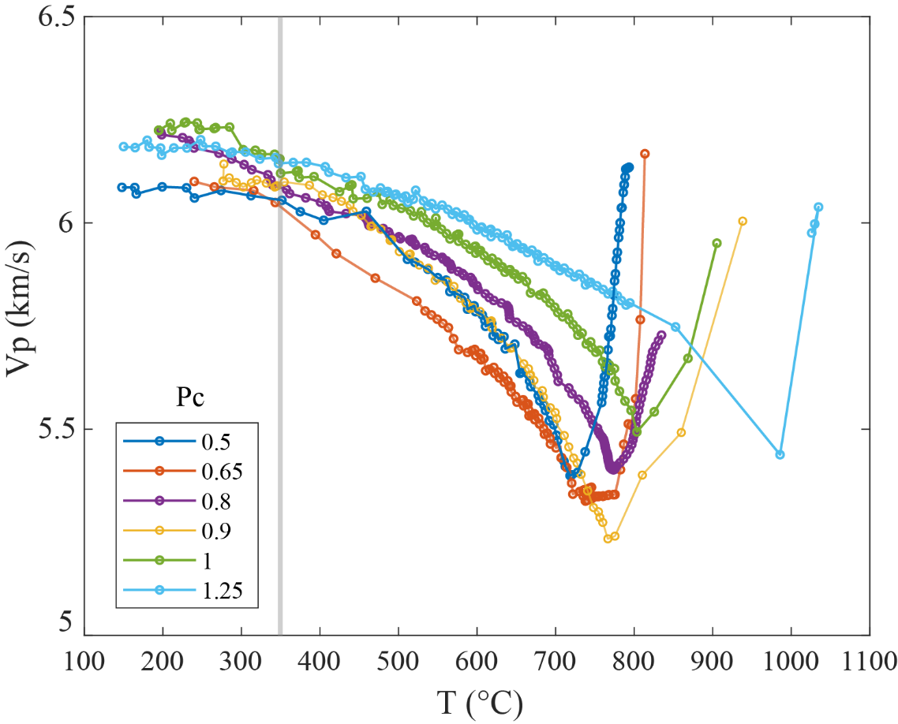
Introduction | Methods | Experiments | Results | Conclusions
Active acoustic monitoring measurements:
Notes:
Une photo

Slide 9
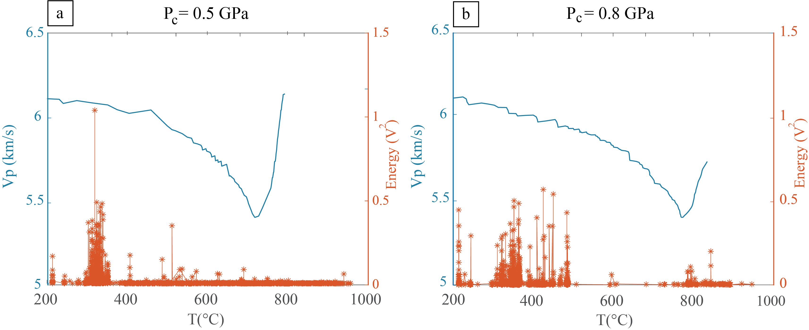
AE recording measurements:
Introduction | Methods | Results | Discussion | Conclusions
Notes:
Une photo

Slide 10
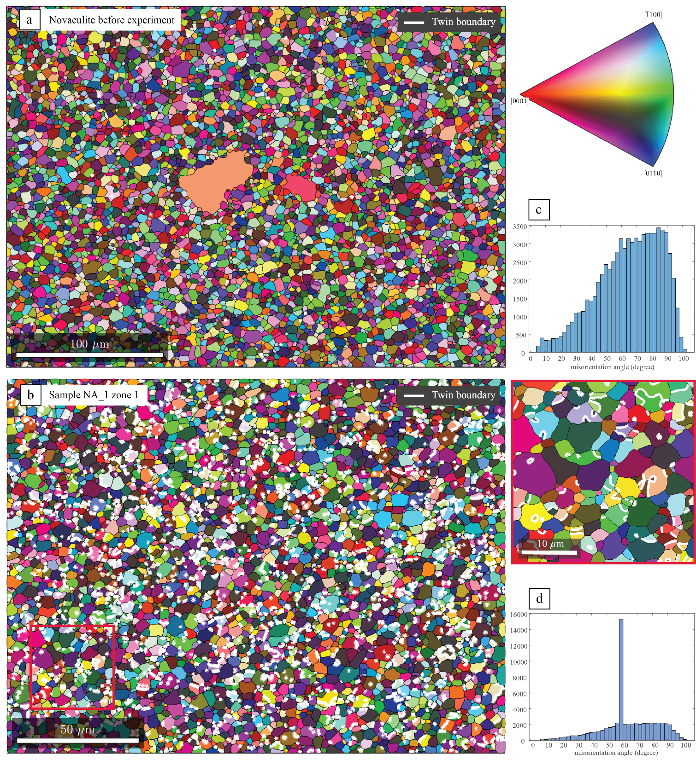
Introduction | Methods | Results | Discussion | Conclusions
Microstructural evidences of the transition:
Notes:
Une photo

Slide 11
Introduction | Methods | Results | Discussion | Conclusions
Microstructural evidences of the transition:
Notes:
Une photo

Slide 12
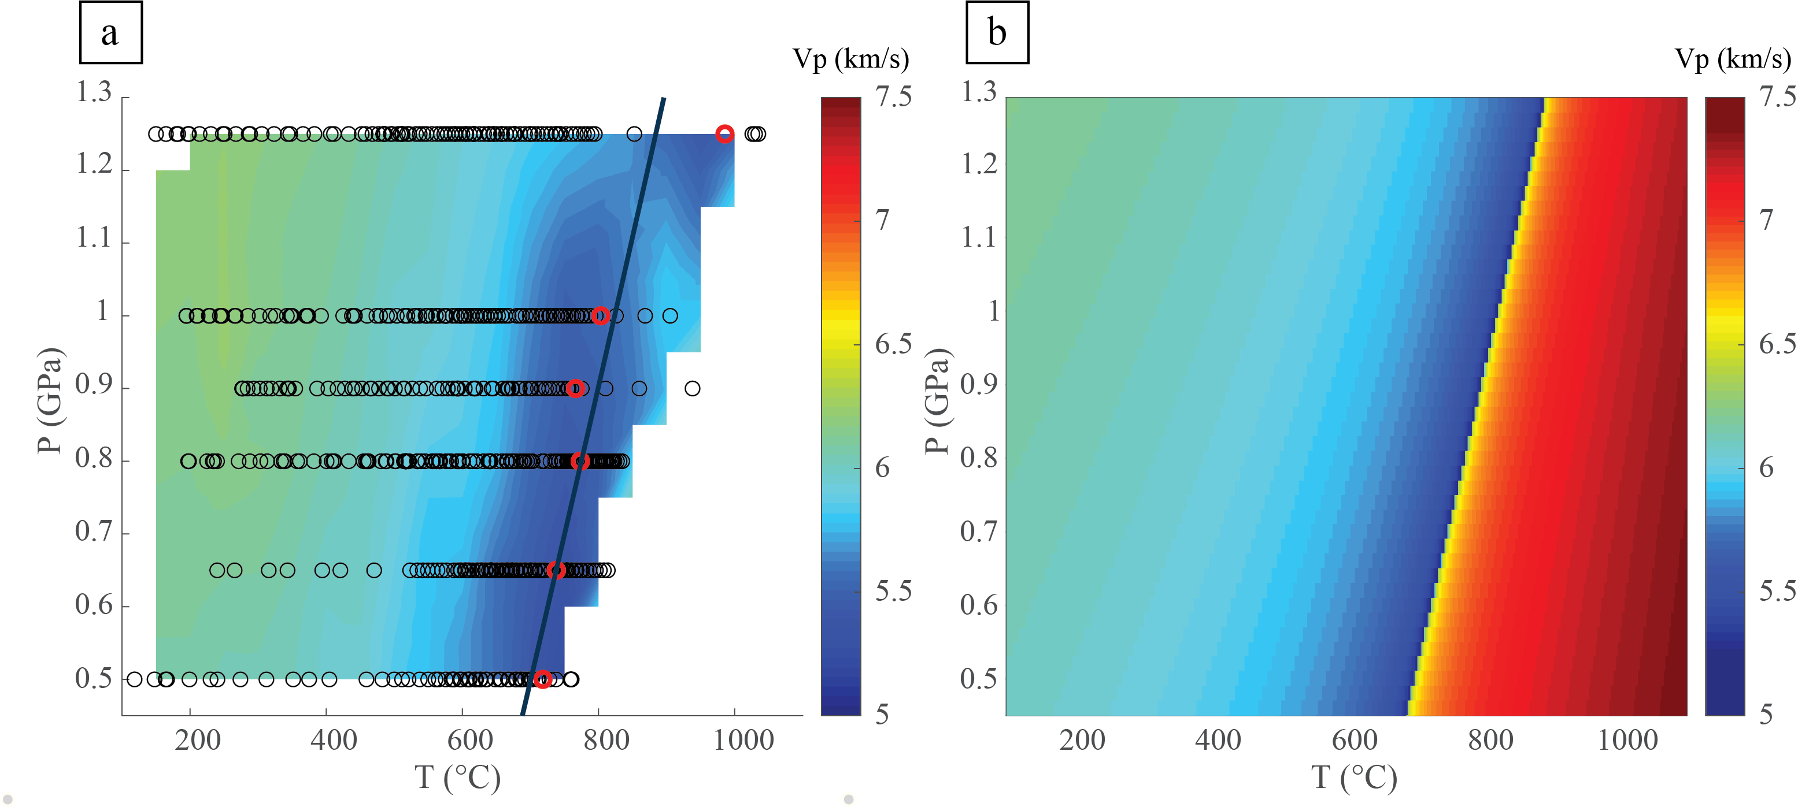
Introduction | Methods | Results | Discussion | Conclusions
Comparison with previous experimental data and thermodynamic databases :
Notes:
Une photo

Slide 13
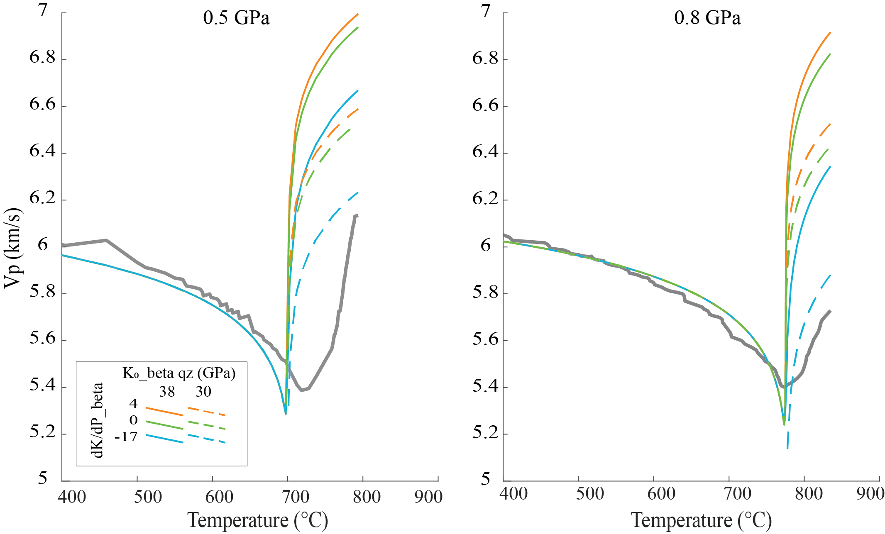
Introduction | Methods | Results | Discussion | Conclusions
Comparison with previous experimental data and thermodynamic databases :
Notes:
Une photo

Slide 14
Introduction | Methods | Results | Discussion | Conclusions
We observed a minimum in P-wave velocity at temperatures compatible with the predicted P-T conditions at which the transition should occur.
Acoustic emission monitoring reveals that there is no (dynamic) microcracking related to the transition, at least within the microcrystalline aggregate.
The velocities obtained in the β field reveal that the bulk modulus of β quartz and its pressure derivative remain largely unconstrained, and suggest that both Ko and K’ are smaller than predicted by typical thermodynamic databases.
Our results implies a refinement of the interpretation of seismic discontinuities in terms of the ’seismic signature’ of the α → β transition.
Notes:
Une photo

