Slide 1
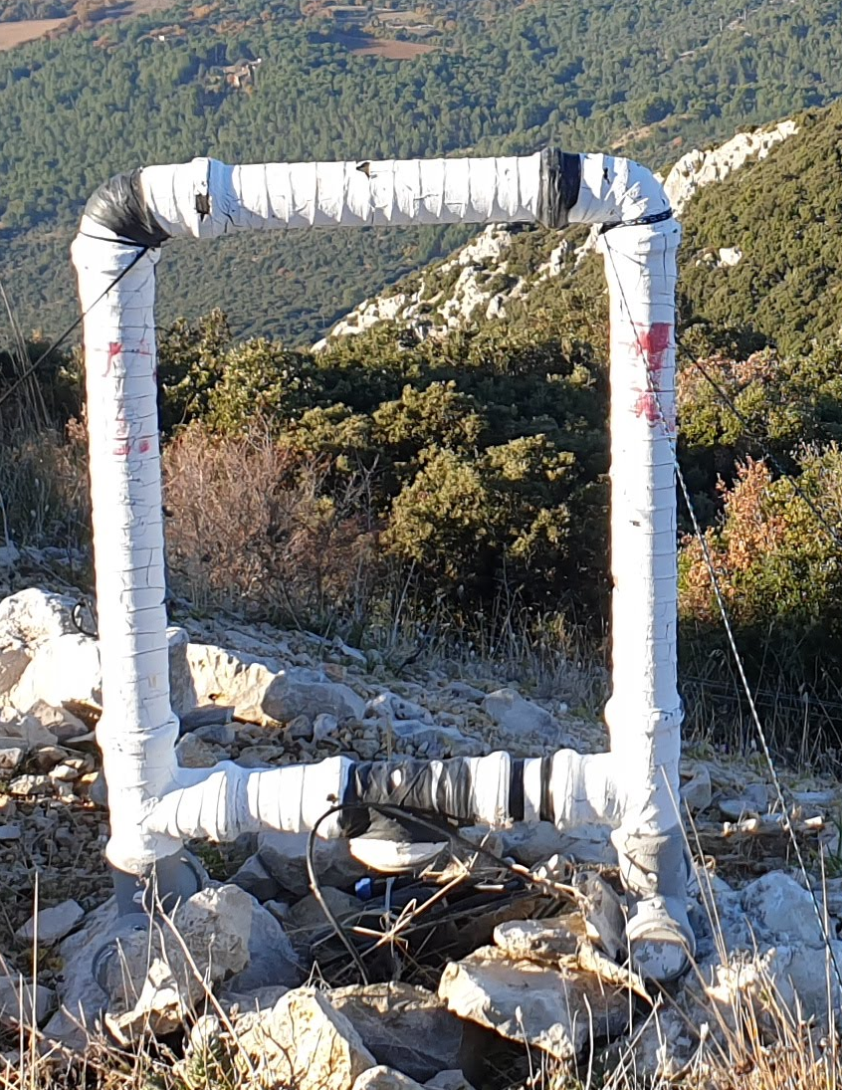




EGU22-3752
Characteristics of pulse trains observed during the initial stage of high peak current winter flashes
I . Kolmašová(1,2), O. Santolík(1,2), S. Pedeboy(3), A. Kolínská(2,1), S. Amrich (2,1), R. Lán(1), and L. Uhlíř(1)
(1) Department of Space Physics, Institute of Atmospheric Physics of the Czech Academy of Sciences, Prague, Czechia
(2) Faculty of Mathematics and Physics, Charles University, Prague, Czechia
(3) Météorage, Pau, France

Slide 2
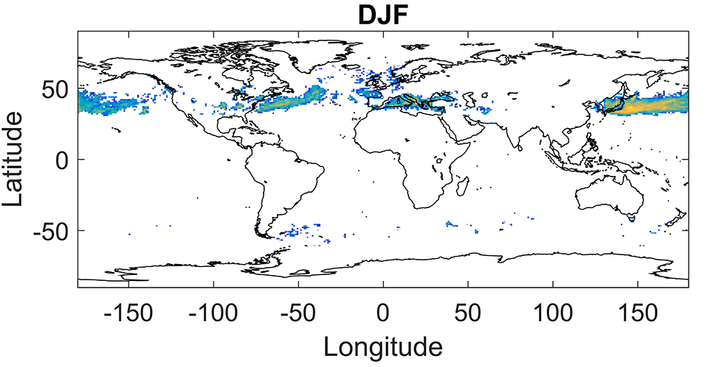
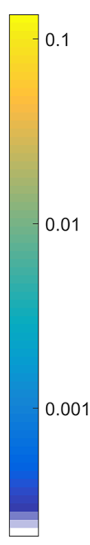
Motivation
global lightning activity associated with winter thunderstorms is relatively low compared to summer thunderstorms
winter storms can produce very energetic lightning events
during the winter, the most active regions of the northern hemisphere are Japan, Mediterranean and the USA
meteorological scenario for winter lightning: cold air spread over warmer lake, ocean or sea water
Wu et al., 2013,
Wang et al., 2018
Brook, 1992
This study:
analysis of electromagnetic signatures of lightning initiation of strong winter (>100 kA) lightning produced in the Mediterrainean region
Montanya et al., 2016, Williams, 2018
Notes:
Warm sea in Japan is oveblown by Siberian winds, Great lakes are overblown with arctic air from Canada and over warm Mediterreanean Sea run cold european air masses from atlantic ocean
In Europe, the prevailing Icelandic low and the Azores high pressure systems can produce intense low-pressure systems
developing over the warm Gulf Stream, cold unstable arctic air masses transported from the Atlantic ocean often stagnate in the area of the Mediterranean Sea, forming Genoa lows with a high number of fall/winter thunderstorms.
Lightning Activity in Winter Storms: A Meteorological and Cloud Microphysical Perspective E. Williams
Figure 4. Seasonal variation of the winter lightning stroke density distribution for the period of 2009–2013. The values are calculated as the
average number of strokes for the 5 years in each grid cell divided by the area of the cell.
Wang LMA v Japonsku The results show that compared to summer thunderstorm, winter thunderstorm can exhibit extremely complicated charge structures.
the vertical distance between the two charge layers in opposite polarity is usually small, around 1 or 2km. Dipole and tripole structures of both positive and negative polarities have all been observed

Slide 3
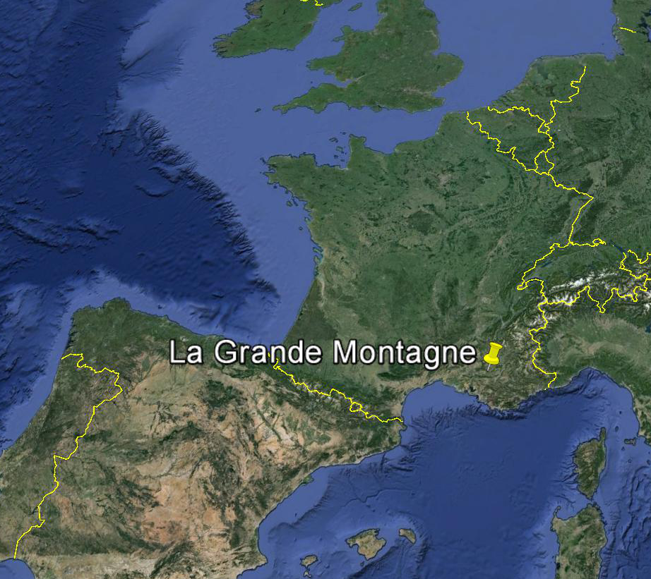
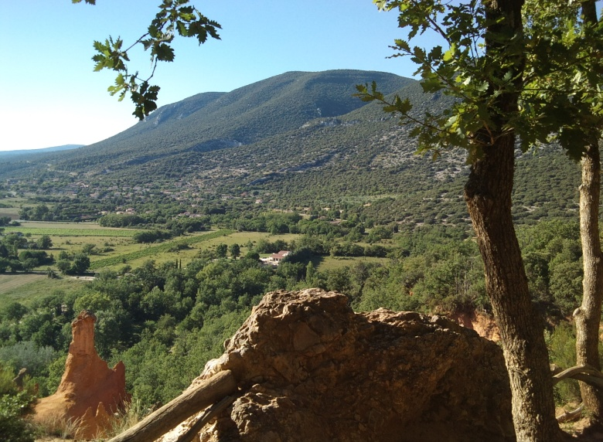
Receiving site
La Grande Montagne (1028 m, 43.9410N, 5.4836E), Plateau d'Albion, France – external measurement site of the Laboratoire souterrain a bas bruit (LSBB), Rustrel, France
France
Spain

Slide 4
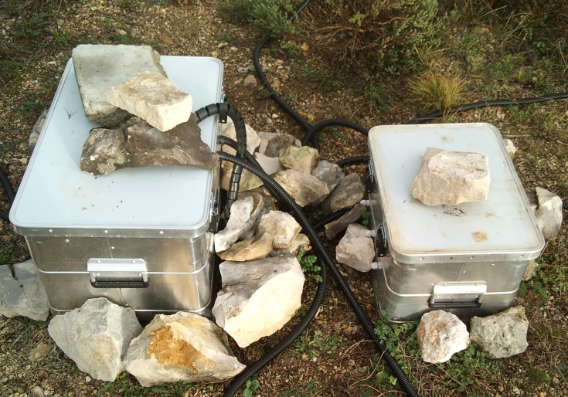
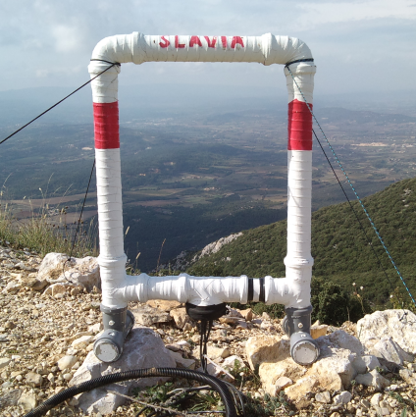
Instrumentation
Power supply
220V
Battery
oscilloscope
Data logger
5 kHz - 90 MHz
Ethernet
oscilloscope
4
5 kHz - 90 MHz
GPS
3 – component VLF measurement, electric field mill

Slide 5
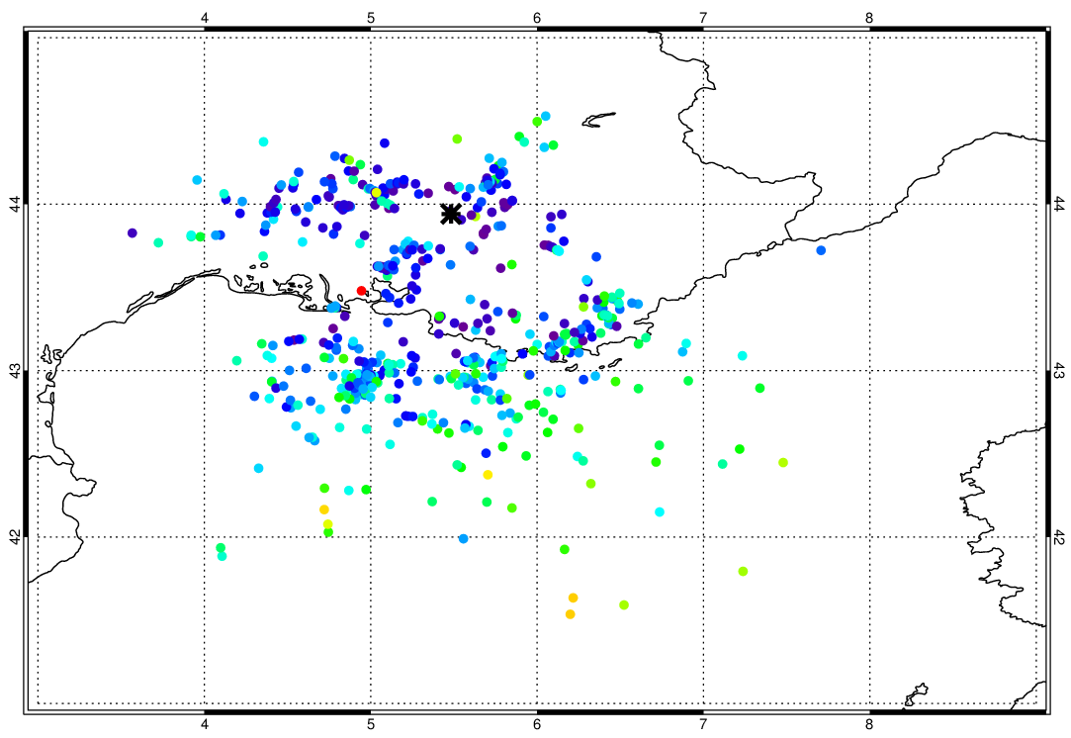
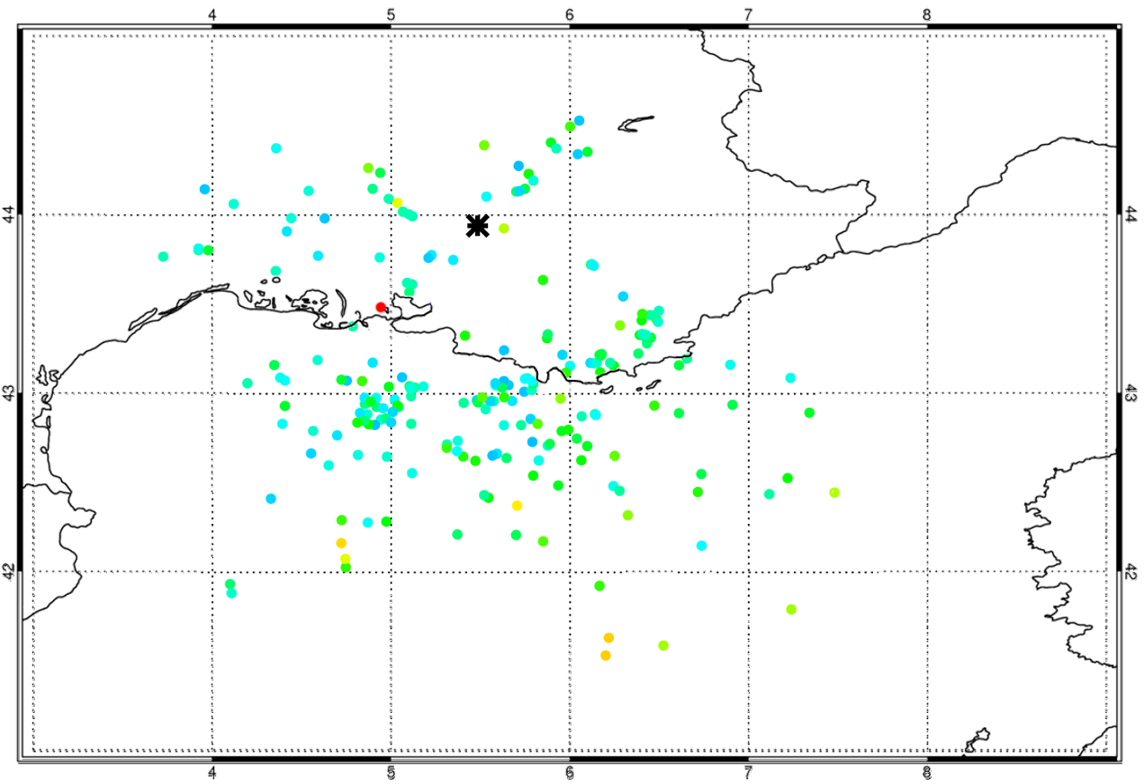
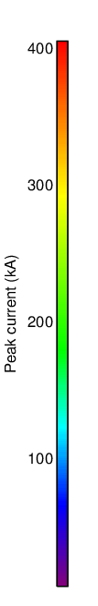
Distribution of RS peak currents
France
LSBB
Italy
Mediterranean Sea
Subset of strong lightning discharges with recognisable initial breakdown phase (both polarities)
All detected lightning discharges with recognisable initial breakdown phase (both polarities)

Slide 6
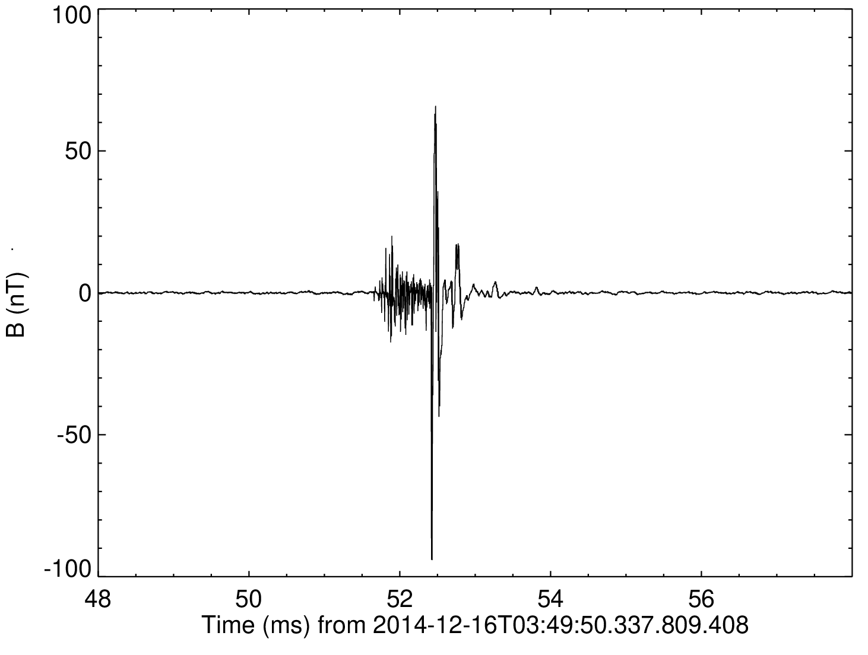
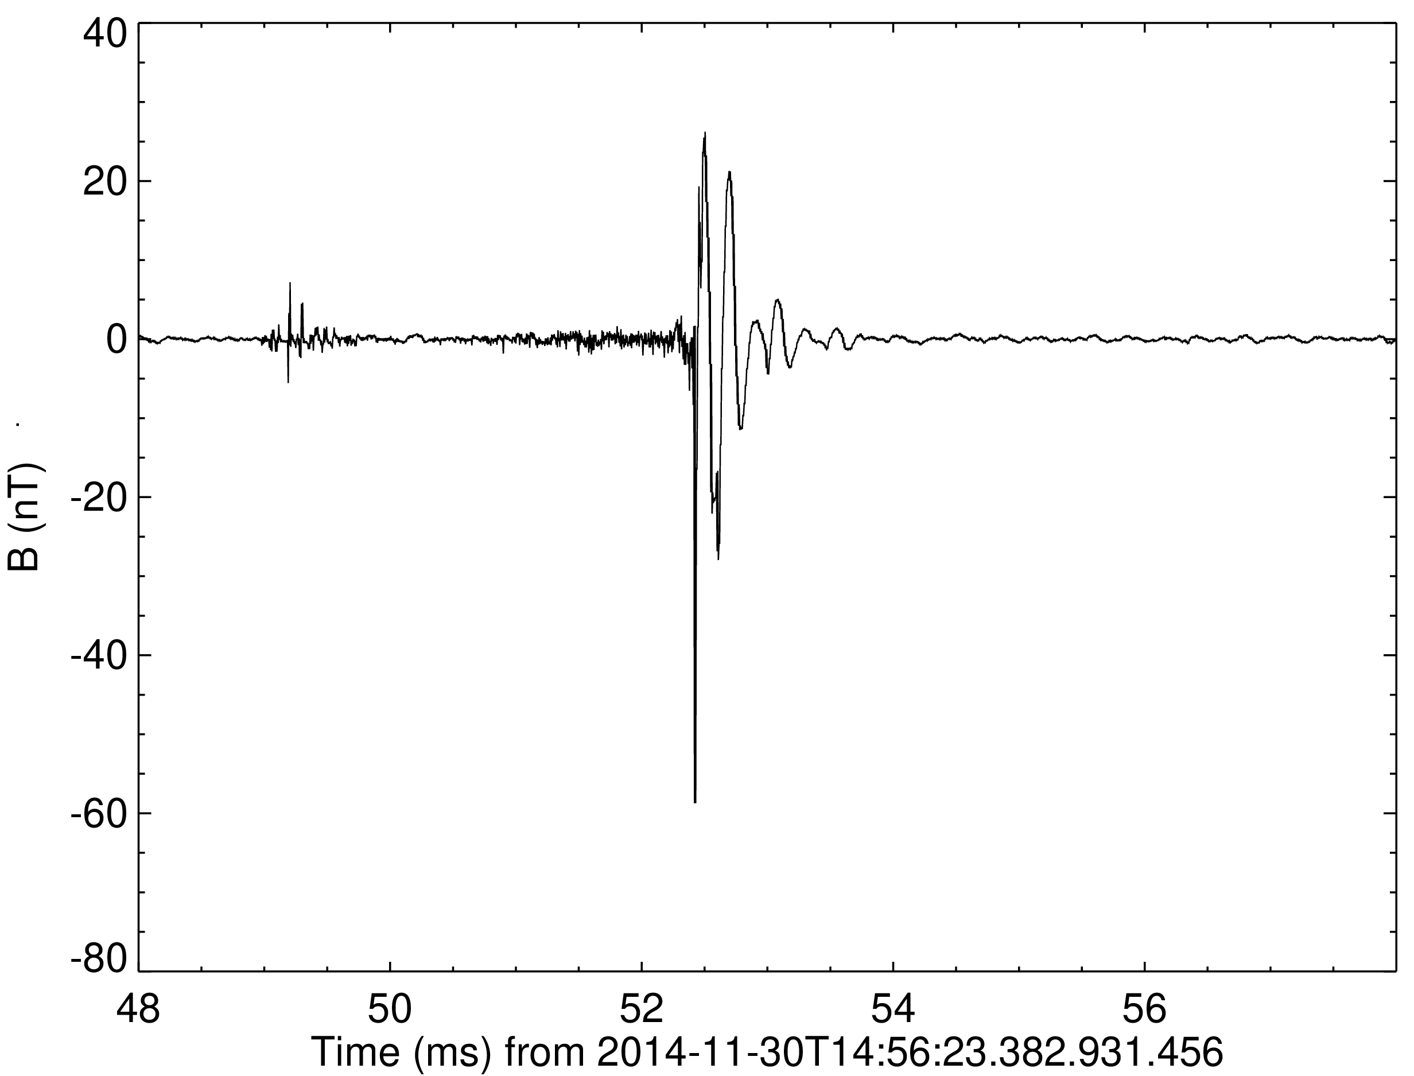
Data set
0.57 ms
We analyzed broadband magnetic-field measurements recorded in the West Mediterranean region in winter 2014/2015.
By combining our data with information provided by the French national lightning locating system MÉTÉORAGE, we selected 193 waveform captures, which contained return stroke (RS) pulses emitted by negative CG discharges with peak currents exceeding 100 kA.
The frequency band of our instrumentation (5 kHz-90 MHz) allowed us to investigate fine details of recorded waveforms.
We focused on the properties of trains of preliminary (initial) breakdown pulses preceding RS pulses.
-168 kA
3.4 ms
-193 kA

Slide 7
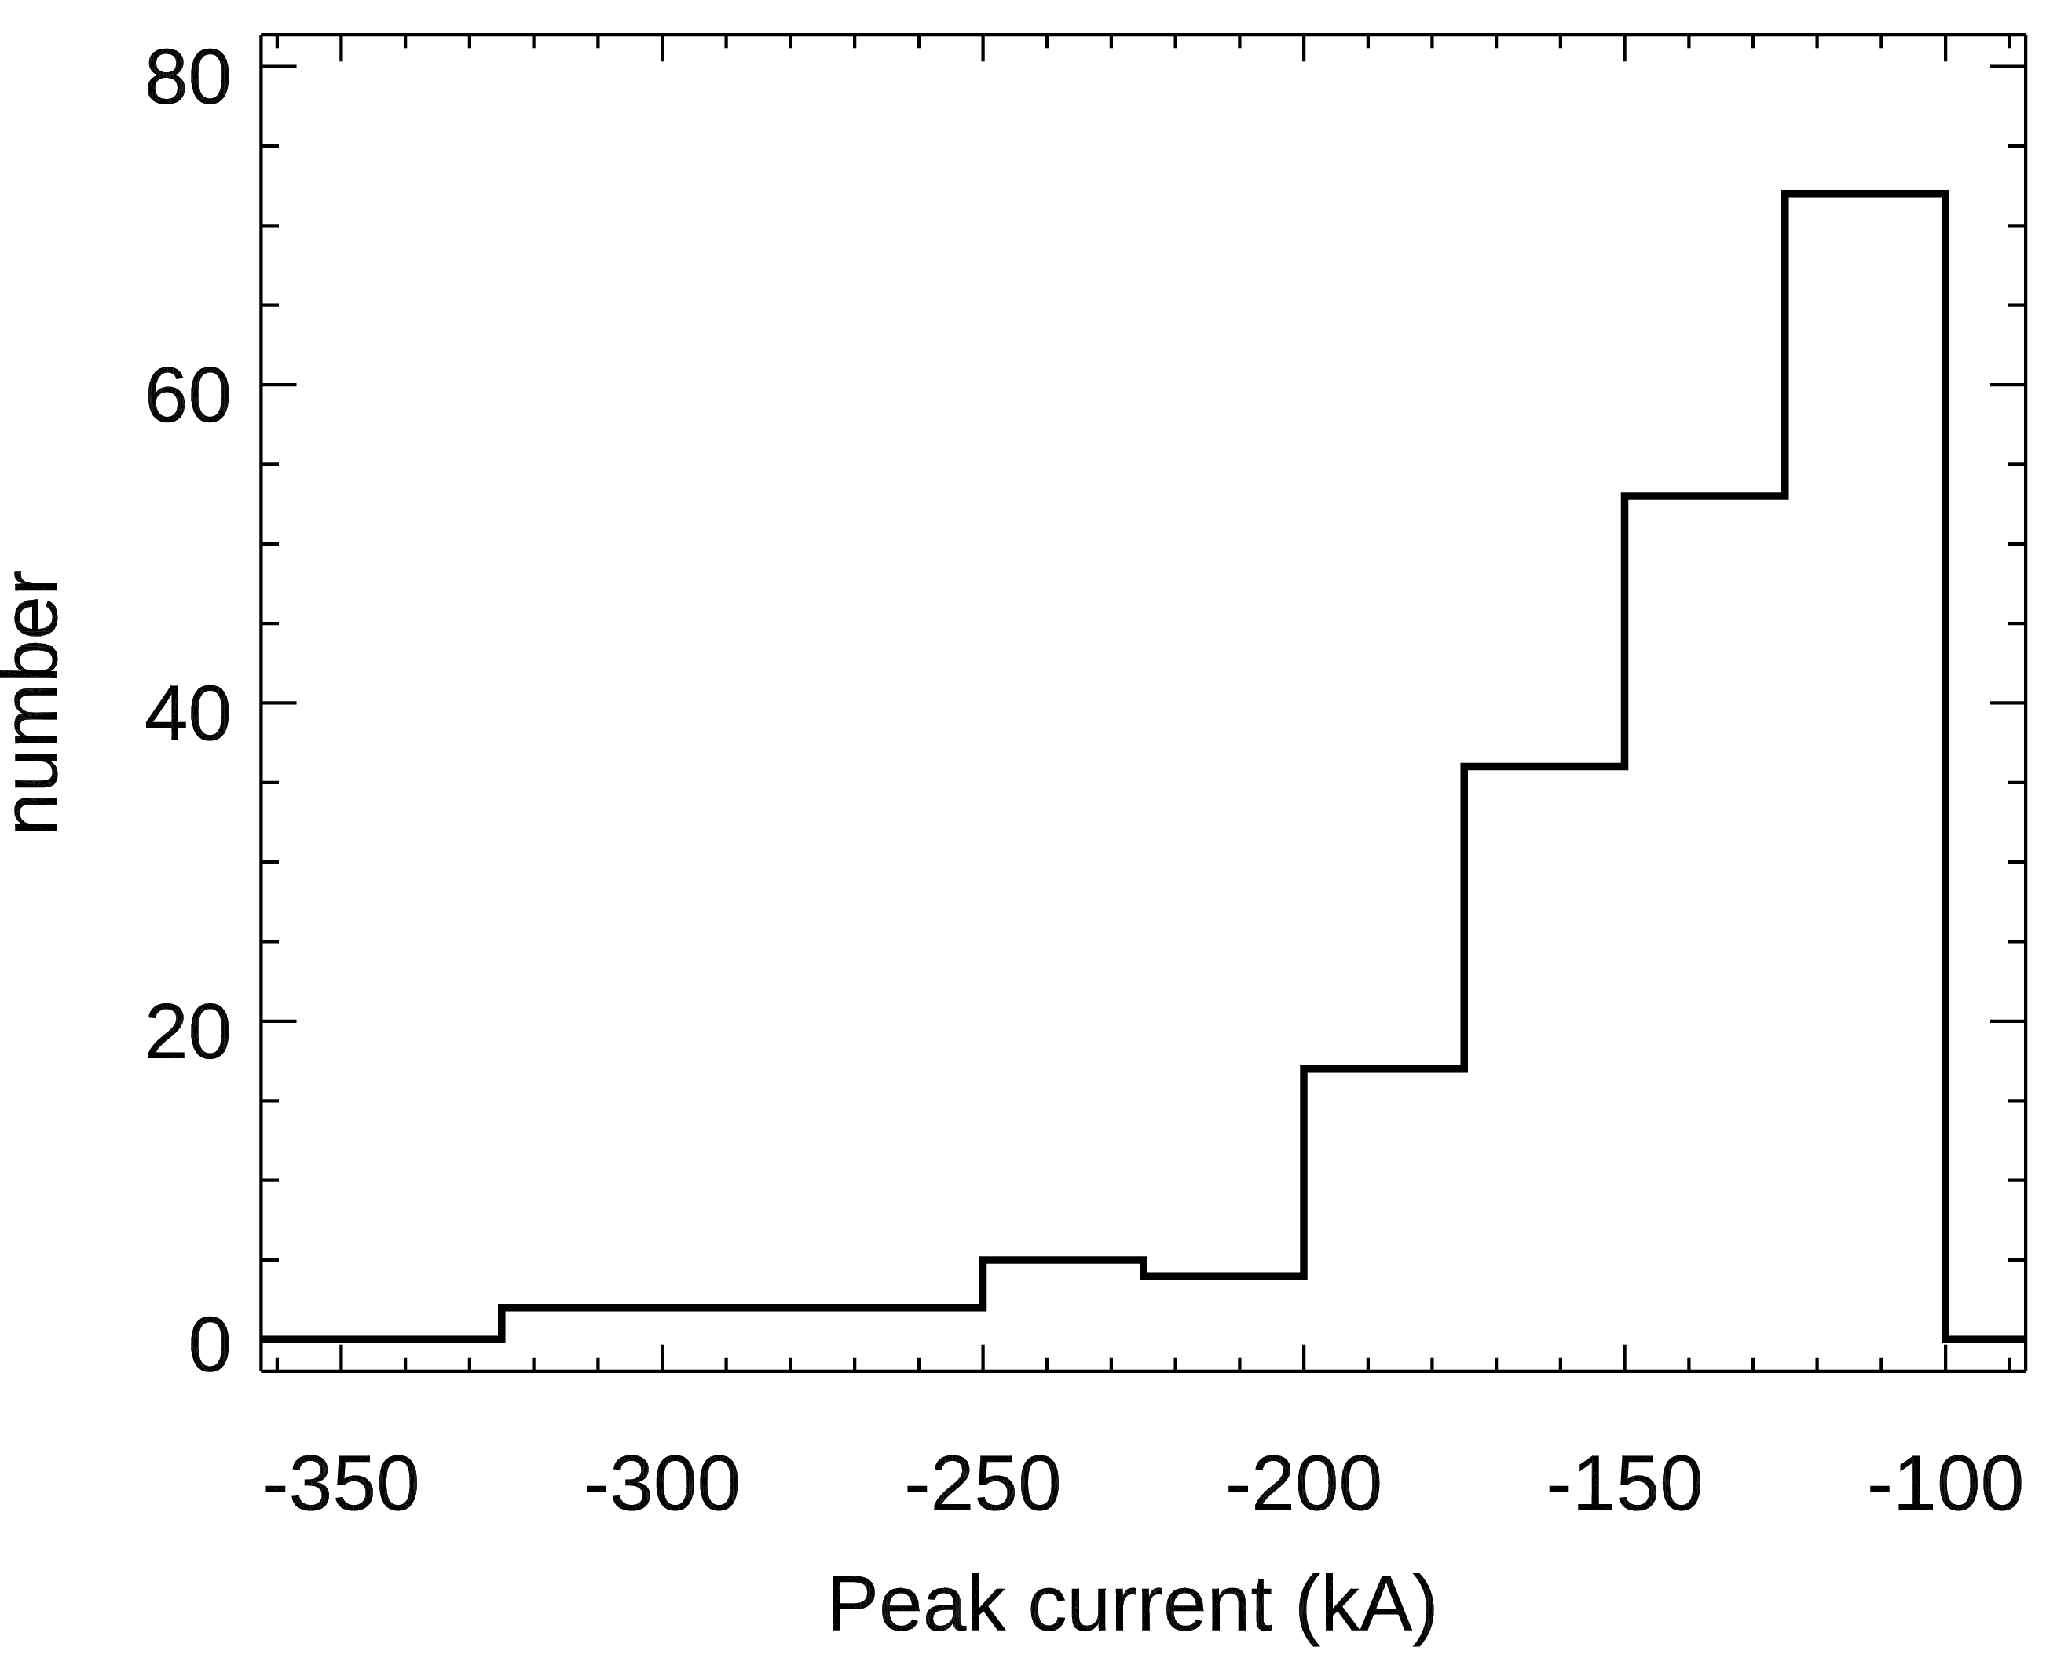
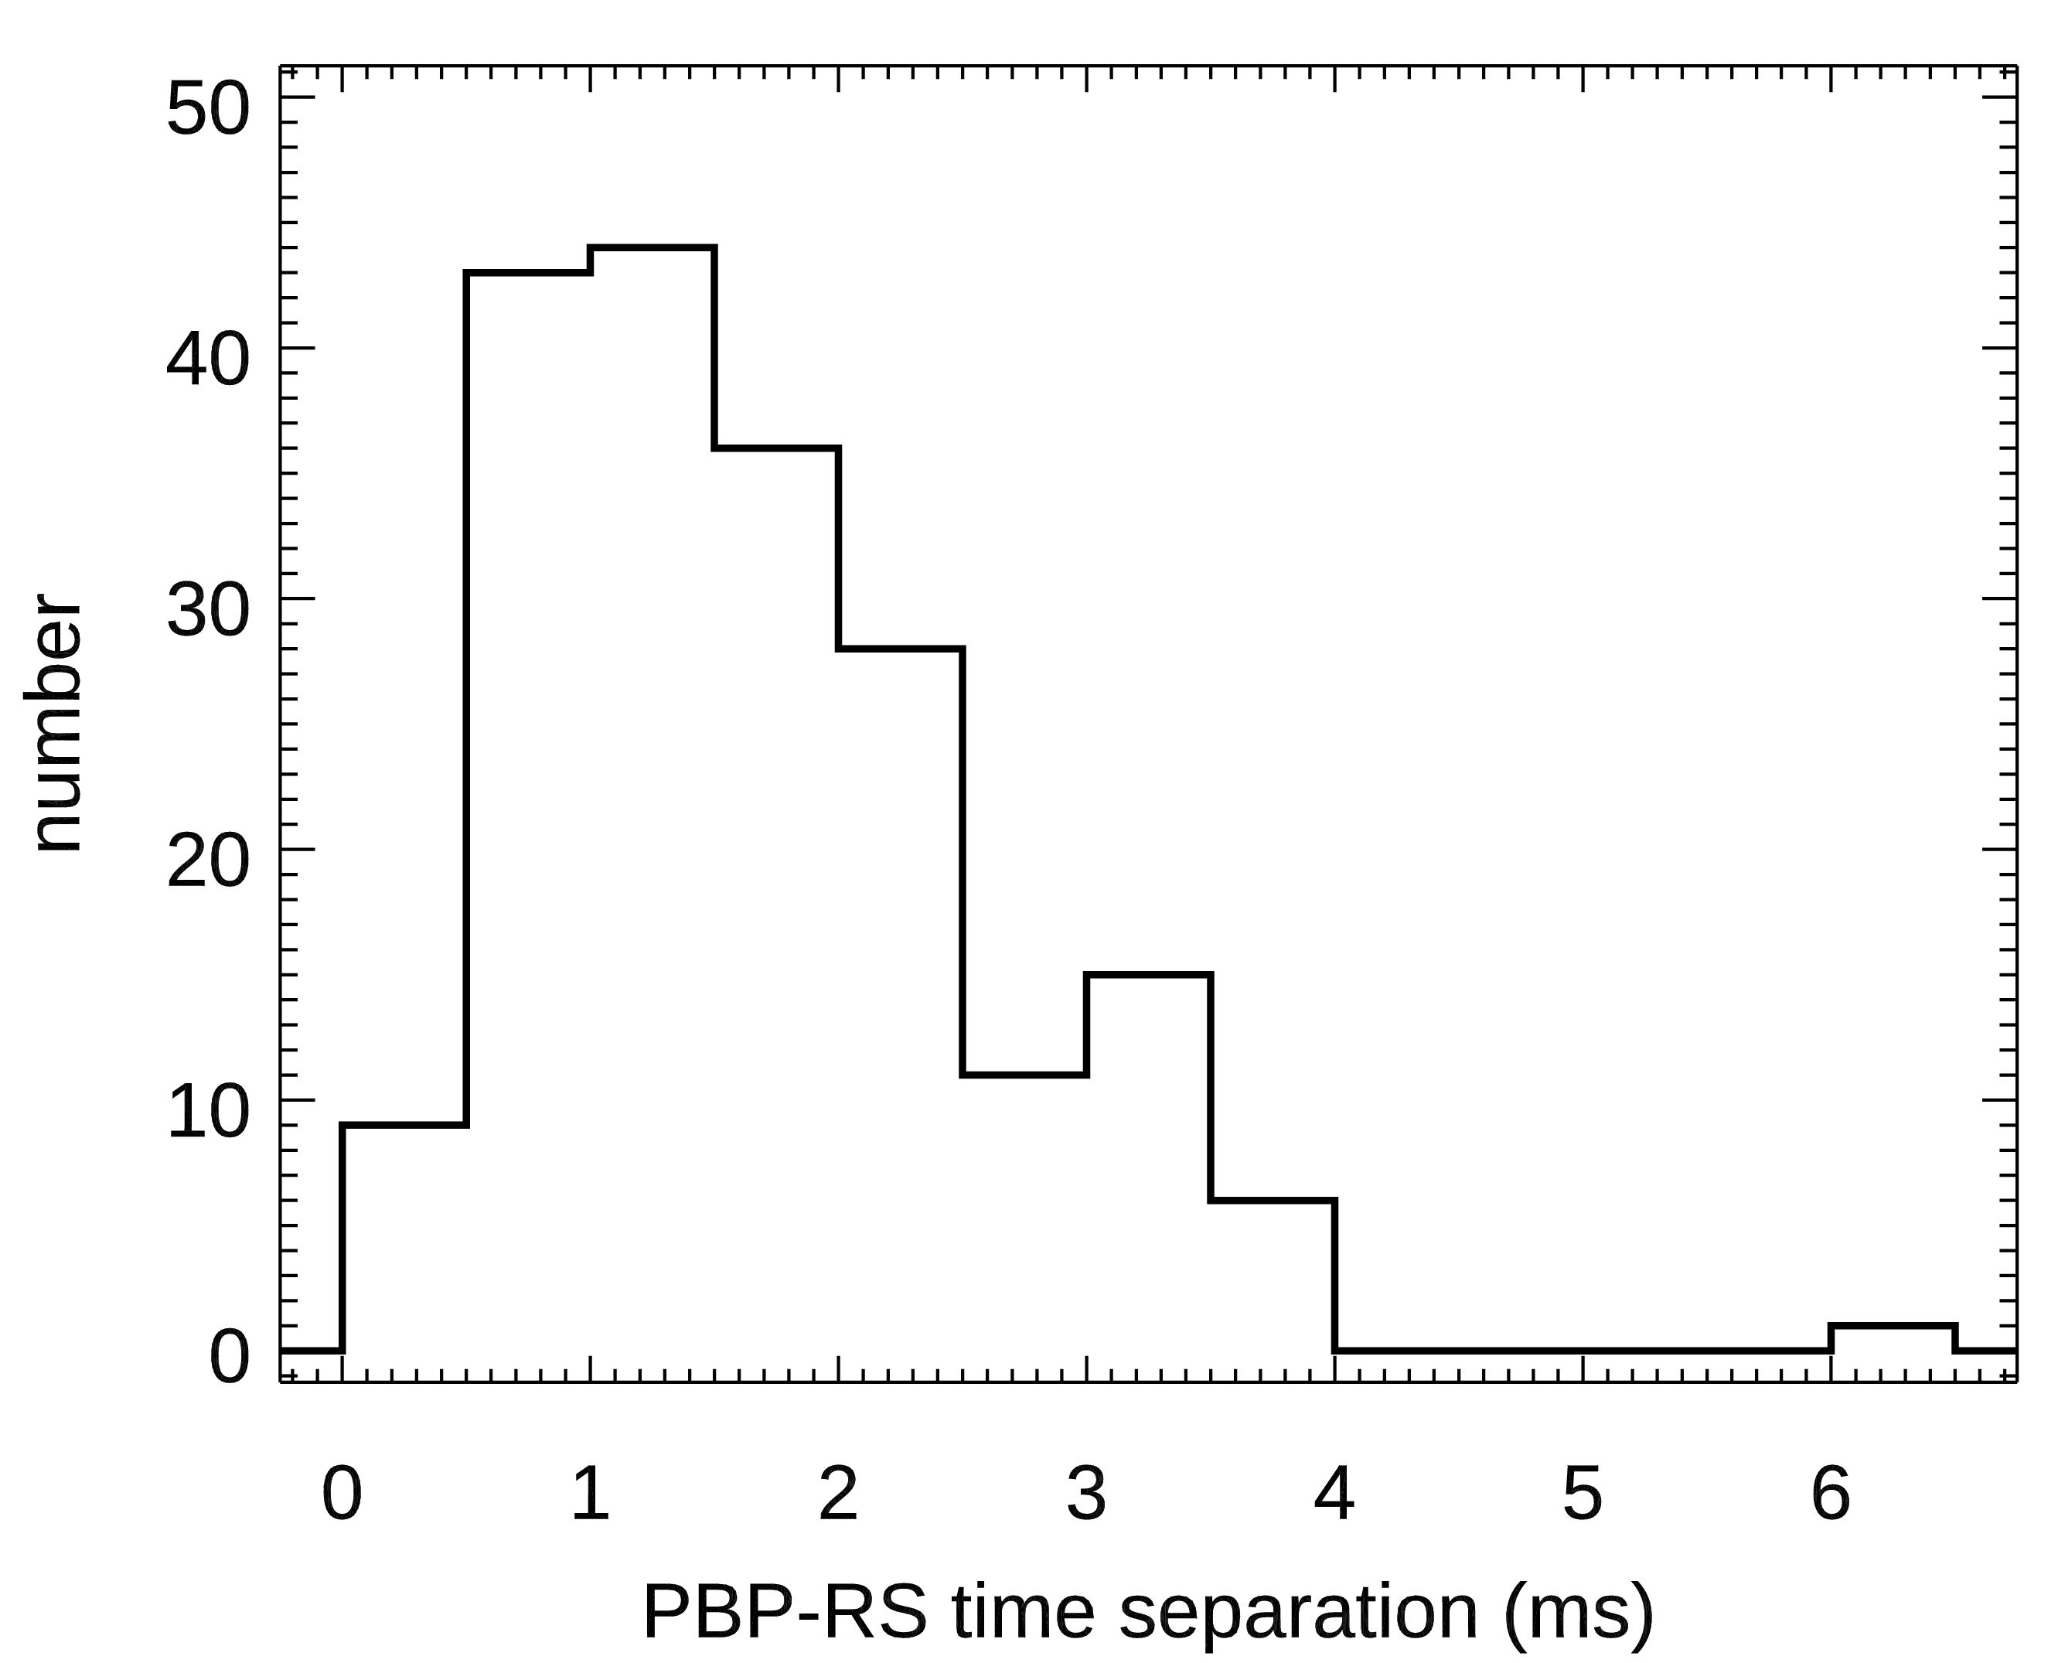
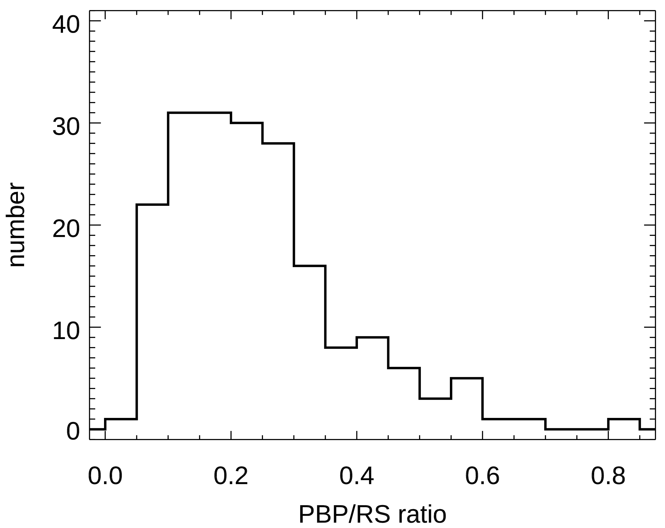
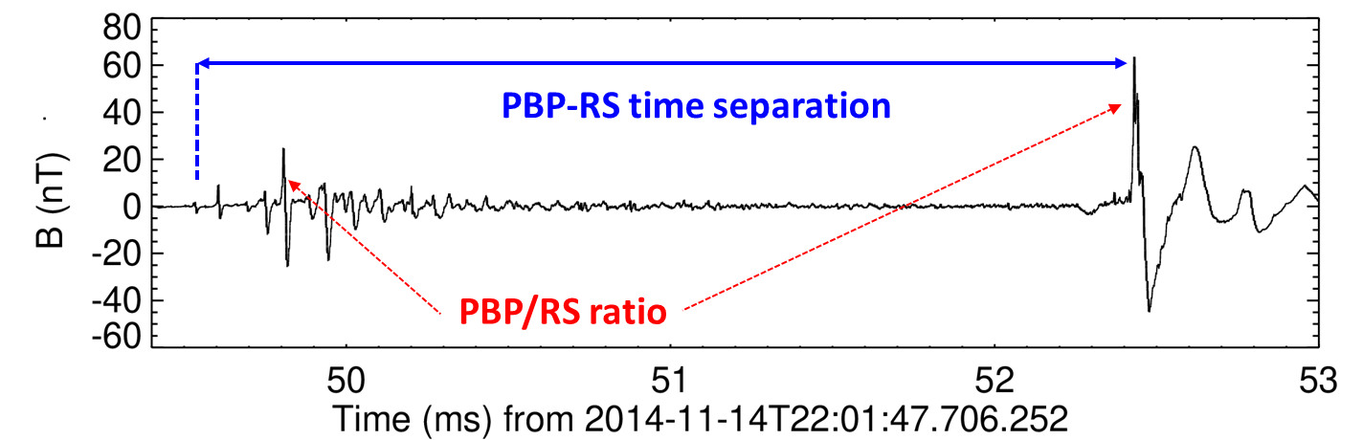
Properties of pulse trains
All 193 neg. CGs
1.7±0.9 ms
0.24±0.14
PBP-RS= 2.9 ms;
PBP/RS= 38 %;
I peak RS = - 118 kA;
I peak PBP= - 46 kA
PBP-RS distance= 2 km

Slide 8
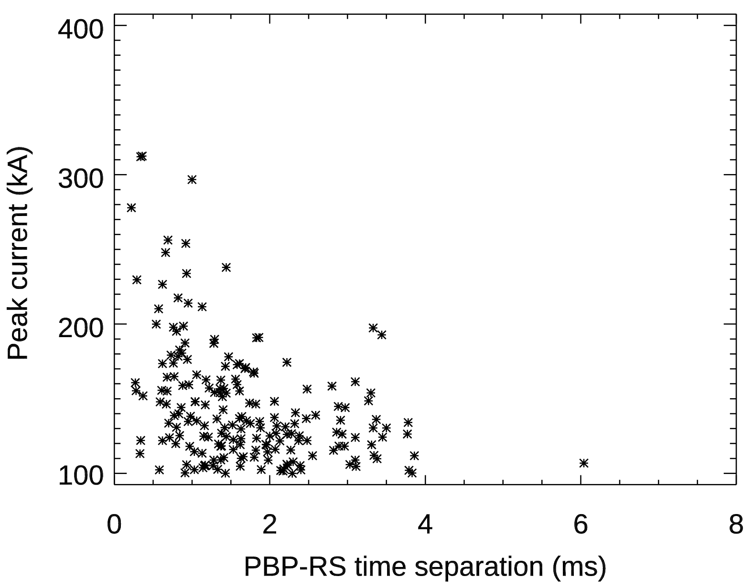
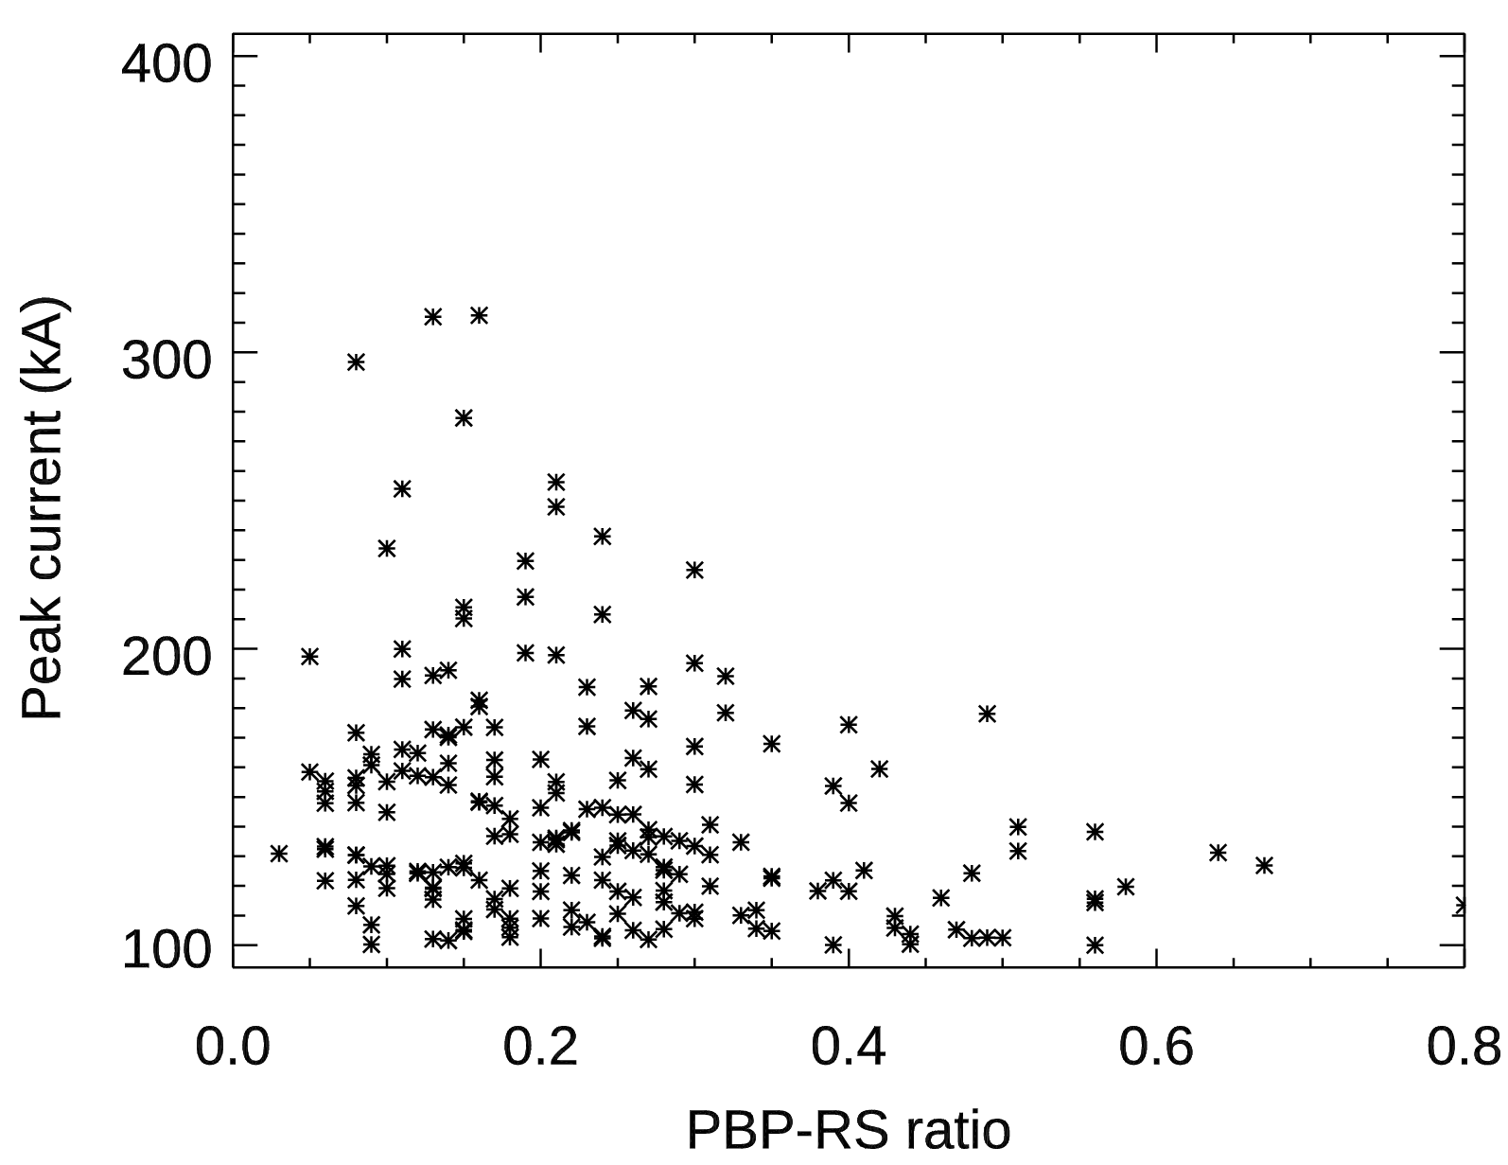
PB properties
 | PBP- RS time separation (ms) | PBP/RS ratio
Mediterranean, France, >100 kA (neg.) | 1.7 | 0.24
Albany, NY, USA (Brook, 1992) | 2.8 | 0.7
Hokuriku, Japan (Wu et al., 2013) | 5.4 | 0.47

Slide 9
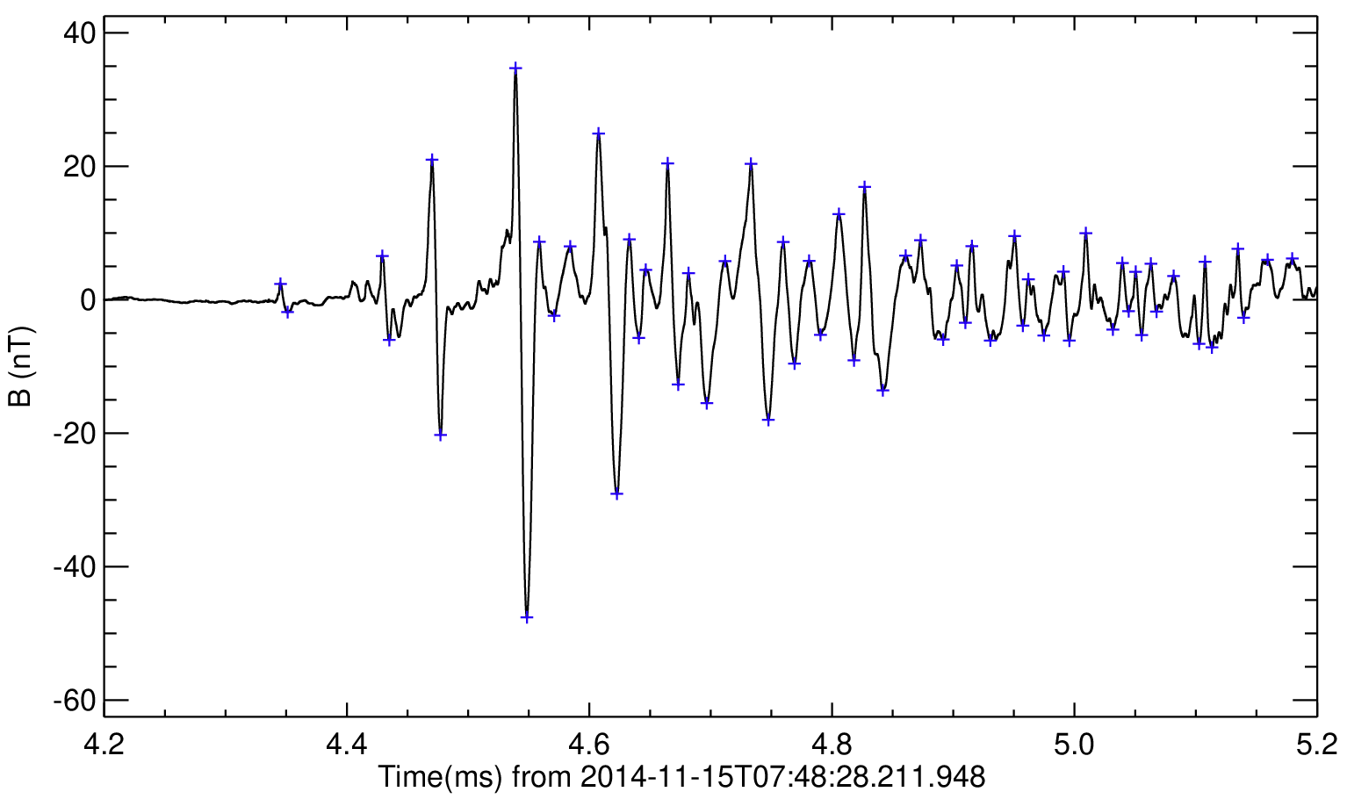
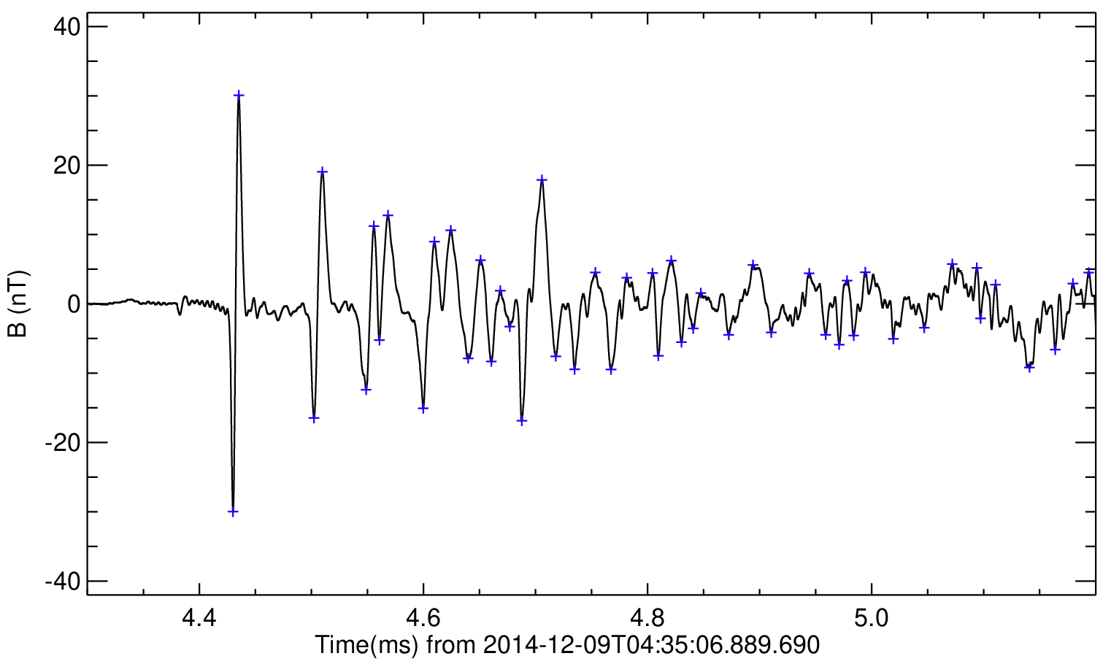
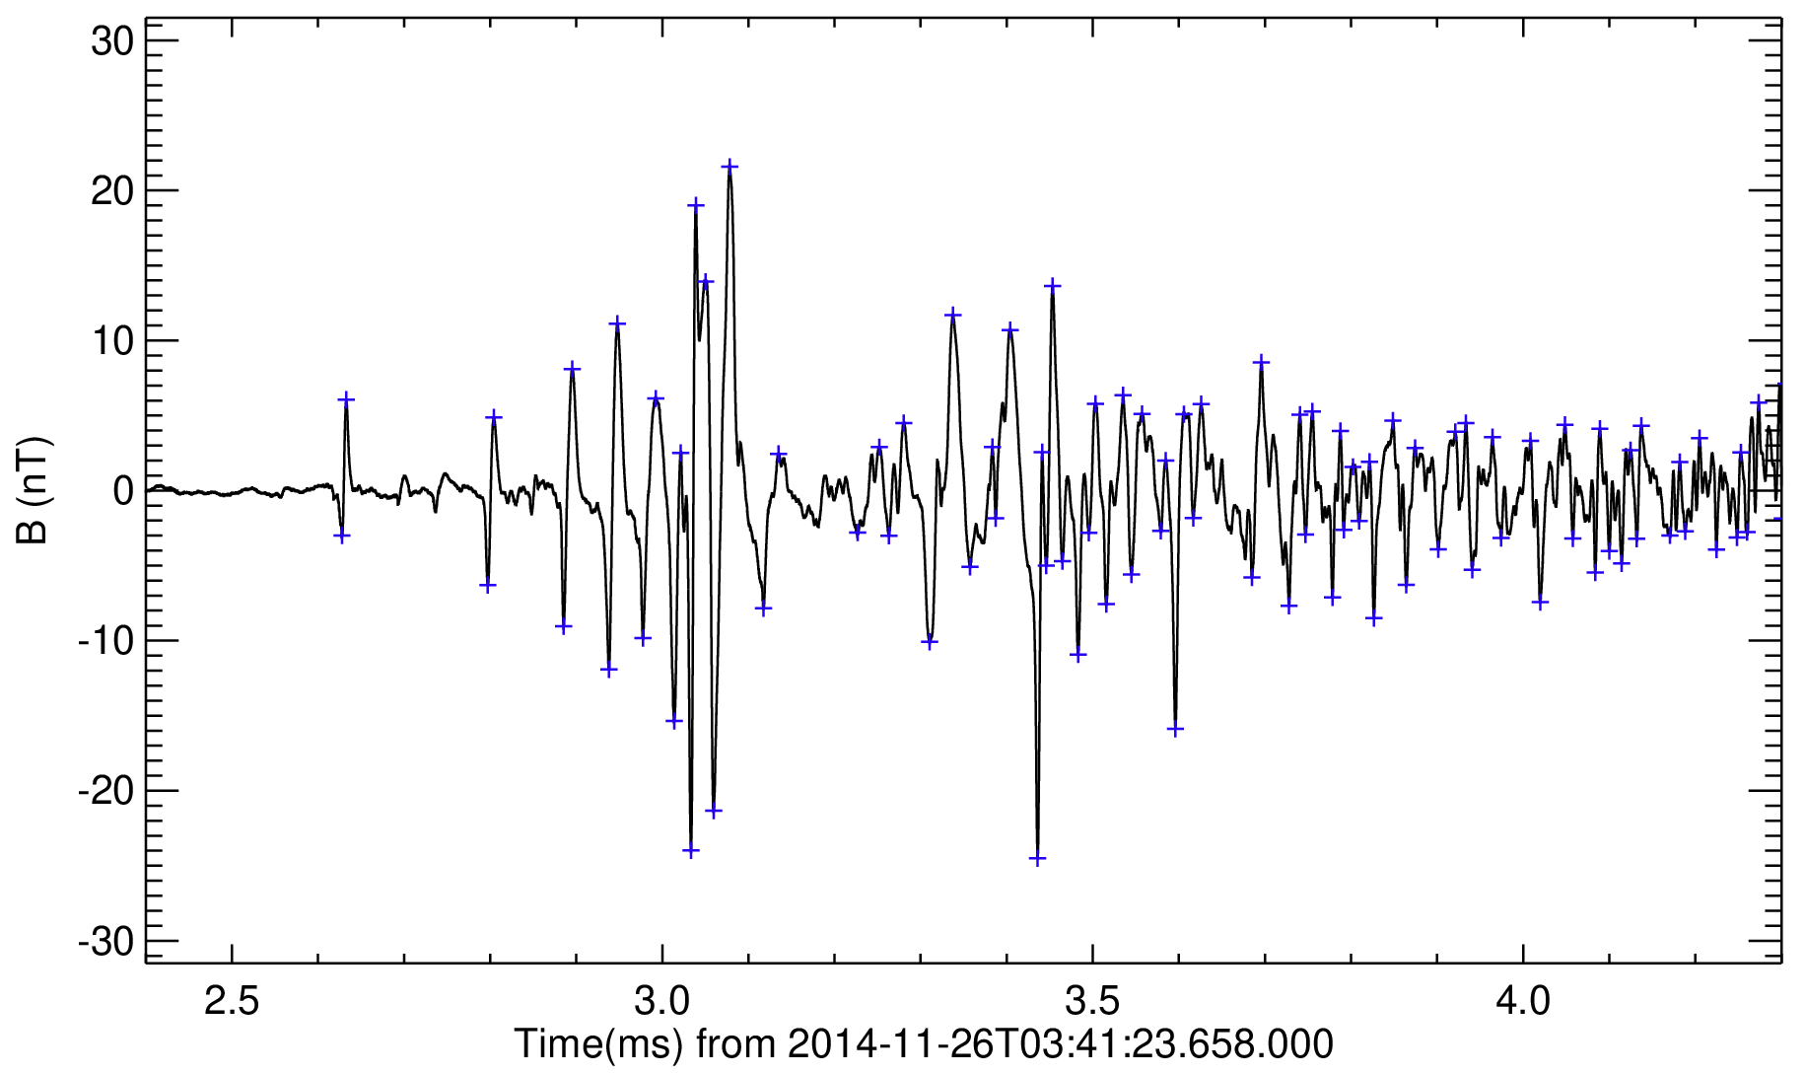
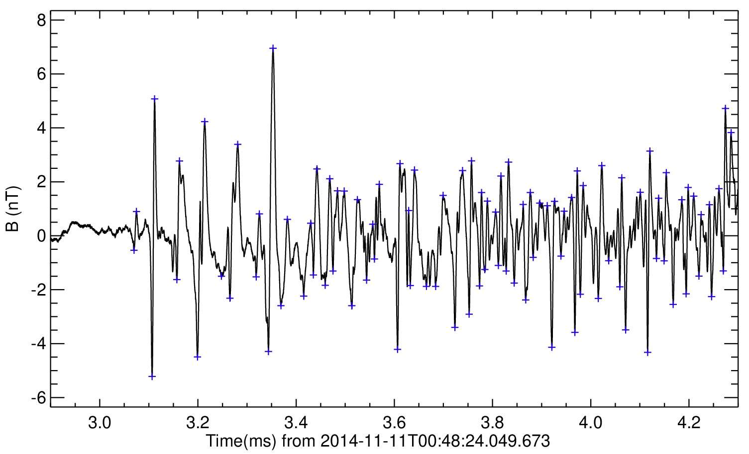
Examples of pulse trains
“first big” – 3 %
“diamond” – 65 %
“half diamond” – 10 %
“irregular” – 22 %
“2 trains” – 3 events

Slide 10
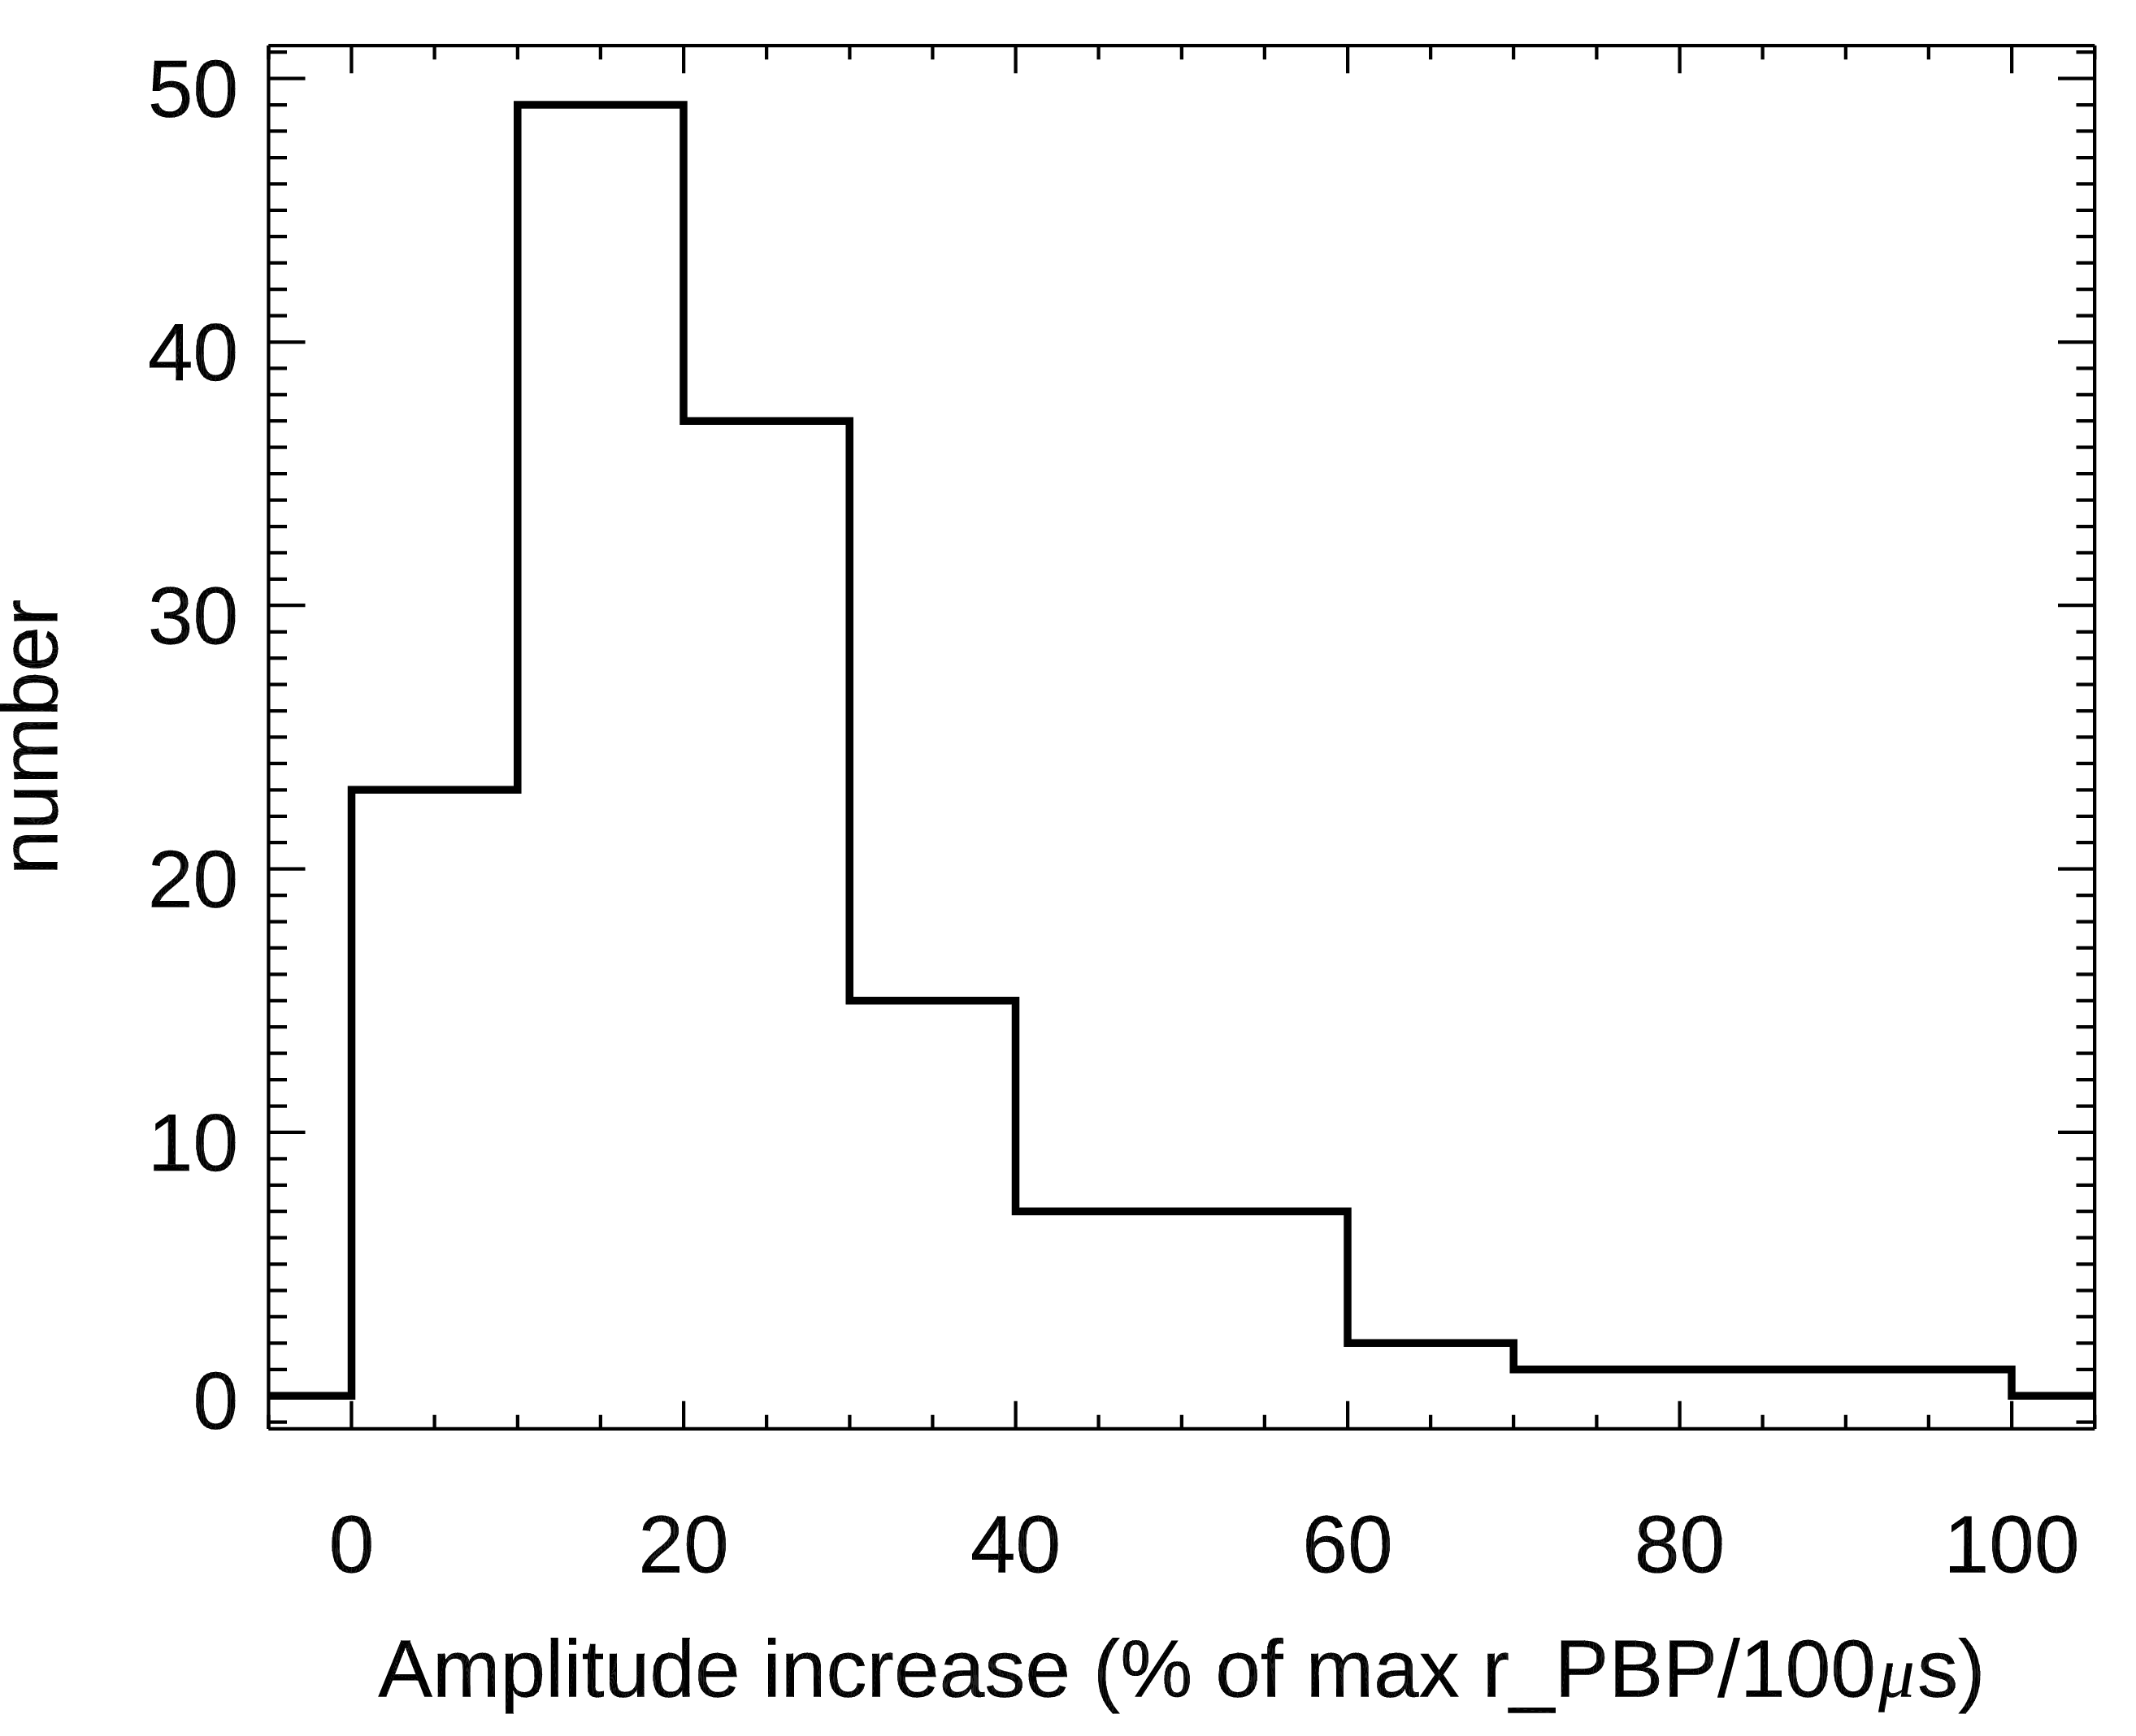
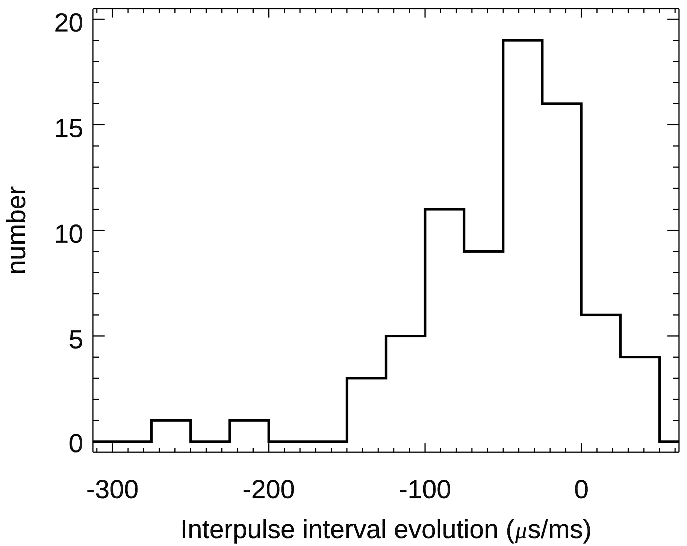
Properties of regular pulse trains
Bottom thundecloud dipole
24±16 %/100µs
-49±52 µs/ms
143 neg. CGs
“diamonds”
“half-diamonds”
75 neg. CGs
regular
PB-RS>1.5 ms
Dense charge pocket
-CG diamond type

Slide 11
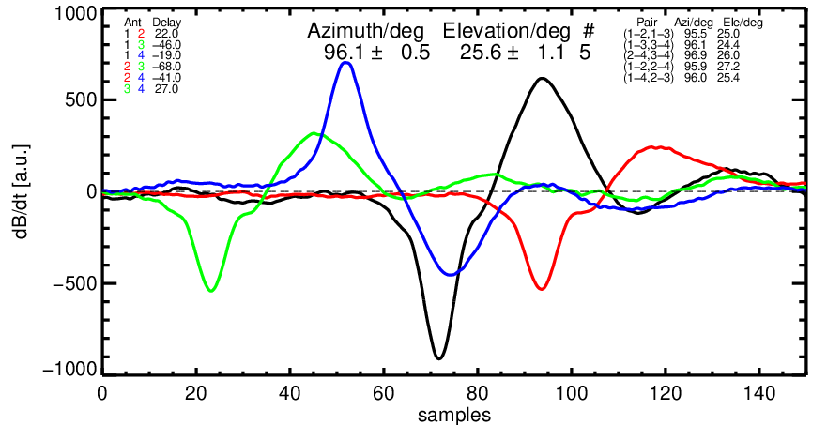
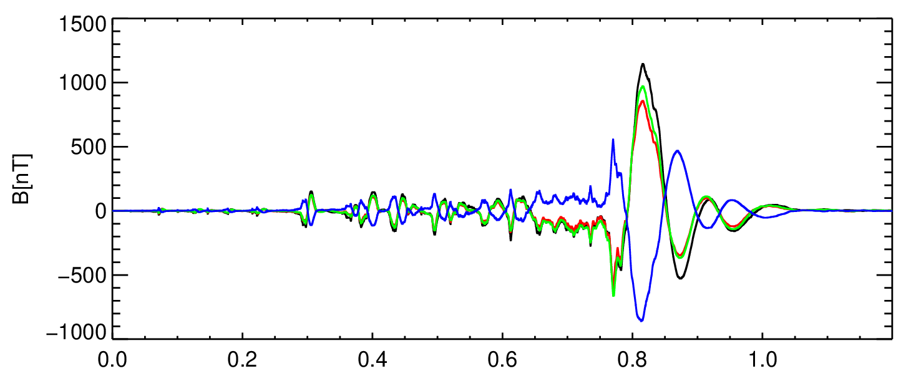
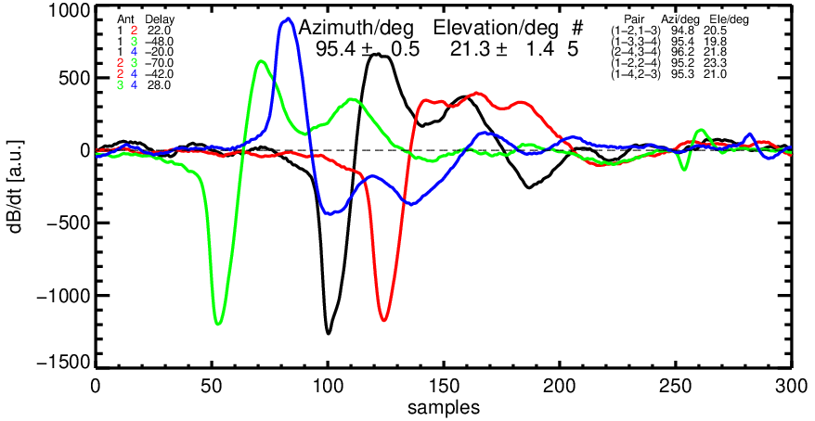
Estimation of the initiation height
12 km from the receiving station
A
H_{A} ~ 5.6 km
H_{B} ~ 4.6 km
dt=130 µs
v = 7.7·10⁶ m/s
A
B
B
Time from 2014-11-15T05:46:33.010.7
PBP-RS= 0.7 ms; PBP/RS= 21%;
I peak RS = - 256 kA

Slide 12
Summary
winter thunderstorms in the West Mediterranean region exhibit similar electromagnetic signatures as the thunderstorms in the other active regions of the Northern hemisphere
short PB-RS separation indicates strong negative charge centres inside thundeclouds and very fast lightning leaders ( ~ 8 ·10⁶ m/s for CG-, -256 kA)
the strongest discharges are the shortest ones
pulse peak amplitudes in 78 % of PBP sequences follow one of the patterns (“diamond”, “half-diamond”, or “first big”)
the time evolution of pulse peak amplitudes and inter-pulse intervals reflects the charge distribution in the lower thundecloud dipole -> follow up study

