Slide 1
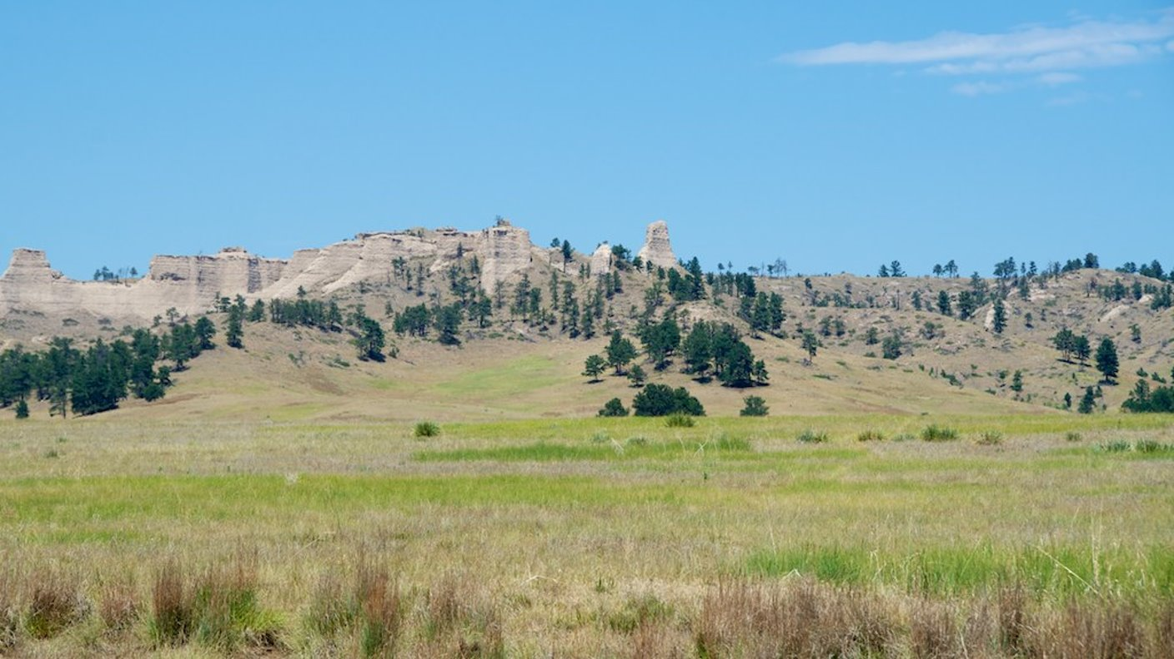




Reservoir Characterization for Potential CO₂ Storage in Western Nebraska
Sam Fleagle¹, Dr. Caroline M. Burberry¹, and Dr. Seunghee Kim²
¹ University of Nebraska-Lincoln, Earth and Atmospheric Sciences, United States of America (sfleagle2@huskers.unl.edu)
² University of Nebraska-Lincoln, Civil and Environmental Engineering, United States of America
Notes:
Hi, My name is Sam Fleagle and I am a first year masters student at the University of Nebraska. Today I will be presenting my work so far on Reservoir Characterization for Potential Co2 storage in Western Nebraska.

Slide 2
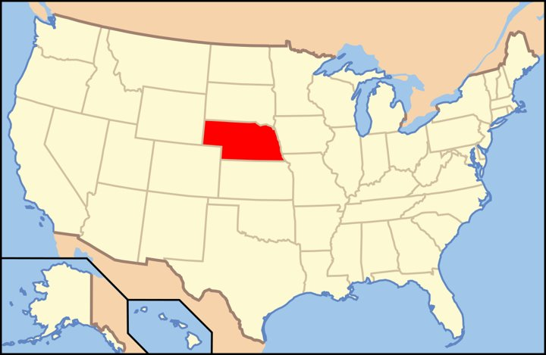
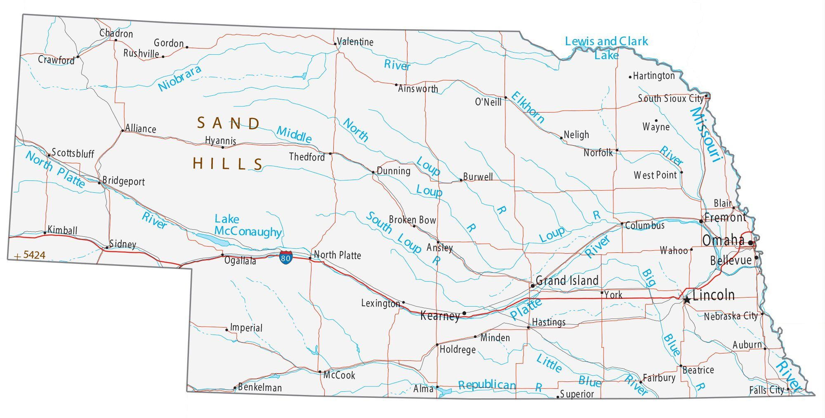

Study Area
https://en.wikipedia.org/wiki/Nebraska
Notes:
Our project area is in the center of the United States, in Nebraska. Specifically, we are studying the western portion of the state, as you can see highlighted in red

Slide 3
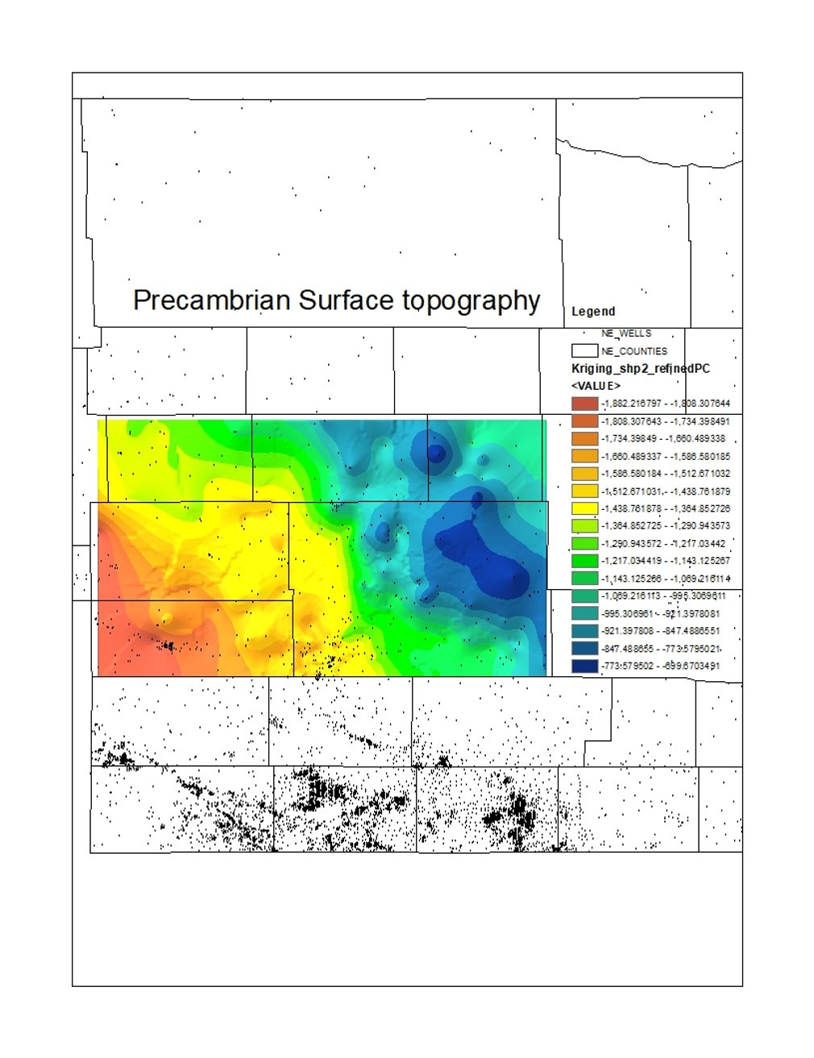
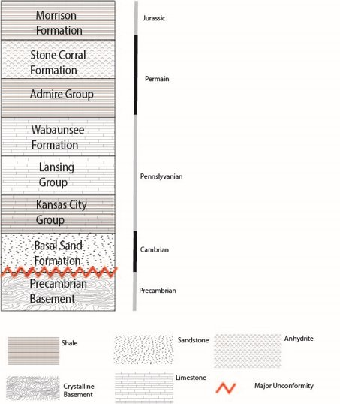
Regional Geology

Slide 4
Regional Geology

Slide 5
Data Available (* not yet acquired)
Seismic Survey Data (Bird Data)
Nebraska Oil and Gas Commission driller call outs
Rock Core (CSD and USGS Core Store)
Gamma-Ray/Well logging data suites
Drone-based Magnetometer surveys*
Notes:
The data sets we are working with so far are: formation call outs from drillers available through the Nebraska Oil and Gas Commision for a majority of wells drilled in the study area. We have currently gone through six counties worth of wells (roughly 1000) and plotted formation tops and thickness of groups for each major unit. Secondly, the Nebraska Oil and Gas Commision has scans of the wireline log data suites taken for a well. I've been using the gamma ray log, which is used a proxy for reservoir/seal intervals based on clay content) to validate the drillers formation calls. Futhermore, the University of Nebraska's school of Natural Resources conservation and survey division has several cores of our depths of interest which we were just able ot access last week. We have prelimary air permeability data from these cores and are using them as a comparison with the gamma ray logs to validate our interpretations.

Slide 6
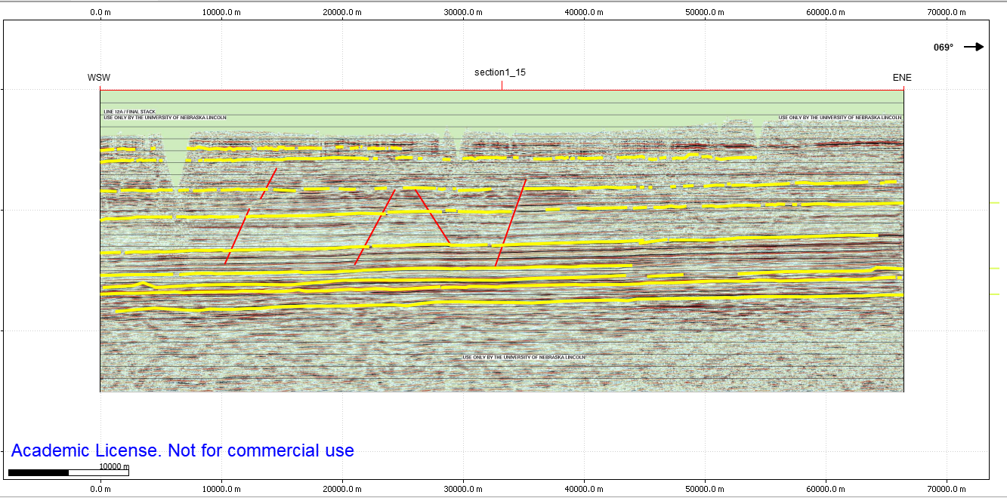
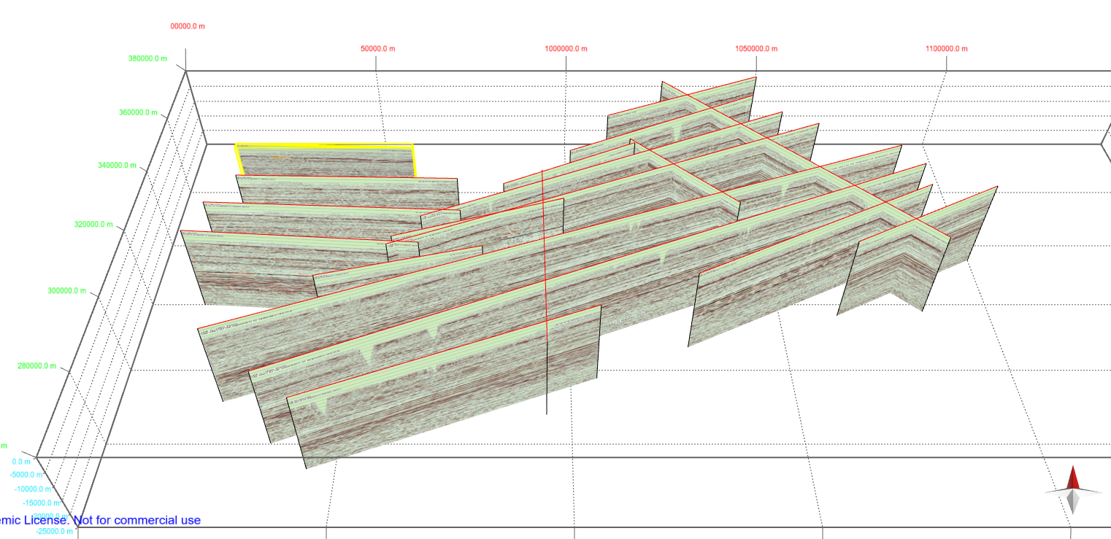
Seismic Data
Notes:
18 shots

Slide 7
GR Correlations
Log interpretation methods from Smith 2020, and N Sea.
Notes:
The blue line at left is representative of the cross section constructed from west to east of the gamma ray logs (as defined by 0<70<200 as per Smith and Joeckel) for the county. The labeling shows seals, reservoirs,and mixed intervals but predominantly features the basal sand as a previously ignored reservoir. The log signature of the gamma ray log has been continued laterally across the county, most logs are started at 2600 feet (800 meters) below ground surface. Some are not and those are labeled thusly, in the figure labels.

Slide 8
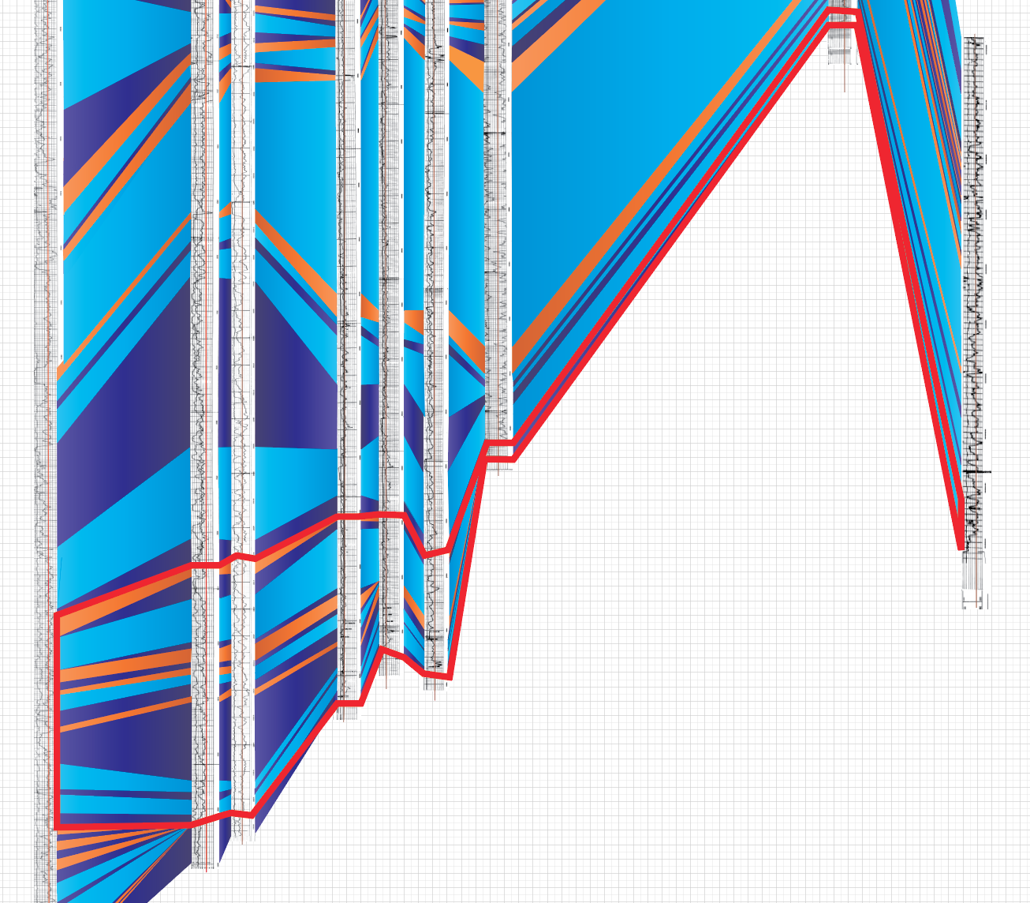
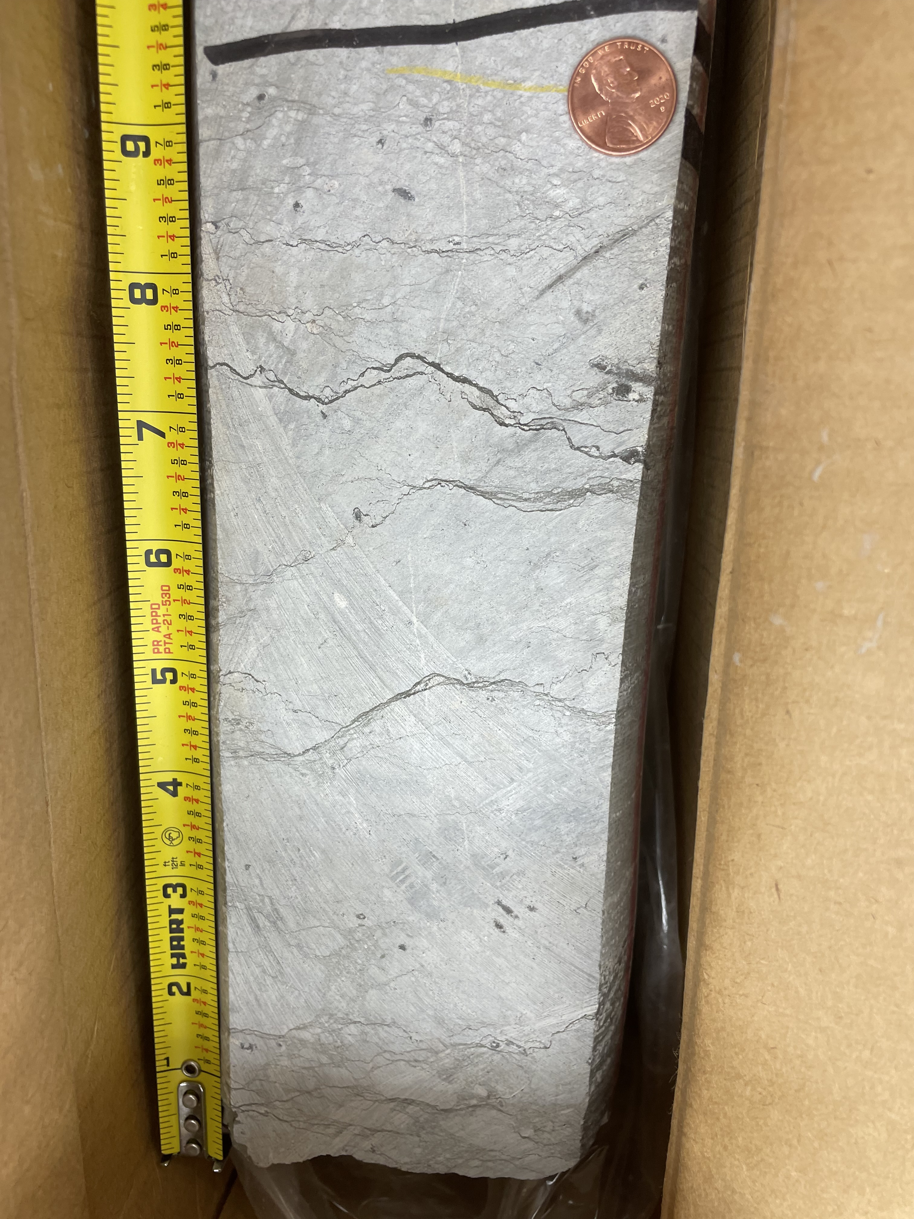
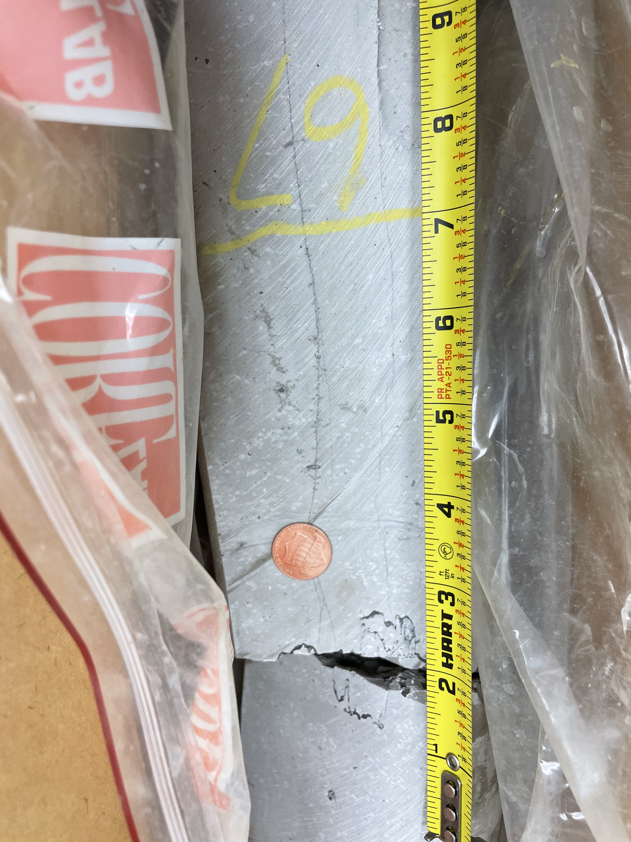
Pennsylvanian Storage System
Formation: Wabuansee
Depth: 6838 ft
Structural Closure
Formation: Lansing
Depth: 7067 ft

Slide 9
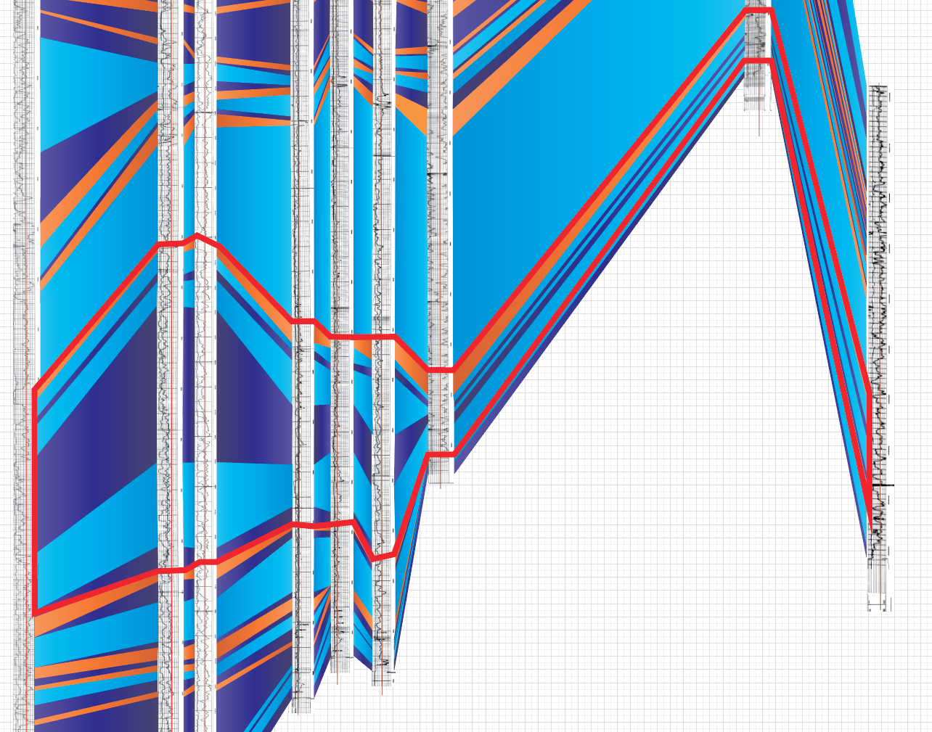
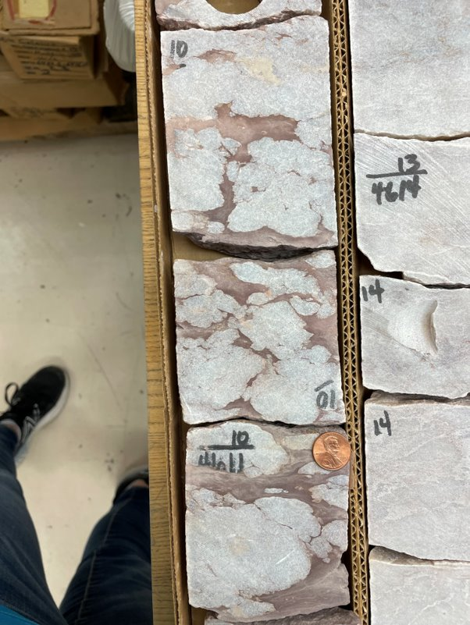
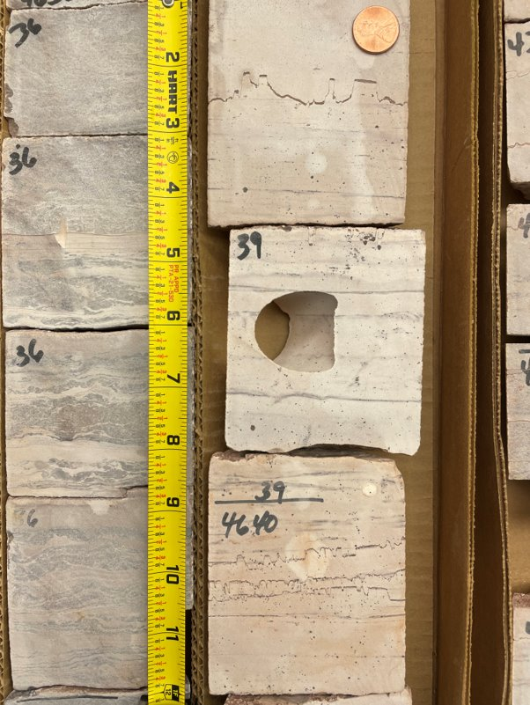
Permian Storage System
Formation: Anhydrite (Stone Corral)
Depth: 4611 ft
Formation: Amazon Dolomite
Depth: 4641 ft
Notes:
The blue line at left is representative of the cross section constructed from west to east of the gamma ray logs (as defined by 0<70<200 as per Smith and Joeckel) for the county. The labeling shows seals, reservoirs,and mixed intervals but predominantly features the basal sand as a previously ignored reservoir. The log signature of the gamma ray log has been continued laterally across the county, most logs are started at 2600 feet (800 meters) below ground surface. Some are not and those are labeled thusly, in the figure labels.

Slide 10
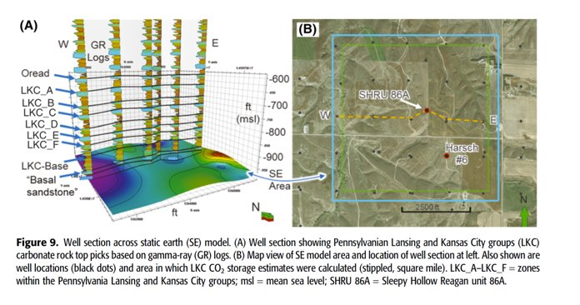
Putting it all together
Towards 50 mt storage
Smith, V. L., & Joeckel, R. M. (2020)

Slide 11
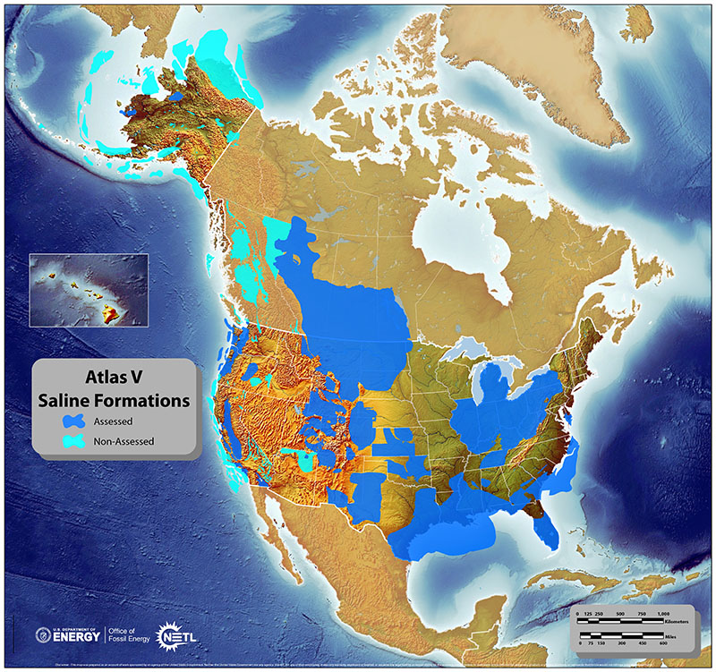
What other systems can we reevaluate?

