Slide 1
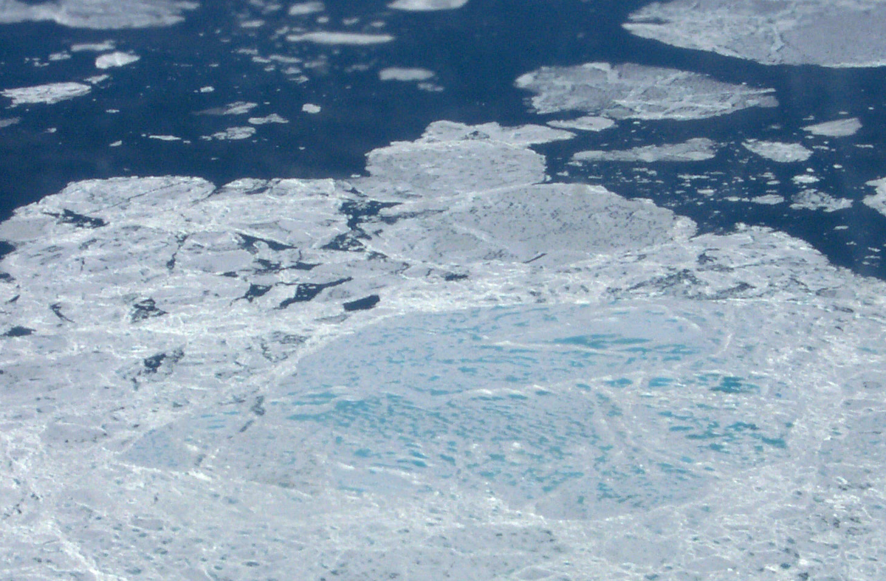



Utilising Cryosat-2 observations of the Arctic sea ice cover to produce a new Arctic sea ice reanalysis
Nicholas Williams: n.p.williams@pgr.reading.ac.uk
Nicholas Byrne, Danny Feltham, Peter Jan van Leeuwen, Ross Bannister, David Schroeder & Andy Shepherd

Slide 2
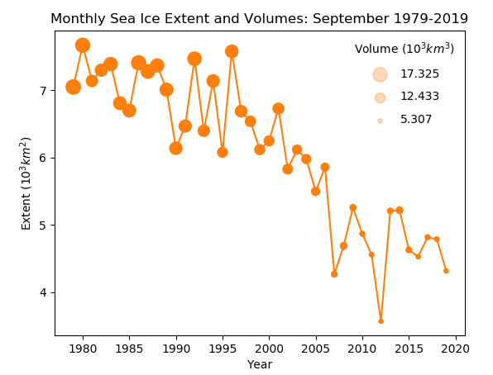
Sea ice is a key indicator of climate change.
In the satellite era, Arctic sea ice is not only retreating, but is also thinning rapidly.
We want to improve the understanding of this change by combining our existing sea ice model with newly developed observations of sea ice, and producing a reanalysis.
Arctic mean sea ice extent data: NSIDC
Arctic mean sea ice volume data: PIOMAS

Slide 3
CICE-PDAF
CPOM version of the sea ice model CICE
  Elastic-plastic-anisotropic rheology (Tsamados et al., 2013)
  Topographic melt pond scheme (Flocco et al., 2012)
CPOM-CICE coupled to the parallelised data assimilation framework (PDAF), a software environment which enables models to use ensemble based data assimilation.
We use the Local Ensemble Transform Kalman Filter (LETKF). This works as a weighted mean between model and observation, with weights coming from the ensemble spread and observation error statistics.

Slide 4
Generating an ensemble spread
CICE is a forced dissipative model – it will be difficult to generate a sufficient ensemble spread for the assimilation to be effective.
If ensemble spread is too low the observations will be ignored as the confidence in the model will be too high.
To create ensemble spread, we perturb the atmospheric forcing fields using multivariate EOFs and random numbers from a standard distribution.

Slide 5
Assimilation Experiments
In these experiments I run CICE-PDAF with:
  Ensemble size of 100
  Forgetting factor of 0.995
  Localisation radius of 100 km
4-year runs of CICE-PDAF from 2012-2015, assimilating different configurations of 3 types of observation:
  Control: no assimilation
  Assim_conc: assimilation of bootstrap sea ice concentration
  Assim_conc_hi: assimilation of bootstrap sea ice concentration and Cryosat-2 mean sea ice thickness
  Assim_conc_hi_4hd: assimilation of bootstrap sea ice concentration, Cryosat-2 mean sea ice thickness and Cryosat-2 sea ice thickness distribution

Slide 6
Concentration and thickness observations
Bootstrap sea ice concentration assimilated daily, using error statistics depending on season and ice concentration measured.
Cryosat-2 mean thickness assimilated as a monthly mean once during the middle of the month. Not assimilated from May-September due to melt pond interference.
Only assimilate Cryosat-2 mean thickness measurements above 1m due to uncertainty in Cryosat-2 thickness estimates of thinner ice, use 23% error (Tilling et al., 2018).

Slide 7
Thickness distribution observations
CPOM-CICE uses five ice thickness categories (lower limits: 0m, 0.6m, 1.4m, 2.4m, 3.6m)
Individual Cryosat-2 observations binned according to the thickness measured to attain ice concentration and ice thickness in each category (Schroeder et al., 2019).
Assimilate concentration and thickness in thinnest 4 categories. To maintain a consistent error, used error algebra to attempt to derive consistent errors, we found that using 0.3 for ice concentration and 0.7 m for ice thickness was reasonable.

Slide 8
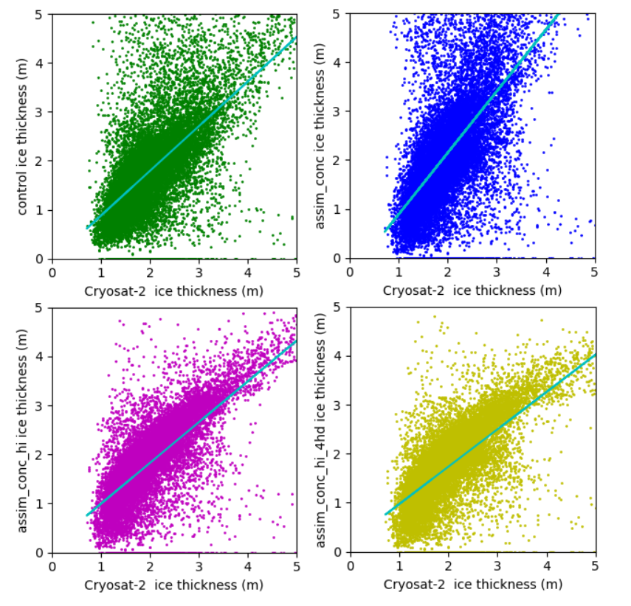
Ice Thickness RMSE
Randomly select around 75% of Cryosat-2 observations for assimilation. 25% used for evaluation.
Ice thickness RMSE halved when assimilating Cryosat-2 ice thickness.
RMSE increased when only concentration assimilated compared to the control.
Cryosat-2 v CICE-PDAF ice thickness for the control (no assimilation), assim_conc (assimilation of concentration), assim_conc_hi (assimilation of concentration and Cryosat-2 mean thickness) and assim_conc_hi_4hd (assimilation of concentration, mean thickness and Cryosat-2 thickness distribution). Solid line shows ensemble mean, shading shows ensemble spread.

Slide 9
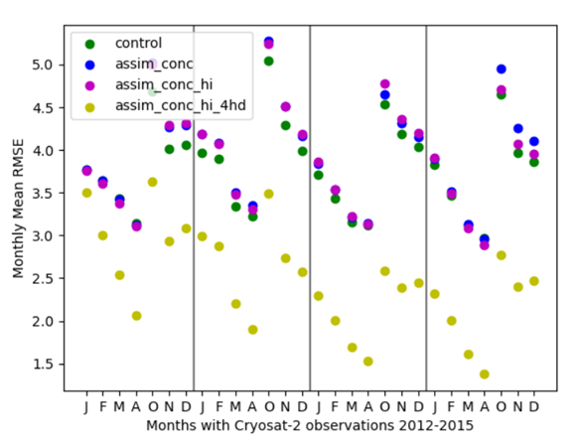
Thickness distribution improvements
Significantly improve RMSE for category 5 ice thickness by assimilating thickness distribution of the four thinnest categories.
Category 5 Ice thickness RMSE reduced by almost two-thirds when assimilating thickness distribution than without.
Assimilating thickness distribution results in lower sea ice volume estimates.
CICE-PDAF category 5 ice thickness RMSE in months with Cryosat-2 observations for the control (no assimilation), assim_conc (assimilation of concentration), assim_conc_hi (assimilation of concentration and Cryosat-2 mean thickness) and assim_conc_hi_4hd (assimilation of concentration, mean thickness and Cryosat-2 thickness distribution). Solid line shows ensemble mean, shading shows ensemble spread.

Slide 10
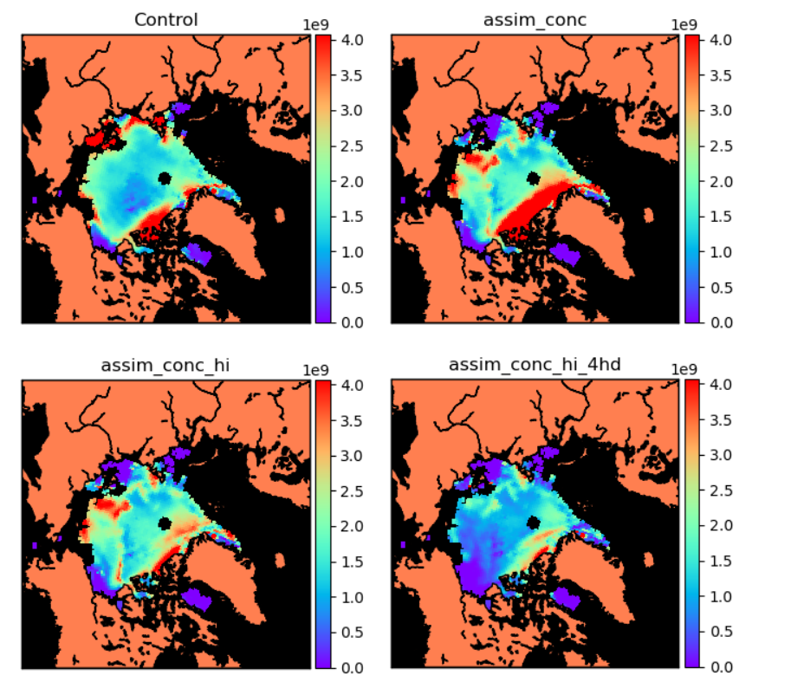
Thickness distribution improvements
Use Bootstrap observations to compare CICE-PDAF volume with Cryosat-2 x Bootstrap volume.
Sea ice volumes when assimilating thickness distribution have lowest RMSE to this volume product.
Especially outperforms other models between October and January.
CICE-PDAF category 5 ice volume RMSE against Cryosat-2 x Bootstrap volume in December for the control (no assimilation), assim_conc (assimilation of concentration), assim_conc_hi (assimilation of concentration and Cryosat-2 mean thickness) and assim_conc_hi_4hd (assimilation of concentration, mean thickness and Cryosat-2 thickness distribution). Solid line shows ensemble mean, shading shows ensemble spread.

Slide 11
Control run has much larger areas of thinner ice.
When only assimilating concentration, thickness is significantly larger than in Cryosat-2.
When assimilating thickness distribution, mean thickness is decreased in central Arctic but slight increase in thickest ice close to Greenland.
Monthly mean sea ice thickness (in metres) in October 2012 (Top row), 2013 (2nd row), 2014 (3rd row) and 2015 (bottom row). The columns show Cryosat-2 and our CICE-PDAF experiments (ensemble mean). Grid cells lacking Cryosat-2 data are shown in black in the Cryosat-2 column.

Slide 12
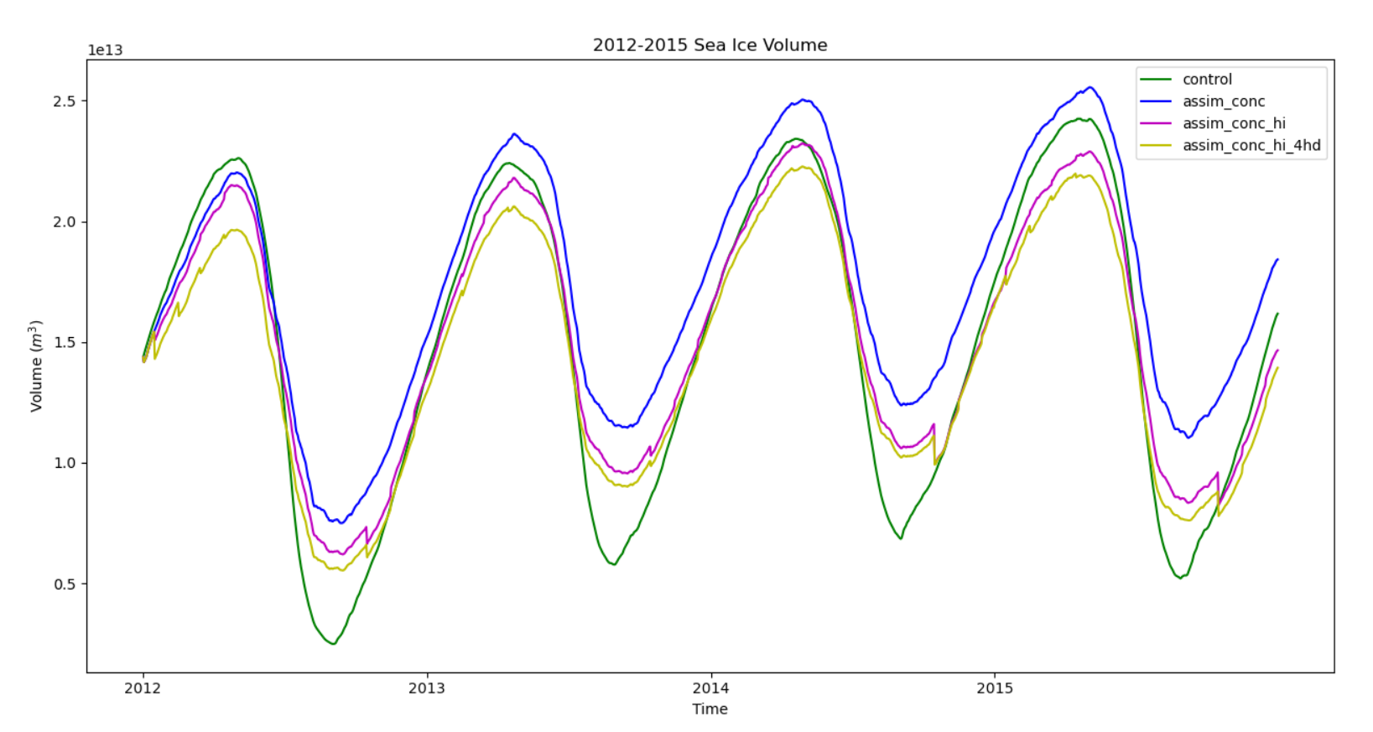
CPOM-CICE (control) has lower sea ice volumes in summer than the assimilation runs.
Assimilating only concentration leads to greater sea ice volumes.
Assimilating mean thickness or thickness distribution reduces this effect.
Ensemble mean sea ice volume from 2012 to 2015 for the control (no assimilation), assim_conc (assimilation of concentration), assim_conc_hi (assimilation of concentration and Cryosat-2 mean thickness) and assim_conc _hi_4hd (assimilation of concentration, mean thickness and Cryosat-2 thickness distribution).

Slide 13
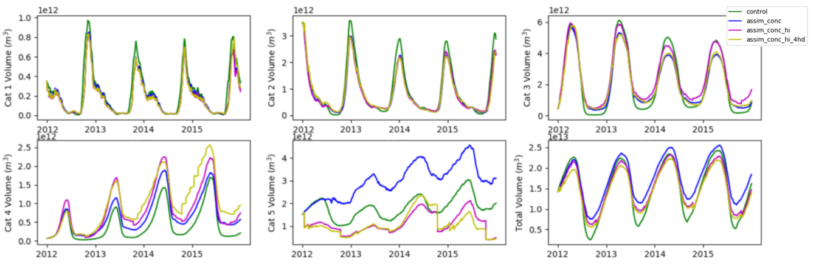
Sea Ice Volume Reanalysis
Fig: From left to right, sea ice volume in categories 1-3 (top row) and categories 4, 5 and total volume (bottom row) from 2012-2015 for the control (no assimilation), assim_conc (assimilation of concentration), assim_conc_hi (assimilation of concentration and Cryosat-2 mean thickness) and assim_conc _hi_4hd (assimilation of concentration, mean thickness and Cryosat-2 thickness distribution).
Assimilation of concentration and mean thickness moves ice from category 5 into categories 3 and 4.
Additionally assimilating thickness distribution favours increasing ice volume in category 4.
Although the last two experiments have similar ice volumes in category 5, the ice is distributed differently in the Arctic, and assimilation of thickness distribution has much lower RMSE to Cryosat-2 observations…

Slide 14
Summary
Assimilation is performing well compared with independent observations.
Assimilated a sea ice thickness distribution for the first time.
Assimilating thickness distribution leads to significantly better estimates of ice in category 5 in the model (RMSE reduced by two-thirds) which changes CICE-PDAF sea ice volume estimates – particularly in the regions of thicker ice.
CICE-PDAF with assimilation of the thickness distribution generally estimates thinner ice in the central Arctic and thicker ice closer to Greenland than when assimilating the mean thickness.
Assimilating thickness distribution removes ice from category 3 and 5 and increases ice in category 4. Assimilating only mean thickness removes ice in the category 5 and adds ice in category 3.

