Slide 1
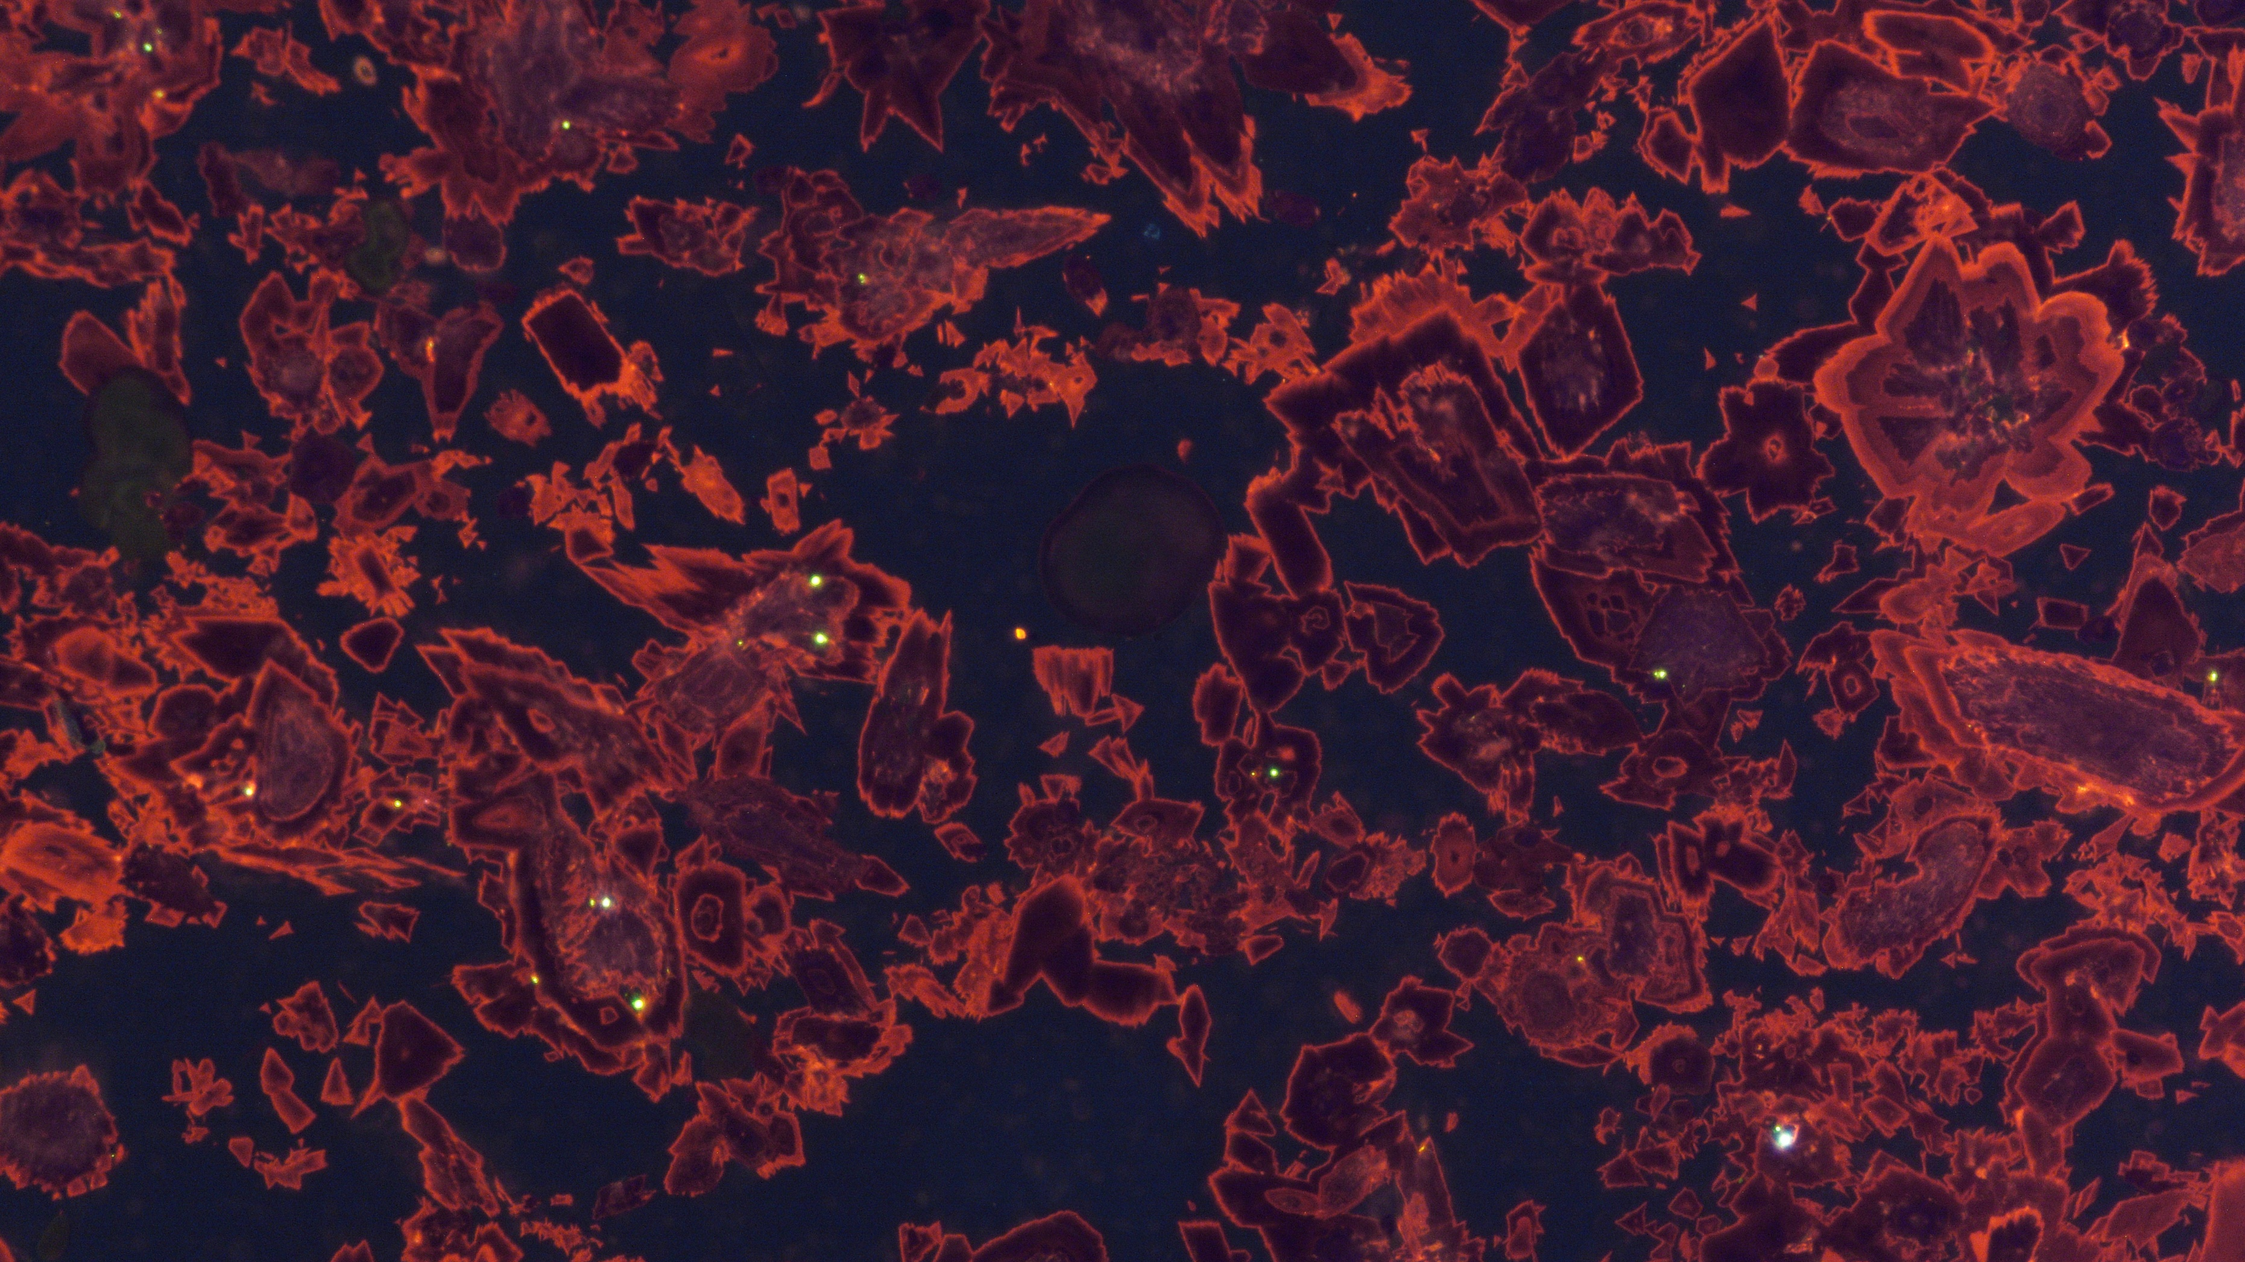
Can glendonites be used as palaeothermometers?
Madeleine L. Vickers¹*, Stefano Bernasconi², Bo Pagh Schultz³, Mikhail Rogov⁴, Victoria Ershova⁴, Clemens V. Ullmann⁵, Allan R. Chivas⁶, Florian W. Dux⁶, Morgan Jones¹
¹Centre for Earth Evolution and Dynamics (CEED), University of Oslo, P.O. Box 1028 Blindern, 0315 Oslo, Norway; ²ETH Zurich, Geologisches Institut, Sonneggstrasse 5, 8092 Zürich, Switzerland; ³Museum Salling, Fur Museum, Nederby 28, 7884 Fur, Denmark; ⁴Geological Institute of Russian Academy of Sciences; ⁵Cambourne School of Mines, University of Exeter; ⁶School of Earth, Atmospheric and Life Sciences (SEALS), University of Wollongong NSW 2522 Australia

Slide 2
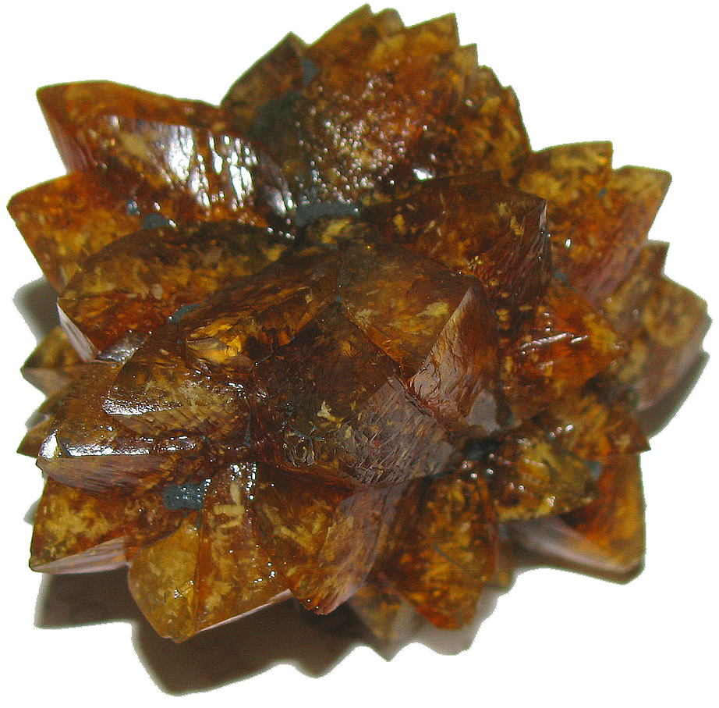
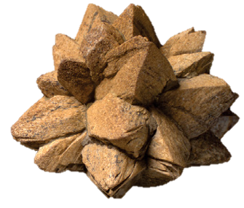
What are glendonites?
Fossilized ikaite
Rogov et al. (2021)
Grasby et al. (2016)
Modern day ikaite from seafloor sediments
Glendonite from the Early Cretaceous of Arctic Canada

Slide 3
Ikaite: calcium carbonate hexahydrate, CaCO₃•6H₂O
To stabilise ikaite, need to inhibit the more stable polymorphs: e.g. low temperatures, high phosphate/sulphate/alkalinity/Mg²⁺…
In nature, marine sedimentary ikaite is only found growing below 4 °C
Would be great if glendonite presence could be used to infer near-freezing temperatures, since they would give a quantitative T estimate for deep-time climate studies where other proxy reconstructions are impossible
But, lab have synthesized ikaite at Ts up to 30°C

Slide 4
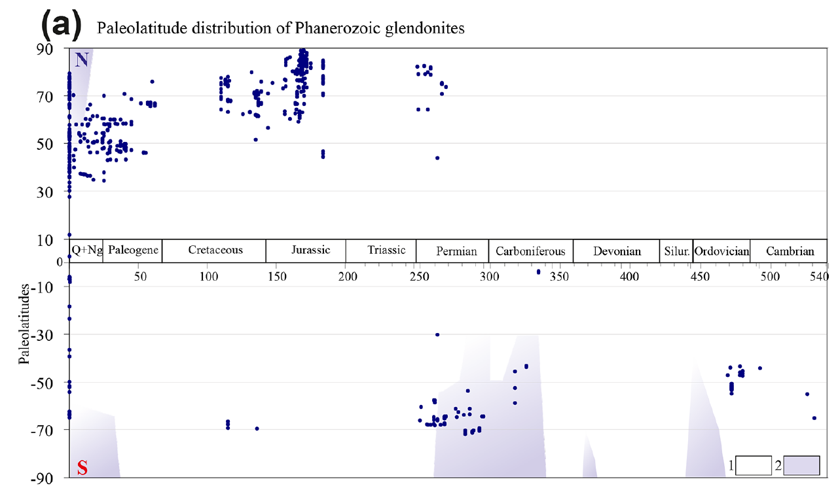
Glendonite distribution throughout the Phanerozoic is odd…
Rogov et al. (2021)

Slide 5
Furthermore, glendonite distribution throughout the Phanerozoic is odd…
Rogov et al. (2021)
Big glaciation, no glendonites

Slide 6
Furthermore, glendonite distribution throughout the Phanerozoic is odd…
Long-term Greenhouse conditions
(poss. glaciation S hemisphere)
Rogov et al. (2021)
Big glaciation, no glendonites

Slide 7
Furthermore, glendonite distribution throughout the Phanerozoic is odd…
Long-term Greenhouse conditions
(poss. glaciation S hemisphere)
Rogov et al. (2021)
Big glaciation, no glendonites
Alley et al. 2019

Slide 8
Furthermore, glendonite distribution throughout the Phanerozoic is odd…
Long-term Greenhouse conditions
(poss. glaciation S hemisphere)
Rogov et al. (2021)
Big glaciation, no glendonites
Alley et al. 2019
Korte et al. 2015

Slide 9
Furthermore, glendonite distribution throughout the Phanerozoic is odd…
Long-term Greenhouse conditions
(poss. glaciation S hemisphere)
Rogov et al. (2021)
Big glaciation, no glendonites
Alley et al. 2019
Bodin et al. 2020
Korte et al. 2015

Slide 10
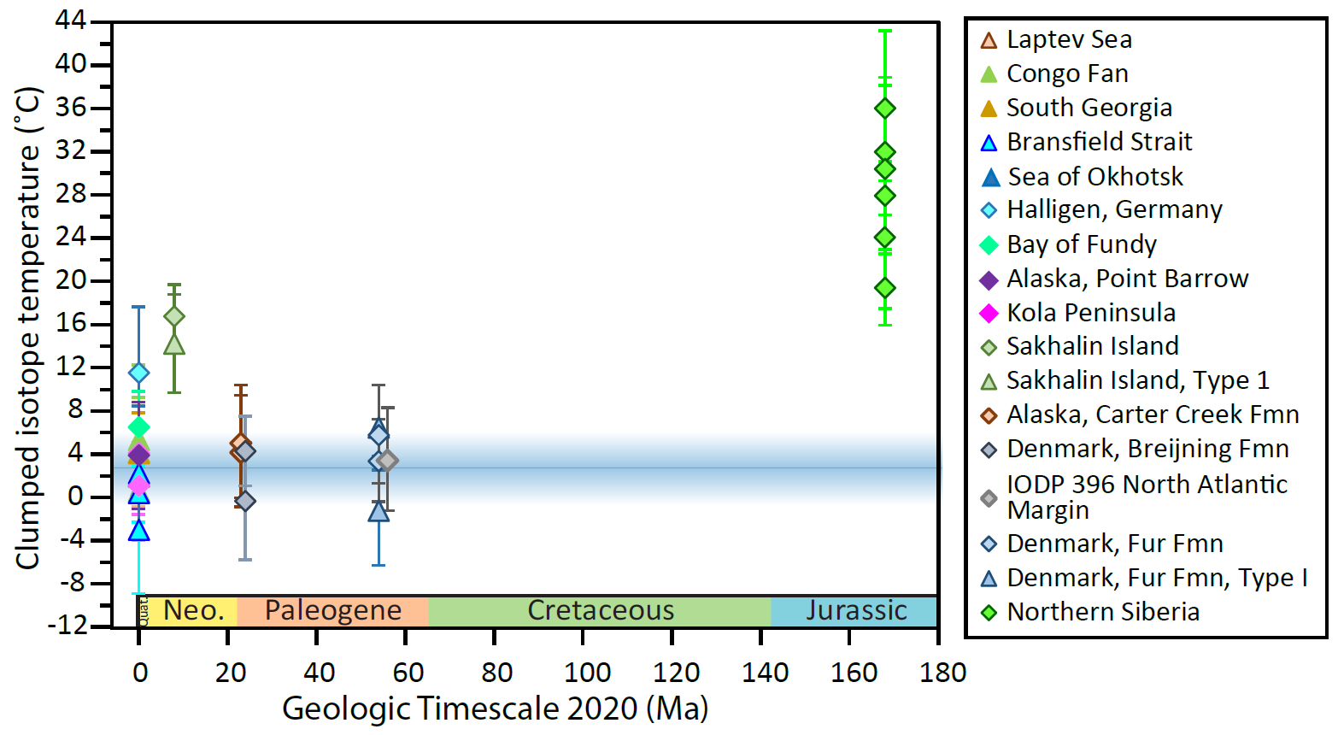
We undertook clumped isotope thermometry on glendonites from Jurassic to recent, to ascertain an upper limit for growth temperature* of the parent ikaite.
*talk to me after if you want discuss the arguments for this being so.

Slide 11
Two confounding factors here….
Ancient glendonites may contain multiple diagenetic phases
Clumped isotope thermometry records the crystallisation temperature of a carbonate. It is also susceptible to solid-state reordering:
If temperatures are elevated (e.g. >80 ˚C) for geological timescales (e.g. with deep burial of the sediments), apparent Δ₄₇ temperatures may be increased by re-ordering of the ¹³C-¹⁸O. no minor element or visible change, even at the microscopic level, occurs in the carbonate.

Slide 12
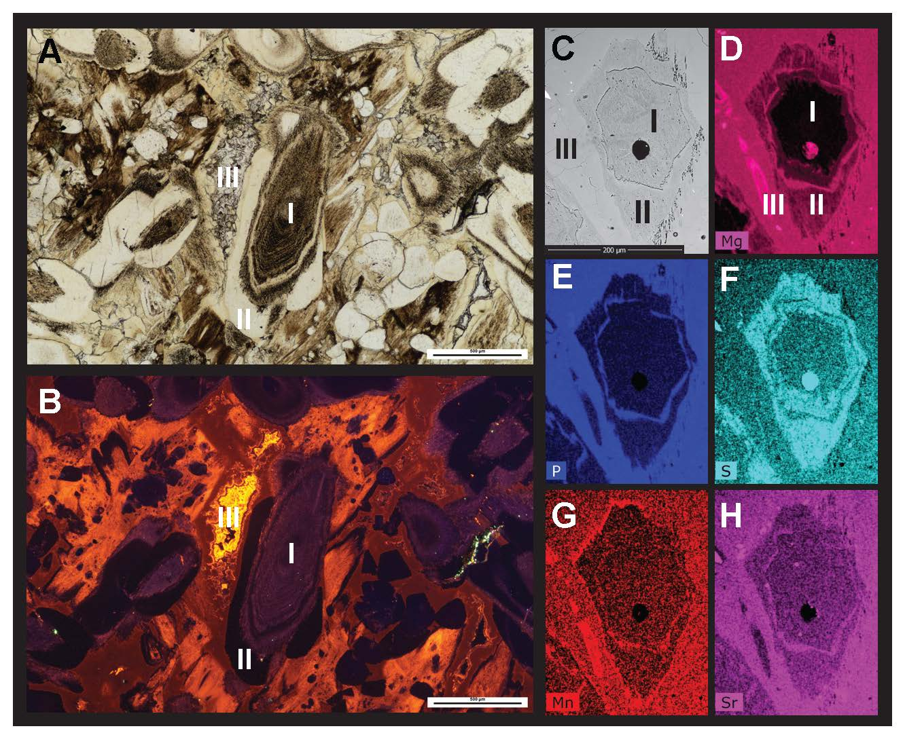
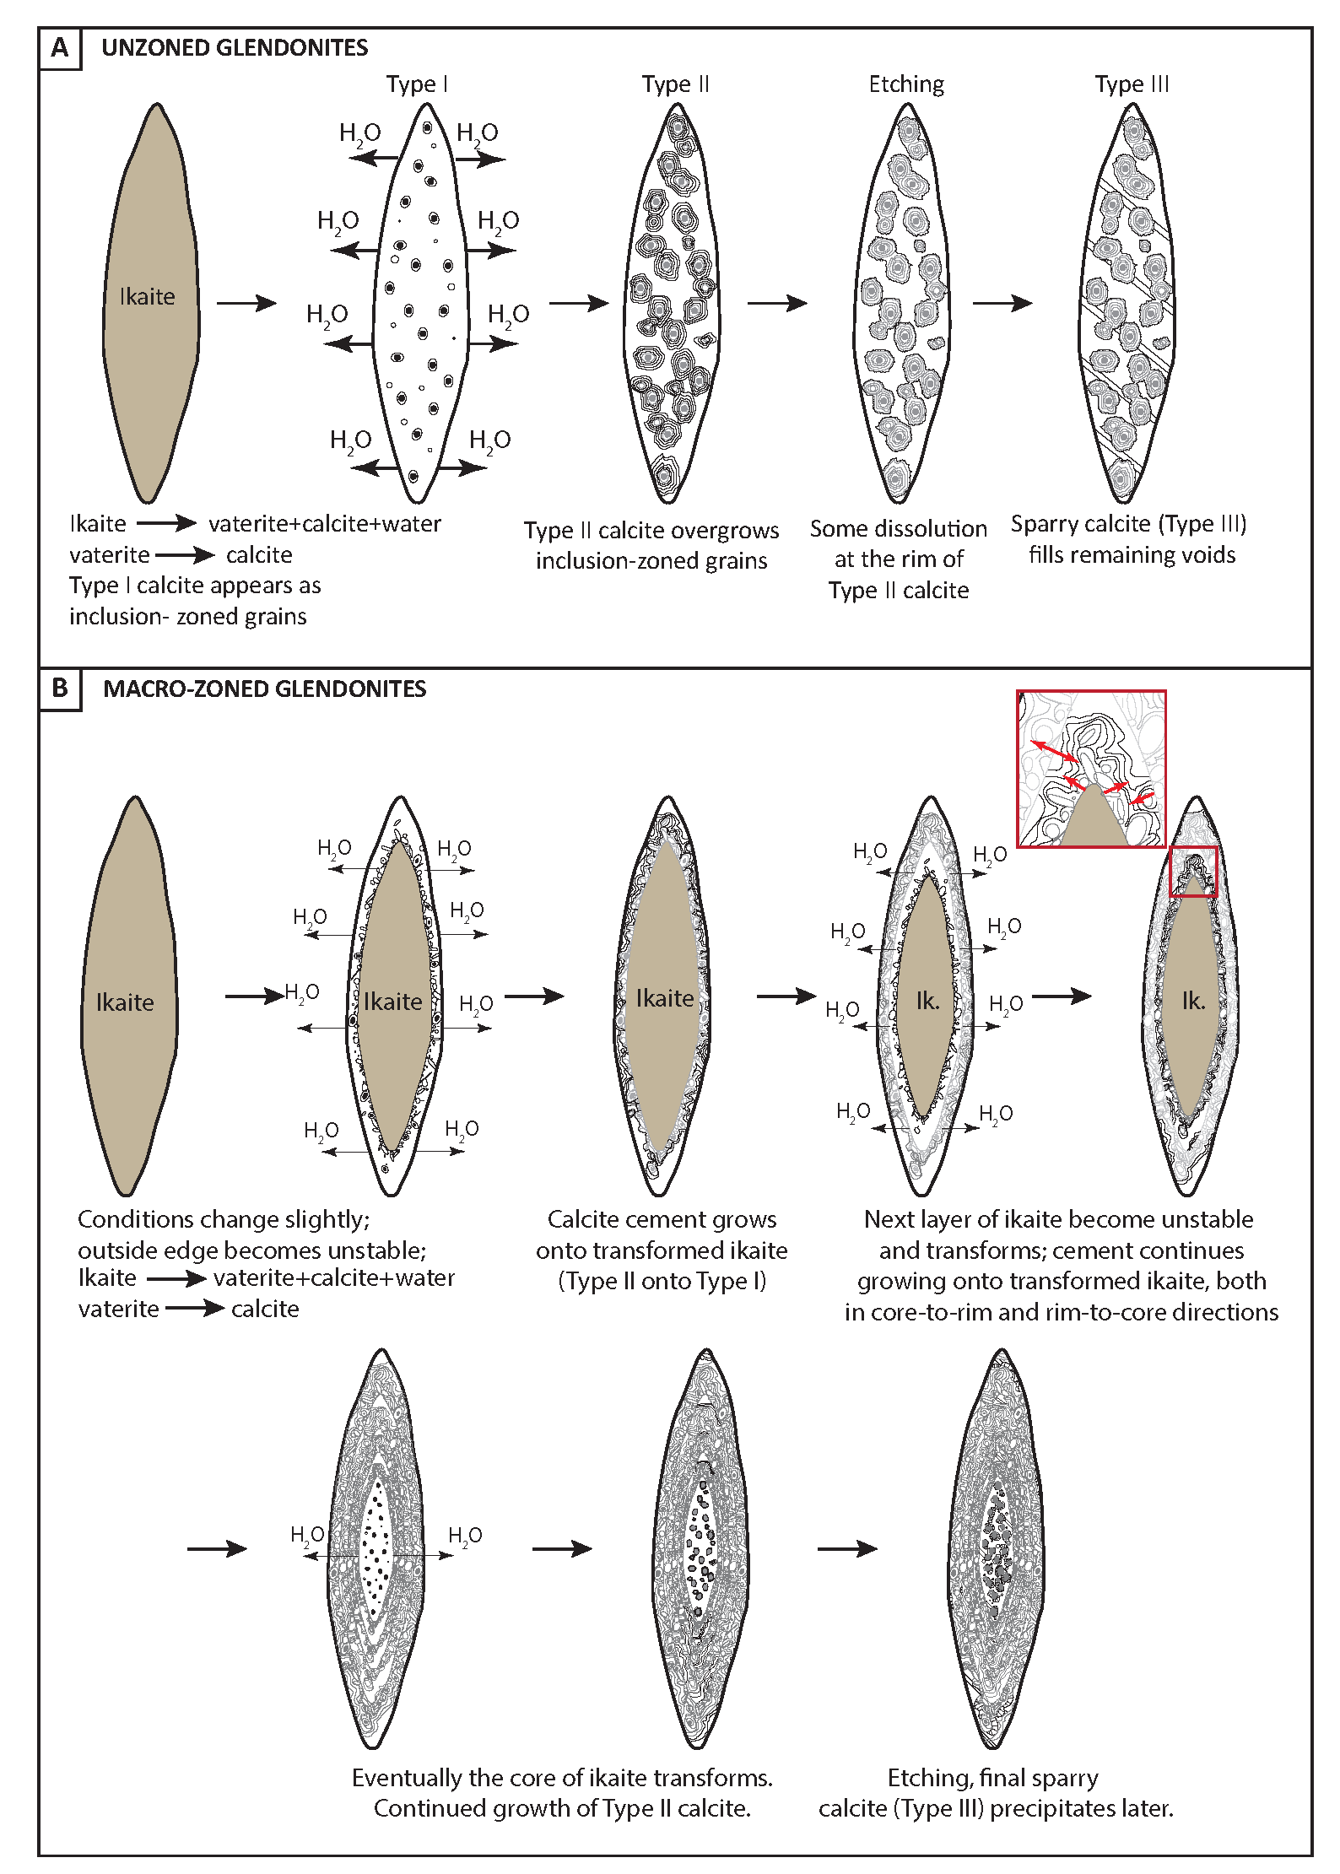
Glendonites may preserve a diagenetic history
Vickers et al. (2018)
Volume loss when ikaite turns to calcite. Multiple diagenetic calcite phases overgrow the ikaite-derived calcite.
Vickers et al. (2020)

Slide 13
Determining a maximum temperature for the Danish glendonites
Smash the glendonite and hand-separate clear spar fragments from brown primary calcite
Tertiary calcite phase III in glendonite: av. 10 °C
Type 1 & 2 calcite phase in glendonite: av. 3 °C
Vickers et al., 2020

Slide 14
Yet, bulk glendonite clumped temperature is within error of “primary” phase, likely due to the low percentage of spar, and large uncertainties on clumped temperatures

Slide 15
So, what about these?

Slide 16
Very old Jurassic glendonites. Lack the clear phases discernible in the younger glendonites: recrystallisation of the ikaite-derived calcite

Slide 17
Also look recrystallised. Glendonites from the underlying Gennoishi Fmn gave Ts > 80 ˚C; suspect high heat flow through the sediments has destroyed original signal.

Slide 18
Halligen sample: Late Quaternary (3666 ±-35 BP). Secondary calcites not present; unlikely to be recrystallised/undergone solid-state reordering, since timescale so short. Real signal? Investigations ongoing…

