Slide 1
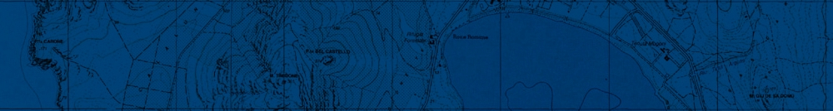




Company
A strategy of territorial control:
from the standard comparison techniques to
the Advanced Unsupervised Deep Learning Change Detection
in high resolution SAR images
GI2.2 session – 'Data fusion, integration, correlation and advances of non-destructive testing methods
and numerical developments for engineering and geosciences applications'
Speaker: Ilaria Pennino – NEMEA Sistemi srl
Authors: Ilaria Pennino
Cagliari, 15 September 2021
Ilaria Pennino
Vienna, Austria & Online | 23-27 May 2022

Slide 2

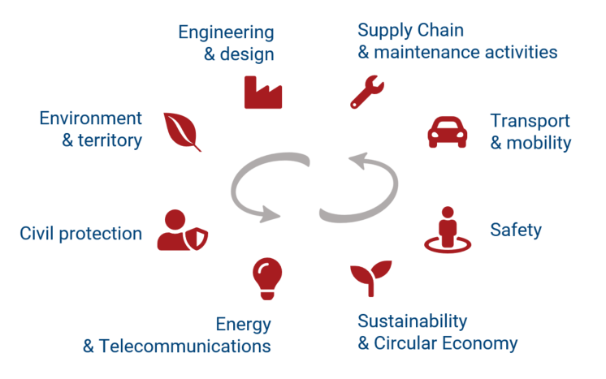
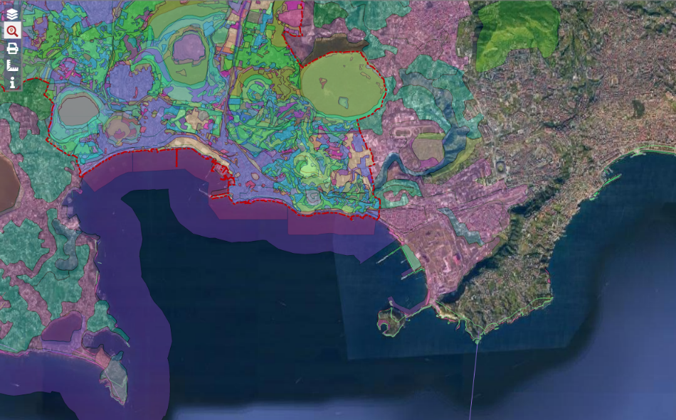
Company
NeMeA Sistemi Srl an Italian company that operates in the Geographic Information Systems (SIT and GIS) and territorial fields’ providing highly specialized solutions based on customer’s needs.
NeMeA Sistemi Srl integrates data and systems with particular attention to remote sensing and the processing of RADAR/SAR satellite images.
In recent years, the company has specialized in the development of plugin for QGIS and in the development of webGIS portals.
Vienna, Austria & Online | 23-27 May 2022
Ilaria Pennino

Slide 3
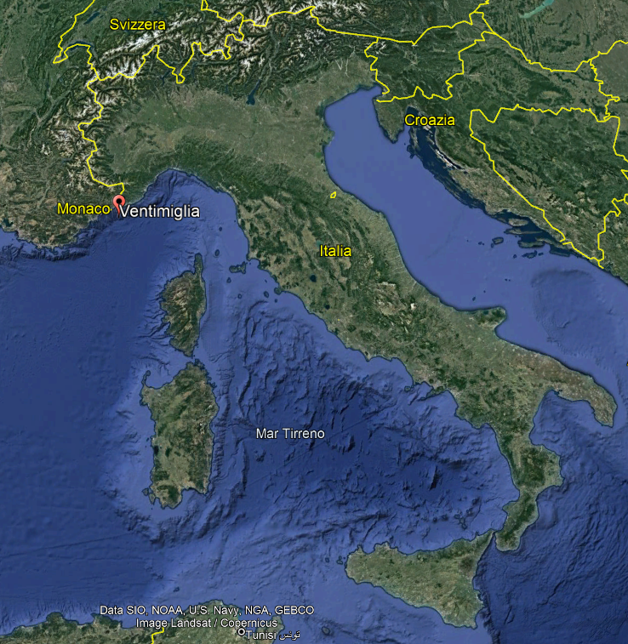
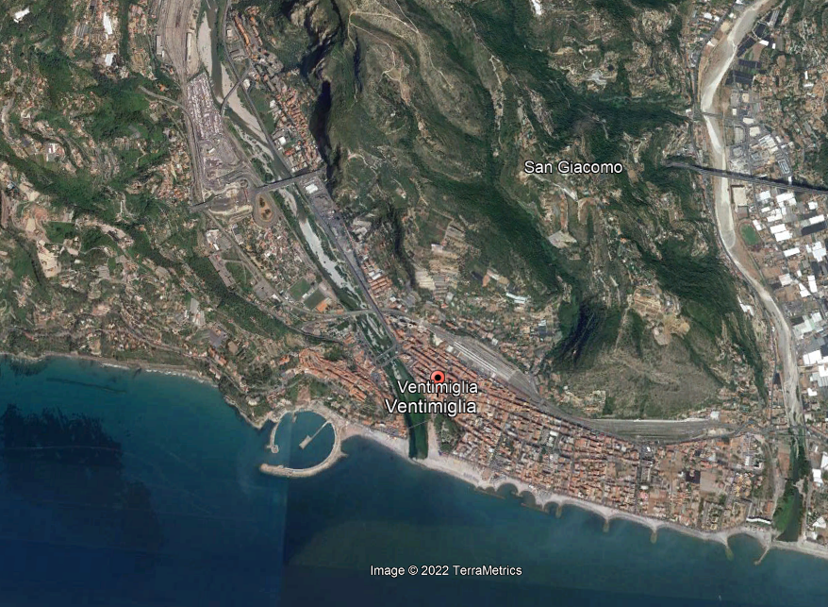
Ventimiglia legalty project
The project aims to identify all the physical components (artifacts, fences, roofs, foundation excavations, perimeter walls, roads and accesses) that are not present in land belonging to a particular area of the city of Ventimiglia
AIMS:
Coastline extraction
Roya stream sediments detection
Built –up areas extraction
Vienna, Austria & Online | 23-27 May 2022
Ilaria Pennino

Slide 4
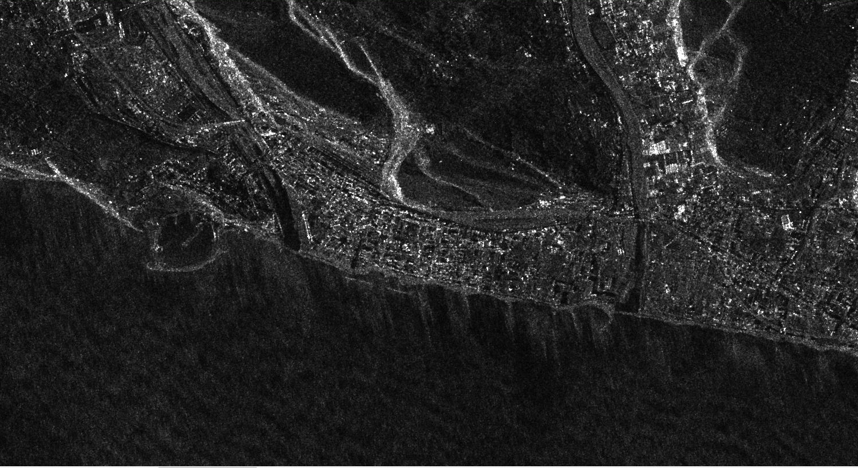
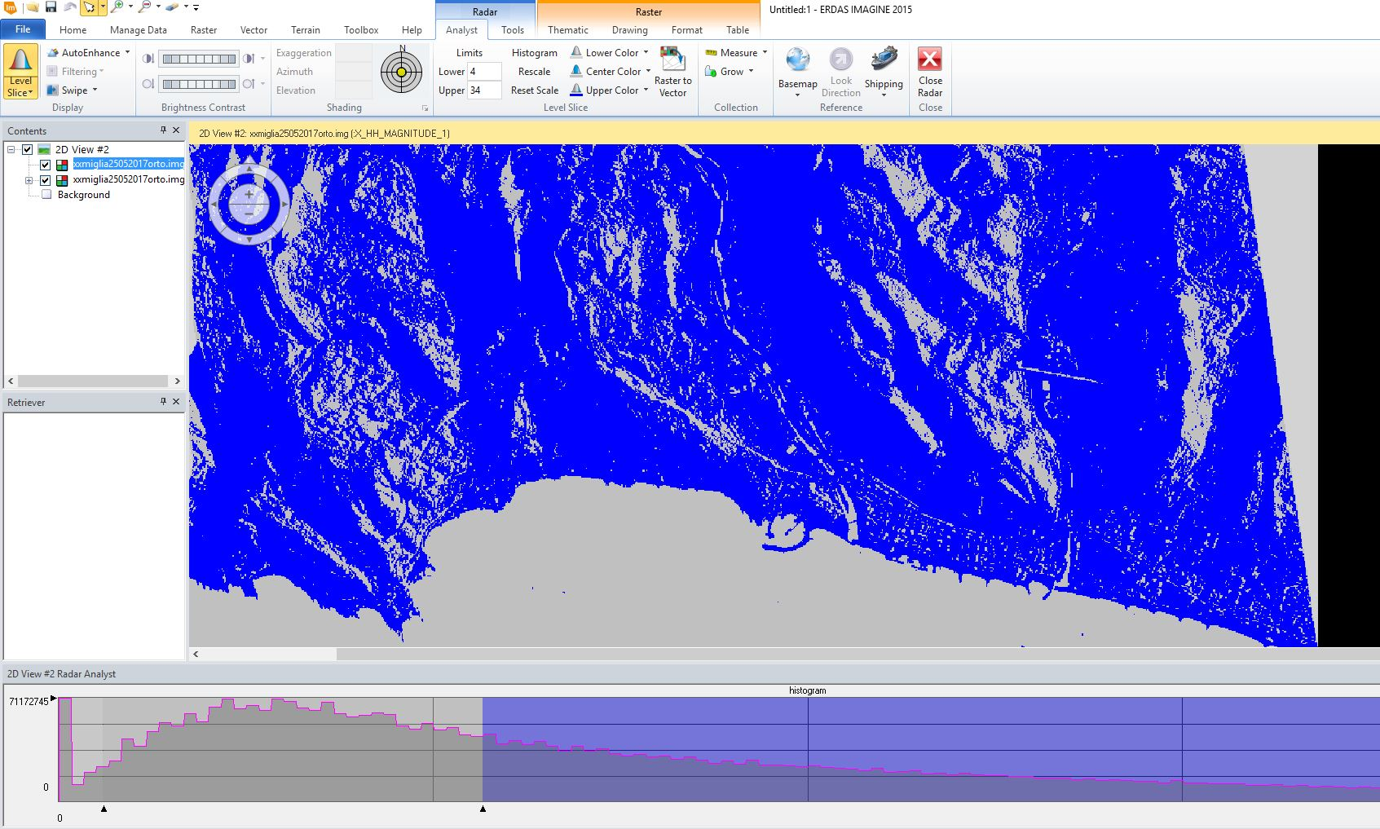
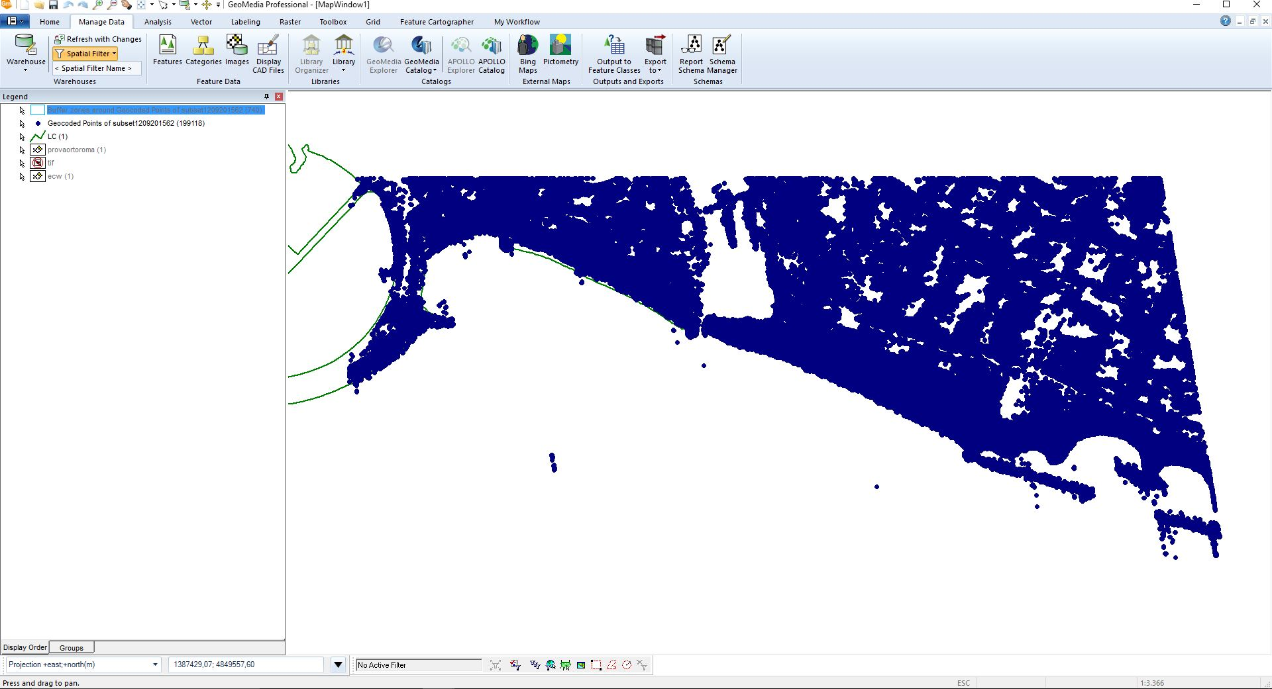
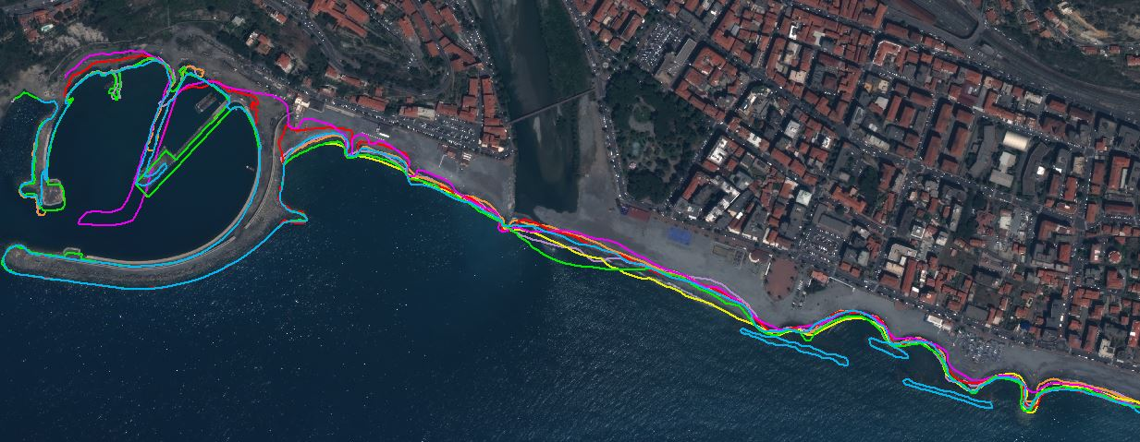
Ventimiglia legalty project - Coastline Extraction
STANDARD APPROACH
CSK- SPOTLIGHT image
LAND-SEA map extraction
COASTLINE VECTORIZATION
We are able to investigate the coastline trend and evolution
Vienna, Austria & Online | 23-27 May 2022
Ilaria Pennino

Slide 5
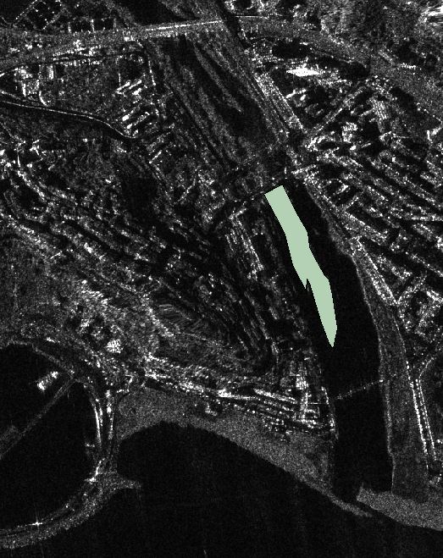
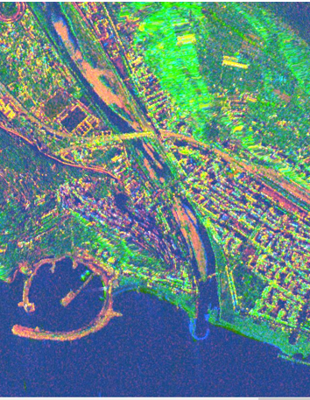
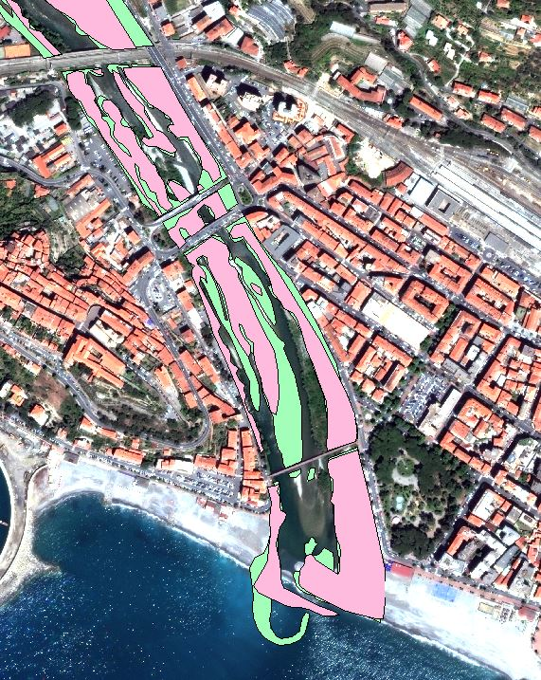
Ventimiglia legalty project - Detect & characterize sediments
STANDARD APPROACH
Processing the radar image we pick out only the «sediment» pixels and vectorialize them
Vienna, Austria & Online | 23-27 May 2022
Ilaria Pennino

Slide 6
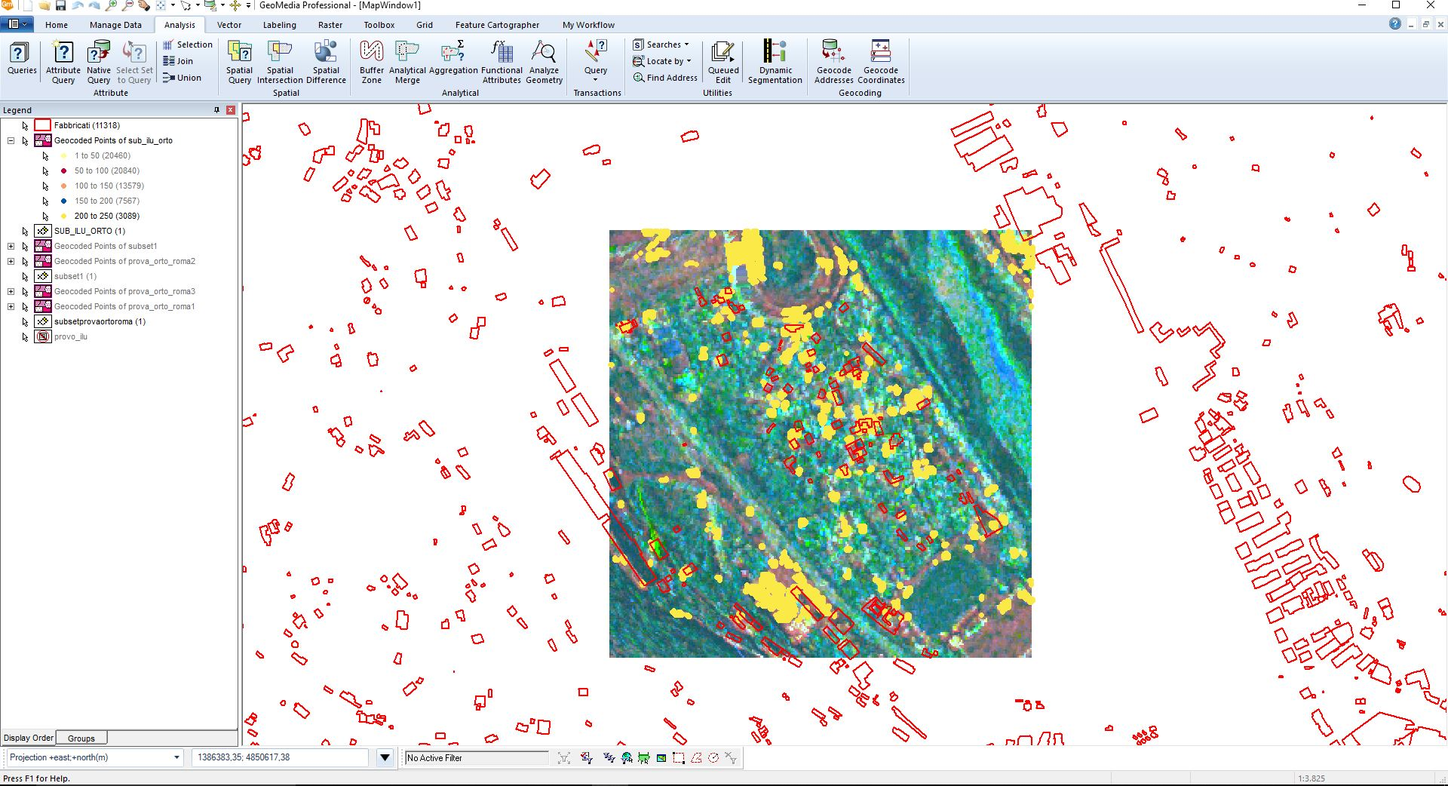
Ventimiglia legalty project - Built –up areas extraction
STANDARD APPROACH
Through a few steps in GIS software, vectorize the pixels centroids with the high coerence value
Vienna, Austria & Online | 23-27 May 2022
Ilaria Pennino

Slide 7
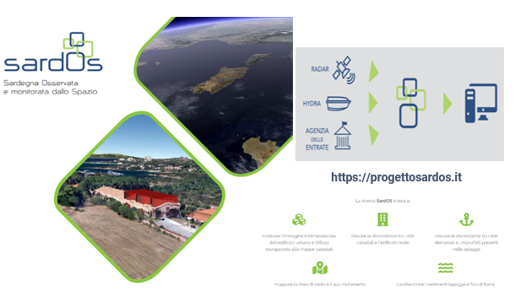
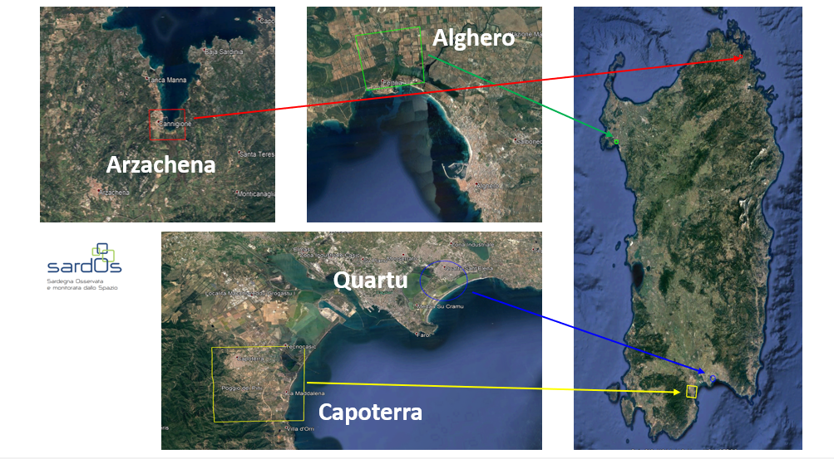
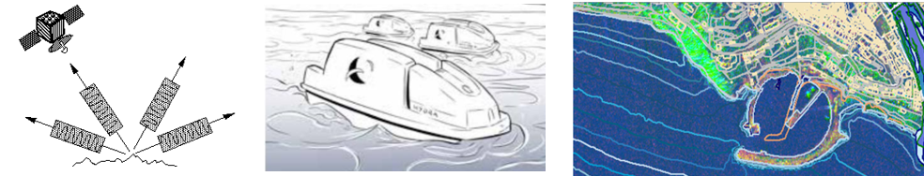
SardOS project
RADAR / SAR images
(COSMO-SkyMed – SPOTLIGHT - X-band products)
January 2018
Is one of the 5 winning projects of the call
“POR FESR 2014-2020 – Programma di ricerca e sviluppo – Settore Aerospazio “
To detect the coastline and its evolution
To detect and characterize sediments (beaches and river mouths)
To detect artefacts (urban and diffused buildings) and give information about its height
USV data (HYDRA® VOL. II - multifunctional craft)
To survey of both the coastline and bathymetry
To analyze coastal trends and verify the potential effects of human activities on coastal dynamics
Vienna, Austria & Online | 23-27 May 2022
Ilaria Pennino

Slide 8
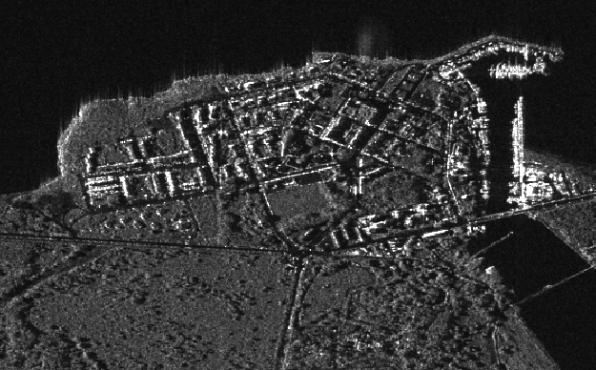
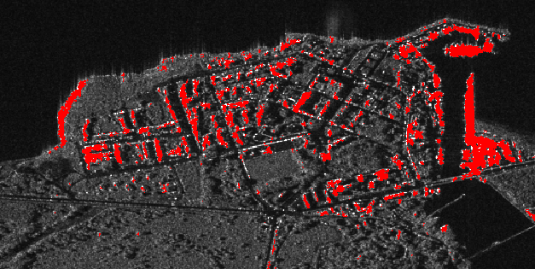
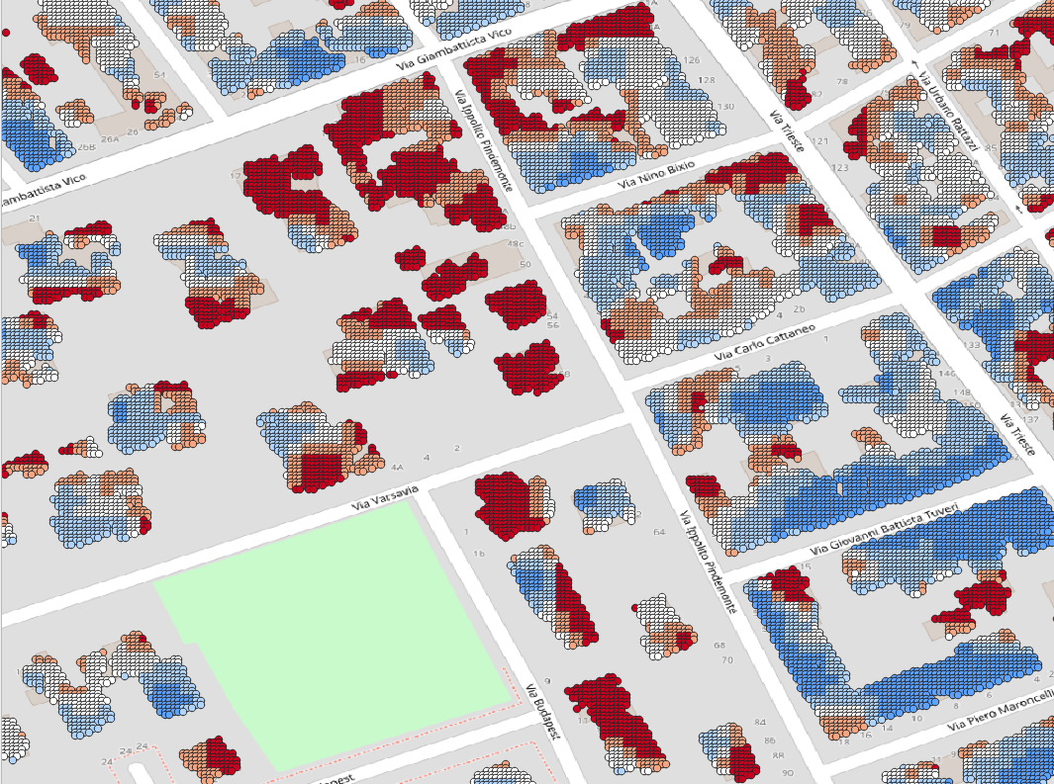
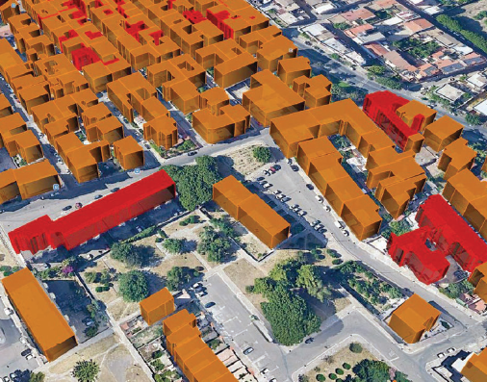
SardOS project – Built up areas & Buildings Height
SUPERVISED CLASSIFICATION
&
NEW ALGORITHM IMPLEMENTATION
Built up areas
CSK image
Flow chart
Buildings
Height
3D Buildings
Height
Vienna, Austria & Online | 23-27 May 2022
Ilaria Pennino

Slide 9
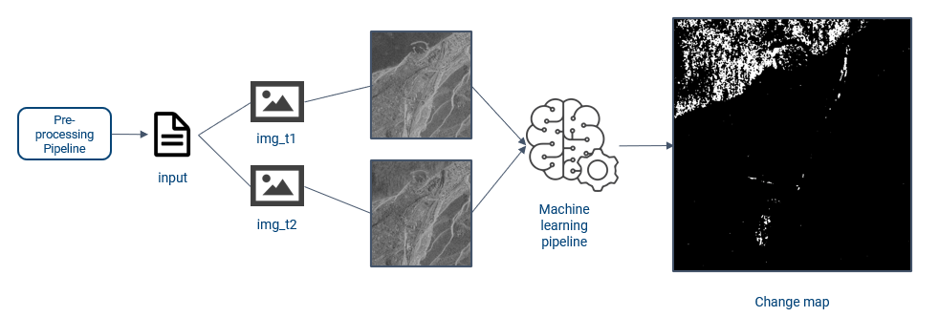
3XA project
Deep Learning SAR change detection following the training, the inference produces an accurate change map of the areas where the change is present. The change map (CM) can be used overlapping the original image or orthorectified to highlight the areas that show change
It is an infrastructure of convolutional neural networks on which gyms are created where we train algorithms that operate in unsupervised mode. From the raw data we extract information ready to be used on GIS in a short time.
Vienna, Austria & Online | 23-27 May 2022
Ilaria Pennino

Slide 10
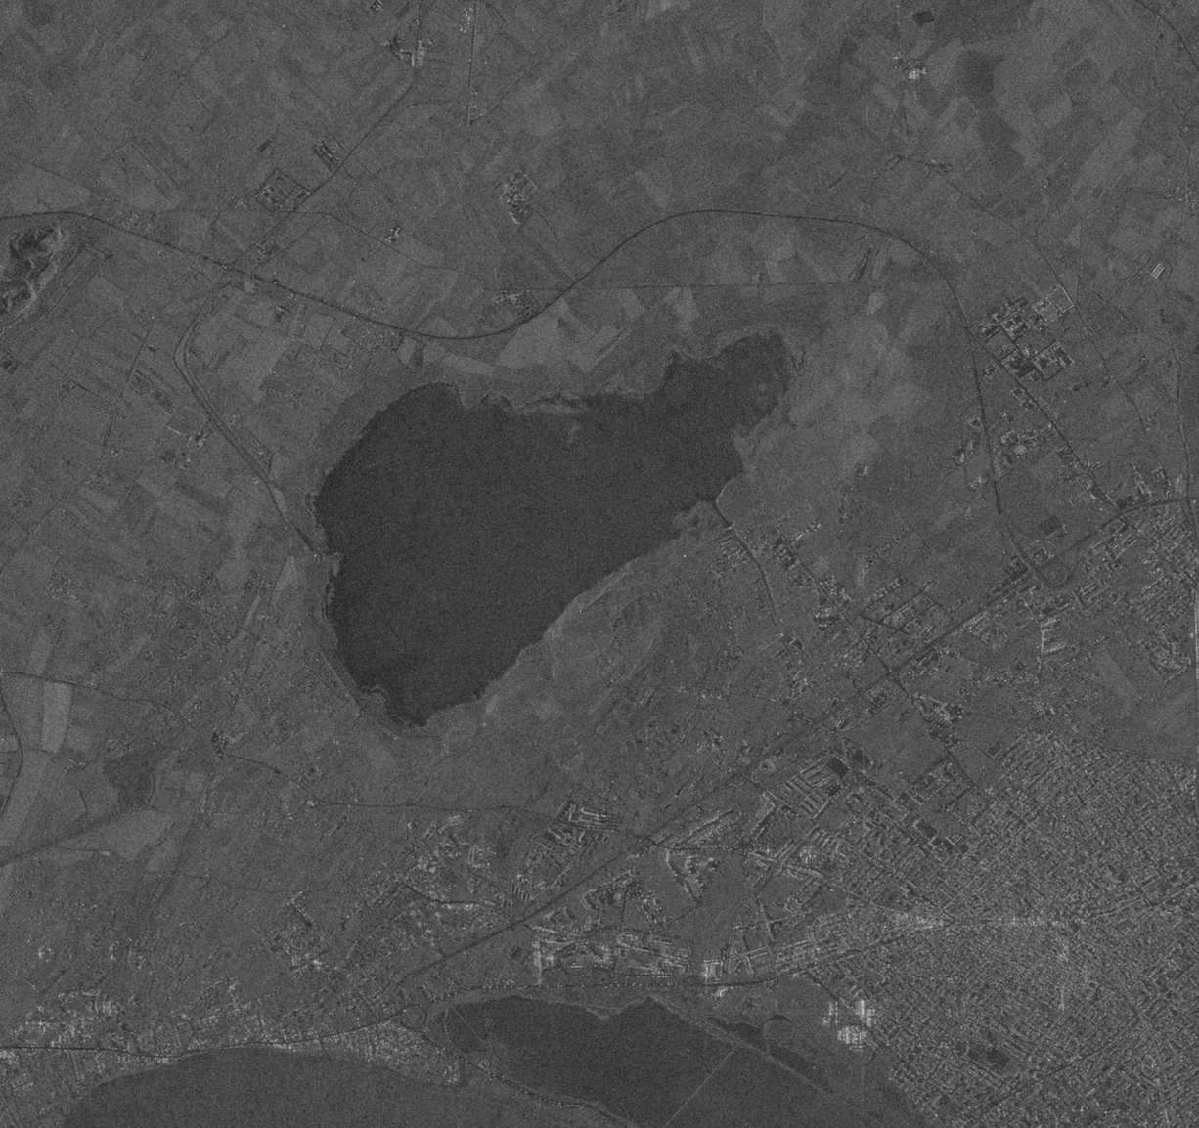
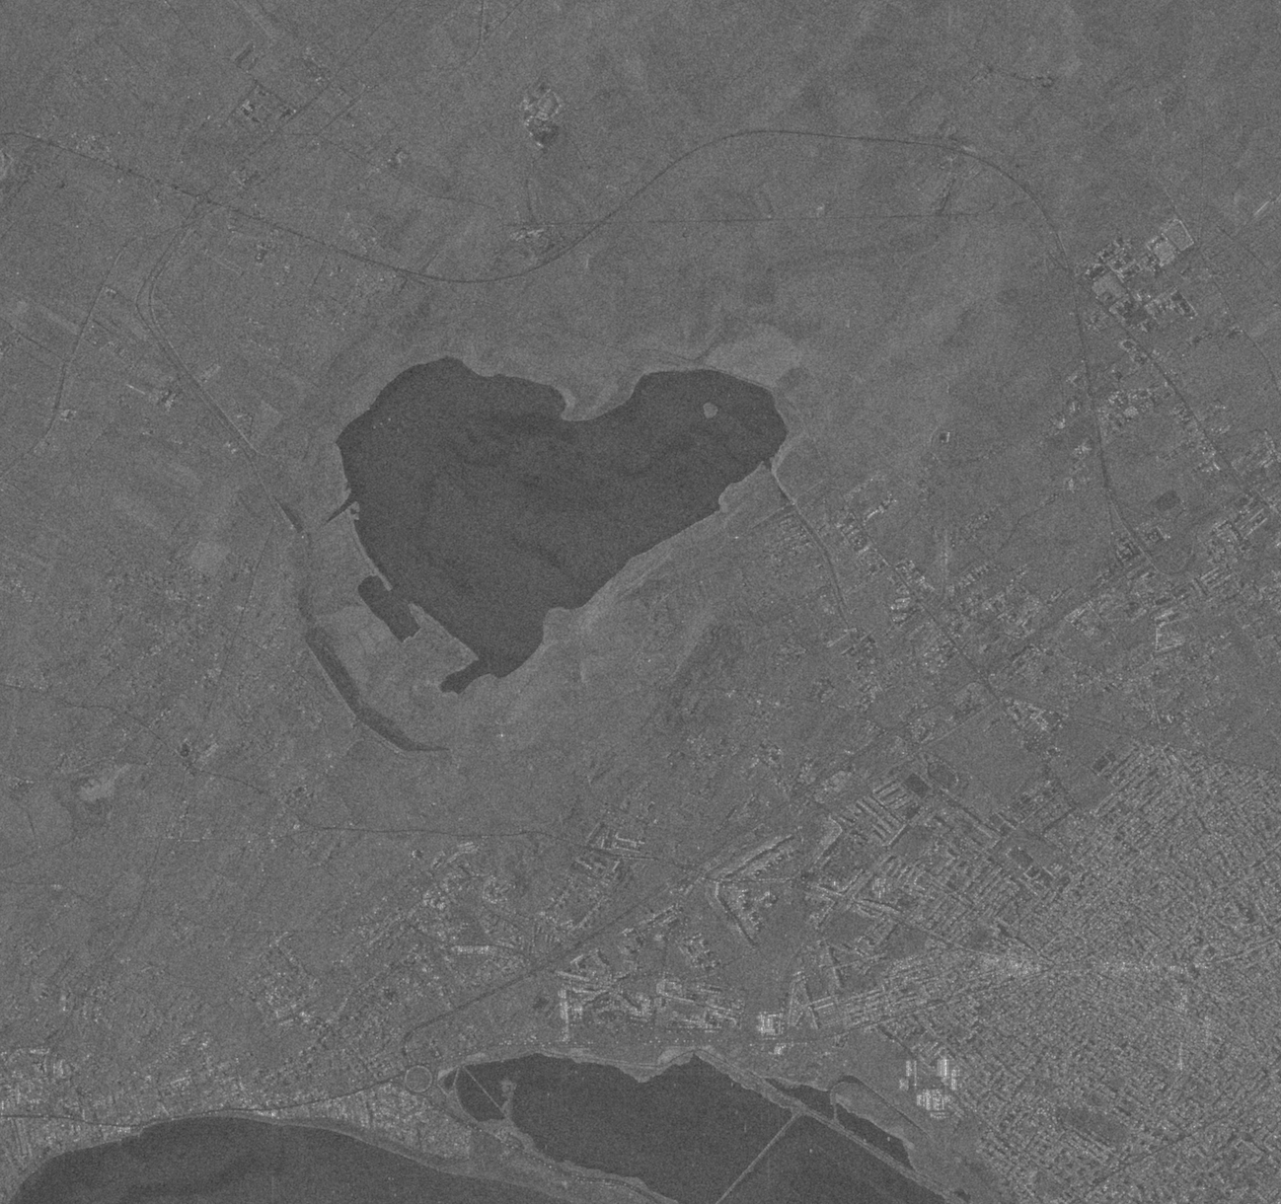
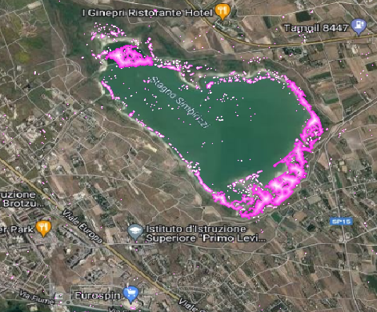
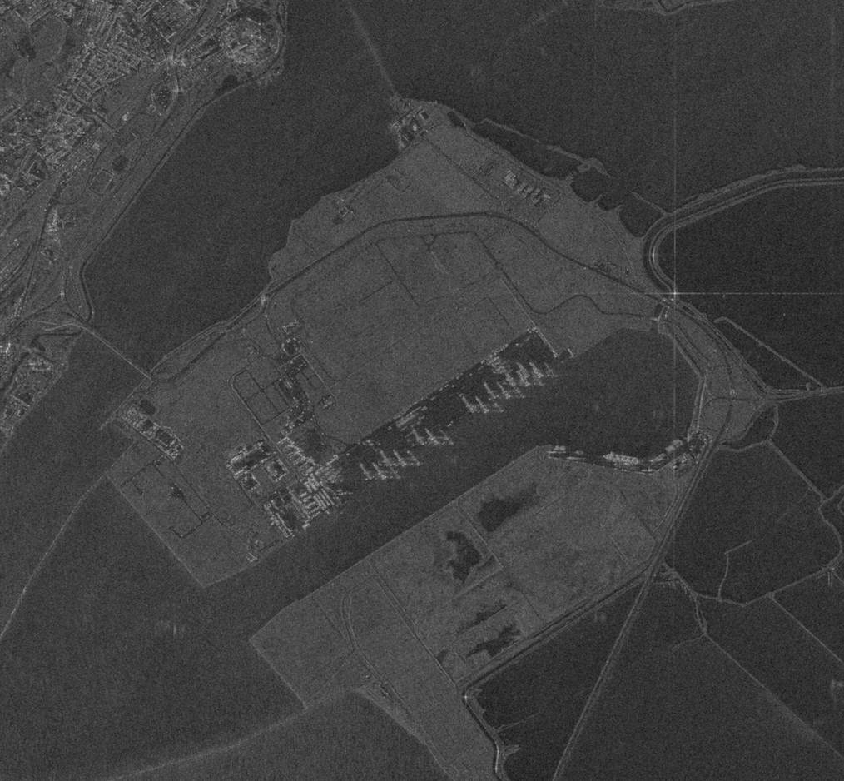
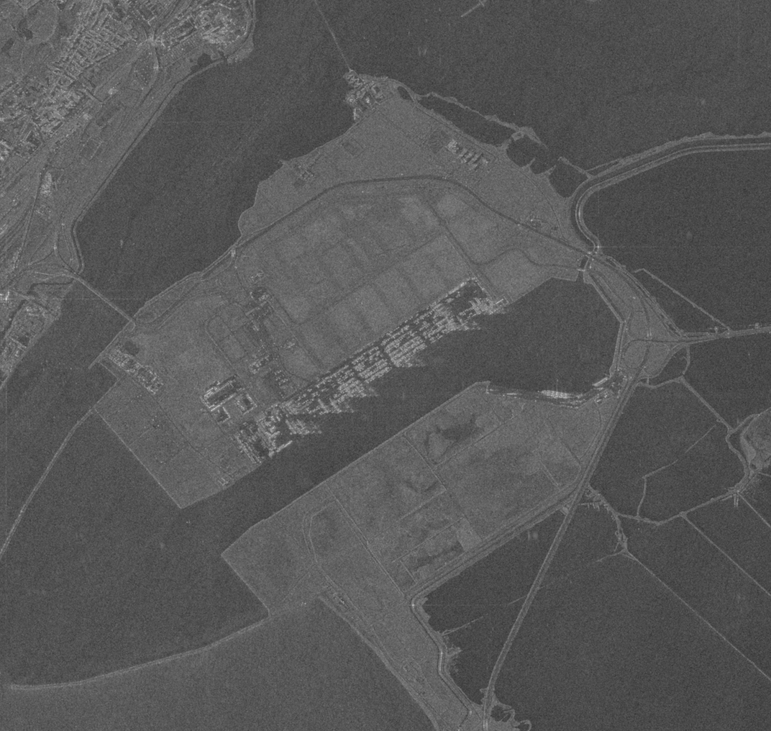
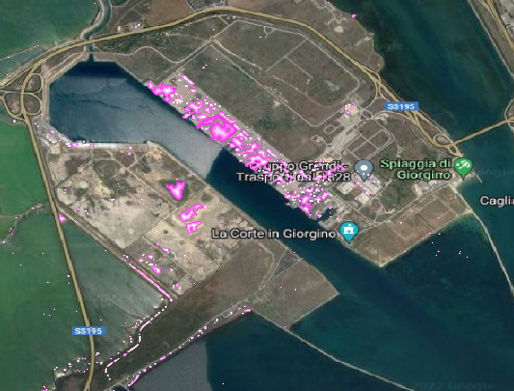
3XA project - Advanced Unsupervised Deep Learning Change Detection
CSK master image
CSK slave image
3xA change map
CSK master image
CSK slave image
3xA change map
Vienna, Austria & Online | 23-27 May 2022
Ilaria Pennino

Slide 11


Thanks !
Vienna, Austria & Online | 23-27 May 2022
Ilaria Pennino

