Slide 1
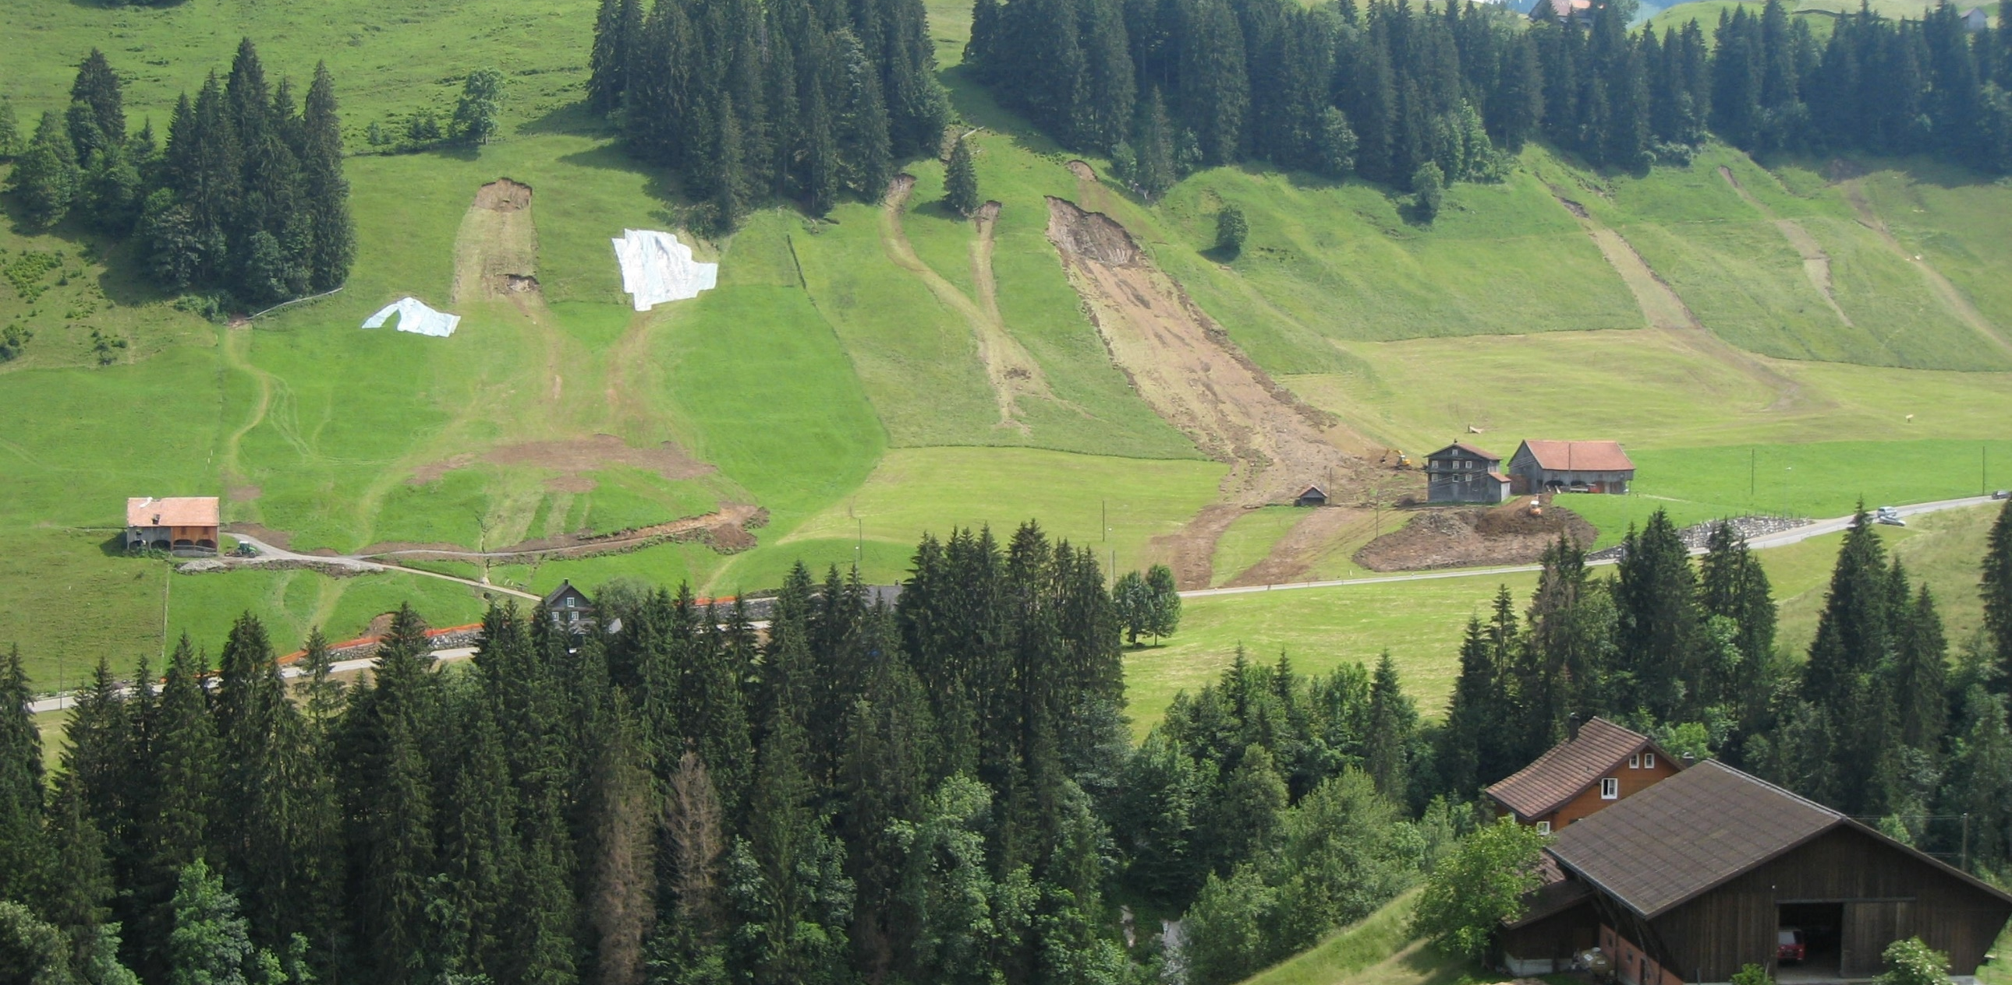
Role of measured and simulated water content patterns for landslide early warning systems
Tobias Halter (ETH Zurich, Switzerland)
Peter Lehmann (ETH Zurich, Switzerland)
Adrian Wicki (WSL, Switzerland)
Manfred Stähli (WSL, Switzerland)
Landslide Napf, Picture by C. Rickli
Notes:
Hi everybody my name is Tobias Halter and I am currently working on my master thesis together with peter Lehmann from eth Zurich, Adrian Wicki and Manfred Stähli from WSL who is also present today.
We are conducting research on the Role of measured and simulated water content patterns for landslide early warning systems.

Slide 2
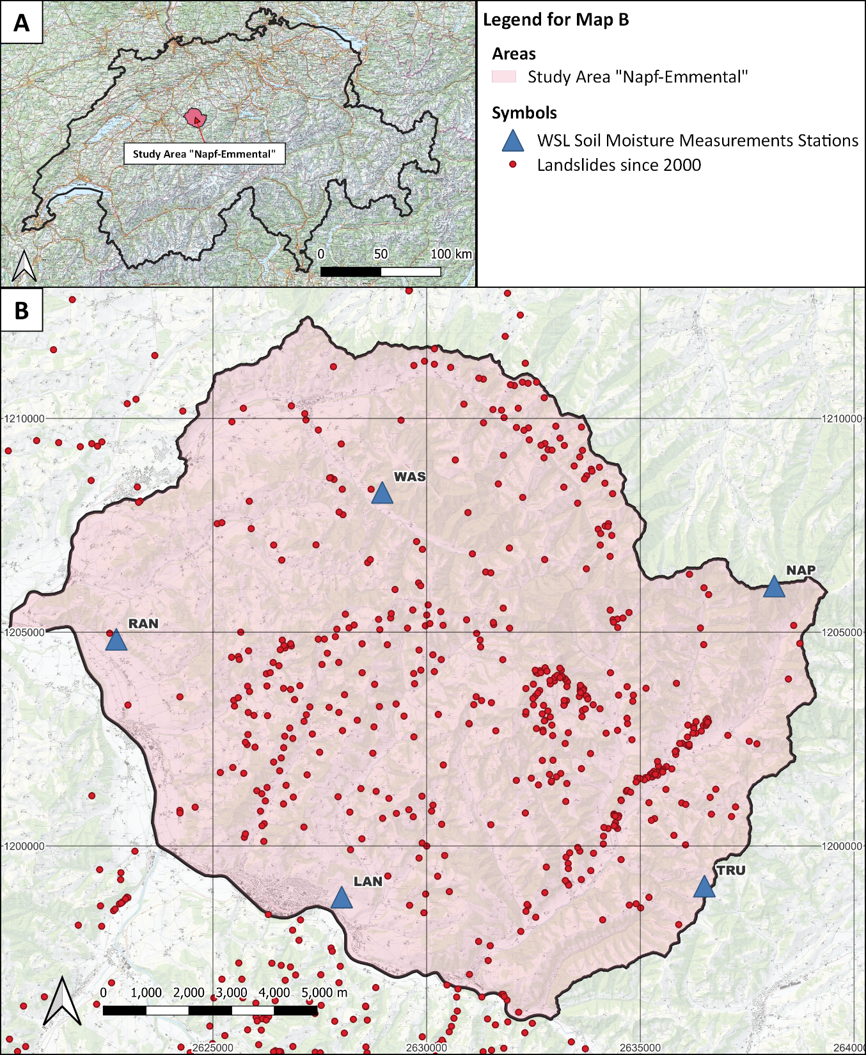
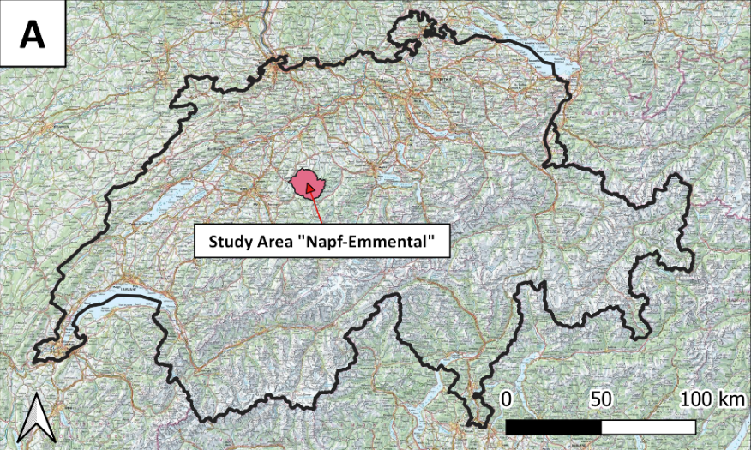
Pilot Region for Landslide Early Warning: Napf-Emmental
To develop Landslide Early Warning Systems (LEWS) for Switzerland, a test region was delineated and instrumented
The relevance of soil water content patterns for landslide triggering will be defined
186 km² with 300 documented landslides since year 2000
6 soil moisture measurement stations (water content and matric potential at four depths, precipitation;
thesis A. Wicki, 2022)
Notes:
In Switzerland a project is currently underway to develop a functioning early warning system for landslides, for which a test area has been delineated and instrumented. It is located in the canton of Bern and aims to define the relevance of soil water content patterns for triggering landslides.
The region is very prone to landslides due to the many steep pre-alpine meadow and forest slopes. Since the year 2000 over 300 LS have been documented in this rose area which is 186 km^2 large.
In addition there are 6 soil moisture measurement stations within the project area, which measure the volumetric water content and the matric potential at four different depths, as well as the precipitation.

Slide 3
Role of Water Content Patterns in LEWS
Methods
Analysing time series of volumetric water content (VWC) and rainfall events
Developing logistic regression model based on VWC series to predict spatial saturation patterns (normalized VWC)
Physically based modelling of landslide triggering (STEP-TRAMM)
Objectives of the project
To quantify the benefit of spatially distributed saturation in physically based modelling
To define rainfall and soil saturation thresholds
Notes:
In our work we analyse the VWC and precipitation data of the 6 soil moisture station to predict spatial saturation patterns.
Here in this figure you can see the mean VWC series of the last summer for two station; and how much the measured water content (in red) are affected by rainfall periods (indicated with these blue bars).
So, the first thing we do is normalizing VWC to soil saturation and then determining the Saturation at the onset of a rain event. By doing so, we obtain 217 Saturation values for the period of the last summer which serve as input for logistic regression models with which we then are able to spatially distribute the initial soil saturation before a rain event.
These spatially distributed soil saturation maps are implemented into physically based landslide modelling using the numerical model STEP-TRAMM.
So the objectives of this study is really to quantify the benefit of spatially distributed soil saturation maps in physically based modelling.
And further to define rainfall and soil saturation landslide thresholds.
X: And further, to quantify the increase of soil saturation during rainfall periods, which will allow the spatial prediction of landslide hazards.

Slide 4
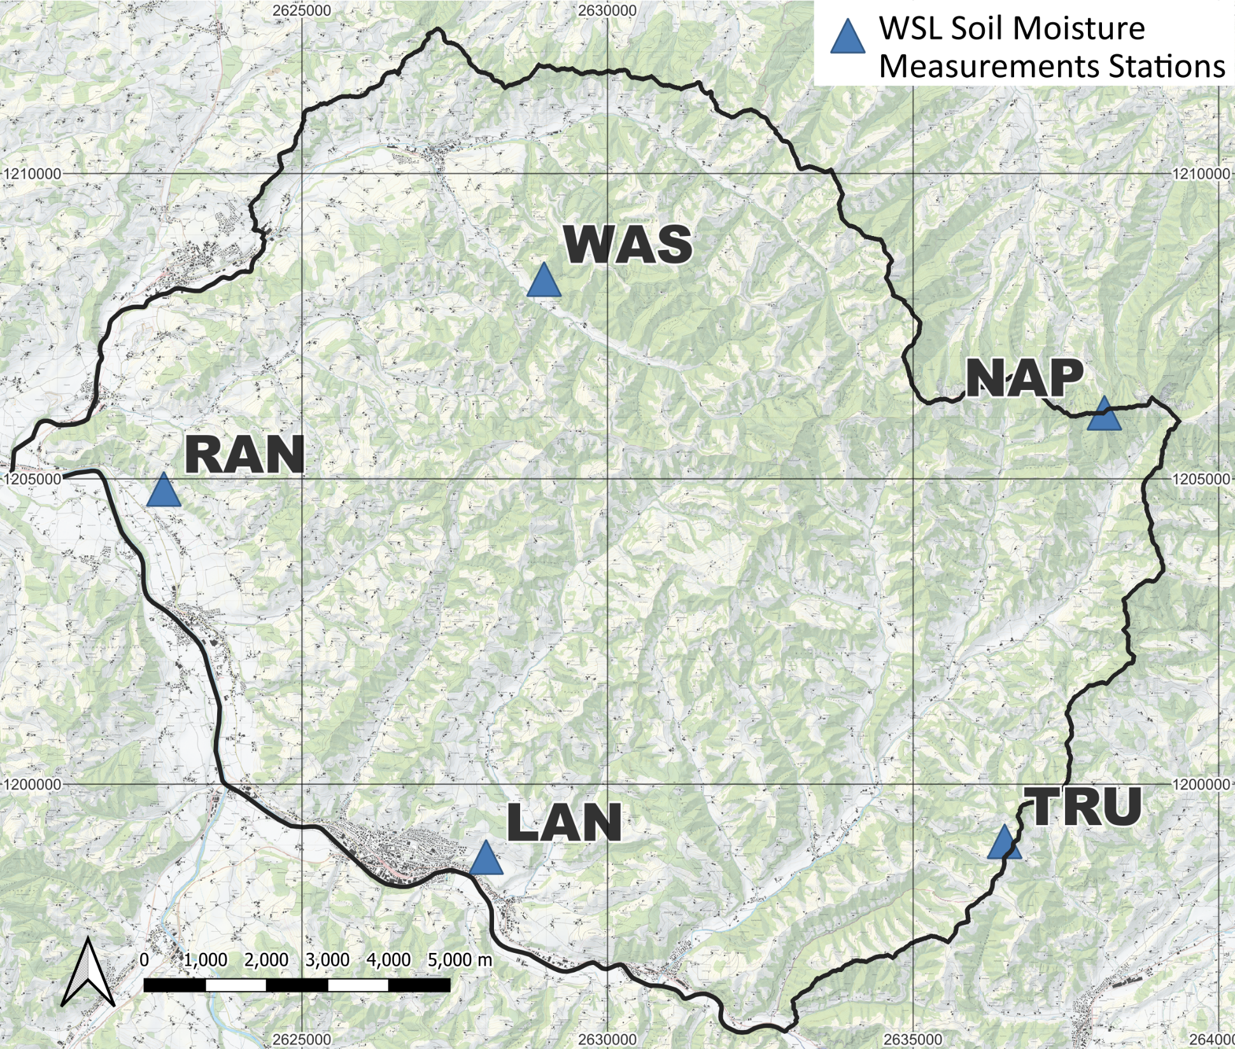
Logistic Regression Model for Saturation Patterns
Model is based on:
14 day antecedent rainfall (based on 6 VWC stations)
14 day antecedent potential evapotranspiration (based on 2 weather stations)
Topographic Wetness Index (TWI)
Notes:
So here in this figure you can see how we use the measured saturation values at the onset of a rainfall event (on the x-axis) to predict the soil saturation based on a logistic regression model (here on the y-axis). The model shown here comprises of only 3 variables. The 14 day antecedent rainfall, (which is measured at all 6 soil moisture measurements stations), the 14 day antecedent potential evapotranspiration (which is computed at 2 meteorological weather stations), as well as the topographic wetness index. This model which is based on measurements from summer 2021, yields a reasonable correlation of r^2 equal to 0.54.
X: So this is exact model is only used to define the initial soil saturation before a rainfall event, which is used is input in the numerical model. Slightly different models are developed to simulate the soil saturation increase during an event.

Slide 5
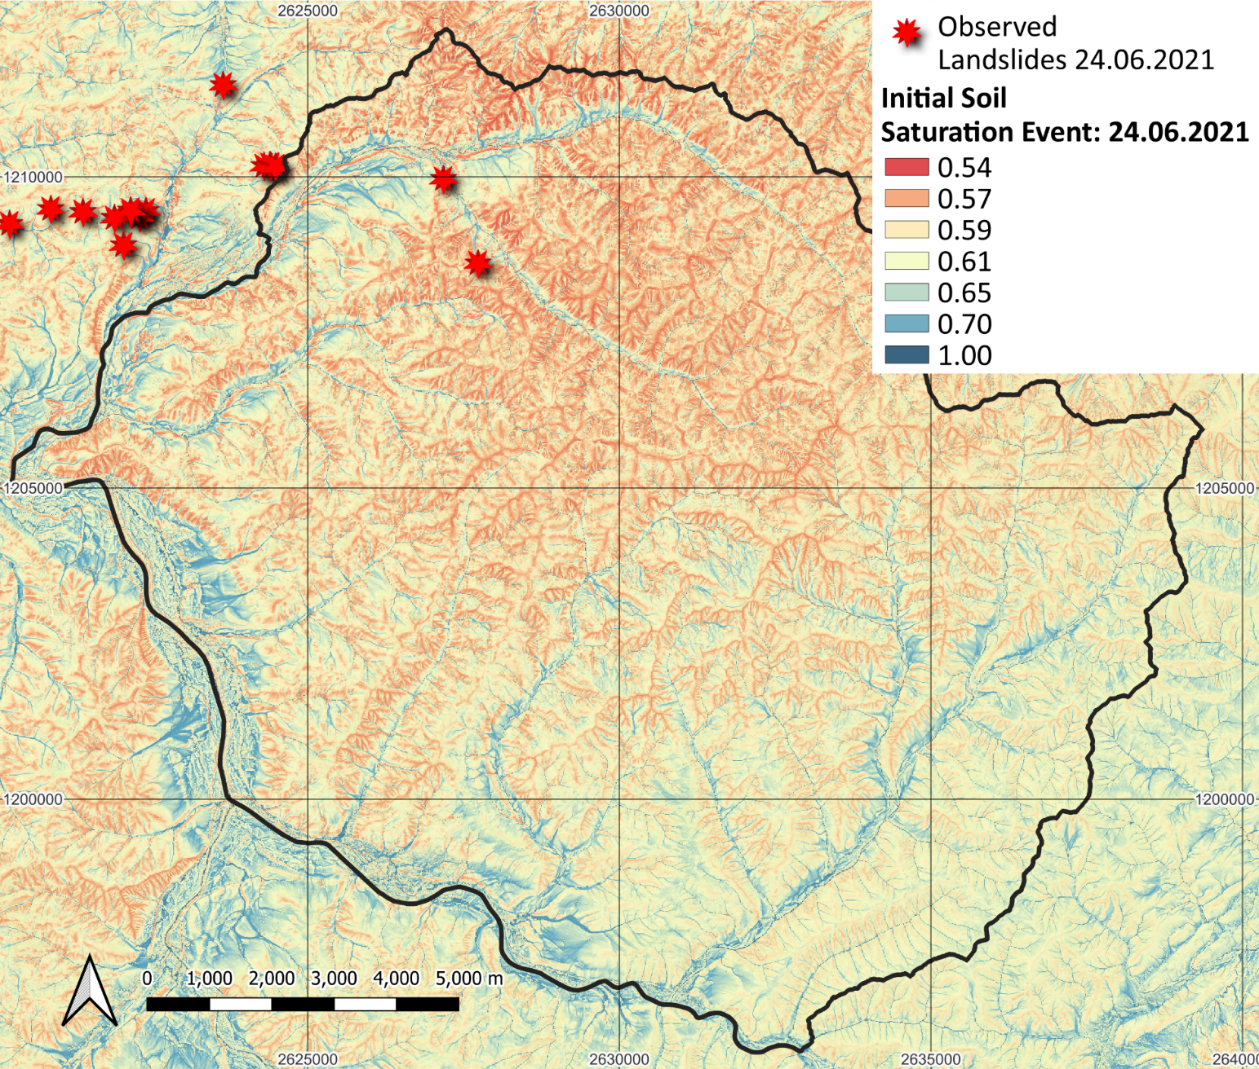
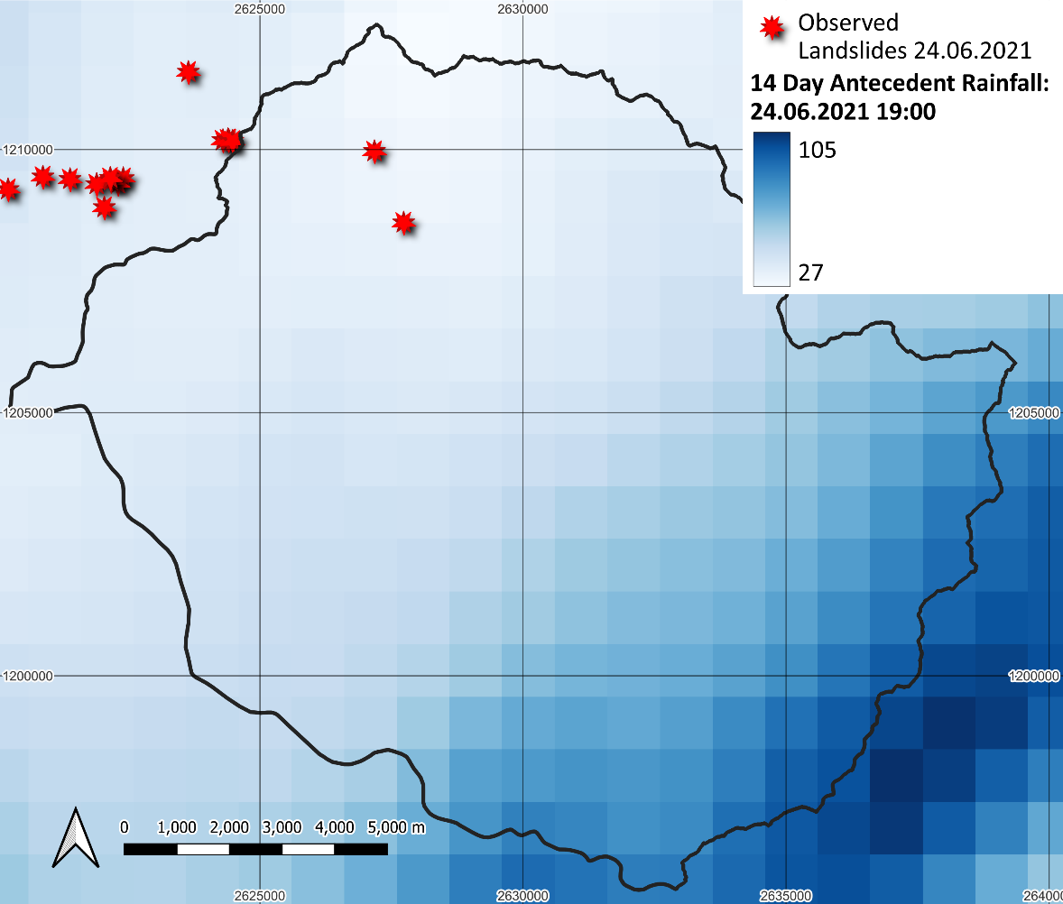
Map of Initial Soil Saturation - Event with 17 Landslides (June ’21)
High saturations close to channels and regions with high antecedent rainfall
Notes:
So how does such a spatially distributed soil saturation map look like? In the figure on the right, you can see an example for an event which occurred in 17 landslides last June. And we can see how the soil saturation is dependent on the topography. In the sense that that (close to channels), in convective flow areas, higher saturation values are predicted compared to ridges and steep slopes, which is very much realistic. And when we further compare areas with generally larger soil saturation, here in the south-east for example, with the cumulated rainfall 14 days prior to the rainfall event, we can clearly see a dependency of the predicted saturation on the antecedent rainfall.

Slide 6
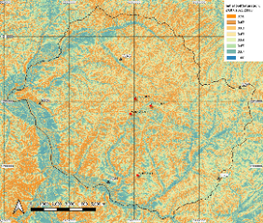
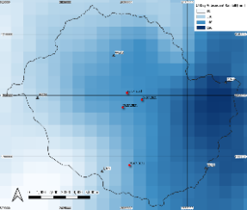
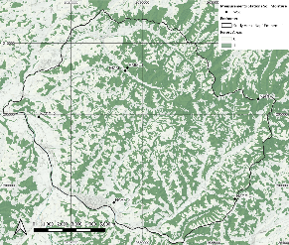
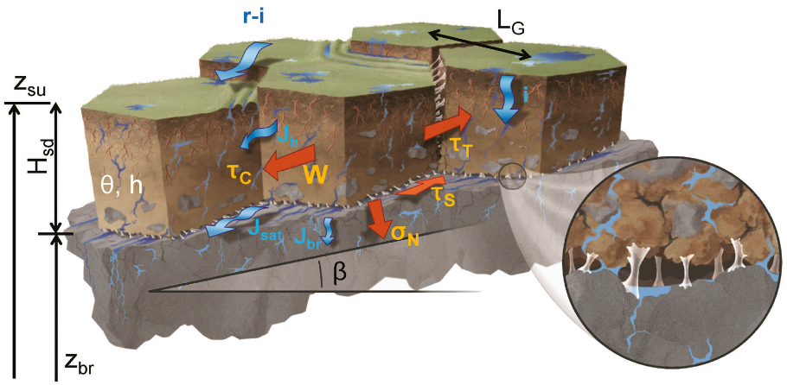
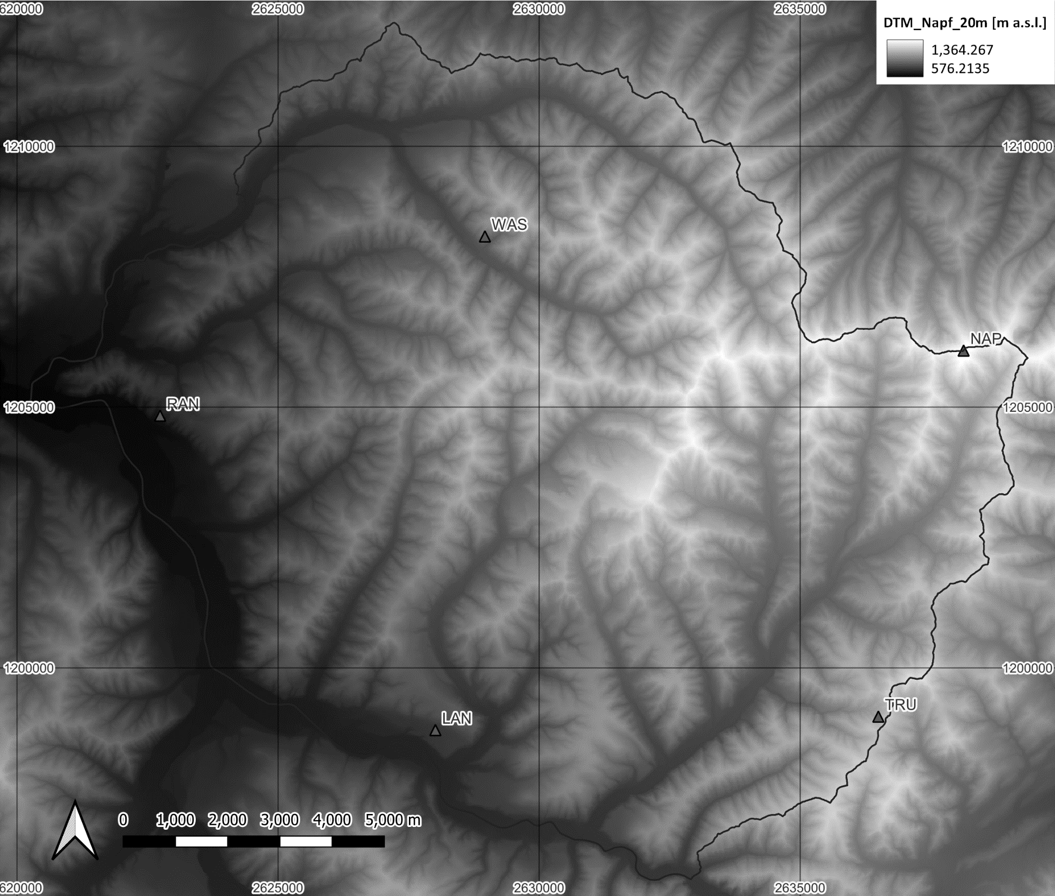
Numerical Simulation with STEP-TRAMM
Heterogeneous Soil Saturation
Model which calculate soil depth and load redistribution to mass release
Spatio-Temporal Rainfall
STEP-TRAMM
Landslide
Point
Patterns
Forest Map
DEM
Source: Lehmann and Or, 2012
Notes:
As mentioned before, we implement these initial soil saturation maps, together with Spatio-Temporal Rainfall maps, forest Maps and digital elevation model into the numerical model Step Tramm. Step-TRAMM then simulates landslide triggering in a product of spares landslide point patterns based on calculations of the soil depth and load redistributions to mass release.

Slide 7
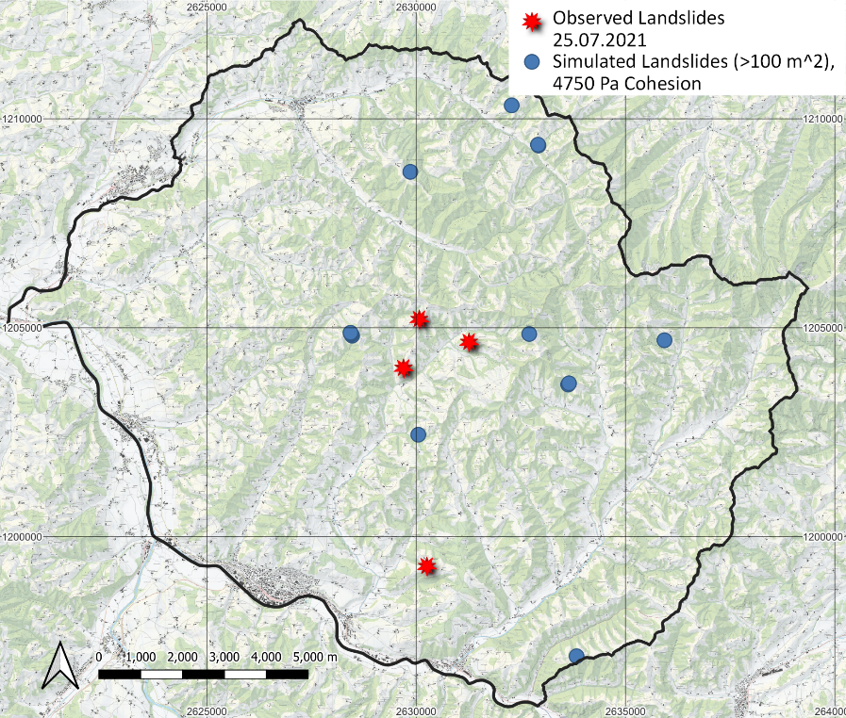
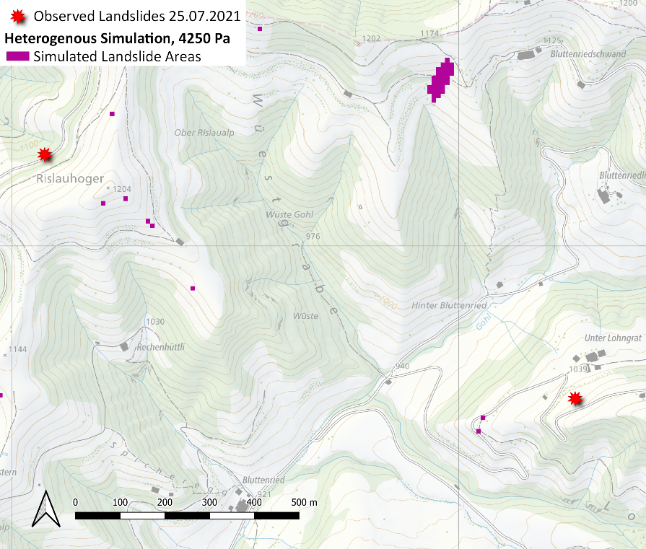
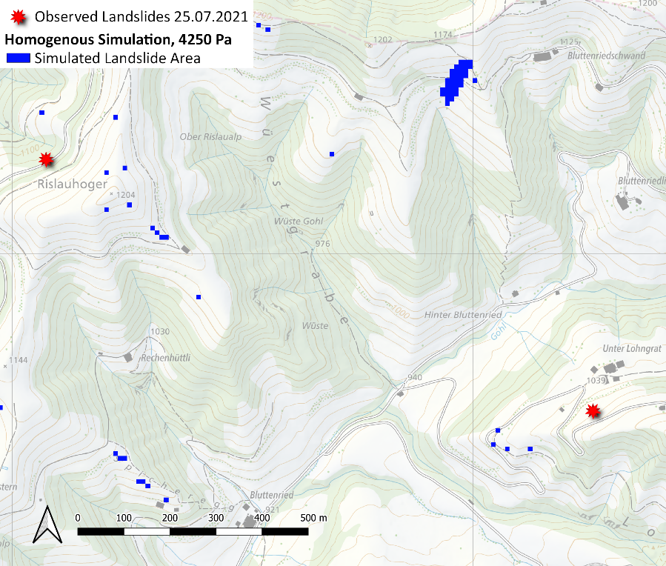
Preliminary Simulation Results (Event July ‘21)
Large Scale Results
Heterogeneous Soil Saturation
Homogenous Soil Saturation
First conclusions of calibration study:
  Simulations are feasible on the entire pilot region
  Realistic soil properties used in calibration (loam, cohesion 4.25 - 5.00 kPa, 30° Friction angle)
  Results indicate more landslides for homogenous compared to heterogeneous initial saturation patterns
  Analysis of VWC time series enables the generation of saturation maps relevant for landslide triggering
Notes:
So here we want to show you preliminary results of the numerical simulation with STEP-TRAMM for an event that occurred in 4 landslide in July 2021. The observed landslides are indicated by the red stars and the predicted landslides are shown by the blue circles. With this first simulations we could conclude that we can reasonably well reproduce the observed landslides patterns with realistic soil properties used in the calibration and that simulations are feasible on the entire pilot region with a resolution of 10 m.
Next we aimed to qualitatively determine the benefit of heterogeneously distributed initial soil saturation maps over constant homogenous soil saturation maps. And we could see that with homogenous soil saturation condition more landslides were triggered compared to heterogeneous soil saturations. Thus simulations with homogenous soil saturation tend to overestimate the landslide potential.
In addition we conclude that the analysis of VWC time series enable the generation of saturation maps relevant for landslide triggering.
End, but much more in simulation in mind to futher investigate on the role of simulated and measured water content for LEWS.

