Slide 1


Multi-temporal crop classification using Sentinel-1 time series backscatter images
23 May 2022, EGU Vienna
Qingying Shu (q.shu@lancaster.ac.uk) Co-author: Ce Zhang
Notes:
LANCASTER UNIVERSITY POWERPOINT TEMPLATES
These PowerPoint templates are for use by all Lancaster University staff. Please see below for further information regarding the use of these templates. Should you have any further queries, please contact the marketing team via marketing-services@lancaster.ac.uk
Template slide 3: Insert a new slide
If you need to insert a new slide, from the ‘home’ toolbar, click on ‘new slide’ and select from the templates the style you require from the dropdown box.
Template slide 4: Typing new text and copying text from another document
New text should be typed over the text in the appropriate template. Copy and pasting text from another document will result in changing the style of the typography and layout. This is unavoidable as it is part of the Microsoft software. We appreciate that in sometimes you will need to copy text from another document into this template. Once you have pasted the existing text into the template, you will need to change the formatting so that they typefaces, sizes, colour, line spacing and alignment are consistent with the rest of the template.
Template slide 5: Inserting images
There are three choices of templates with images already inserted. Please use the template with the relevant image size and positioning. To insert an image, please go to ‘insert’ then ‘picture’ and find your image, highlight it and ‘insert’. Resize the image and position as per the example template.
Template slide 6: Text boxes
If a text box is deleted, either insert a new slide (using the appropriate template) or go to another slide and copy a text box. To select a text box for copying, please click on the outer edge of the text box so that the line goes solid (not dashed). Right click your mouse and select ‘copy’, then go back and ‘paste’ it into the slide where the text box is missing which should paste into the correct position on the slide.
Template slide 7: Other information
Typefaces, sizes and colours All copy is Calibri.
Slide title copy throughout:
Size: 36 point
Colour Lancaster University red: (RGB) R: 181 G: 18 B: 27 (recent colours on PowerPoint) Small copy on first and last slide: Size: 16 point Colour grey: (RGB) R: 102 G: 102 B: 102 (recent colours on PowerPoint)
Sub-headings: Size: 24 point – italics Colour grey: (RGB) R: 102 G: 102 B: 102 (recent colours on PowerPoint)
Bullets copy and body copy: Size: 24 point (see below for a further option) Colour grey: (RGB) R: 102 G: 102 B: 102 (recent colours on PowerPoint)
It isn’t advisable to have too much text on a slide, however on rare occasions it may be necessary, therefore there is a slide using 20 point bullet pointed text.
Line spacing and alignment
Single line spacing (apart from the main headings which is ‘exactly 35 point’)
All text is aligned left
Slide title options
There are two options for titles on the slides – one line or two lines for longer titles. Ideally, the one line title should be used, however on rare occasions a two line title maybe needed.

Slide 2
Background and Aims
Crop identification is important for agricultural monitoring and distinguishing crops can be challenging
To develop a recurrent neural network (RNN) for crop classification using Sentinel-1 time series backscatter images
To discriminate a wider variety of crops (over 30 types)and to improve the classification accuracy using full time-series data
Study area: Northwest Germany

Slide 3
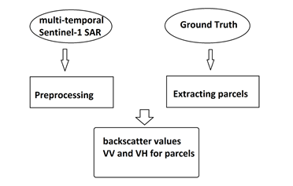
Data: SAR images
Pre-processing steps:
Applying orbit file
Atmospheric correction
Co-registration
Thermal noise removal
Speckle filtering
Terrain calibration
Calculating phenological metrices
batch processing chart

Slide 4
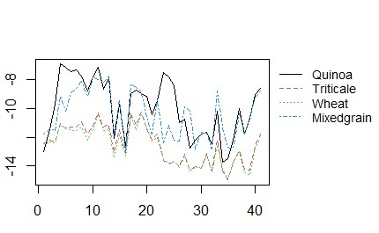
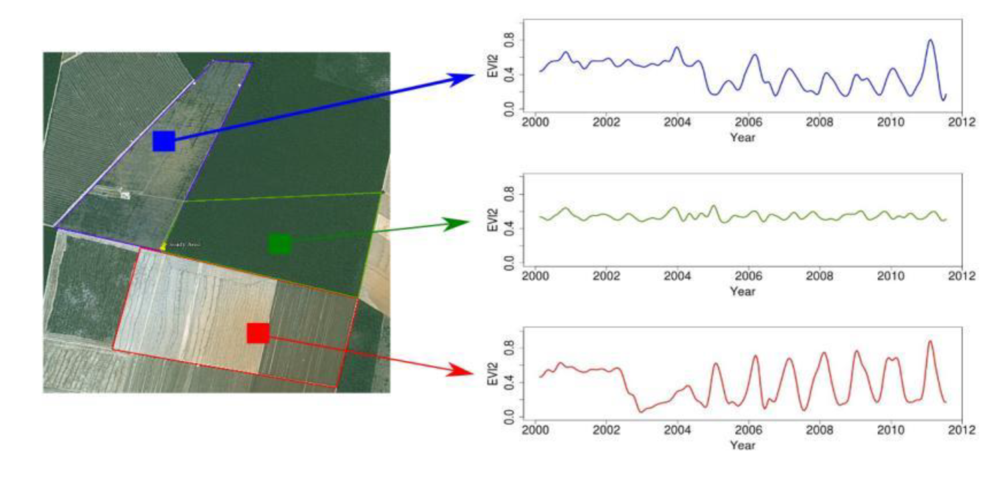

Data: Satellite time series

Slide 5
LSTM (Long short-term memory) networks
Example image
LSTM is capable of handling time dependency and can be used for classifying the SAR time series

Slide 6
Other considerations
Multi-temporal image analysis:
Detect changes (abrupt/gradual)
Characterize the timing of changes
Near real-time monitoring
Other classification methods
Challenges:
Resampling
Evaluating the interpretability of deep learning models

Slide 7
Thank you! Questions?
23 May 2022, EGU Vienna
Qingying Shu (q.shu@lancaster.ac.uk) Co-author: Ce Zhang

