Slide 1
Moisture sources of the Amazon carbon source Arie Staal, Gerbrand Koren, Graciela Tejada & Luciana Gatti EGU, 24 May 2022 Arie Staal (a.staal@uu.nl) Copernicus Institute of Sustainable Development, Utrecht University

Slide 2
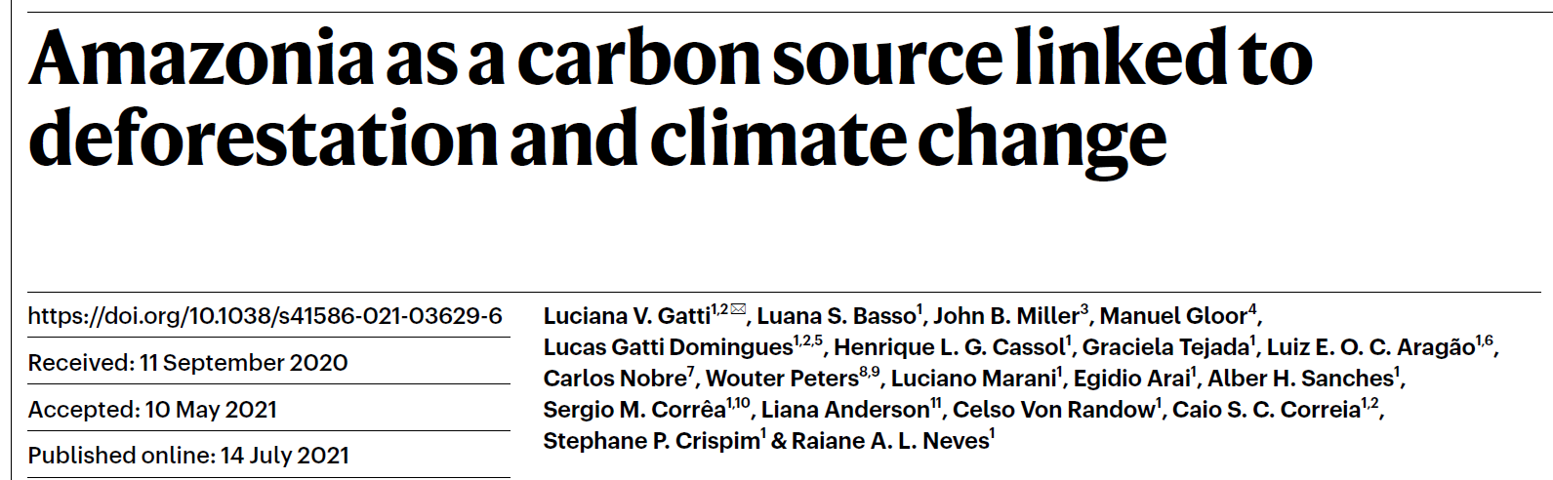
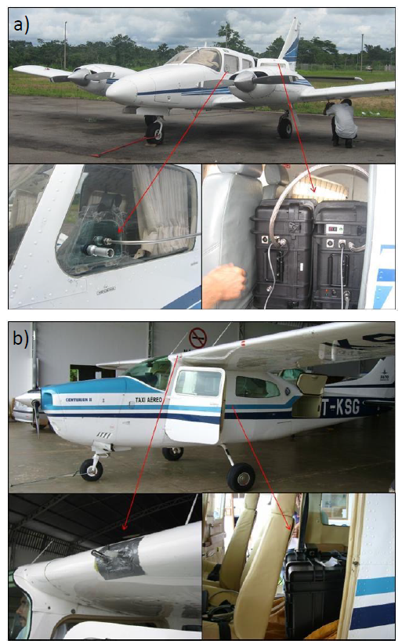
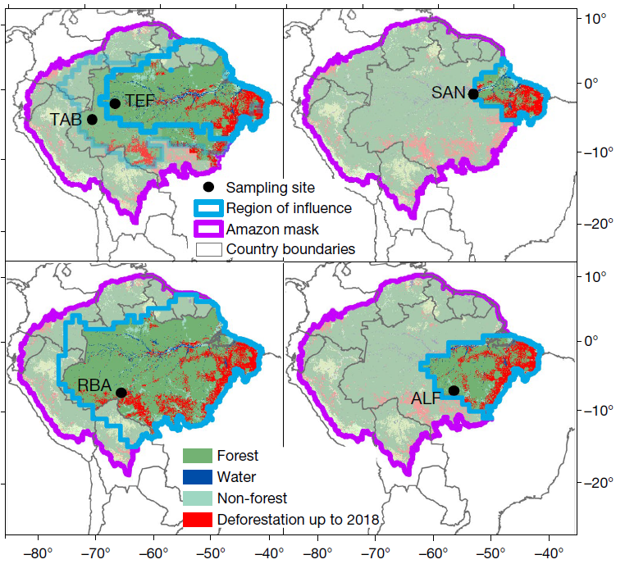
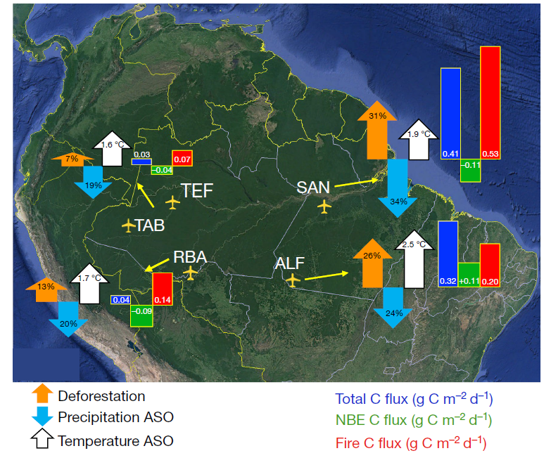
Gatti et al. (2021), Nature 595:388-393

Slide 3
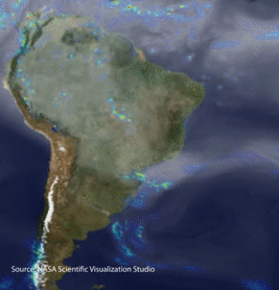
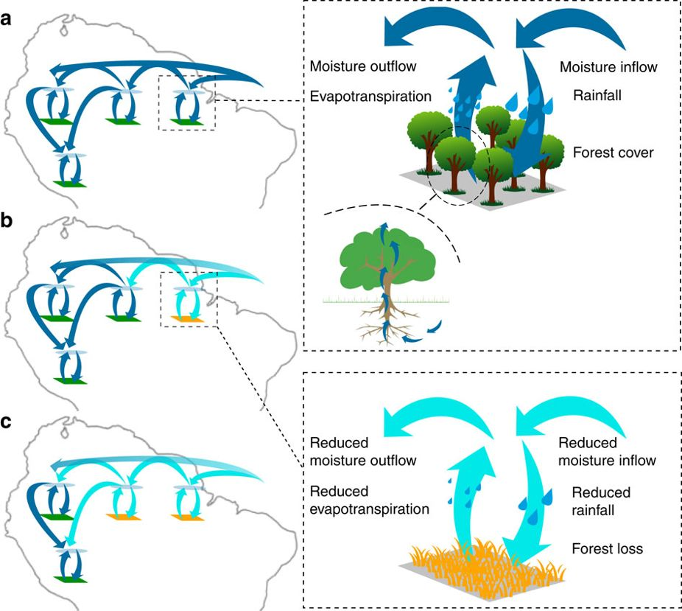
Moisture sources and sinks
Zemp et al. (2017), Nature Comms. 8:14681

Slide 4
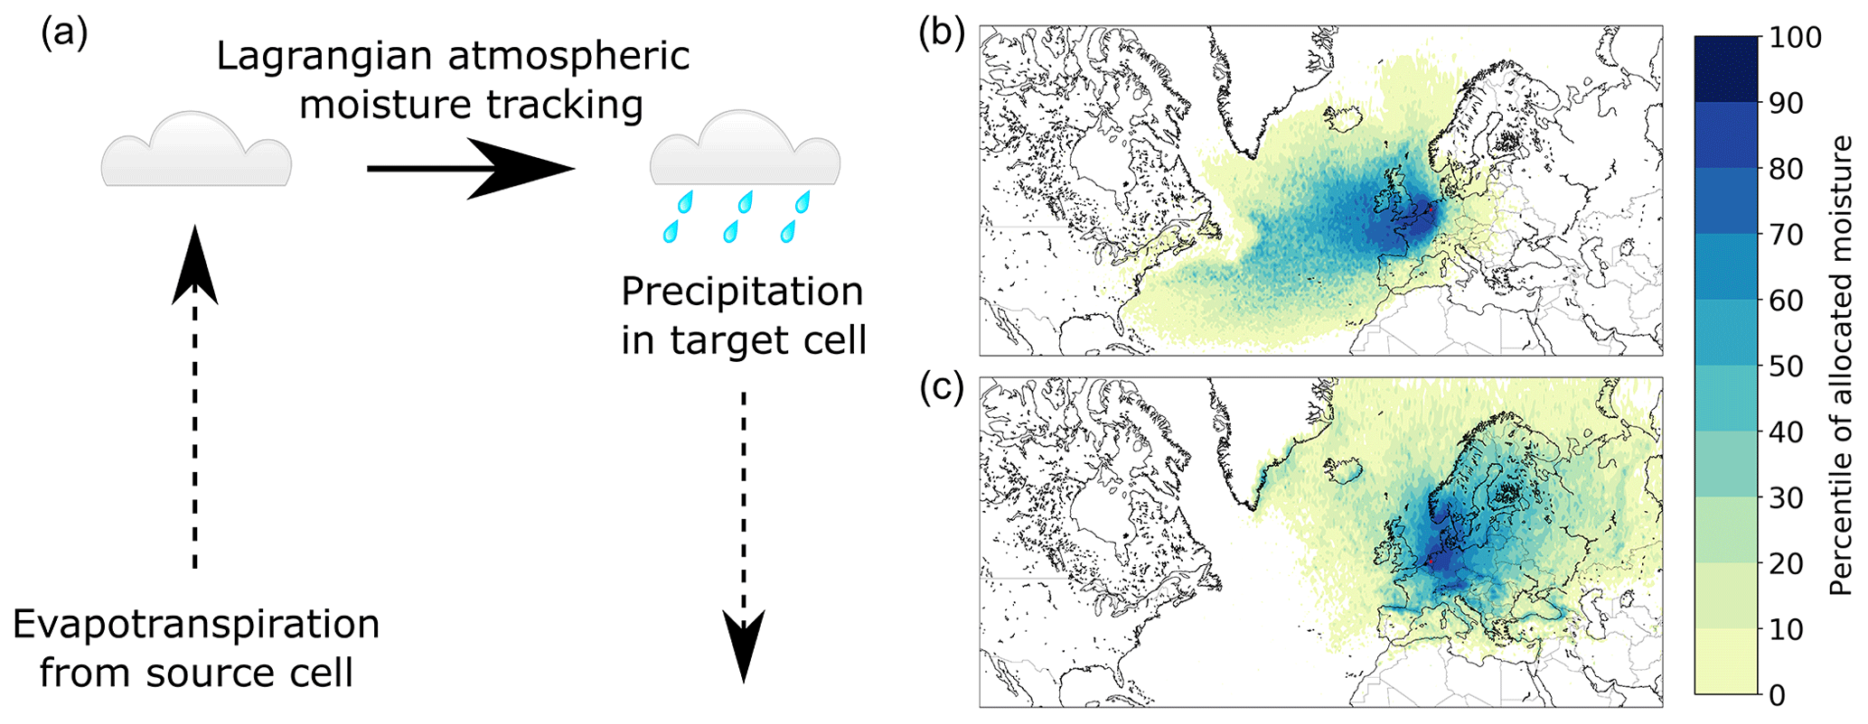
Atmospheric moisture tracking model UTrack
Lagrangian tracking of moisture parcels in three-dimensional space, forced with hourly atmospheric data, with output at 0.25 degree
Tuinenburg & Staal (2020), Hydrol. Earth Syst. Sci. 24:2419-2435
Tuinenburg et al. (2020), Earth Syst. Sci. Data 12:3177-3188

Slide 5
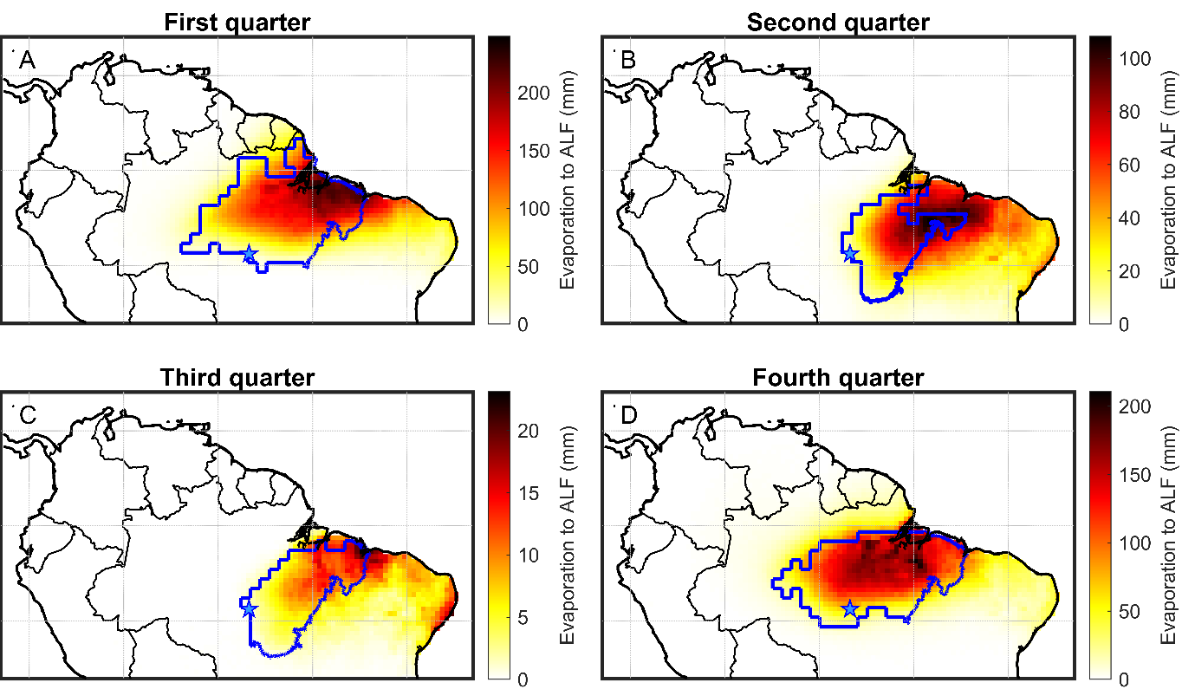
Moisture sources of the Amazon carbon source
Staal et al. in prep.

Slide 6
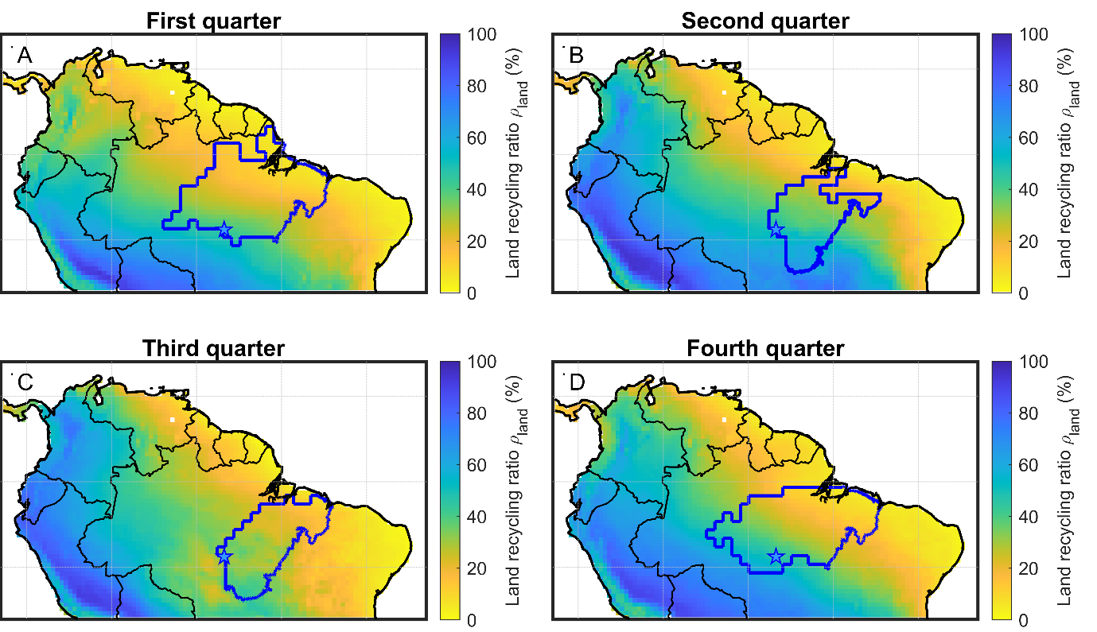
Rainfall coming from land
Staal et al. in prep.

Slide 7
Statistics and next steps
ALF (the carbon source) receives 36% of rainfall from land and 23% locally
In Q4, 45% from land and 32% locally
Next steps:
Quantify the effects of terrestrial moisture on carbon fluxes
Land cover at the moisture sources: restoration potential?

Slide 8



Thank you and thanks to co-authors
Contact: a.staal@uu.nl
@ArieStaal

