Slide 1
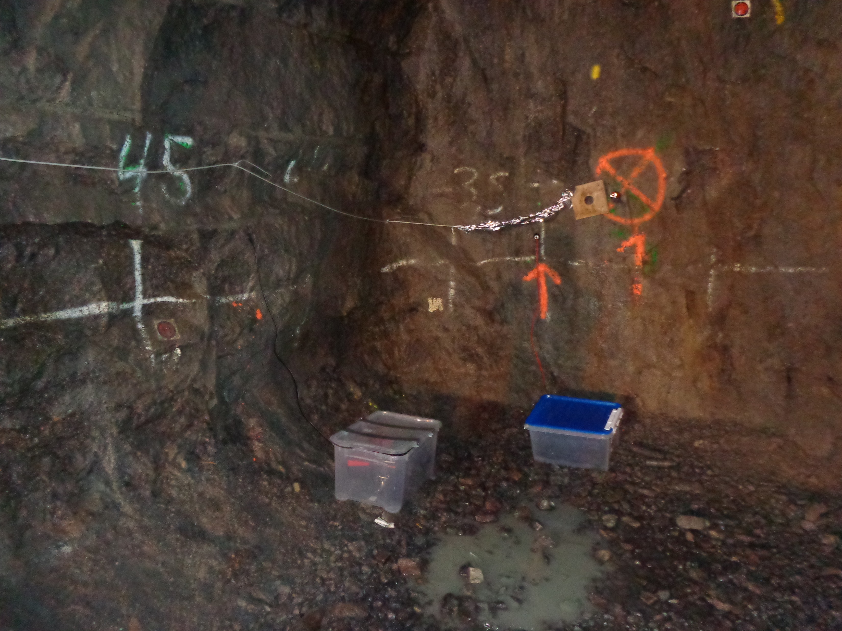
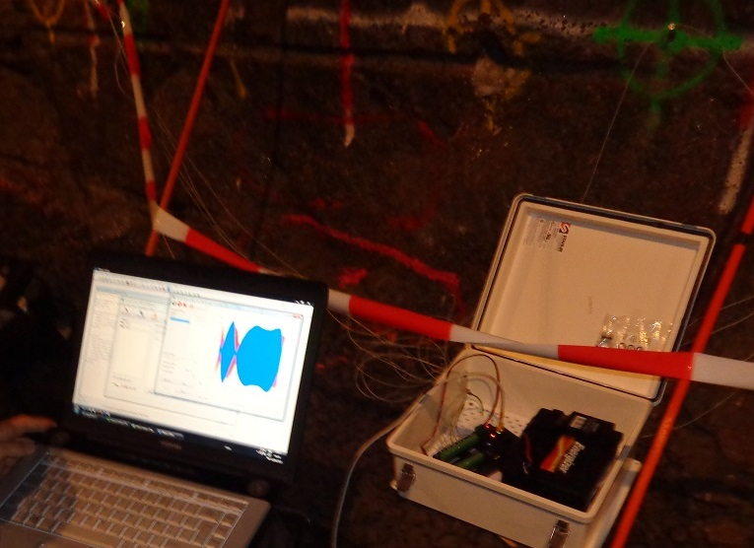
Electric self-potential and electro-magnetic monitoring of hydraulic fracturing experiments in the Äspö Hard Rock Laboratory (HRL)
N. Haaf, E. Schill

Slide 2
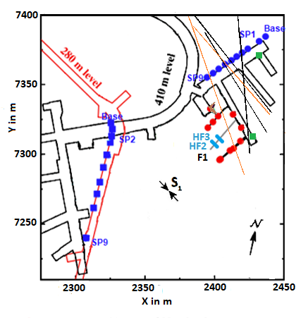
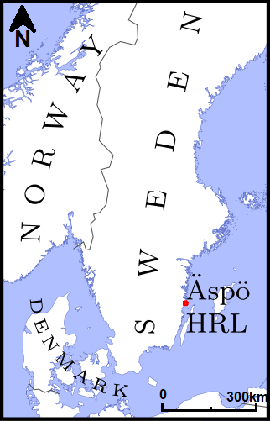
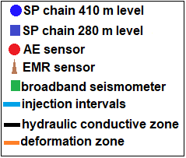
Sensor array during hydraulic fracturing experiments HF2 and HF3 in the Äspö HRL
modified after Zang et al., 2017, SKB, 2013
Notes:
Location of the lab Äspö in SE sweden
Map of the sensor array and setup
Well drilled in direction of shmmin
28 m long, 22.5 and 19 m is mid test interval and injection for HF2&3
In total 6 experiments but 2 are part of my thesis
SP chains
AE
EMR sensors

Slide 3
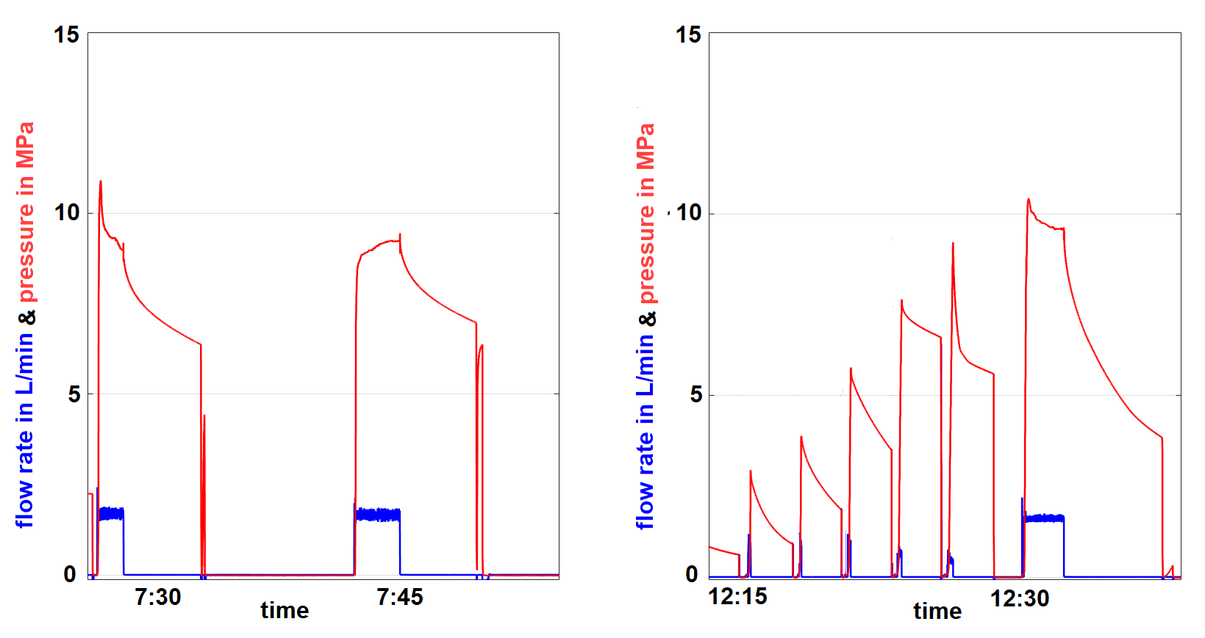
Flow rate and pressure changes during the hydraulic fracturing experiments HF2 and HF3
HF2
HF3
re-frac
Injection
main frac
main frac
Shut-in
re-frac
10 min
Bleed-off
10 min
Notes:
The experiments comprise an initial fracturing stage and up to five refracturing stages.
Each stage consists of three phases: (a) in the injection phase, water is injected with a constant flow rate.
(b) In the shut-in phase, the injection is stopped (flow rate is zero), but the borehole interval is still closed, so the pressure is maintained or slowly decreasing.
(c) In the bleed-off phase, the interval is opened, and previously injected water is allowed to flow back,
while the remaining pressure is quickly decreasing

Slide 4
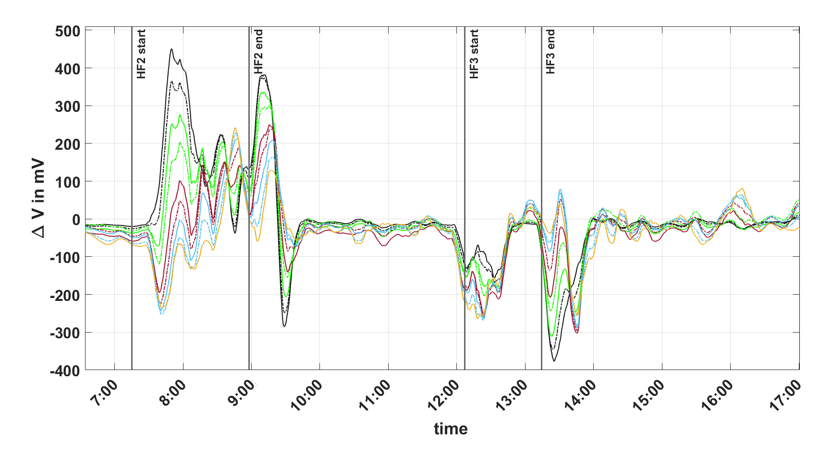
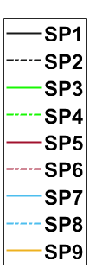
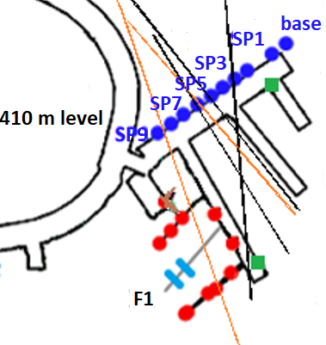
Changes in SP during HF2 and HF3 at the 410m level
1 hour
Notes:
SP data from HF2 and HF3
SP distributions near field
background signal is reached about 45 minutes after the last pressure release.
Two major maxima after main frac and last frac of experiment
HF3 with variations but smaller compared to HF2.

Slide 5
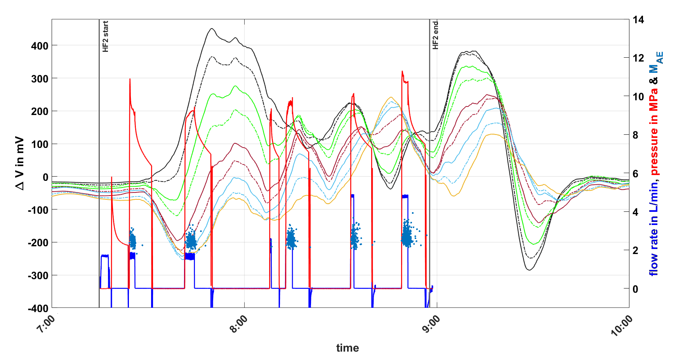
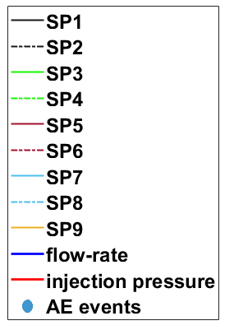
Comparison between SP, hydraulic and AE data during HF2 at the 410m level
30 min
AE data by Niemz et al., 2020
Notes:
HF2 Sp data together with hydraulic data and AE emissions
Show AE increasing magnitude and amount
Hydraulic with pressure, flow-rate and cycles
Maxima in SP, smaller ones and a big one after end of experiment
Delay but amount of maxima coincides with cycles
Largest one in last RF, also big SP
Largest maxima after largest injection pressures
Slow SP decay
Not all injected fluid is recovered, about 40-50%

Slide 6
Conclusion
SP monitoring during hydraulic fracturing experiments at Äspö HRL provides significant results
Number of fracs corresponds to the number of amplitude maxima in SP
Trend of increasing amplitude with opening pressure
Temporal delay between fracs and SP signal; about 45 min of relaxation to initial SP values
Thank you for your attention
Niemz et al., 2020. Full-waveform-based characterization of acoustic emission activity in a mine-scale experiment: a comparison of conventional and advanced hydraulic fracturing schemes. Geophys. J. Int. (2020) 222, 189–206.
SKB. (2013). Äspö Hard Rock Laboratory-Annual report 2012 (Tech. Rep. No. TR-13-10). Svensk Kärnbränslehantering AB. Swedish Nuclear Fuel Management
Zang et al, 2017: Hydraulic fracture monitoring in hard rock at 410 m depth with an advanced ﬂuid-injection protocol and extensive sensor array, Geophys. J. Int. (2017) 208, 790–813

