Slide 1
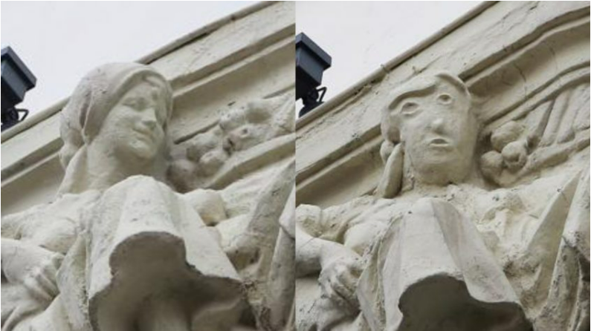



Investigation of custom-made metakaolin-based geopolymers
for stone conservation
preliminary results on activation
©Thelocal
University of Antwerp (Belgium)
PhD student: Sophie van Roosmale
Supervisors: Tim De Kock & Johan Blom
Notes:
Goodmorning everyone, My name is Sophie. I’m a PhD student at the university of Antwerp in the heritage department as well as in the applied engineering department. My research is about finding a new strategy for the conservation of stone-built heritage with geopolymers.
the sculpture—part of a bank façade in the city of Palencia—depicted a smiling woman surrounded by cattle and livestock. Because the building was completed in 1923, the figure’s downturned features were understandably weathered, but they remained recognizable. Now, the carving is essentially ruined, with some observers saying that it more closely resembles Donald Trump or Mr. Potato Head than a female figure.

Slide 2

Introduction
Notes:
As stone is a traditional building material in our regions and worldwide, it is used in a lot of monuments and sculptures. Stone is associated with durability but it is not an inert material. It undergoes changes in appearences leading to degradation and material loss. Our stone-built heritage faces numerous threats, like climate impacts, air pollution, natural hazards, neglect and so on.

Slide 3
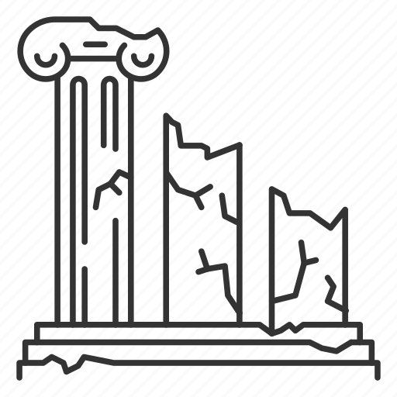
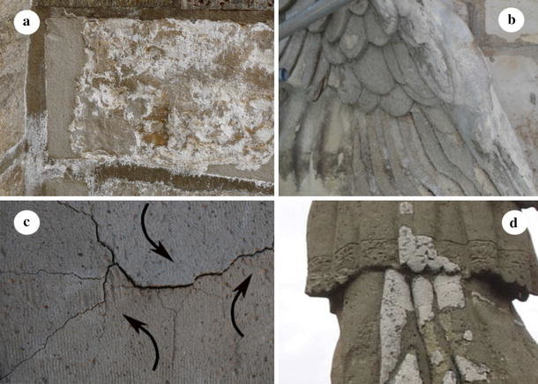
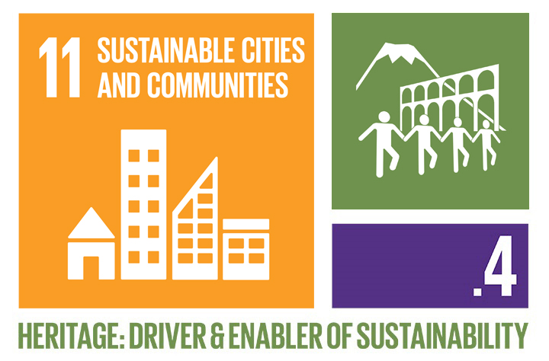
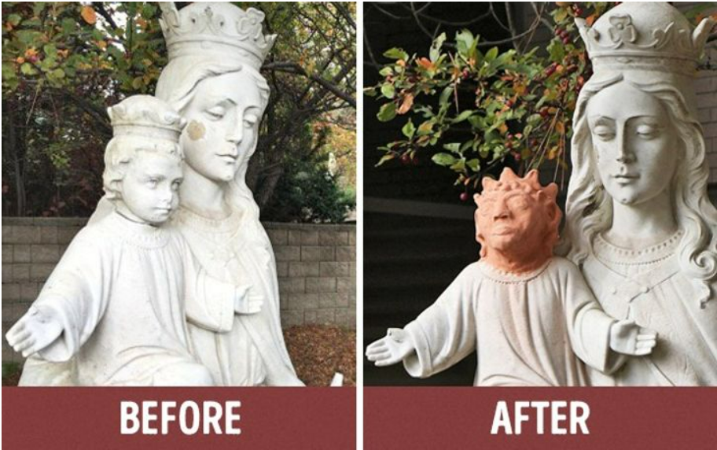
Disadvantages of repair mortars
Compatibility
Sustainability
Quality
©Springer
©ICOMOS
©Brightside
Notes:
Currently repair mortars are being used to reconstruct the missing parts. They can be made of inorganic or organic materials like air lime, hydraulic lime, Portland cement or organic binders like epoxy. This is an efficient way to conserve stone, but they have 3 major disadvantages:
The repair mortars are not fully compatible with the original material.
The second disadvantage is that they are not sustainable, which is in conflict with the worldwide demand for more sustainability. Besides a lot of material on conservation sites is thrown away, but I think we can re-use this building dust and stone rubble.
Lastly, the quality of the conservation depends on the user’s skills, leading to very mixed results.
Mary and Baby Jesus statue (mid 20th-century) Sainte-Anne-des-Pins Catholic Church, Sudbury, Ontario
The sculpture of the Virgin Mary and Baby Jesus in Sudbury, Canada, once suffered at the hands of vandals: the baby’s head was chipped off and stolen.
Artist Heather Wise volunteered to make a new head, but the result of her work looked more than strange and provoked discontent among the locals.
But in the end, Heather’s actions played a positive role: the man who stole the real head got embarrassed and brought it back. The sculpture was restored. (https://brightside.me/creativity-art/8-fatal-restoration-fails-which-shook-the-world-354560/)

Slide 4

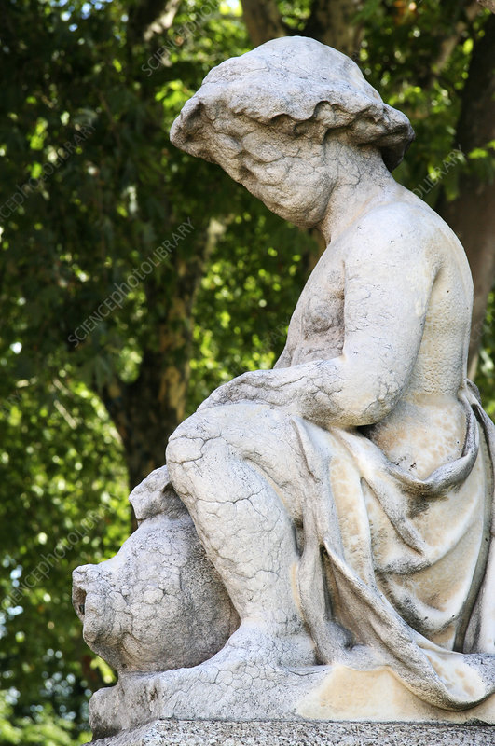
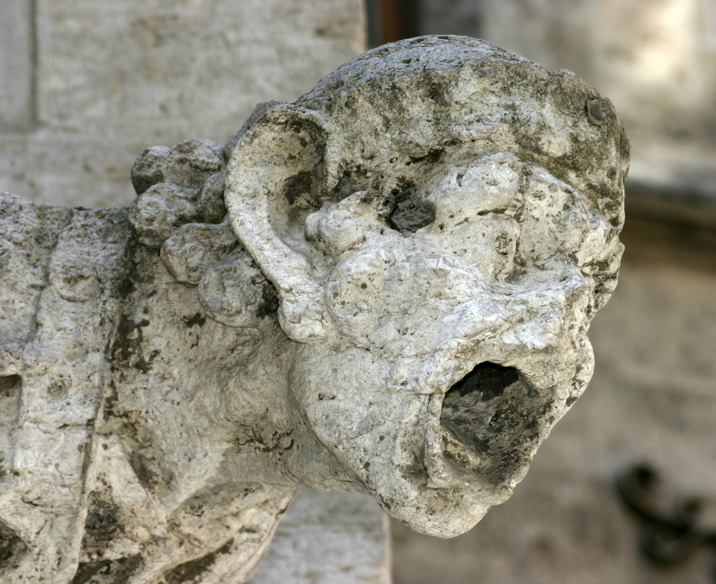
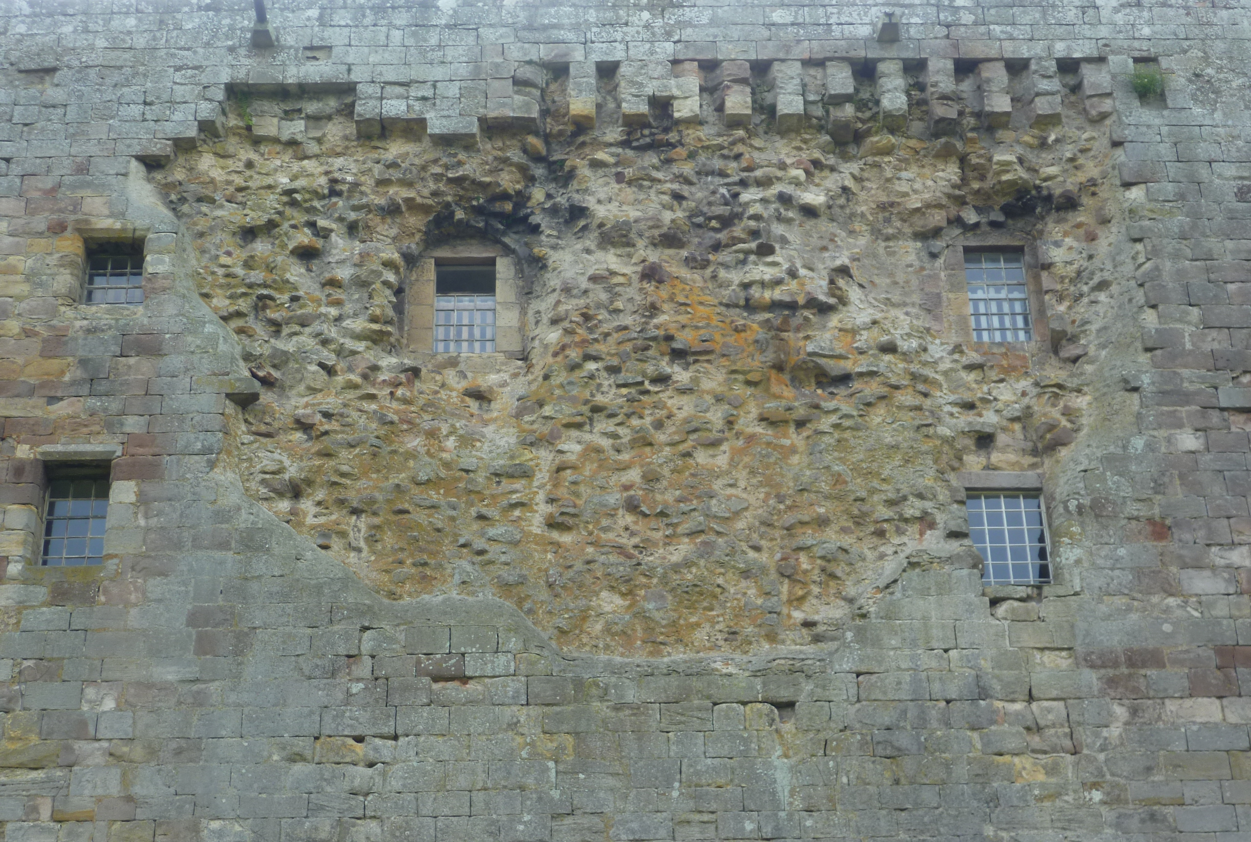
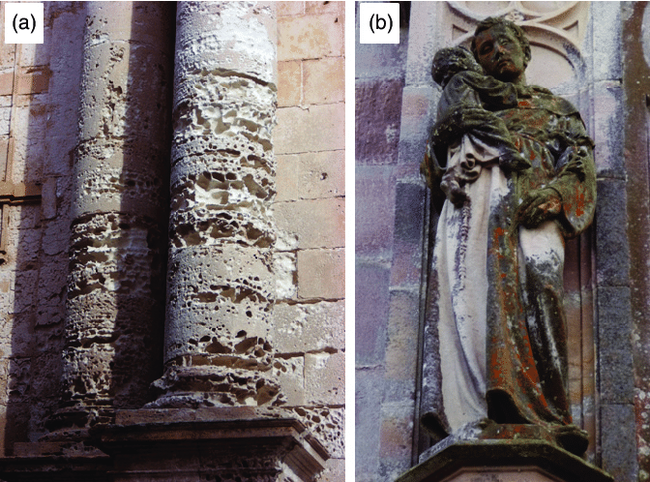

Research aim
Research aim
        Creating our basic matrix;
        Ensuring compatibility;
        Making the conservation of stone-built heritage more sustainable;
        Technological validating the use of tailored 3D printable geopolymers.
Notes:
So, our goal is to make the conservation of stone-built heritage more sustainable, with a higher quality and more compatibility with the original materials.
First, we start by creating our basic matrix of geopolymer and activator. The next step is to ensure compatibility by experimenting with different types of aggregates and also to create more sustainability by implementing degraded original material in the matrix. The last step is to ensure it is possible to 3D print our created geopolymer. So we can reach a higher quality not only based on experience but corrected with 3D scans.
In the next part I would like to tell you something about the first test phase we did and some results. But first let me tell you something about our method.
Technological validating the use of tailored 3D printable geopolymers and the necessary fillers with a commercial available printer in a relevant environment (Level 5 of TRL).

Slide 5
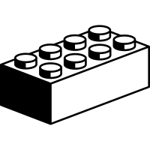
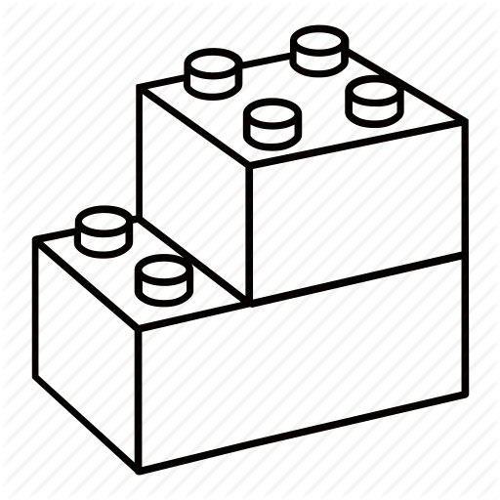

Method
Micro scale
Meso scale
Macro scale
Notes:
So, our final goal is to conserve heritage with custom-made material based on science and knowledge and not only on experience and skills. We call that our macroscale. But to reach this goal, we actually need to start on a microscale to better understand our material and its reaction. After that we can move on to the meso scale where we start experimenting with the properties of the material and with the effects of aggregates and different ways of curing. When optimising the properties of our material, we constantly check what changed on a microscale so we know the reaction is complete. After this we can start implementing our material and techniques on a macroscale by validating it on different case studies.

Slide 6
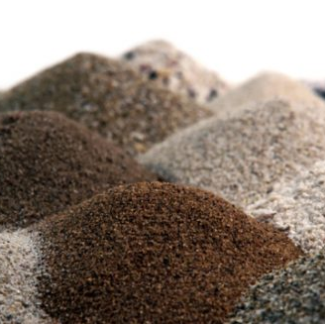
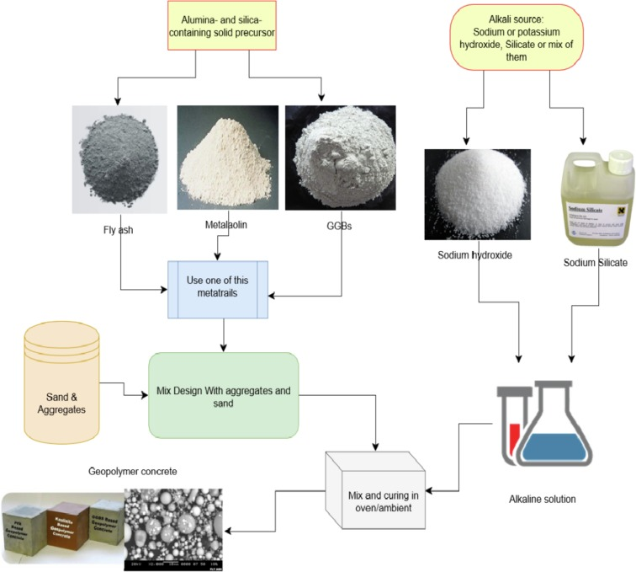
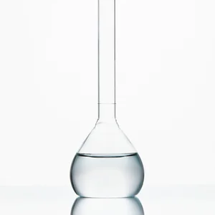
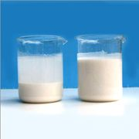
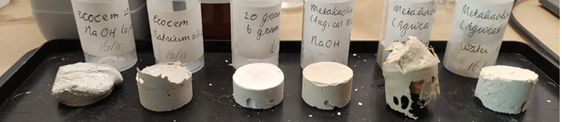
Preliminary tests - composition
©ScienceDirect
©123RF
©DentalINFO
©GeorgeHill
Type
Activator
Aggregates
Metakaolin
Blast Furnace Slags (BFS/GGBS/ECO₂CEM)
Fly-ash
NaOH
KOH
Ca(OH)₂
Sand
Stone dust
Etc. (pigments,
superplastifiers, fibers)
Notes:
We experimented with different types of geopolymers, different activators, concentrations and diverse proportions. And after these first tests we tried also a few aggregates. These recipes were based on and/or inspirated by literature
The first step was to make sure there was enough reactivity to cure the samples. As you can see in this picture in the lower part of the slide, is not the case for every mixture. We tried 70 different recipes and chose the mixtures that seemed cured. The ones we selected were tested on reactivity.

Slide 7
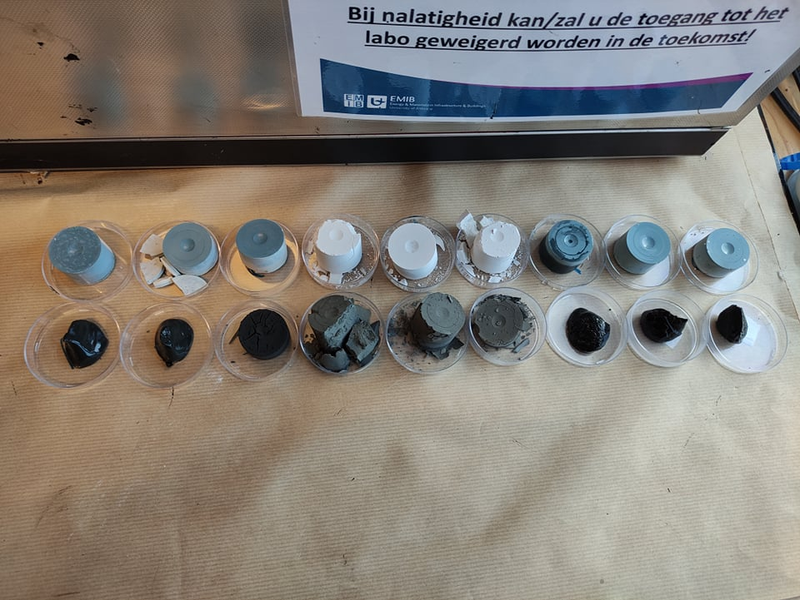
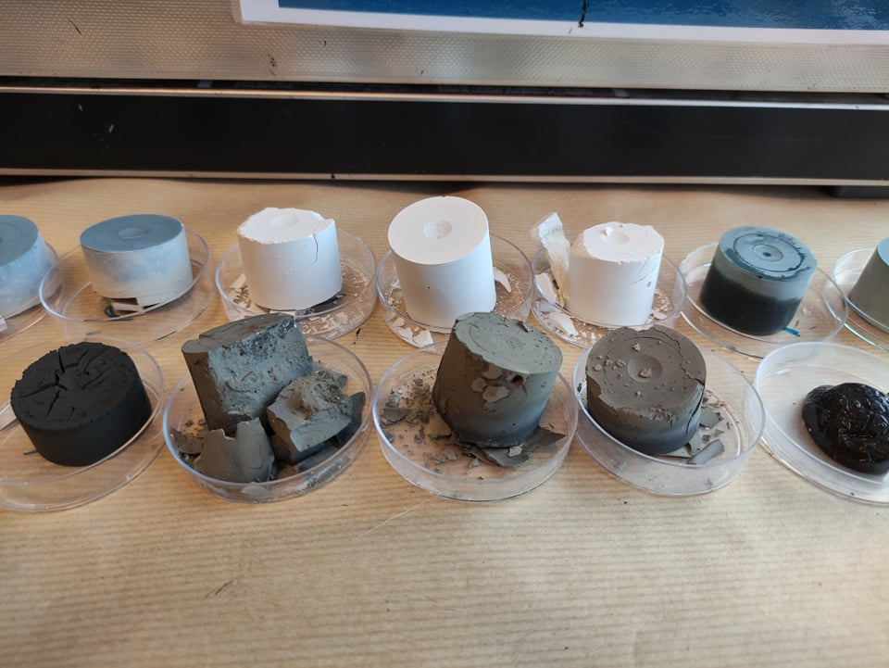
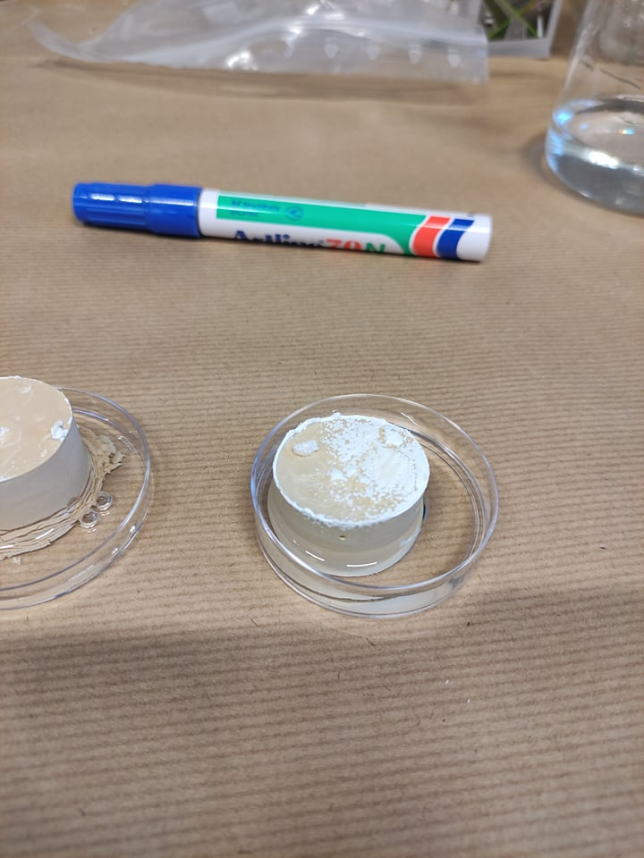
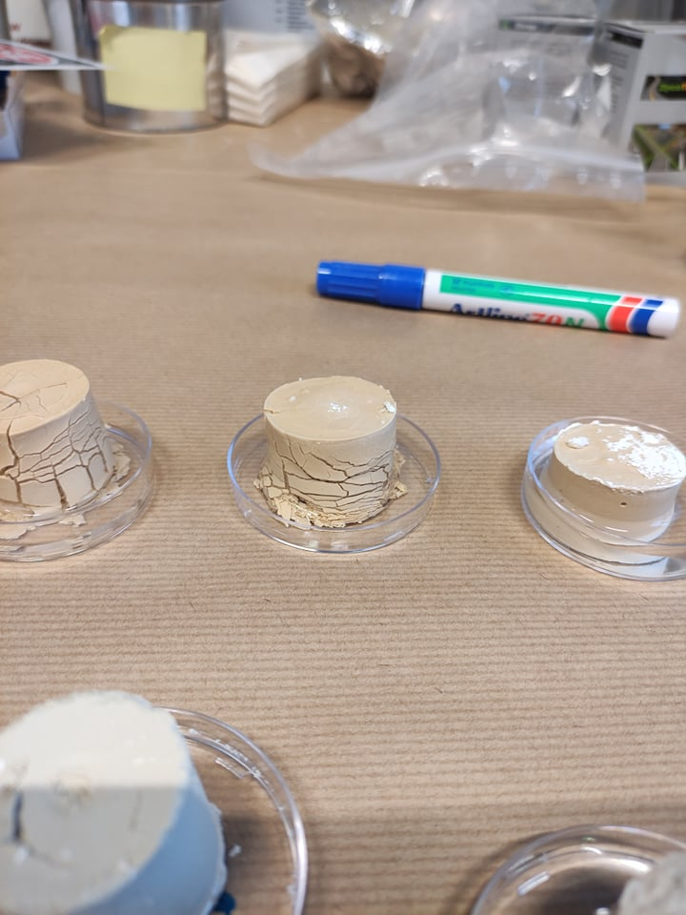
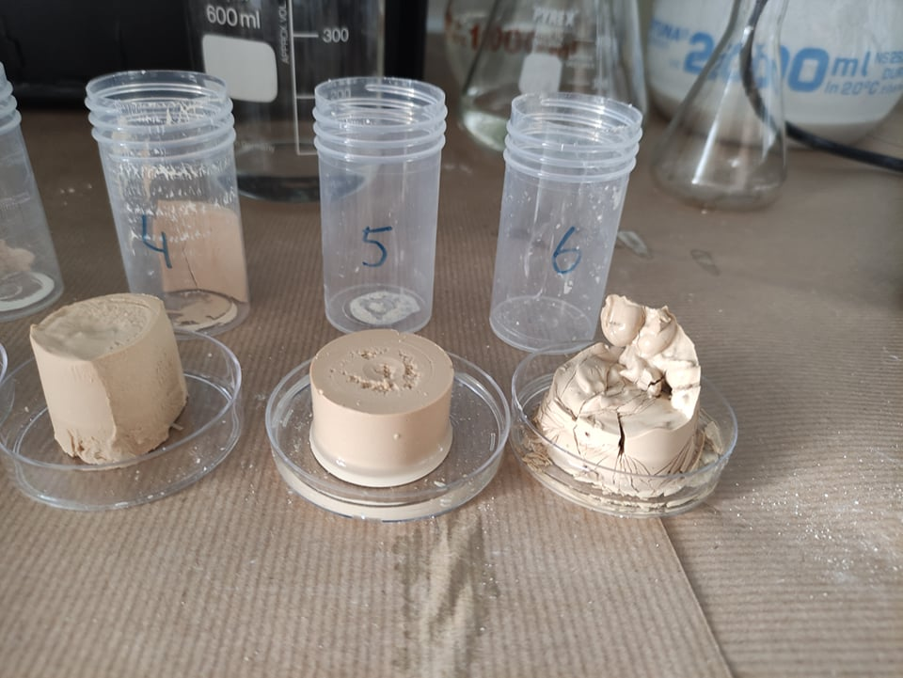
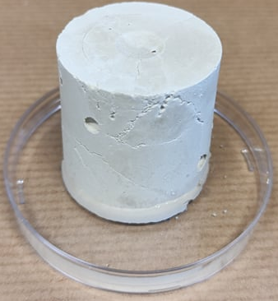
Preliminary tests – Results reactivity test
 | 4M NaOH | 4M KOH | 4M Ca(OH)₂
Blast Furnace Slag (ECO₂CEM)
Fly-ash
Metakaolin
Notes:
To test our recipes we performed a set of reactivity tests, for example by immersing our samples in water and see if their shape remained. I took this pictures in between 10 minutes up until two hours after immersing in water. As you can see a lot of samples collapsed or had salt crystallisation on the surface. So those mixtures were eliminated, based on too little reactivity. Also the samples with a black, dark grey or blue colour were not selected, because of the requirements we chose. The one with a green square around it we selected for the next reactivity tests. The ones with a yellow square also gave quite good results, but were not the most optimal choices.

Slide 8
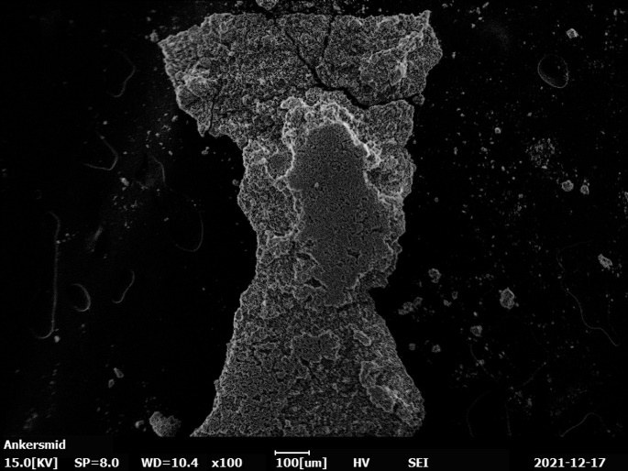
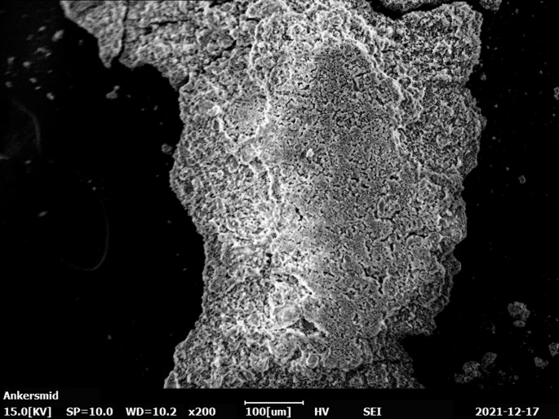
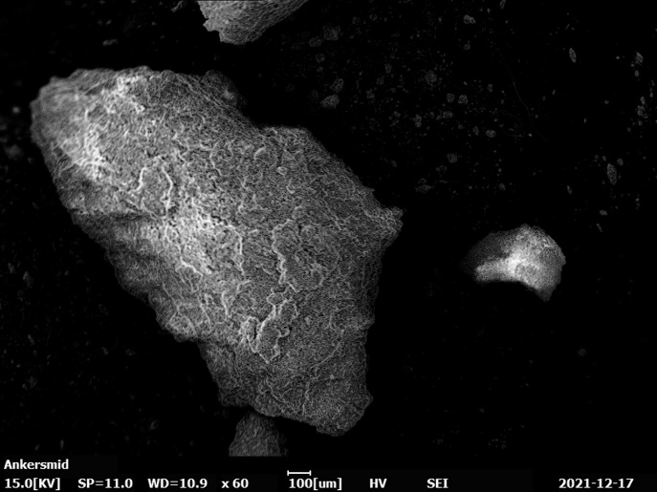
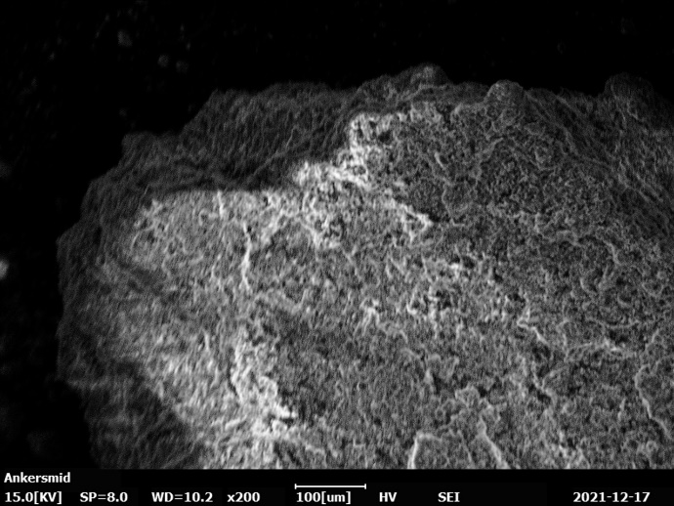
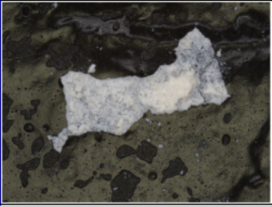
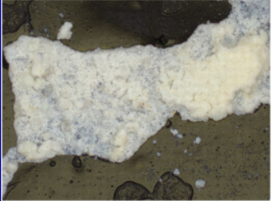
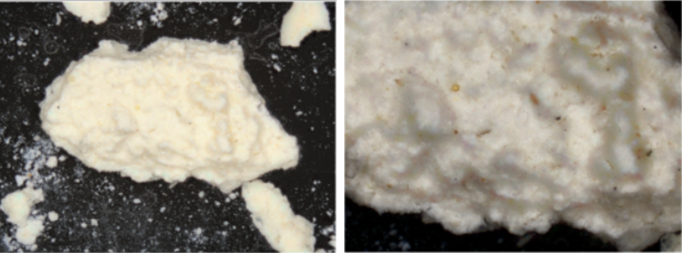
Preliminary tests – Results reactivity test
Sample A
Scanning Electron Microscope (SEM)
Magnification 100, 200 µm
Confocal Laser Scanning Microscope (CLSM)
Magnification x5, x10
Sample B
Scanning Electron Microscope (SEM)
Magnification 100, 200 µm
Confocal Laser Scanning Microscope (CLSM)
Magnification x5, x10
Notes:
Another reactivity test we performed is by making SEM scans and Confocal Laser scans to look for defects in the structure like non-reacted and loose powder. In the left sample you can see a lot of unreacted material because it has a lot of layers and some things we call ‘cauliflower structures’. This sample has a lower concentration of activator.
On the right side of the slide you can see a sample of a better example, with a higher concentration of activator. The structure is more formed like a cluster with less non-reacted material and also less layering.
We can conclude from these results that metakaolin and calcium hydroxide gave the best results in a ratio of 1.5. (20 gr MK + 30 ml 4M Ca(OH)₂)

Slide 9


Next steps & final goal
Experimenting with more aggregates and making hybrids
Experimenting with 3D printing
More compatible and a higher quality of conservation treatments with a better sustainability
Notes:
So the next step in our research is to experiment with different aggregates, so we can investigate the reactivity and the compatibility between our basic geopolymer matrix and porous sedimentary building stones. The properties that are important for technical compatibility include: porosity, pore size distribution, capillary water absorptive, frost resistance, structure, texture, compressive and bending strength.
It is also a possibility to create hybrid geopolymers with different types and combining activators to create a better reactivity and thus a better result.
After this we want to start experimenting with 3D printing.
So our end goals is to create a more sustainable conservation with a higher quality and more compatibility to the original materials, so that later generations are still able to enjoy the heritage in the future.

Slide 10

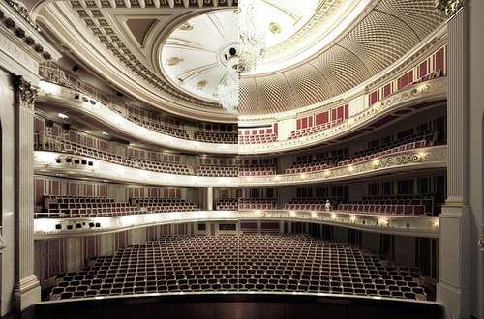
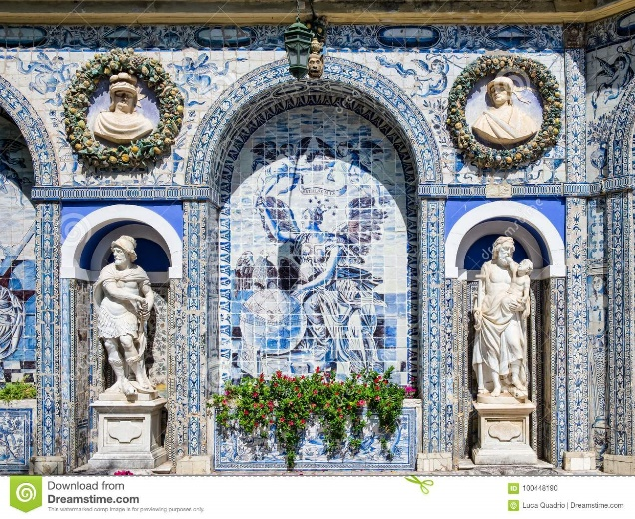
Thank you for listening – Any questions?
A few examples of geopolymers in heritage
Berlin Opera
Azulejo tiles in Portugal
Left part of the photo: Berlin Opera before the renovation,
Right part of the photo: Berlin Opera with the raised roof
©Wiley online Library
Example of Azulejo tiles in the Palace of Frontéira
©Dreamstine
Notes:
Thank you for listening, are there any questions?
There are already a few studies in which they investigated the feasibility of using geopolymers in conservation. For example, the use of geopolymers in heritage is found in the monumental Berlin Opera. The roof of the opera has been raised with a construction of geopolymers to improve the acoustic properties, without impairing the external appearance. The choice for using geopolymers is based on the fire safety, strength and looks [19]. Another example is by Geraldes et al. (2018), they used geopolymers in the restoration of Portuguese Azulejo tiles, claiming better performance than repair mortars such as lime and organic pastes that are currently being used, because the geopolymers are more resistant to various weather conditions due to their durable and versatile nature [18].
In general, these studies suggest that geopolymers are a promising and interesting material to use in the conservation of stone heritage. However, there is currently not enough knowledge about how to process metakaolin geopolymers to be fully compatible and thus replace the repair mortars and how they react on different types of fillers, for example, the fillers made from degraded original material.

Slide 11

References
Jakob, Van Deventer Jan Stephanus, John L. Provis, and J. L. Provis. Geopolymers - Structure, Processing, Properties and Industrial Applications. Woodhead Publishing, 2009.
Clausi, Marina, Serena C. Tarantino, Laura Lorenza Magnani, Maria Pia Riccardi, Cristina Tedeschi, and Michele Zema. “Metakaolin as a Precursor of Materials for Applications in Cultural Heritage: Geopolymer-Based Mortars with Ornamental Stone Aggregates.” Applied Clay Science 132-133 (2016). https://doi.org/10.1016/j.clay.2016.08.009.
Duxson, P., A. Fernández-Jiménez, J. L. Provis, G. C. Lukey, A. Palomo, and J. S. J. Van Deventer. “Geopolymer Technology: the Current State of the Art.” Journal of Materials Science 42, no. 9 (May 19, 2006).
Elert, Kerstin, Carlos Rodriguez-Navarro, Eduardo Sebastian Pardo, Eric Hansen, and Olga Cazalla. “Lime Mortars for the Conservation of Historic Buildings.” Studies in Conservation 47, no. 1 (2002): 62. https://doi.org/10.2307/1506835.
Michael Forsyth. Materials & Skills for Historic Building Conservation. Blackwell Publishing Ltd,. 2008. DOI:10.1002/9780470697696
Geraldes, Catarina F. M., Augusta M. Lima, José Delgado-Rodrigues, João Manuel Mimoso, and Sílvia R. M. Pereira. “Geopolymers as Potential Repair Material in Tiles Conservation.” Applied Physics A 122, no. 3 (2016). https://doi.org/10.1007/s00339-016-9709-3.
Geraldes, Catarina F.M. “Geopolymers as Infill Material for Conservation of Azulejos.” FCT/UNL e UNL - University of Lisbao, December 2015.
Lea, F. M., Peter C. Hewlett, and Liška Martin. Leas Chemistry of Cement and Concrete. Oxford: Elsevier Ltd., 1998.
Oppe, Matthias, Florian Scheible, Boris Peter, and Thorsten Helbig. “Robotergefertigte Elemente Aus Technischer Keramik.” Bautechnik 95, no. 6 (2018): 439–48. https://doi.org/10.1002/bate.201810063.
Pouhet Raphaëlle, and Martin Cyr. Formulation and Durability of Metakaolin-Based Geopolymers. Lieu de publication inconnu: éditeur inconnu, 2015.
Ricciotti, Laura, Antonio Molino, Valentina Roviello, Elena Chianese, Paola Cennamo, and Giuseppina Roviello. “Geopolymer Composites for Potential Applications in Cultural Heritage.” Environments 4, no. 4 (2017). https://doi.org/10.3390/environments4040091.
Xia, Ming, and Jay Sanjayan. “Method of Formulating Geopolymer for 3D Printing for Construction Applications.” Materials & Design 110 (2016). https://doi.org/10.1016/j.matdes.2016.07.136.

Slide 12

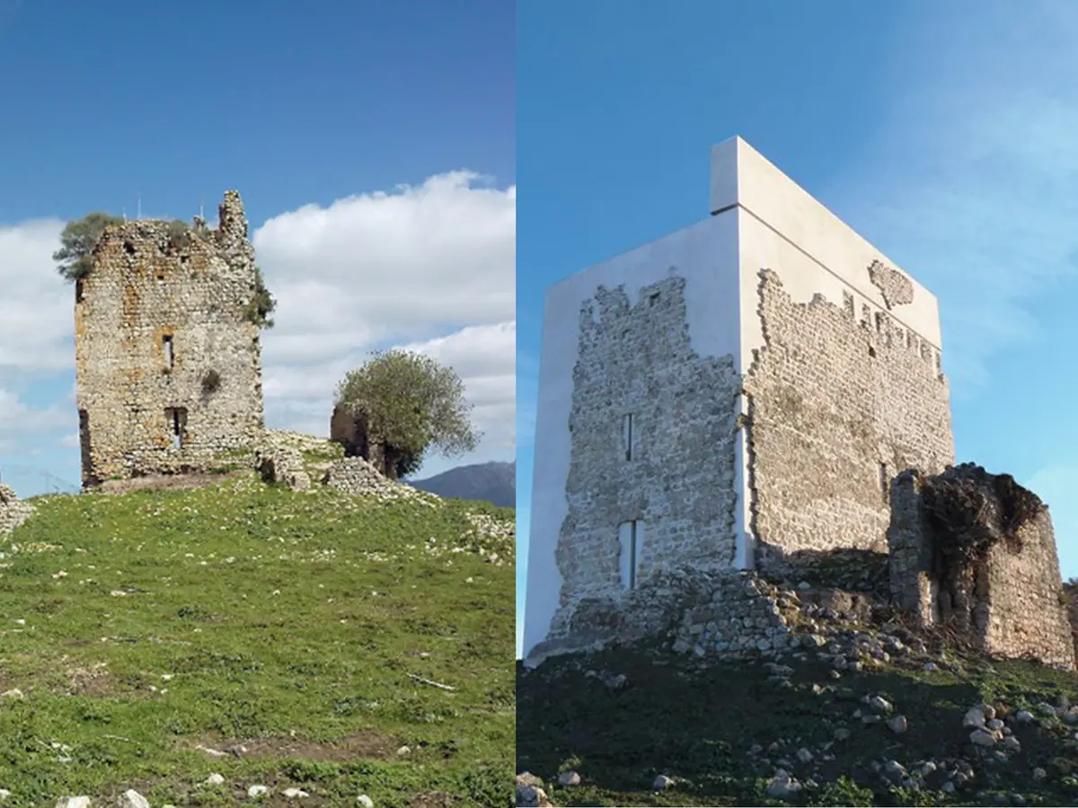
Requirements for a solution
Rules by ICOMOS
Requirements in function of
application
Charter of Venice, 1964:
Reversibility
Traditional materials and techniques
NARA Document, 1994:
Respect the spirit and feeling of the whole
Duration and circumstances of curing
Safety
Colour
Alkaline activator
Source in Europe
©TheIndependent
Notes:
- curing at room temperature and relative humidity from the environment
- In less than 48 hours
- Safe for humans and environment
There are a few rules on which a conservation treatment has to abide by. These are stated in the Charter of Venice and in the NARA document. The most important ones for this case are that the conservation must be reversible, meaning there is no extra damage to the original material. This can be seen as technical compatibility. Another rule is that traditional materials and techniques are preferred over modern materials and techniques. This can be seen as historical compatibility. And the last rule is that conservations should respect the spirit and feeling of the whole, which can be seen as aesthetical compatibility.
We also set up a few requirements for the geopolymers to meet so it can actually be used as a repair mortar. First, it must be safe to use for humans and it must not contain harmful products like solvents. Another requirement is that the geopolymers need to be cured at room temperature and relative humidity to correspond with conditions you can expect when executing a conservation treatment. Also the curing needs to take place in 48 hours, again with eye on the real conditions of conservating. And we would like to create a white or light grey/beige geopolymer, so it looks more like limestone or sandstone or it is still a possibility to colour the geopolymer in a later phase, which is not the case with a black or any other darker colour.
There are also a few requirements for the type of geopolymer selected. For this study, the geopolymers with an alkaline activator are selected, because the acid activator of the acid-base types can potentially damage natural stones based on limestone. Within the group of alkaline geopolymers, a geopolymer based on metakaolin is chosen, as substantial kaolin resources (from which Metakaolin is made) are available in Europe, reducing transport and guaranteeing supplies.
Castle of Matrera (ca. 9th century) Villamartin, Spain by architectural firm Carlos Quevado Rojas
After the ninth-century medieval fortress partially collapsed in 2013, restorers rebuilt and stabilized the structure—but the Historic Heritage Law bans mimetic reconstructions, which meant the firm had to use modern materials that were visually distinct from the existing ruins

