Slide 1
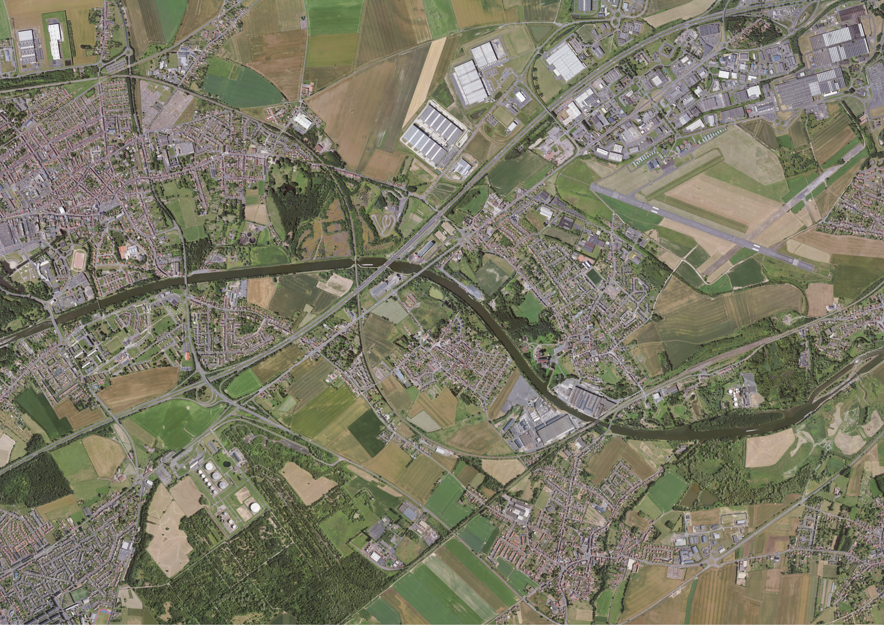





Fingerprinting approach to trace sedimentary and contaminant sources in a canalized section of the Scheldt river (Northern France) for watershed management
Dylan Laurence
PhD Student
Geosciences Center
Mines ParisTech
Thesis supervision
Laurent DE WINDT (Mines ParisTech) Christine FRANKE (Mines ParisTech) Claire ALARY (IMT Nord Europe)
Partnership
Voies navigables de France [VNF] (Marion DELPLANQUE) Agence de l’eau Artois-Picardie

Slide 2
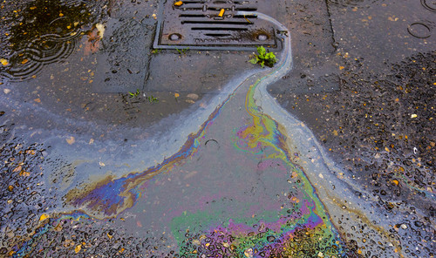
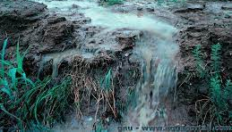
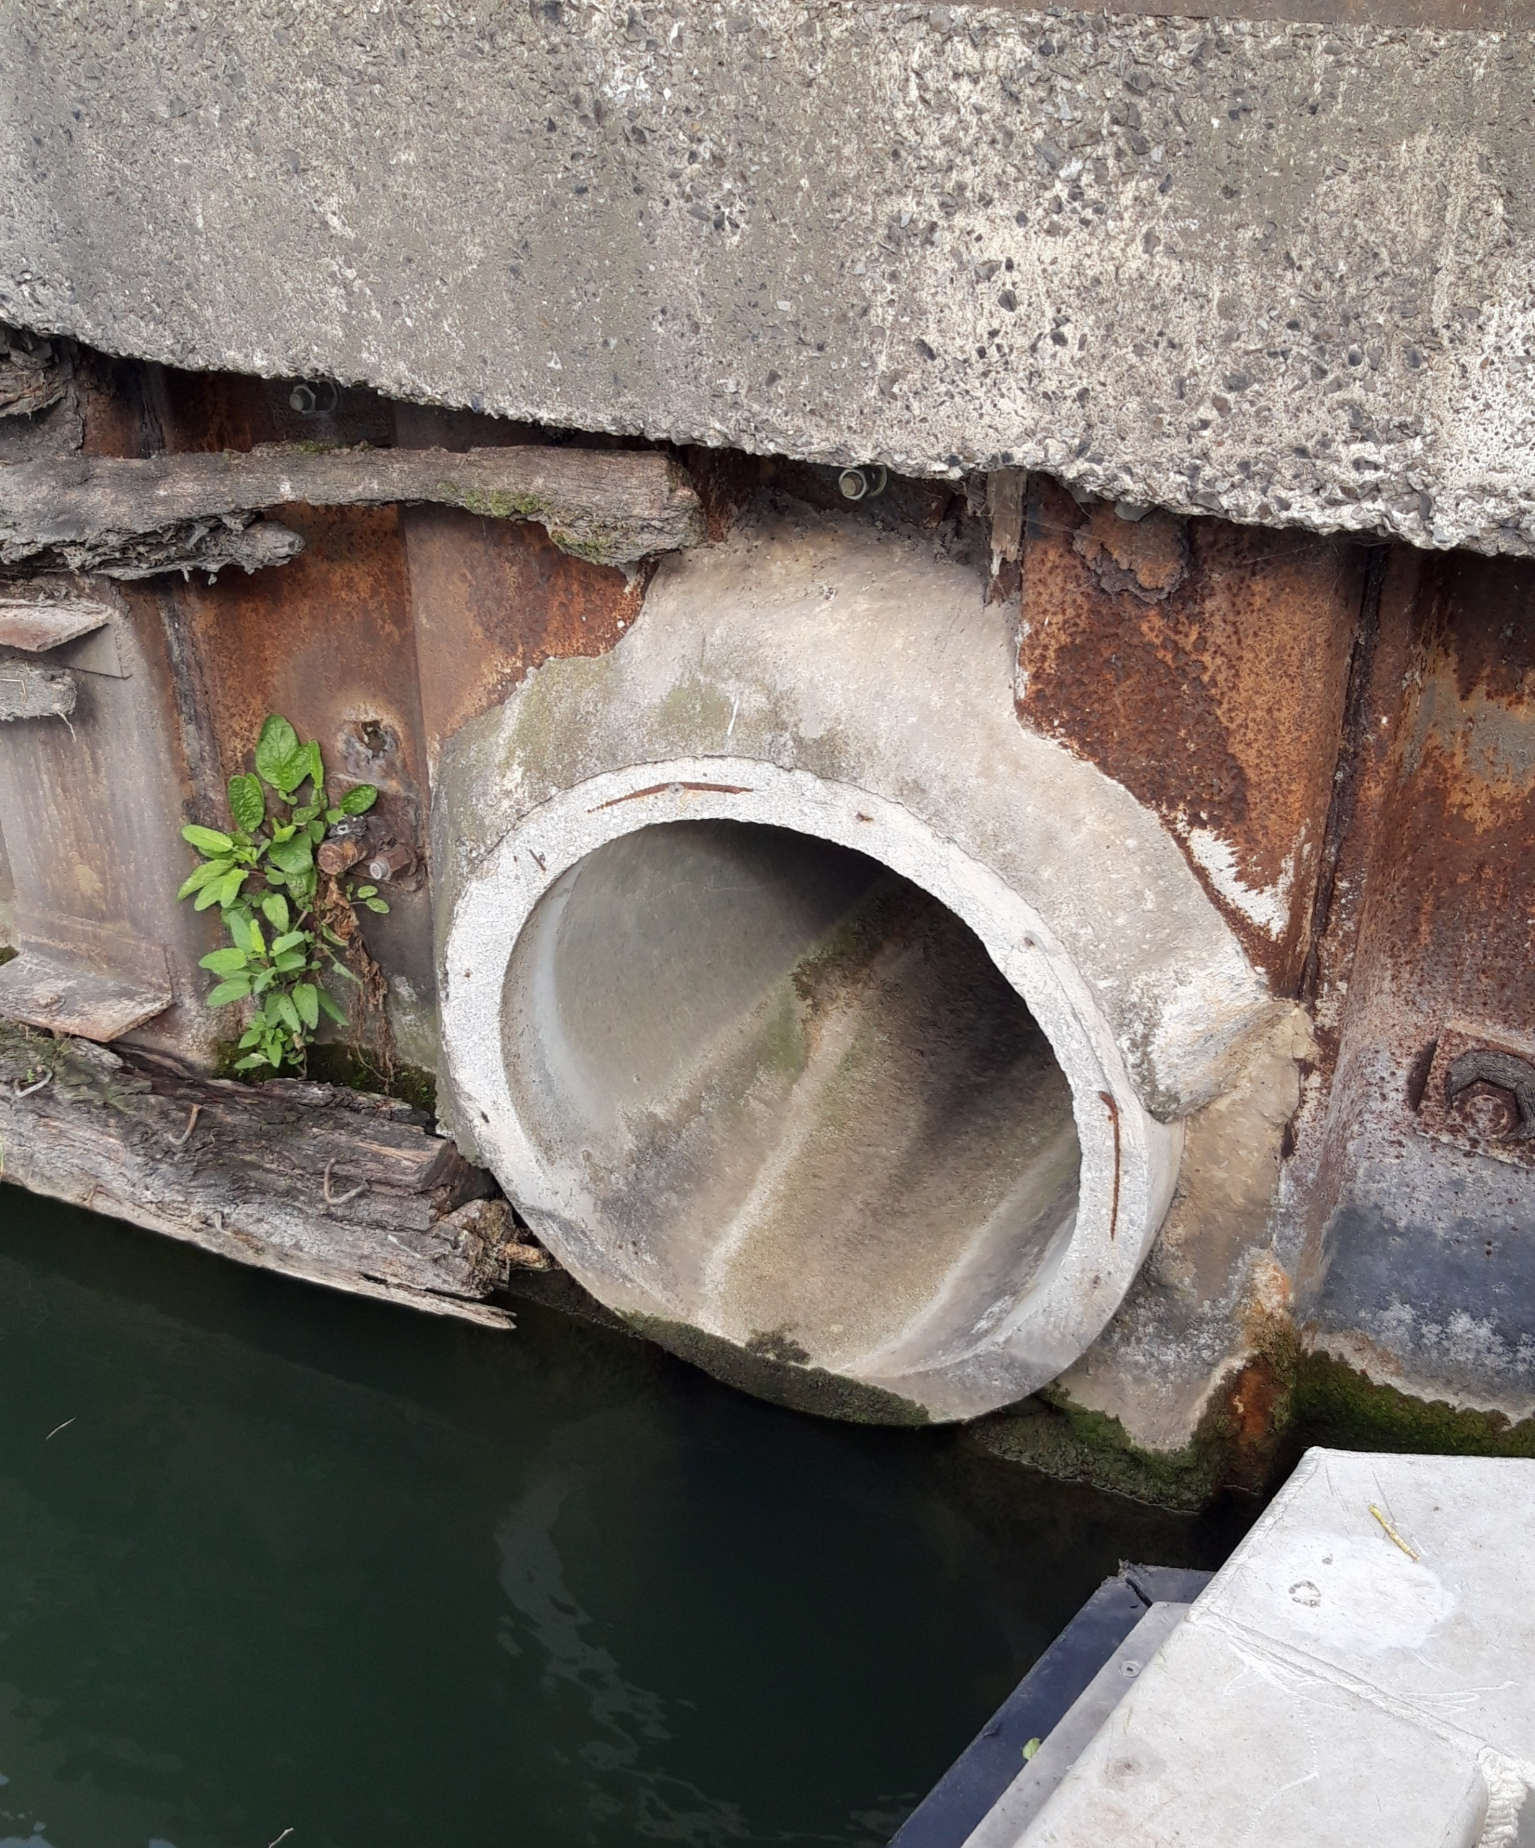
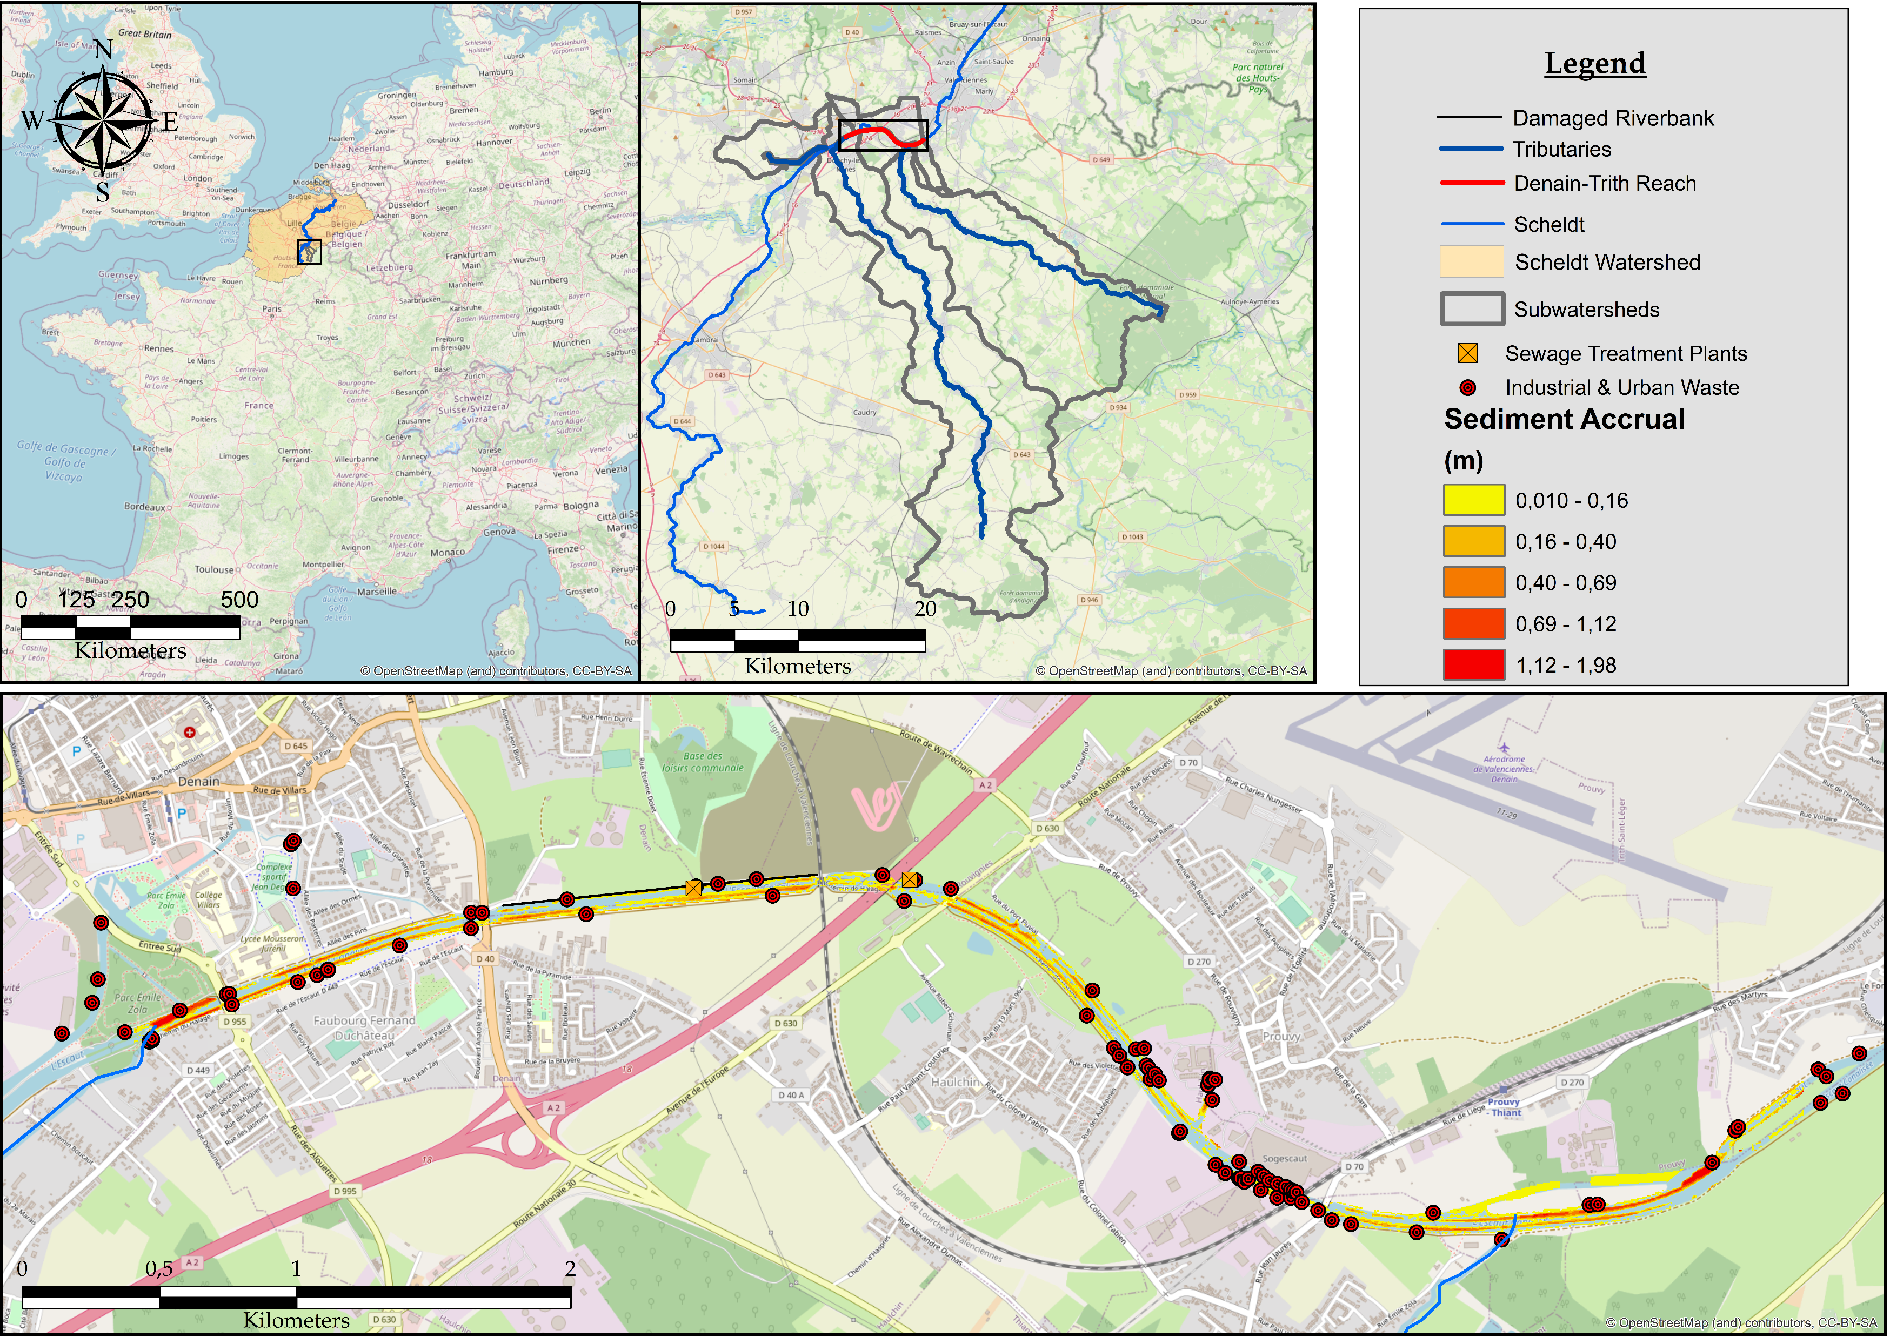
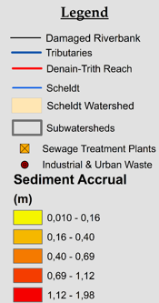

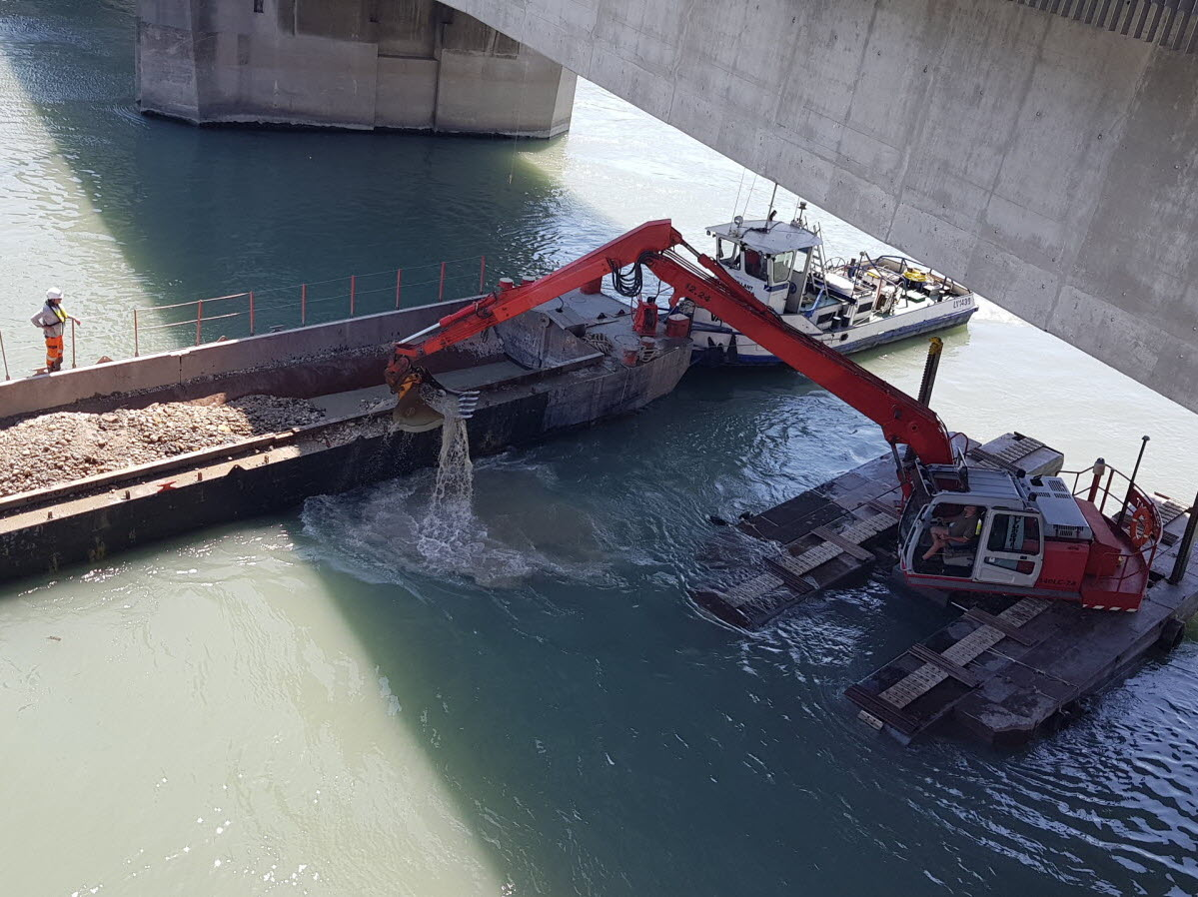
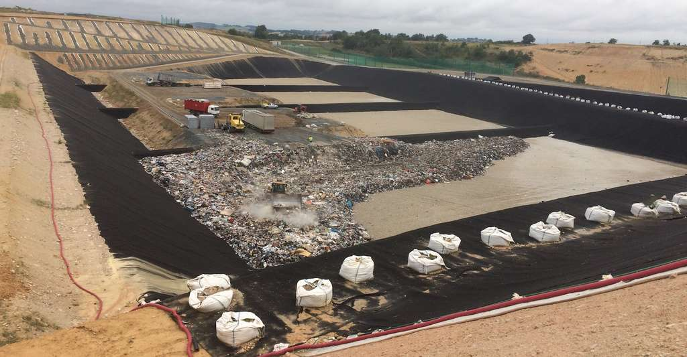
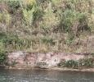
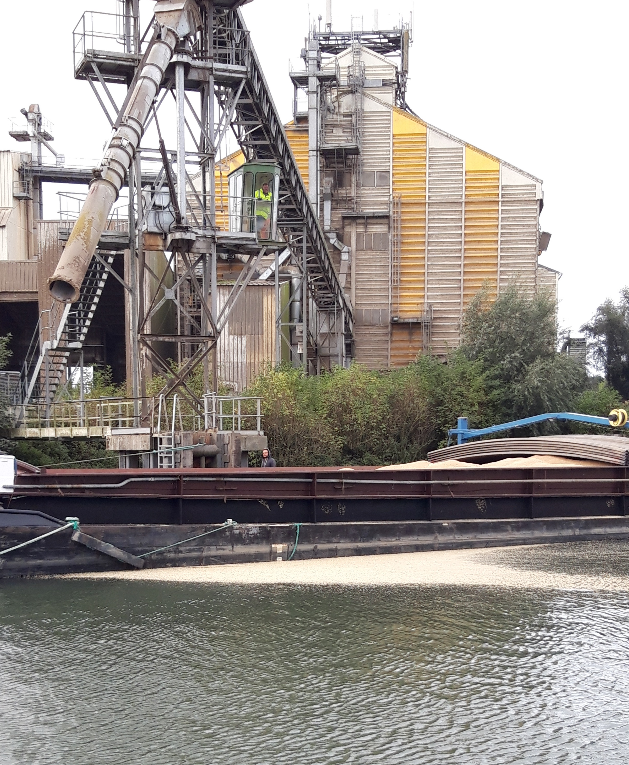
Sediment Accumulation & Contamination Issues in Hauts de France (France)
+
Lateral
Naville
Run off
Ecaillon
Urban/Industrial Wastes
=
Selle
+
Sediment Dragging
Contaminated Waste Storage
Study Area : Denain-Trith reach (canalized section of the Scheldt River)
EXPANSIVE FOR VNF
Upstream
What about :
Annual Accrual ≈ 18.000 m³/year
Contamination = Pb, Zn, Cd
95 Industrial & Urban Wastes
Matter & contaminant sources ?
Activities
Malthouse
Fiber-cement
Sewage Treatment Plants
Their respective contributions ?
Downstream
Selle
The impact of sediment accruals on those contributions ?
Ecaillon

Slide 3
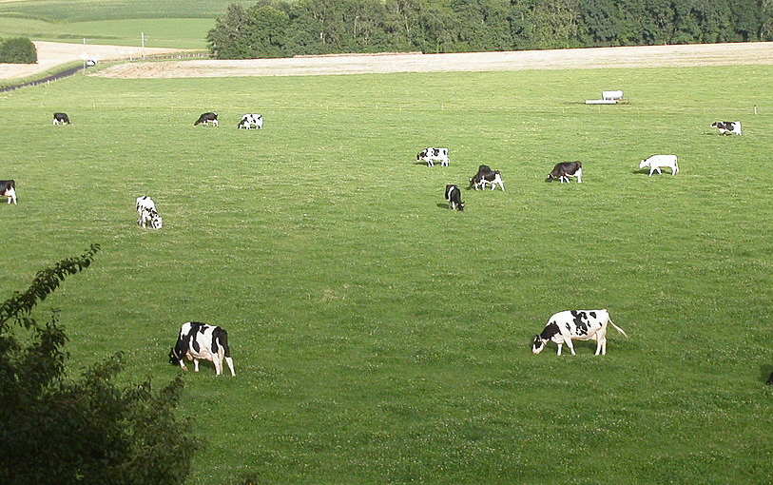

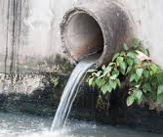
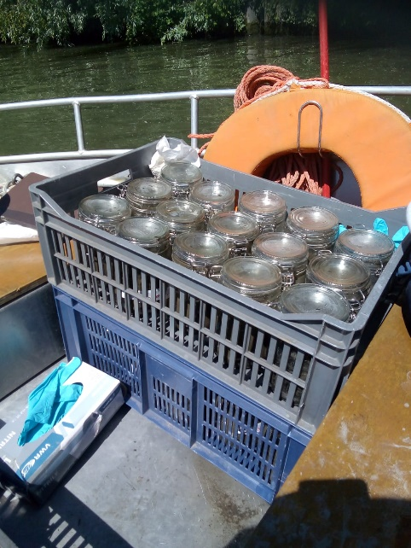
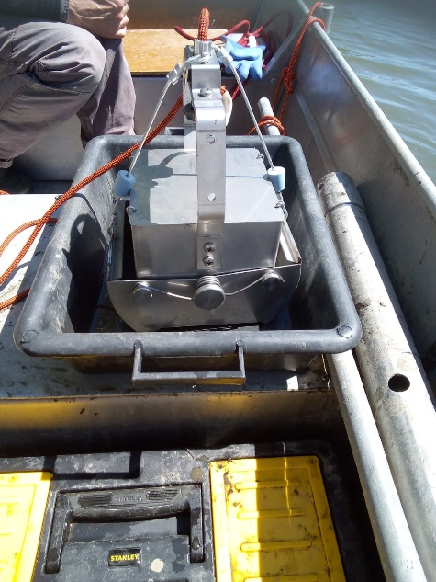

Fingerprinting approach to quantify sediment & contaminant sources contributions
Sources (& Tracers) to…
…Sink
Characterisation of sources
Grass land-Antibiotics :
Sulfamethazine, Chloramphenicol
Elementary/Molecular & Mineral Analyses
Croplands-Pesticides :
Isoproturon, Aclonifen, Chlortoluron
Upstream & Downstream logic
Upstream
Sink media
+
Wastewater treatment plants
Antibiotics : Ofloxacine, Ciprofloxacine, Flumequine, …
Others : Cafein, …
Downstream
Industrial wastewater
Fiber-cement : Ca, Mg, … ; Minerals (Calcite, …)
Malt house : Mn, Ni, … ; Pesticides (Deltaméthrine)
Sediment sampling
Analyses
Fingerprinting
Determine tracers (Haddachi, 2013 ; Gorman Sanisaca and al., 2017)
Estimate sources contributions (Collins and others, 2010 ; Gellis, Noe, and others, 2015)
Geostatistcial Analyses
Impact of sediments on contributions
(Alary and Demougeot-Renard, 2010)
Chemical Analyses
Mineralogical Analyses
Suspended particles
&
Sediments
Magnetism Analyses
Modèle fingerprinting

Slide 4
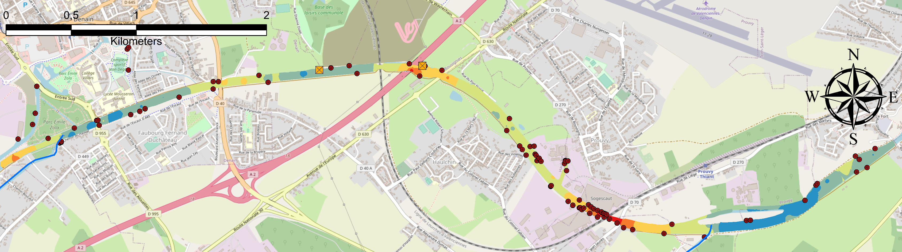
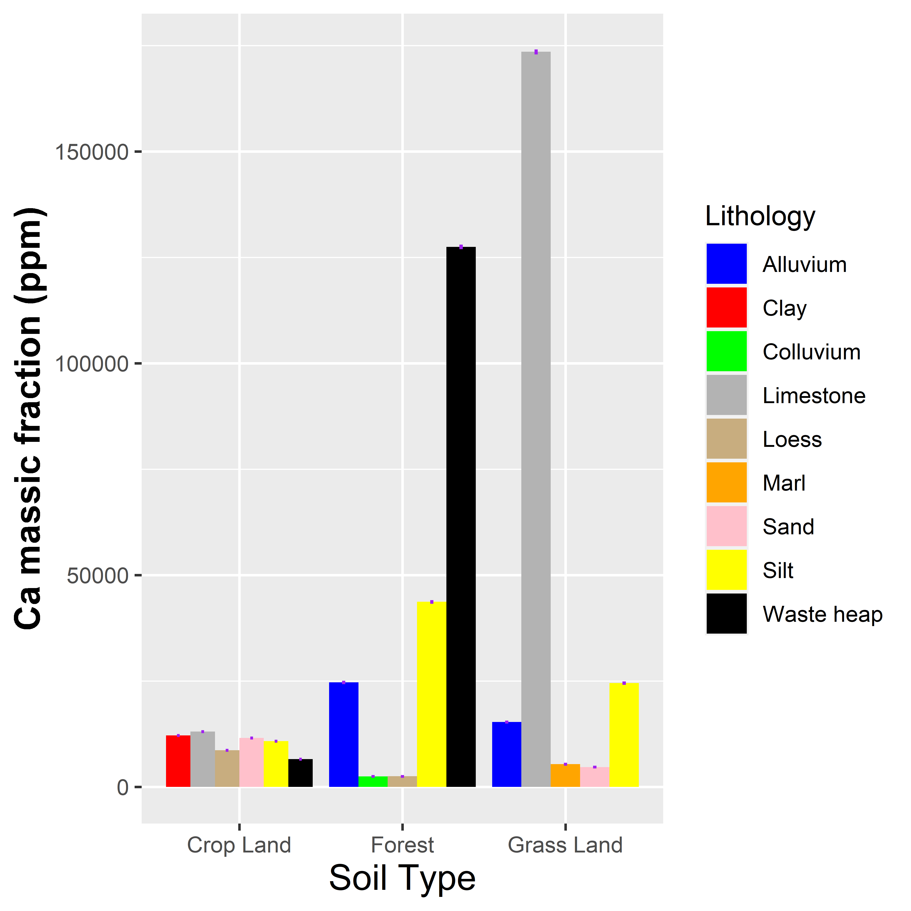
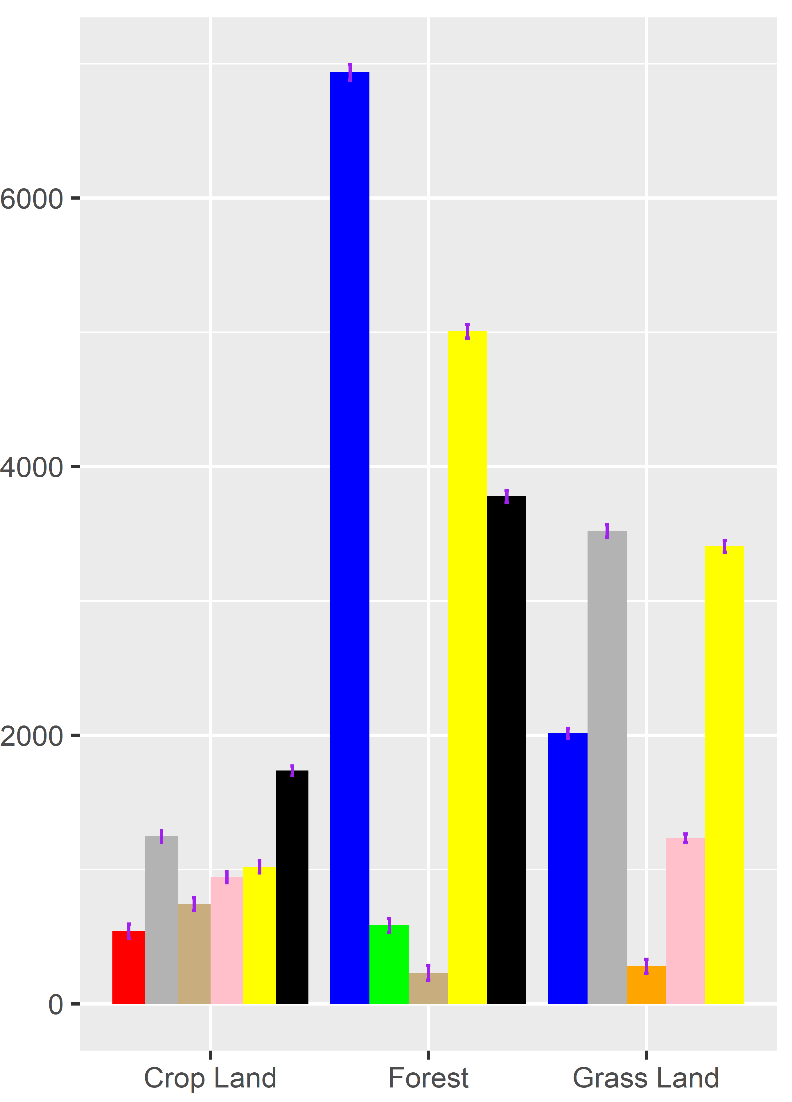
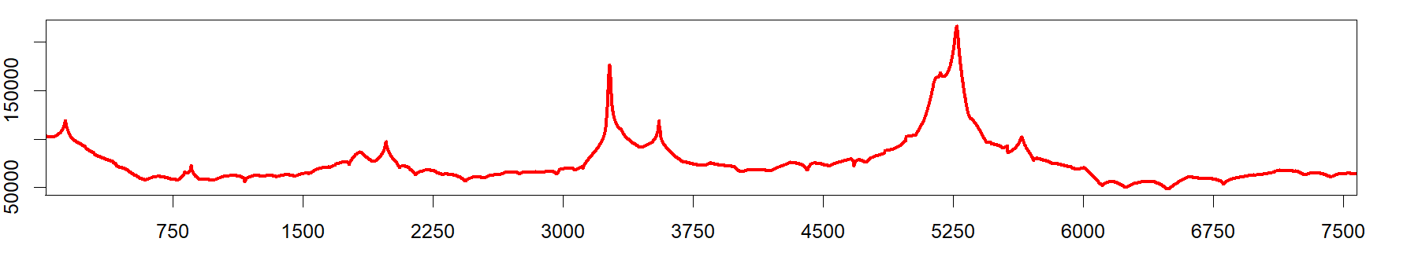

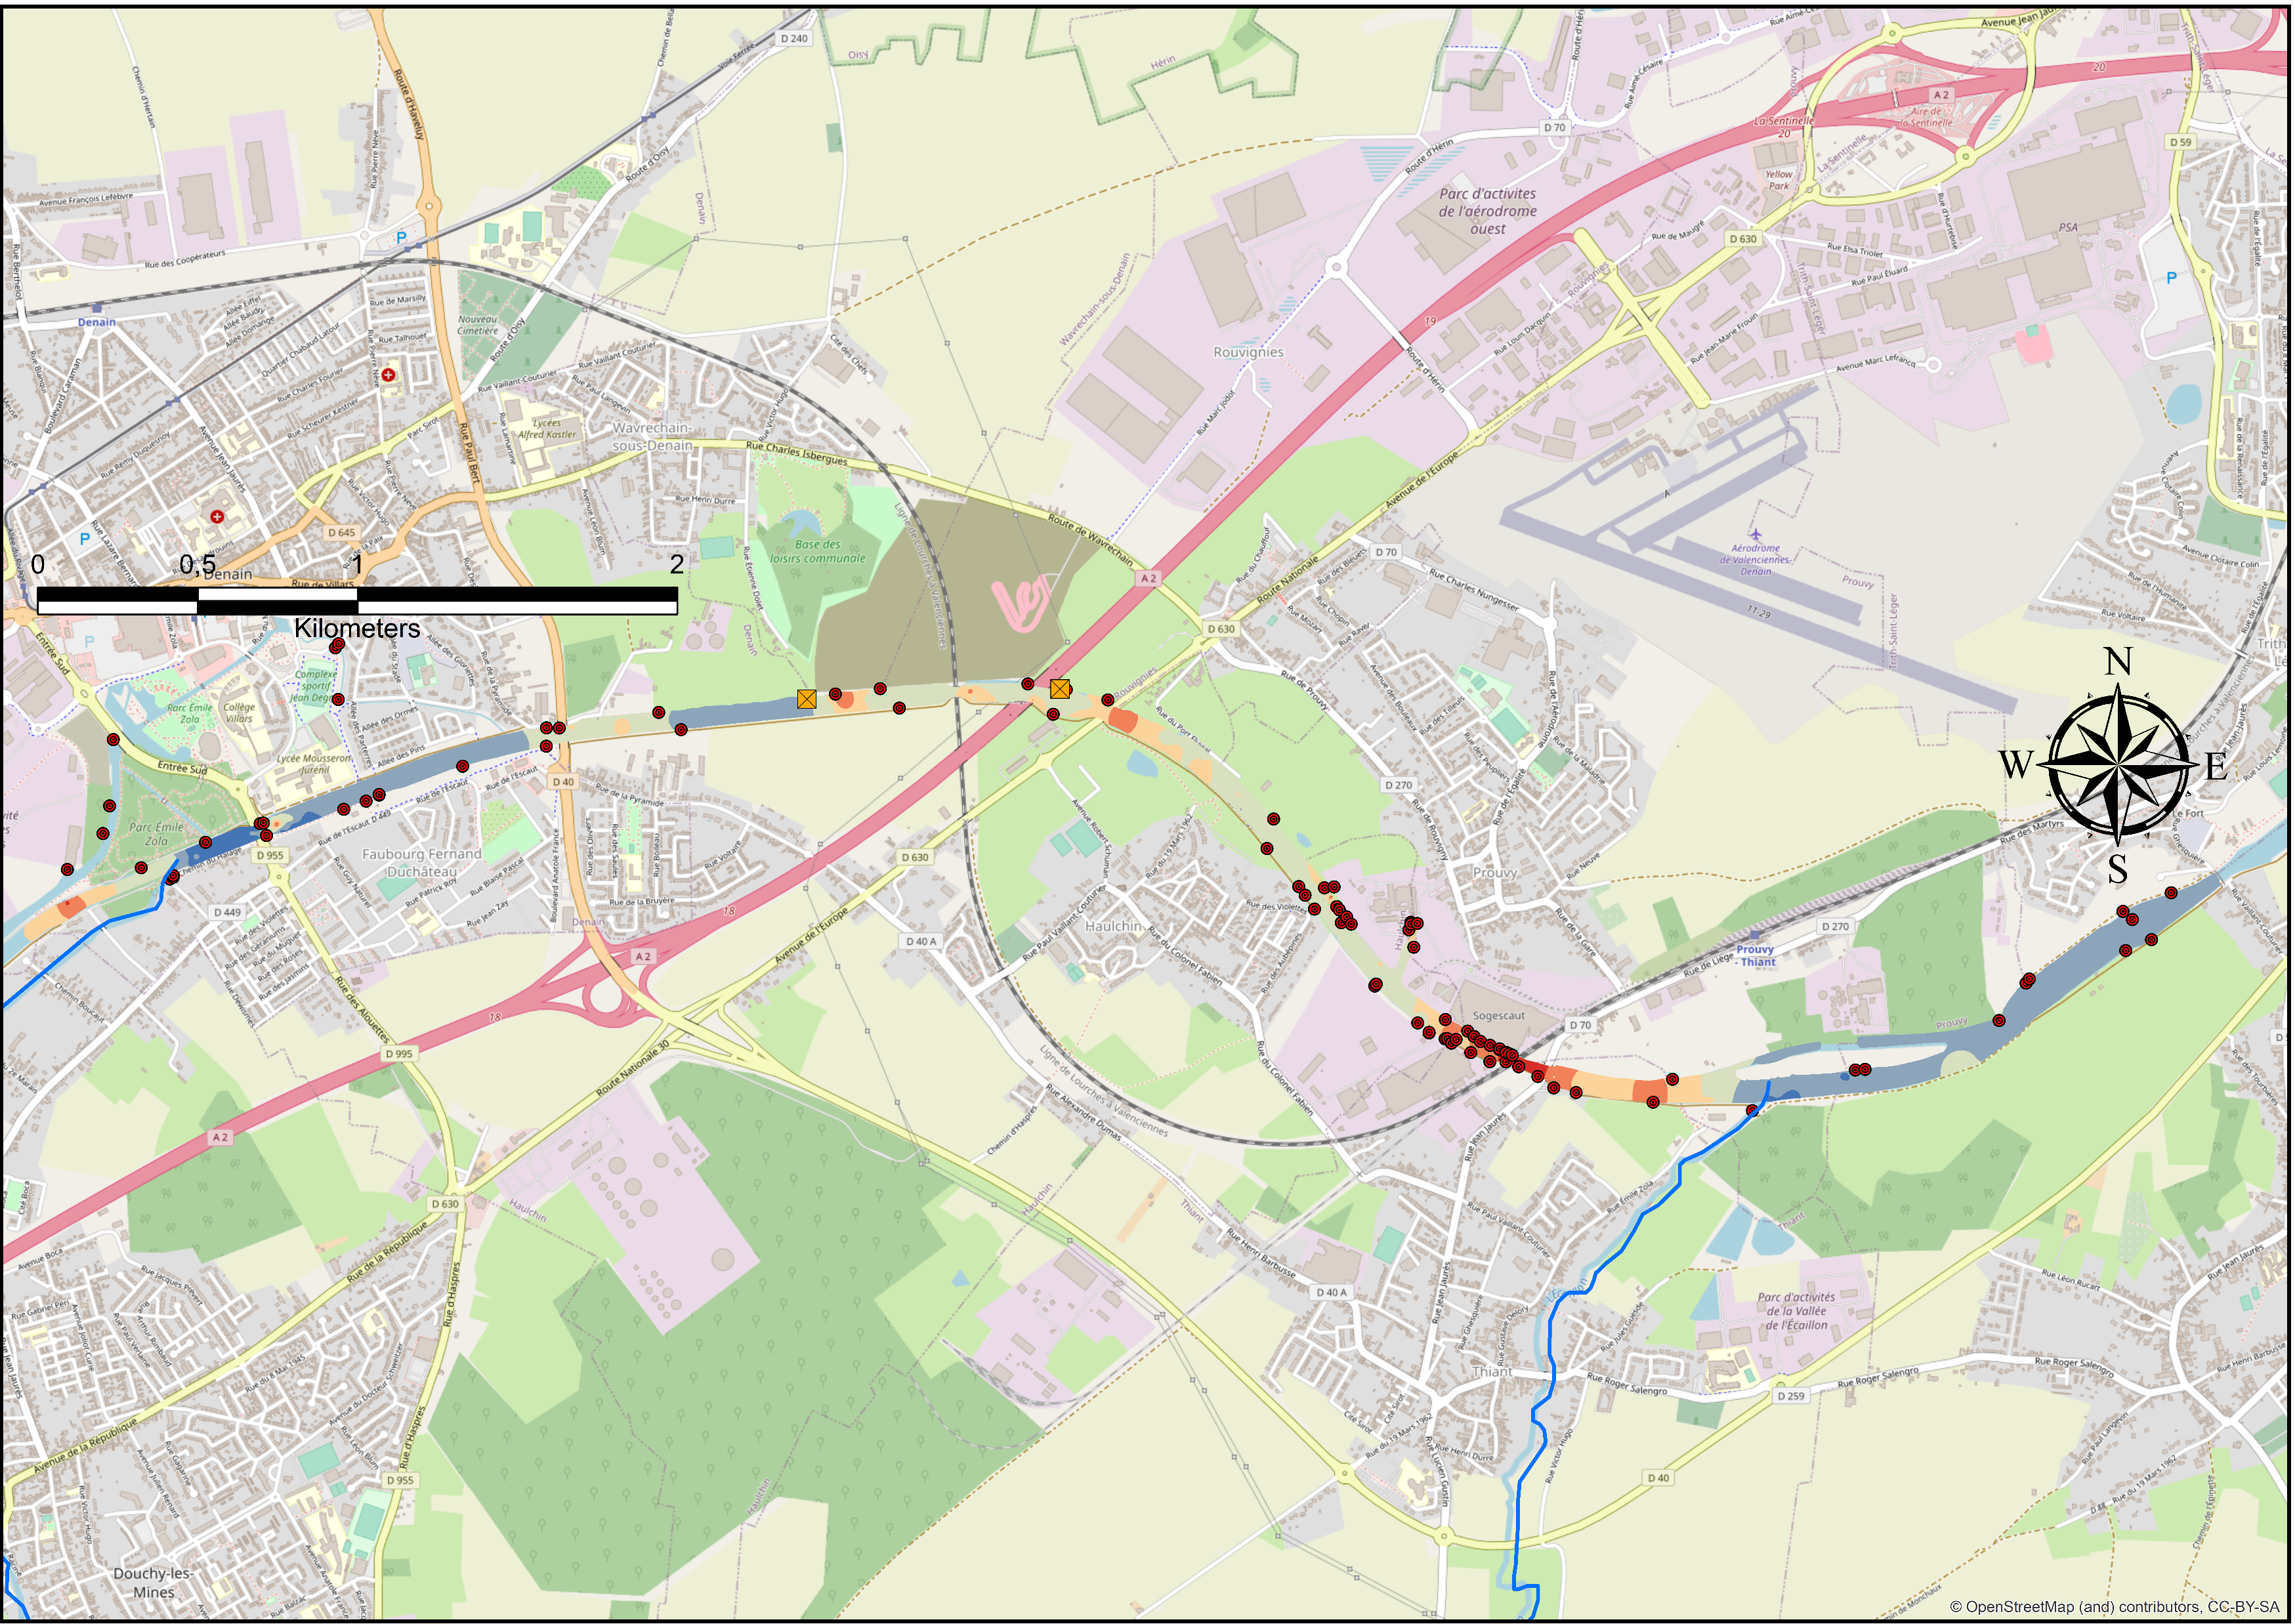
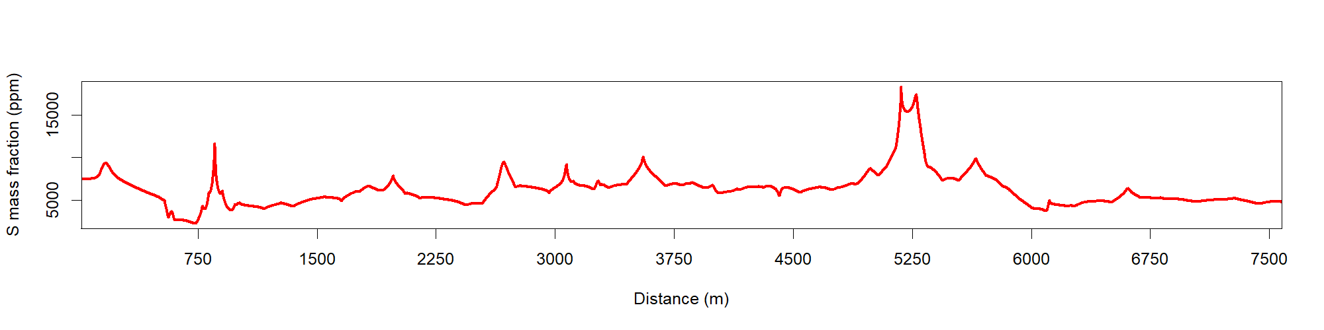
Sources characterisation & Upstream-Dowstream Evolutions on the Reach
Sources characterization…
…Upstream – Downstream Evolution on the reach
Soils…
Ca mass fraction (ppm)
S mass fraction (ppm)
Increase of carbonate proportions (10 % to 50 %)
Substratum
Ca
Substratum
S
Mean
Ca
Fiber-cement
factory
3307
2935
Ca mass fraction (ppm)
40156
46850
1038
10449
…& Wastewaters
In progress…
S
Fiber-cement
factory
Work in progress
S mass fraction (ppm)
Sample other soil sources
Sample wastewaters
Calculate first source contributions
Deepen the kriging
Upstream
Distance (m)
Downstream
Modèle fingerprinting

Slide 5
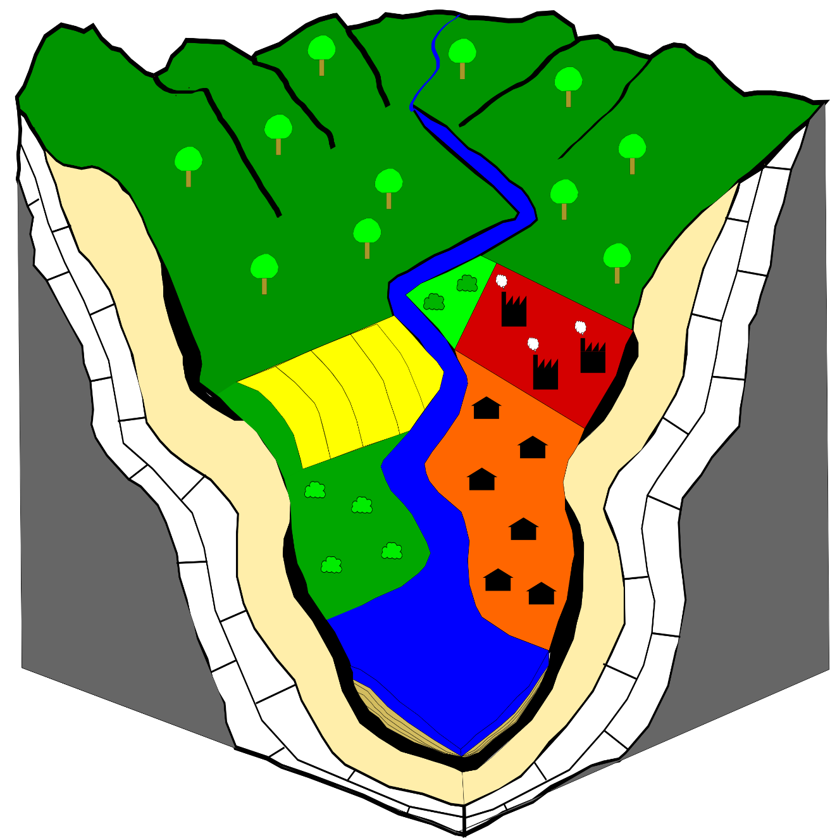
Preleminary conclusions & Upcomings
Preleminary conclusions…
SOURCES
Elementary composition distinctions between soils (croplands, grass lands, …)
Impact of substratum on soils compositions ?
Tilling effect for croplands ?
REACH SEDIMENTS-According to source localisations
Elementary peak concentrations
Mineralogical variations
To do…
Impact of industrial wastes ?
Contribution of eroded riverbanks ?
Sources contributions ?
Bias from the sink sediment composition ?
Modèle fingerprinting

