Slide 1



Recent changes of the tropical Hadley circulation: a trend or multidecadal variability?
Žiga Zaplotnik¹, Matic Pikovnik¹ and Lina Boljka²
¹ Faculty of Mathematics and Physics, University of Ljubljana
² Geophysical Institute and Bjerknes Centre for Climate Research, University of Bergen, Bergen

Slide 2

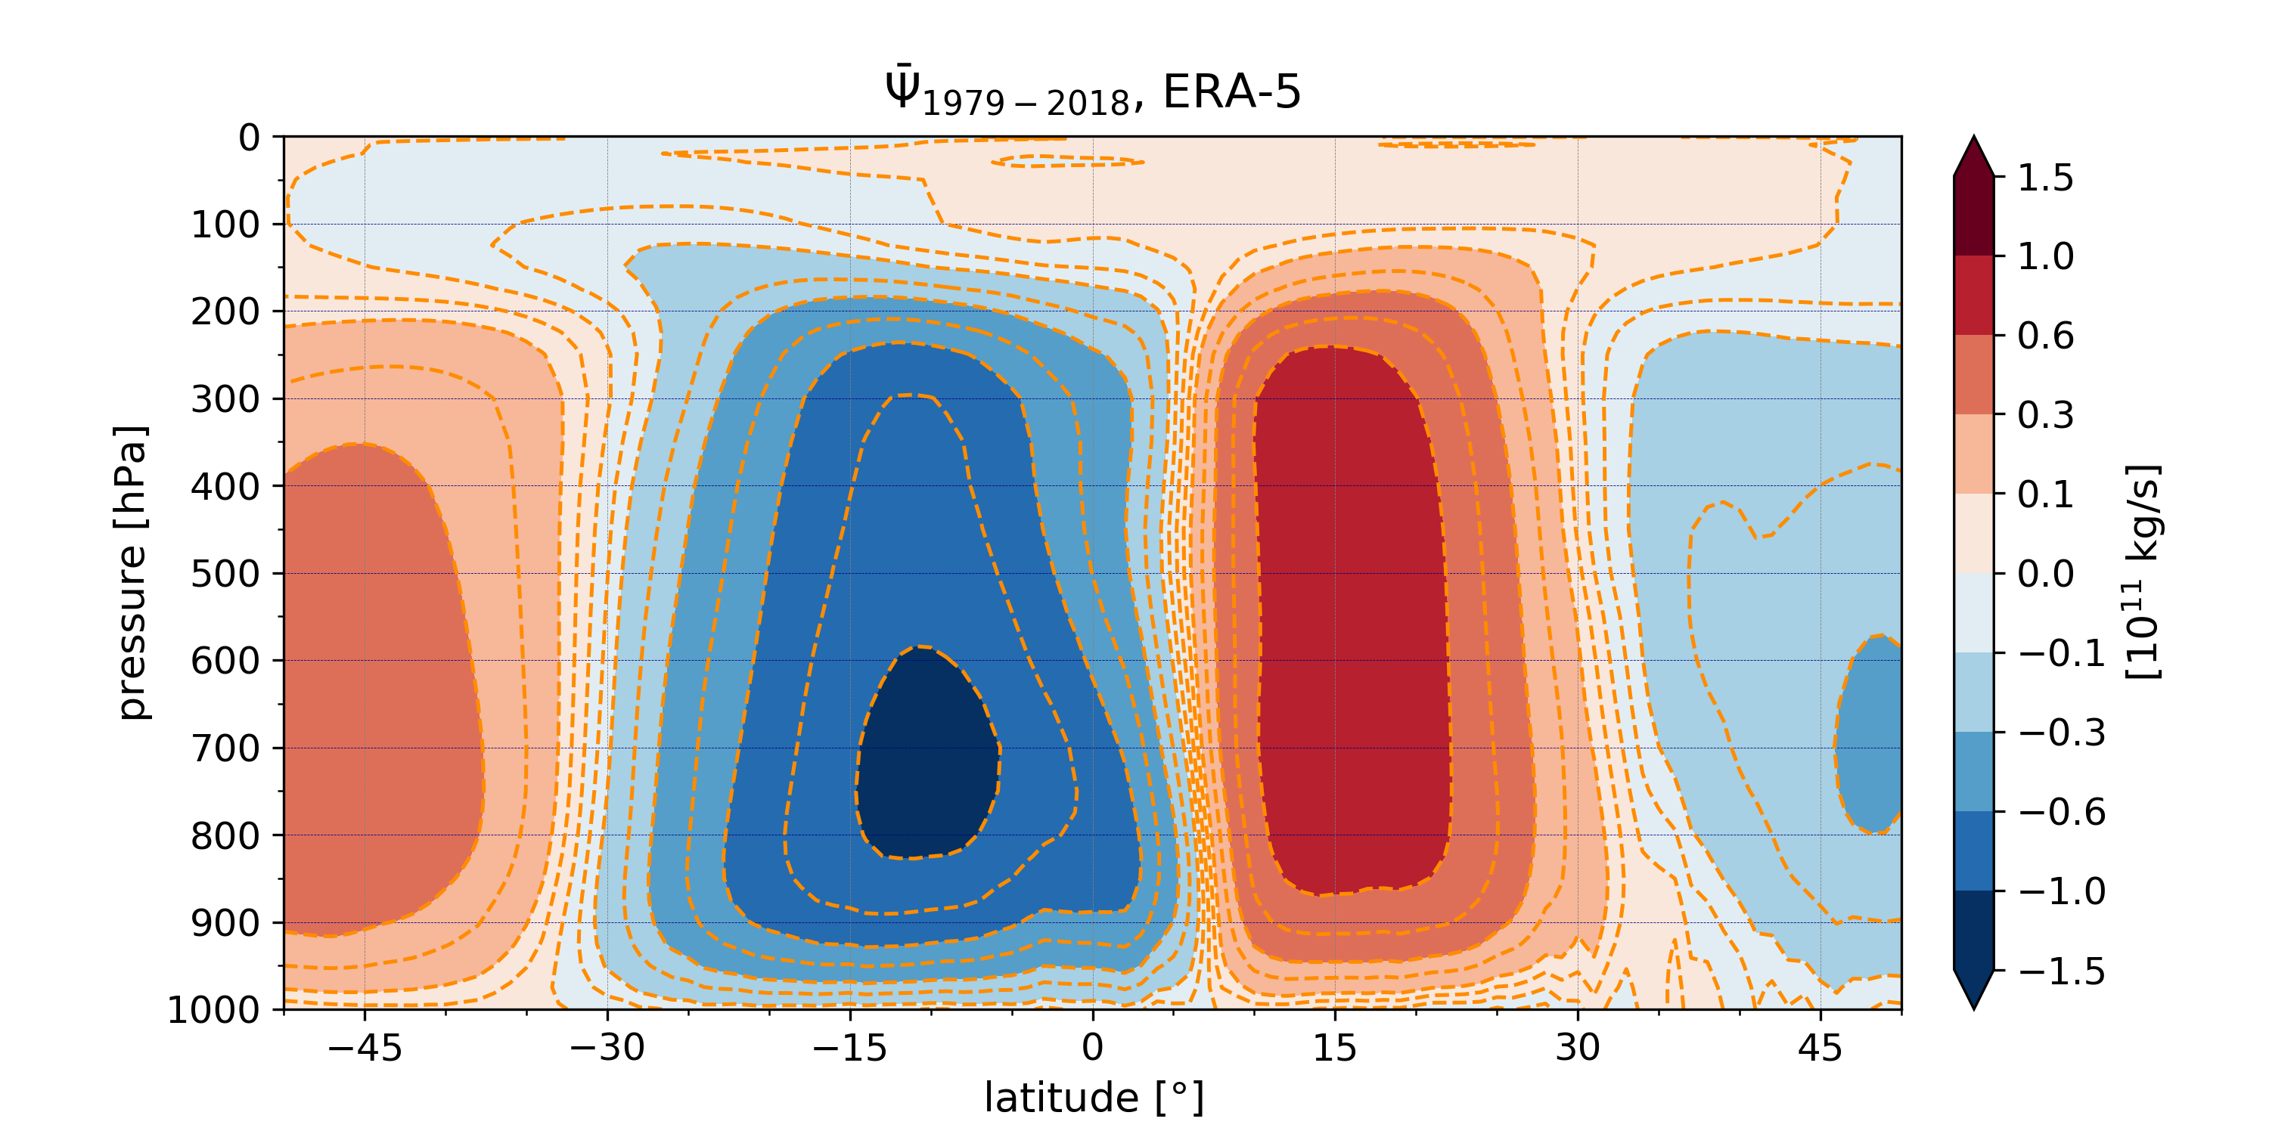
Hadley circulation (HC) strength
Typically use streamfunction on pressure-meridional plane:
CLIMATOLOGICAL MEAN
Metrics of HC strength:
previous studies: 500 hPa max/min
here: average streamfunction over whole northern/southern cell

Slide 3
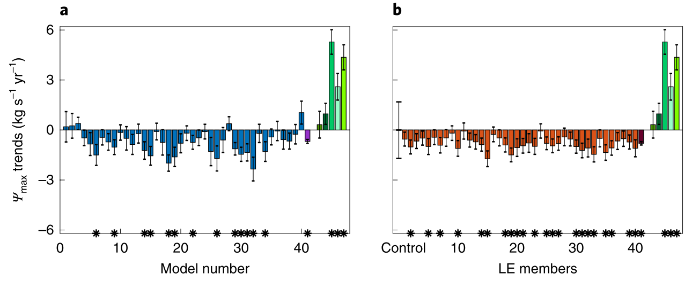
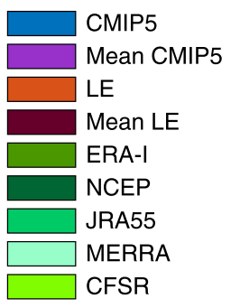
Is Hadley cell strengthening or weakening (1979-2018)?
CLIMATE MODELS: weakening
REANALYSES: strengthening (including ERA5)
NH Hadley cell trends
Chemke R., Polvani L. (2019). Opposite tropical circulation trends in climate models and in reanalyses. Nat. Geos. 12.

Slide 4
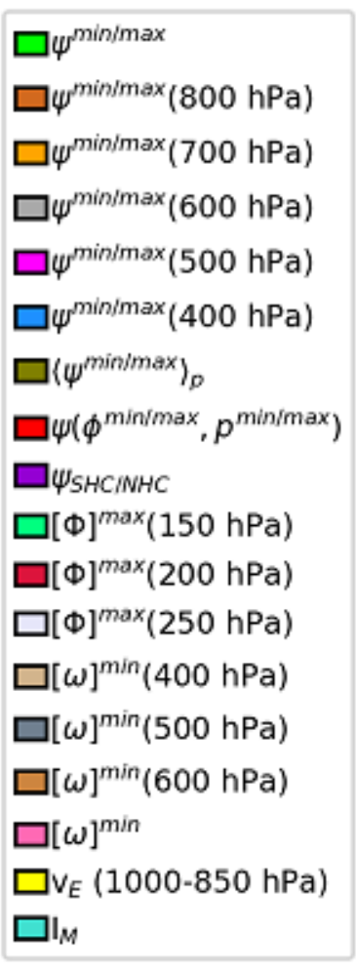
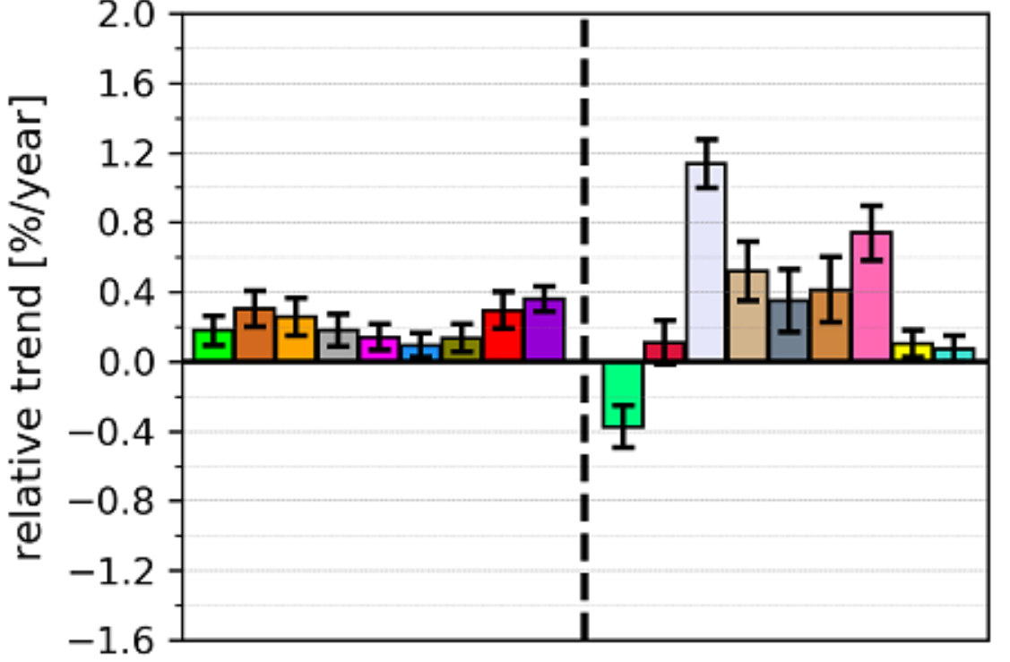
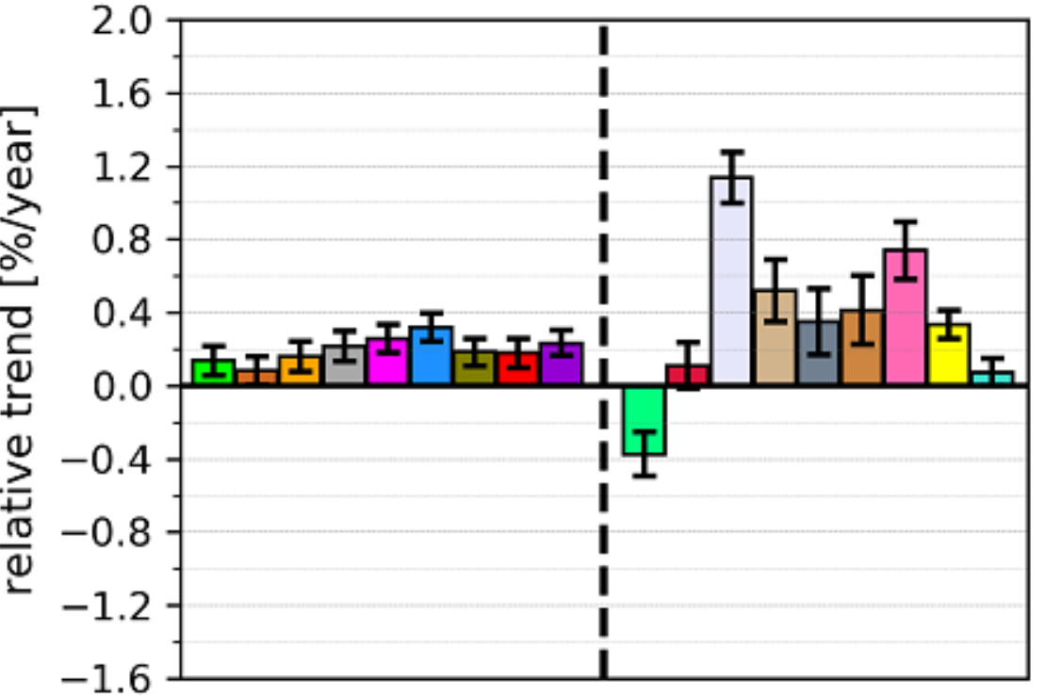
Trends of HC strength in ERA5 reanalysis
Northern Hadley cell (NHC)
Southern Hadley cell (SHC)
Stream function metrics
Pikovnik M., Zaplotnik Ž., Boljka L., Žagar N. (2022). Metrics of the Hadley circulation strength and associated circulation. Accepted in Weather and Climate Dynamics.

Slide 5
Is Hadley cell strengthening or weakening (1979-2018)?
CLIMATE MODELS: weakening
REANALYSES: strengthening (including ERA5)
WHY?
NH Hadley cell trends
Chemke R., Polvani L. (2019). Opposite tropical circulation trends in climate models and in reanalyses. Nat. Geos. 12.

Slide 6
Is Hadley cell strengthening or weakening (1979-2018)?
CLIMATE MODELS: weakening
REANALYSES: strengthening (including ERA5)
WHY?
NH Hadley cell trends
ARTEFACTS IN THE REANALYSES?
MULTIDECADAL VARIABILITY?
OTHER?
Chemke R., Polvani L. (2019). Opposite tropical circulation trends in climate models and in reanalyses. Nat. Geos. 12.

Slide 7
Is Hadley cell strengthening or weakening (1979-2018)?
CLIMATE MODELS: weakening
REANALYSES: strengthening (including ERA5)
WHY?
NH Hadley cell trends
ARTEFACTS IN THE REANALYSES?
MULTIDECADAL VARIABILITY?
OTHER?
Chemke R., Polvani L. (2019). Opposite tropical circulation trends in climate models and in reanalyses. Nat. Geos. 12.

Slide 8
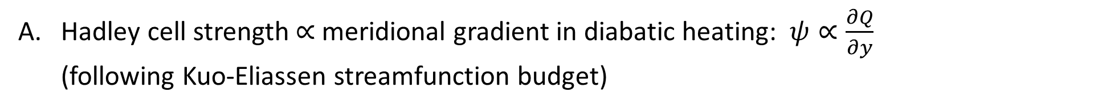
What drives Hadley cell strengthening in reanalyses?
Hadley cell strength $∝$ meridional gradient in diabatic heating: $ψ∝\frac{∂Q}{∂y}$ (following Kuo-Eliassen streamfunction budget)
Zaplotnik Ž., Pikovnik M., Boljka L. (2022). Recent Hadley circulation strengthening: a trend or multidecadal variability? Accepted in Journal of Climate.

Slide 9
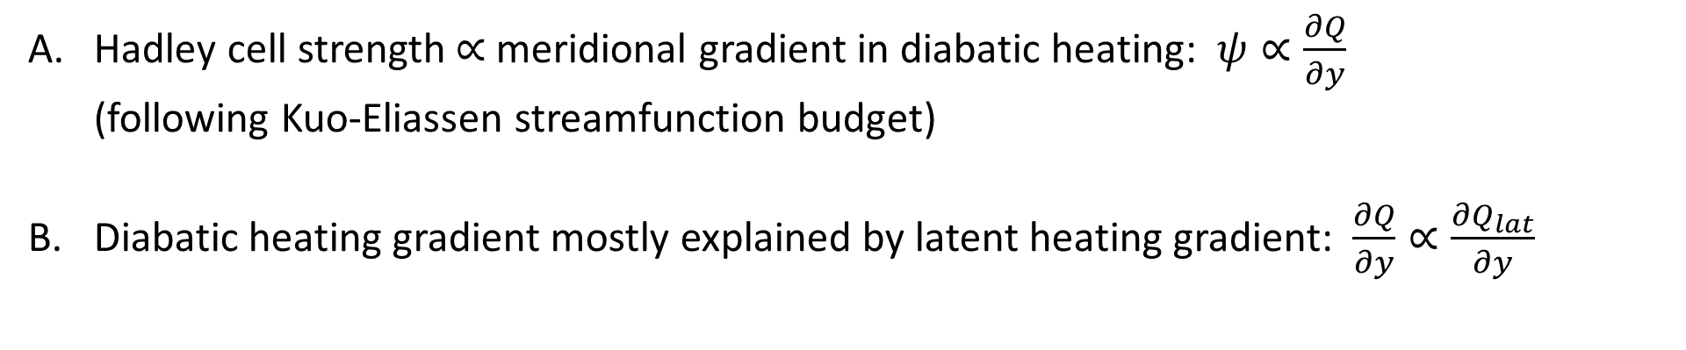
What drives Hadley cell strengthening in reanalyses?
Hadley cell strength $∝$ meridional gradient in diabatic heating: $ψ∝\frac{∂Q}{∂y}$ (following Kuo-Eliassen streamfunction budget)
Diabatic heating gradient mostly explained by latent heating gradient: $\frac{∂Q}{∂y}∝\frac{∂Q_{lat}}{∂y}$
Zaplotnik Ž., Pikovnik M., Boljka L. (2022). Recent Hadley circulation strengthening: a trend or multidecadal variability? Accepted in Journal of Climate.

Slide 10
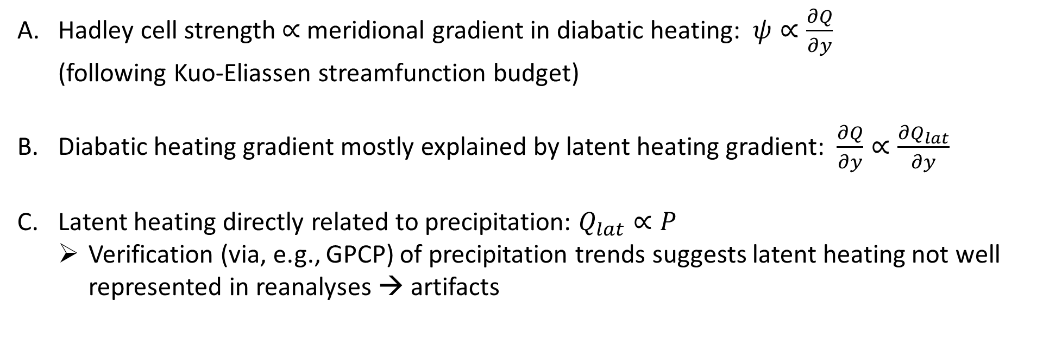
What drives Hadley cell strengthening in reanalyses?
Hadley cell strength $∝$ meridional gradient in diabatic heating: $ψ∝\frac{∂Q}{∂y}$ (following Kuo-Eliassen streamfunction budget)
Diabatic heating gradient mostly explained by latent heating gradient: $\frac{∂Q}{∂y}∝\frac{∂Q_{lat}}{∂y}$
Latent heating directly related to precipitation: $Q_{lat}∝P$
Verification (via, e.g., GPCP) of precipitation trends suggests latent heating not well represented in reanalyses → artifacts
Zaplotnik Ž., Pikovnik M., Boljka L. (2022). Recent Hadley circulation strengthening: a trend or multidecadal variability? Accepted in Journal of Climate.

Slide 11
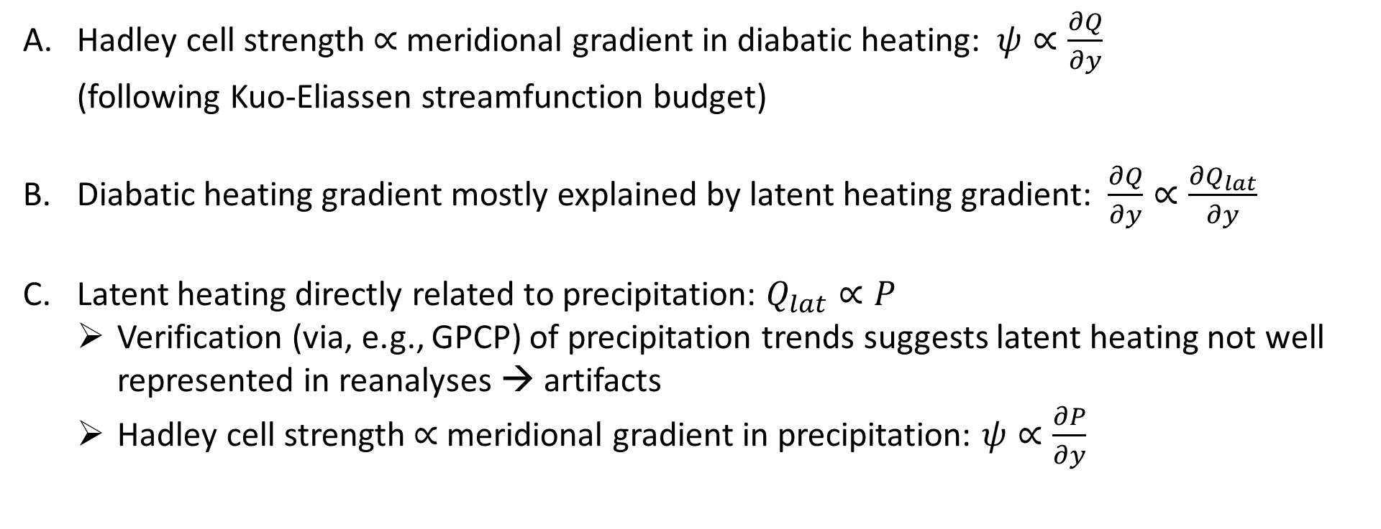
What drives Hadley cell strengthening in reanalyses?
Hadley cell strength $∝$ meridional gradient in diabatic heating: $ψ∝\frac{∂Q}{∂y}$ (following Kuo-Eliassen streamfunction budget)
Diabatic heating gradient mostly explained by latent heating gradient: $\frac{∂Q}{∂y}∝\frac{∂Q_{lat}}{∂y}$
Latent heating directly related to precipitation: $Q_{lat}∝P$
Verification (via, e.g., GPCP) of precipitation trends suggests latent heating not well represented in reanalyses → artifacts
Hadley cell strength $∝$ meridional gradient in precipitation: $ψ∝\frac{∂P}{∂y}$
Zaplotnik Ž., Pikovnik M., Boljka L. (2022). Recent Hadley circulation strengthening: a trend or multidecadal variability? Accepted in Journal of Climate.

Slide 12
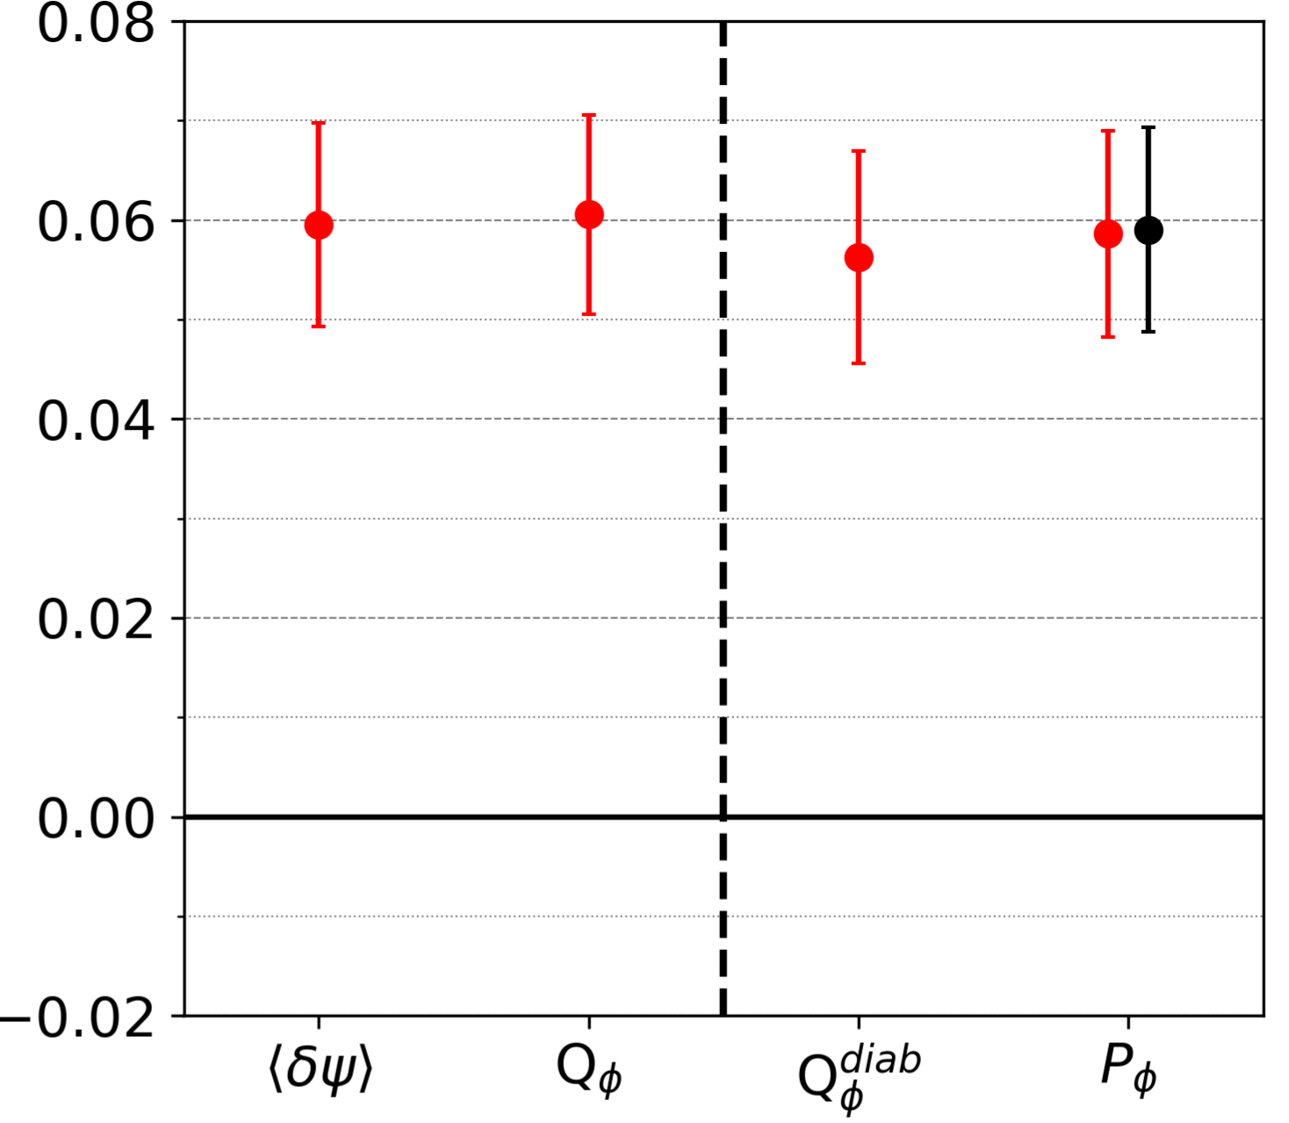
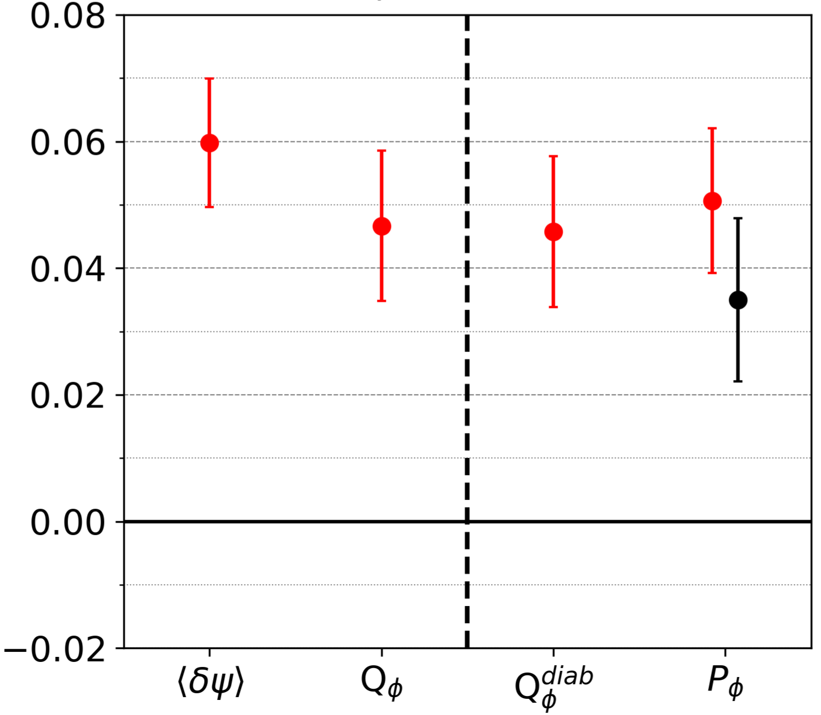
What drives Hadley cell strengthening in reanalyses?
NHC
How well do trends of precipitation gradient in ERA5 fit observations (e.g. GPCP)?
Trends in meridional gradient of diabatic heating, precipitation & Hadley cell strength are consistent and of similar (normalised) magnitude
Despite some artifacts, the trends might be physical as well!
trend
ERA5
SHC
GPCP
trend
Zaplotnik Ž., Pikovnik M., Boljka L. (2022). Recent Hadley circulation strengthening: a trend or multidecadal variability? Accepted in Journal of Climate.

Slide 13
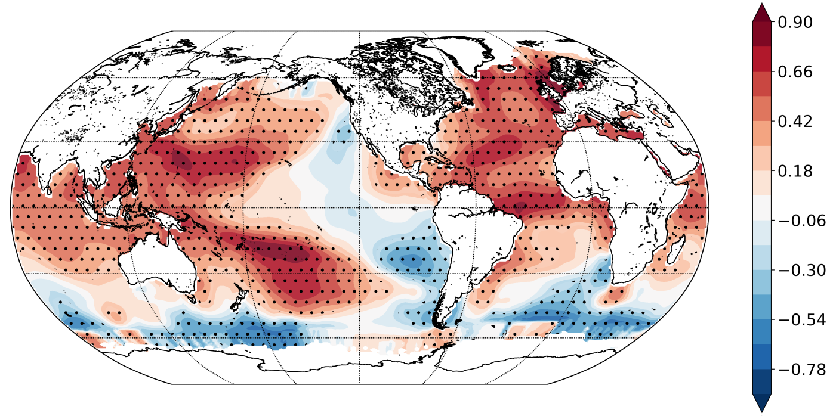
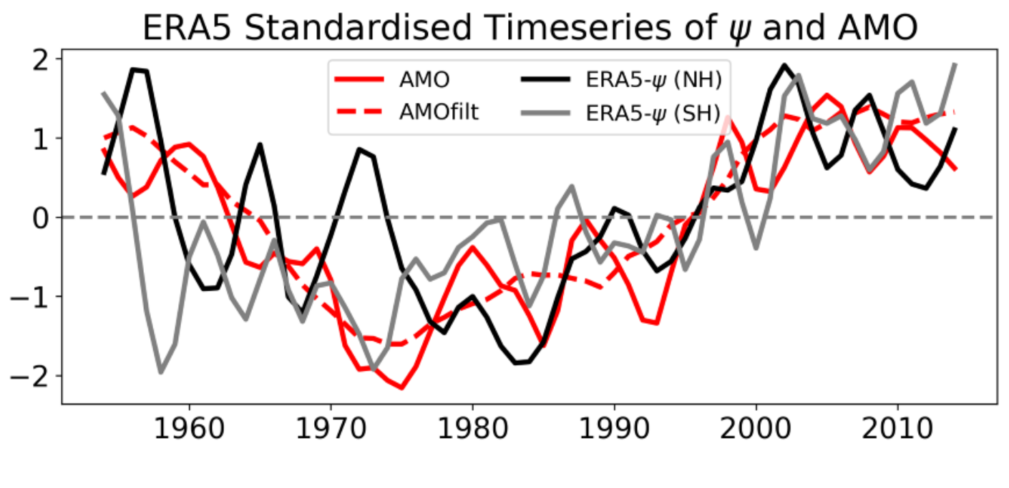
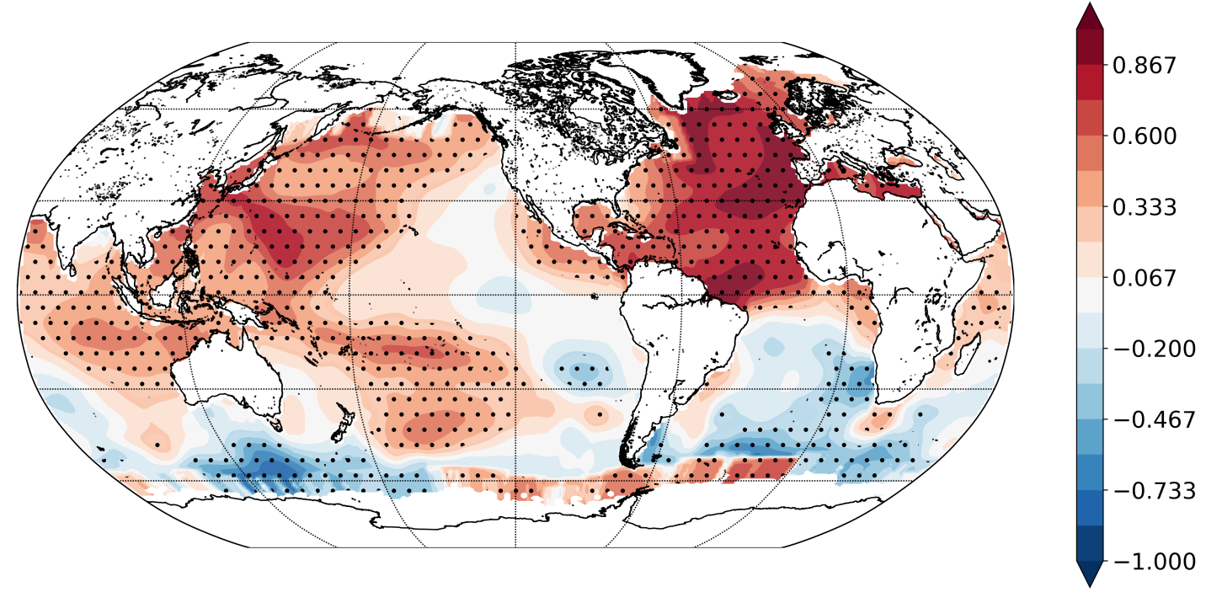
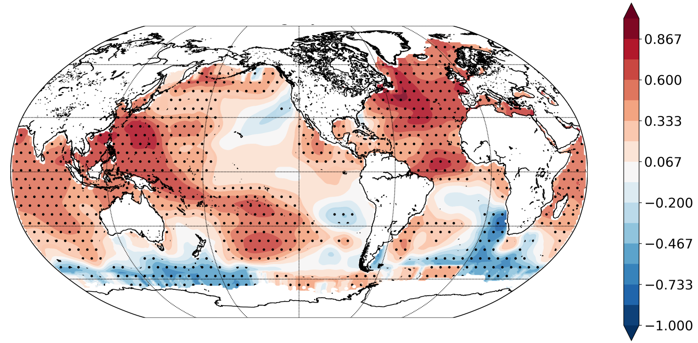
Is it multidecadal variability?
Perhaps! Hadley cells in ERA5 show variability consistent with Atlantic Multidecadal Oscillation (AMO)
Other long-range reanalyses (e.g. ERA-20C, NOAA-20CR) consistent only in SH cell
SST–NHC strength correlation
SST–AMO correlation
SST–SHC strength correlation
Zaplotnik Ž., Pikovnik M., Boljka L. (2022). Recent Hadley circulation strengthening: a trend or multidecadal variability? Accepted in Journal of Climate.

Slide 14
Conclusions
„Consensus“: the Hadley cells will weaken with climate change
Reanalyses/observations show strengthening in the last 4 decades
Why do reanalyses and climate models differ?
Artefacts in reanalyses with representation of precipitation
Models struggle to represent multidecal variability
We identified a link between AMO and SH Hadley cell (maybe also NH)
We proposed a mechanism for the interplay of AMO and HC based on our findings and previous studies (e.g. Li et al. (2016))

Slide 15
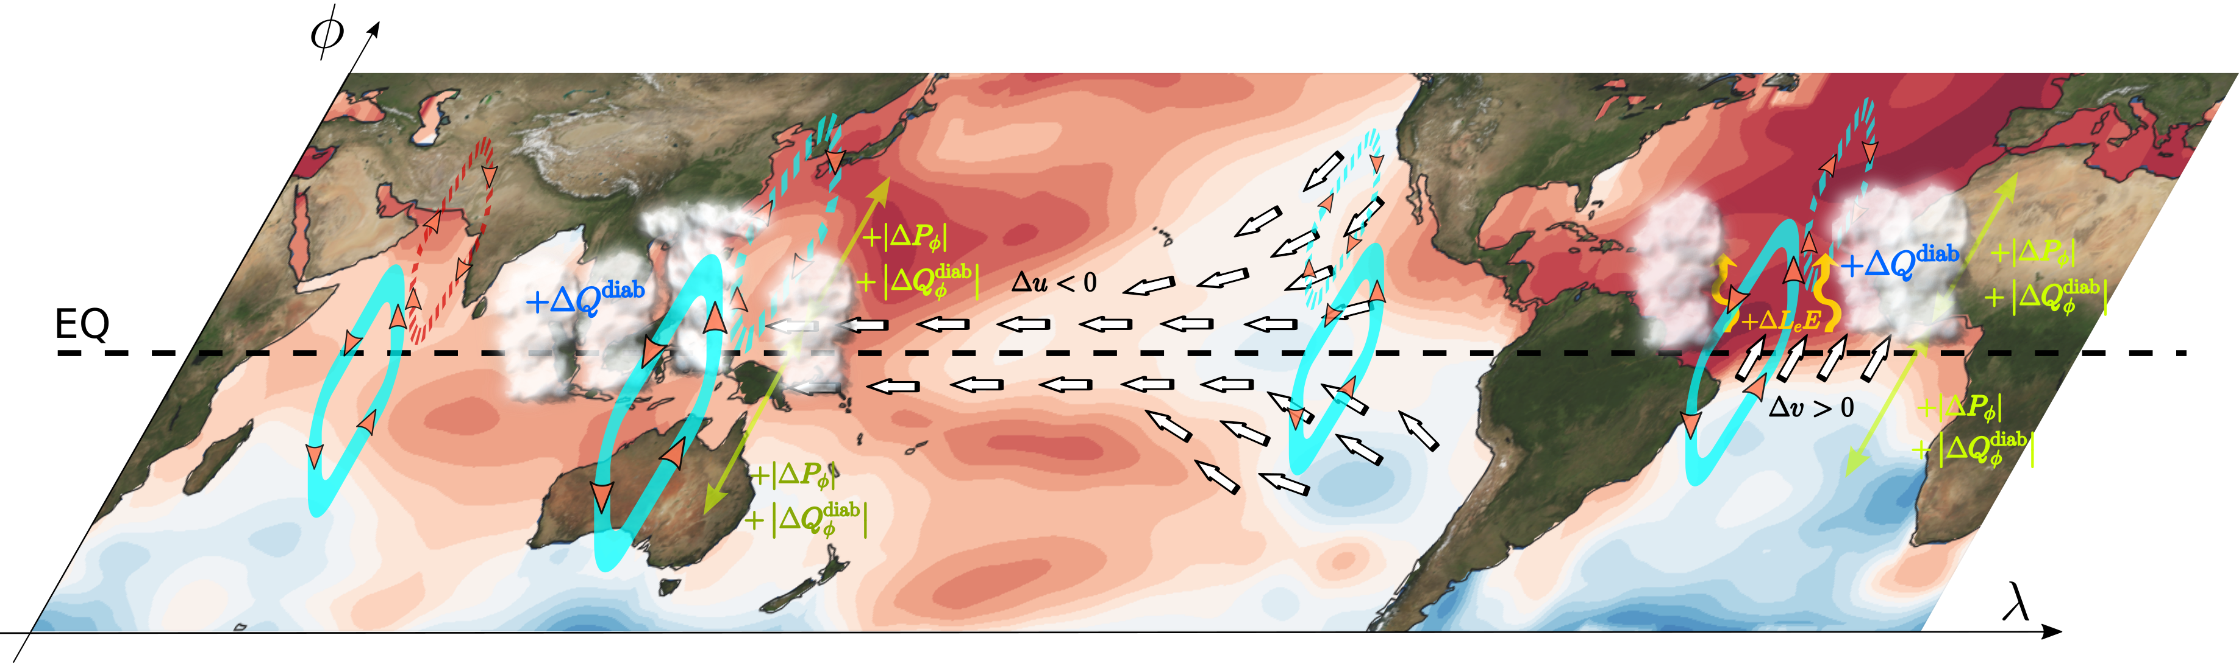

AMO impact on the Hadley circulation
$$∇T$$
Zaplotnik Ž., Pikovnik M., Boljka L. (2022). Recent Hadley circulation strengthening: a trend or multidecadal variability? Accepted in Journal of Climate.

Slide 16
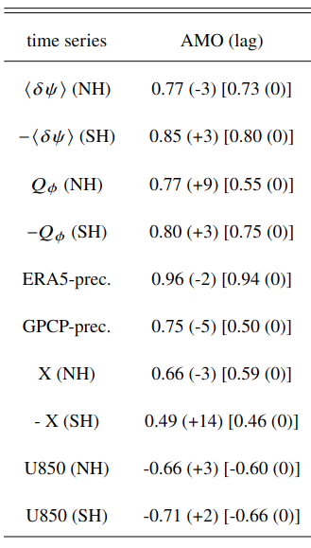
An imprint of AMO in HC strength?
Sea surface temperature –AMO correlation
Sea surface temperature –NHC strength correlation
Sea surface temperature –SHC strength correlation

Slide 17
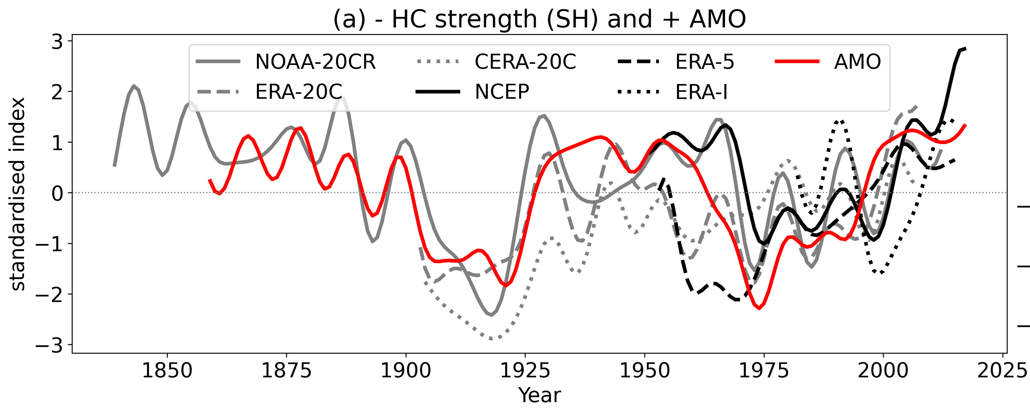
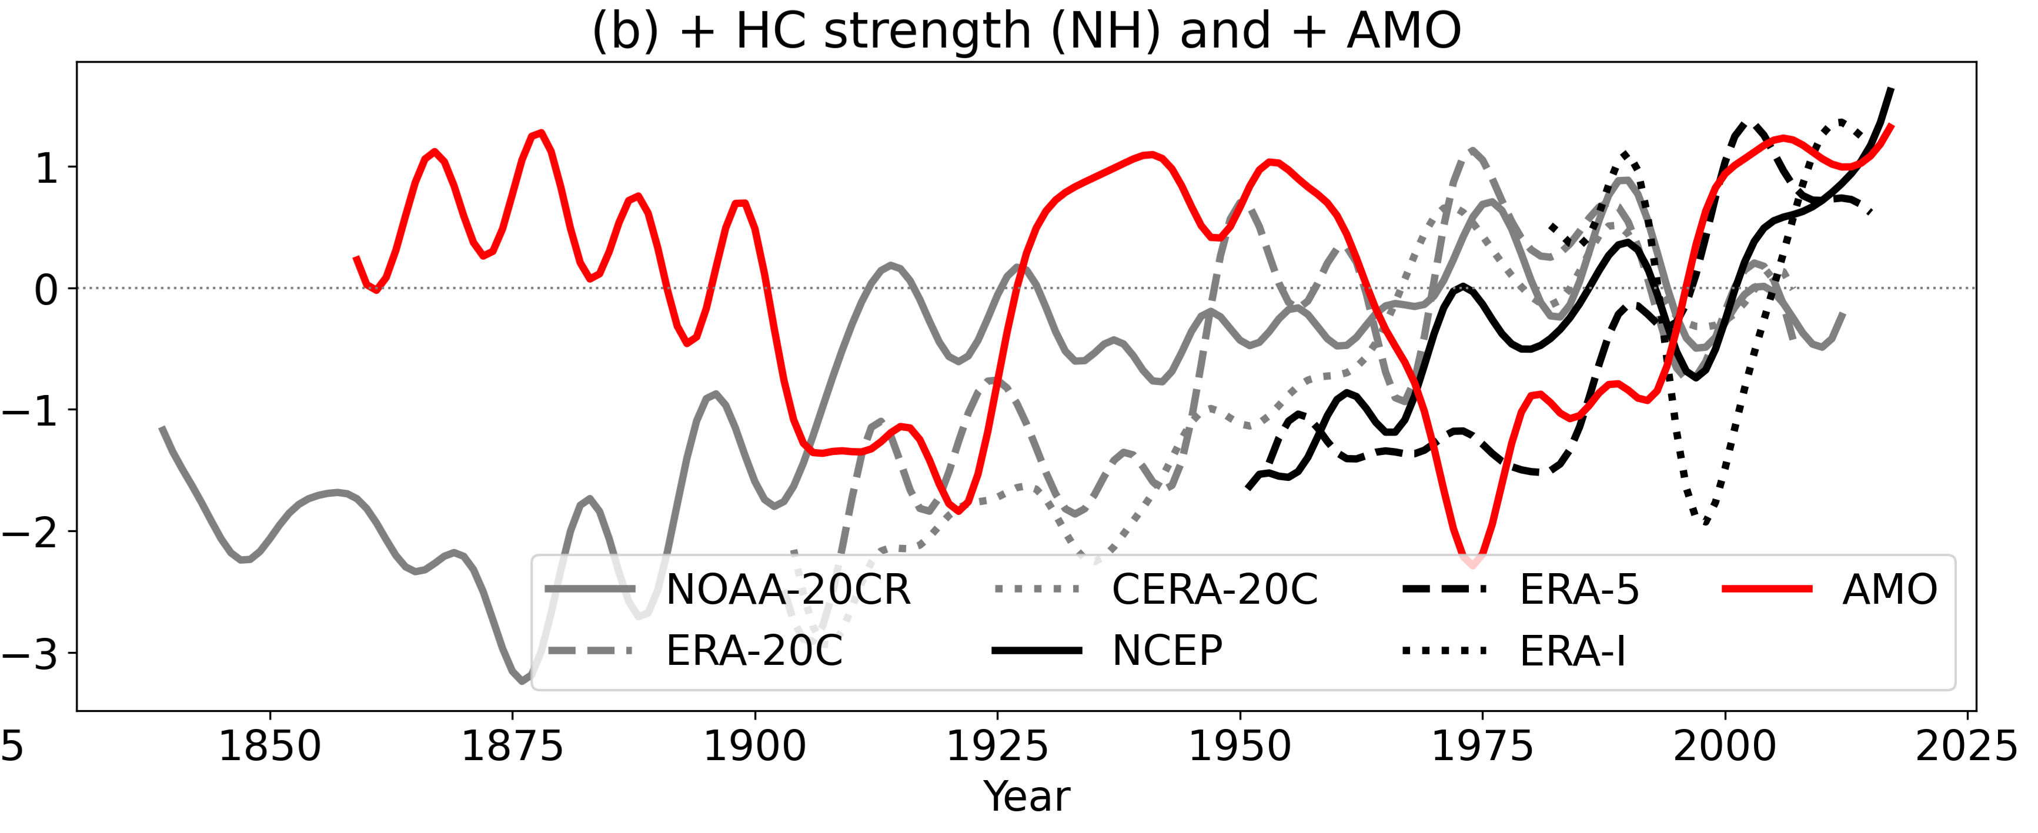
An imprint of AMO in HC strength?
The AMO signal has been also tested in other reanalyses:
ERA-Interim (1979-2018)
ERA-20C (1900-2010): only forced by SST/SIC
CERA-20C (1900-2010)
NOAA-20CR (1836-2015): only forced by SST/SIC
NCEP (1948-2018)
Southern Hadley cell strength is aligned with AMO in most reanalyses
Northern Hadley cell strength correlates well with AMO only in ERA5

