Slide 1
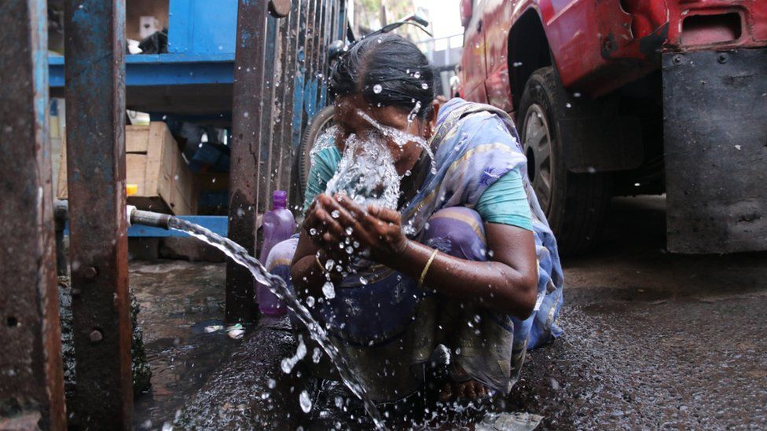






@GETTY IMAGES
Compound drought and heatwave identification: daily-scale independent extreme events based on 120-year observations
Baoying Shan, Bernard De Baets, Niko E.C. Verhoest
Baoying.Shan@Ugent.be

Slide 2

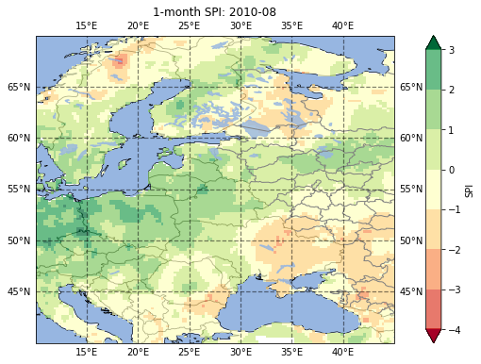
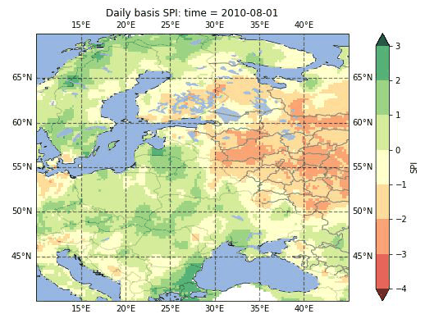
Existing problems in the identification of compound drought and heatwave events
Do CDHW events only happen in summer or the extended summer season?
Ecological influences by the relative heatwave in winter
E.g. increase in mortality rates of UK butterflies
Coarse-resolution and scale inconsistency of drought and heatwave indices
E.g. monthly basis SPI + daily temperature index
Baoying.Shan@Ugent.be

Slide 3
Heatwave is defined in a relative sense
Solutions
A heatwave is defined as a period of excessively high temperatures compared to the expected normal temperatures in this period.
Method
SPI
Calculate SPI and SHI on daily basis using a moving window
0
Date
SPI
Label every day potentially belonging to droughts or heatwaves
①
②
③
④
0
Date
Pre-identification
threshold
Duration
Deficiency area
Severity
Inter arrival
Aggregate events by removing and adding dry (or heatwave) days based on statistical assumptions
SPI
①
②
0
Date
Removed
Added
Severity
Inter arrival
Duration
Baoying.Shan@Ugent.be

Slide 4
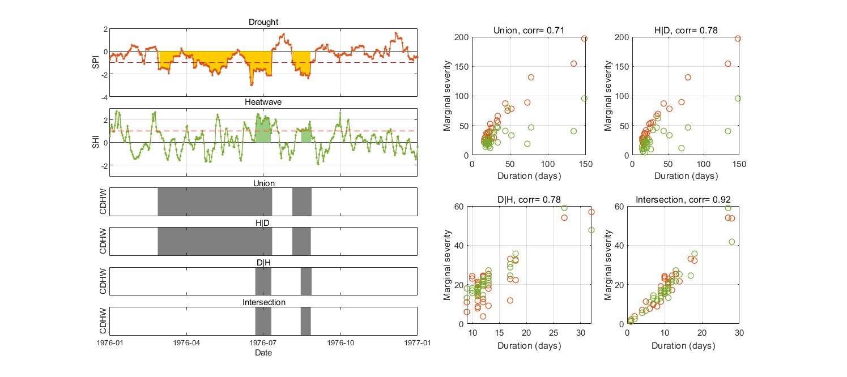
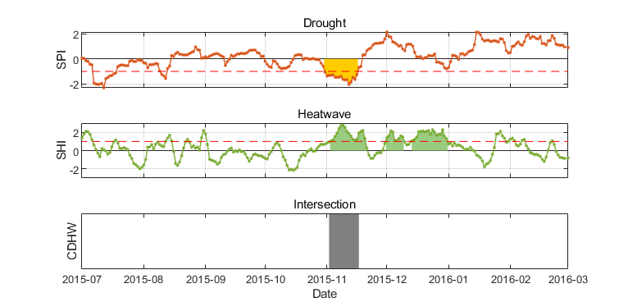
To demonstrate our method, we make use of 120 years (1901-2020) of daily precipitation and temperature observed at Uccle, near Brussels, Belgium.
Results
Results show that the proposed method:
can identify winter CDHW events
allows for a more precise identification of onset and end dates of events
A winter event
1976 CDHW events
Baoying.Shan@Ugent.be

Slide 5
To demonstrate our method, we make use of 120 years (1901-2020) of daily precipitation and temperature observed at Uccle, near Brussels, Belgium.
Results
Results show that the proposed method:
shows the desired behavior by removing and adding periods
demonstrates seasonal characteristics in Uccle
Removing threshold for drought
Cumulation scales (days) | Start and end thresholds
 | SPI = -0.5 | SPI = -1 | SPI = -1.3
15 | 23 | 14 | 10
30 | 42 | 22 | 20
45 | 44 | 31 | 25
60 | 58 | 45 | 24
90 | 81 | 59 | 32
Baoying.Shan@Ugent.be

