Slide 1
Drought legacy effects on gross primary productivity across eddy-covariance sites
Xin Yu, René Orth, Markus Reichstein, Michael Bahn, and Ana Bastos
2022.05.23
Email: xyu@bgc-jena.mpg.de

Slide 2
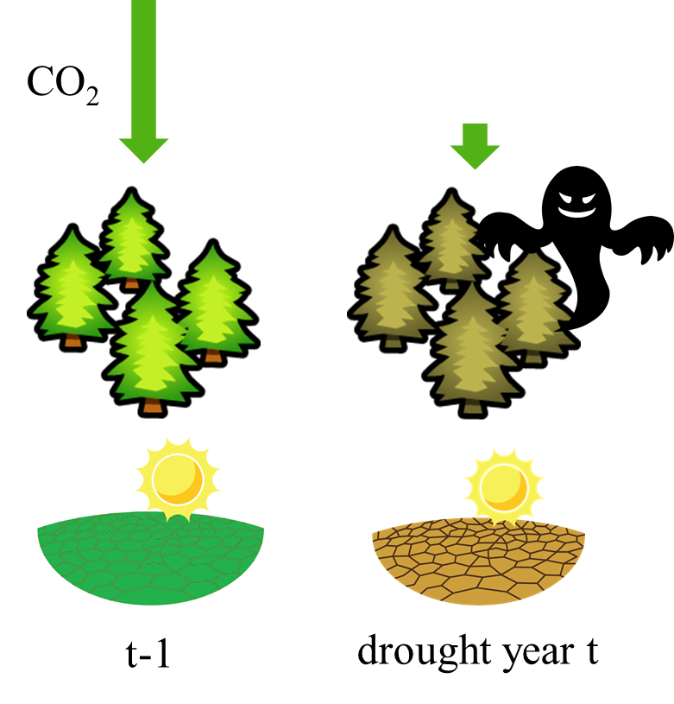
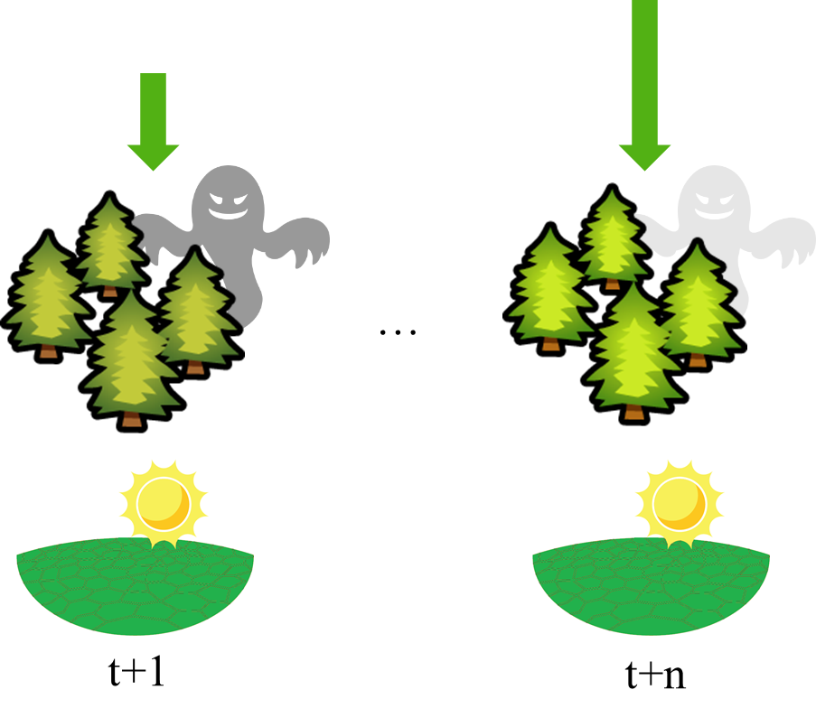
“Ghosts of the past”
Concurrent effects
Legacy effects
How to quantify drought legacy effects on GPP?
Kannenberg et al. 2020

Slide 3
How to quantify drought legacy effects on GPP?
A methodology to quantify drought legacy effects on GPP using eddy-covariance data
Legacy effects = GPP_{actual} – GPP_{potential}
GPP_{potential} = f(Temp, SM, Rad, VPD, Rad_{potential})
Model uncertainties
Yu et al., 2022 BG Discussion

Slide 4
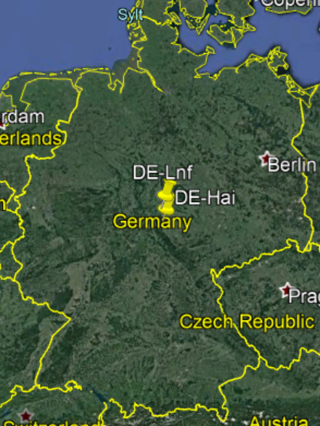
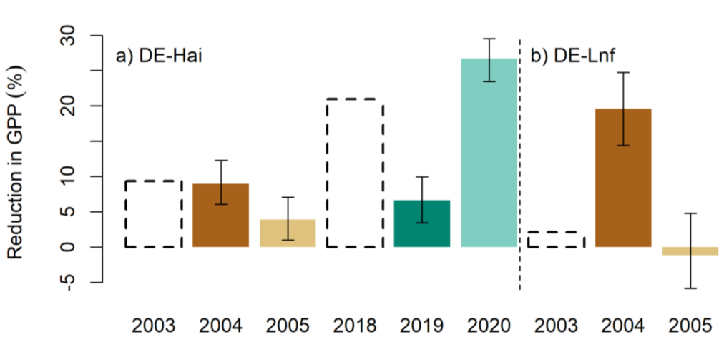
Motivation
Legacy effects
Concurrent effects
(from Google Earth Pro)
Two neighboring forest sites
DE-Hai
DE-Lnf
Legacy effects are comparable with concurrent effects at two studied sites
Yu et al., 2022 BG Discussion

Slide 5
Research questions
Are legacy effects comparable with concurrent effects in general?
How does vegetation type modulate drought legacy effects?

Slide 6
Data
La Thuile 2007, FLUXNET 2015, and ICOS Warm Winter 2020
>=7 years
>=1 legacy year
Forest (46) and grassland (12)
58 sites

Slide 7
Preliminary results
positive
negative
Legacy effects are comparable with concurrent effects in many sites
Grasslands tend to show positive legacy effects
Forests show both positive and negative legacy effects

Slide 8

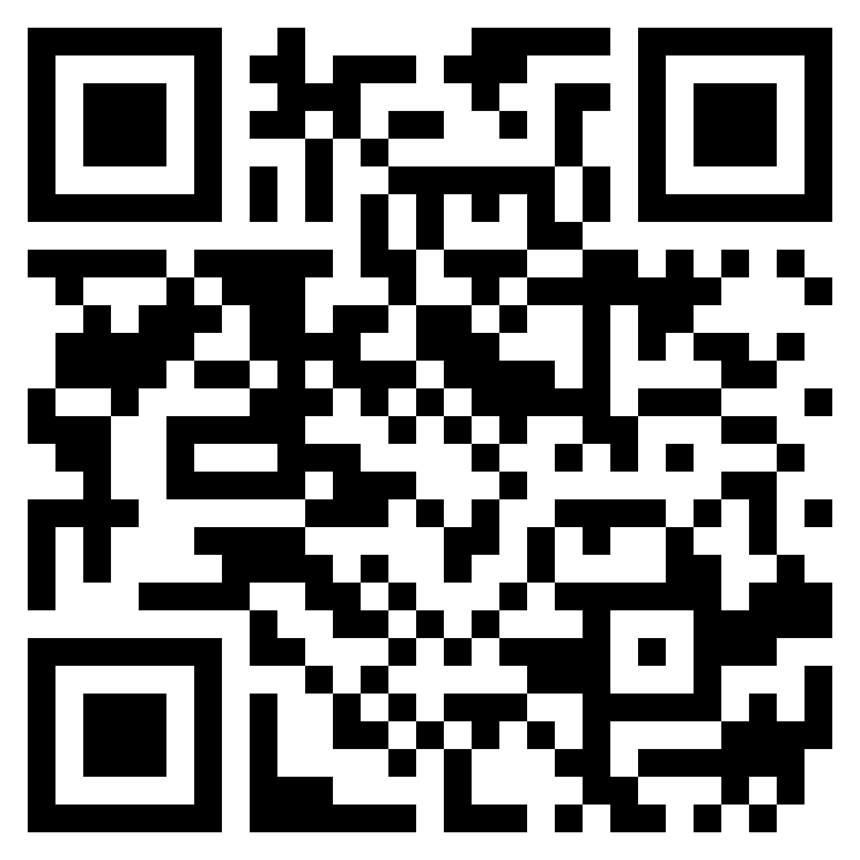
Take home message
A methodology to quantify drought legacy effects on GPP using eddy-covariance data (Yu et al., 2022 BG Discussion)
Drought legacy effects on GPP are comparable with concurrent effects in many sites
Thanks for your attention!
(Yu et al., 2022 BG Discussion)
Email: xyu@bgc-jena.mpg.de

