Slide 1
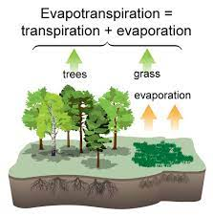




REFERENCE EVAPOTRANSPIRATION ESTIMATION AND INFLUENCE OF COFFEE ON REAL EVAPOTRANSPIRATION IN HUMID CLIMATIC REGIONS OF KENYA
Peter K. Musyimi ^{1, 2}, Balázs Székely¹, and Tamás Weidinger³
¹ Eötvös Loránd University, Department of Geophysics and Space Science, H-1117 Budapest Pázmány Péter sétány 1/C, Hungary.
² Karatina University, Department of Humanities and Languages, P.O BOX 1957-10101, Karatina, Kenya. E-mail: pemusyimi@gmail.com , musyimipeter@student.elte.hu
³ Eötvös Loránd University, Institute of Geography and Earth Sciences, Department of Meteorology, H-1117 Budapest Pázmány Péter sétány 1/A, Hungary.

Slide 2
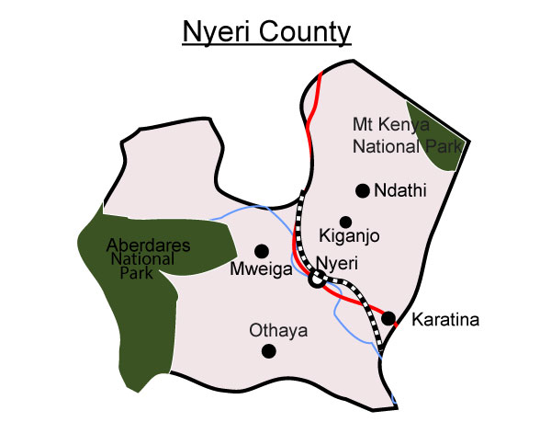
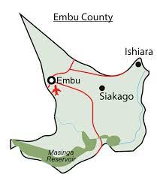
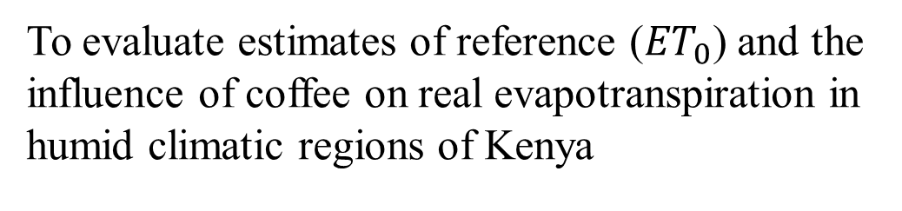
Objective
Study Area
Embu County
on the eastern slopes of Mount Kenya (5199 m a.s.l)
Nyeri County
between Mount Kenya (5199 m a.s.l) and Aberdare ranges (approximately 3350 m a.s.l)
climate classification ranges from Cfa to Cwa (Peel et al., 2007)
To evaluate estimates of reference (${ET}_{0}$) and the influence of coffee on real evapotranspiration in humid climatic regions of Kenya
Figure 1: Study Counties: Embu and Nyeri

Slide 3
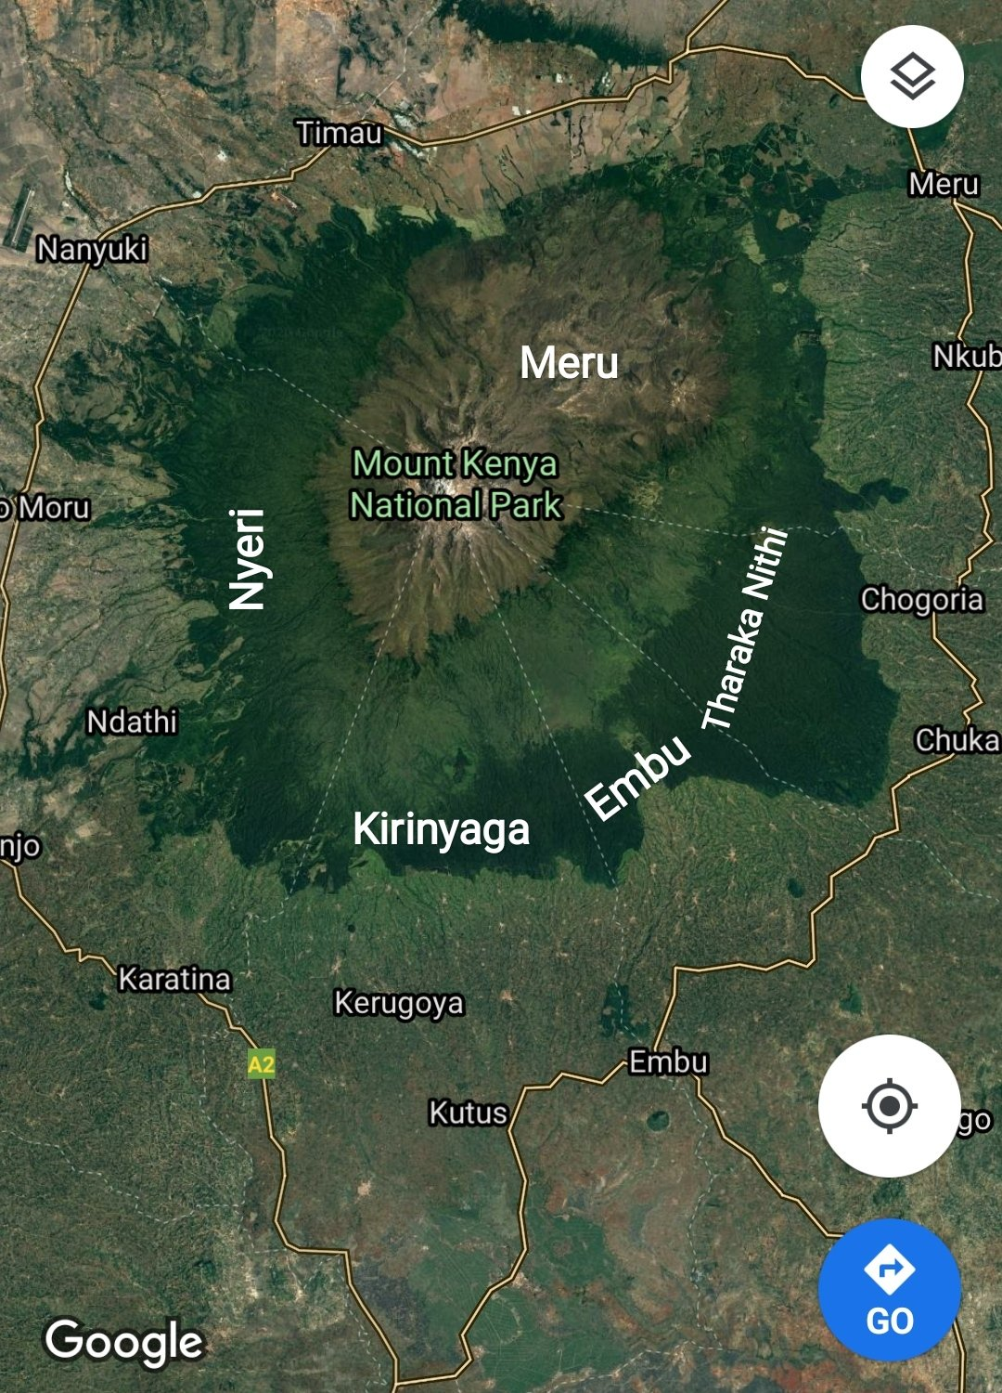
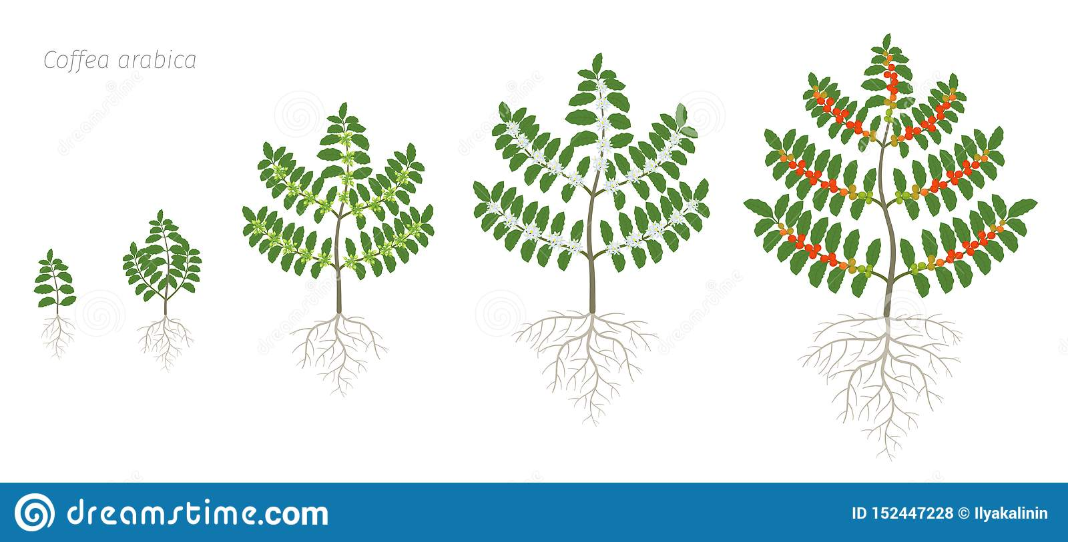
Coffee crop at various stages
Source: https://www.dreamstime.com/growth-stages-coffee-plant-bush-tree-coffea-arabica-red-beans-plantation-branch-harvest-colorful-flat-vector-green-image152447228
Figure 2: Study Counties: Embu and Nyeri on the slopes of Mt Kenya(5199 m a.s.l)

Slide 4
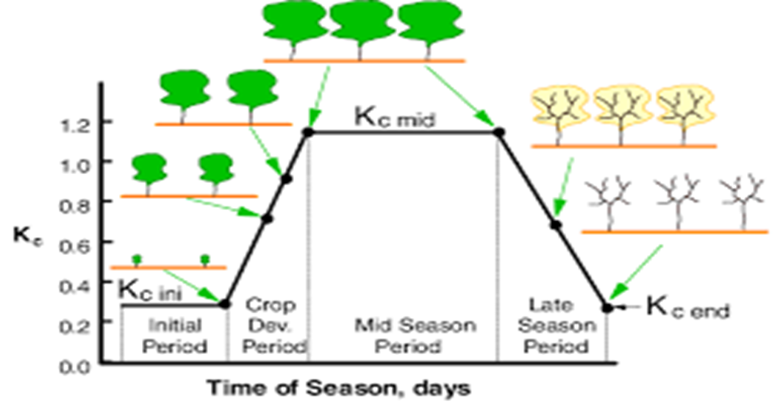

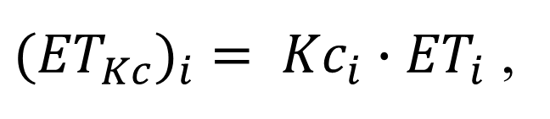

Methodology
${ET}_{0i}=\frac{0.408∆(R_{n}−G)+γ\frac{900}{T+273}u_{2}(e_{s}−e_{a})}{∆+γ(1+0.34u_{2})}$
(Allen et al., 1988)
$R_{n}$ – net radiation at the crop surface [MJ m^{–2} day^{–1}],
G – soil heat flux density [MJ m^{–2} day^{–1}]
T – mean daily air temperature at 2 m height [°C]
$u_{2}$ – wind speed at 2 m height [m s⁻¹],
(Zotarelli et al., 2010; Lakatos et al., 2020), $e_{s}$ – saturation vapour pressure [kPa]
$e_{a}$ – actual vapor pressure [kPa]
$e_{s}–e_{a}$ – saturation vapor pressure deficit [kPa],
Δ – the slope of the vapor pressure curve [kPa ºC^{–1}]
$γ$– psychrometric constant[kPa °C^{–1}]
${{(ET}_{Kc})}_{i}= {Kc}_{i}∙{ET}_{i}$ ,
Figure 3: Schematic representation of crop coefficients during initial, development, mid-season, and late-season growth

Slide 5
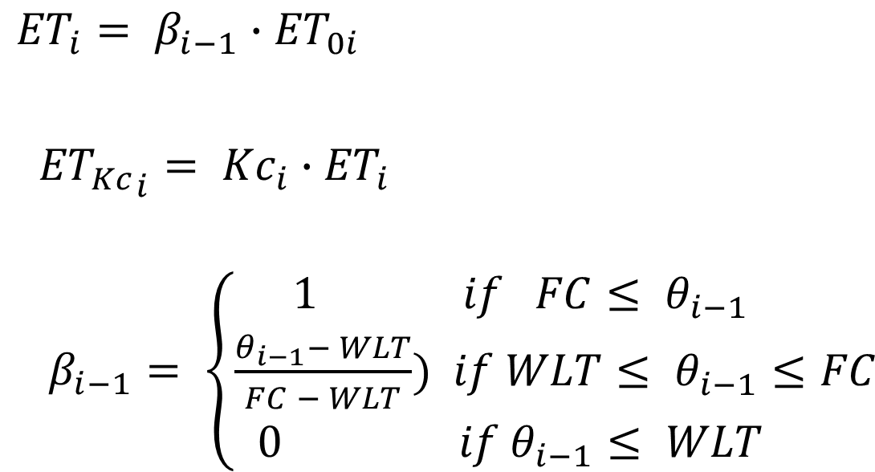
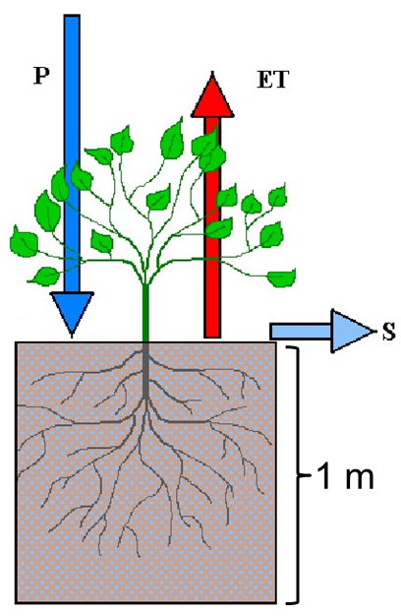
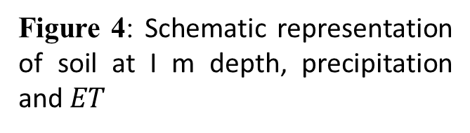
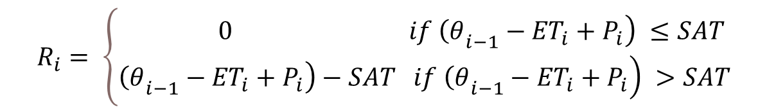
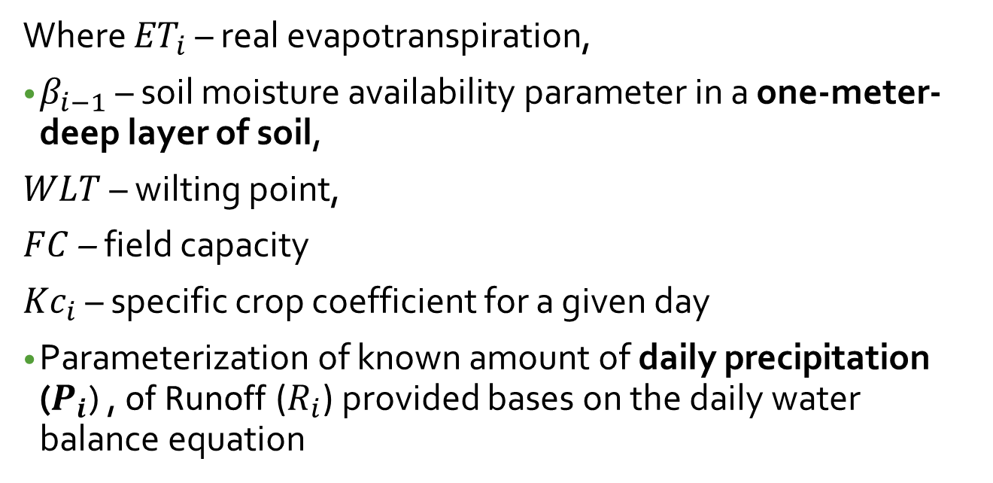
$$R_{i}= \left\{\begin{matrix}\left. 0 if {\left(θ\right.}_{i−1}−{ET}_{i}+P_{i}\right) ≤SAT \\ \left.\left.{\left(θ\right.}_{i−1}−{ET}_{i}+P_{i}\right)−SAT if {\left(θ\right.}_{i−1}−{ET}_{i}+P_{i}\right) >SAT\end{matrix}\right.$$
Where ${ET}_{i}$ – real evapotranspiration,
$β_{i−1}$ – soil moisture availability parameter in a one-meter-deep layer of soil,
$WLT$ – wilting point,
$FC$– field capacity
${Kc}_{i}$ – specific crop coefficient for a given day
Parameterization of known amount of daily precipitation ($P_{i}$) , of Runoff ($R_{i}$) provided bases on the daily water balance equation
Figure 4: Schematic representation of soil at I m depth, precipitation and $ET$

Slide 6
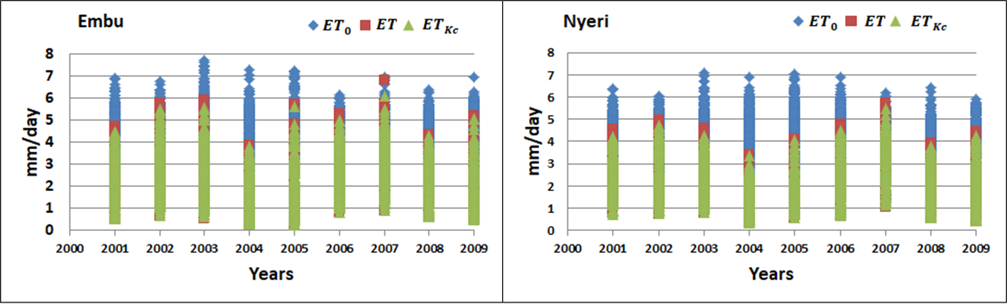
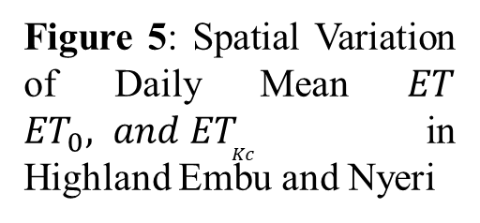
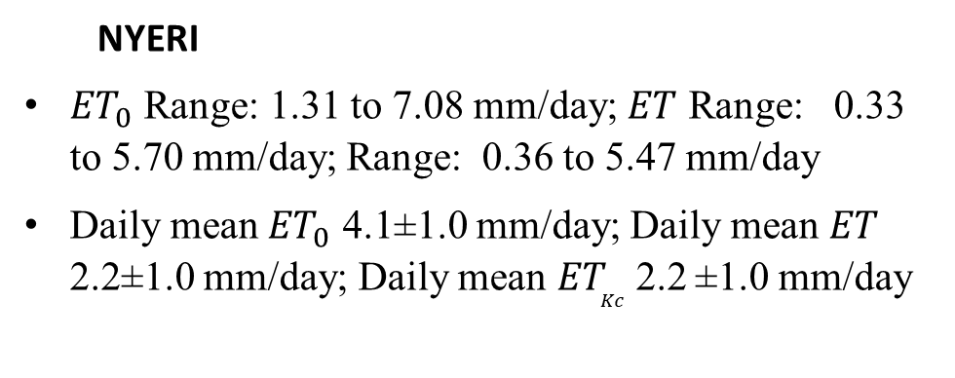
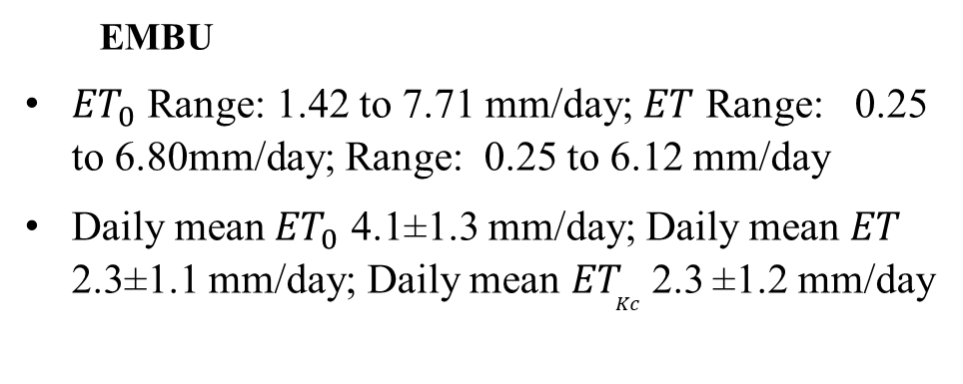
RESULTS Spatial Variation of Daily Mean $ET$ ${ET}_{0}{, and ET}_{Kc}$ in Highland Embu and Nyeri
Figure 5: Spatial Variation of Daily Mean $ET$ ${ET}_{0}{, and ET}_{Kc}$ in Highland Embu and Nyeri
EMBU
${ET}_{0}$ Range: 1.42 to 7.71 mm/day; $ET$ Range: 0.25 to 6.80mm/day; Range: 0.25 to 6.12 mm/day
Daily mean ${ET}_{0}$ 4.1±1.3 mm/day; Daily mean$ET$ 2.3±1.1 mm/day; Daily mean${ET}_{Kc}$2.3 ±1.2 mm/day
NYERI
${ET}_{0}$ Range: 1.31 to 7.08 mm/day; $ET$ Range: 0.33 to 5.70 mm/day; Range: 0.36 to 5.47 mm/day
Daily mean ${ET}_{0}$ 4.1±1.0 mm/day; Daily mean$ET$ 2.2±1.0 mm/day; Daily mean${ET}_{Kc}$2.2 ±1.0 mm/day

Slide 7
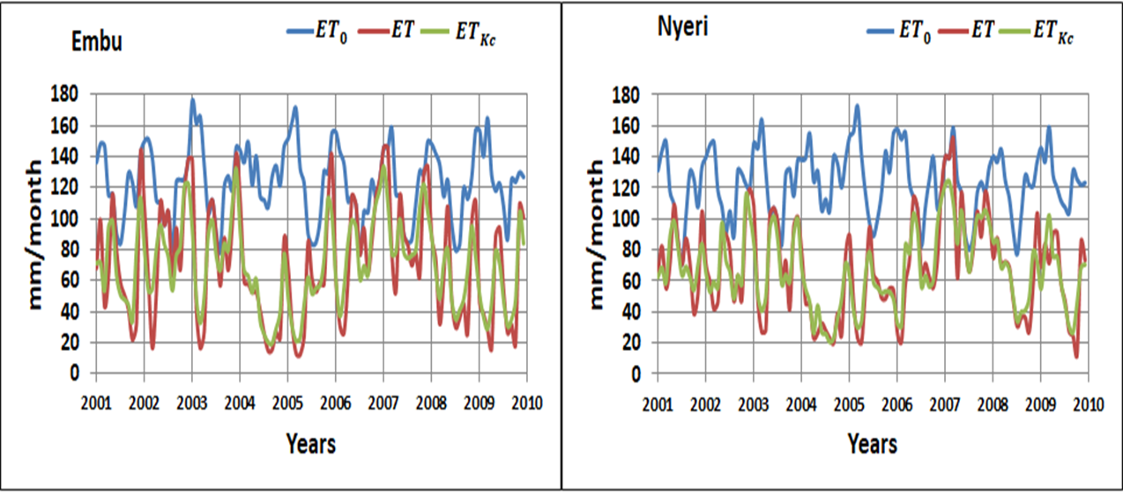
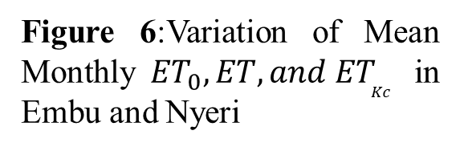
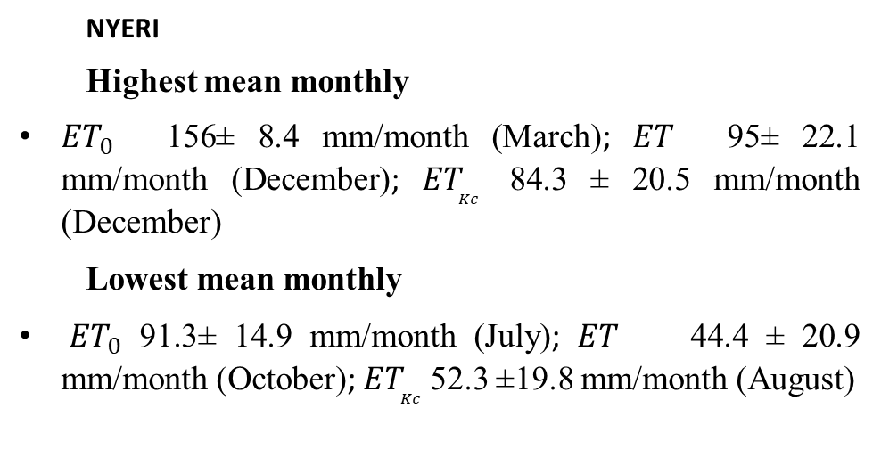
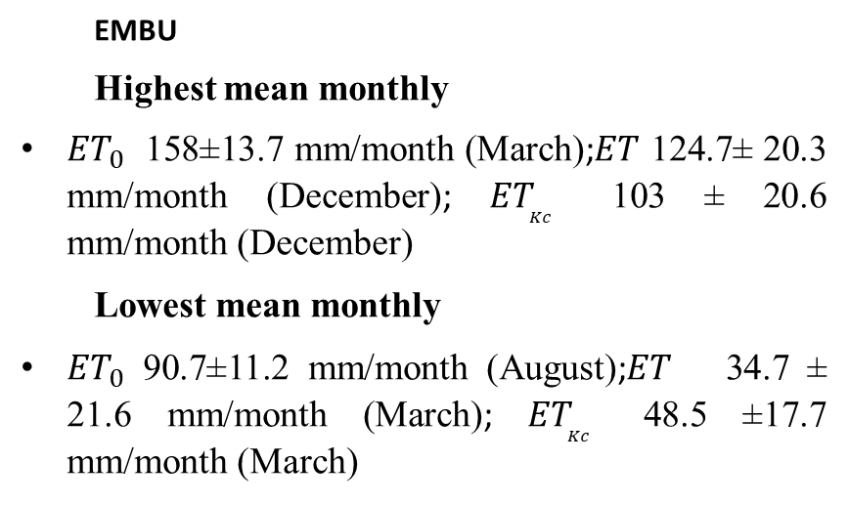
Variation of Mean Monthly ${ET}_{0}{, ET, and ET}_{Kc}$ in Highland Embu and Nyeri (Cfa)
EMBU
Highest mean monthly
${ET}_{0}$ 158±13.7 mm/month (March);$ET$ 124.7± 20.3 mm/month (December); ${ET}_{Kc}$ 103 ± 20.6 mm/month (December)
Lowest mean monthly
${ET}_{0}$ 90.7±11.2 mm/month (August);$ET$ 34.7 ± 21.6 mm/month (March); ${ET}_{Kc}$ 48.5 ±17.7 mm/month (March)
NYERI
Highest mean monthly
${ET}_{0}$ 156± 8.4 mm/month (March); $ET$ 95± 22.1 mm/month (December); ${ET}_{Kc}$ 84.3 ± 20.5 mm/month (December)
Lowest mean monthly
${ET}_{0}$ 91.3± 14.9 mm/month (July); $ET$ 44.4 ± 20.9 mm/month (October); ${ET}_{Kc}$ 52.3 ±19.8 mm/month (August)
Figure 6:Variation of Mean Monthly ${ET}_{0}{, ET, and ET}_{Kc}$ in Embu and Nyeri

Slide 8
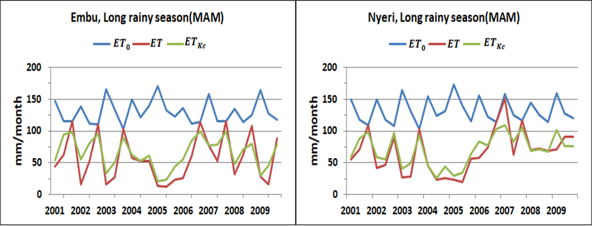
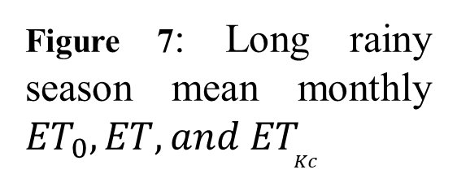
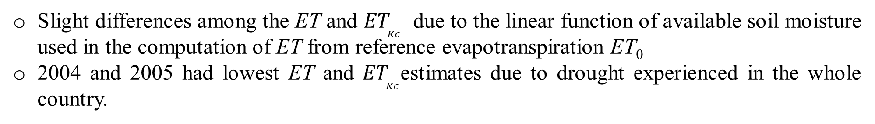
Long rainy season (MAM) Mean Monthly ${ET}_{0}{, ET, and ET}_{Kc}$ in Highland Embu and Nyeri (Cfa)
Figure 7: Long rainy season mean monthly ${ET}_{0}{, ET, and ET}_{Kc}$
Slight differences among the ET and ${ET}_{Kc}$ due to the linear function of available soil moisture used in the computation of ET from reference evapotranspiration ET₀
2004 and 2005 had lowest ET and ${ET}_{Kc}$estimates due to drought experienced in the whole country.

Slide 9
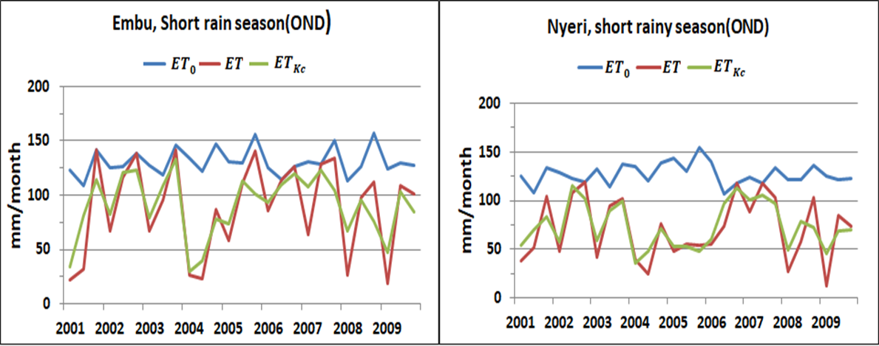
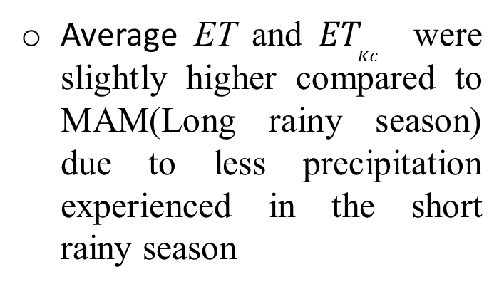
Short rainy season (OND) Mean Monthly ${ET}_{0}{, ET, and ET}_{Kc}$ in Highland Embu and Nyeri (Cfa)
Average ET and ${ET}_{Kc}$ were slightly higher compared to MAM(Long rainy season) due to less precipitation experienced in the short rainy season
Figure 8: Short rainy season (OND) Mean Monthly ${ET}_{0}{, ET, and ET}_{Kc}$
In Nyeri county, the average annual estimate ET₀ was 1488±52 mm/year while in Embu it was 1488±48 mm/year.
Average annual ET depicted slightly higher variation with estimates of 813±216 mm/year in Nyeri and 830±166 mm/year in Embu county
Average monthly estimates of ET₀ and ET were almost the same with estimates of 124±21 mm/month and 68±30 mm/month in Nyeri and 124±23 mm/month and 71±37 mm/month in Embu county

Slide 10
Conclusions
IMPORTANCE
For agrometeorology and agricultural planning processes in different climatic regions of Kenya
For food security preparedness in climate change and variability regimes
important in investigating the role of 1D Palmer type soil model on ET₀ and coffee coefficient influence on real evapotranspiration in Kenya in these regimes of climate extremes.
ET₀ and ET estimation is complex and dynamic
Coffee coefficient (Kc) had a slight influence on real evapotranspiration in humid climatic regions understudy
Reason: the Kc values were almost 1 with a range of between 0.9 to 0.95.
Soil parameters are fundamental in operationalizing productive agricultural decisions and managing hydrological processes

Slide 11
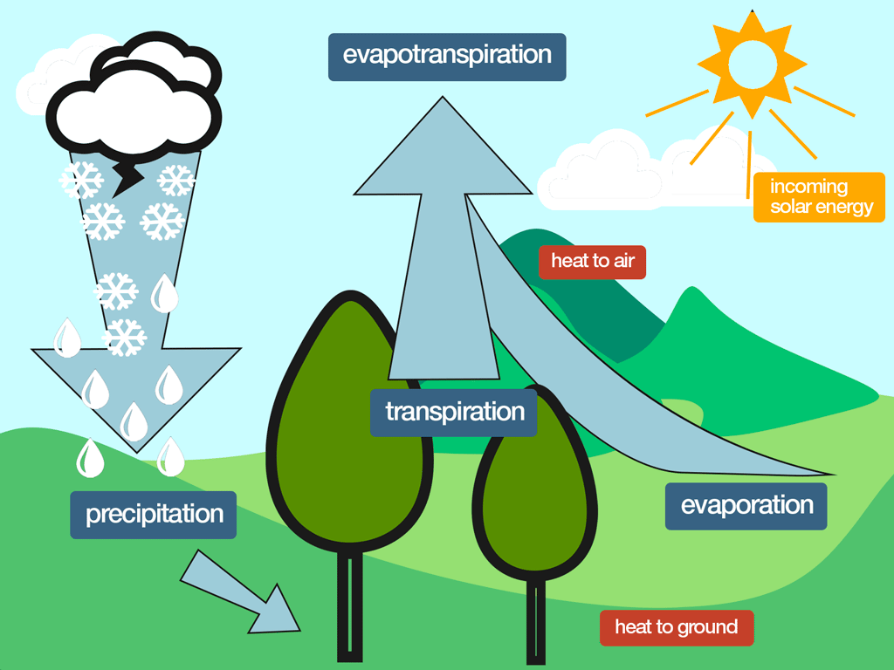
Thank You!

Slide 12
References
Allen, R.G., Pereira, L.S., Raes, D., and Smith, M., 1998: Crop evapotranspiration: FAO Irrigation and drainage paper 56. FAO - Food and Agriculture Organization, United Nations Rome, Italy. http://www.fao.org/3/X0490E/X0490E00.htm. ISBN 92-5-104219-5
Dy, C. Y., Fung, J. C.-H., 2016: Updated global soil map for the Weather Research and Forecasting model and soil moisture initialization for the Noah land surface model. Journal of Geophysical Research: Atmospheres, 121, 8777–8800. doi:10.1002/2015JD024558.
Ferina, J., Vučetić, V., Bašić, T., Anić, M., 2021: Spatial distribution and long-term changes in water balance components in Croatia. Theoretical Applied Climatology, 144, 1311-1333. https://doi.org/10.1007/s00704-021-03593-1
Lakatos, M., Weidinger, T., Hoffmann, L., Bihari, Z., and Horváth, Á., 2020: Computation of daily Penman-Monteith reference evapotranspiration in the Carpathian Region and comparison with Thornthwaite estimates. Advances in Science and Research, 16, 251-259. https://doi.org/10.5194/asr-16-251-2020
❖Palmer, W. C., 1965: Meteorological drought. U.S. Research Paper No. 45, US Weather Bureau, Washington, DC. Indicator codes: CLIM 029, LSI 007
Peel, M.C., Finlayson, B.L., and McMahon, T.A., 2007: Updated world map of the Köppen-Geiger climate classification. Hydrology and Earth System Sciences Discussions, European Geosciences Union, 11, 1633-1644. https://doi.org/10.5194/hess-11-1633-2007
❖Zotarelli, L., Dukes, M. D., Romero, C. C., Migliaccio, K. W., Morgan, K. T., 2010: Step by step calculation of the Penman-Monteith evapotranspiration (FAO-56 method). Institute of Food and Agricultural Sciences. The University of Florida

