Slide 1

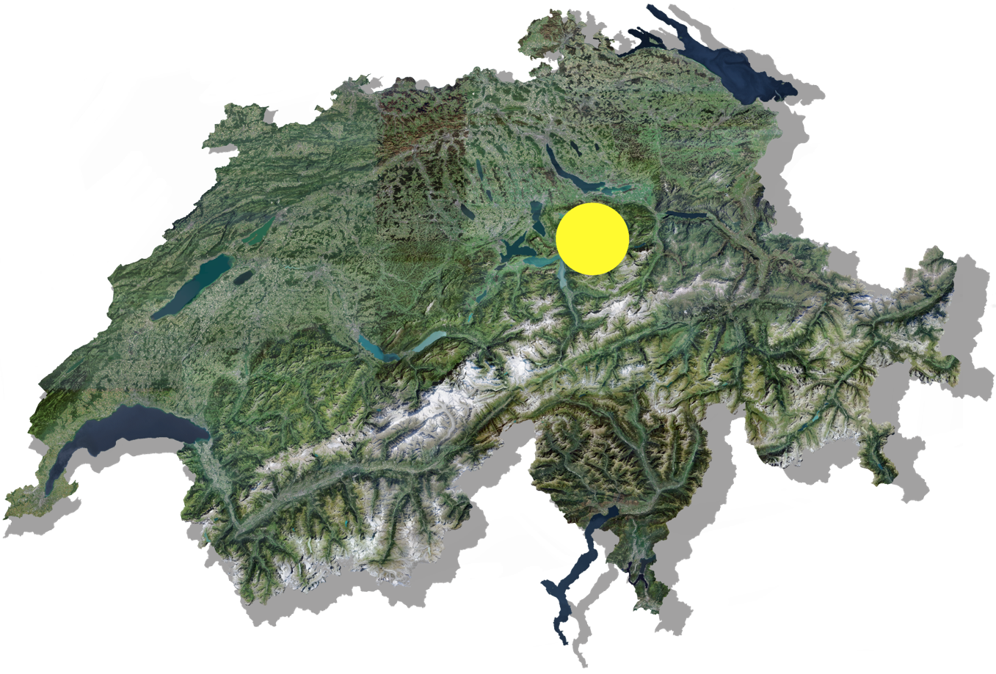
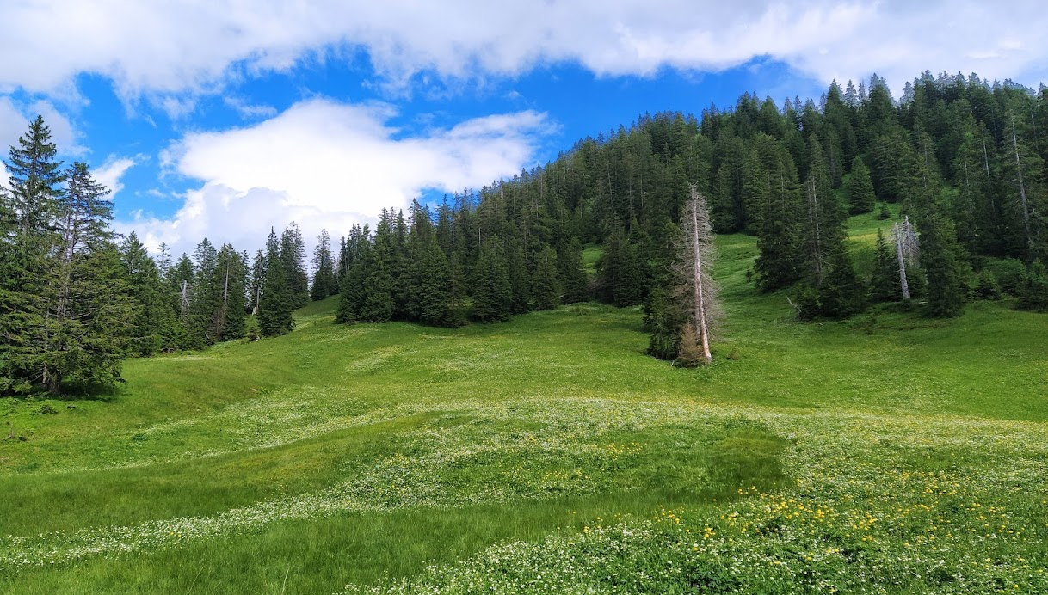
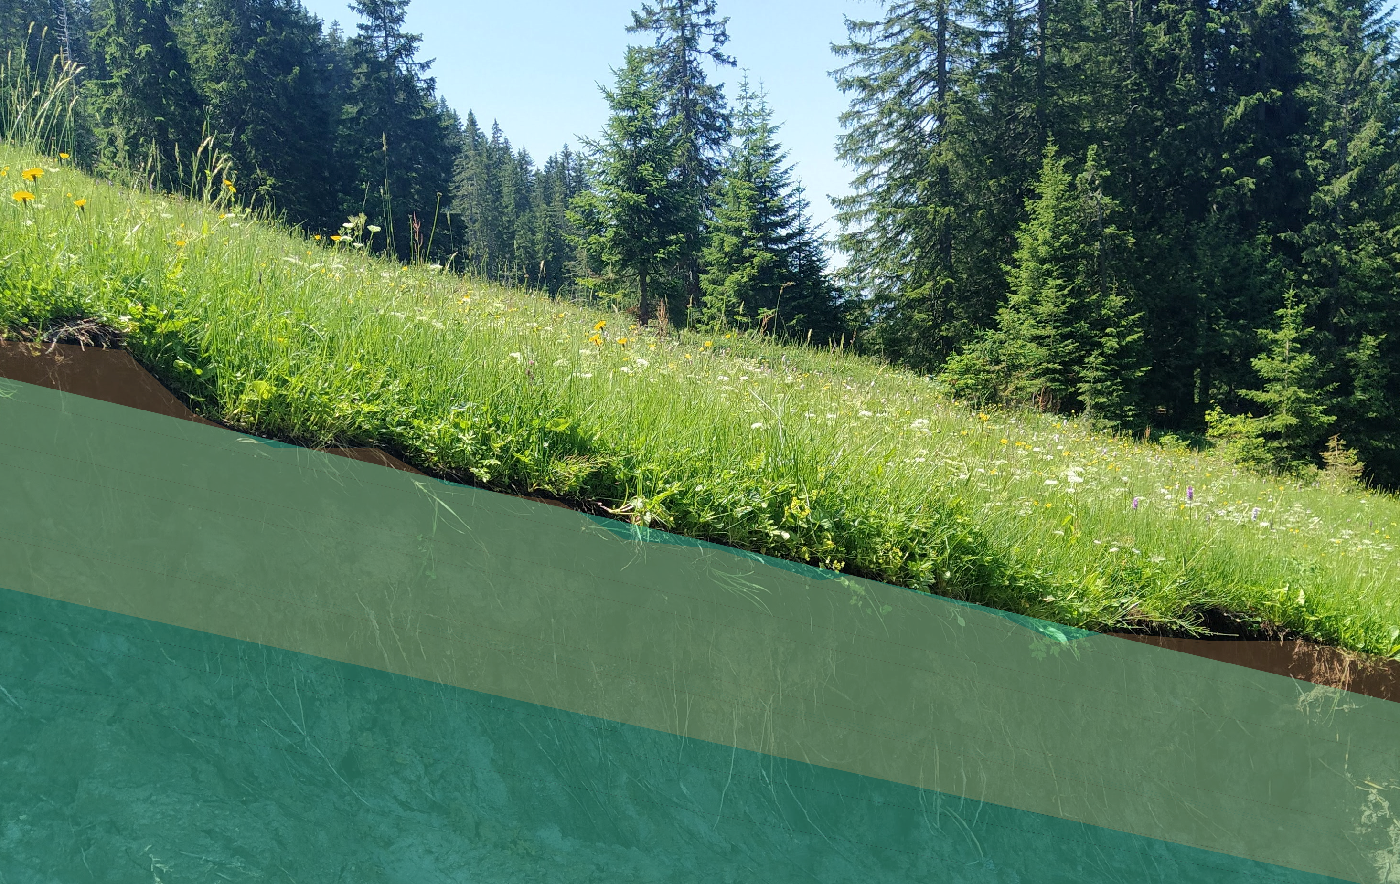

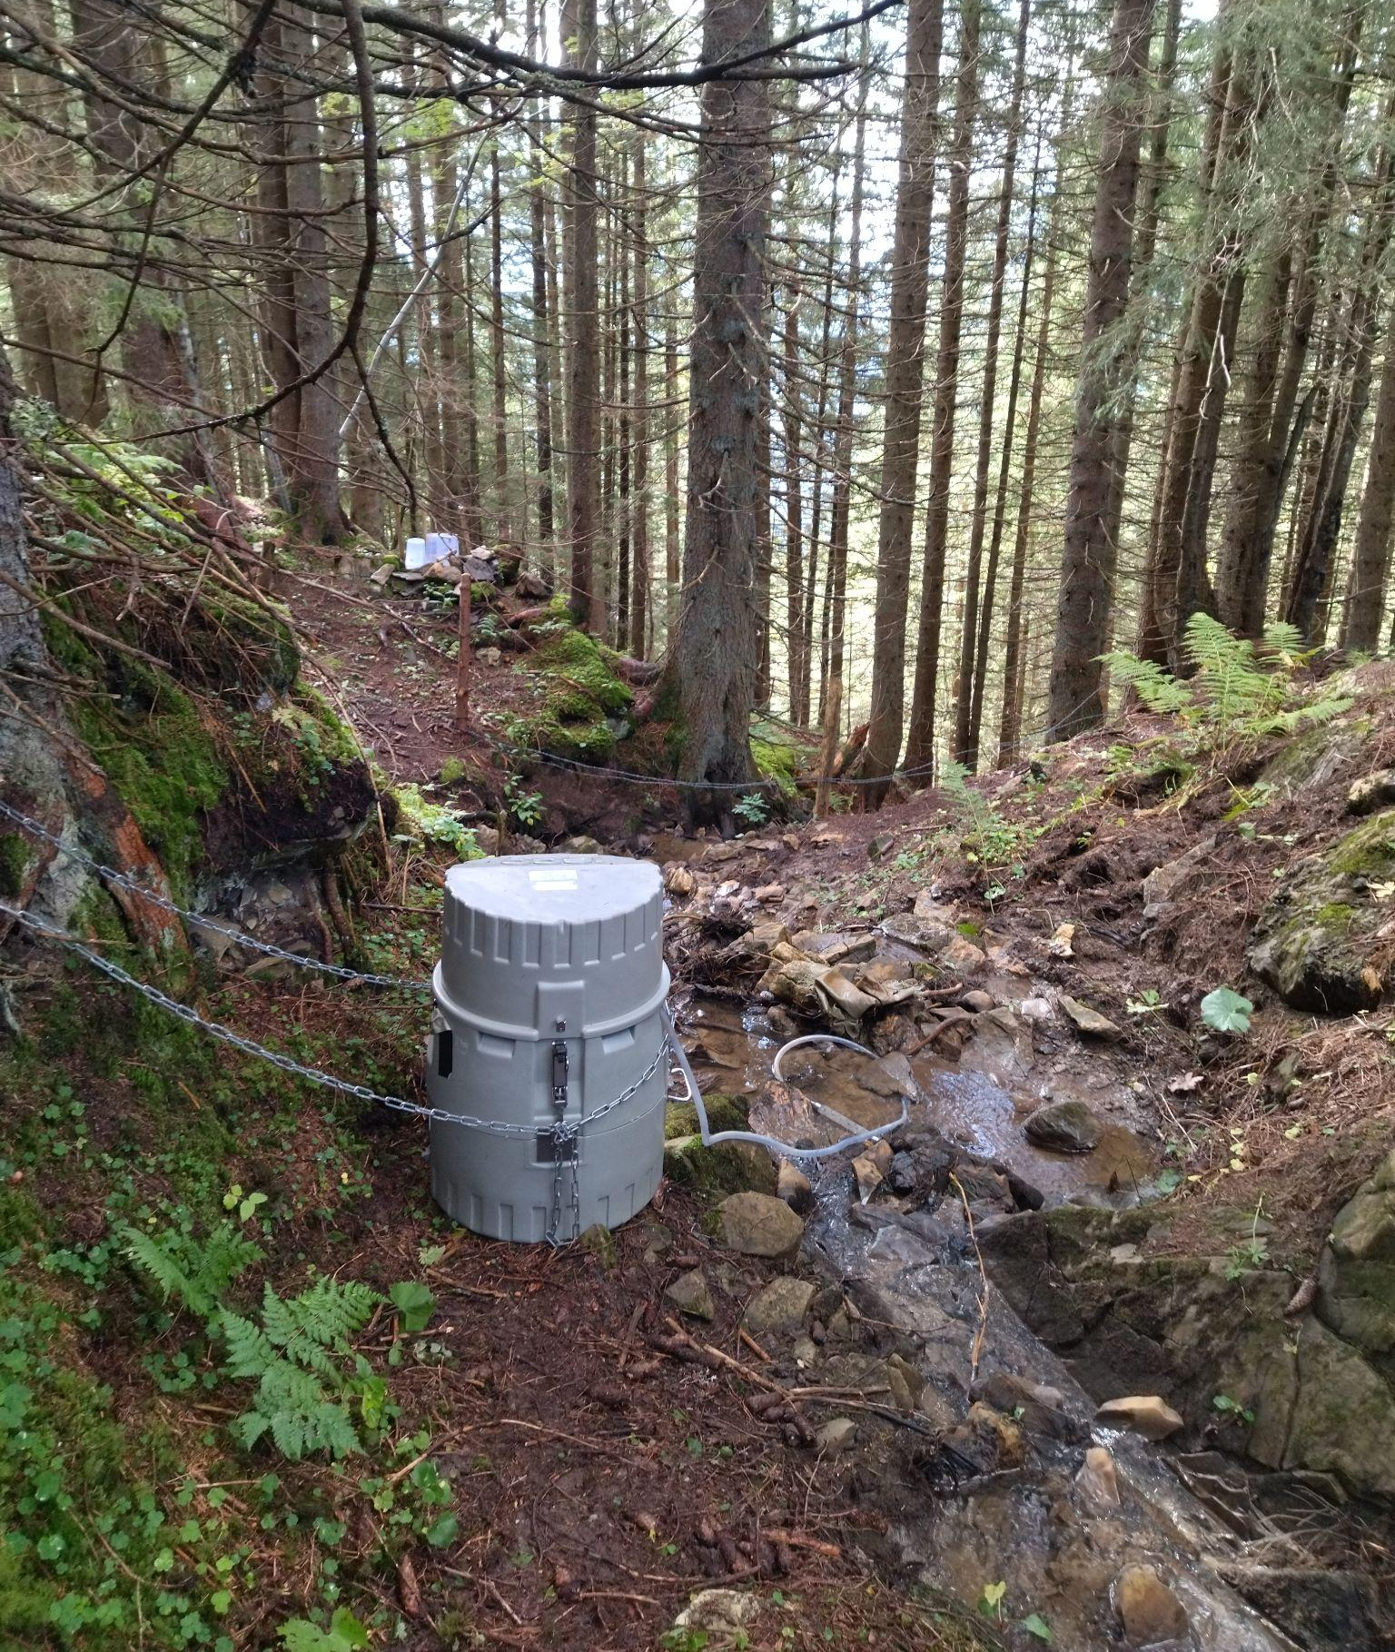
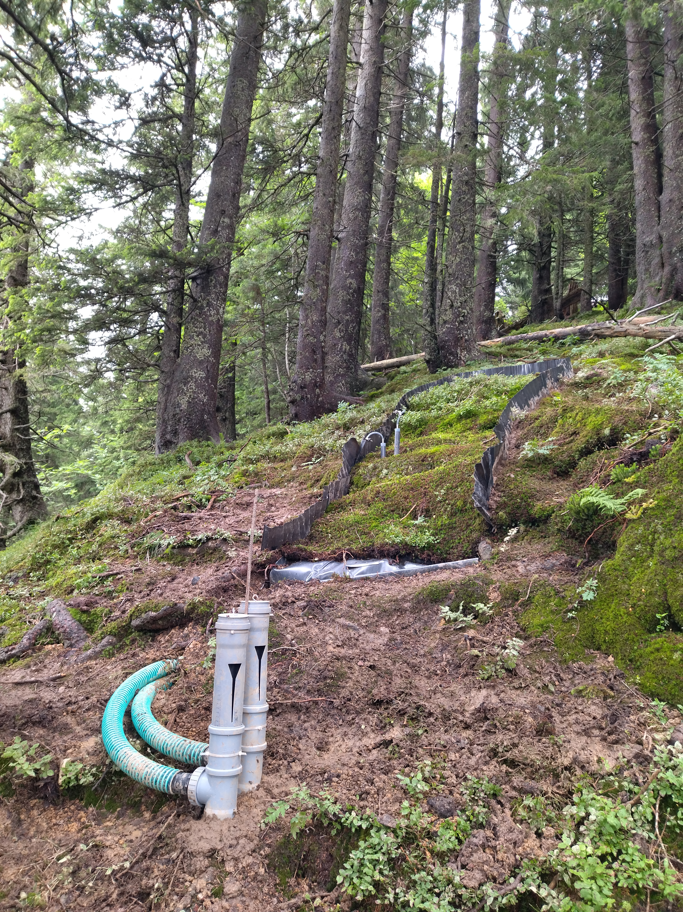
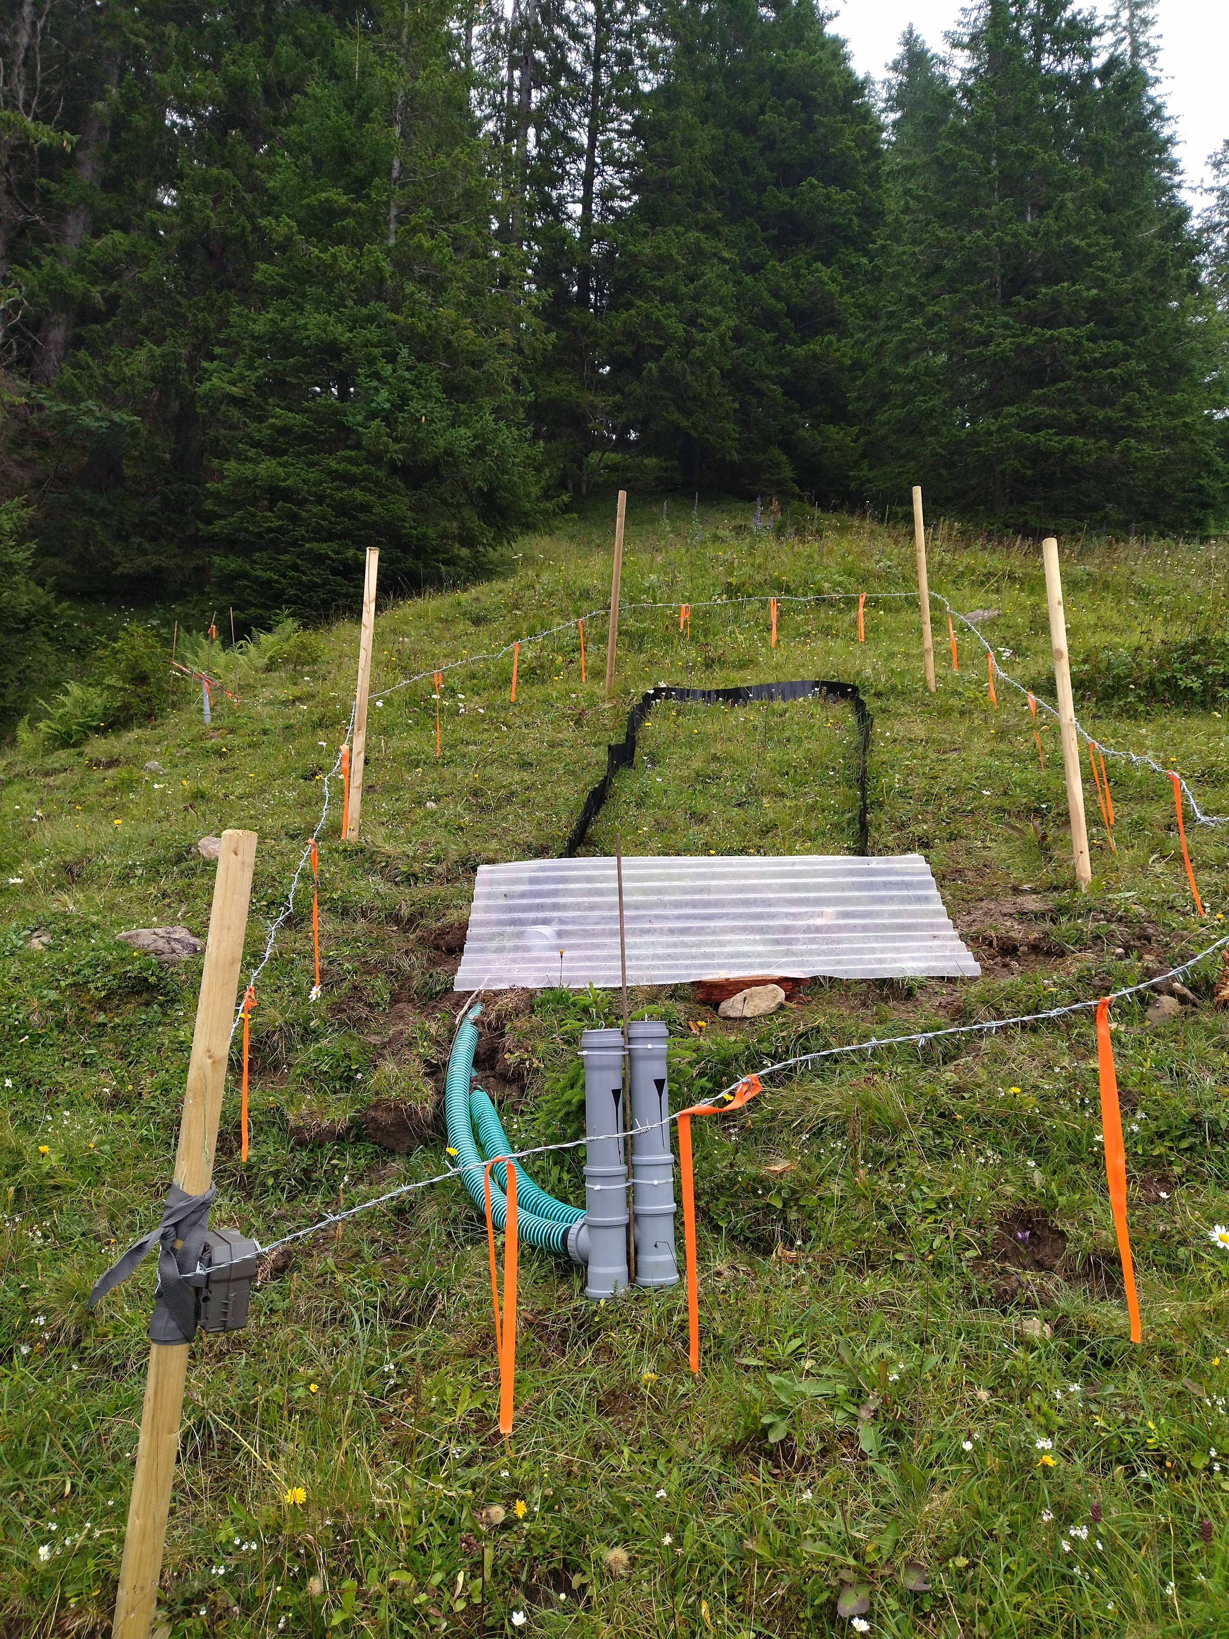
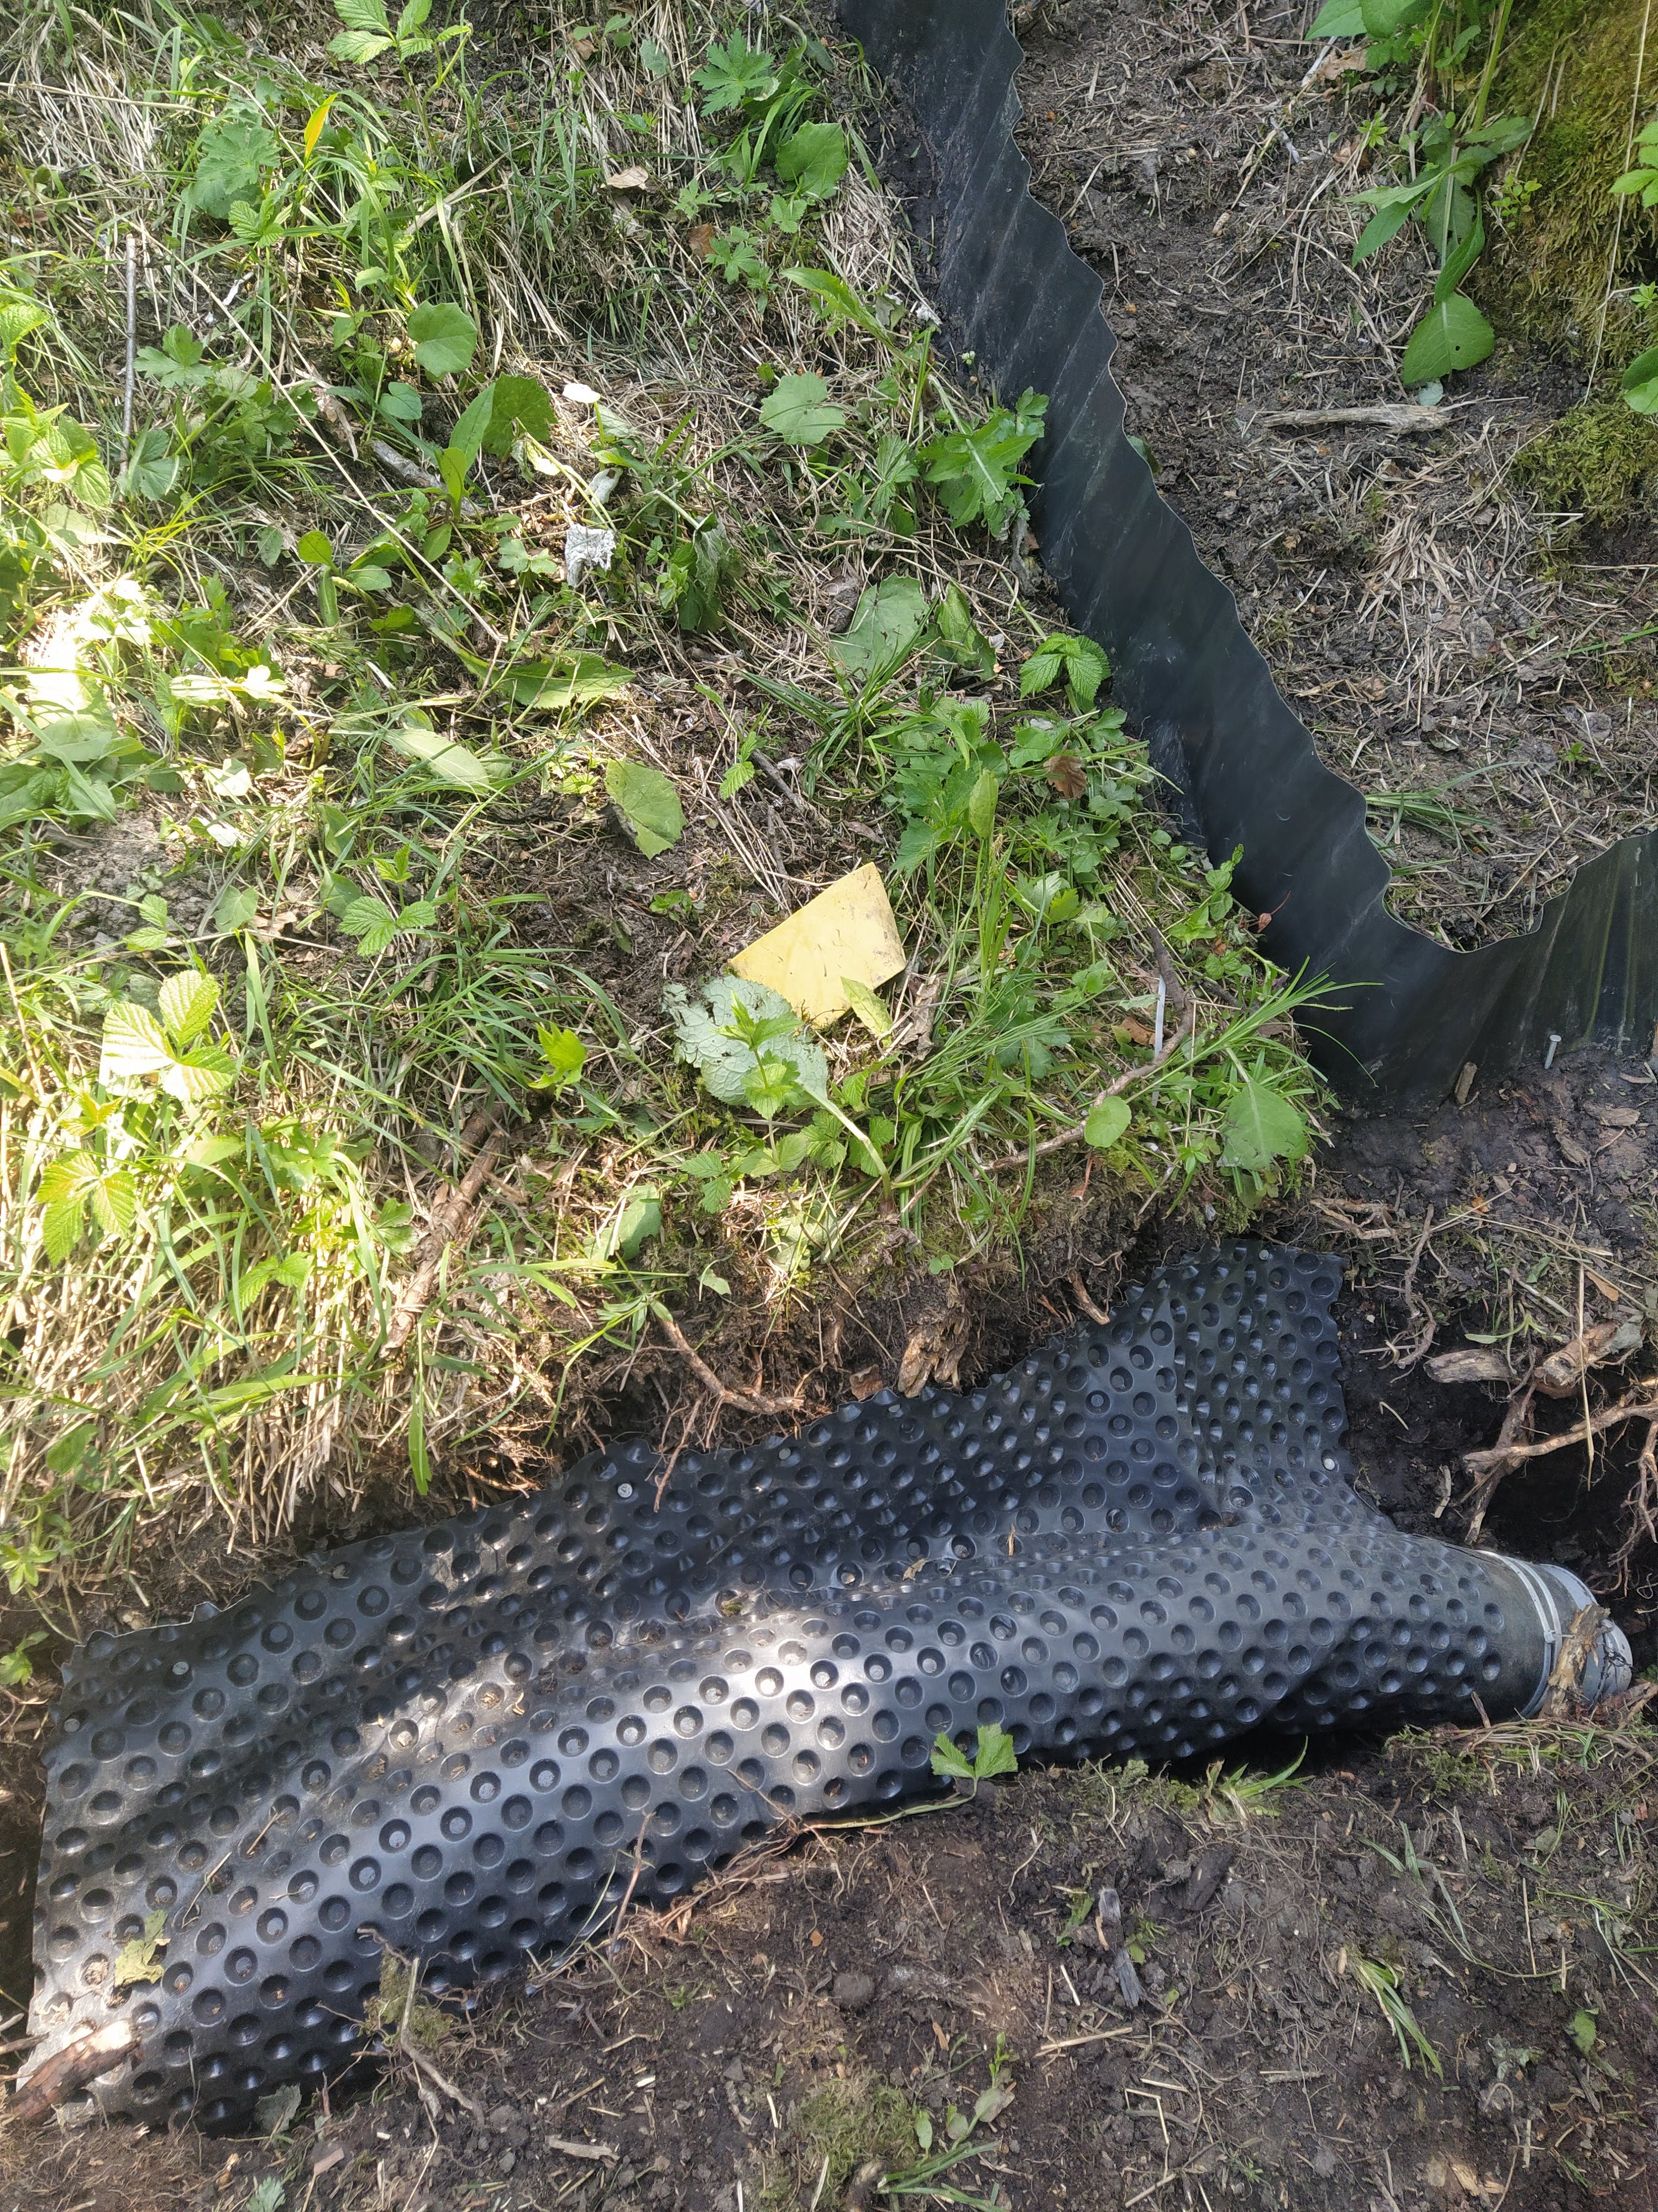


Spatial and temporal variability of near-surface flow pathways in a Swiss pre-Alpine headwater catchment
Anna Leuteritz, Victor Gauthier, Ilja van Meerveld
Department of Geography, University of Zurich, Switzerland
Study Area
Methods
Vegetated, steep (20-40°) hillslopes in humid, temperate climate
Continuous measurements of overland flow and subsurface flow, EC & temperature
overland flow
subsurface flow
Event-based sampling for chemical composition & stable water isotopes
Low permeability Gleysols
Research Questions
Runoff plots (3 )
$$m^{2}$$
How important are near-surface flow pathways?
What is the contribution of soil water and groundwater?
What is the effect of landscape position and rainfall event characteristics?

Slide 2
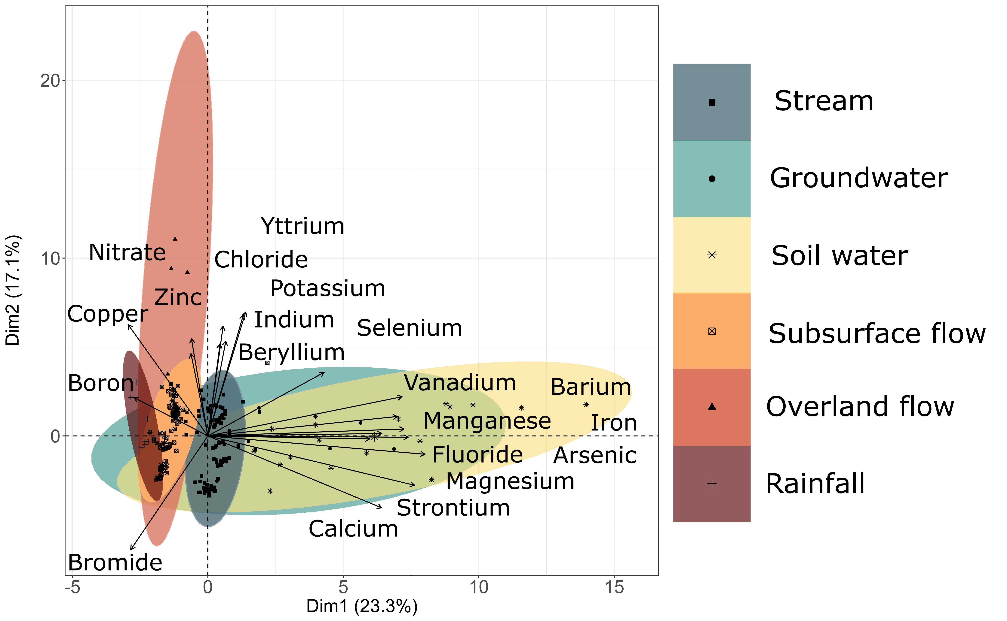

Preliminary Results
Principle component analysis of all water sources in one location
Overland flow differs from soil water and groundwater
Soil water and groundwater are similar to each other
High variability in overland flow, soil water and groundwater
Low variability in subsurface flow and stream
…field studies to be continued in 2022
Anna Leuteritz
Department of Geography
Hydrology and Climate
University of Zurich
Winterthurerstrasse 190
CH-8057 Zürich
Contact
anna.leuteritz@geo.uzh.ch

