Slide 1





Performance and limits of a shallow model for landslide generated tsunamis: from lab experiments to simulations of flank collapses at La Montagne Pelée (Martinique)
Pablo Poulain¹, Anne Le Friant¹, Anne Mangeney¹, Sylvain Viroulet^{1,2}, Enrique Fernandez-Nieto³, Manuel Castro Diaz⁴, Marc Peruzzetto^{1,5}, Gilles Grandjean⁵, François Bouchut⁶, Rodrigo Pedreros⁵, and Jean-Christophe Komorowski¹
¹Université de Paris, Institut de Physique du Globe de Paris, CNRS, F-75005, Paris, France (poulain@ipgp.fr)
²Institut de Mécanique des Fluides de Toulouse (IMFT) - Université de Toulouse, CNRS, 31400; Toulouse, France
³Dpto. Matematica Aplicada I, ETS Arquitectura - Universidad de Sevilla, Avda. Reina Mercedes S/N, 41012 Sevilla, Spain
⁴Departamento de Analisis Matematico, Estadística e Investigación Operativa y Matemática Aplicada. Universidad de Malaga, Facultad de Ciencias, Campus Teatinos S/N, 29081 Málaga. Spain.
⁵BRGM (French Geological Survey), Orléans, France
⁶Laboratoire d’Analyse et de Mathématiques Appliquées (UMR 8050), CNRS, Univ. Gustave Eiffel, UPEC, F-77454, Marne-la-Vallée, France
Monitoring difficulties ⟹ unpredactibility & no direct measurements
Lack of data
(no live records)
simulation of avalanche and generated wave
Hypothesis made
(scenario, model)
Simulation ⟹ Hazards maps
(with uncertainities)
Volcanic flank collapse events ⟹ Widely recognized
Dynamics and wave quantification ⟹ Open Issue
Numerical simulation ⟹ unique tool
Results’ interpretation
We investigate the dynamics and deposits of granular flows and the amplitude of the generated water waves using the depth-averaged shallow numerical model HySEA, both at the lab- and field scales. We investigate the different sources of errors by quantitatively comparing the simulations with (i) six new laboratory experiments of granular collapses in different conditions (dry, immersed, dry flow entering water) and slope angles, and (ii) numerical simulations made with the code SHALTOP that describes topography effects better than most landslide-tsunami models. In the laboratory configurations, at the limit of the shallow-approximation in such models, we show that topography and non-hydrostatic effects are crucial. However, when empirically accounting for topography effects by artificially increasing the friction coefficient and performing non-hydrostatic simulations, the model is able to reproduce the granular mass deposit and the waves recorded at gauges located at a distance of more than 2-3 times the characteristic dimension of the slide, with an error ranging from 1 % to 25 % depending on the scenario, without any further calibration. Taking into account this error estimation, we simulate landslides that occurred on Montagne Pelée volcano, Martinique, Petites Antilles as well as the generated waves. Results support the hypothesis that large flank collapse events in Montagne Pelée likely occurred in several successive sub-events. This result has a strong impact on the amplitude of the generated waves, and thus on the associated hazards. In the context of the on-going seismic volcanic unrest at Montagne Pelée volcano, we calculate the debris avalanche and associated tsunami for two potential flank-collapse scenarios.

Slide 2

Objectives
How can we estimate and quantify the errors made when using one landslide generated tsunamis model?
Can those codes be used in a crisis management context?
Contribution of this work :
show, analyze and quantify the error associated with the numerical code HySEA (by comparing with SHALTOP code and laboratory experiments) using friction law
Benchmark HySEA code in the volcanic context of Martinique in the hydro and non hydro hypothesis using friction law
Application in Martinique
Notes:
Therefore, several questions are raised:
How to estimate and quantify the errors associated with the use of a numerical landslide tsunami model
Can these codes be used in a crisis management situation?
The work carried out during this thesis is a contribution that aims to answer these questions
By analyzing and quantifying the errors related to the use of the HySEA code by comparing the results obtained to those of another numerical code SAHLTOP and to laboratory experiments
By confronting it to the simulation of field cases in Martinique
To finally apply it to Montagne Pelée

Slide 3
Laboratory Experiments
Show, analyze and quantify the error associated with the numerical code HySEA (by comparing with SHALTOP code and laboratory experiments)
Benchmark HySEA code in the volcanic context of Martinique in the hydro and non hydro hypothesis
Notes:
Let's focus first on the comparison of simulation results with analog experiments

Slide 4
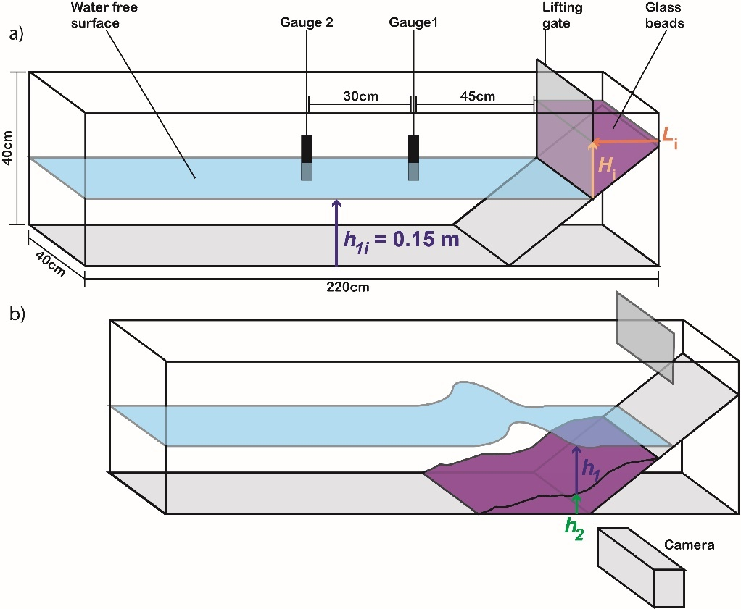
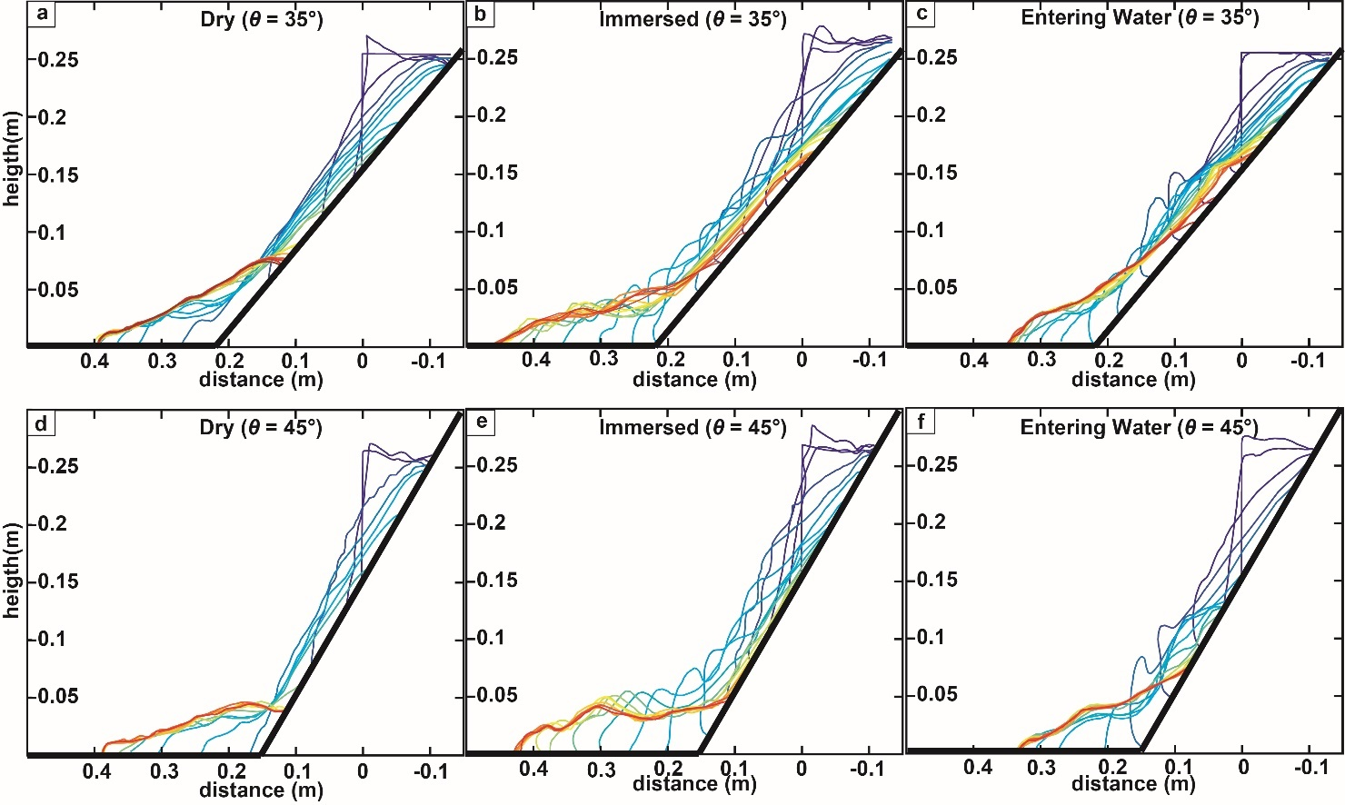
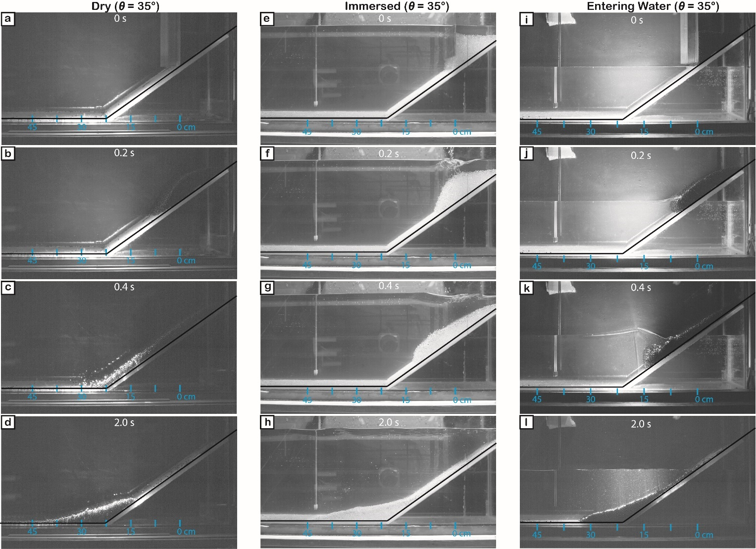
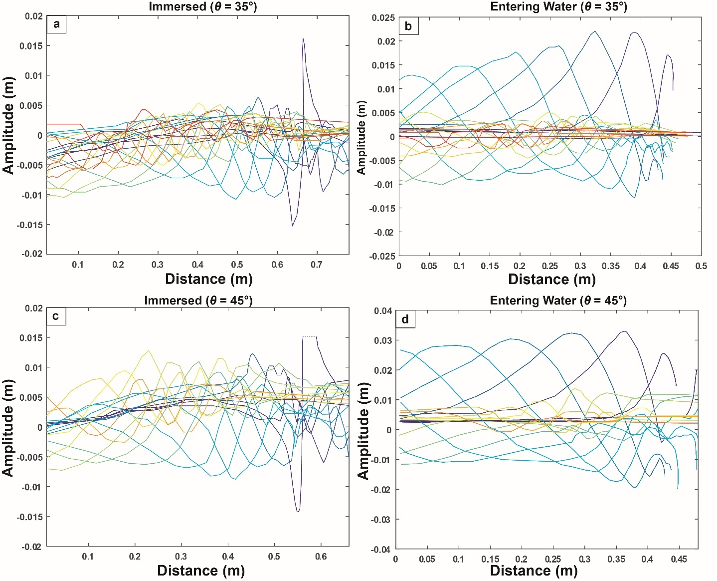
Experimental setup
Dry (θ = 35°)
Immersed (θ = 35°)
Entering Water (θ = 35°)
40 cm
8 partially published experiments
(Viroulet et al., 2014), 2 slope angles,
Dry (subaerial), immersed, entering water
20 cm
2,20 m
Digitalize the results to compare to simulation
Dry (θ = 45°)
Immersed (θ = 45°)
Entering Water (θ = 45°)
Dry (θ = 35°)
Immersed (θ = 35°)
Entering Water (θ = 35°)
Complex dynamics in the presence of water
Granular flow relatively thin on the slope
Deposits formed after the slope break
Immersed (θ = 35°)
Entering Water (θ = 35°)
(Poulain et al, in rev)
Notes:
We study for that 8 experiments realized by Sylvain Ciroulet and whose results were partially published in a 2014 article.
The experimental device consists of a tank in which is placed an inclined plane, on which rests a granular mass held by a gate. The experimental conditions are defined by the angle of the inclined plane as well as the initial height of the water defining the submerged dry conditions and enters the water.
The granular flow is recorded with a high speed camera and the waves with probes placed along the tank.
In order to compare precisely the experiments with the results of the simulations I have digitized the free surfaces of the experiments at a large number of instants manually
You can see here on the left three examples of these experiments at several instants.
Once the results are digitized we get this type of profile for the granular flow on top and for the waves on the bottom with the colors representing the time evolution
The observation of the images of the experiments highlights the great complexity of the dynamics of the flow in the presence of water.
We can also see that the flows are relatively thin on the slope and the deposits are formed shortly after the slope break.

Slide 5
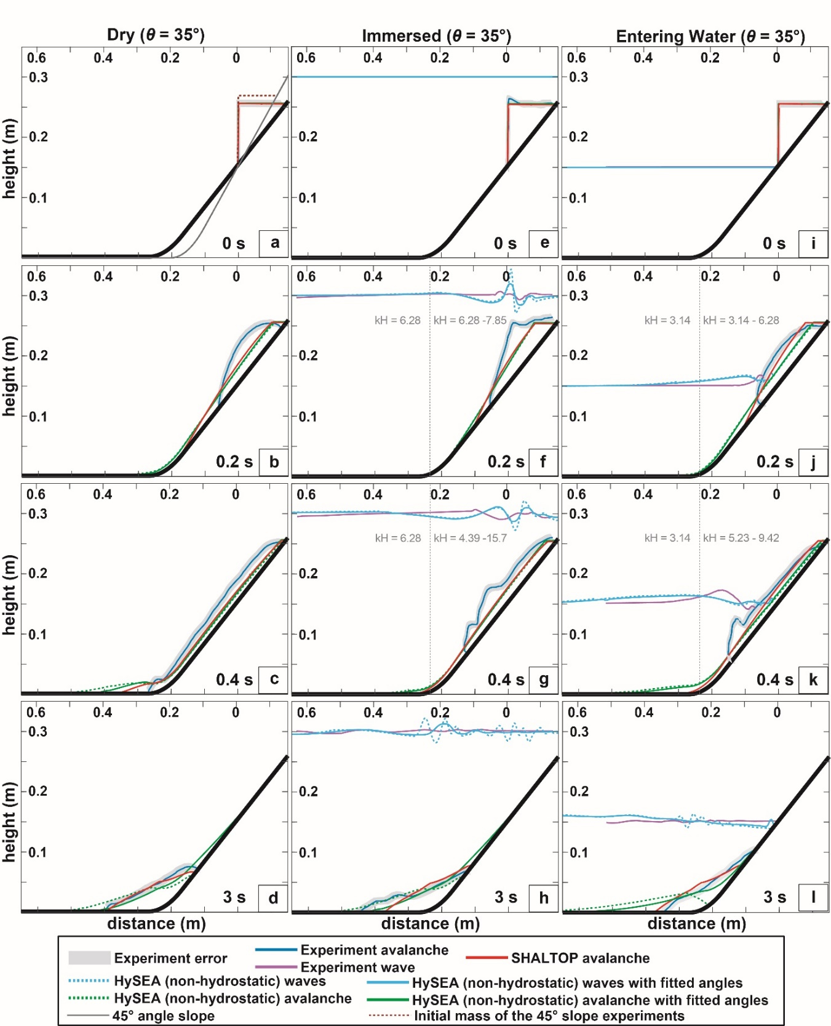
Granular flow simulation results
(Poulain et al, in rev)
Notes:
We now compare the results of the simulations performed with HySEA (in light blue for the wave and in green for the flow) with the experiments (in dark blue for the granular part and in pink for the waves) and the results of the SHALTOP code (in Red).

Slide 6
Granular flow simulation results
Simulations faster than experiments
(Poulain et al, in rev)
Notes:
In the three conditions dry, immersed and in the water, the slides are faster in the simulation than in the experiments.

Slide 7
Granular flow simulation results
Simulations faster than experiments
SHALTOP well reproduces the deposits
HySEA: Calibration of the friction angles
⟹ empirically correct topography effects
Calibrated HySEA well reproduces the deposits
(Poulain et al,in rev)
Notes:
Shaltop reproduces the experimental deposits quite faithfully.
Contrary to HySEA, which overestimates the maximum distance traveled
This difference could be due to the fact that the curvature effects of the topography are not taken into accountin HySEA contrary to SHALTOP.
In order to take them into account empirically, we calibrated the friction angles used in HySEA in order to reproduce the deposits more faithfully.

Slide 8
Granular flow simulation results
Simulations faster than experiments
SHALTOP well reproduces the deposits
HySEA: Calibration of the friction angles
⟹ empirically correct topography effects
Calibrated HySEA well reproduces the deposits
Complex dynamics ⟹
not reproduced by simulations
(Poulain et al, in rev)
Notes:
We observe during the flow that the models are not able to reproduce the complex dynamics of the granular mass interacting with the water

Slide 9
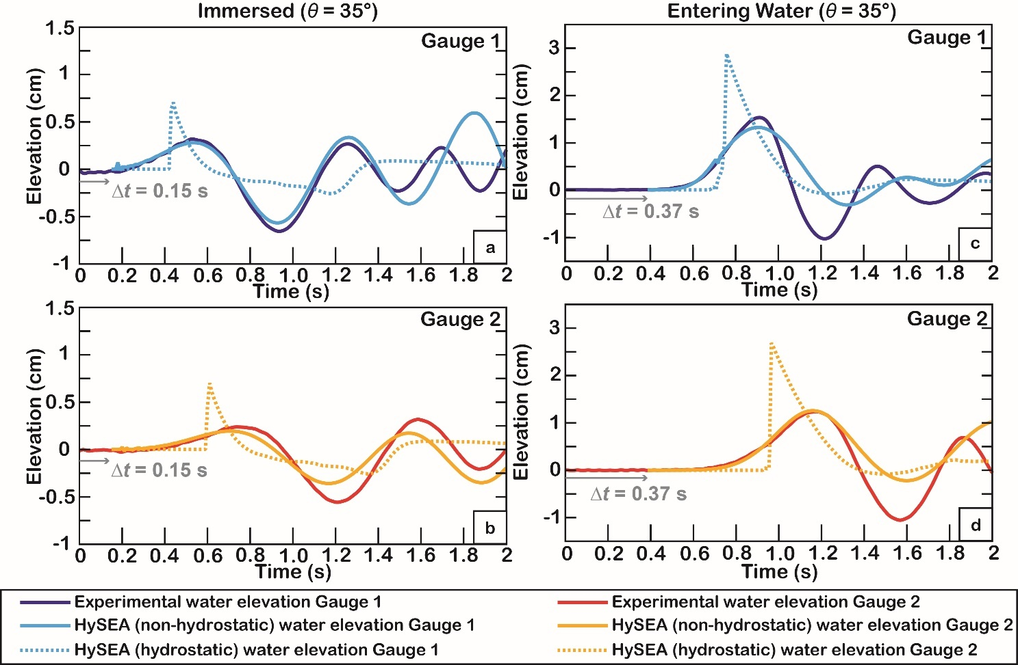
Generated waves
HySEA Hydrostatic :
Overestimated generated waves
Error ⟹ 25% to 100%
HySEA Non-Hydrostatic :
Errors ⟹ 10 % to 25%
Much better representation of
amplitude and wavelength
(Poulain et al, in rev)
Need to use non-hydrostatic model in those conditions
Notes:
The waves generated by the two versions of HySEA used here in light colors (hydrostatic and non-hydrostatic respectively in dotted and solid lines) were compared to the data recorded by the probes during the analog experiments
In both cases shown here, the use of the hydrostatic code results in an overestimation of the waves generated by 25 to 100%.
The use of the non-hydro code in these conditions greatly improves the results with amplitude errors of 10 to 25% and the generation of a wave train closer to the experimental results
In the particular conditions of the experiments it is therefore necessary to use the non-hydro code

Slide 10
Application to Montagne Pelée
Show, analyze and quantify the error associated with the numerical code HySEA (by comparing with SHALTOP code and laboratory experiments)
Benchmark HySEA code in the volcanic context of Martinique in the hydro and non hydro hypothesis
Notes:
Having now an idea of the errors related to the use of the numerical code HySEA and knowing that it is able to reproduce satisfactorily the deposits of granular flow as well as the generated waves, the next step consists in confronting it with a field case, the detabilization of the flanks of the Montagne Pelee in Martinique

Slide 11
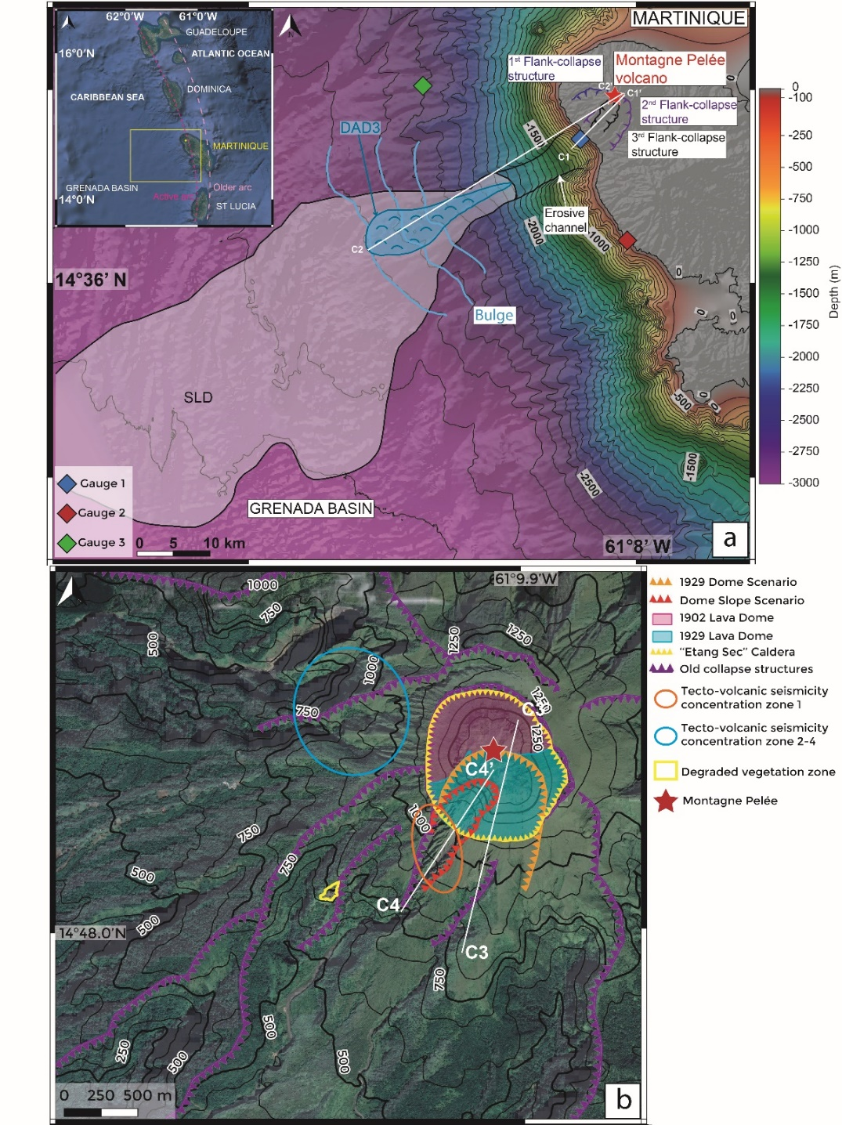
Montagne Pelée history and previous work
Lesser Antilles Arc: subduction of the Atlantic plate under the Caribbean plate (40 Ma)
Montagne Pelée (early Miocene to present): explosive type active and dangerous volcano
Montagne Pelée ⟹ 3 flank collapse events (1.8 km³ to 16 km³)
DAD 3 (Debris-avalanche deposits) results from volcano flank collapse 3
Bulge: result from the accumulation of the 2 older DAD 1 and 2
(Poulain et al, in rev)
Montagne Pelée:
Since April 2019 Increase of the volcanic seismic activity
Volcano-tectonic earthquakes (5 km below the summit + a few deep volcano-tectonic)
November 2020: long period earthquakes and volcanic tremors
December 2020: degraded vegetation on the south-eastern flank of Montagne Pelée
⟹ Increase in the activity of the hydrothermal system
⟹ We are concerned by the inherent mechanical instability of the 1929 lava dome and its consequences
(Poulain et al, in rev)
Notes:
Since April 2019, Pelee Mountain shows an increase of its simo-volcanic as presented before
Those events raise questions about the stability of the 1929 dome and the consequences that a destabilization of a part of this structure or its suroundings could have.

Slide 12
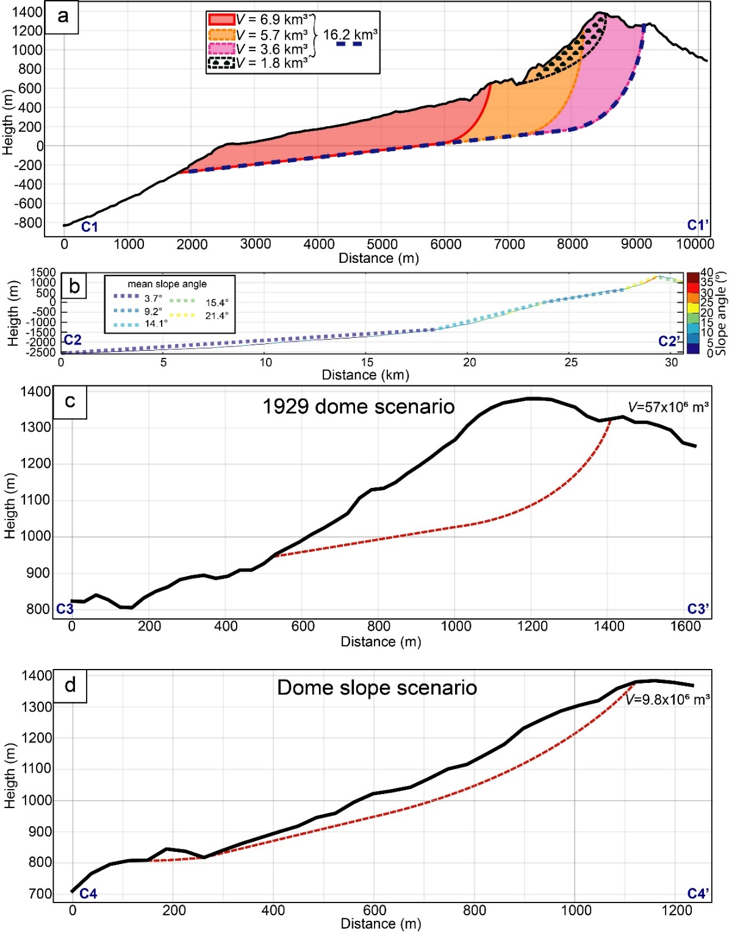
Collapse scenarios and data preparation
To test different parameters for deposits/runout distance and generated waves :
Volumes ( 0.01, 60 , 1.8 , 16.2 km³) and mass morphology
1 event vs. 3 sub-events
Erodible deposits vs. Non erodible deposits
To provide a first assessment of the potential instability giving the current unrest conditions
1929 dome scenario: 57x10⁶ m³
Dome slope scenario: 9.8 x 10⁶ m³
⟹ The DTM (topography from IGN and bathymetry collected during AGUADOMAR) was altered to reproduce a past topography close to reality
(Poulain et al, in rev)
Notes:
Before applying the model to the current scenario it was necessary to test it on available field data
Sensitivity tests were performed to highlight the impact of certain parameters on the deposit and wave generation
The DTM was modified to reproduce the past topography of the volcano in order to perform the simulations

Slide 13
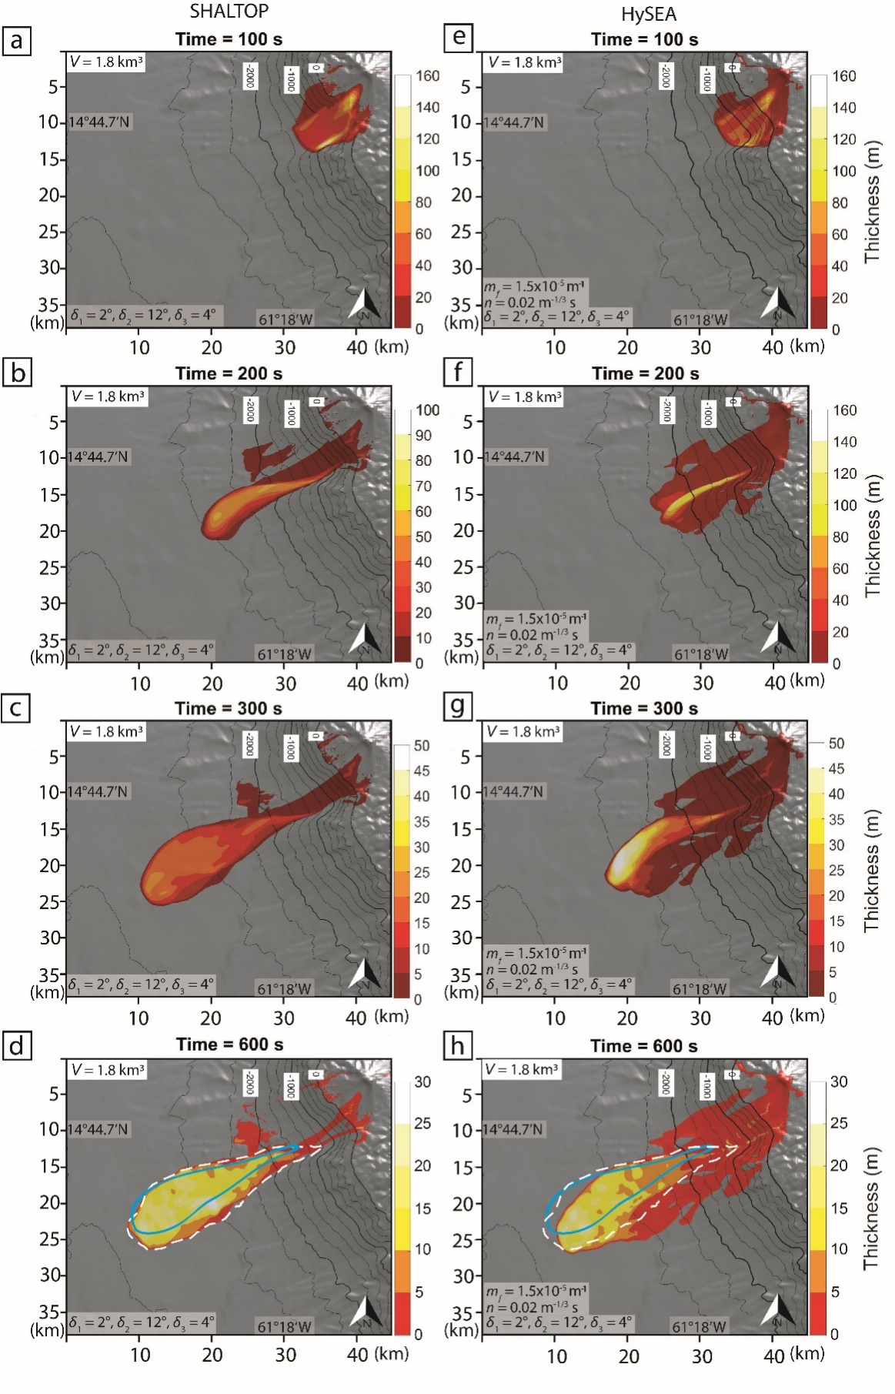
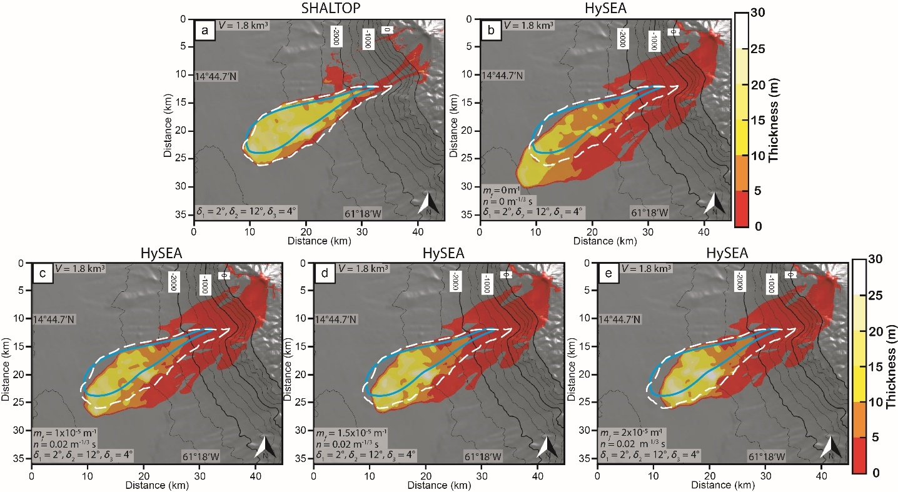
Collapse scenarios and data preparation
Flow dynamics
Similar but flow slightly faster with SHALTOP
max runout distance reached after 300 sec
thickness max (SHALT0P 29.3m, HySEA 28.3 m)
⟹ HySEA can be used as it gives a good runout distance of the flow
(Poulain et al, in rev)
Need to introduce a drag in HySEA between the water and granular layer with a coefficient (m_{f}) and a Manning coefficient (n)
Best deposit with m_{f} = 1.5 x 10⁻⁵ m⁻¹ and n = 0.02 m^{-⅓}s
Deposit slightly larger with HySEA
(Poulain et al, in rev)
Notes:
In a first step, HySEA and SHALTop were compared at the field scale in order to reproduce the deposits of the 1.8 km3 collapse, taking as a basis the previous work done by Brunet and collaborators in 2017.
Tests performed on the manning and friction coefficients between the water and the avalanche show that hysea's results are better for a friction of 1.5 10-5 m -1 with a manning of 0.02 representing a manning value corresponding to the ocean floor and which will be the values used later.
The comparison of the dynamics of the slickness between HySEA and SHALTOP shows similar dynamics with a higher speed for SHALTOP, a larger deposit size for HYSEA and similar maximum deposit thickness values.
It is therefore possible to use HySEA to reproduce this type of event.

Slide 14
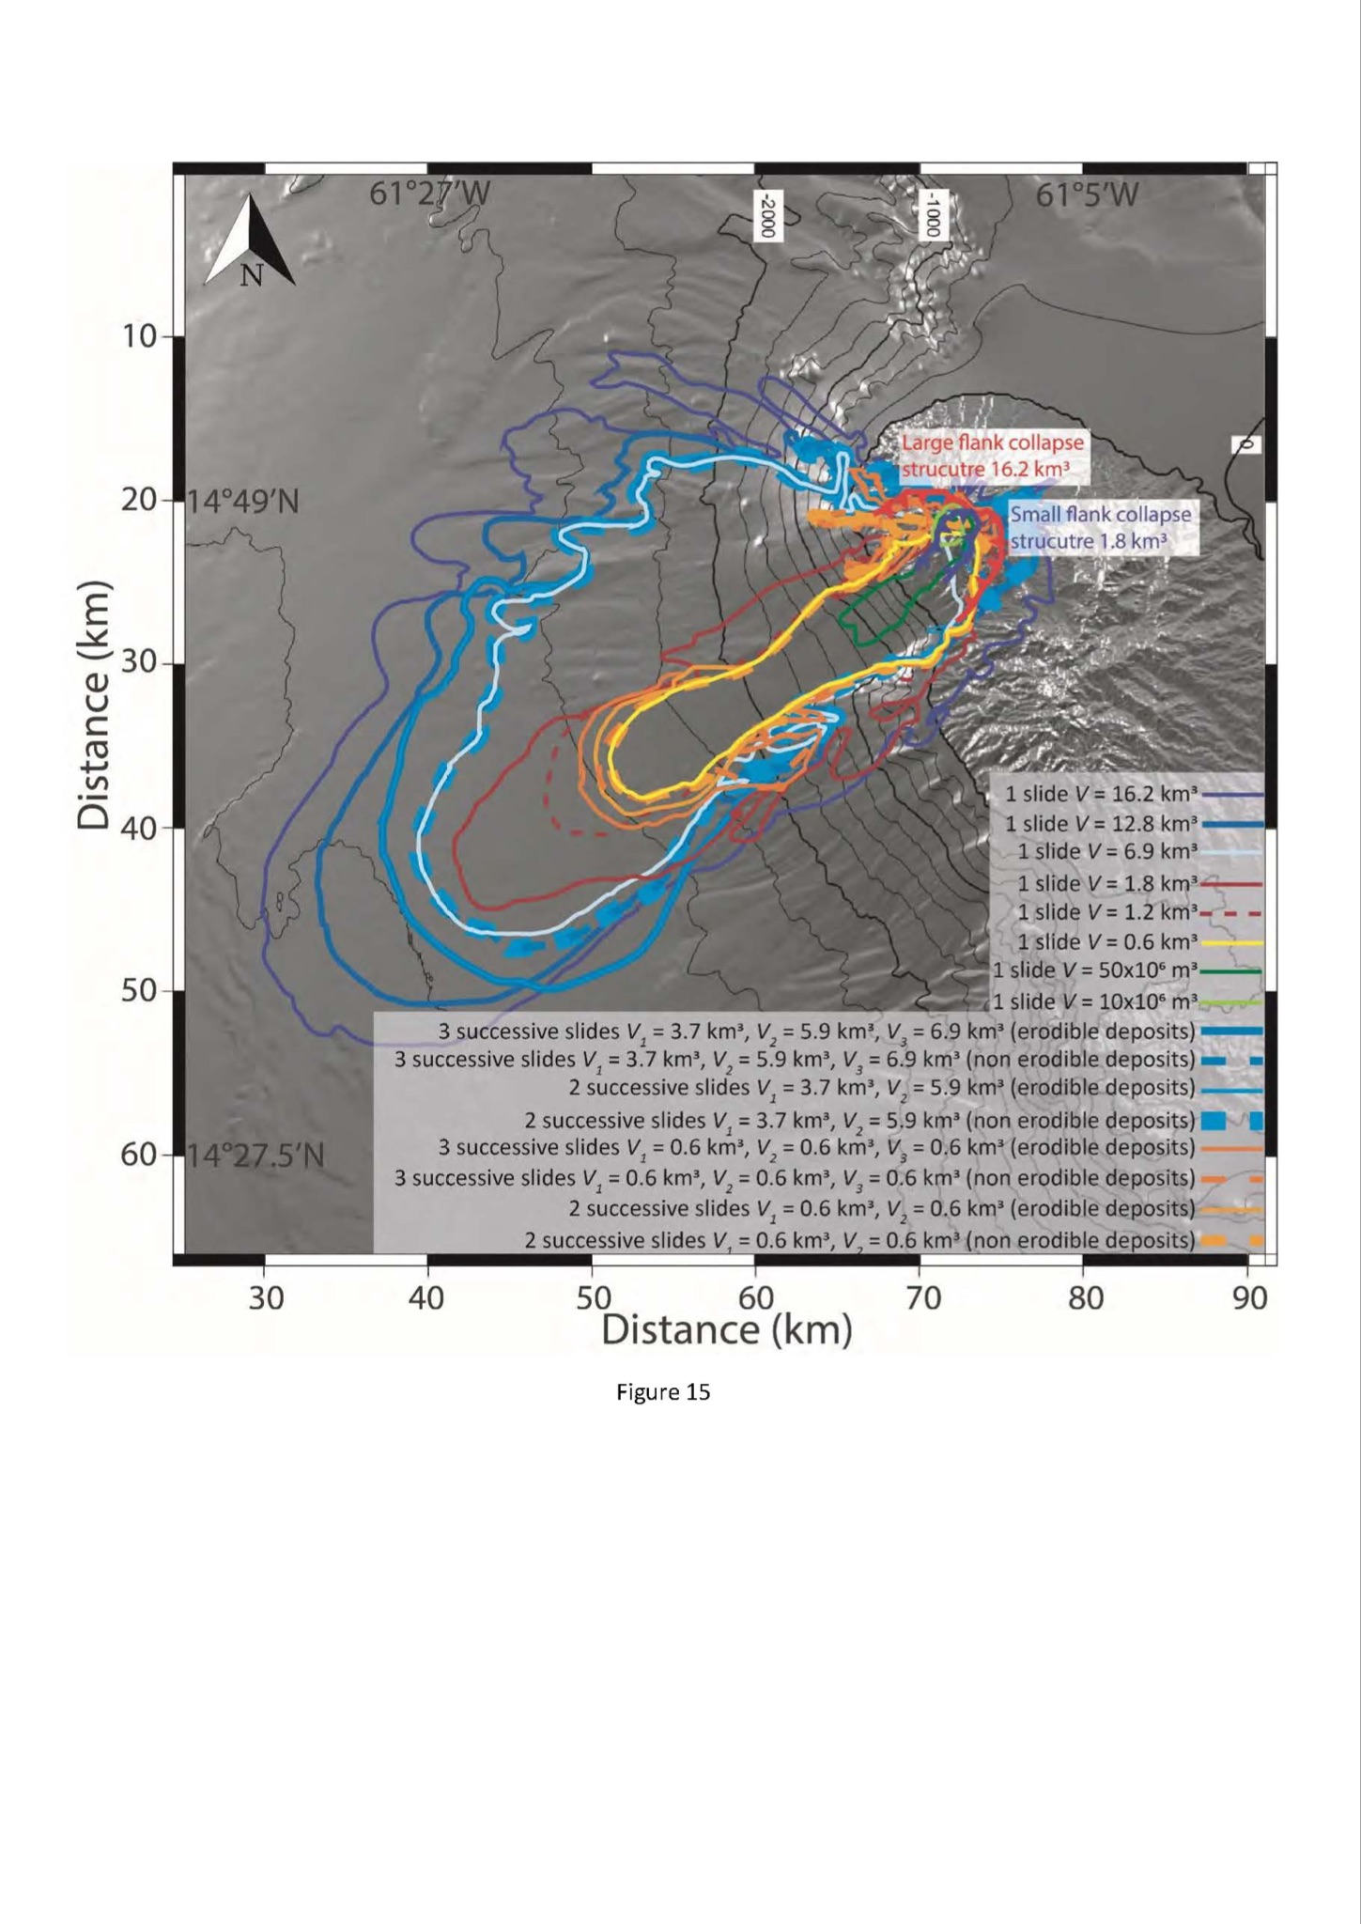
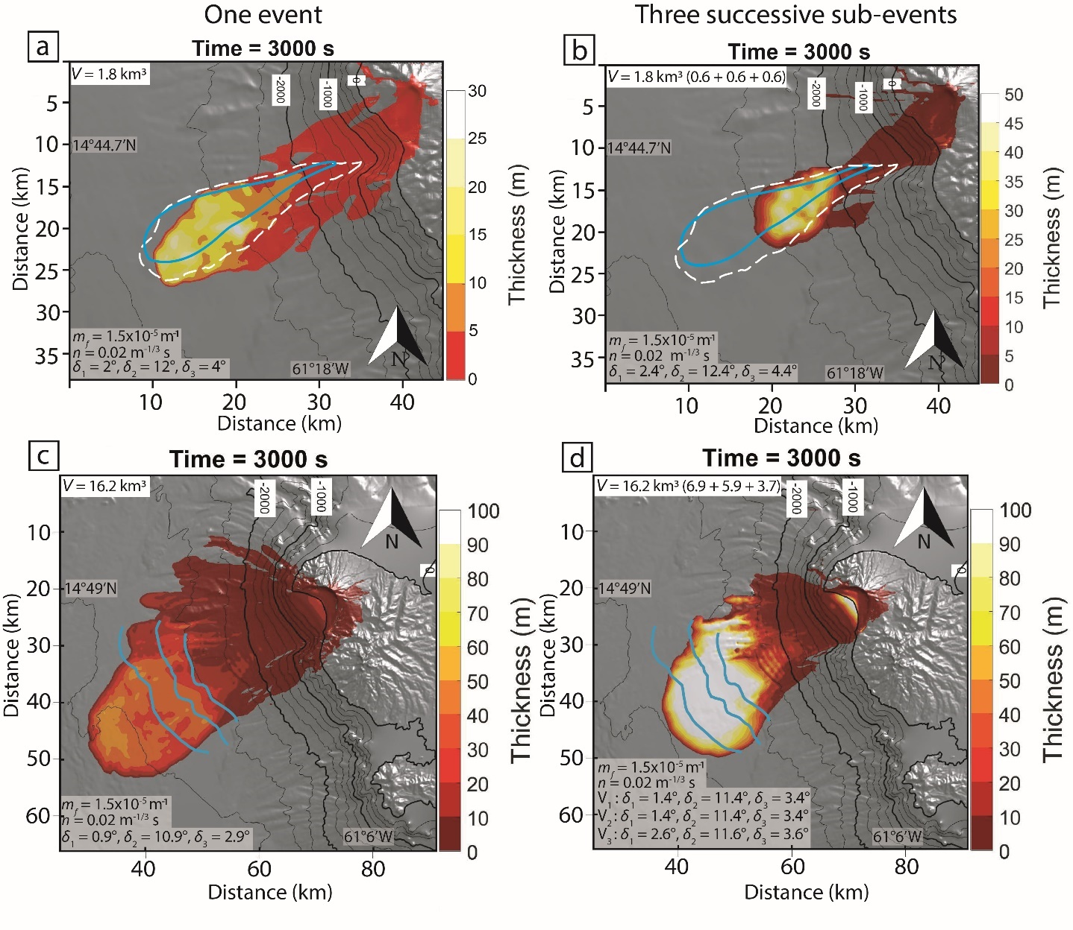
Sensitivity tests on volumes and number of events with hydrostatic/non hydrostatic codes ⟹ Generated waves
(!: order of magnitude as the collapse occurred in one event and not as a flux of material entering the sea)
Impact of the volume
single event versus 3 successive events
Volumes:
10x10⁶ m³
16.2 km³
(Poulain et al, in rev)
For 1,8 km³ subdivided ⟹ runout distance smaller than observed deposits
For 16,2 km³ subdivided ⟹ runout distance closer to observed deposits
(Poulain et al, in rev)
Notes:
This map shows the extent of the different tests carried out according to the volume of the landslides, with deposits extending from a few km offshore to 44 km from the coast for the most voluminous scenario.
On the right, in the case of the most important landslide, we observe that the simulation of this landslide in 1 event is not in agreement with the field data. We have therefore tried to simulate the emplacement of these deposits by the succession of several sub-events.
In the case of the 1.8 km3 landslide subdivided into three 0.6 km3 events, we observe that the simulation represents less well the deposits mapped at sea.
In the case of the most important landslide the succession of sub-events is more representative of the deposits at sea.

Slide 15
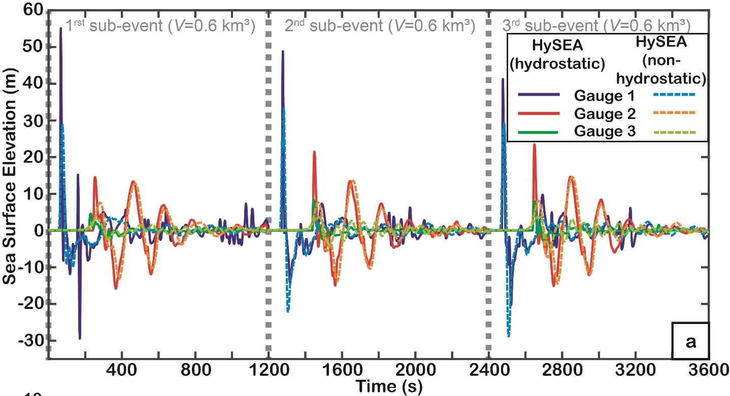
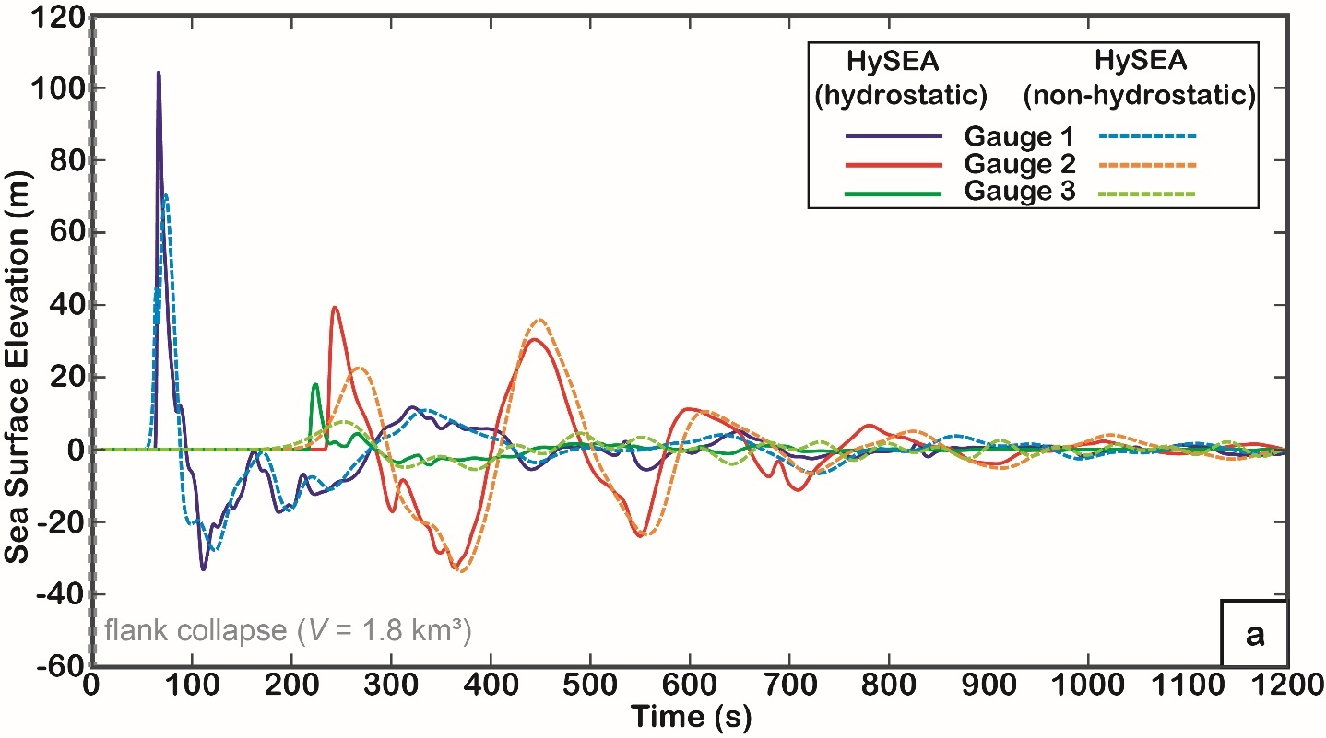
Sensitivity tests on volumes and number of events with hydrostatic/non hydrostatic codes ⟹ Generated waves
(!: order of magnitude as the collapse occurred in one event and not as a flux of material entering the sea)
1.8 km³ (3 sub- event)
1.8 km³ (Single event)
(Poulain et al, in rev)
(Poulain et al, in rev)
(Poulain et al, in rev)
Increasing amplitude of the waves generated by the successive events
⟹ related to their increasing velocity as the successive events start to flow higher on the slope.
Erodible substratum: the wave generated by the last sub-event generates a stronger wave
Hydrostatic model:
gauge 1: first wave 32% higher
gauge 2: first wave 42% higher
gauge 3: 57 % higher
Debris avalanche deposits: similar
Notes:
In the case of a successive event, the waves generated are more important due to the initiation of the slide higher on the slope and therefore at a higher speed when impacting water.
Moreover, in the case of the presence of an erodible bed, successive slides tend to generate more important waves (gauge 2).

Slide 16
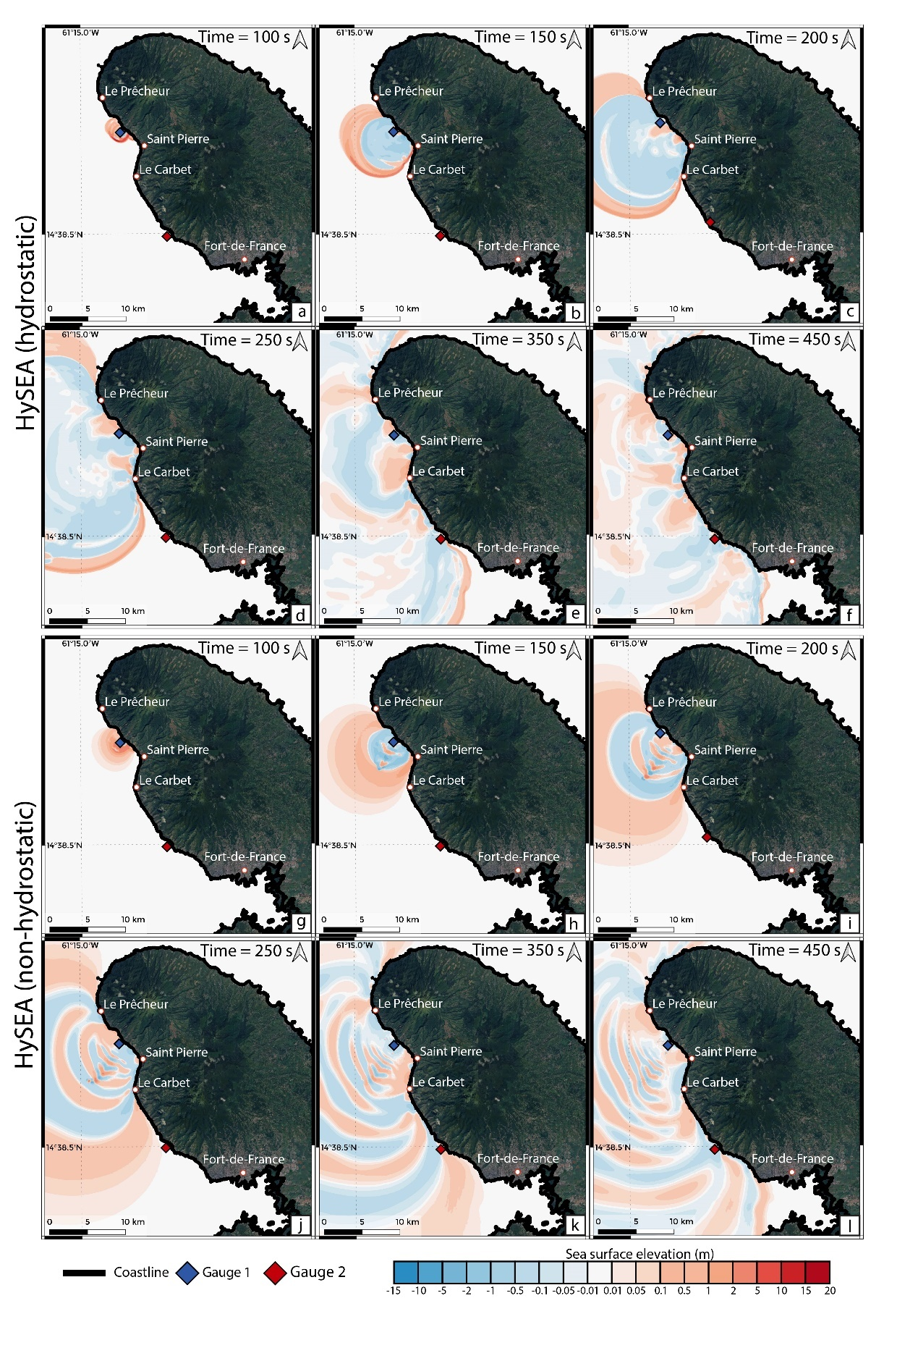
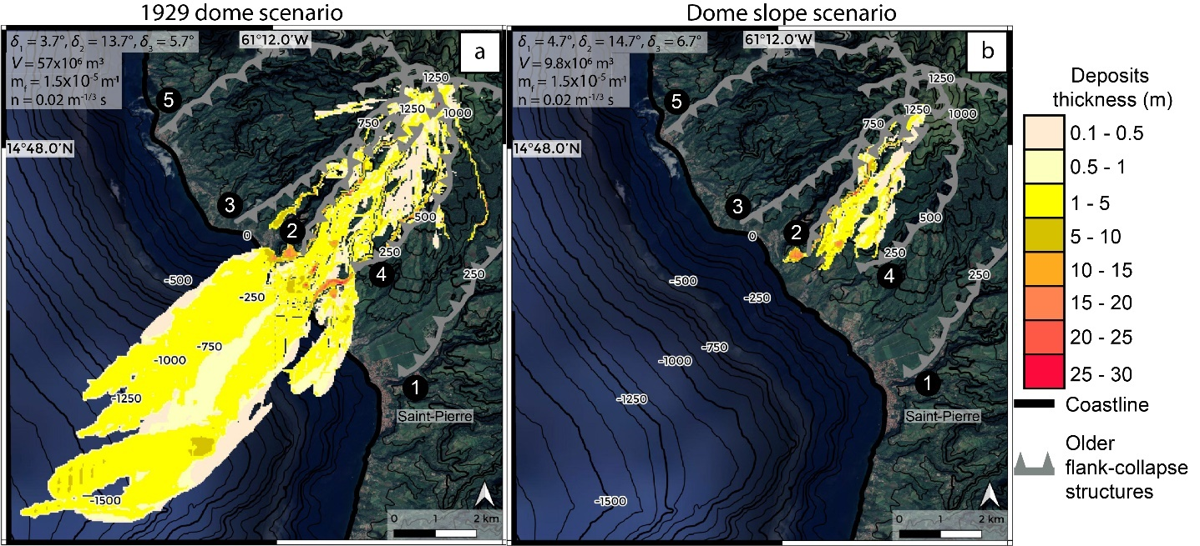
Potential collapse scenarios related to ongoing volcano-tectonic activity (57x10⁶ m³ and V=10x106 m³)
Wave propagation
Debris avalanche
(Poulain et al, in rev)
- Debris avalanche going toward Saint Pierre
- Debris avalanches channeled by older structures (max thicknesses: 30m , 27.9m)
- Smaller volume does not reach the sea
- Wave generated 100s after the begining of the collapse (St Pierre: 150s, Le Carbet: 200s, Fort de France : 450s)
⟹ in both cases: consequences for the population
(Poulain et al, in rev)
Notes:
Let's focus on the two theoretical scenarios of destabilization of the 1929 cone whose volumes are 10 million cubic meters and about 60 million cubic meters.
In both scenarios the landslide propagates towards the city of Saint Pierre, the avalanches being channeled by the scars on the ground of the former slides.
The small volume scenario does not reach the sea, while the 57 cubic km scenario spreads into the sea.
The wave associated with this outburst is generated 100s after the beginning of the landslide and reaches Saint Pierre at 150s then the carbet at 200 and Fort de France at 450s.
However, these two scenarios would have significant consequences on the populations.

Slide 17
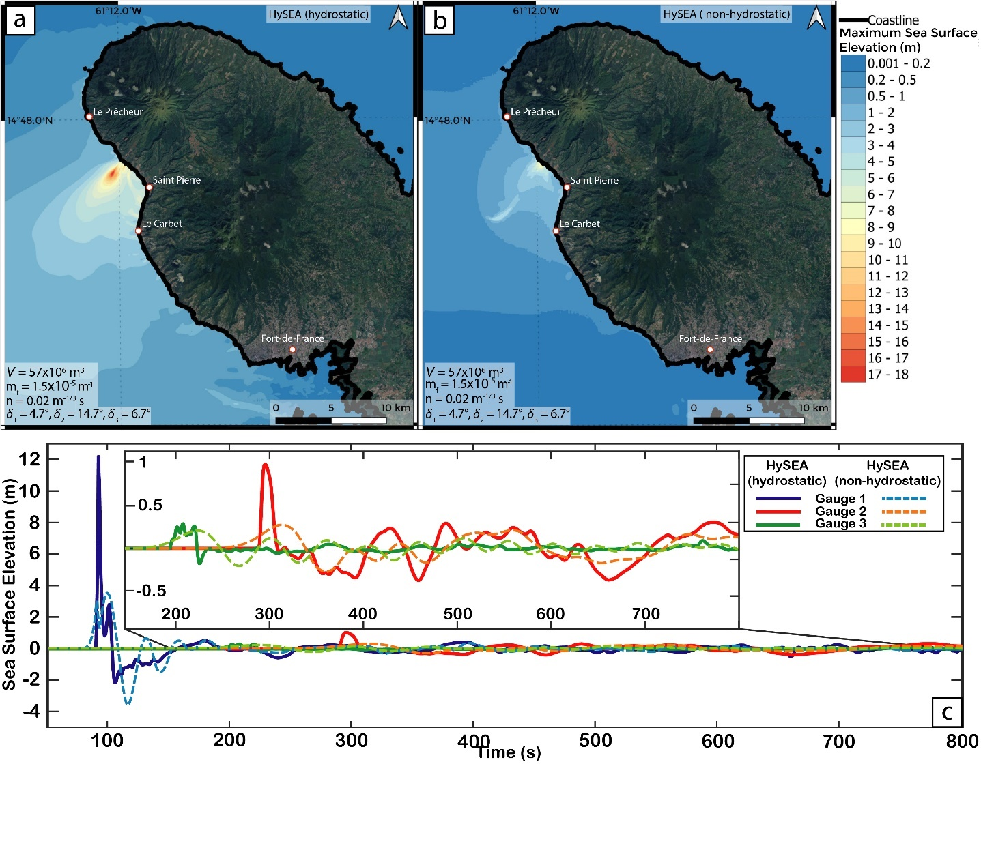
Potential collapse scenarios related to ongoing volcano-tectonic activities
Maximum sea surface elevation for Hydrostatic and Non-Hydrostatic simulations
⟹ Maximum value recorded at debris avalanche emplacement : 18 m (hydro)/8.9 m (non-hydro).
⟹ Amplitude of the first wave significantly decreases during its propagation
Gauge 1 (blue gauge) ⟹ First wave of 12.2 m (Hydro)/3.5 m (Non-Hydro) at 92 s. Gauge 2 (red gauge) ⟹ 1 m/0.29 m
Gauge 3 (green gauge) ⟹ 30 cm/22 cm
(Poulain et al, in rev)
Elevation of the sea surface elevation at each gauge
(Poulain et al, in rev)
Notes:
The results of the simulation are translated into a map of the maximum elevation of the sea surface
The maximum amplitude generated is located in the area of the avalanche spread at sea
The amplitude of the first wave generated decreases significantly during its propagation to reach, depending on the version of the model used, 1m or 30cm at the pace gauge in Bellefontaine

Slide 18
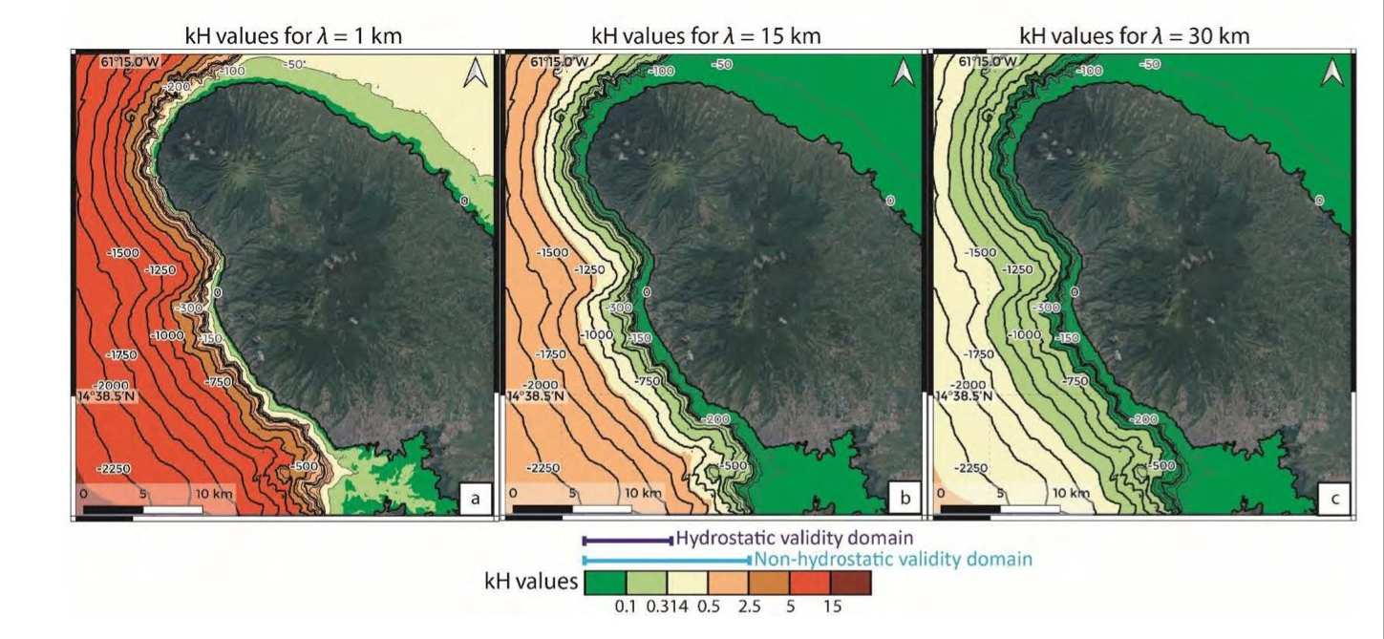
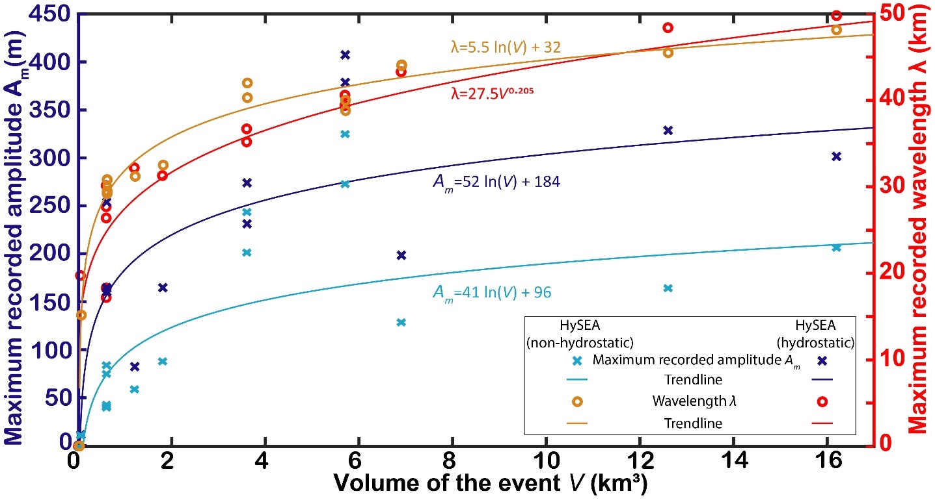
Generated waves results and validity domain of the numerical model
Maximum amplitude and wavelength of the generated waves (for all the scenarios )
Validity criteria of Hysea hydrostatic (kH<0.314) and non hydrostatic (kH<2.5) models
(Poulain et al, in rev)
(Poulain et al, in rev)
The wave amplitude increases logarithmically as a function of increasing volume
The wavelength increases as a function of volume according to a power law
For short wavelengths waves (l <1 km) : the hydrostatic assumption is only valid close to the coastline (depth < 50 m) and the non-hydrostatic assumption is only valid where ocean depth is less than 400 m
Notes:
For all the scenarios considered, the wave amplitude increases logarithmically with the increase of the slipstream while the wave lengths follow a power law reaching a plateau after which these values increase little with the increase of the volume.
The maps present here the range of applicability of the hydro and non-hydro codes as a function of the kH value. This value depends on the depth of the water and the wavelength of the waves considered. For small wavelengths of 1km the hydro code is only valid up to a depth of 50m and 400m for the non hydro. This range expands with increasing wavelength of the waves.

Slide 19
Conclusion

Slide 20
Conclusion
Landslide-HySEA is able to reproduce the landslide runout and generated waves both at lab and field scale, when calibrating the friction coefficients.
Topography and non hydrostatic effects are crucial in modeling.
Calibrating the model ⇒ complex.
Large flank collapse occurred on Montagne Pelée ⇒ occurred in several smaller sub-events ⇒ smaller tsunamis impact
Propagation of the waves ⇒ Necessity to use non-hydrostatic model
⇒ Premliminary work important in the context of the ongoing seismic volcanic unrest at La Montagne Pelée since 2019 (OVSM-IPGP, 2019-2021; 2020-2021)
Future work should focus on a more realistic simulation of the flooding, that is, the propagation of the tsunami wave inland (which was not done here), to better assess the impact on land for the population and infrastructures

Slide 21
Thank you for your attention !

