Slide 1
PSMSL (Permanent Service for Mean Sea Level) Sea level projections portal for communicating impacts to policymakers Andy Matthews and Sveta Jevrejeva National Oceanography Centre, United Kingdom
Notes:
Today I’m going to talk about a simple web tool we built to help communicate projected sea level rise

Slide 2


Funding: UK Official Development Assistance
https://projects.noc.ac.uk/accord/
https://projects.noc.ac.uk/cme-programme/
Notes:
Before I continue – quick acknowledgement of funding
The work comes out of two bits of work down with UK government international development funding
Both projects covered multiple locations doing a wide variety of work, but focused on capacity building
NOC (including Sveta) held workshops with with local scientists, infrastructure managers etc., discussing what would be helpful.
Included adding infrastructure (e.g. new tide gauges), modelling, also knowledge transfer (training in use of equipment, also data management).
Our portion was focused on sea level, and based in the Caribbean (particularly Grenada and St Vincent & The Grenadines)

Slide 3
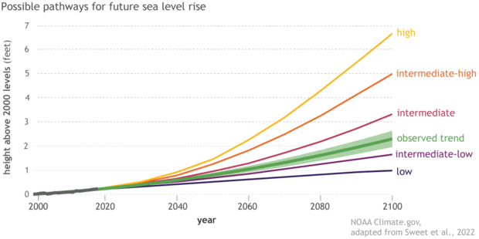
How do we communicate future sea levels?
Global average
Mean sea level
No uncertainty
Notes:
A typical sea level projection plot, one of the first hits on Google
Very nice, great for general communication about sea level rise
But not much use for an individual
It doesn’t tell you about local sea level rise, and in particular relative sea level rise, which is what will flood your house
It also is only about mean sea level, so doesn’t account for other variability (seasonal, tides, surges)
Doesn’t show uncertainties (it’s the best estimate of each projection)

Slide 4
What do we want for communicating threats from sea level?
Simplicity
Shows a realistic ‘worst case scenario’
Provides local information
Web design: open-source, lightweight, responsive, easy-to-maintain, extensible

Slide 5
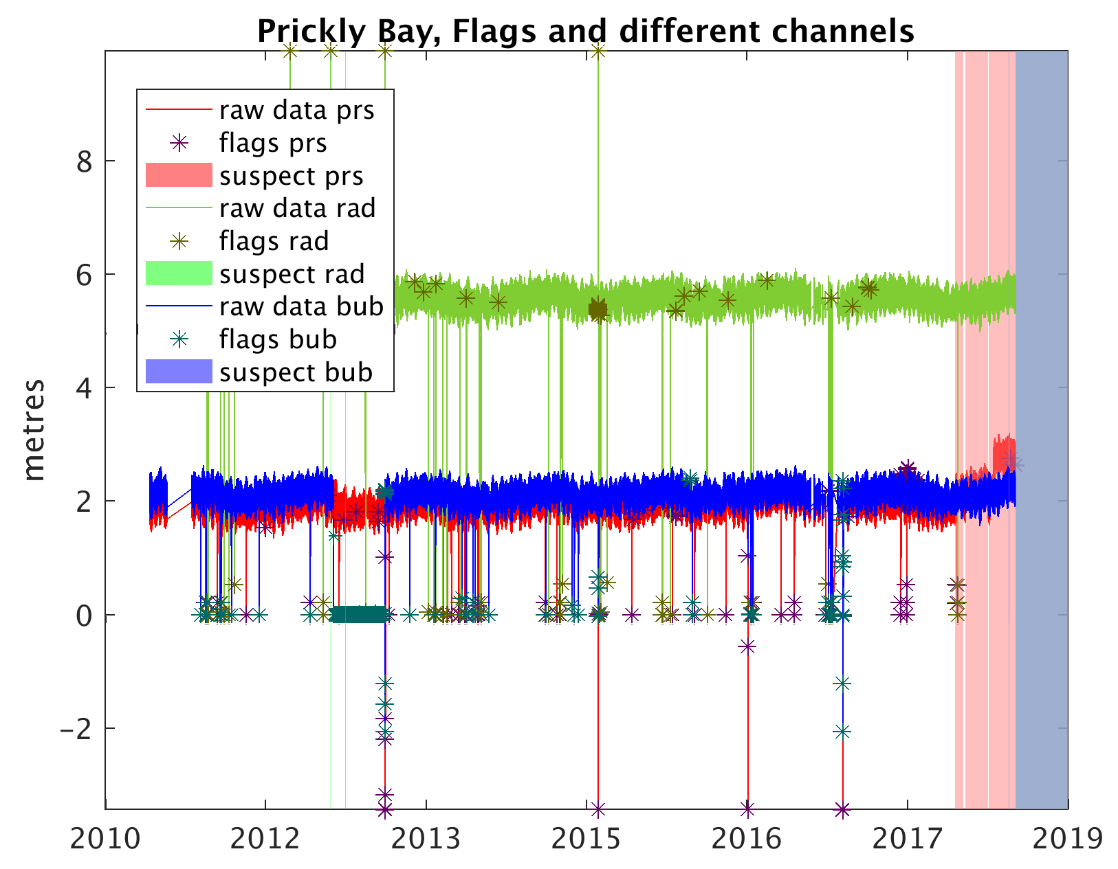
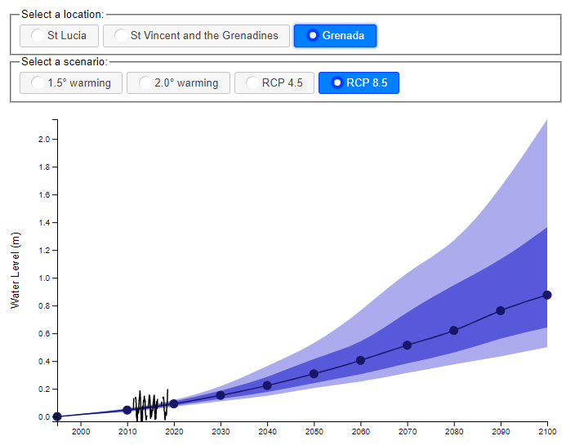
Initial Commonwealth Marine Economies (CME) project
Automatic Quality Control Software
Projection Viewer
https://psmsl.org/cme/autoqc.php
https://psmsl.org/cme/projection.php
Notes:
Auto QC software allowed us to produce some monthly MSL data for three local gauges
It’s not good enough for PSMSL (no datum control etc), but good enough to show monthly variability.
We created a simple projection viewer, allowing you to see a number of projections at the three study sites we’d been working at.
Good, although it’s embedded in the PSMSL website, so quite cumbersome

Slide 6
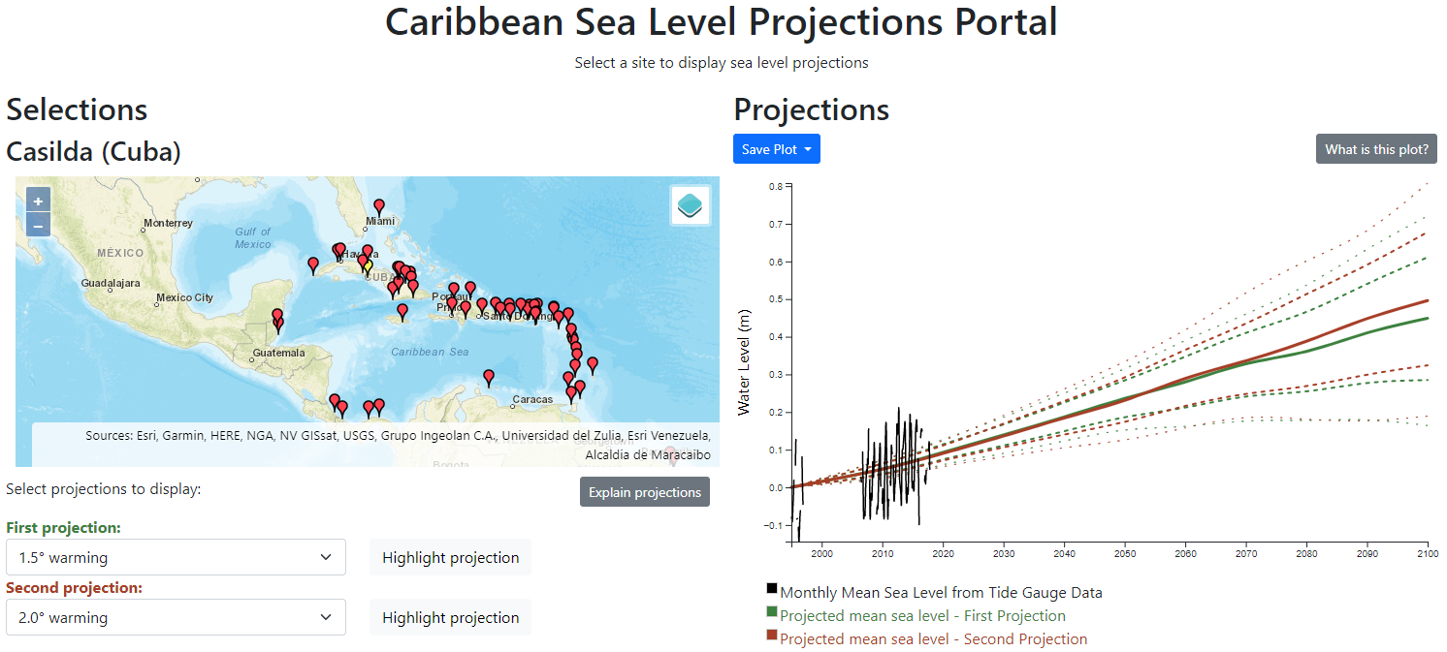
https://psmsl.org/accord/projections.html
Notes:
Second iteration, under ACCORD programme.
Many more sites – about 50 across the Caribbean. Lots more auto-QC data, but also pulled in records from PSMSL & other TG data suppliers.
Can now compare two projections.
Simple design, based on open access libraries
Responsive (good on mobile and PC)
Lightweight – good on a poor connection.
Also simple to host – purely javascript, so just a bunch of static files to put on your server. No need for a database or other server side processes
Extensible – easy to add more sites or projections, just edit the configuration files and add data files
Modular – easy to switch out map or plot used
Can’t see here, but there’s also a data table, you can save plots / data

Slide 7
https://psmsl.org/accord/projections.html
insert-your-domain-here.org
Future extensions?
Global
variability due to tides, surges and waves
more projections
Contact: antt@noc.ac.uk
Notes:
Some ideas for the future!
Trivial to extend to other areas, if you use already QC’d data (e.g. PSMSL)
Add other projections
Add some indication of variability due to high frequency forms of variability, which will really help plan future infrastructure

