Slide 1





Estimation of soil moisture within drip irrigation context in pepper fields using ALOS-2 and Sentinel-1 data
EGU General Assembly 2022
Emna Ayari^{1,2}, Zeineb Kassouk² , Zohra Lili-Chabaane² , Nicolas Baghdadi³ , and Mehrez Zribi ¹
¹CESBIO (CNES/CNRS/INRAE/IRD/UPS), 18 av. Edouard Belin, bpi 2801, 31401 Toulouse cedex9, France;
²National Agronomic Institute of Tunisia, Carthage University, LR17AGR01 InteGRatEd Management of Natural Resources: remoTE Sensing, Spatial Analysis and Modeling (GREEN-TEAM), Tunis 1082, Tunisia;
³CIRAD, CNRS, INRAE, TETIS, University of Montpellier, AgroParisTech, CEDEX 5, 34093 Montpellier, France;
Presented by:
Emna Ayari

Slide 2
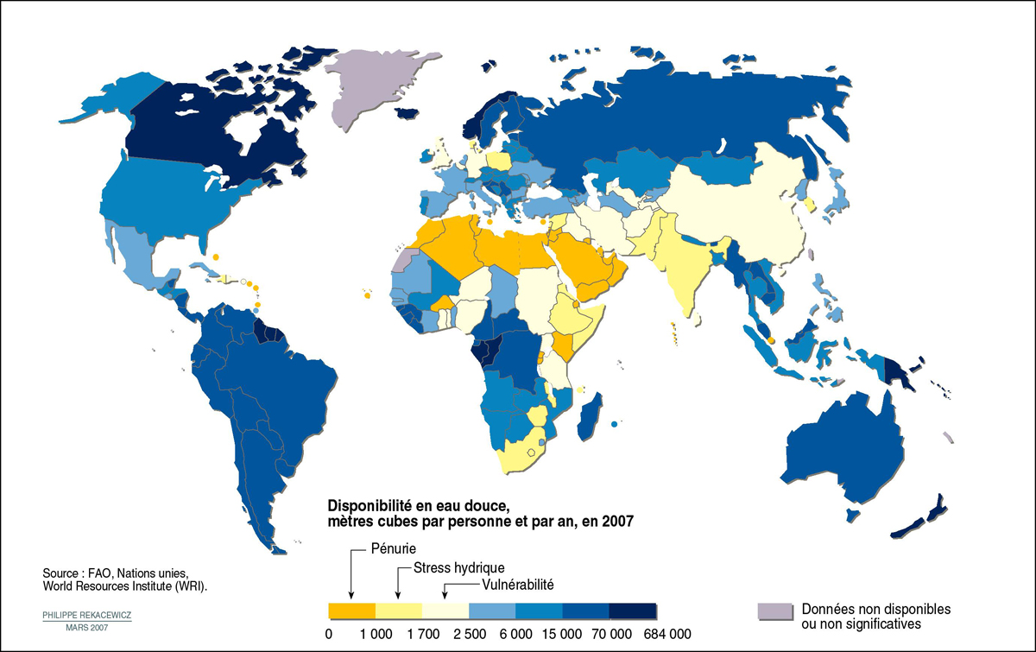
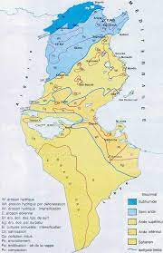
Problematic
Water resources (WR) are under pressure of :
- the arid climate of the southern Mediterranean region
- the high demography
- the irrigated areas extension
Increasing degradation of WR quality
Overexploitation
In Tunisia :
Agriculture sector consumes about 80% of available WR
On ¾ of the Tunisian territory, the climate is semi-arid to arid.
Optimizing irrigation water management from the field scale to regional one
Soil moisture: Main component for estimating irrigation needs at the field scale

Slide 3
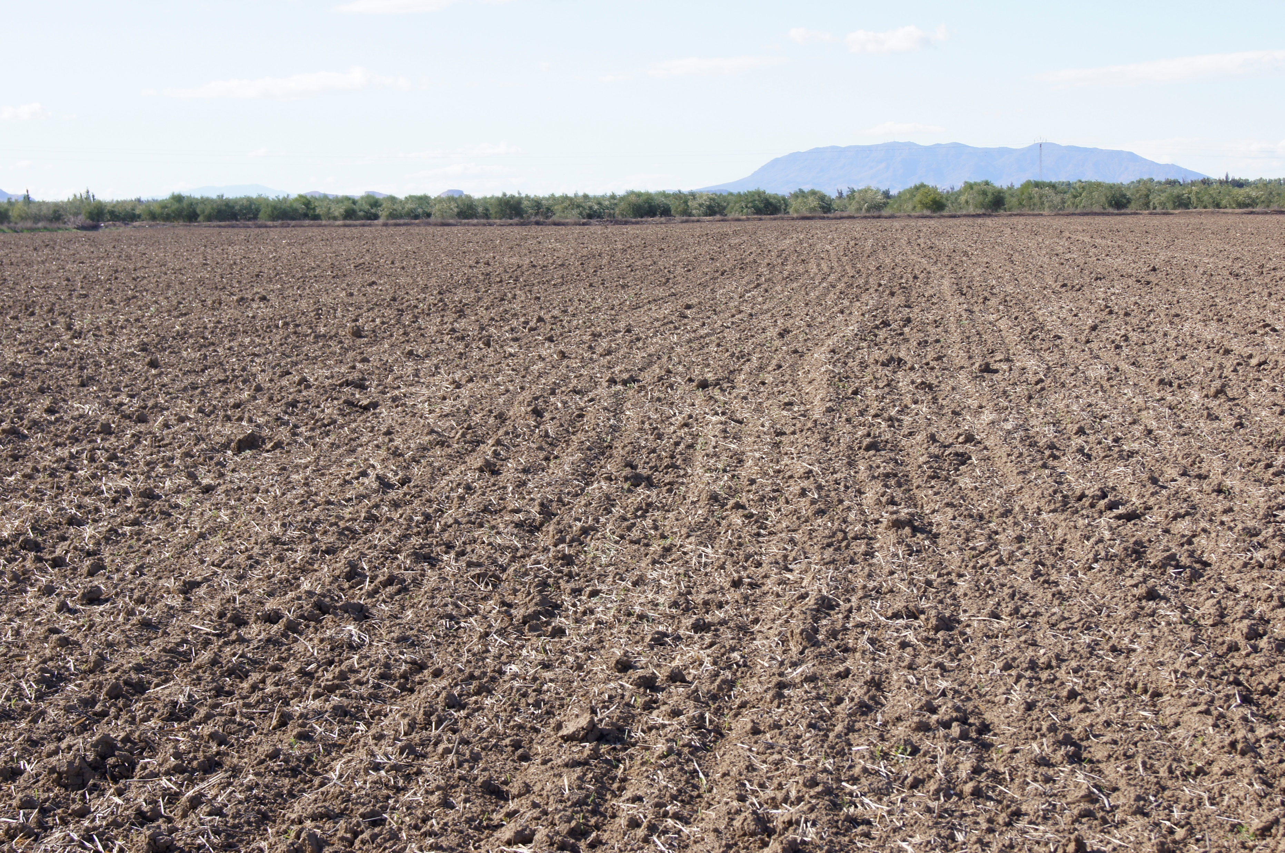
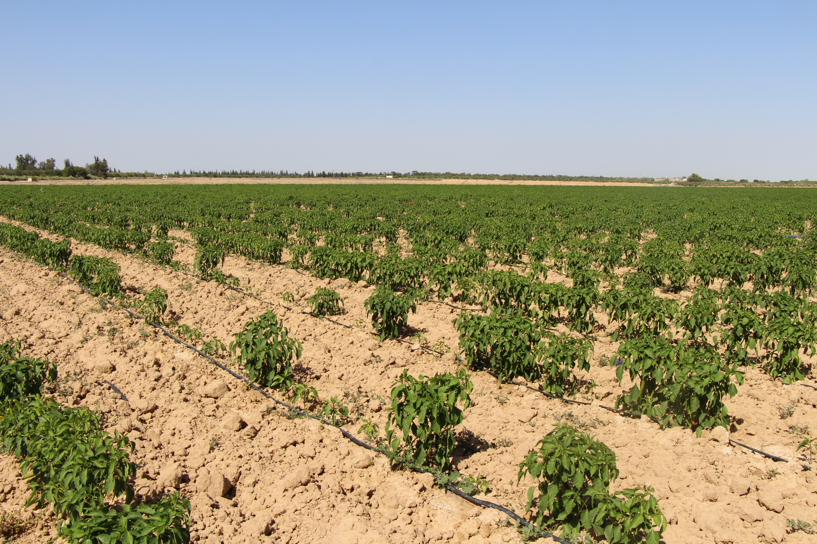
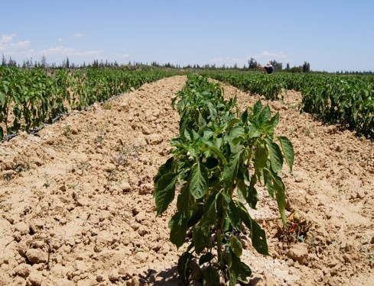

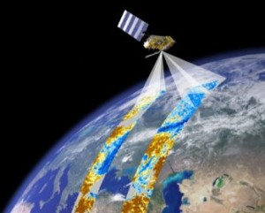
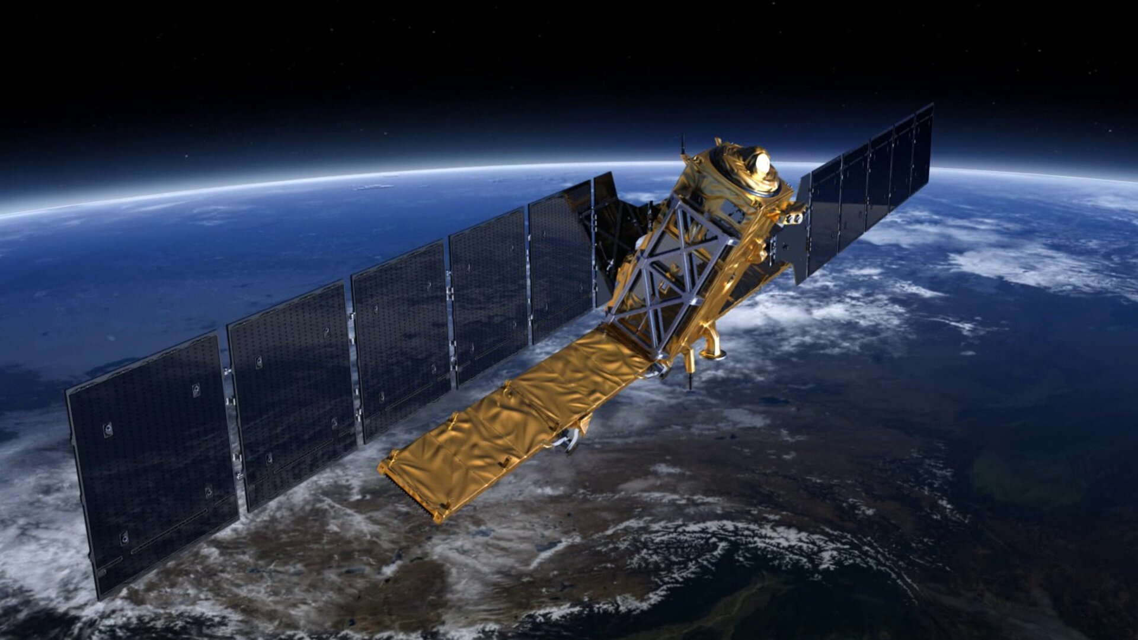
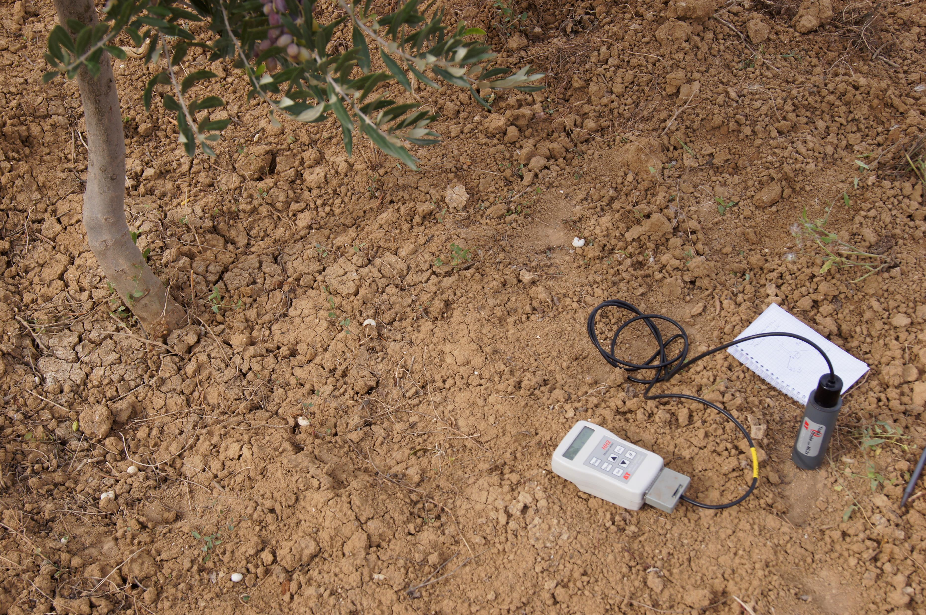
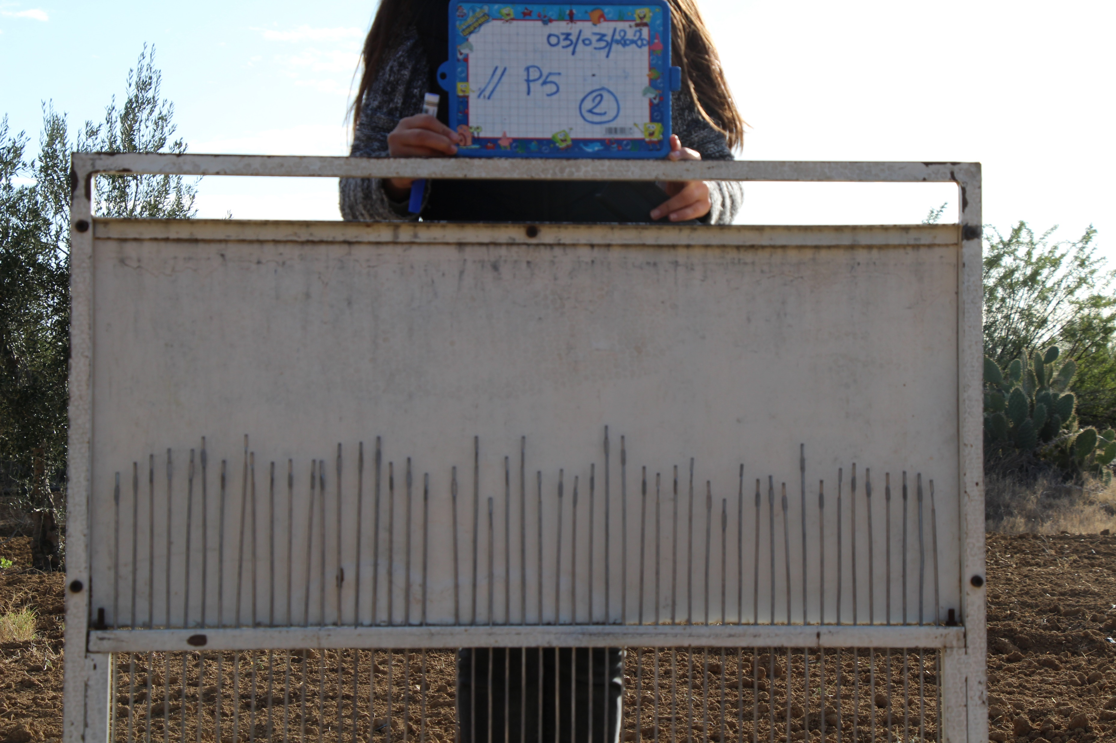
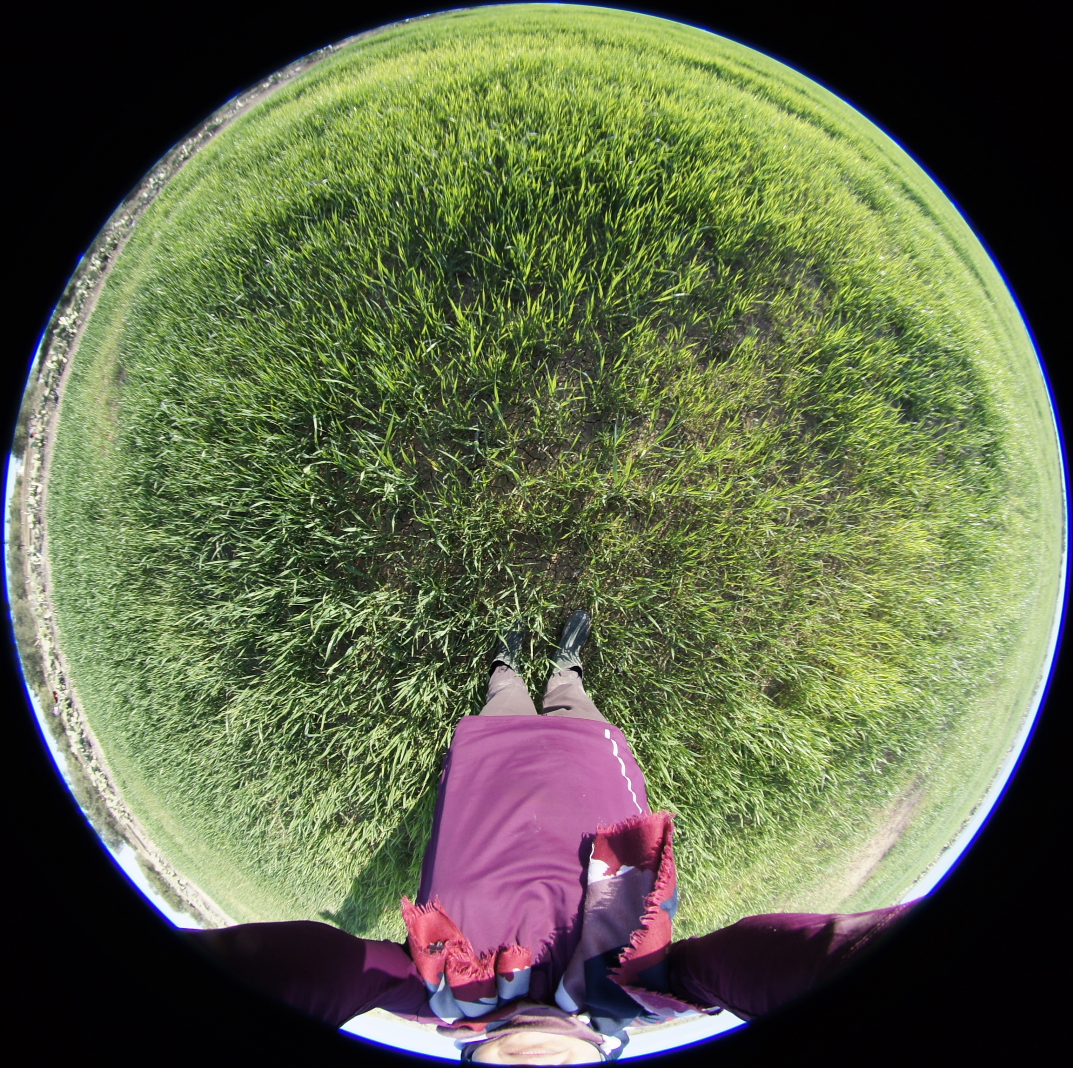
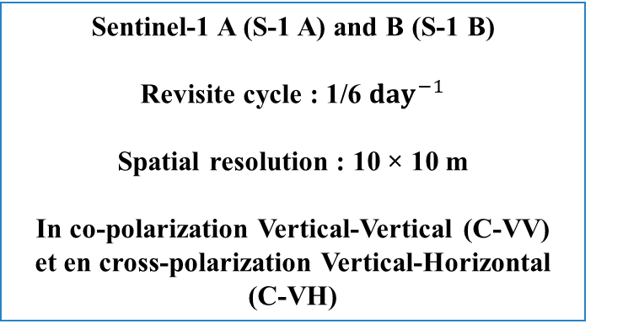
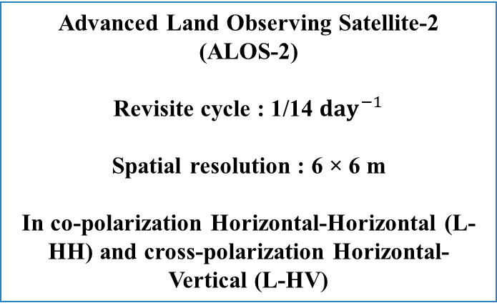
Soil moisture Retrieve
SAR data
ALOS-2
Advanced Land Observing Satellite-2 (ALOS-2)
Revisite cycle : 1/14 ${day}^{−1}$
Spatial resolution : 6 × 6 m
In co-polarization Horizontal-Horizontal (L-HH) and cross-polarization Horizontal-Vertical (L-HV)
Satellite Images
At the field scale
High temporal repetitivity
High spatial resolution
Sentinel-1 A (S-1 A) and B (S-1 B)
Revisite cycle : 1/6 ${day}^{−1}$
Spatial resolution : 10 × 10 m
In co-polarization Vertical-Vertical (C-VV) et en cross-polarization Vertical-Horizontal (C-VH)
Sentinel - 1
In-situ measurements

Slide 4
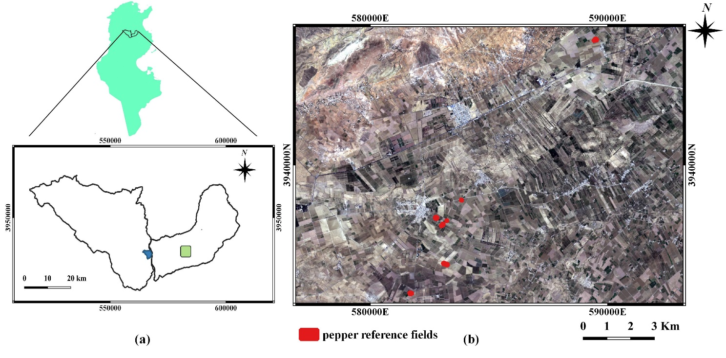
Study area and dataset
Soil Moisture
Soil roughness
LAI / H
The Kairouan Plain
Flat landscape extending over 3000 km²
Semi-arid
Annual precipitations about 300 mm
Occupied by large, irrigated fields of cereal, olive tree and market garden crops
LAI = Leaf Area Index and H = Vegetation Height

Slide 5
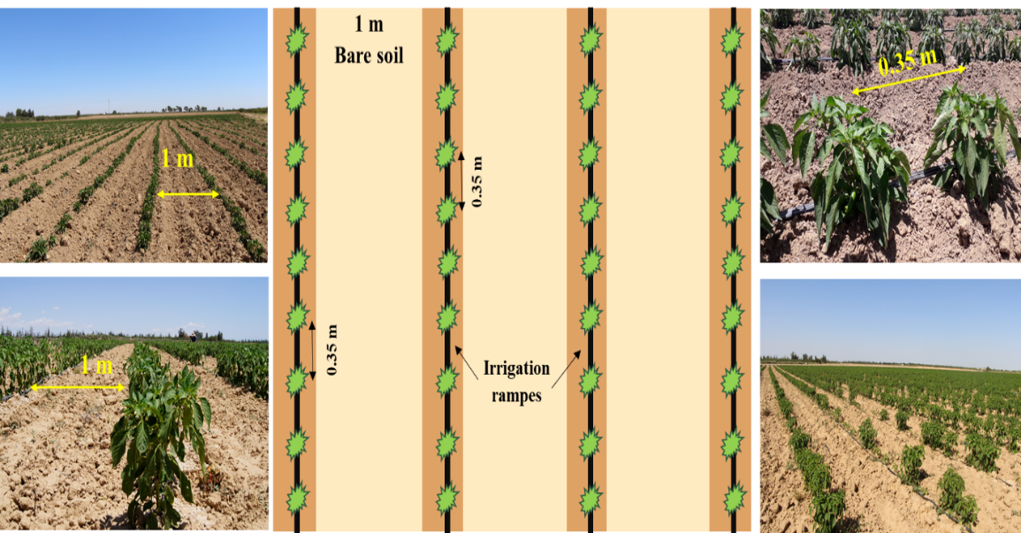
Study area and dataset
$$Mv= α∗ {Mv}_{inter−row}+(1−α)∗ {Mv}_{veg−row}$$
Average soil moisture value $Mv$ based on the hypothesis that bare soil, characterized by ${Mv}_{inter_row}$, covered the proportion $α$of the field area and $1−α$ was covered by rows of pepper plants equipped by irrigation tapes, characterized by ${Mv}_{veg−row}$.
According to the ground truth observations, $α$ is equal to 0.85

Slide 6
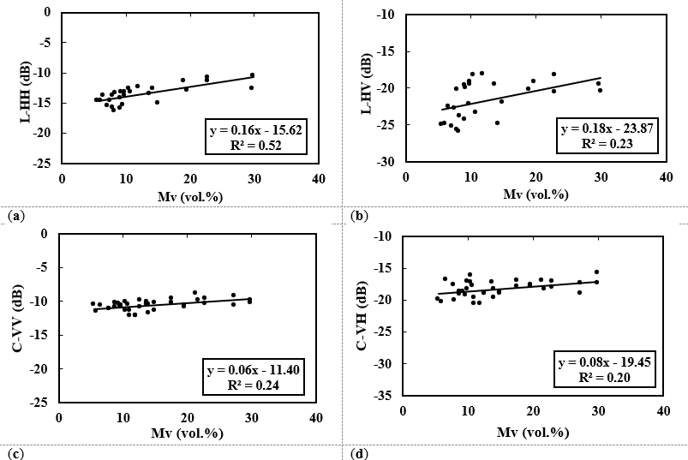
Radar signal sensitivity to soil moisture
Pepper high (m) | Between 0.17 and 0.65
LAI | Between 0.07 and 1.75
Fc | Less than 0.5
L-HH data were more sensitive than were the C-VV data to the soil water content.
Correlation values are lower using cross-polarized data
The contribution of vegetation volume scattering
We investigated and analyzed the potential of co-polarized SAR data, to limit the volume scattering effect on soil moisture retrieval in the following sections.

Slide 7
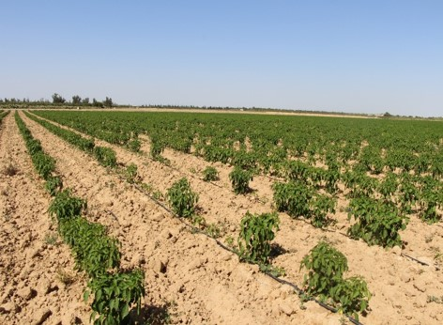
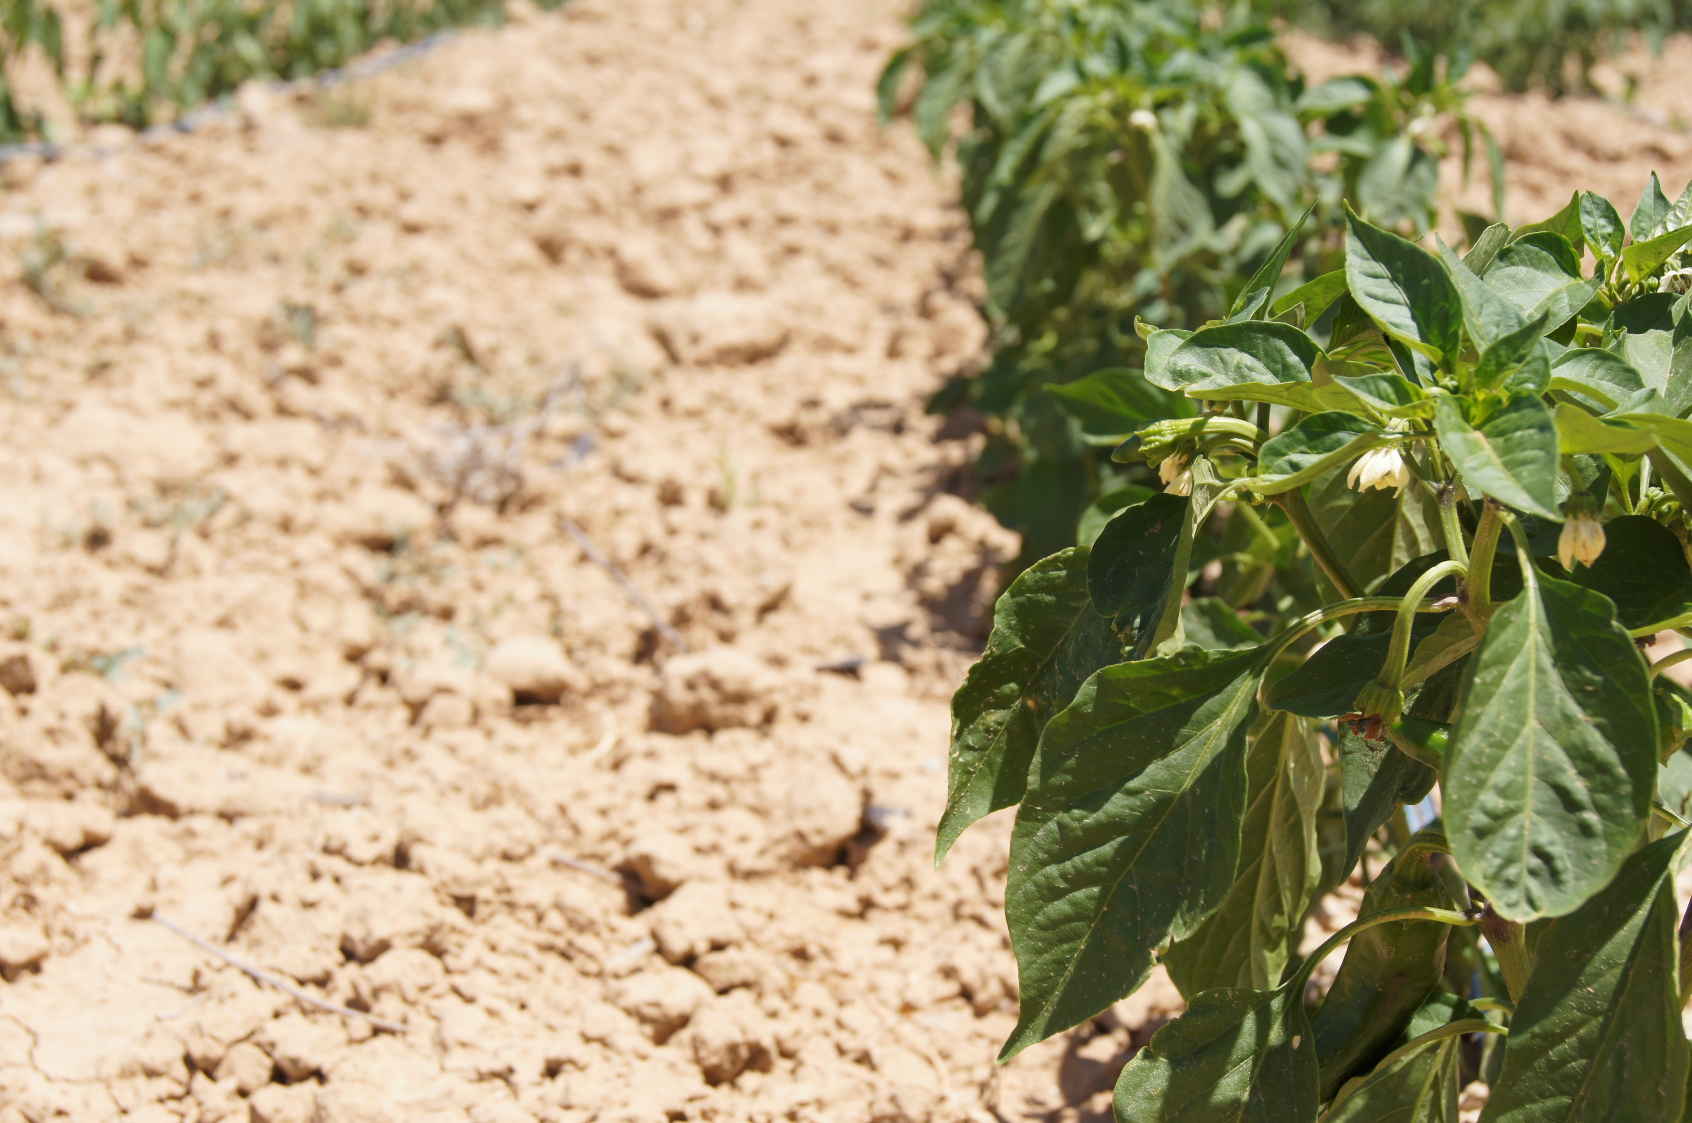
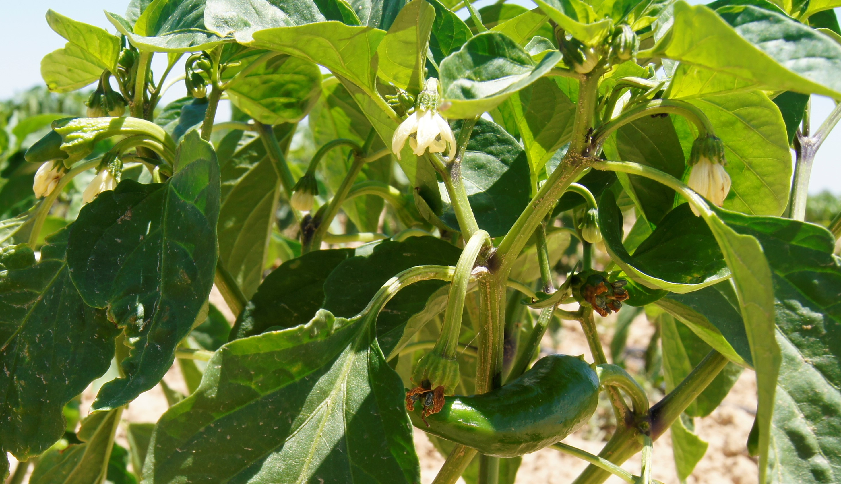
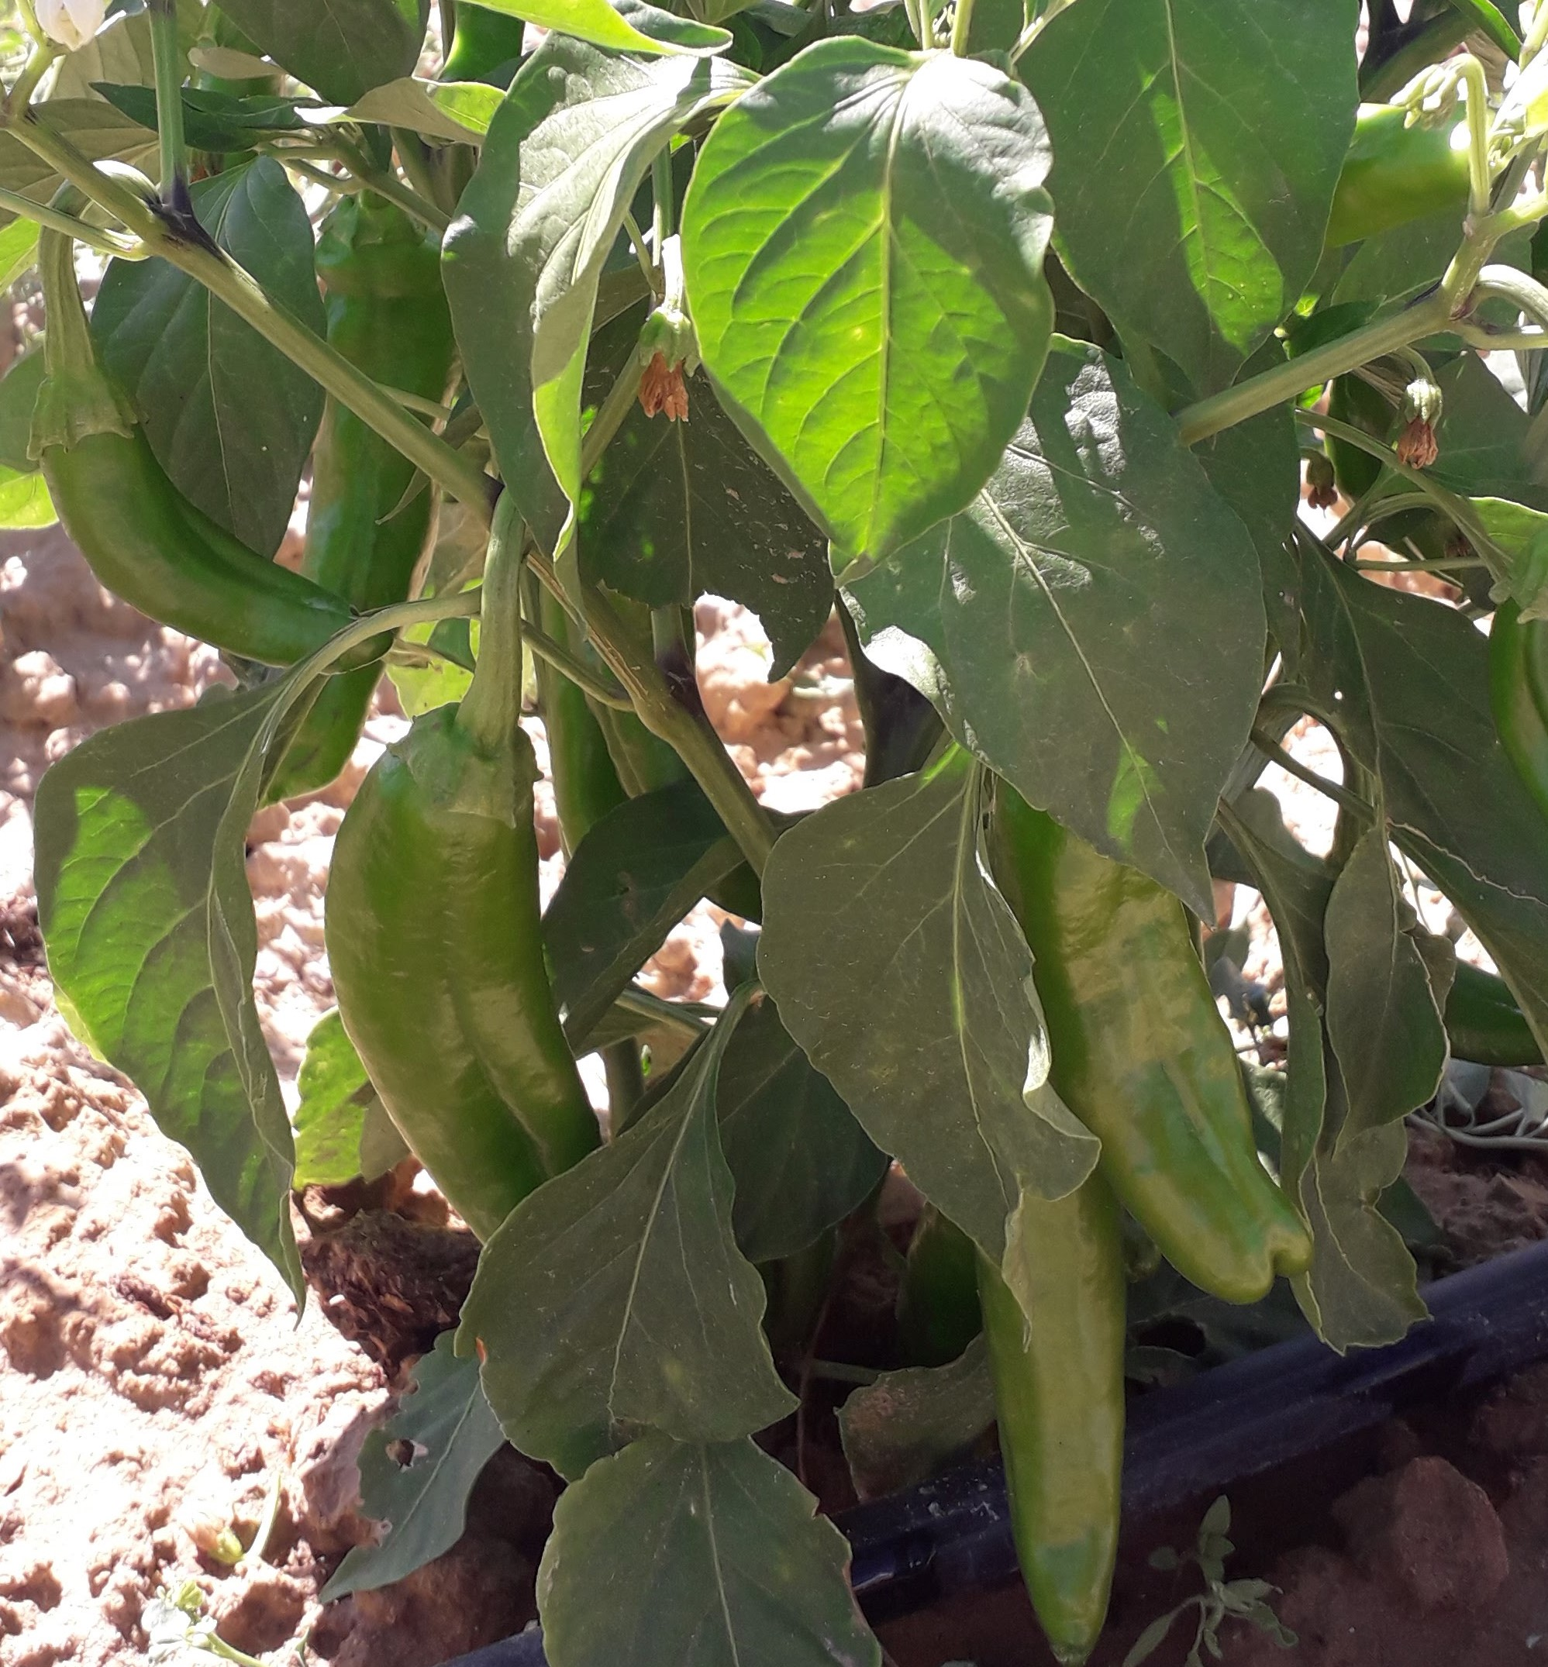
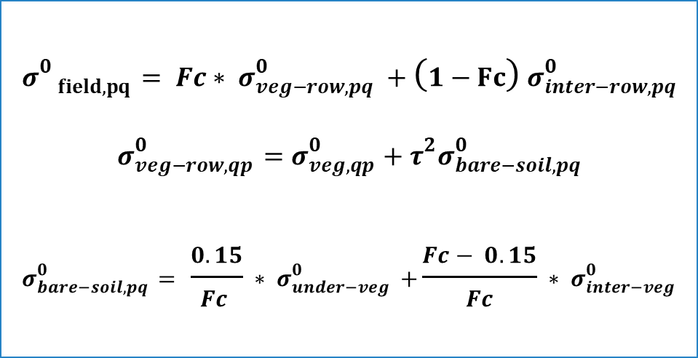
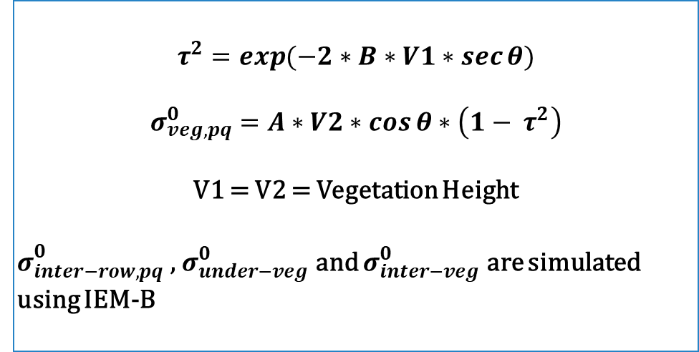
Methodology
Sol couvert :
Modified Water Cloud Model
$${σ^{0 }}_{field, pq}= {Fc∗ σ}_{veg−row, pq }^{0}+\left(1−Fc\right) σ_{inter−row,pq}^{0}$$
$${σ_{veg−row,qp}^{0}=σ_{veg,qp}^{0}+τ}^{2}σ_{bare−soil,pq}^{0}$$
$$σ_{bare−soil,pq}^{0}= { \frac{0.15}{Fc } ∗ σ}_{under−veg}^{0} +{\frac{Fc− 0.15}{Fc} ∗ σ}_{inter−veg}^{0}$$
$$τ^{2}=\exp{(−2∗B∗V1∗\sec{θ)}}$$
$$σ_{veg,pq}^{0}=A∗V2∗\cos{θ}∗\left(1− τ^{2}\right)$$
V1 = V2 = Vegetation Height
$σ_{inter−row,pq}^{0}$ , $σ_{under−veg}^{0}$ and $σ_{inter−veg}^{0}$ are simulated using IEM-B
Where A and B are parameters that depend on the characteristics of the vegetation canopy and SAR configurations and V1 and V2 are vegetation descriptors, $σ_{inter−row,pq}^{0}$ is the bare soil backscattering term separating two pepper rows simulated with IEM-B and $σ_{veg_row, pq }^{0}$ is the total contribution of the vegetation rows.

Slide 8
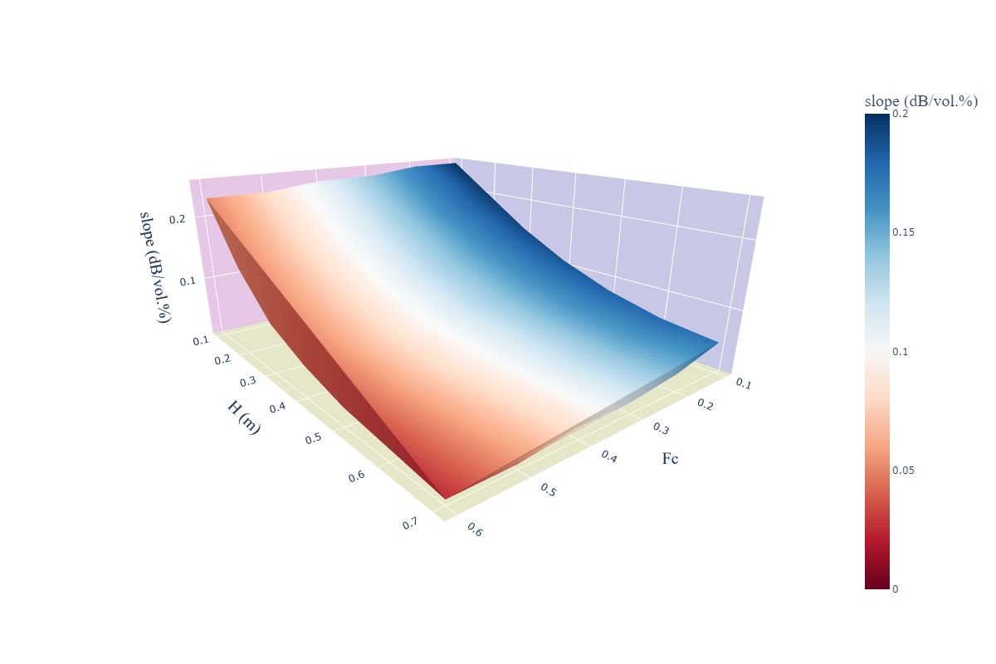
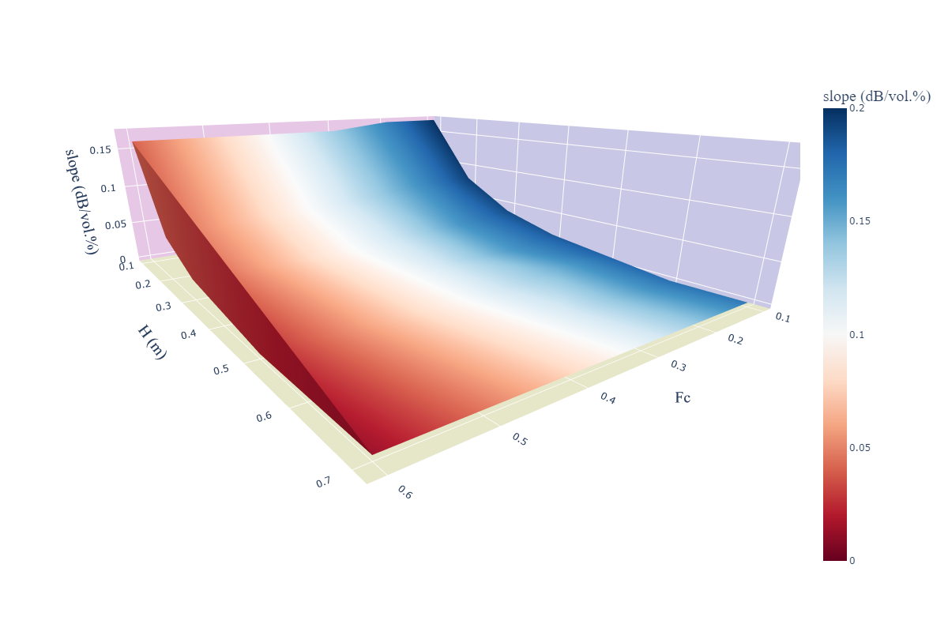
Modified WCM simulations
L-HH data : a high sensitivity was found at a low vegetation cover fraction and small height despite the smaller slope values starting at a height of 0.5 m and an Fc value of 0.4
C-VV data : the model sensitivity decreased from 0.2 dB/vol.% at low Fc and H values to 0 dB/vol.% at an Fc value of 0.3 and a pepper height of 0.3 m.

Slide 9
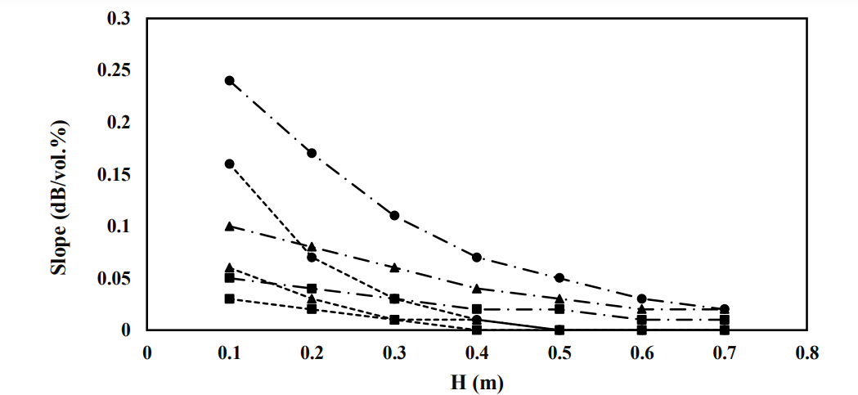
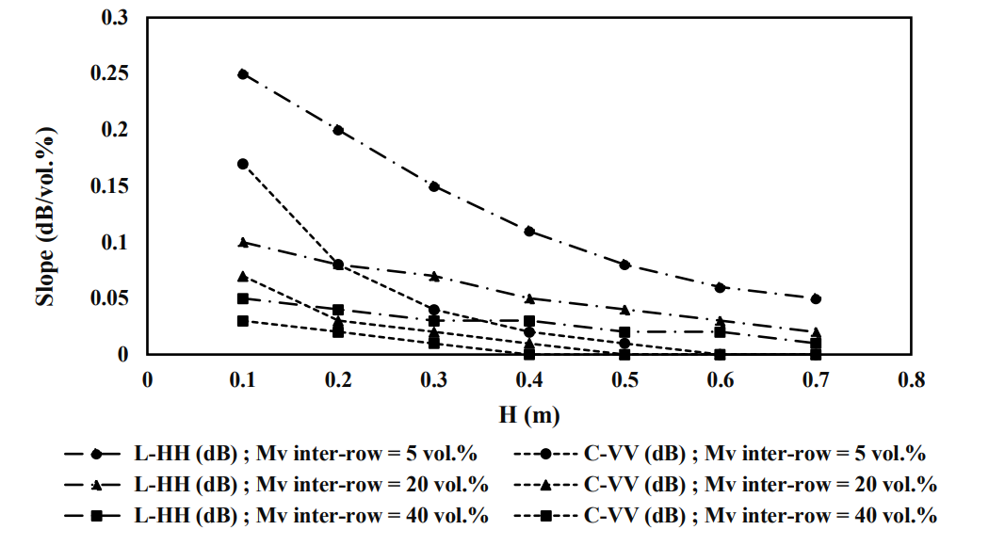
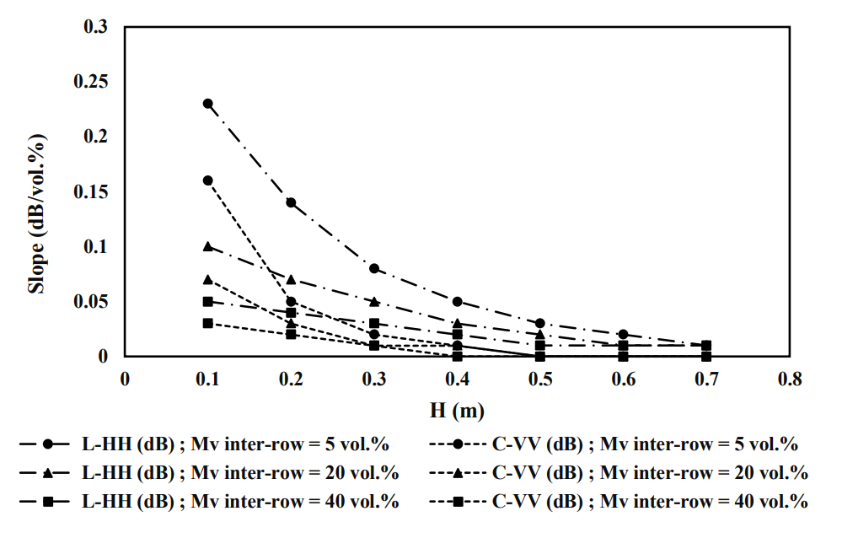
Modified WCM simulations
Fc = 0.3
Fc = 0.1
Fc = 0.6
The modified WCM, using L-HH data, remains sensitive to soil moisture as function of the increase pepper height and the inter-rows soil water content.
The C-VV signal becomes insensitive to soil moisture with the vertical development of pepper plants.
The vegetation backscattering contribution increases with the pepper growth regarding the decrease of bare soil impact
Ayari, E.; Kassouk, Z.; Lili-Chabaane, Z.; Baghdadi, N.; Zribi, M. Investigation of Multi-Frequency SAR Data to Retrieve the Soil Moisture within a Drip Irrigation Context Using Modified Water Cloud Model. Sensors 2022, 22, 580. https://doi.org/10.3390/s22020580

Slide 10
Thank you for your attention

