Slide 1
Unraveling the uncertainties of bulk-derived heat fluxes:
a case study for the Southern Ocean
David Hagman Master’s Student
Notes:
Hello and welcome to my presentation! My name is David Hagman and today I will be presenting my thesis called Unraveling the uncertainties of bulk-derived heat fluxes: a case study for the Southern Ocean

Slide 2
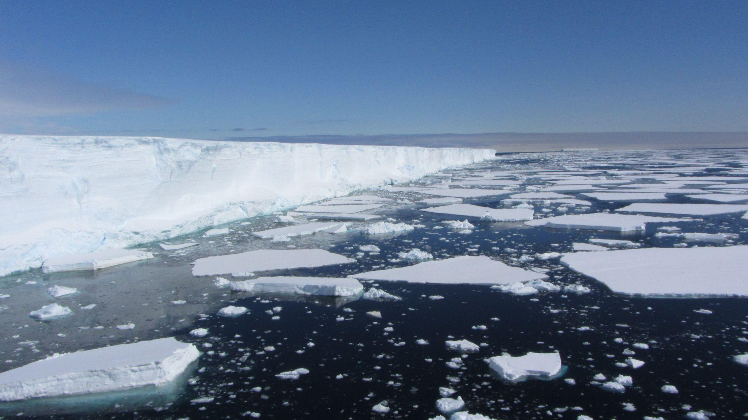
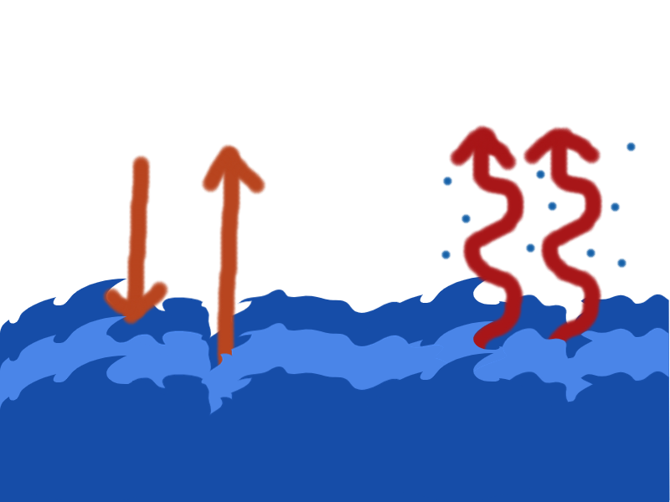
Main Points
Studied Net Heat Flux and its components
Southern Ocean in summer
Focus on seasonal ice zone (SIZ)
Q_{SW}
Q_{sensible}+Q_{latent}+Q_{LW}
In situ bulk heat fluxes vs ERA5 heat fluxes
Calculate bulk flux in situ (SHEBA)
Q_{net}= Q_{sensible}+Q_{latent}+Q_{SW}+Q_{LW}
-
+
Main result
Differing diurnal signals large effect
Details in extra material
Other findings and way forward
Notes:
In this project I used data from the Southern Ocean to study net heat flux and its components. The data from the Southern Ocean focused on observations within the seasonal ice zone during summer (where sea ice concentration is more than 15% at the time)
(click)
The collected data was then compared against the ERA5 reanalysis (And to clarify, reanalysis are a blend of observations assimilated into model forecasts, to give a continuously updating model.).
The in situ data collected was used to calculate bulk sensible and latent heat fluxes.
(click)
Sensible shown on the left here is the direct temperature transfer of molecules, and latent shown on the right here is heat lost or gained from phase changes - solid to gas/liquid.
Within sea ice the equations from the SHEBA experiment were used.
Once sensible and latent were calculated, this allowed a comprehensive comparison of the net heat flux and its components: sensible, latent , shortwave (written as SW here) and longwave (written as LW here). Longwave and shortwave was measured directly on the ship.
(click)
Their relationship is that shortwave is the main source of heat for the ocean, with sensible, latent and longwave often making the ocean lose heat.
(And in this presentation ocean gaining heat is a positive flux)
This allowed me to evaluate these 4 components (and the net) within the seasonal ice zone where observations are often limited.
(click)
What I found was that ERA5 shows a completely different diurnal signal for some of these fluxes, wich made different components either severely overestimated or underestimated. This causes the net heat flux to be far less accurate in ERA5 within the seasonal ice zone.
There were some other interesting things that will be expanded upon in my supplemental material.
But time is of the essence, so now I want to show you what these differences were in some figures.

Slide 3
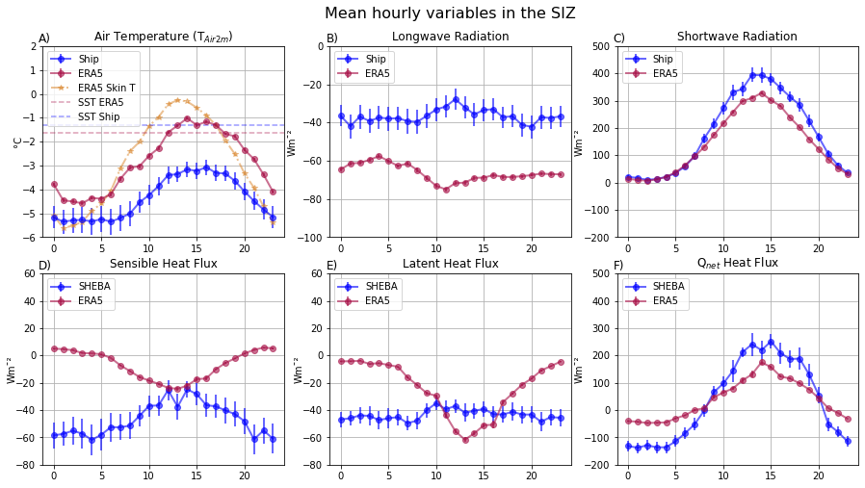
Results
Diurnal signal
A)
C)
E)
B)
D)
F)
= Q_{sensible}+Q_{latent}+Q_{SW}+Q_{LW}
Notes:
To highlight the diurnal differences, Data was binned on an hourly basis, with the dots being the median and the small lines denoting standard error. This helped highlight diurnal trends.
Starting at the top left in figure A), there are some notable diurnal behaviours in air temperature. The main lines are the air temperatures at 2 meters for ship and ERA5. I have also marked the mean SST for ship and ERA5, and this yellow-ish line is the skin temperature from ERA5. As we can see, these two both have a diurnal phase, where it reaches a peak around hour 15.
(click)
Moving into figure B) just below, we see the ship based SHEBA sensible heat flux, as the air temperature increases, the difference between air and sea temperatures decreases - so one can discern a decreased sensible heat flux around hour 13.
But when we compare this to ERA5, the diurnal signal is completely reversed around the same hour. We see in ERA5 air temperature being warmer than SST (which would signify a positive heat flux downwards) but we also see a high negative heat flux in the middle of the day.
the one thing I was able to investigate is the skin temperature. That is the Orange- slightly weaker line in the temperature figure up here . The skin temperature (or surface) in ERA5 becomes warmer than air around hour 8 (click)- the same time that the negative heat flux starts in ERA5. Which makes sense, since the transfer would then go from the skin/surface to the air - a negative upwards flux. But it needs more observations and comparisons to further evaluate this.
(click
There are some more oddities to go through though following up in figure C) - Longwave has a similar diurnal signal in both ERA5 and in ship sensors, but shows a far higher heat loss (as seen with the higher negative Watts per square meters). Both have a slight peak around hour 11 in opposite directions, but the main thing is the difference between them of 20-30 watts per square meters.
(click)
The latent heat flux seen in Figure D) has an even stronger heat loss for the same time in ERA5. Compared to the more constant heat loss seen from the SHEBA based latent heat flux.
(click)
Shortwave in figure E) has a smaller ocean heat gain in ERA5, but a similar diurnal signal yet again when compared to ship sensors. Keep in mind that ship shortwave was corrected by sea ice albedo for this evaluation ( - but not for clouds. The same goes for longwave, ship observations did not take cloud formation into account for either of these fluxes)
(click)
All these differences together show up in the net heat flux in Figure F), the combination of all four components(click) with a small reminder here. All in all this shows an difference in heat gain around hour 10 (click) to 18 in the net heat flux, with ship observations showing about 100 watts per square meters more. And between hour 20 to hour 7, the heat loss is severely lower in ERA5, with a similar magnitude of 100 watts per square meters. This has potentially big effects on the overall net heat flux.

Slide 4
Conclusion
Strong diurnal signal in ERA5 latent and sensible
Radiative fluxes in ERA5 poorly resolved
Net heat flux warm bias in seasonal ice zone
And more! heat loss events, SST discrepancy
Notes:
Sensible and latent heat fluxes showed themselves as a strong reverse diurnal signal that is still baffling to say the least. Why this happens or how ERA5 calculates these things are relevant ways to continue investigating it, or if you have any ideas or thoughts on what may cause this.
(click)
Shortwave and longwave fluxes are not well resolved in ERA5, possibly due to cloud formation being difficult in reanalyses, and sea ice albedo may also factor in. Yet again, further investigation in how ERA5 resolves it compared to ship observations would be very interesting.It is worth noting that ERA5 assimilates the in situ data from these ship observations. This means the biases presented here could potentially be even stronger.
(click)
All in all, the underestimated (negative) turbulent heat fluxes make the total net heat flux warmer, or warm biased in the seasonal ice zone. This effect can change the seasonal shift by up to a month. ((As has been shown in a previous study as well by Yu et al. 2019))
The main thing is that further observations are needed to evaluate and validate reanalyses in the Southern Ocean
(click)
There are still some bonus bits like the observed short term heat loss events that were significant for the total sensible and latent fluxes during the cruise, and ERA5 resolving SST under sea ice compared to ship observations. But that will all be found in the supplemental material video.

Slide 5
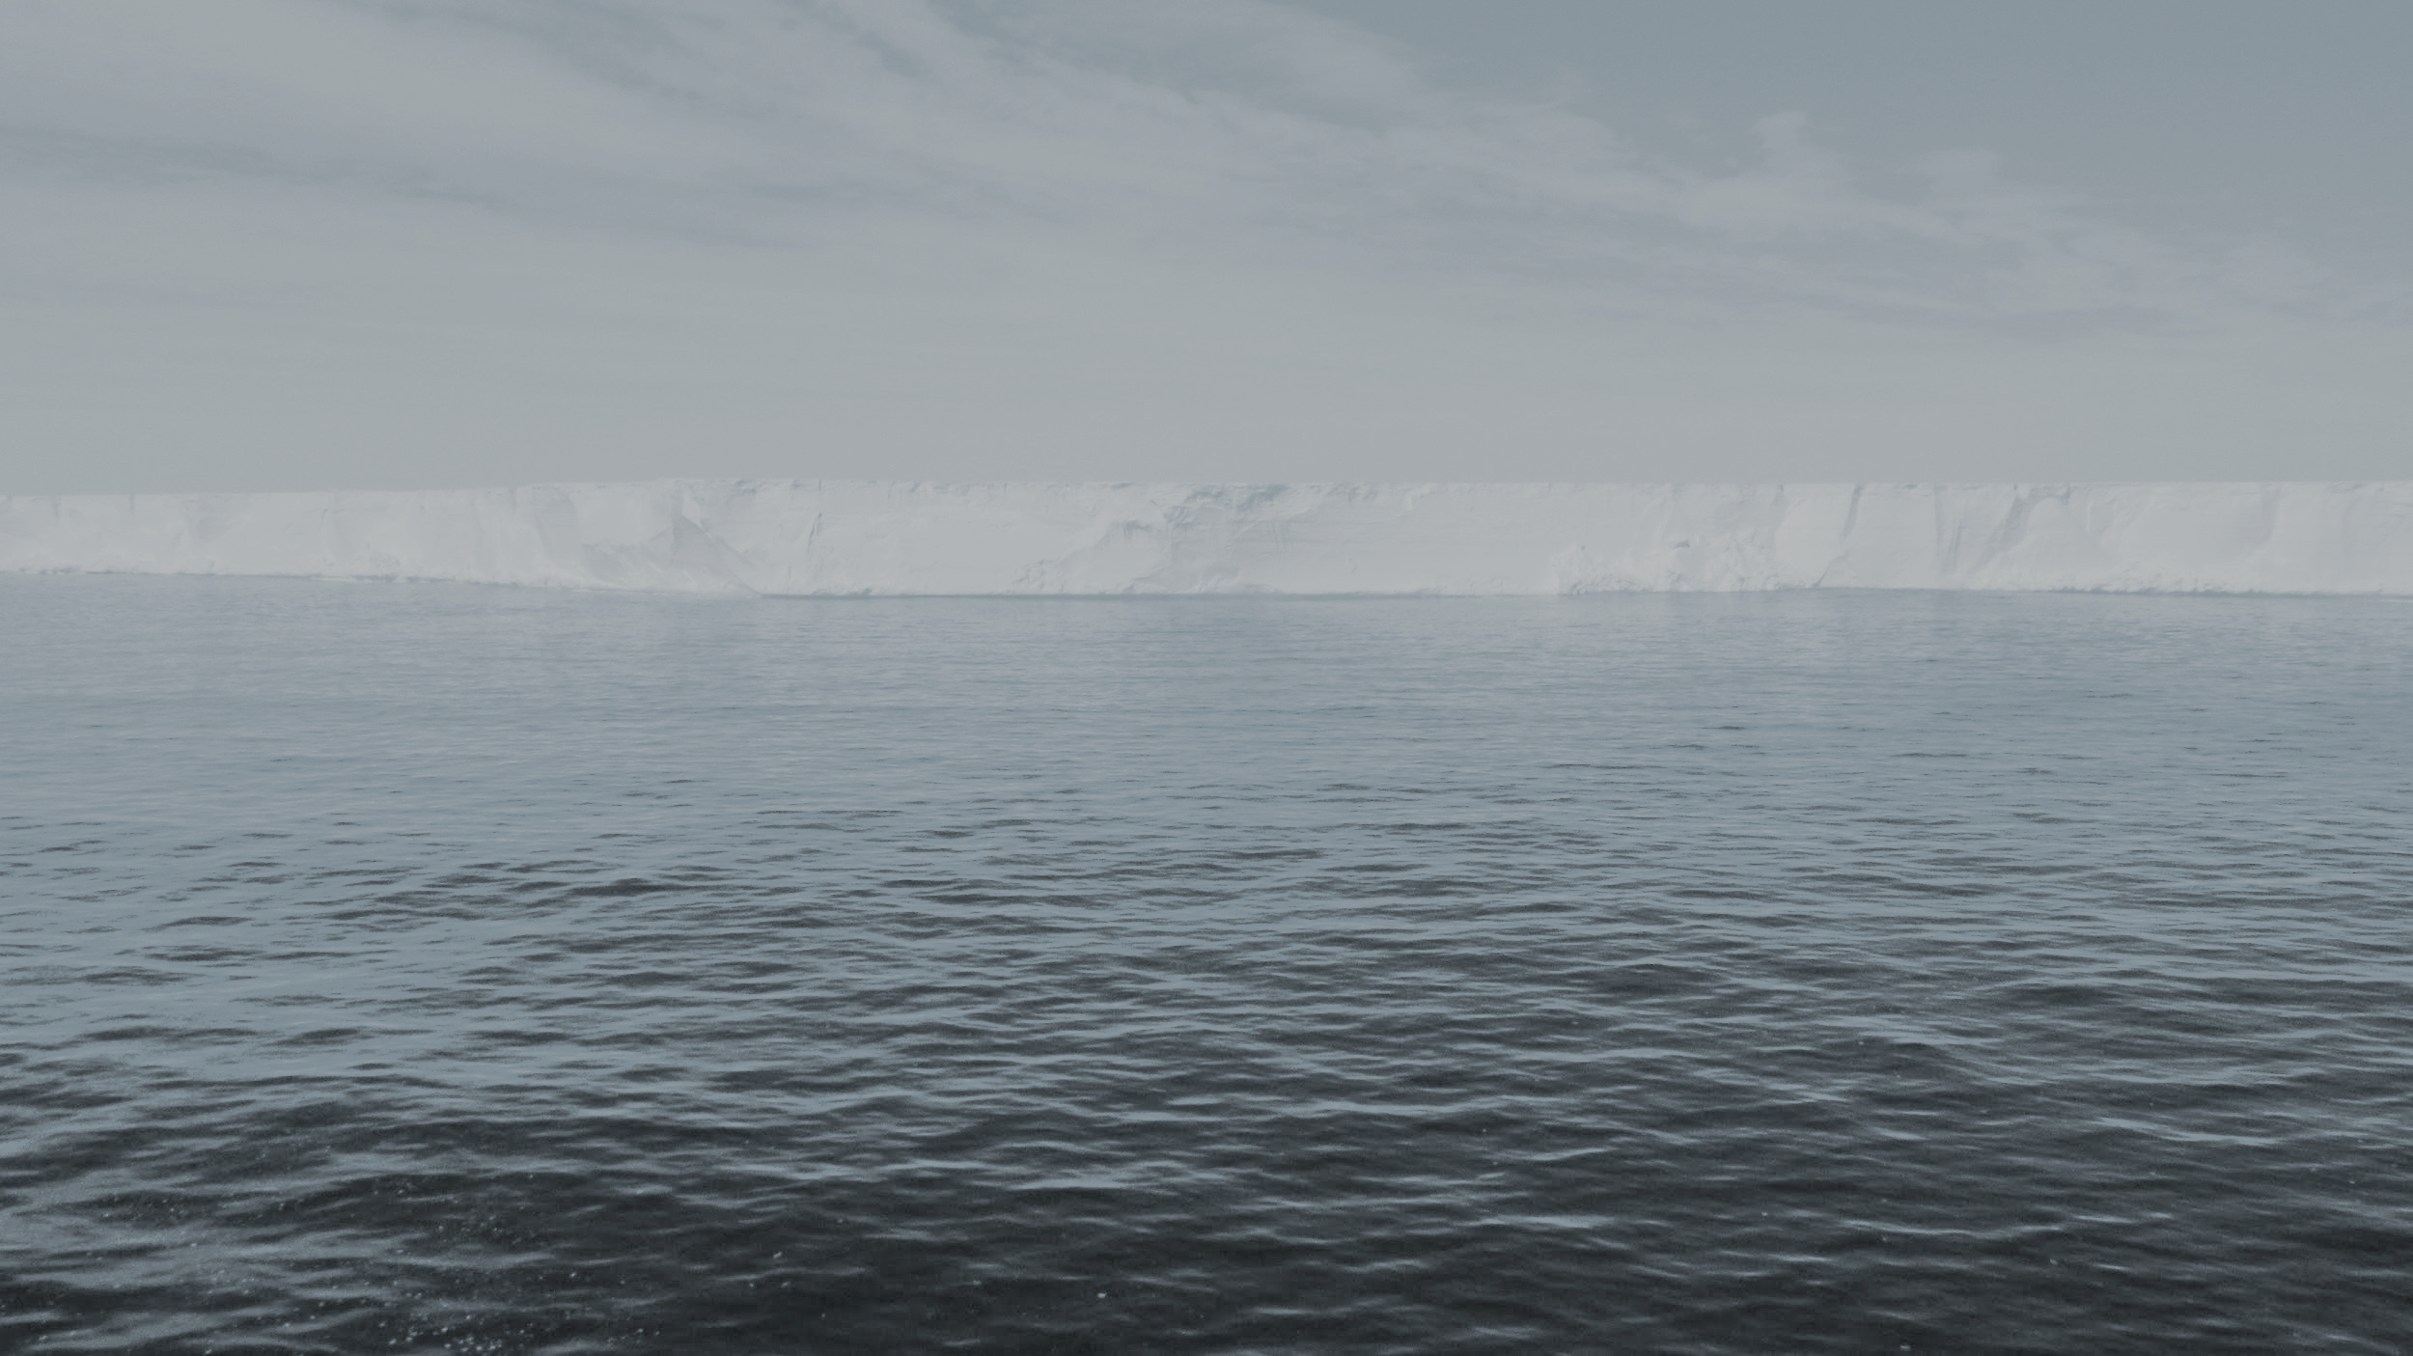
Thank you for listening!
Questions/discuss?
Send to: david.hagman.7@gmail.com
Notes:
I want to extend a final thank you for your time and attention. If you have any questions or want to discuss this further I am available on my main e-mail address shown here.
I have also provided supplemental information in the form of a 30 minute presentation that goes into more detail about my findings. You can find it linked to this presentation, and you can see the youtube link here below.

