Slide 1



Epidemic – Type Aftershock – Sequences (ETAS) model: the case of Arkalochori, Crete island, Greece
Hellenic Mediterranean University
Department of Electronic Engineering
Alexandra Moshou¹, Antonios Konstantaras¹, Panagiotis Argyrakis²
¹ Hellenic Mediterranean University, Department of Electronic Engineering, Faculty of Engineering
² University of West Attica, Department of Surveying and Geoinformatics Engineers, Faculty of Engineering

Slide 2


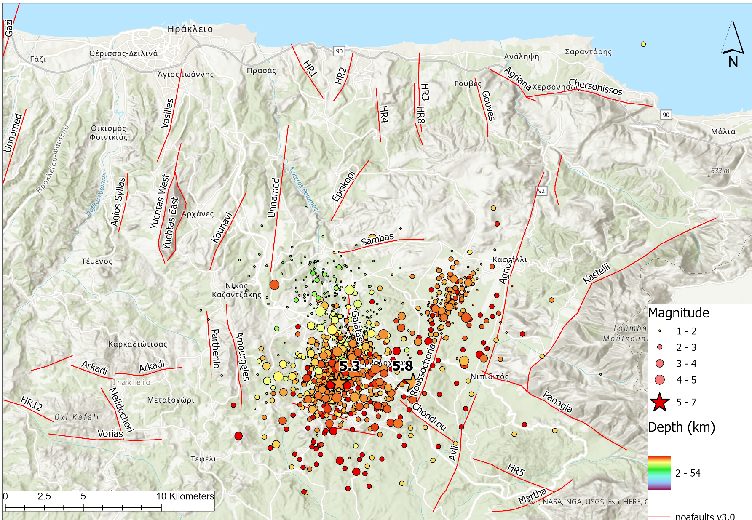
Study area – Data Selection
34.9062 ˚ < Lat < 35.3465 ˚
24.9802 ˚ < Lon < 25.5817 ˚
National Observatory of Athens Institute of Geodynamics
Fixed minimum magnitude as 1.0
From 01 May 2021 until 1 May 2022
Number of Events, N_{r} = 3.990
We skip the first 8 hours after the mainshock when fitting parameters to avoid the influence of missing aftershocks because of catalog incompleteness

Slide 3
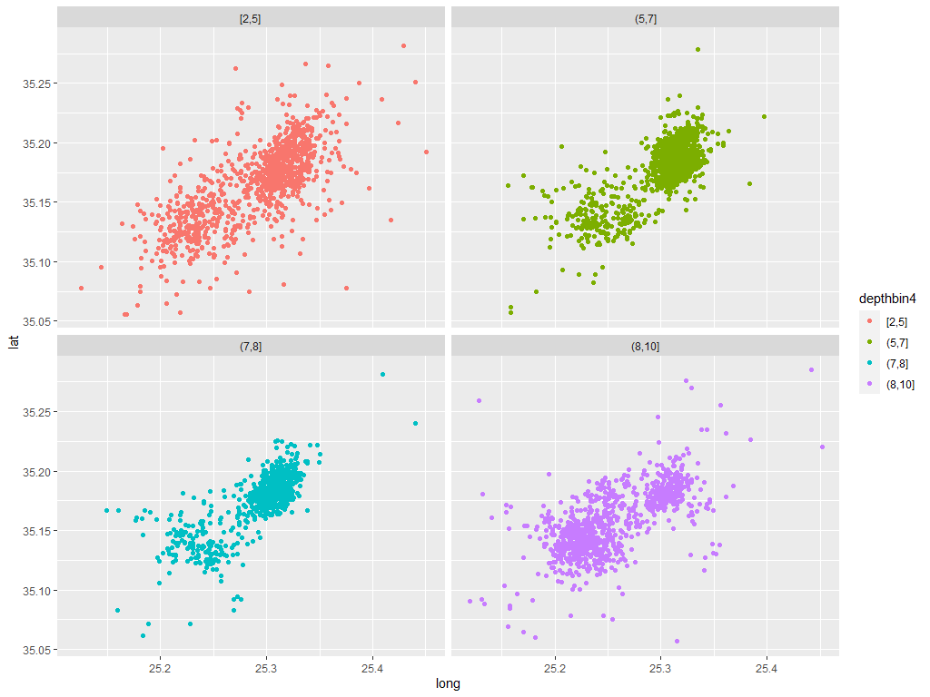
Epicenter Distribution relative to Depth
Epicenter distribution of earthquakes in Arkalochori village, Iraklion, Crete relative to the depth. Total number of events N = 3990

Slide 4

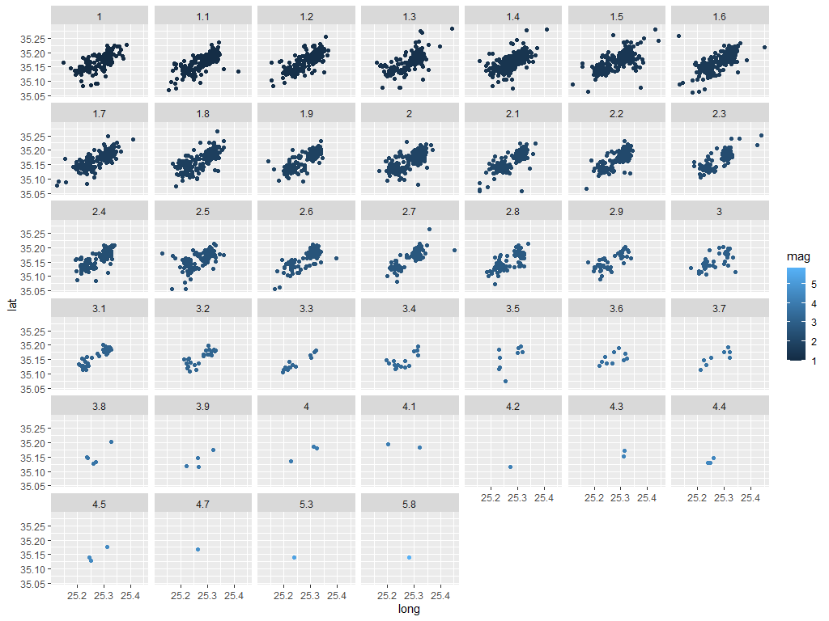
Epicenter Distribution relative to Magnitude
Epicenter distribution of earthquakes in Arkalochori village, Iraklion, Crete concerning the magnitude. Total number of events:
N= 3990

Slide 5
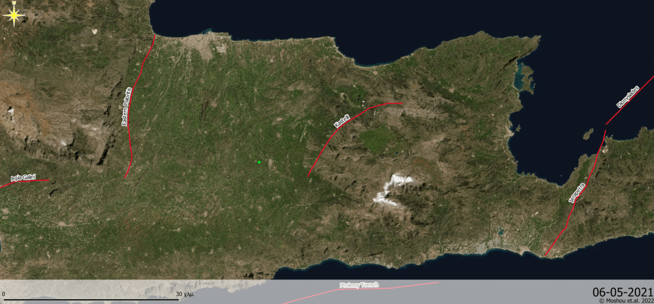
Seismicity in the area of ​​Arkalochori,
Crete Island, Greece: 01/05/2021 – 01/05/2022
Source:
Bbnet.gein.noa.gr. 2022. BBNET - Database of revised events (since 01/01/2008).
[online] Available at: <https://bbnet.gein.noa.gr/HL/databases/database> [Accessed 21 May 2022].

Slide 6


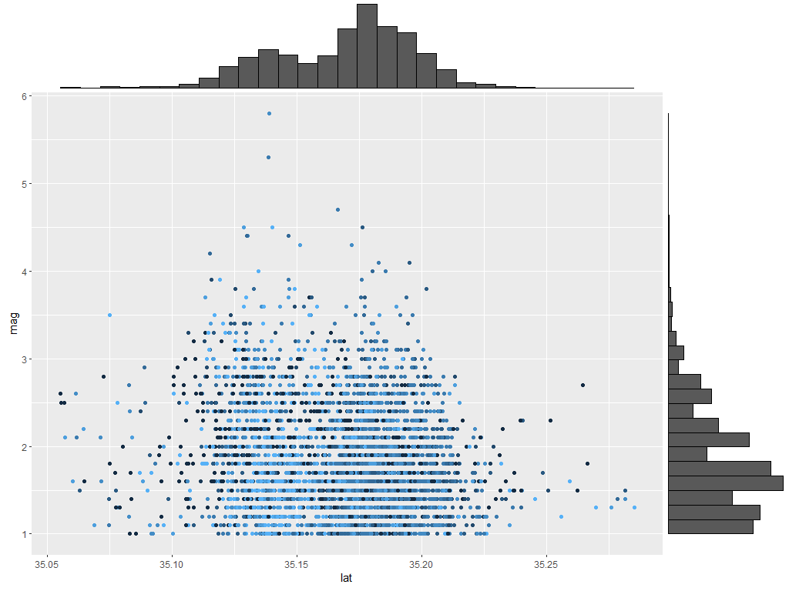
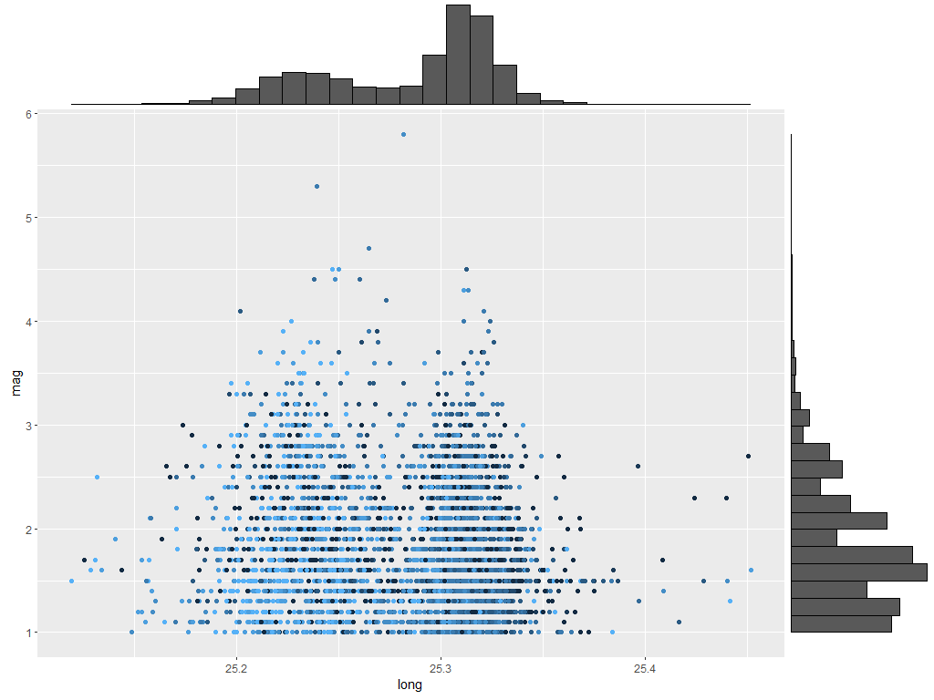
Spatio – Temporal Analysis of the Aftershock Sequence

Slide 7

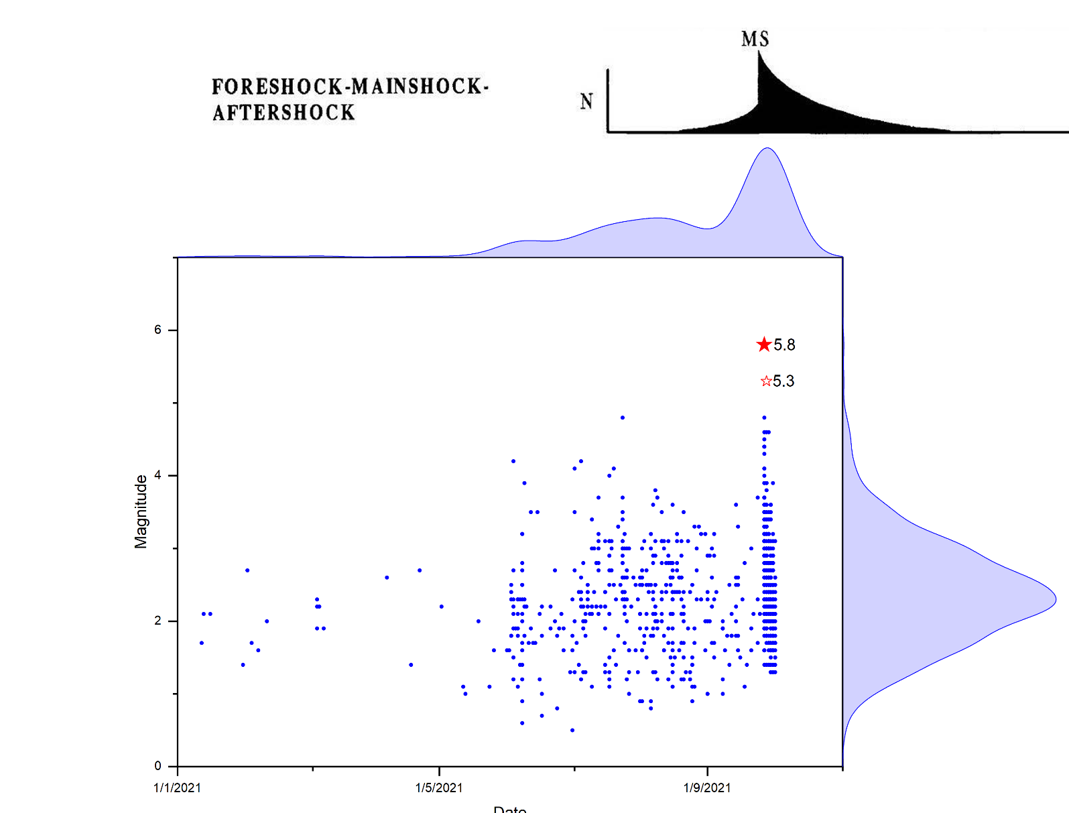
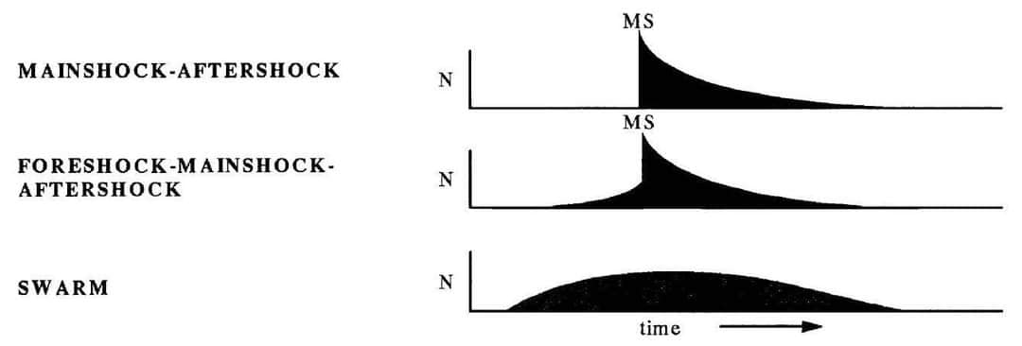
Distribution of the aftershock sequence:
27/09/2021 – 01/05/2022

Slide 8
Epidemic – Type Aftershock Sequence (ETAS)
Fits the space-time Epidemic Type Aftershock Sequence
('ETAS') model to earthquake catalogs using a stochastic 'declustering’ approach. The 'ETAS' model is a 'spatio-temporal' marked point process model and a special case of the 'Hawkes' process. The package is based on a Fortran program
which is modified and translated into C++ and C such that it
can be called from R. Parallel computing with 'OpenMP' is possible
on supported platforms.
https://github.com/jalilian/ETAS

Slide 9
Epidemic – Type Aftershock Sequence (ETAS)
The theoretical study of earthquake sequences is built on a solid mathematical foundation that provides an analytical method to model and analyzes the occurrence.
The Epidemic Type Aftershock Sequence (ETAS) is a well-known statistical seismology model that scientists use to evaluate earthquakes from a probabilistic perspective [Ogata, 1988, 1989, 1998, 1999]. It's a linear self-exciting Hawkes process, to be precise. The ETAS model is built on a branching process in which each event in a generation can develop its own progeny, independent of the other shocks. Ogata's first version was solely temporal, but after a few years, he refined the model by including geographical locations as well.

Slide 10
Epidemic – Type Aftershock Sequence (ETAS)
The space-time epidemic – type aftershock sequence (ETAS) model is a stochastic process in which seismicity is classified into background and clustering components, and each earthquake triggers other earthquakes independently according to some rules
Based on the point process, the ETAS model extends the Omori–Utsu formula (Utsu, 1961) and assumes that any aftershocks may trigger secondary aftershocks

Slide 11

Epidemic – Type Aftershock Sequence (ETAS)
Ogata (1988) developed the ETAS model, which accounts for stationary background seismicity and secondary aftershocks, based on the Omori–Utsu law (Utsu and Ogata, 1995). With space-time models being developed by incorporating both location and occurrence time data (e.g., Ogata, 1998; Zhuang et al., 2002; Zhuang and Ogata, 2006), the ETAS model has been widely and successfully used to quantify the clustering patterns of seismicity (e.g., Helmstetter et al., 2006; Lombardi et al., 2010; Zhuang et al., 2018). Guo et al. recently created the FS-ETAS model from the space-time ETAS model, which incorporates fault geometry and rupture extensions (2017, 2019). The FS-ETAS model outperforms typical space-time point process models for clustering analysis, and as a result, we use the FS-ETAS model.

Slide 12
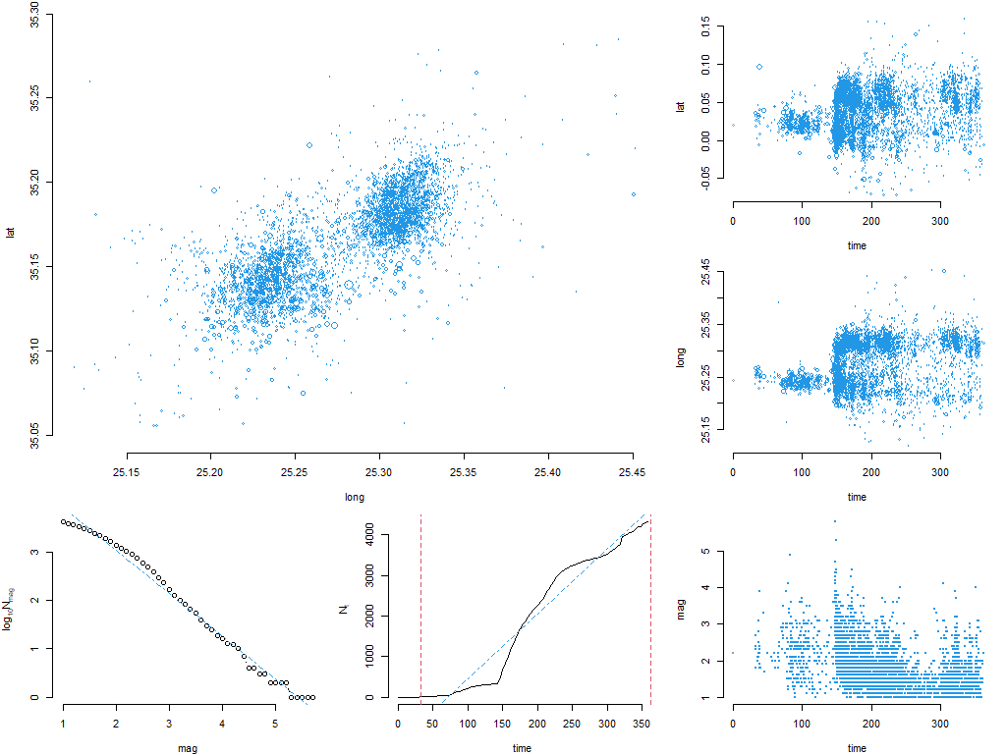
Statistical Analysis from the catalogue – ETAS
27/09/2021 –01/05/2022
N_{r} = 3.990
M_{c} = 1.0

Slide 13
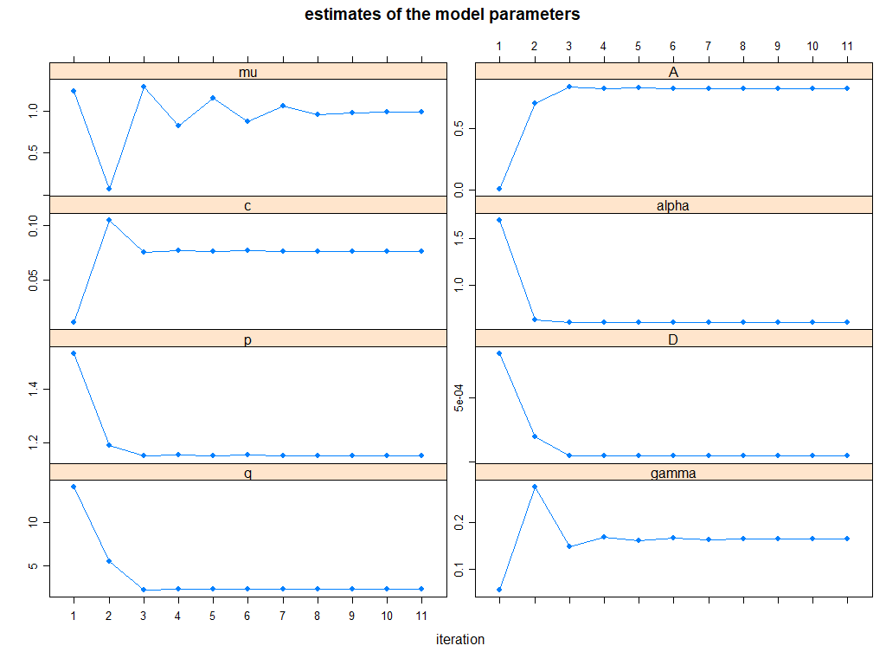
Estimate of the Model Parameters

Slide 14
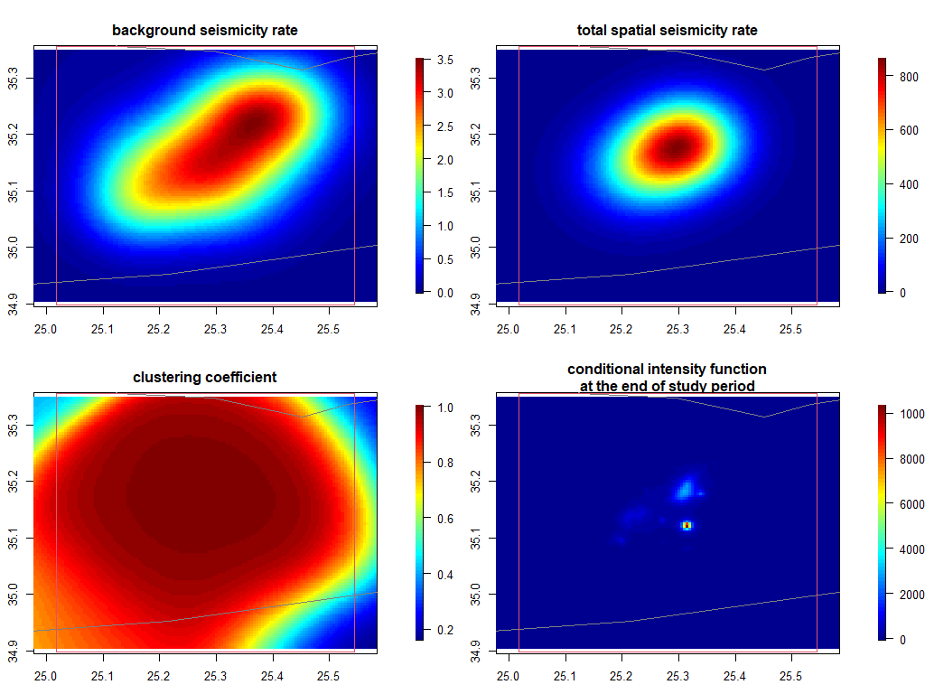
Estimation of the Background Seismicity Rate

Slide 15
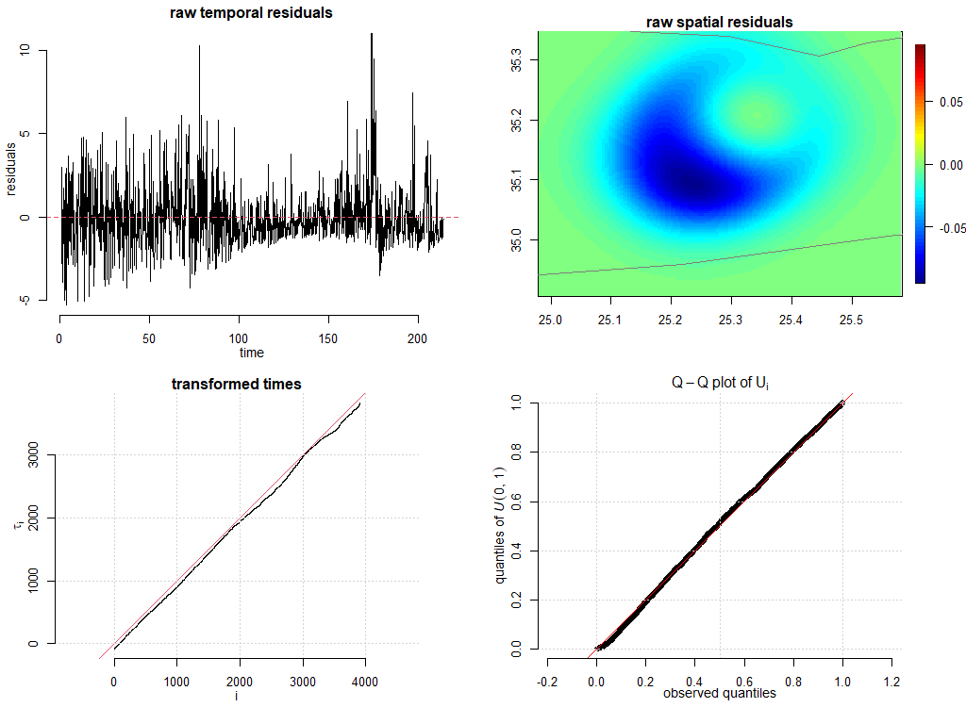
Spatio – Temporal Residuals

Slide 16

Thank you
Questions: amoshou@hmu.gr

