Slide 1

Products of Sedimentary Volcanism around Adamas Labyrinthus, Mars
Vojta Cuřín in cooperation with Petr Brož, Ernst Hauber and Yannis Markonis
Czech University of Life Sciences Prague

Slide 2
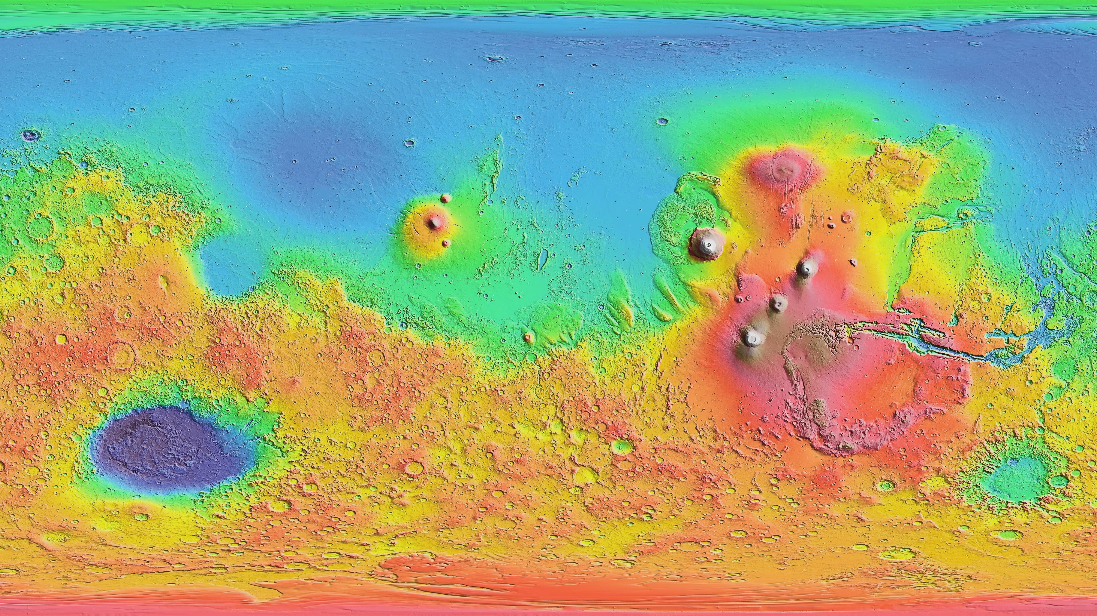
Utopia Planitia
Chryse
Planitia
Zhurong
Amazonis
Planitia
Elysium
Tharsis
Perseverance
NASA/JPL/GSFC

Slide 3
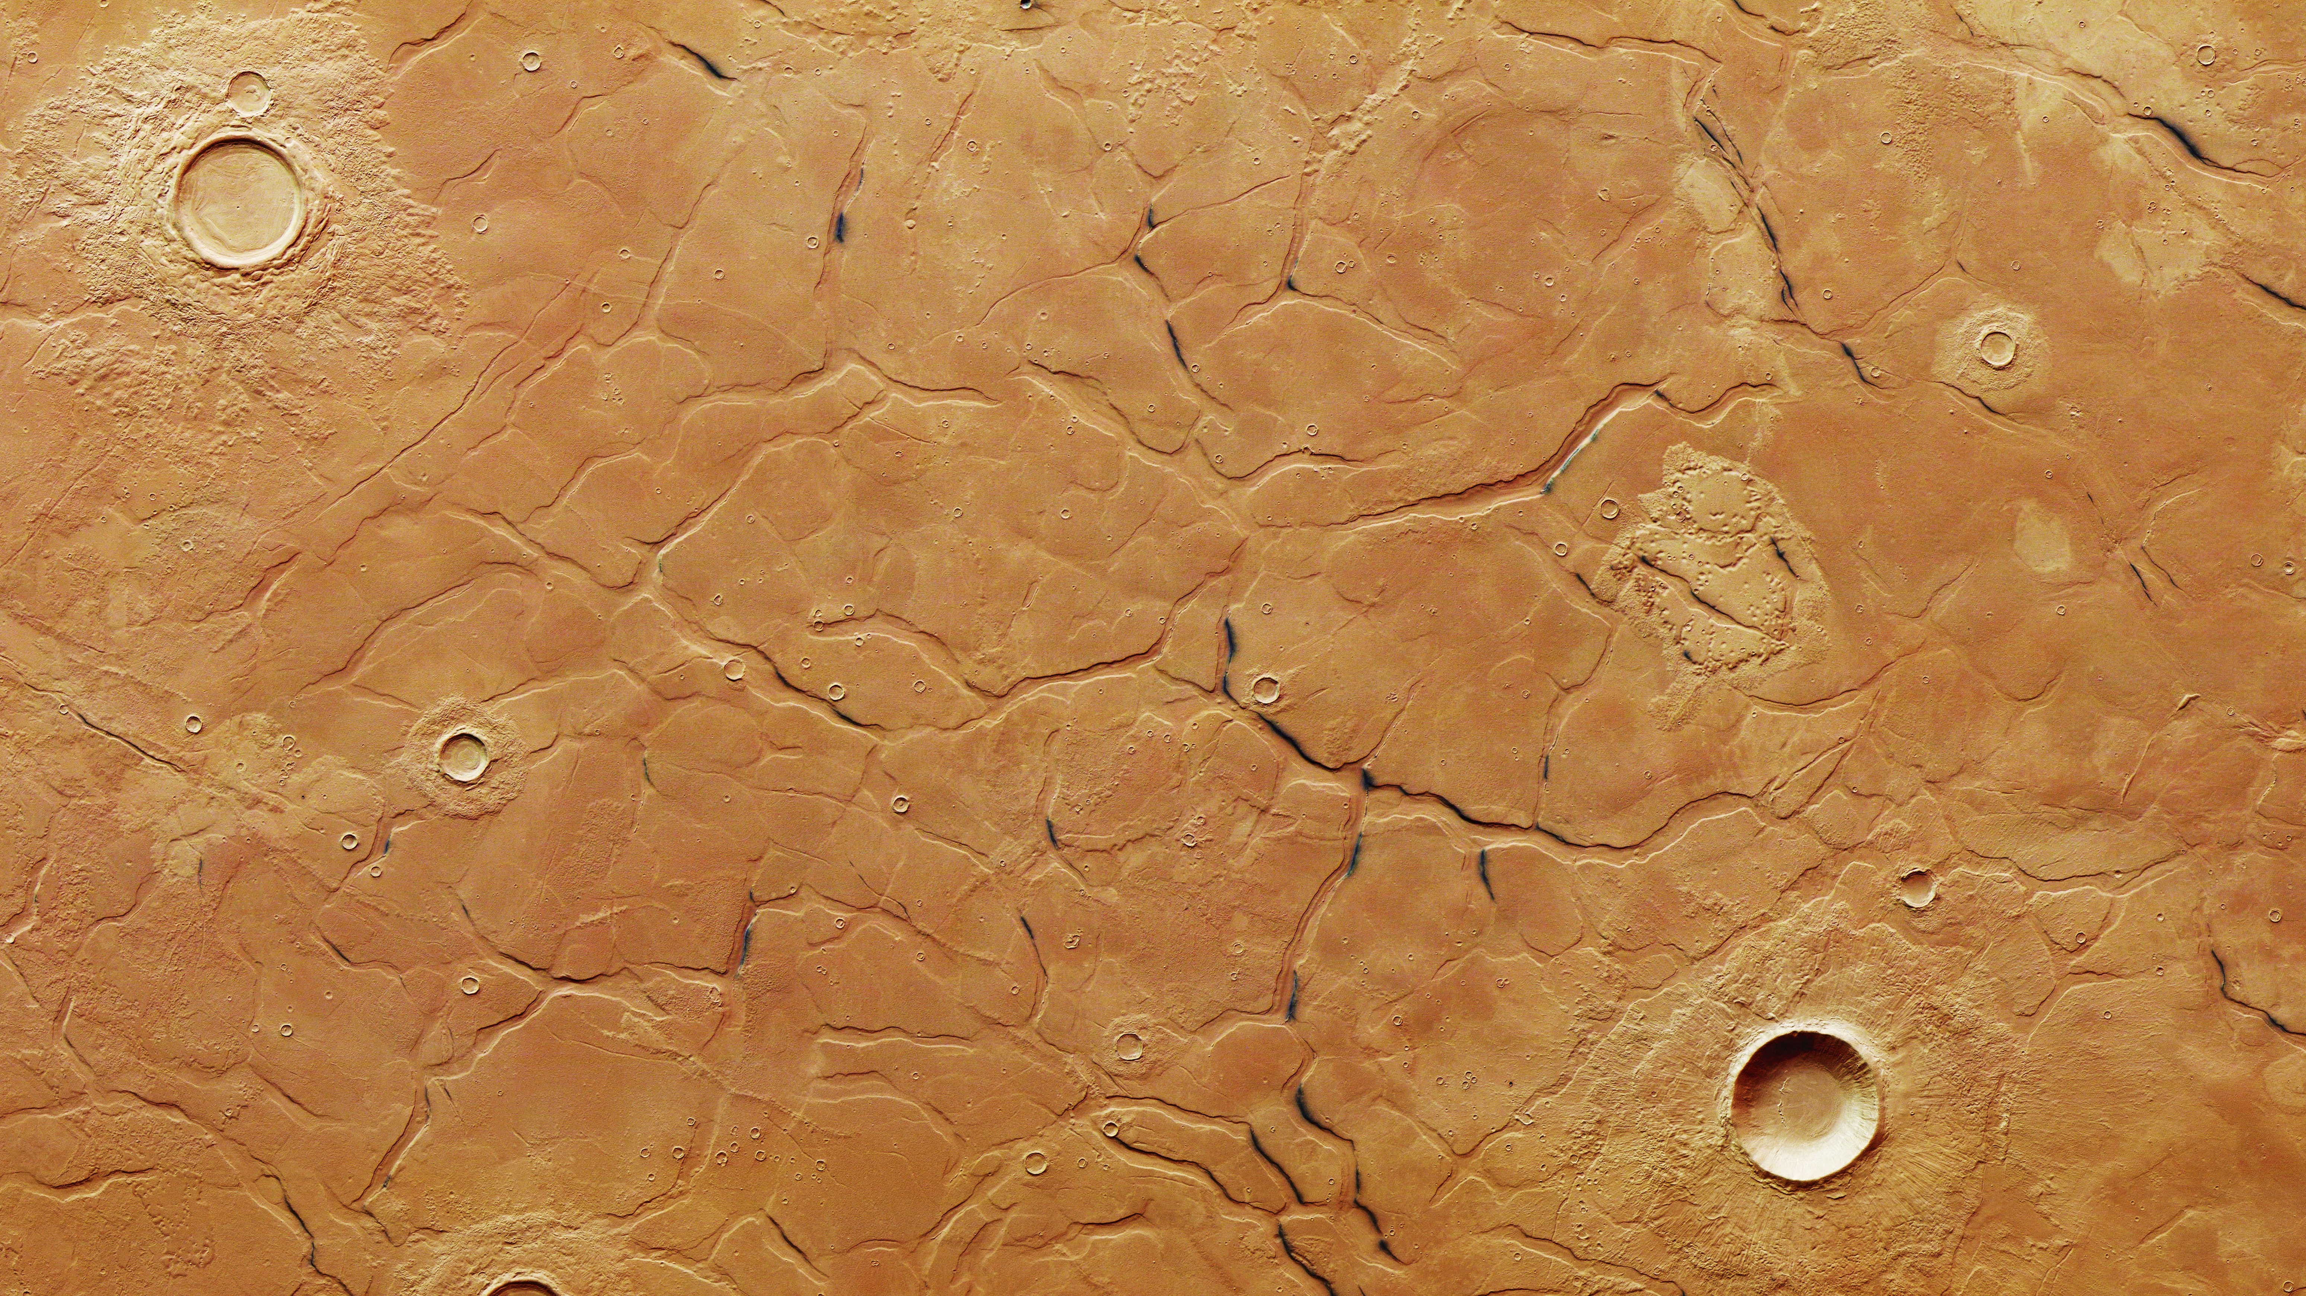
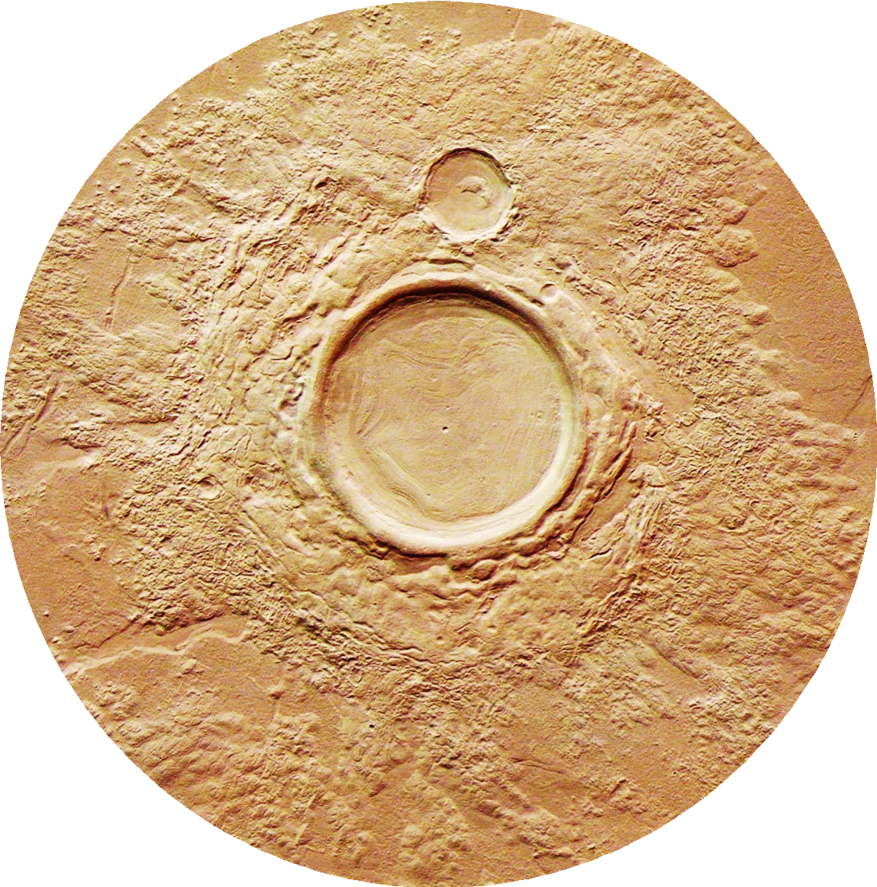
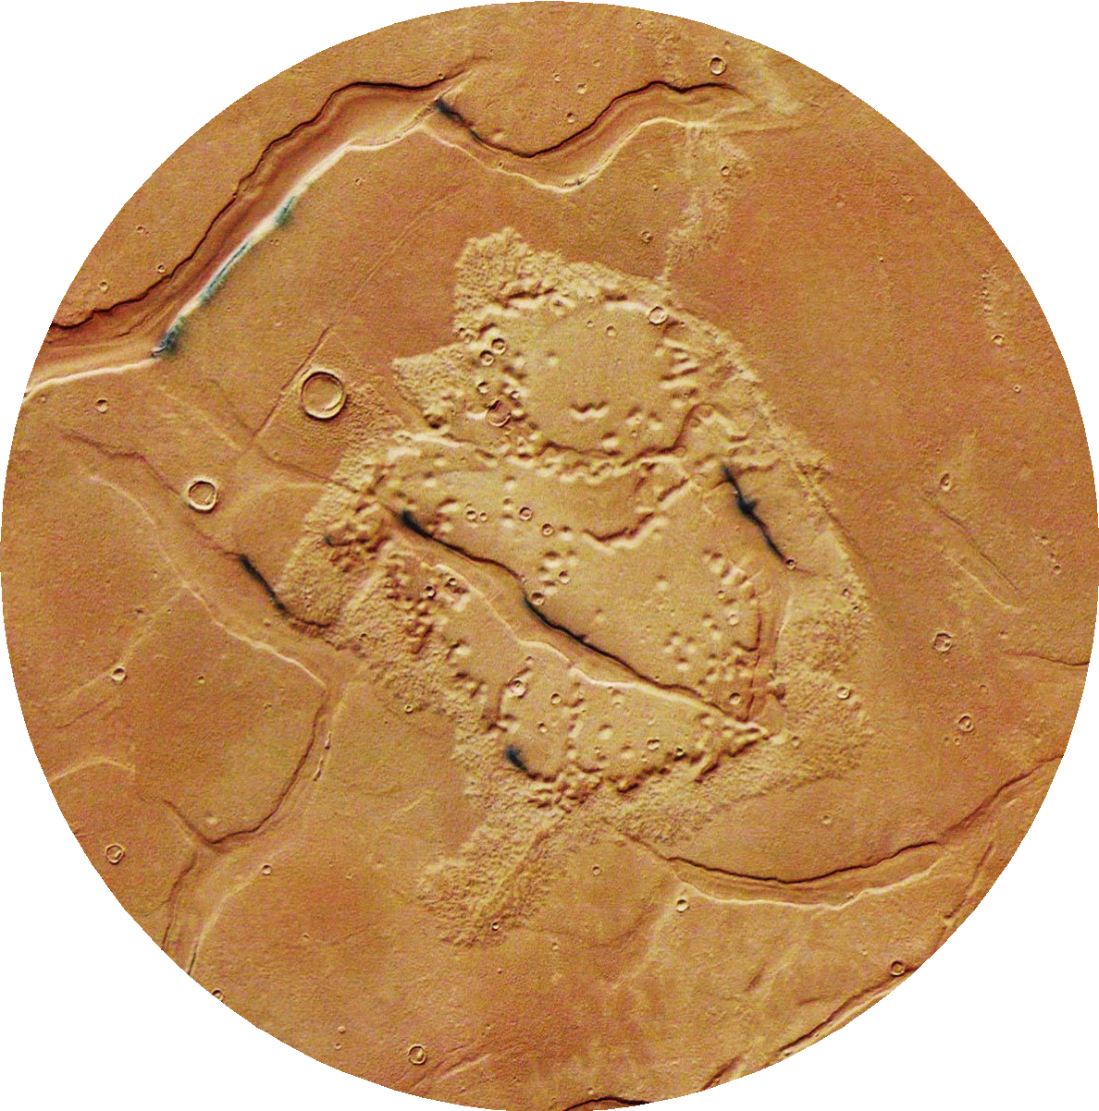
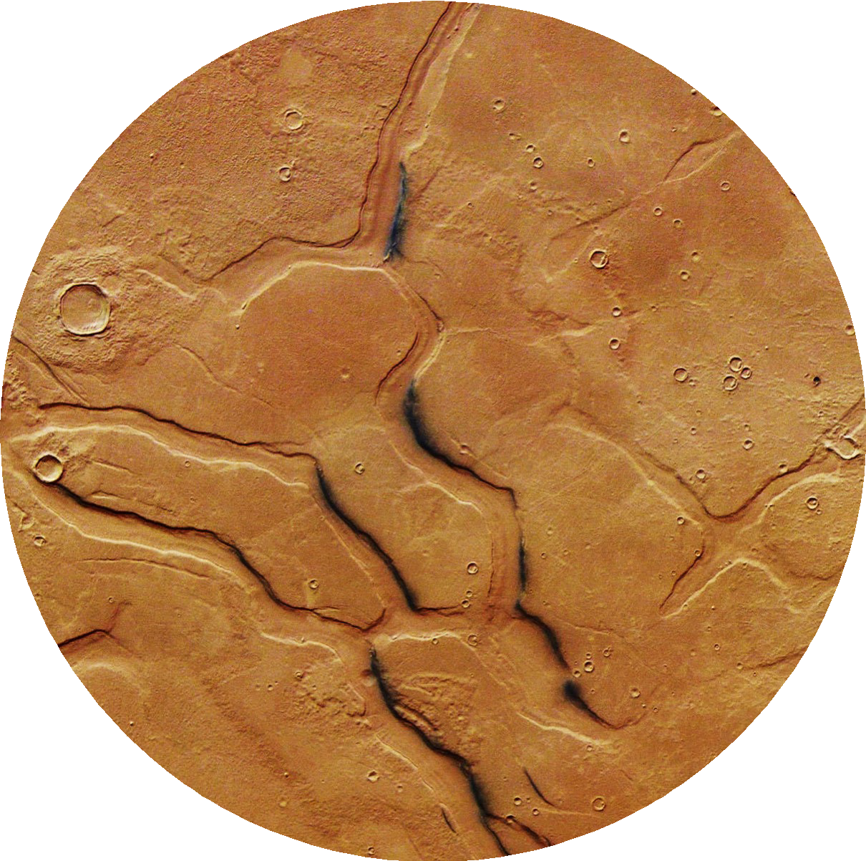
Adamas Labyrinthus
20 km
Concentric fill
Fluidized ejecta
10s of meters deep
Formation tied to volatiles
Flow-like morphology
OUR FOCUS!
ESA/DLR/FU Berlin

Slide 4
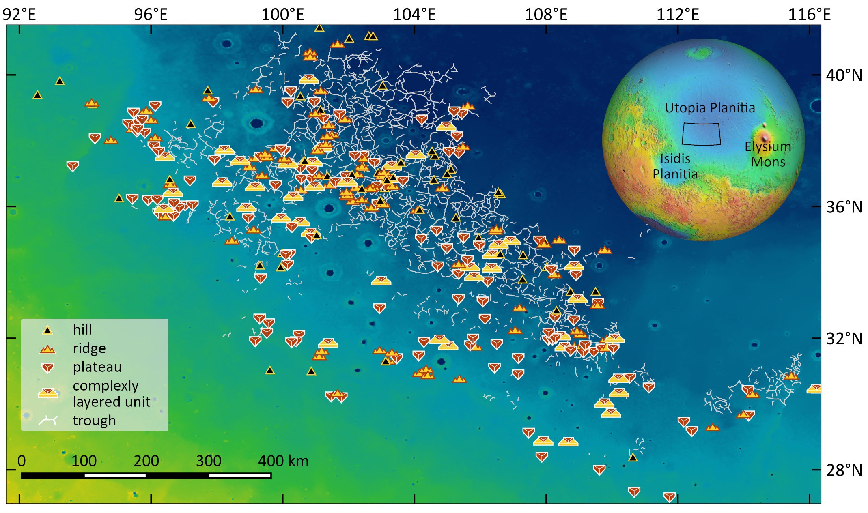
312 landforms, 4 classes
NASA/JPL/GSFC

Slide 5
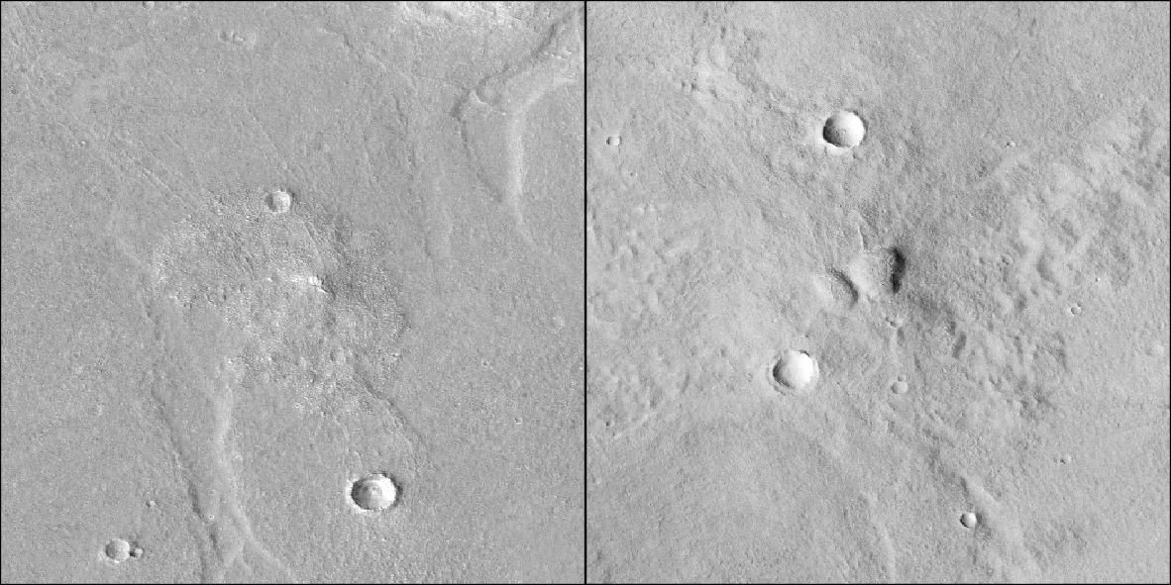
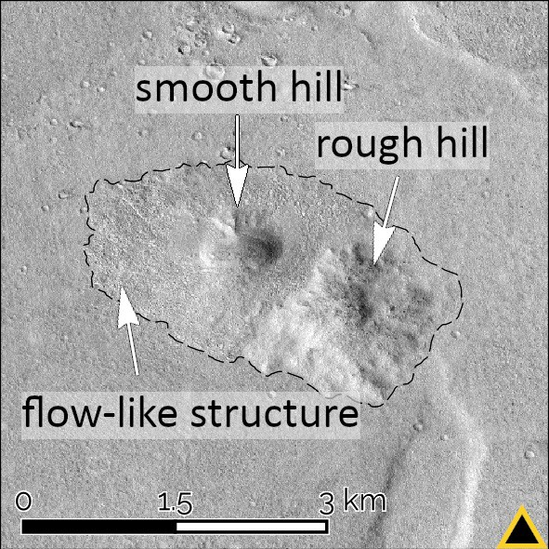

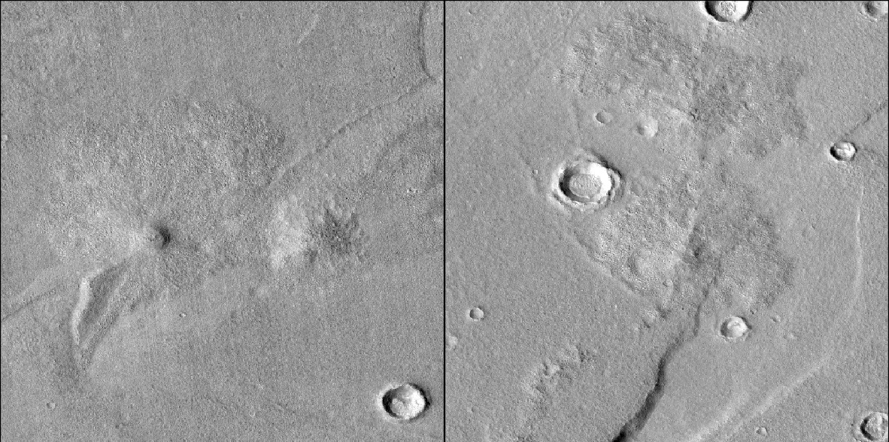
Hills d_{avg} ≈ 1,2 km, h_{avg} ≈ 35 m
NASA/CALTECH

Slide 6
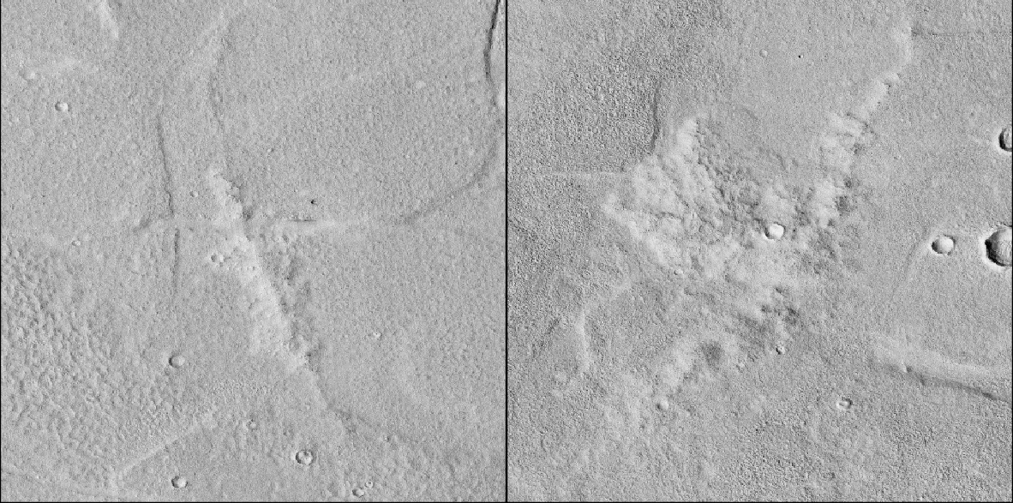
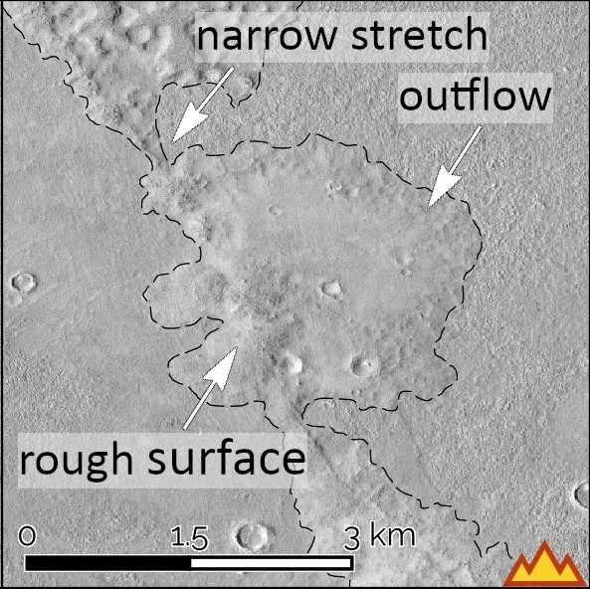
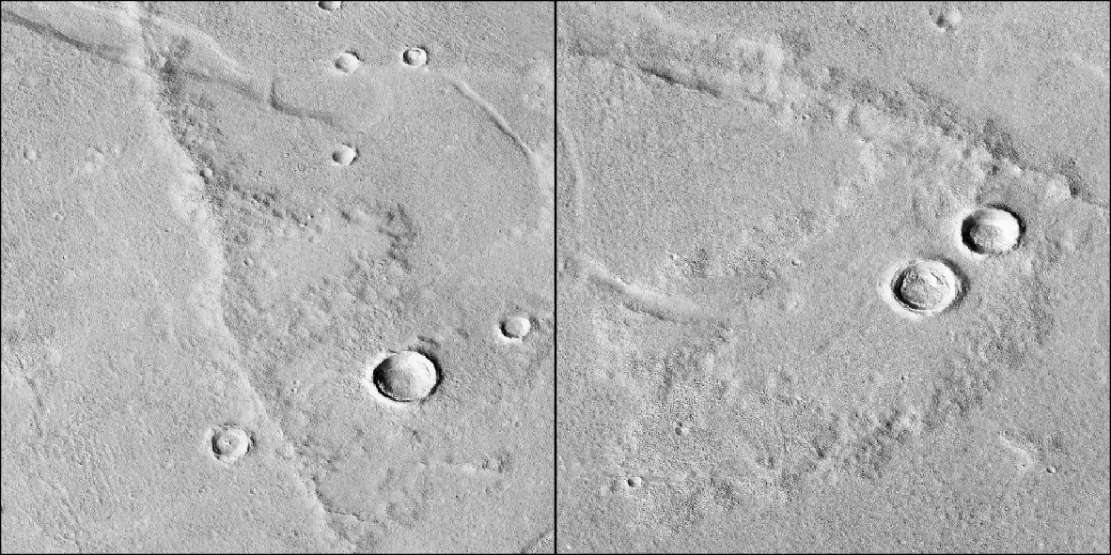
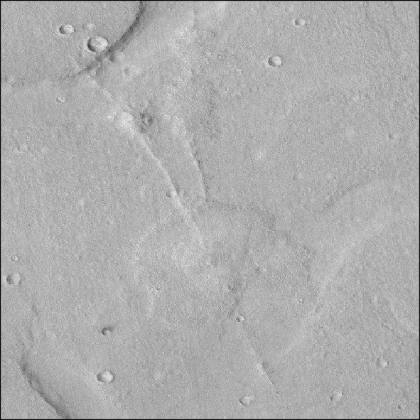
Ridges l_{avg} ≈ 6,6 km, h < 40 m
NASA/CALTECH

Slide 7
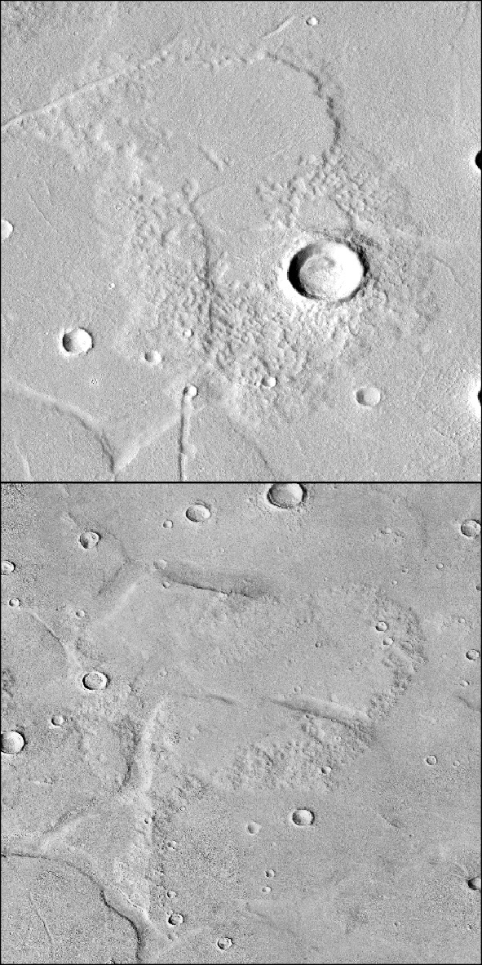
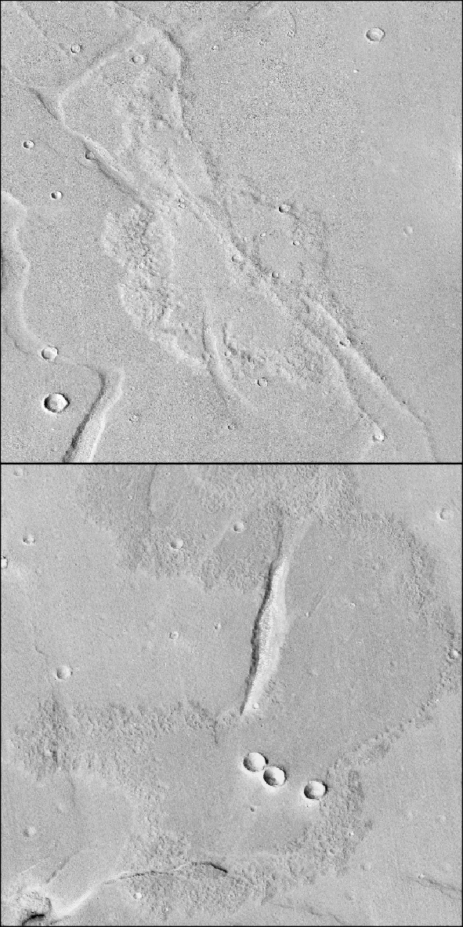
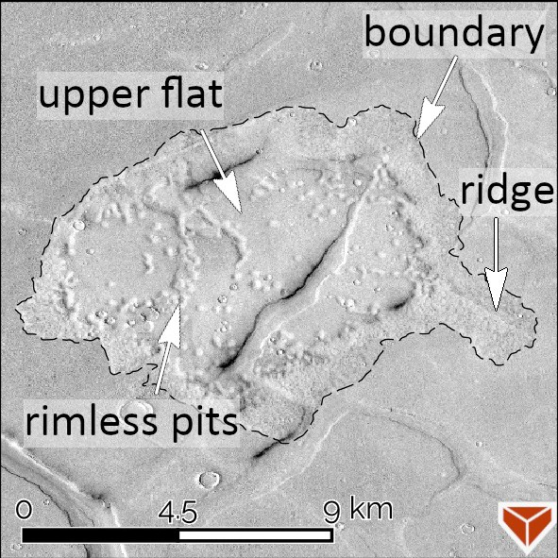


Plateaus a_{avg} ≈ 35 km², h ≈ 20-30 m
NASA/CALTECH

Slide 8
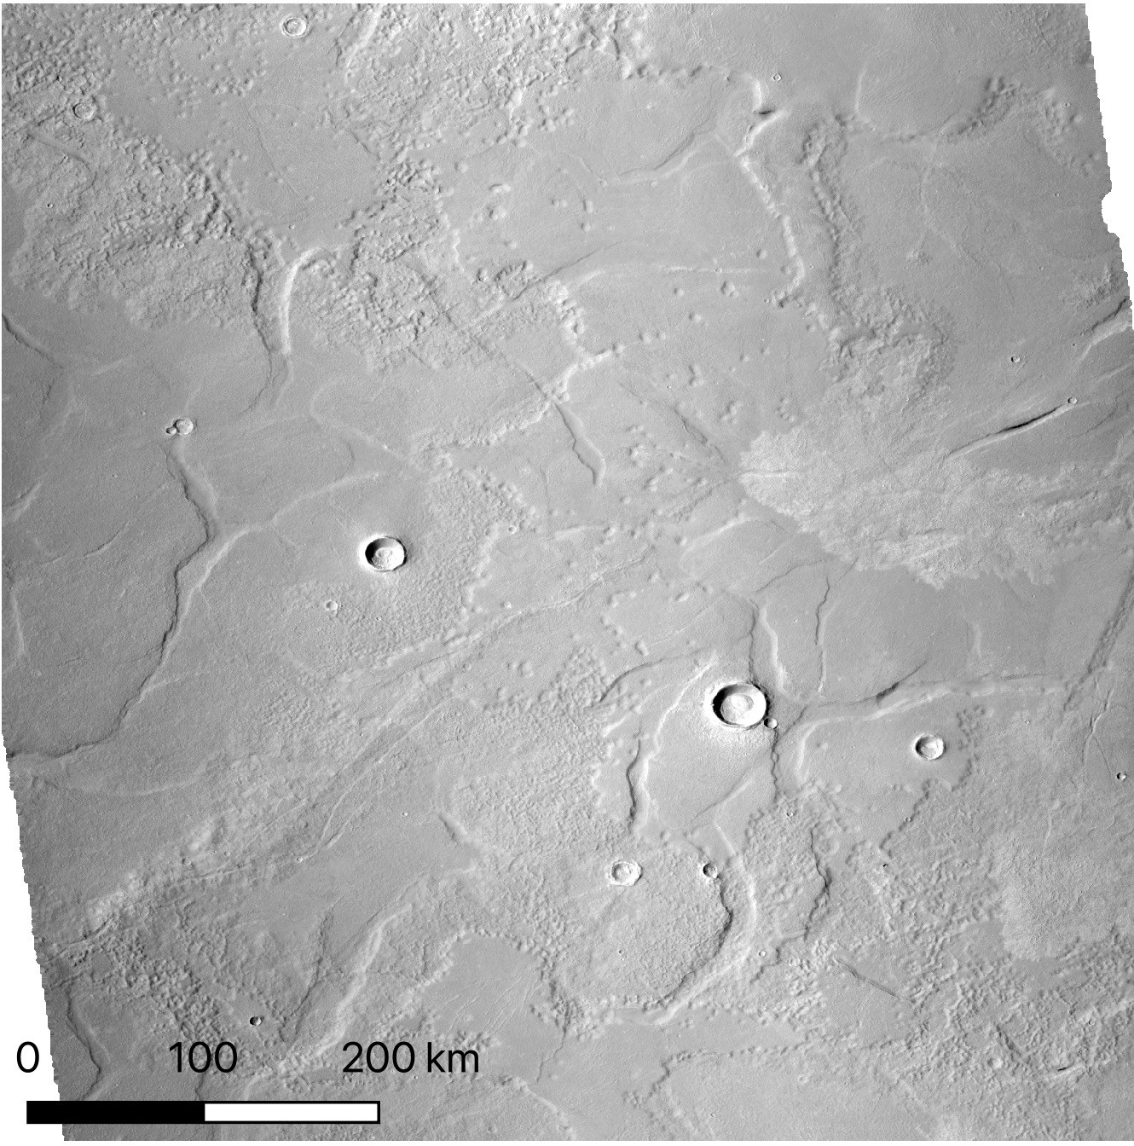
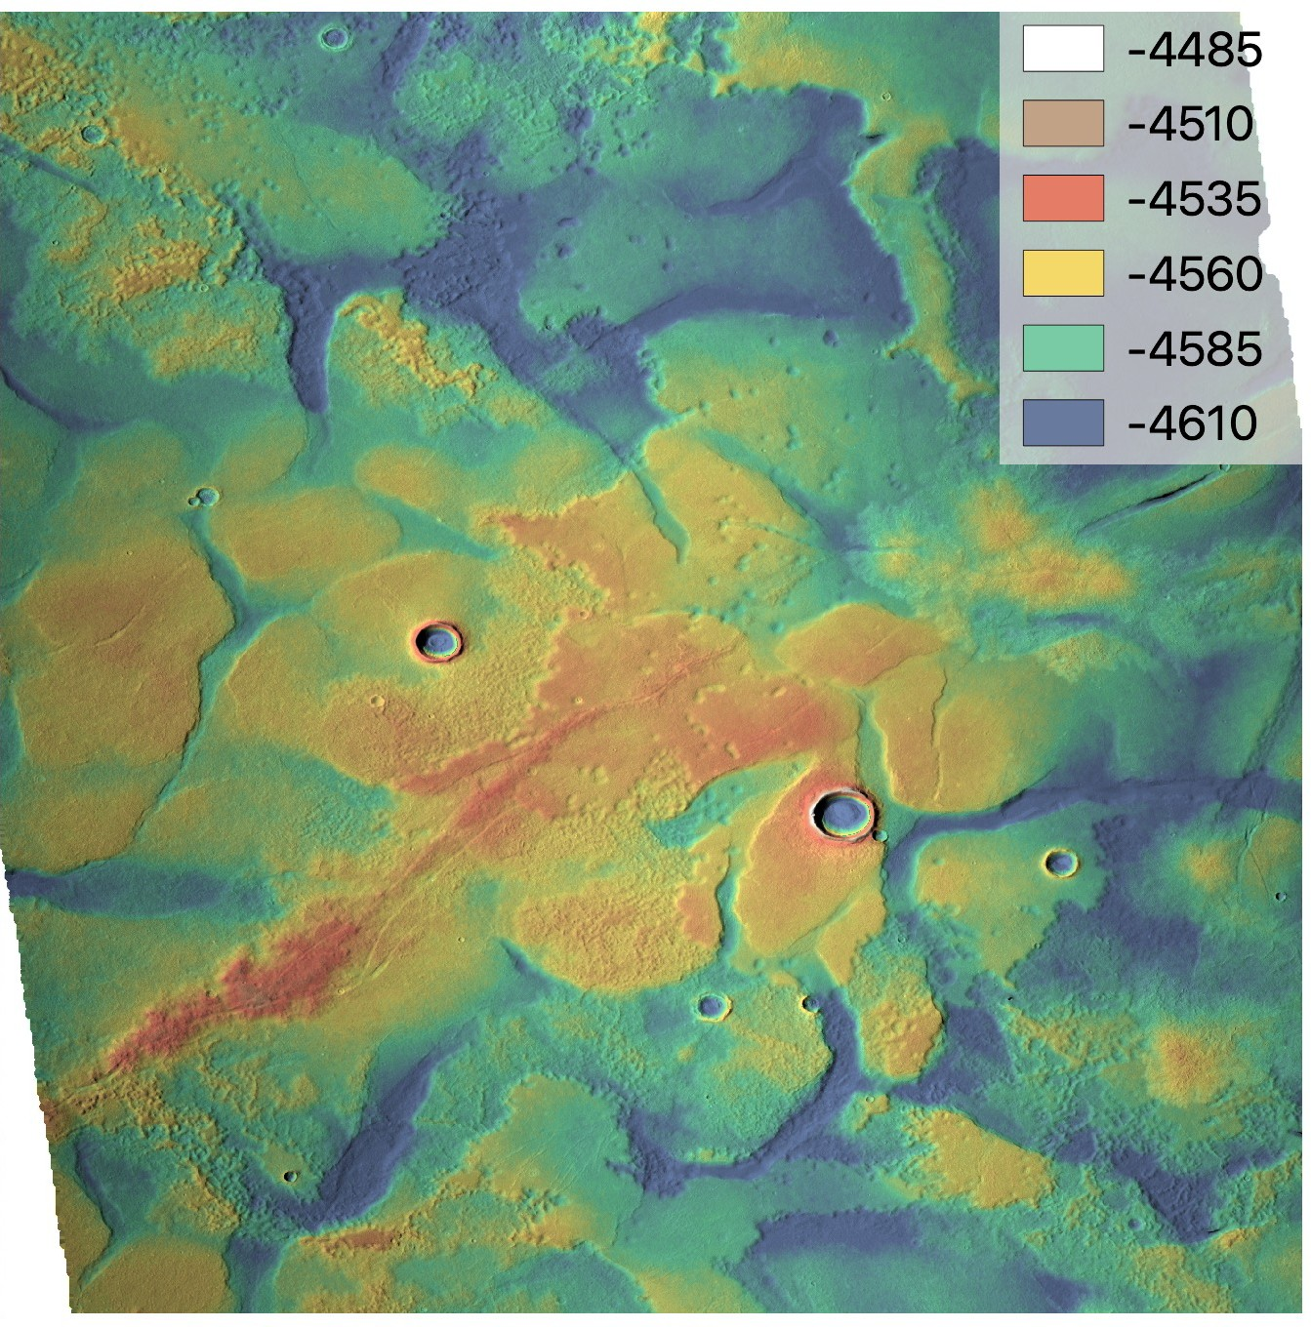
Complexly Layered Units
NASA/CALTECH/MarsSI

Slide 9
300+ landforms, 4 classes with evolutionary sequence among them. How did they form?
NASA/JPL/GSFC

Slide 10
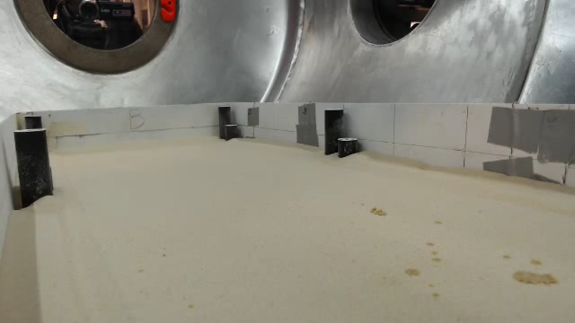
Igneous vs. Sedimentary
Morphological similarities to lava flows
BUT
No water-lava interaction evidence
Low viscosity mud in low p&T behaves similarly to pahoehoe
Location, elevation, latitude
Emplaced around the same time as giant polygons
Brož et al. 2020

Slide 11
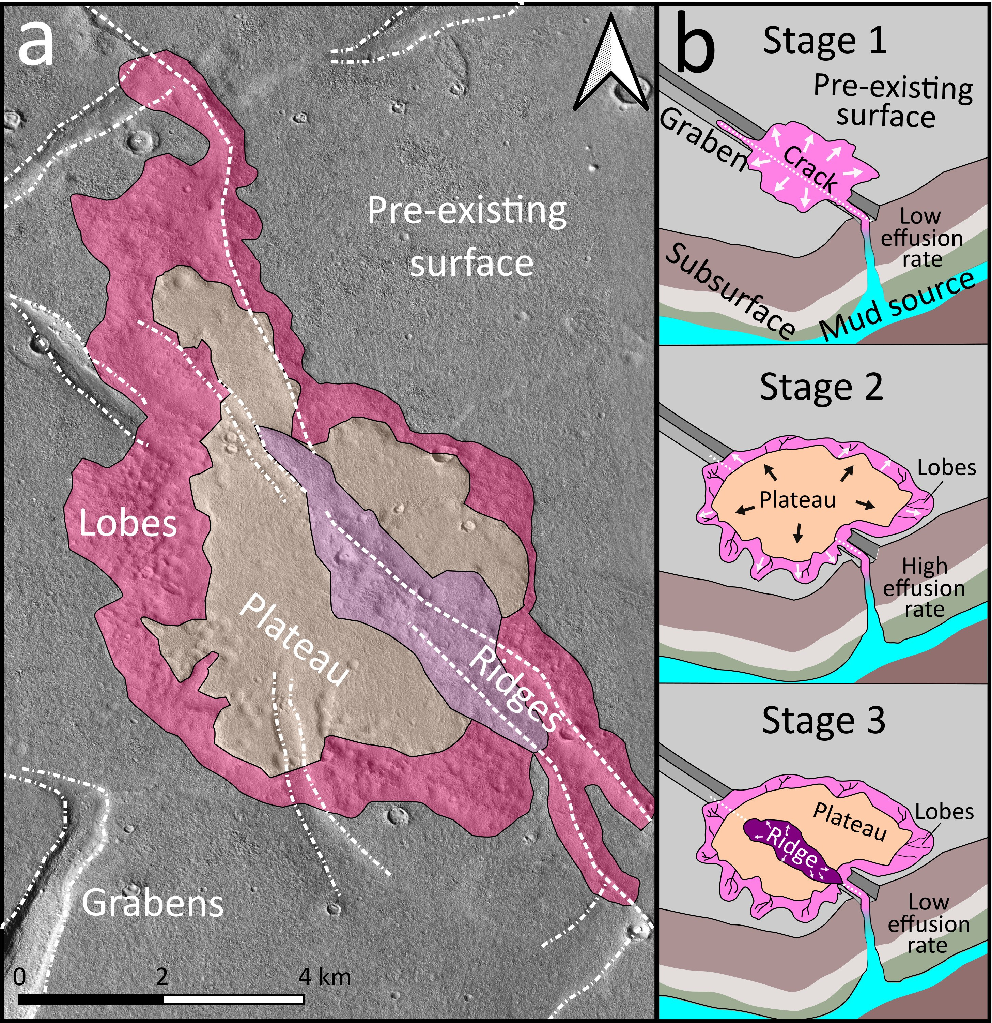
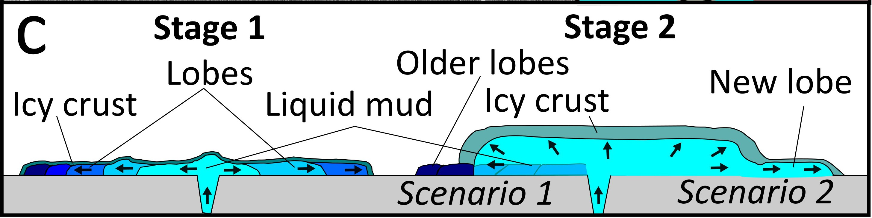
Formation Mechanism
Expultion of mud
Flowing and freezing (evaporative cooling, protective crust)
Limited ability to propagate -> lobes
Variations
Linear vs. point source
Effusion rate, duration
Total volume
Cuřín et al. 2022 (submitted to Icarus)

Slide 12











Related events
Scenarios
Now
Gradual freezing
Load-induced subsidence
Isotropic extension
Vastitas Borealis dep. (lH/eA)
Outflow channels active (lH)
Ivanov et al. 2014
Elysium activity (since lH)
Mass wasting
Geothermal destabilisation
Valley networks active (lN)
Utopia basin formed (eN)
Cuřín et al. 2022
Rapid sedimentation
Volumetric compaction or
Free convection
Mars formed
Cuřín et al. 2022
Notes:
Overburden pressure, overpressure from freezing
Isotropic uplift sublimation of icy body or because of expanding freezing icy lens
Source of pressure & timing – proposed models, theories on troughs, show options, not confirm ocean
Scenario 1: catastrophic floods▸sublimation lag deposits + gradual freezing ▸ troughs (isotropic extension) and plateaus
Scenario 2: water body before catastrophic floods ▸ catastrophic floods bring overburden pressure ▸ troughs (volumetric compaction/Rayleigh free convection) and plateaus
Scenario 3: Elysium Mons was involved (derived material caused overburden pressure/increased heat flux/supply of volatiles)

Slide 13
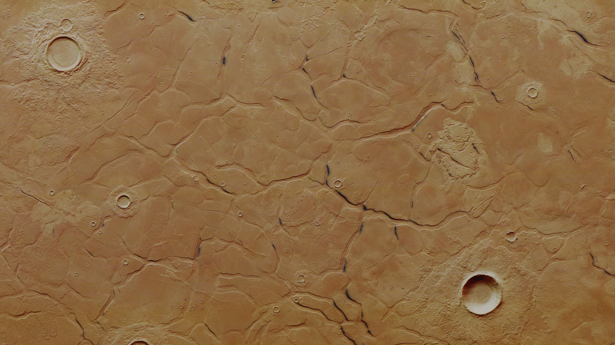
Takeaways!
Sediment mobilisation documented by a wide range of spatially and morphologically associated landforms
Several different sequences of events could have resulted in suitable conditions for their emplacement
“Sedimentary cryovolcanism”

Slide 14


Products of Sedimentary Volcanism around Adamas Labyrinthus, Mars
Vojta Cuřín with Petr Brož, Ernst Hauber and Yannis Markonis
Czech University of Life Sciences Prague
Research supported by Czech Science Foundation grant #20-27624Y
curin@fzp.czu.cz

