Slide 1

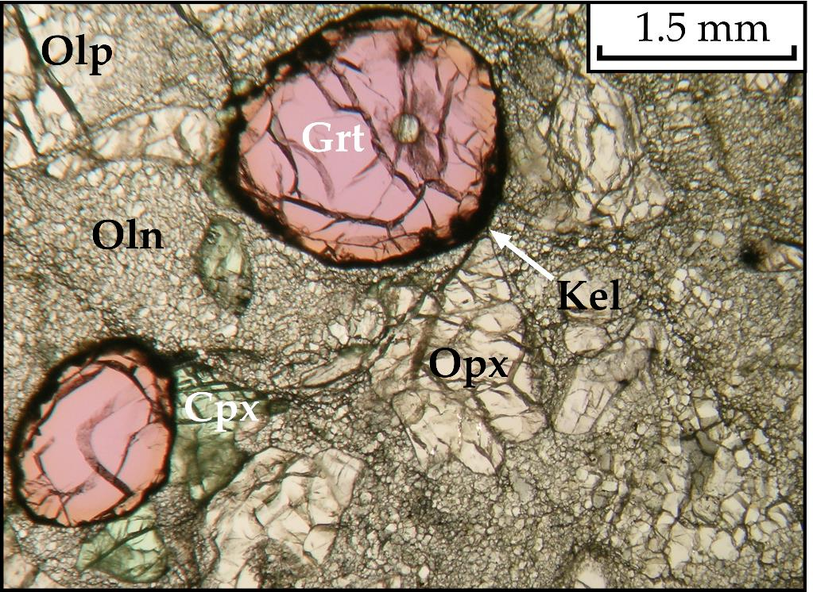
Sample description
The studied xenoliths UV-3/05 (in the figure) and UV-33/04 were sampled from unserpentinised kimberlite of the Udachnaya pipe (e.g., Kamenetsky et al., 2009; Kitayama et al., 2017; Abersteiner et al., 2018).
The xenoliths UV-3/05 (Golovin et al., 2018) and UV-33/04 (Agashev et al., 2013) are a sheared lherzolite and a sheared harzburgite with mosaic-porphyroclastic textures, respectively.
Residence temperature and pressure the xenoliths:
UV-3/04: 6.4 GPa and 1350°C (Golovin et al., 2018)
UV-33/04: 6.2 GPa and 1320°C (Agashev et al., 2013)
Lherzolite xenolith (sample UV-3/05) with a mosaic-porphyroclastic texture
Oln - olivine neoblasts; porphyroclasts: Olp - olivine, Opx - orthopyroxene, Grt - garnet, Cpx - clinopyroxene

Slide 2
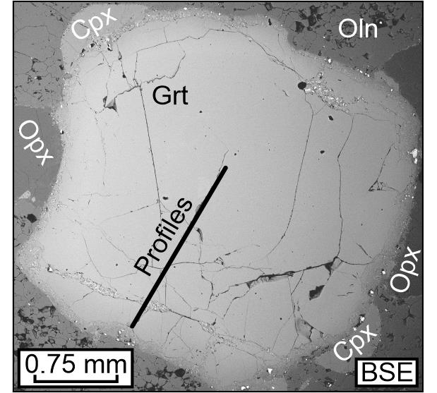
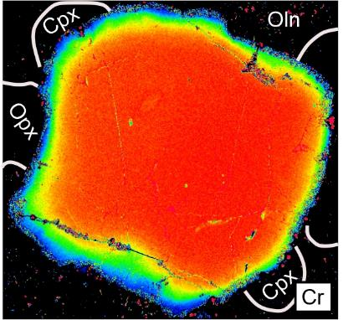
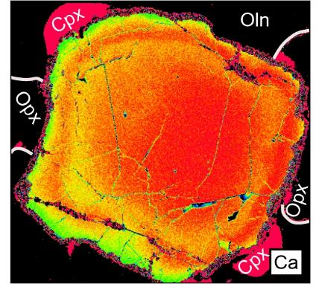
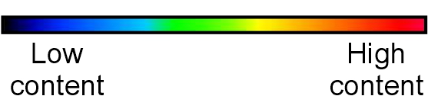
Garnet grains from UV-3/05
Spherical garnet grain with symmetrical zoning
Ellipsoidal garnet grain with asymmetric zoning

Slide 3

Garnet from UV-3/05

Slide 4
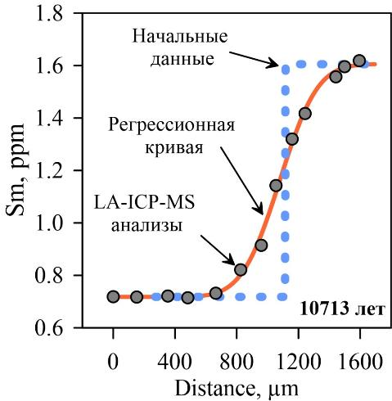
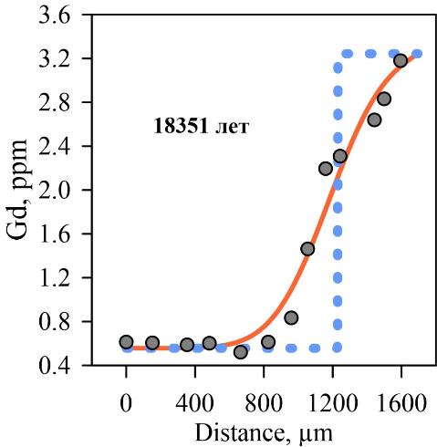
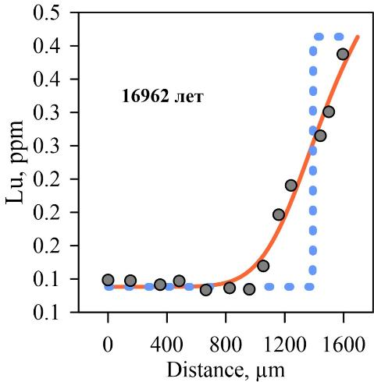
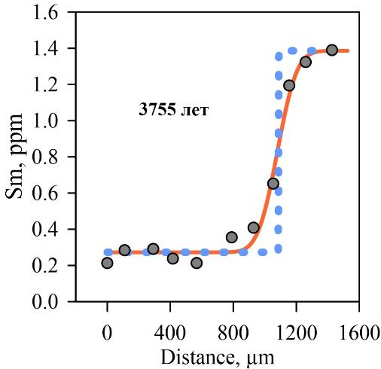
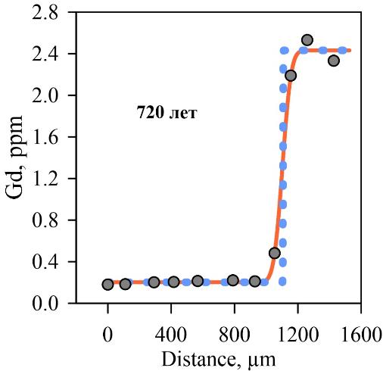
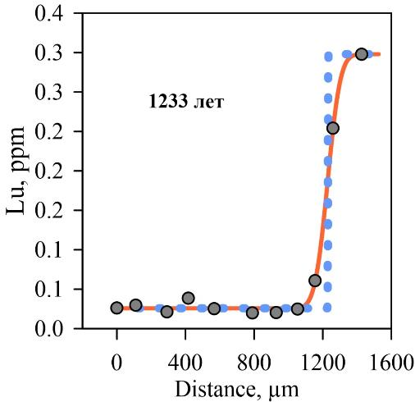
Results of numerical modelling of diffusion
UV-3/05
Initial conditions
Maximum formation times of zoning profiles of Y, Zr, Sm, Eu, Gd, Tb, Dy, Ho, Er, Tm, Yb, Lu, Hf (< 20 000 years)
Diffusion coefficients from Tirone et al. (2005)
18351 years
16962 years
Curve of best fit
LA-ICP-MS analyses
10713 years
UV-33/04
Maximum formation times of zoning profiles of Y, Zr, Sm, Eu, Gd, Tb, Dy, Ho, Er, Tm, Yb, Lu, Hf (< 5 000 years)
Diffusion coefficients from Tirone et al. (2005)
720 years
1233 years
3755 years

Slide 5
Metasomatic agent composition
Composition of a metasomatic agent was calculated using garnet/melt partition coefficients.

