Slide 1


Linking shallow gas occurrences and deeper structure offshore western Poland (Pomeranian Bight)
Quang Nguyen, Michal Malinowski (1)
Regina Kramarska, Dorota Kaulbarsz (2)
Christian Huebscher (3)
Institute of Geophysics PAS, Warsaw
Polish Geological Institute – National Research Institute
Insitute of Geophysics, University of Hamburg

Slide 2
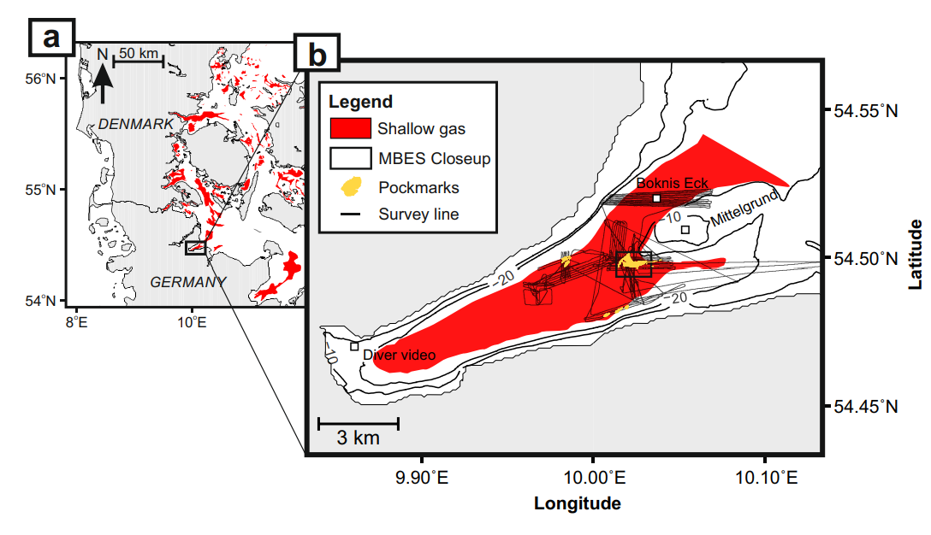
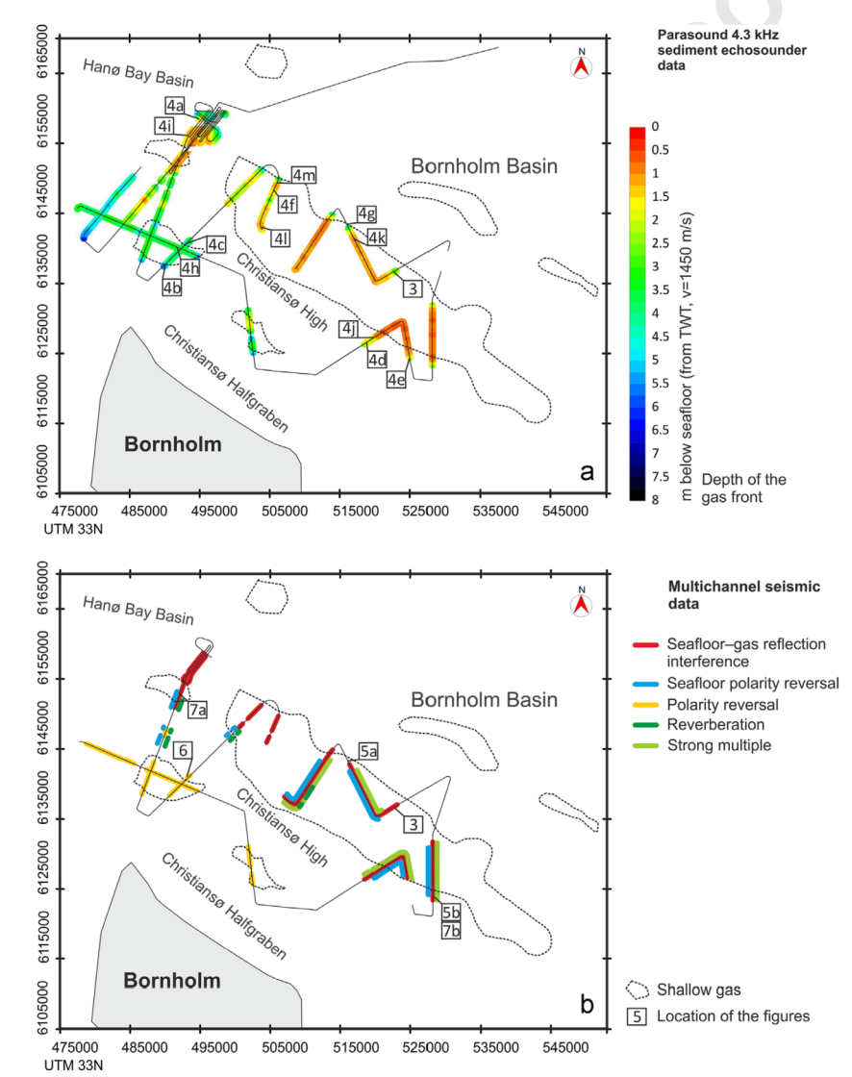
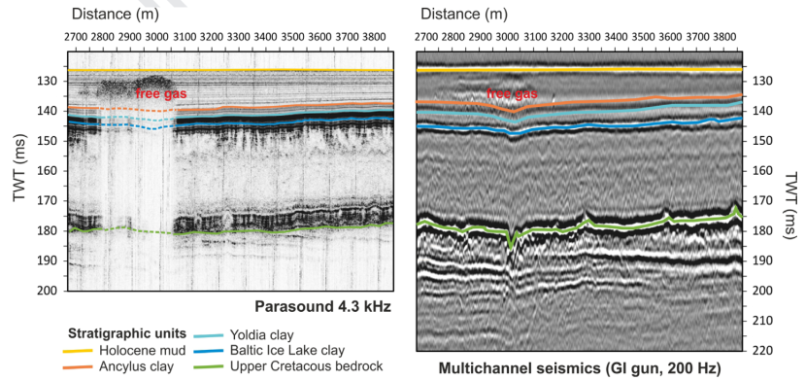
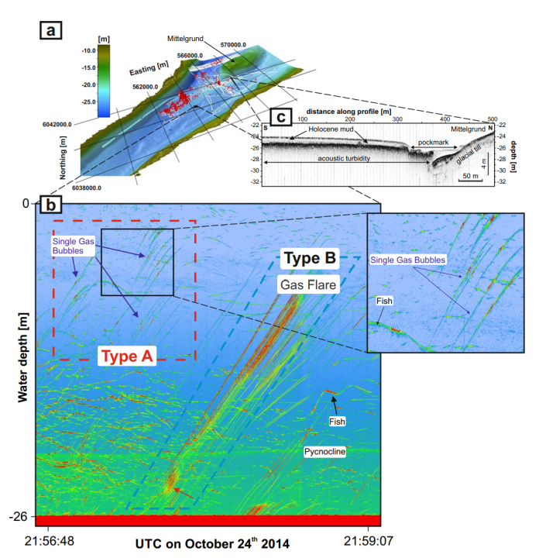
Shallow gas studies in South West of the Baltic Sea
Shallow free gas study using parasound and Multichannels seismic
Toth et al., 2014
Gas methan study using sonar survey
Lohrberg et al., 2020

Slide 3
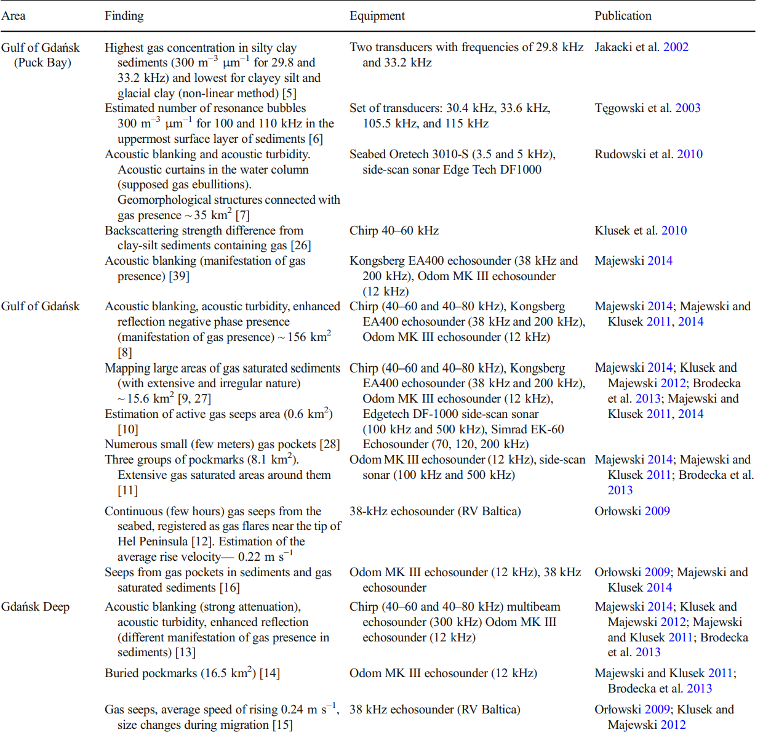
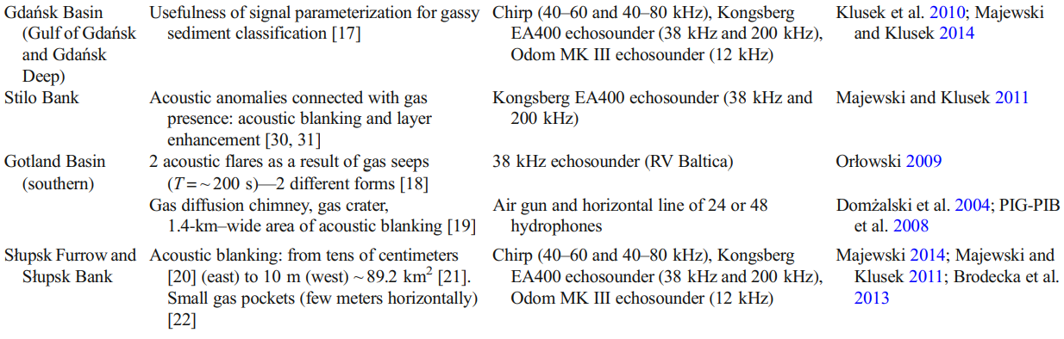
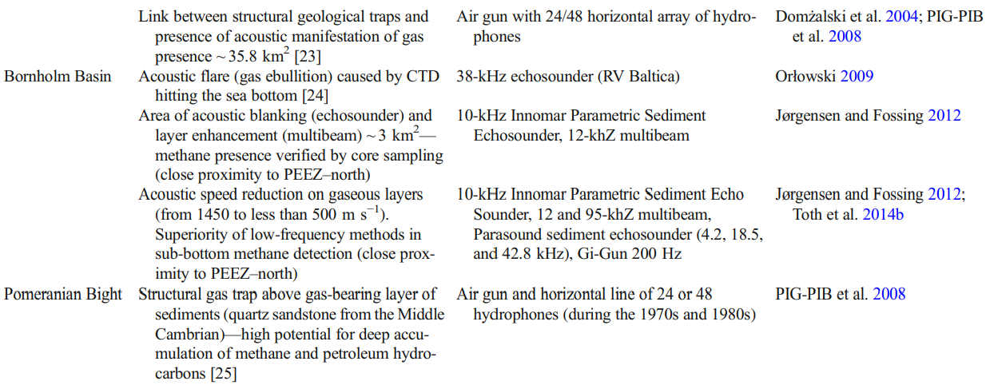
Shallow gas studies in South West of the Baltic Sea
Damian Jaśniewicz et al., 2018

Slide 4
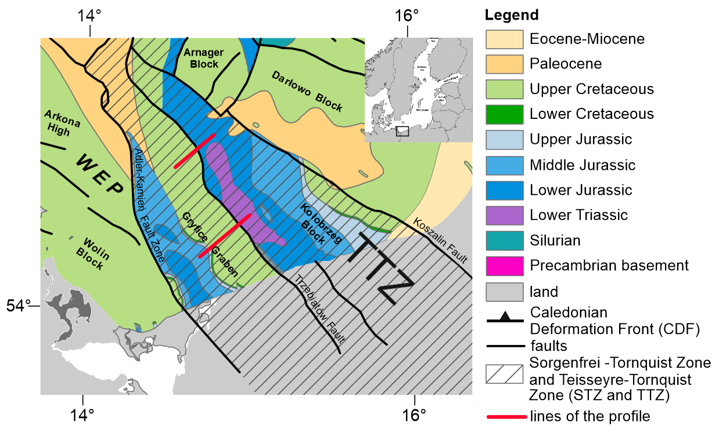
Study area and data
Aim of the study: To demonstrate the presence of methane in the shallow sediments in the SW of the Baltic Sea and link it with the deeper structures and leaking petroleum system
Study area is located offshore Poland, in the Mid-Polish Swell, with the main inversion-related faults: Adler-Kamien and Trzebiatow fault zone
Data in the study acquired during the MSM52 expedition with RV Maria S. Merian cruide in 2016 (Huebscher et al., 2017):
Post-stack and pre-stack 2D seismic data
Hydro-acoustic and multibeam bathy-metry data
Line 212

Slide 5
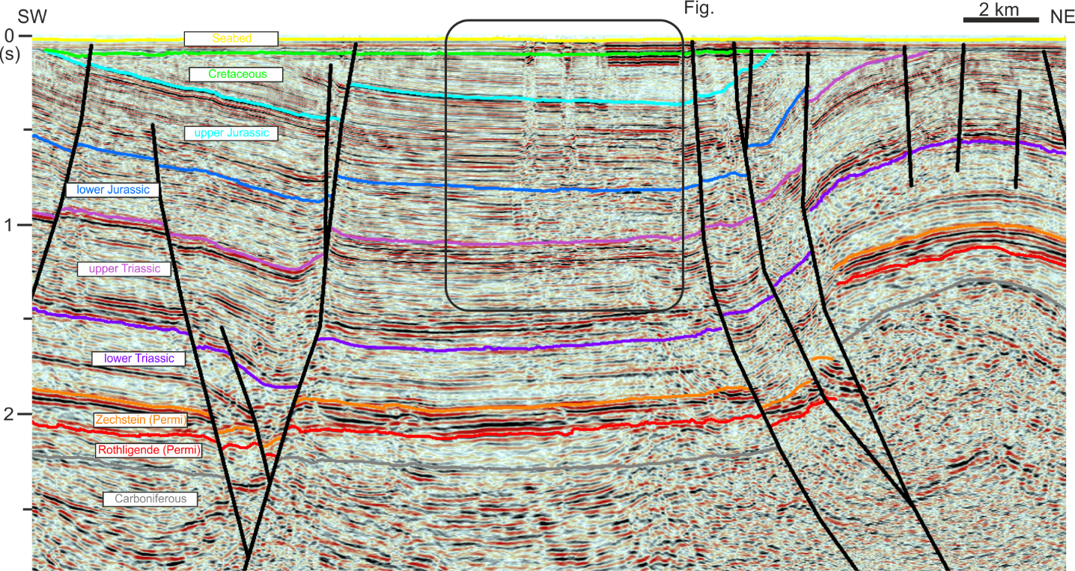
Shallow gas expression on seismic data
Trzebiatów fault
2 clear gas chimneys rooted in Upper Triassic
Potential migration pathway from below “kitchen” or reservoirs to near surface

Slide 6
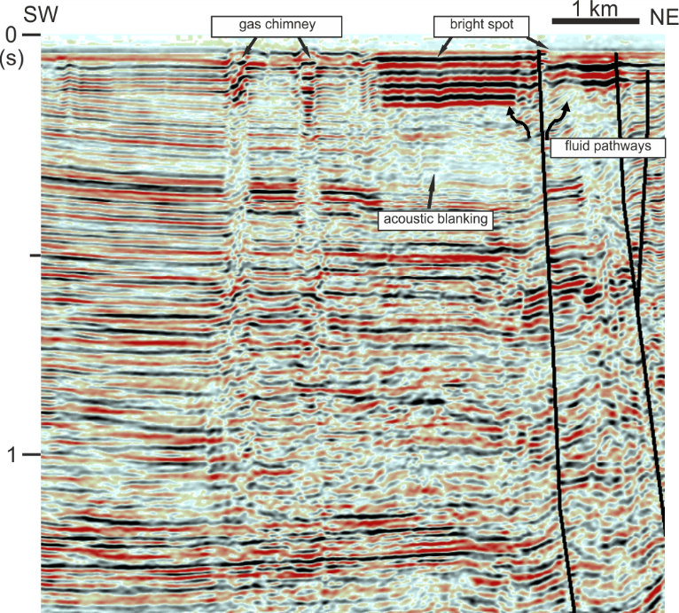
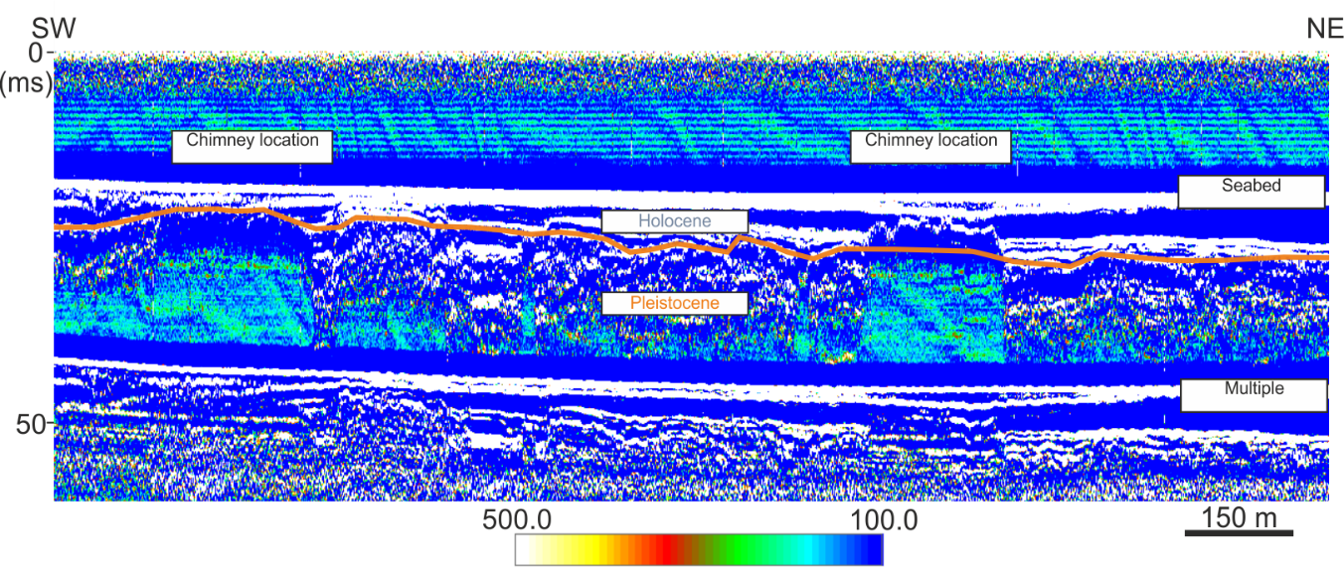
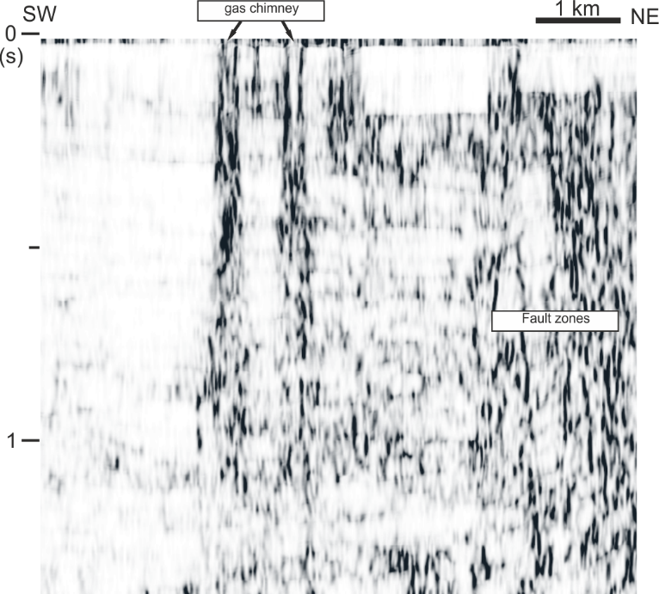
Shallow gas features such as gas chimneys, bright spots, polarity reversals, acoustic blanking are interpreted on seismic section
Coherence attribute supports interpretation, tracking starting point of the gas chimneys
Seismic results corroborated by the hydroacoustic data (parametric sediment profiler)

Slide 7
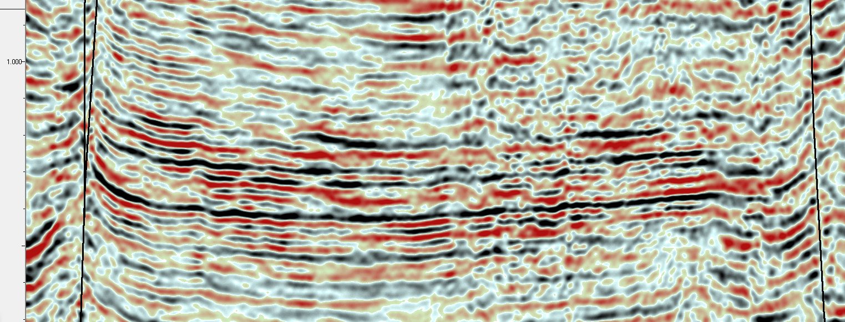
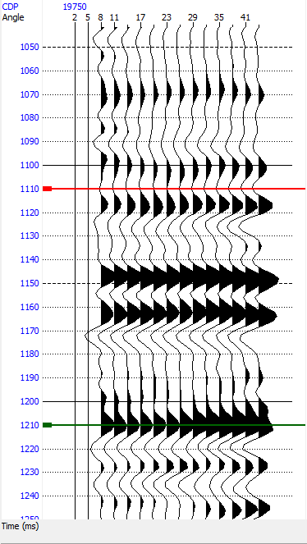
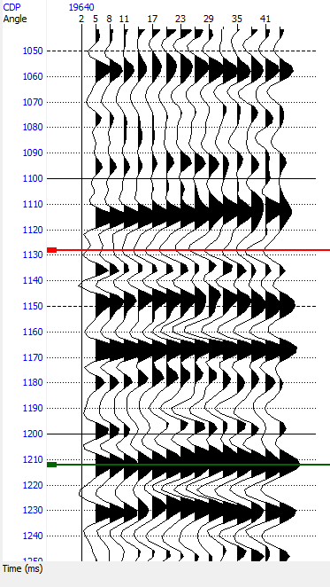
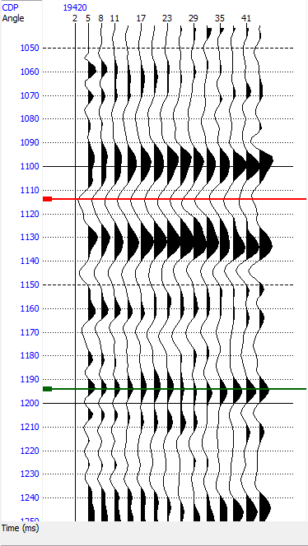
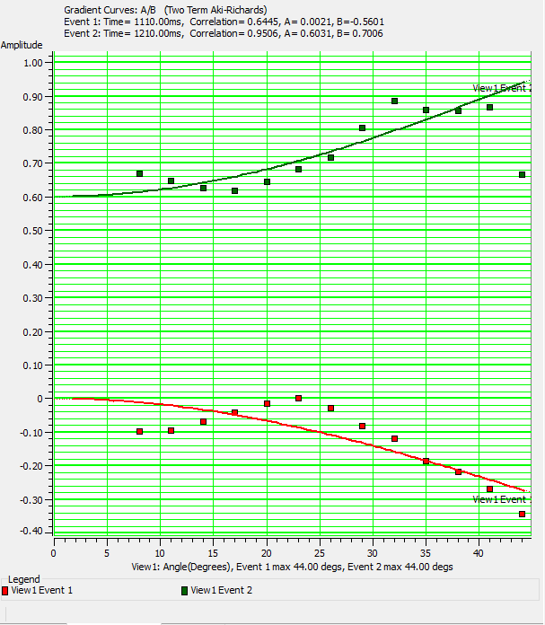
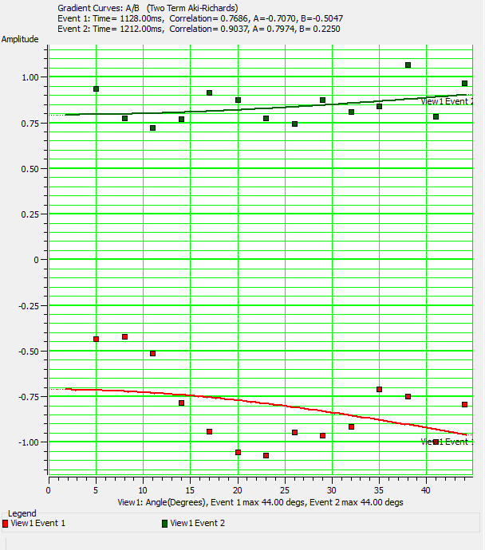
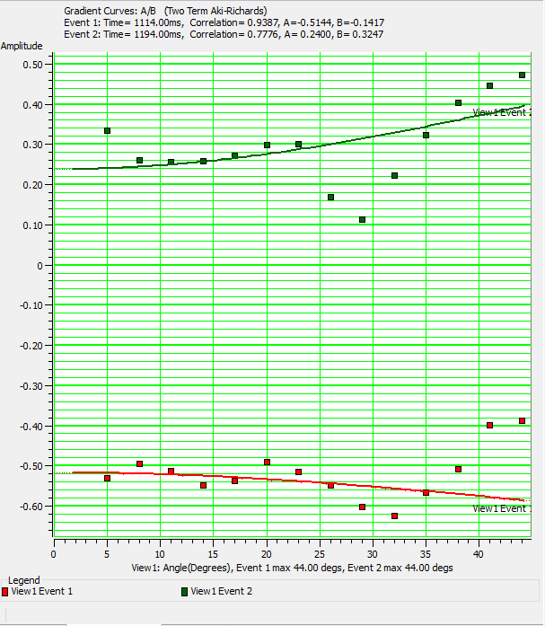
What AVO analysis tells us?
CDP
19750
19640
19420
Direct tool for showing the presence of gas
In this case, AVO analysis prove the remnants of gas existence in potential reservoir
F
F
Notes:
AVO analysis is a technique by which geophysicists attempt to determine thickness, porosity, density, velocity, lithology and fluid content of rocks

Slide 8
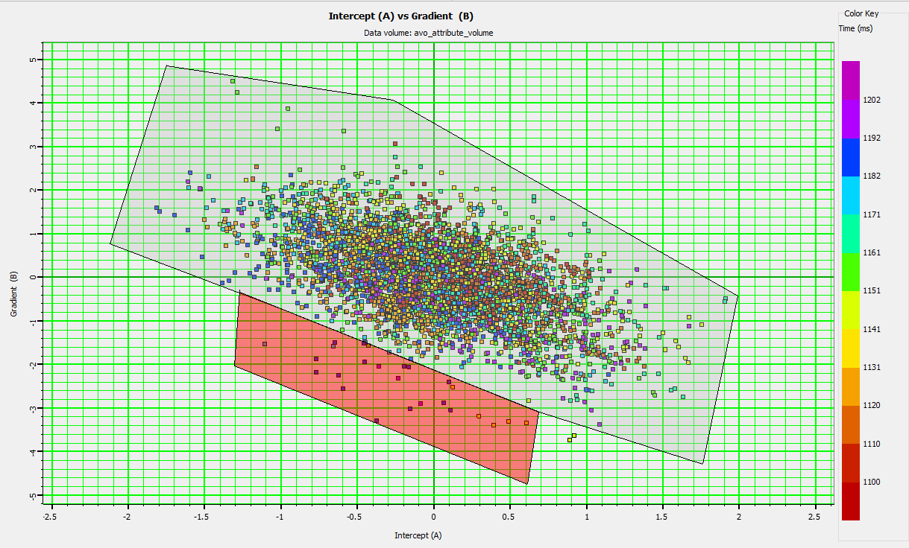
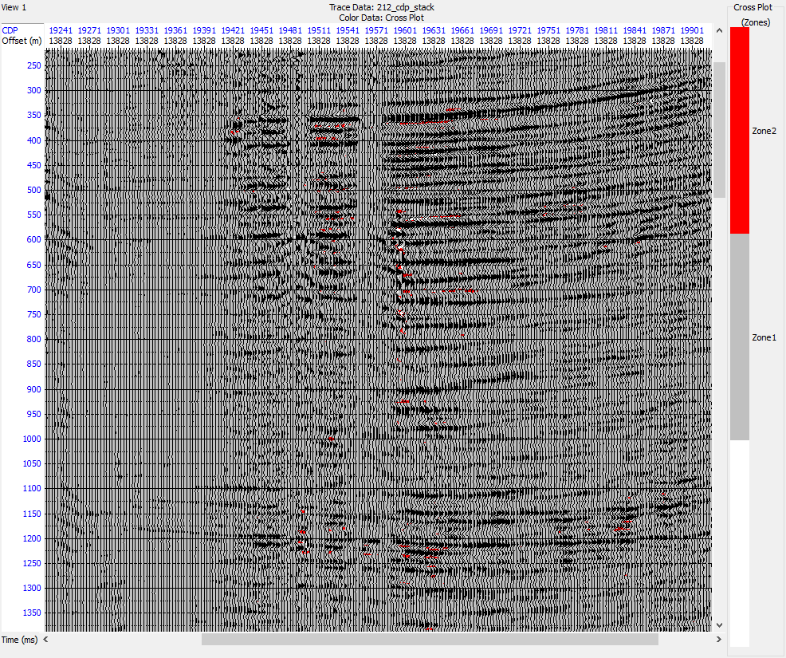
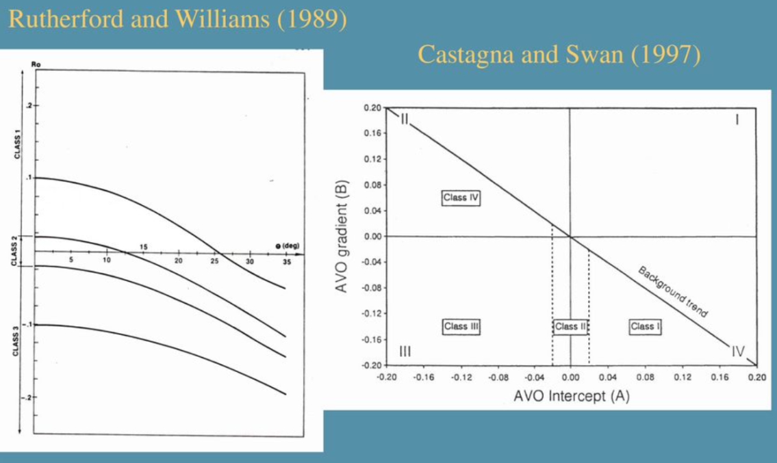
AVO analysis: free gas anomalies?
Gas chimney location
Gradient
Intercept
AVO anomalies from angle gathers highlight in red zone
Free gas deposits in the seismic section!

Slide 9
Conclusions
Shallow gas-escape related features were for the first time identified in the seismic data offshore West Pomerania, Poland
Gas-chimneys and bright spot features located nearby inverted fault zone prove hypothesis of free gas migration pathways from a leaking petroleum system to shallow sediments
Attribute-supported interpretation of larger-scale structures (chimneys, bright spots) from seismic data is corroborated by the hydroacoustic data, showing clear gas related anomalies in shallow sediments
AVO technique can be used to link the shallow-gas expression with the presence of gas at the reservoir level
In the presented example, no seafloor expression of gas escape (pockmarks) was found

Slide 10

Acknowledgements
This work has been funded by the Polish National Science Centre grant no UMO-2017/27/B/ST10/02316. The MARIA S. MERIAN expedition MSM52 was funded by the Deutsche Forschungsgemeinschaft (DFG) and the Bundesministerium für Bildung und Forschung (BMBF).
Thank you !!

