Slide 1
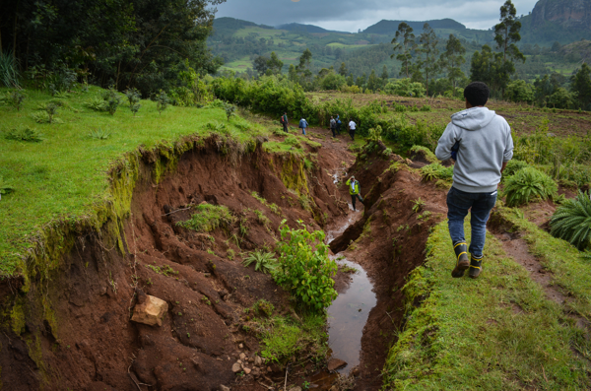
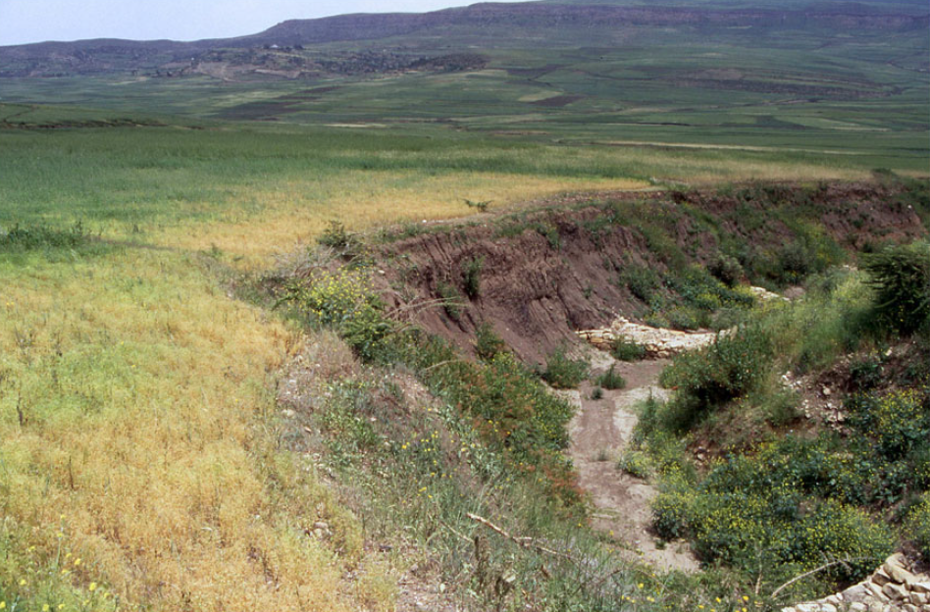
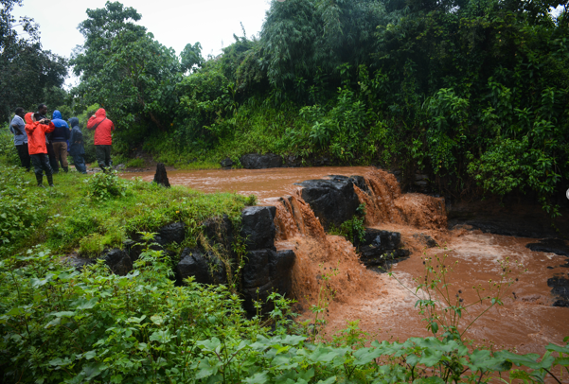
To have an idea of the major gully erosion hotspots
To improve land management strategies
This research:
Bridge the gap between the two scales
Large scale
High resolution
Notes:
Good afternoon everyone, you are probably all aware of the negative impacts of gully erosion such as loss of fertile land, reduced crop yields, but also a decreased water quality. So this poses an important challenge and we need models at high resolution to assess the major gully erosion hotspots and to improve land management strategies. However, we also want these models to be applicable at the large scale. Therefore, this research aims to bridge this gap by...
(Photo 1: Poesen 2018)
(Photo 2: Ethiopia, M. Vanmaercke)
(Photo 3: Ethiopia, M. Vanmaercke)

Slide 2
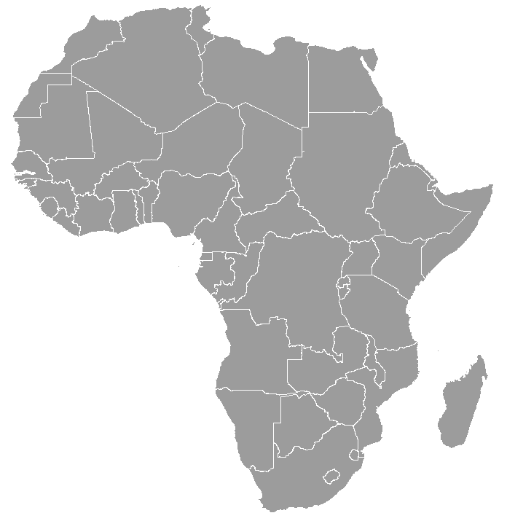




First gully susceptibility map of Africa at 30m resolution
Sofie De Geeter^{1,2,3}*, Matthias Vanmaercke^{1,2}, Gert Verstraeten¹,
Jean Poesen^{1,4}, Benjamin Campforts⁵
¹KU Leuven, Division of Geography and Tourism, Department of Earth and Environmental Sciences, Celestijnenlaan 200E, 3001 Heverlee, Belgium
²University of Liège, Department of Geography, Clos Mercator 3, 4000 Liège, Belgium
³Research Foundation Flanders – FWO, Brussels, Belgium
⁴Maria-Curie Sklodowska University, Faculty of Earth Sciences and Spatial Management, Krasnicka 2D, 20-718, Lublin, Poland
⁵University of Colorado, INSTAAR, Community Surface Dynamics Modeling System, Boulder (CO), USA
*Corresponding Author: sofie.degeeter@kuleuven.be
Notes:
... developing a gully susceptibility model for Africa at 30m resolution.
First thing you need to construct such a model, is of course a dataset. At this scale, fieldwork is not possible, so we used Google Earth images to detect gully heads all over Africa.
(Photo 1: Poesen 2018)
(Photo 2: Ethiopia, M. Vanmaercke)
(Photo 3: Ethiopia, M. Vanmaercke)

Slide 3
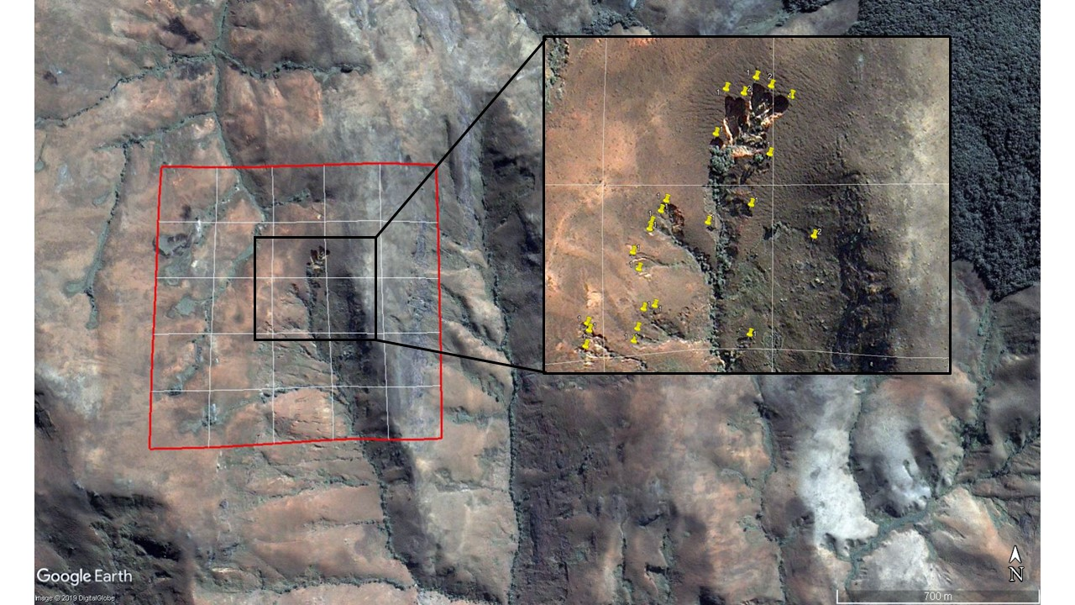
22°47'1.68"S
46°19'13.47"E
Madagascar
1 km
1 km
Notes:
This an example of a site we mapped in Google Earth. The site is 1 km² and we manually mapped all the gully head cuts in this site (indicated with the yellow pins). This is an example of Madagascar where we mapped around 30 gully heads.

Slide 4
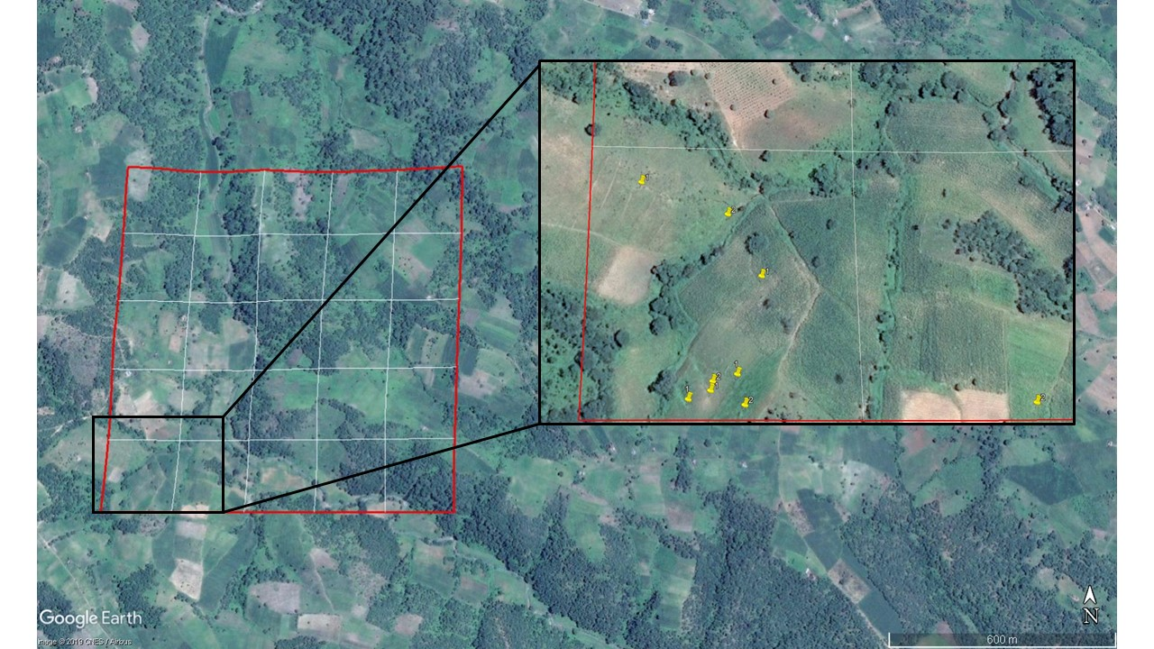
8°47'36.11"S
32°53'18.64"E
Tanzania
Notes:
This totally different landscape in Tanzania 15 gully heads were detected. And I can go on for quite some time showing you examples...

Slide 5
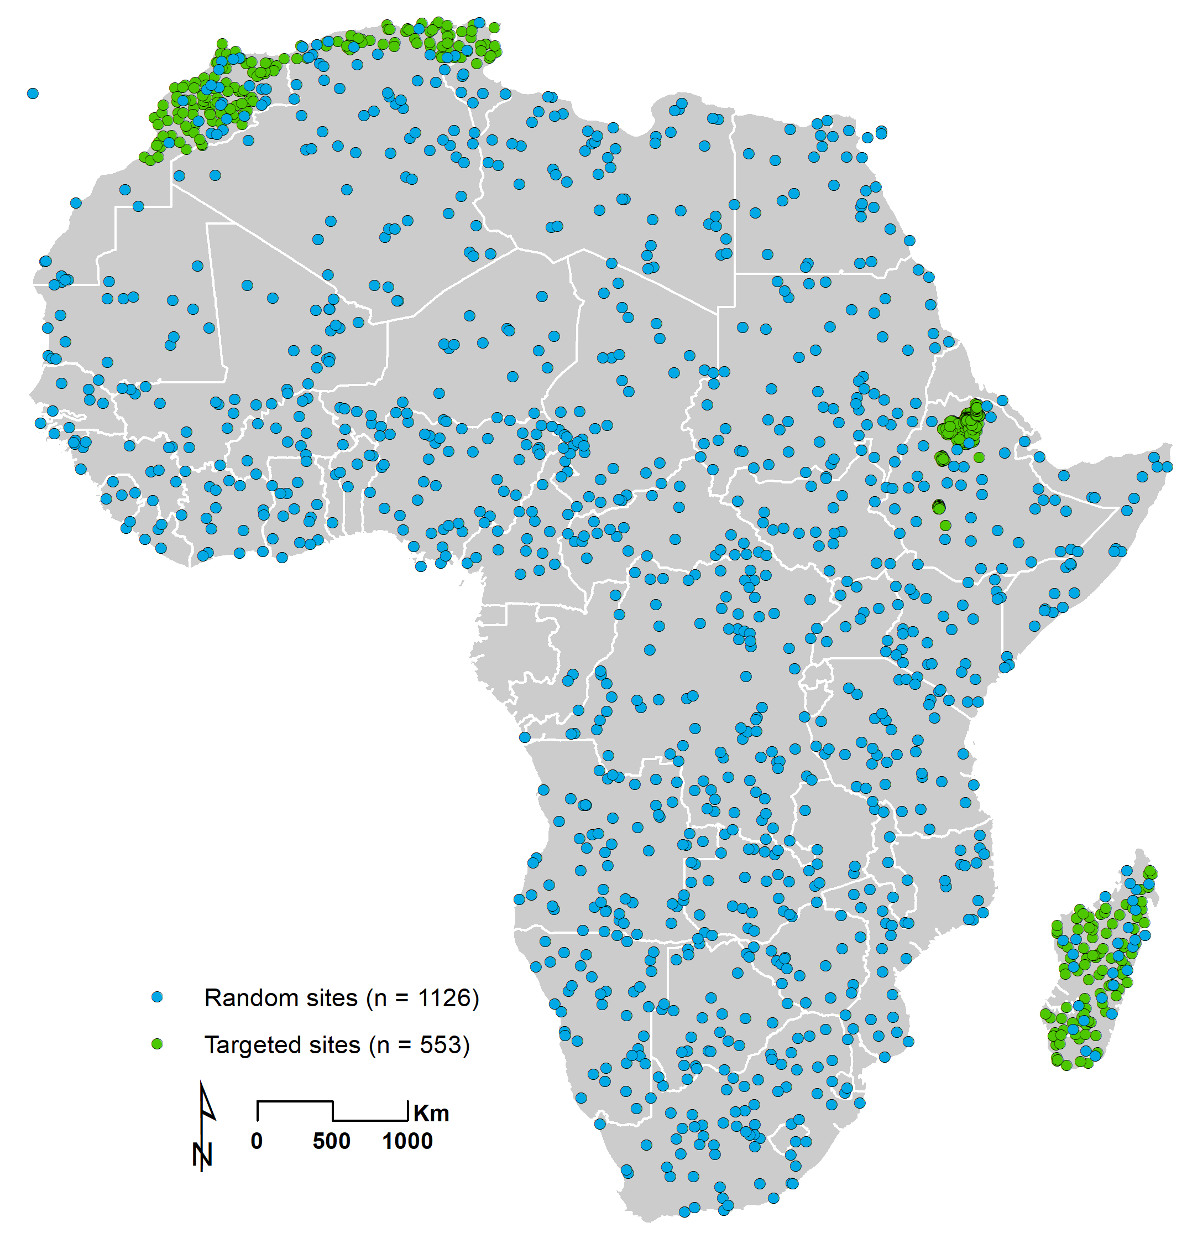
→ Unique and extensive gully head density database
  1689 sites of 1 km²
  44 339 individual gully heads
  ~ 65% randomly distributed
  ~ 35% in gully prone areas
Notes:
...because in total our team mapped more than 1600 sites all over Africa or more than 44000 individual gully heads.

Slide 6
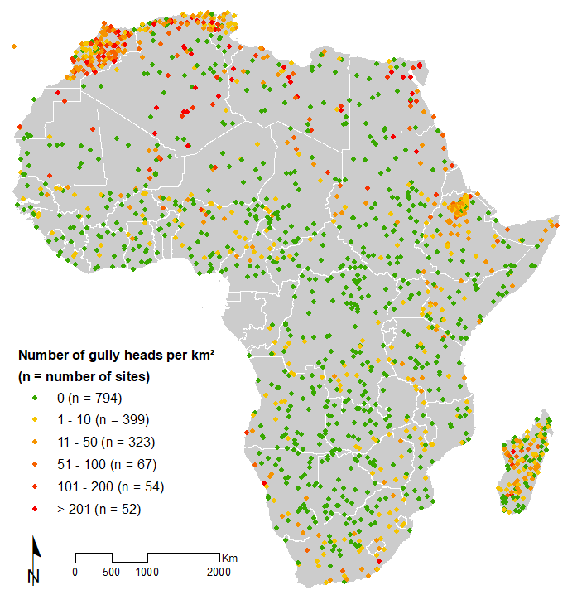
Gully head density database
→ Already some clear spatial patterns visible
Notes:
If we visualize the observed densities on a map of Africa, we clearly see some patterns. Very low densities in the tropical zones, but very high densities in the sahara, north Africa, south Africa and at some locations in Madagascar.

Slide 7
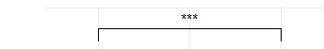
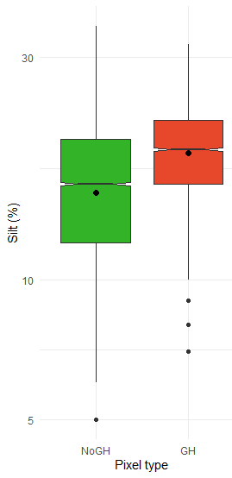
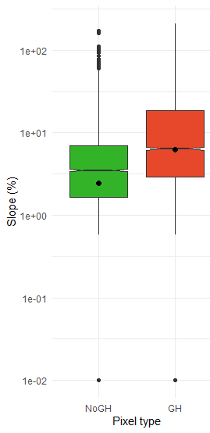
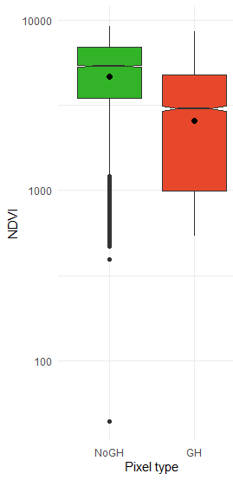
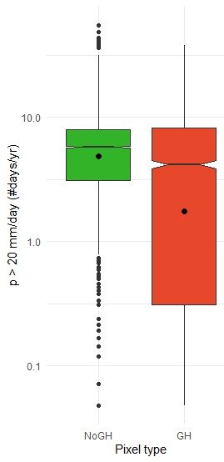
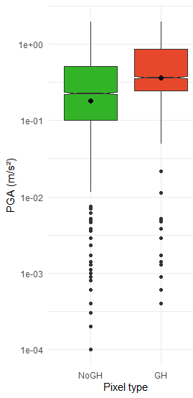
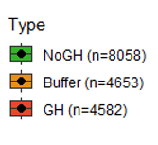
Which environmental factors explain these observed patterns?
Silt
Slope
NDVI
Rainfall
PGA
***p<0.01
Notes:
Which environmental factors explain these observed patterns? We analysed pixels containing a gully head with a random subset of pixels without gully heads for several environmental characteristics and found that GH pixels have a significantly higher silt percentage, a higher slope, lower NDVI and rainfall amount and higher PGA values (which is a measure for the seismicity)

Slide 8
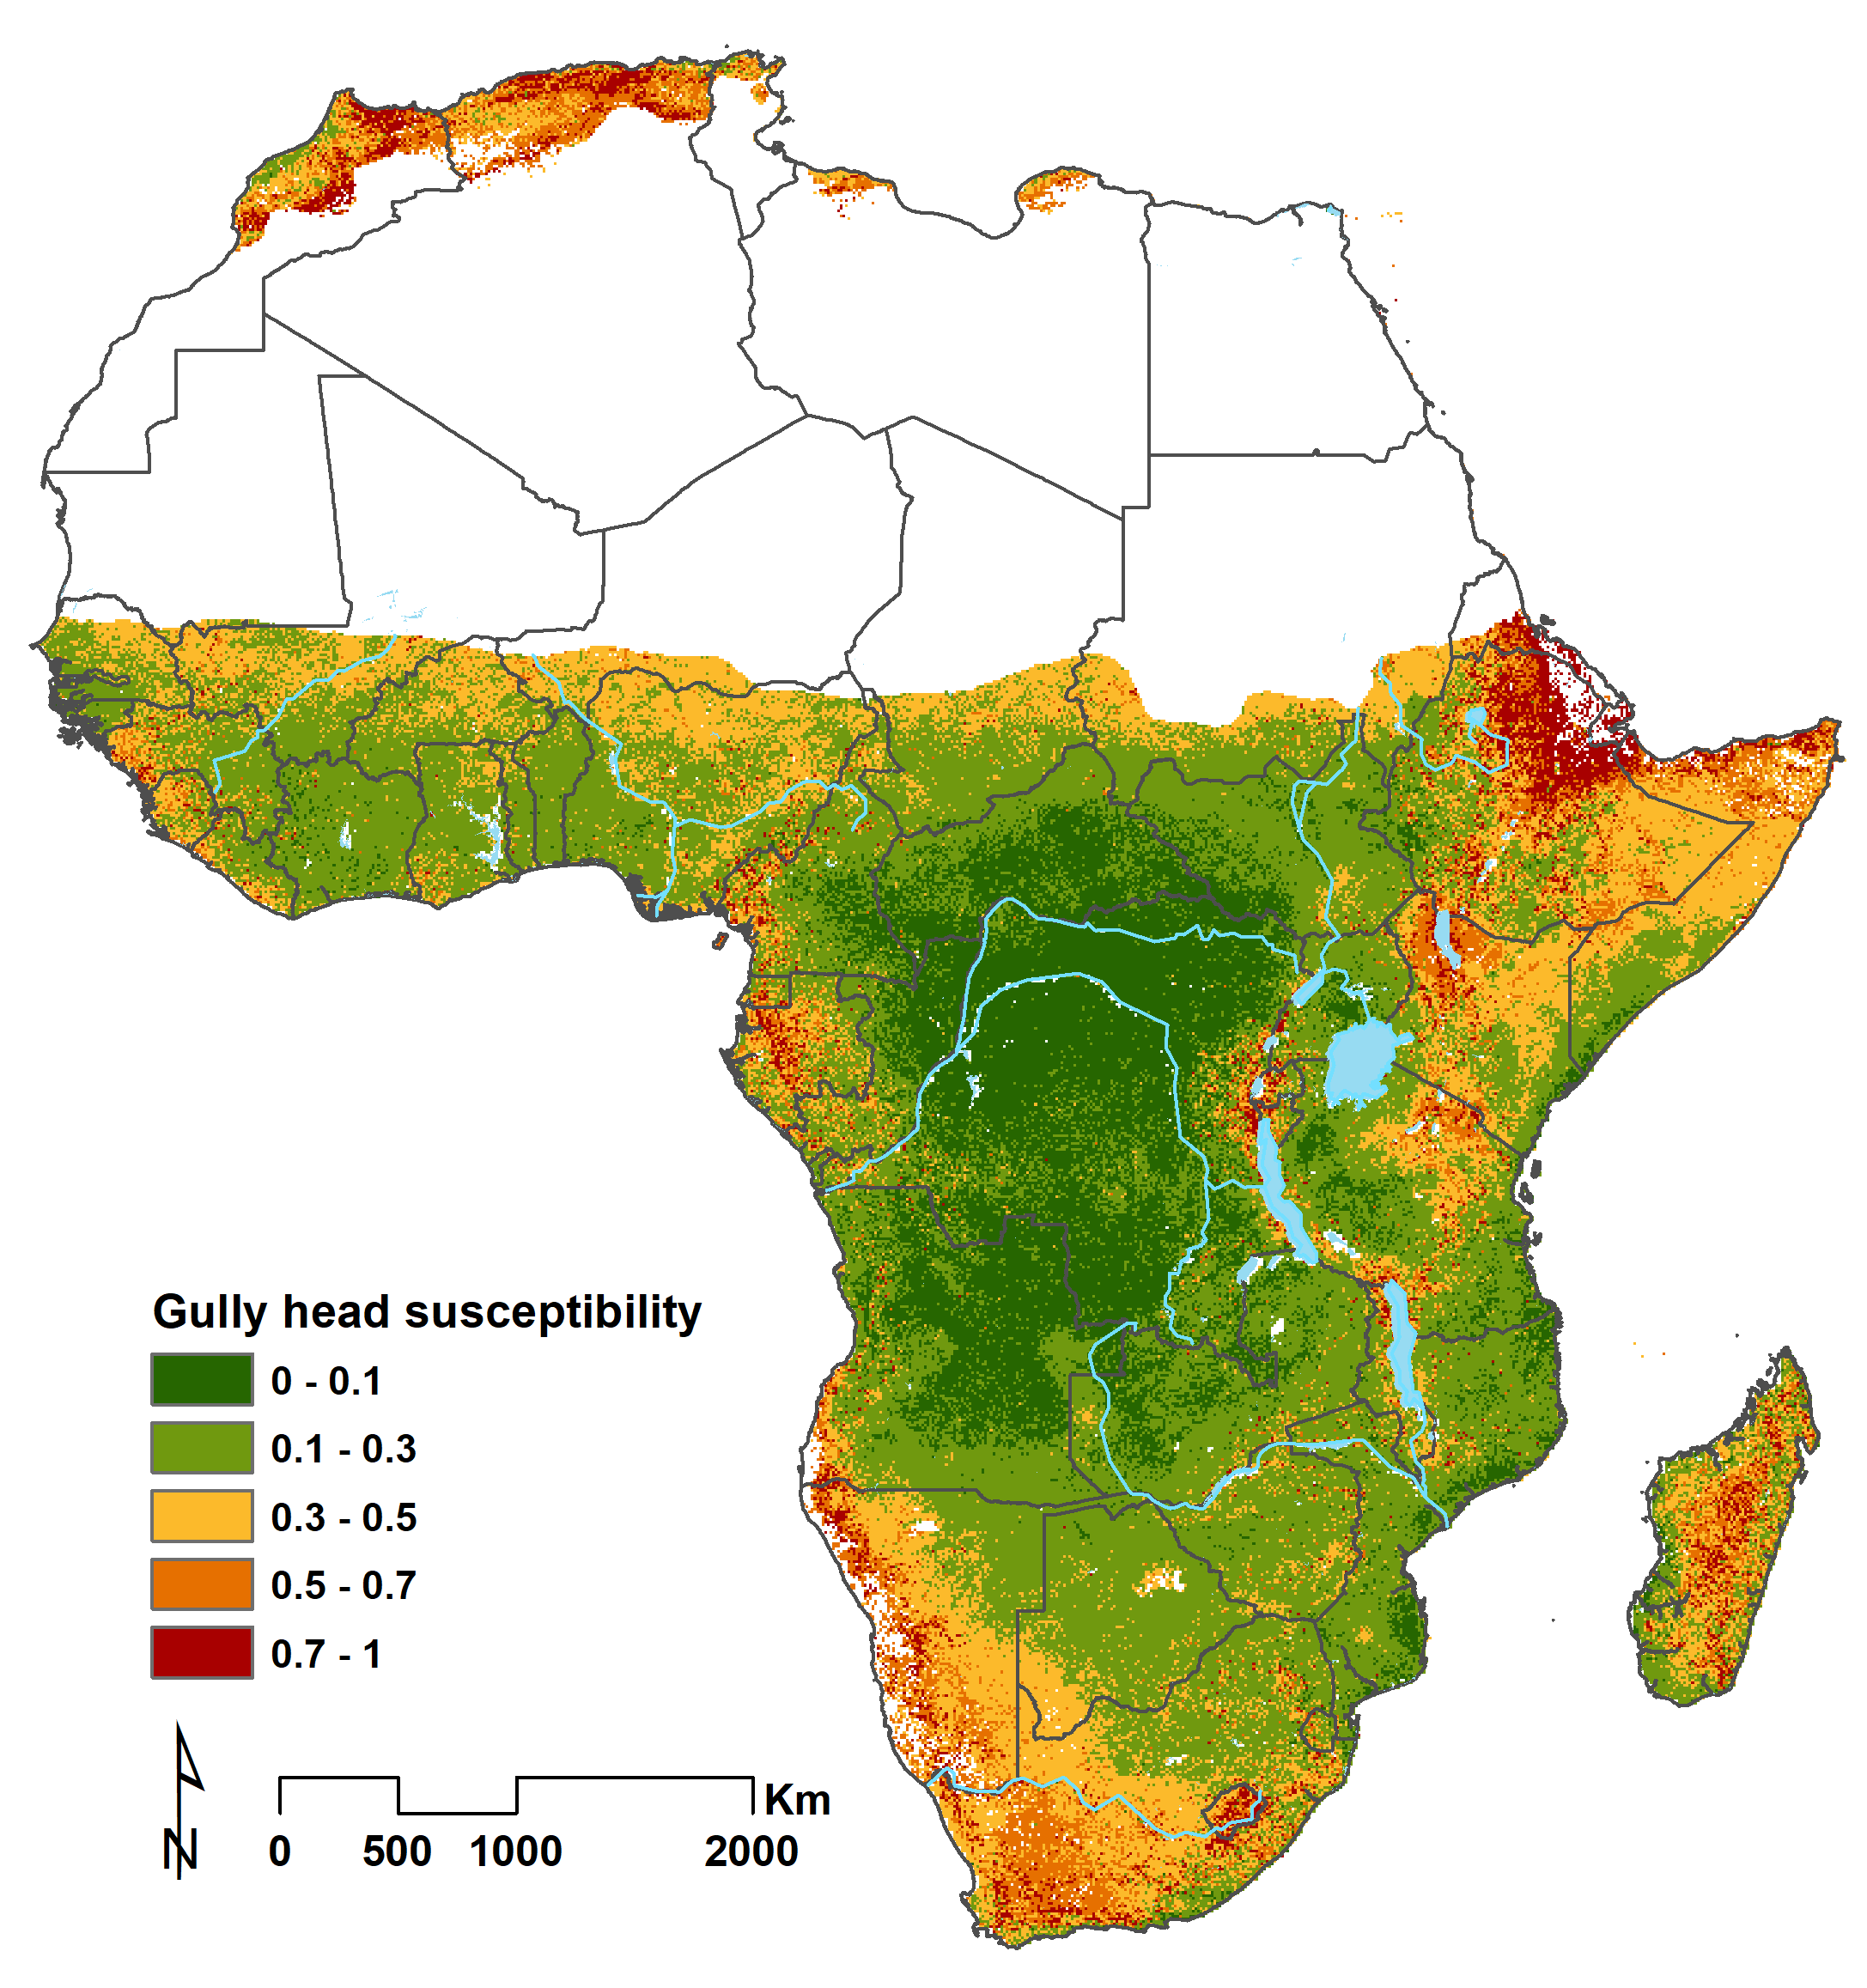
Logistic regression model at 30m resolution
Simulates susceptibility that a pixel has at least 1 gully head
Controlling factors:
slope, NDVI, silt, rainfall intensity, PGA
Notes:
If we combine these factors into a simple logistic regression model, we can simulate the susceptibility that a pixel will contain at least 1 gully head. When calculating this for the African continent, it results in this gully head susceptibility map with red values meaning highly susceptible pixel to gully initiation such as in North Africa, Ehtiopia, Madagascar, and South Africa. And green of low values mainly in the tropics. At this scale, this looks like the expected patterns, but what if we look more closely?

Slide 9
22°47'1.68"S
46°19'13.47"E
Madagascar
1 km
1 km
Notes:
Remember the examples from the beginning? Overall high susceptibilities in Madagascar

Slide 10
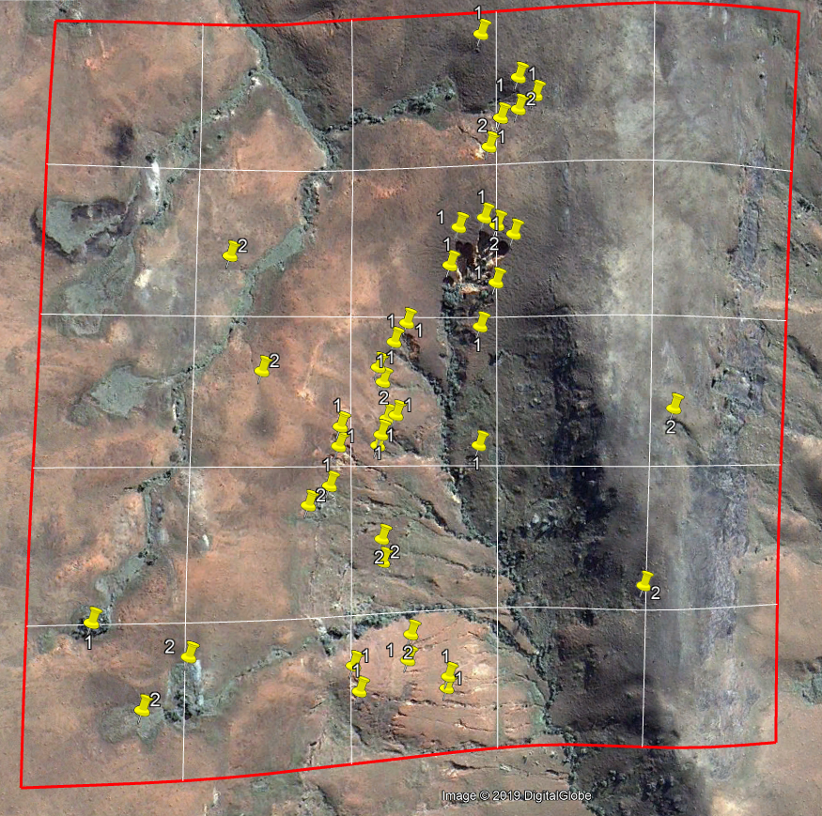
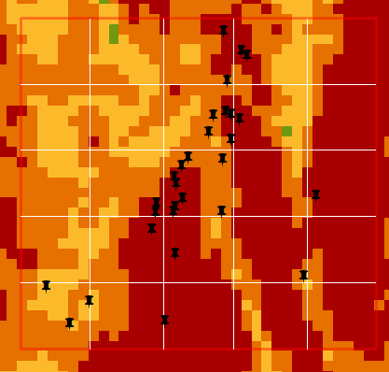
Notes:
But if we look at the scale of the site we also see that the model can differentiate at pixel level between higher and lower susceptibility zones within the site. To the right we see lower vegetation cover and steeper slope resulting in more observed gully heads and higher predicted susceptibilities. To the left the opposite.

Slide 11
8°47'36.11"S
32°53'18.64"E
Tanzania
Notes:
This example in Tanzania is located in a generally lower susceptible area

Slide 12
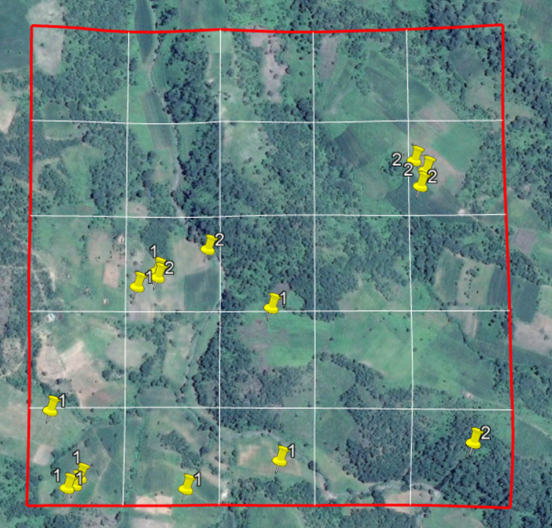
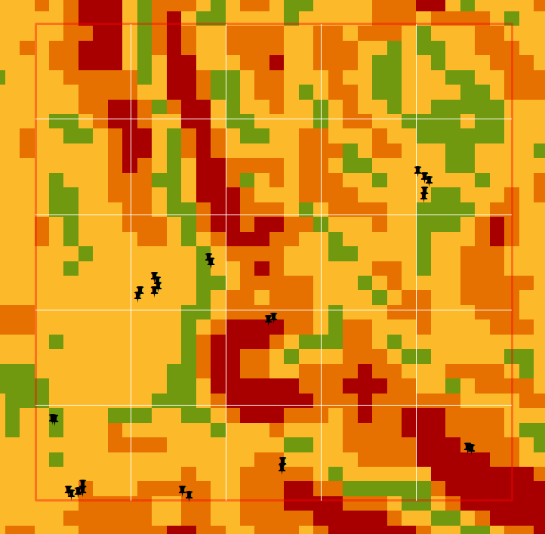
Notes:
but still, if we zoom in, we see that the model predicts a range of susceptibilities indicating that gully heads can form here which is also observed. This example also shows that the model is not perfect but that it is capable of predicting moderate susceptible areas.

Slide 13
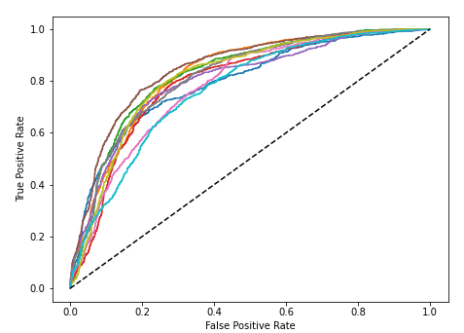
Logistic regression model at 30m resolution
Spatial cross-validation
ROC curves 10-fold cross validation:
Average AUC = 0.81
Notes:
How good does our model really perform? We carried out a spatial cross validation on an independent set of sites which gives us an Area under the curve value of 0.8 showing we developed a good and robust model.

Slide 14
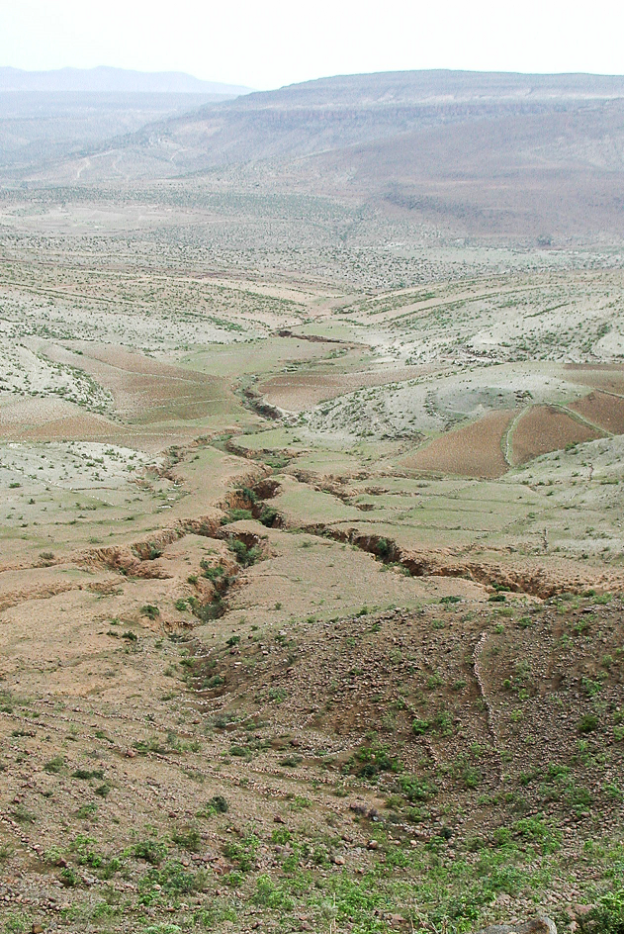
Conclusions
Improved understanding of the factors controlling gully initiation at large scales
Balance between model accuracy and feasible input data
Potential to couple with gully head retreat model
Potential for gully erosion management in Africa
Notes:
To conclude, our results give more insight in the environmental factors controlling gully erosion at large scales and found a good balance between the model accuracy and feasible data requirements. In addition, this model offers potential to couple with a gully head retreat model to predict gully erosion rates in the future and to improve land management strategies in Africa.
Photo: M. Vanmaercke

Slide 15
Thank you!
Questions?
sofie.degeeter@kuleuven.be
Notes:
Photo: M. Vanmaercke

Slide 16
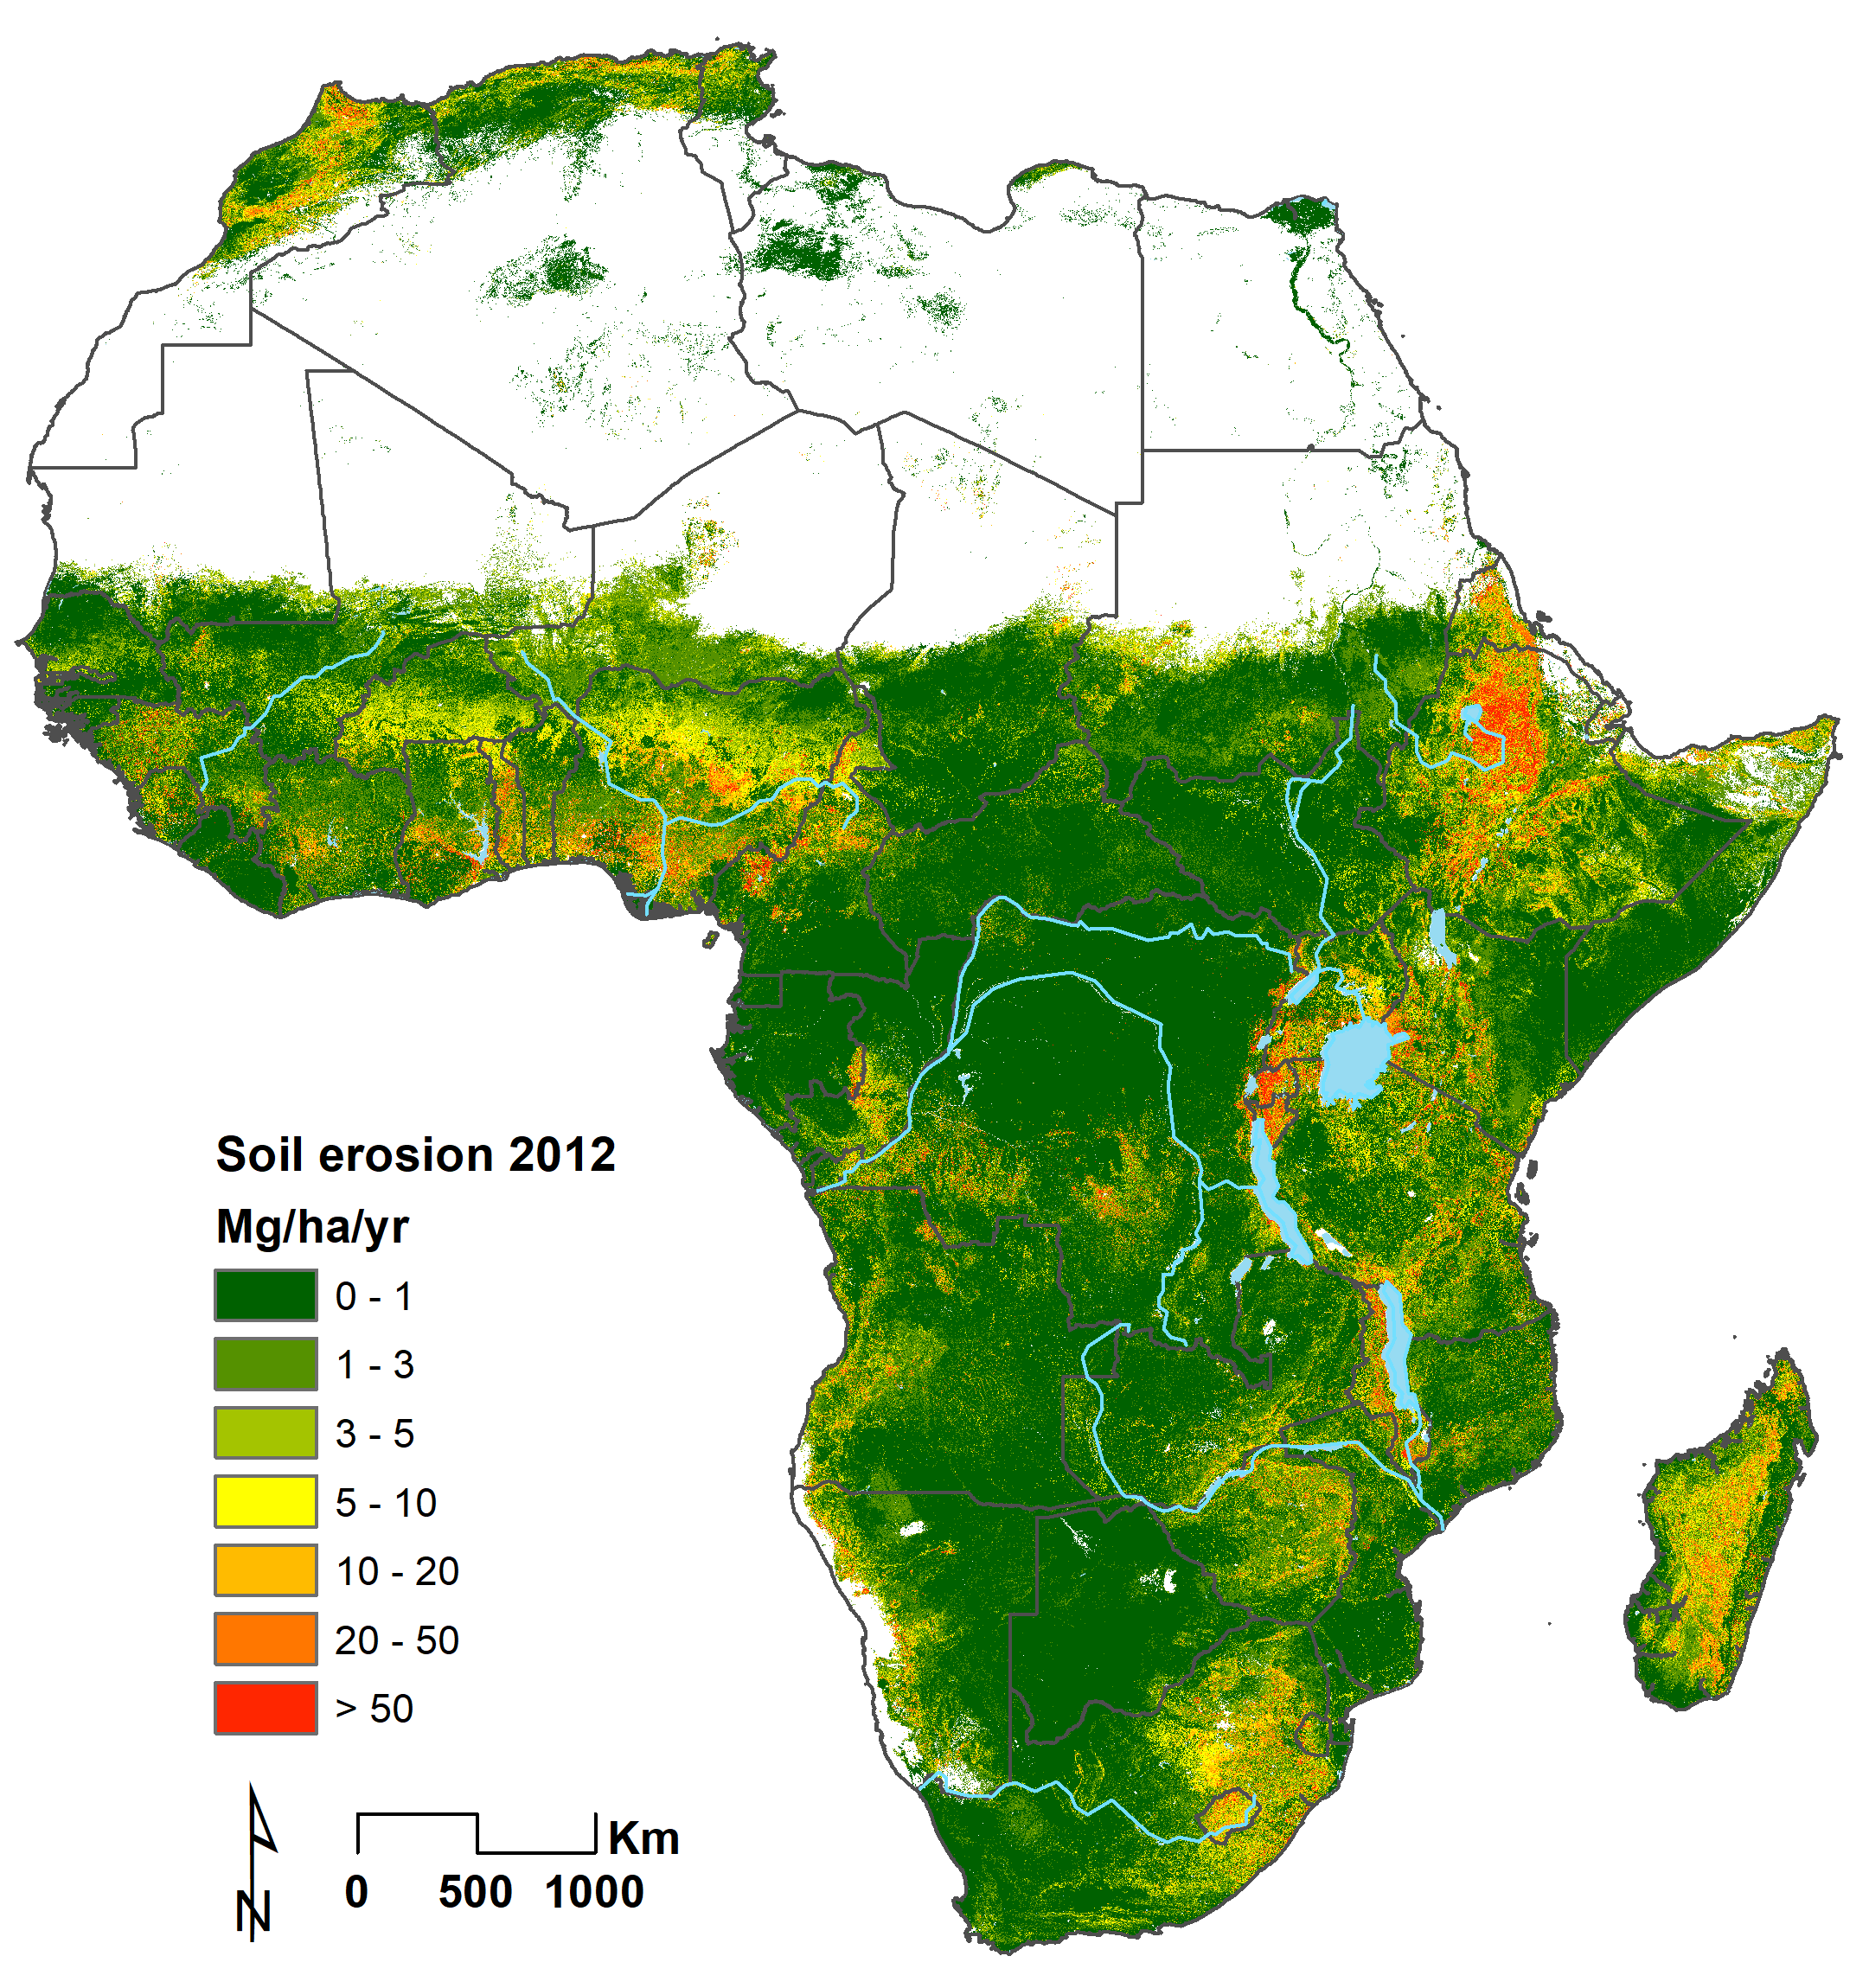
(Borrelli et al., 2017)
Notes:
Lastly, I would like to show you the comparison with the global soil erosion model of Borrelli et al. developed with a RUSLE based modelling approach. Overall, we see very similar patterns with high values in ethiopia, the east African rift system, Madagascar, but also differences in south-west Africa and the tropics meaning that a gully erosion model is an important addition to the erosion models.

Slide 17
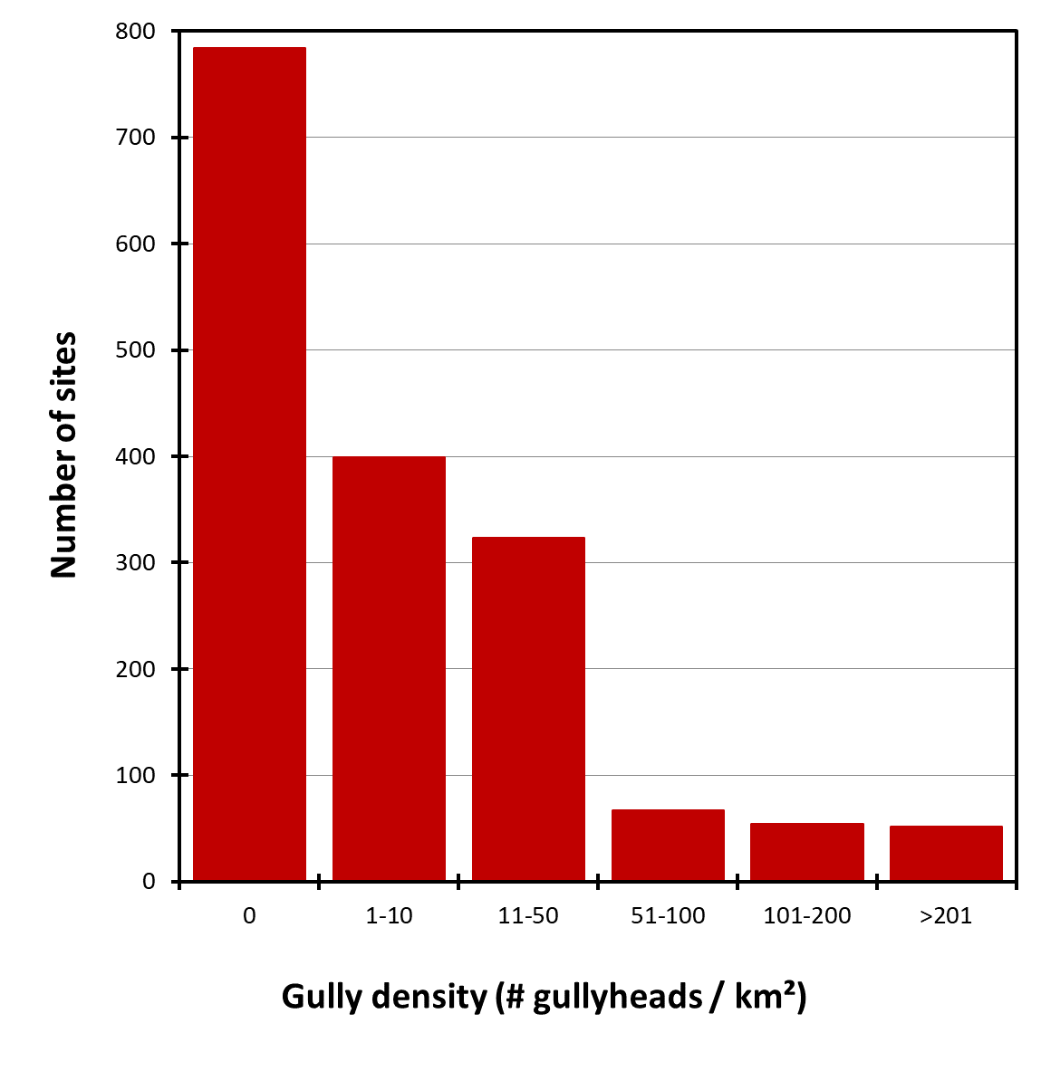
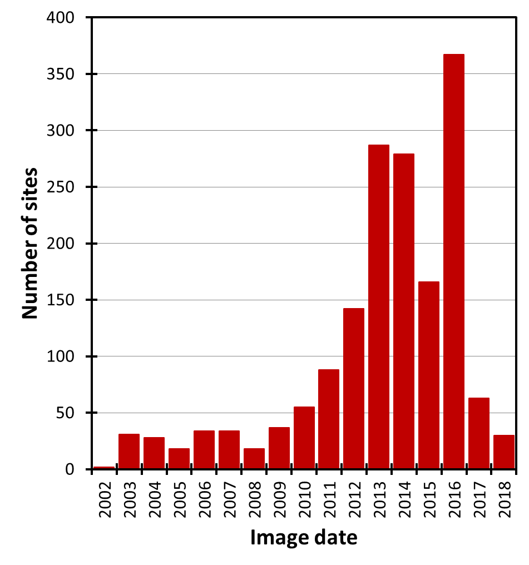
Gully head density database
On 48% of the 1679 sites at least 1 gully was detected
Mapped densities range between 0 and 1530 gully head/km² with an average of 22 gully heads/km²

Slide 18
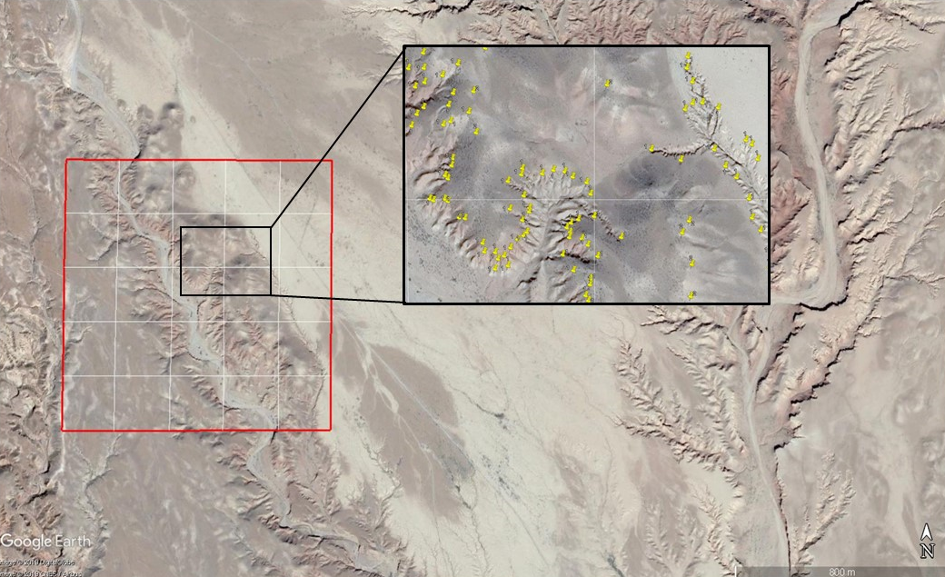
32°55'31.14"N
4°19'48.49”W
Morocco

Slide 19
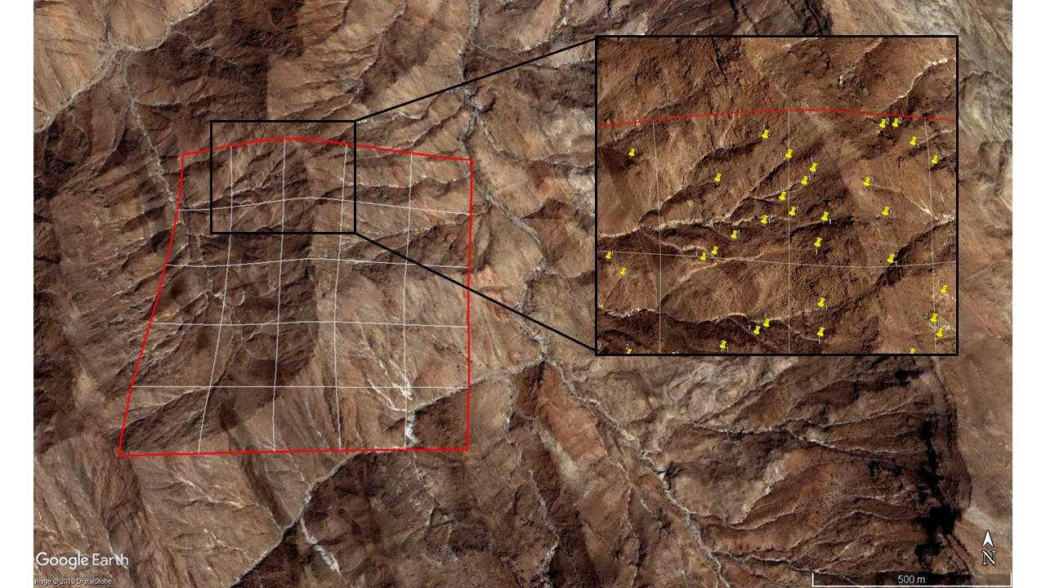
17°53'17.06"N
37°50'1.44"E
Sudan

