Slide 1
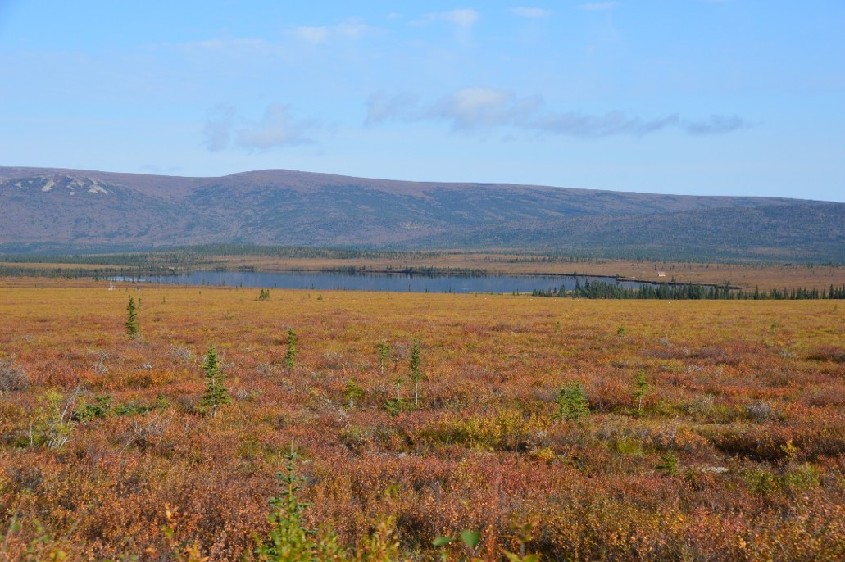





Does vegetation shift in Arctic tundra upon permafrost degradation influence mineral element recycling in the topsoil? Case study : Eight Mile Lake (Alaska, USA)
Maëlle Villani^{1*}, Elisabeth Mauclet¹, Yannick Agnan¹, Arsène Druel², Briana Jasinski³, Meghan Taylor⁴, Edward A. G. Schuur³, Sophie Opfergelt¹
¹Earth and Life Institute, Université catholique de Louvain, Louvain-la-Neuve, Belgium ²URFM, INRAE, Avignon, France ³ECOSS, Northern Arizona University, Flagstaff, AZ, United States
⁴ Adair Lab, University of Vermont, Burlington, VT, USA
*Contact: maelle.villani@uclouvain.be
Website: https://sites.uclouvain.be/wethaw/
Source : @sites.uclouvain.be/wethaw/
Notes:
Hello everyone, my name is Maëlle Villani, I’m a PhD student in the WeThaw project led by Sophie Opfergelt, and we come from Belgium
I’m here today to talk about the influence of vegetation shift in Arctic tundra upon permafrost degradation on mineral element recycling in the topsoil

Slide 2
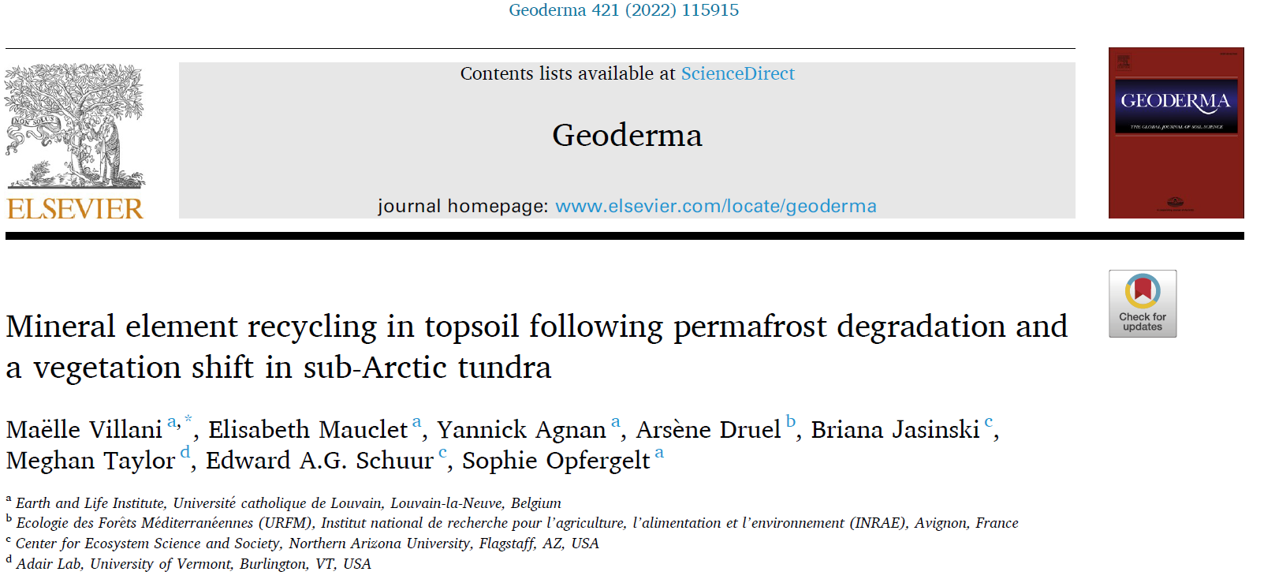

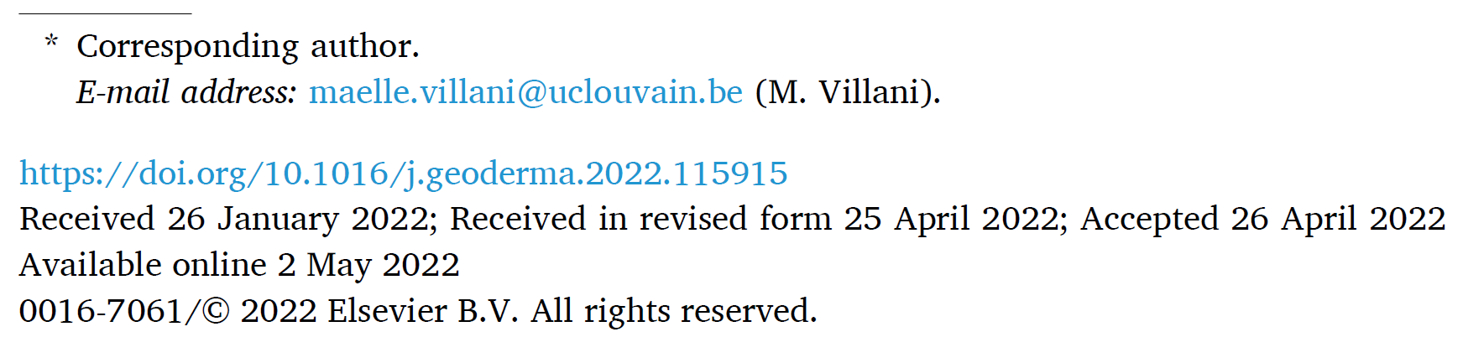
Notes:
I don't have much time to go into details of my research but if you are interested, the article on which this presentation is based has just been published in Geoderma

Slide 3
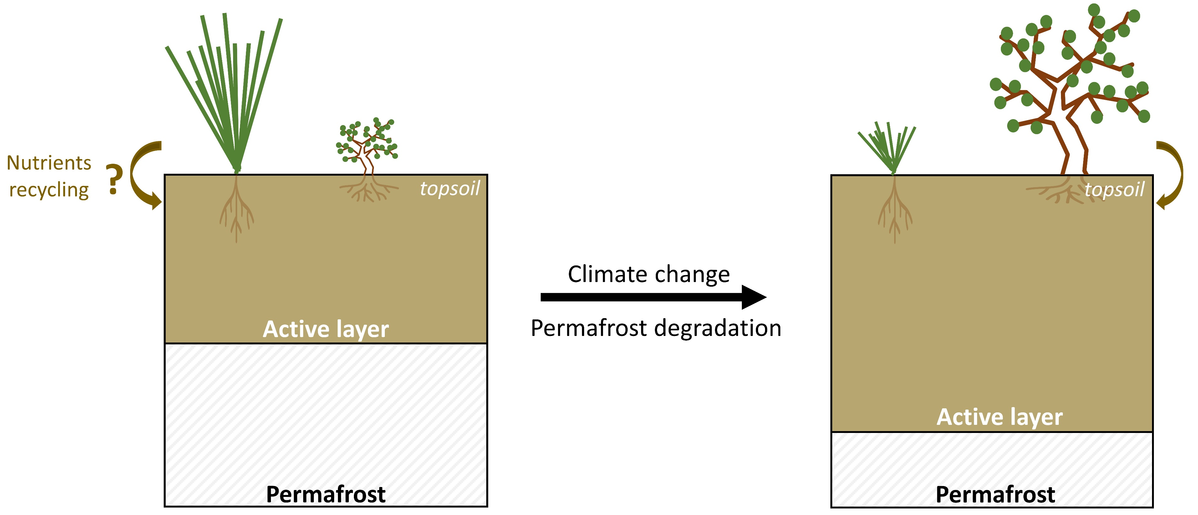
Vegetation change upon permafrost degradation
Notes:
- With the increase in temperature, permafrost is thawing, leading to a deeper active layer. These changes lead to a shift in vegetation from sedges to shrubs

Slide 4
Vegetation change upon permafrost degradation
Notes:
My research question is to know the influence of this vegetation change on mineral element recycling in the topsoil

Slide 5
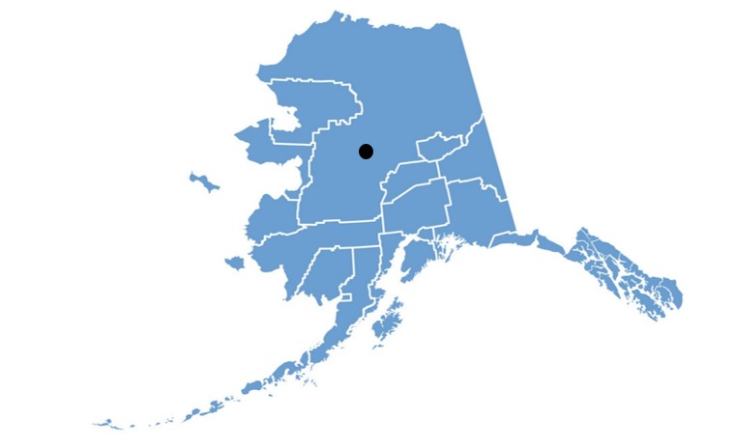
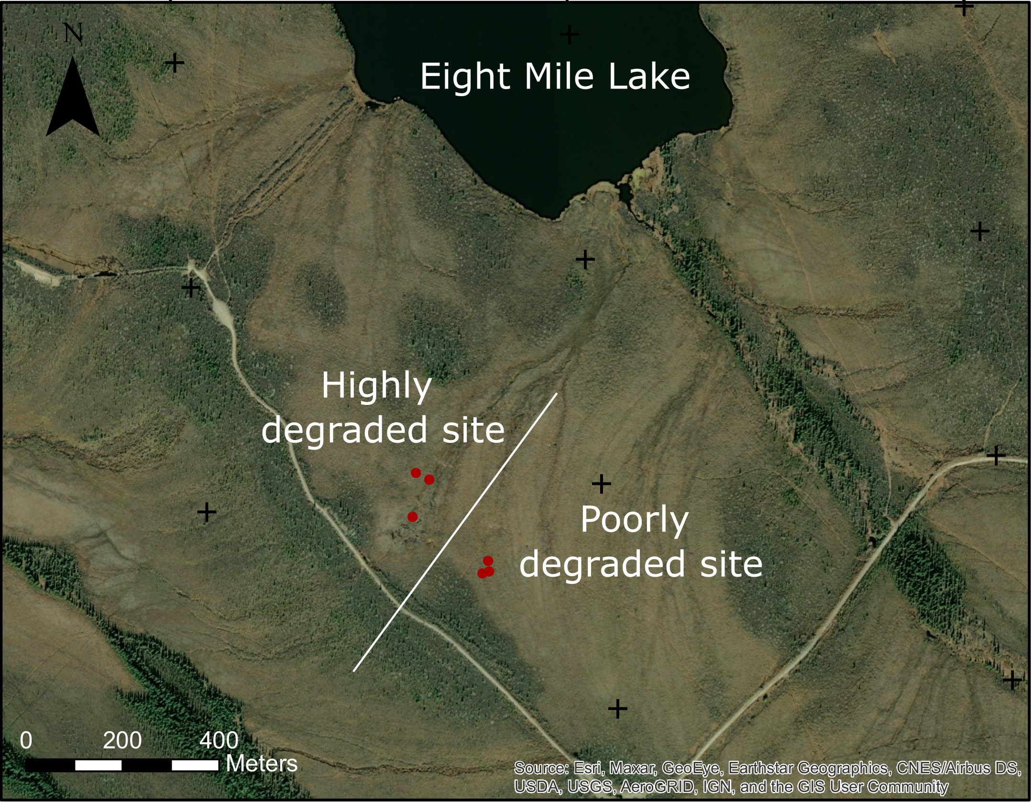


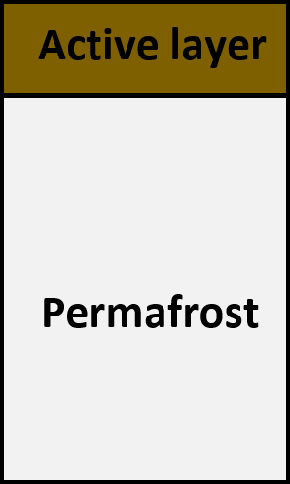

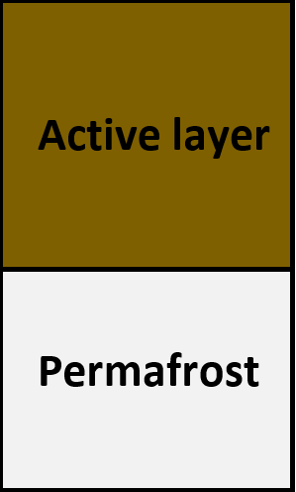
Natural gradient of permafrost thaw at Eight Mile Lake, Alaska
Notes:
To answer to this question, we sampled foliar vegetation (sedge and shrubs) and topsoil at Eight Mile Lake in Alaska which represents a natural gradient of permafrost thaw
We have samples from a poorly degraded site which is dominated by sedges and from a highly degraded site which is dominated by shrubs

Slide 6
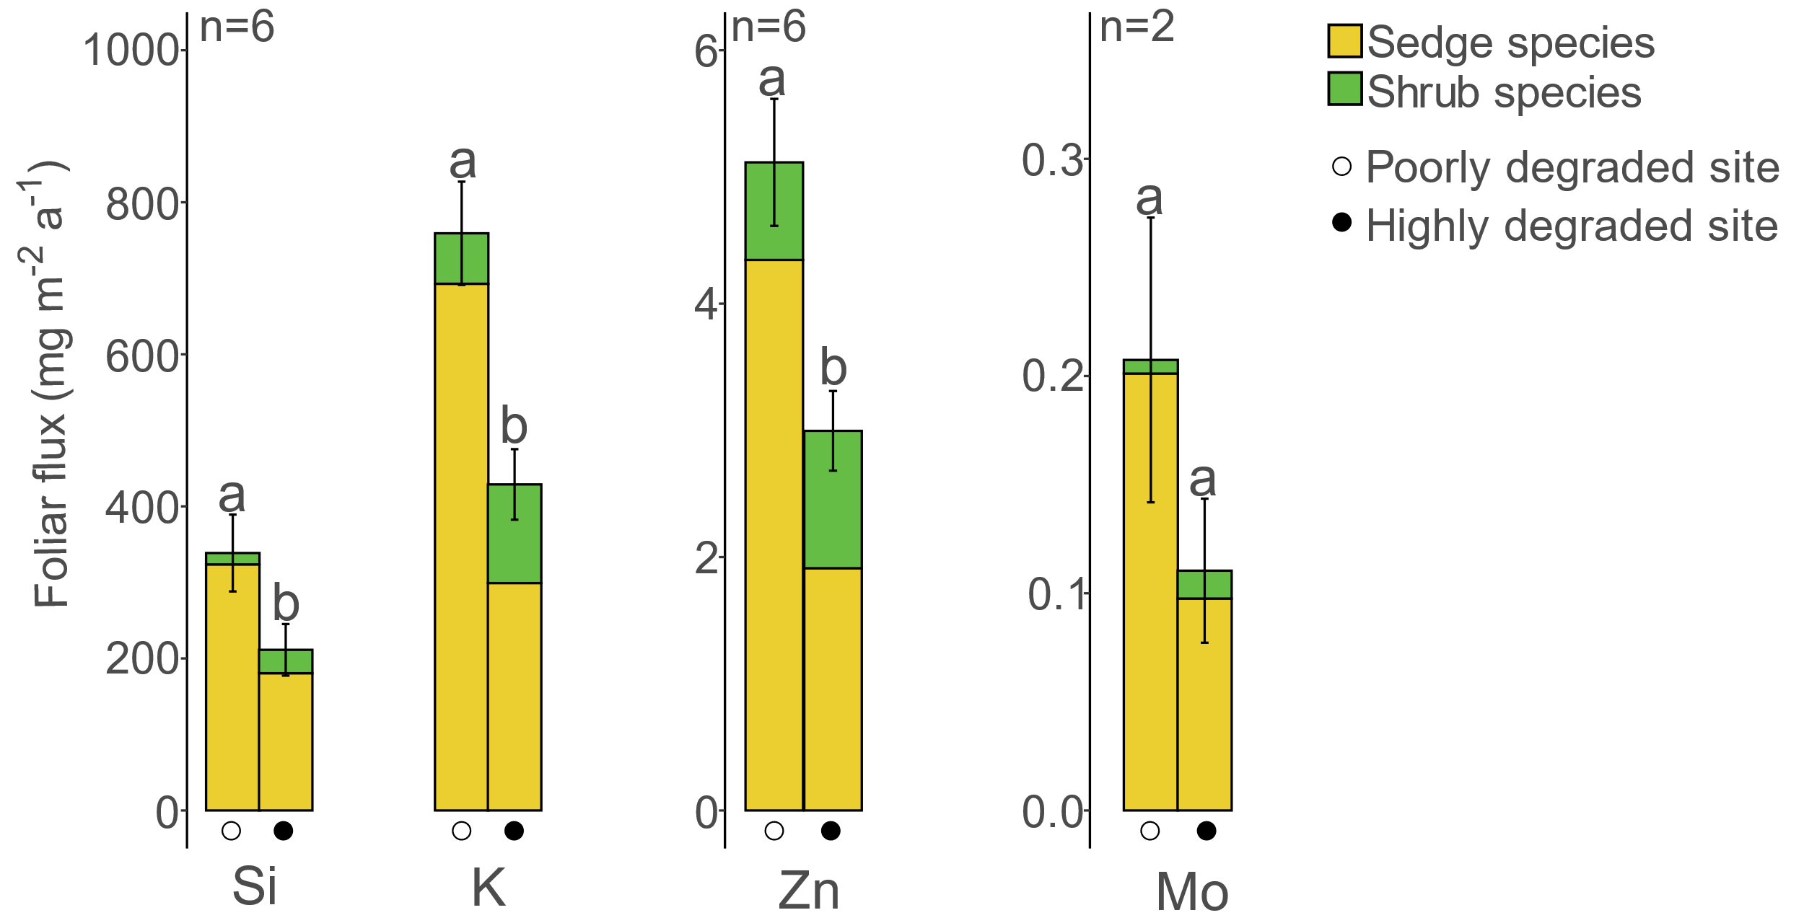
Shift in vegetation influences foliar flux to the topsoil
Notes:
Thanks to foliar vegetation samples, we calculated the foliar flux that returns to the topsoil of different mineral elements
See that mineral element concentration is different between species and that proportion of biomass between sedge and shrub is different between the two sites, fluxes are differents (colors for species, and permafrost degradation points)
Here for example, we have the example of Si, K, Zn and Mo fluxes which is decreasing with permafrost degradation andvegetation change. So we can expect to a lower concentration of these elements in the topsoil with permafrost degradation

Slide 7
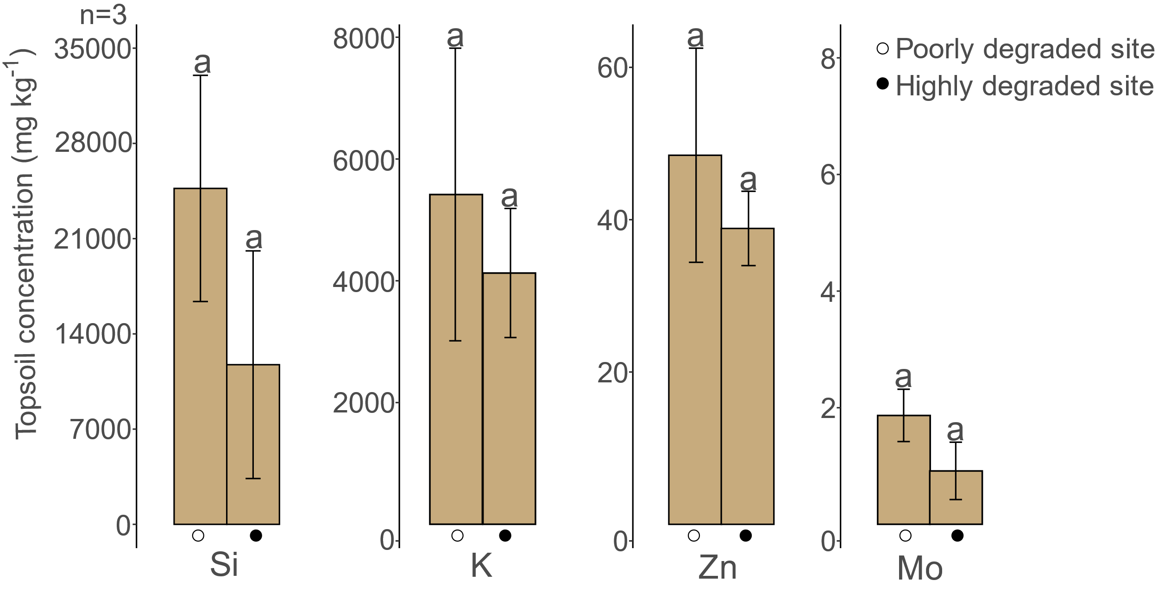
Shift in vegetation affects topsoil mineral element concentration
52%
24%
20%
51%
Notes:
And as expected, we can see that topsoil concentration of these elements is decreasing with permafrost degradation

Slide 8
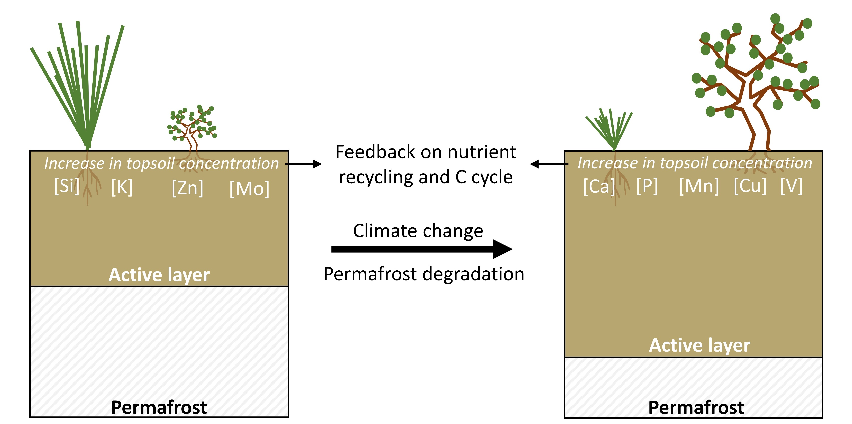
Expected changes in topsoil element composition
Notes:
I studied other elements that I did’nt show you today but with sedge expansion, these elements are increasing and these elements are increasing with permafrost degradation and shrub expansion
This change in mineral element concentration in the topsoil can create feedbacks by influencing nutrient recycling with vegetation uptake and influencing C cycle because for example Mn can promote OC decomposition in the topsoil, so It can influences the OC decomposition rate

Slide 9
Notes:
Thank you for listening and do not hesitate to contact me and read this paper if you are interested by this subject!

