Slide 1






Operational short-term hydro-ecological forecasting for algae-related threats in seawater desalination
Maria Sklia, Kyriakos Kandris, Evangelos Romas, and Apostolos Tzimas
https://ifos.emvis.gr/
@iFOS_Project
kkandris@emvis.gr

Slide 2
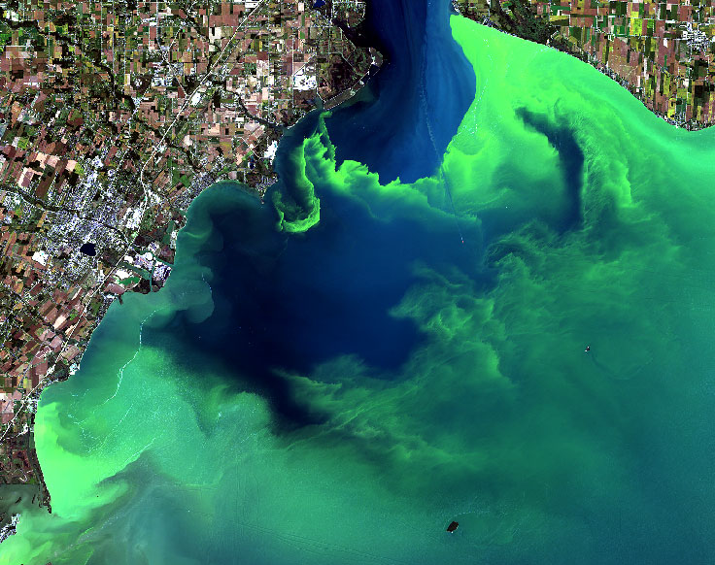
Ecological extremes in the coastal domain
During the last two decades, anthropogenic pressures combined with climate change have stimulated the prevalence, significance, and geographic extent of algal blooms, i.e., the proliferation of microscopic algae in seawater.
Algal blooms pose an emerging operational threat at a global scale for the blue growth sector.

Slide 3
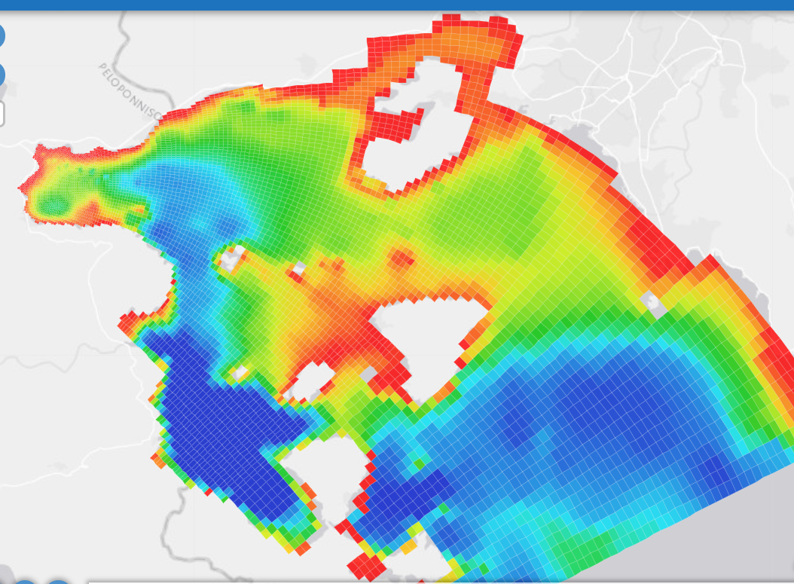
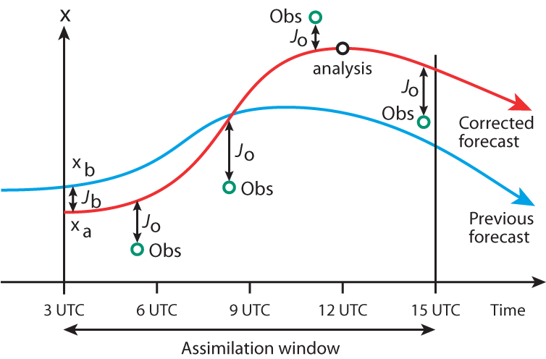
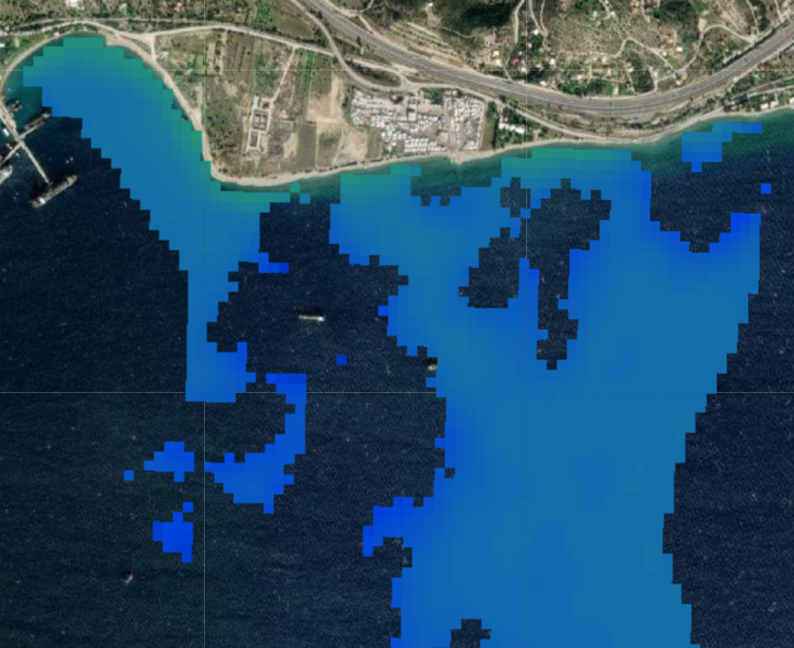

An operational early warning system for algal blooms
Leveraging the wealth of satellite-derived data to develop data-oriented models of highly complex and dynamic biological systems at fine spatial and temporal resolutions.
The onset of a bloom event is notoriously difficult to predict; a credible representation of the physical component of the system is required.
Physical component
A three-dimensional, coupled hydrodynamic-wave model predicts the circulation patterns, mixing, water temperature, and salinity dynamics.
Water quality component
A spatiotemporal machine learning model maps hydrometeorological predictors to chlorophyll-a.
Data assimilation
Automatic real-time assimilation of Earth-Observation-derived water temperature improves the predictive abilities of the physical component using a variational assimilation scheme.
Early Warning System (EWS)
An EWS forecasts the probability of exceeding a threshold of chlorophyll-a in the coastal domain environment for lead times up to 5 days.

Slide 4
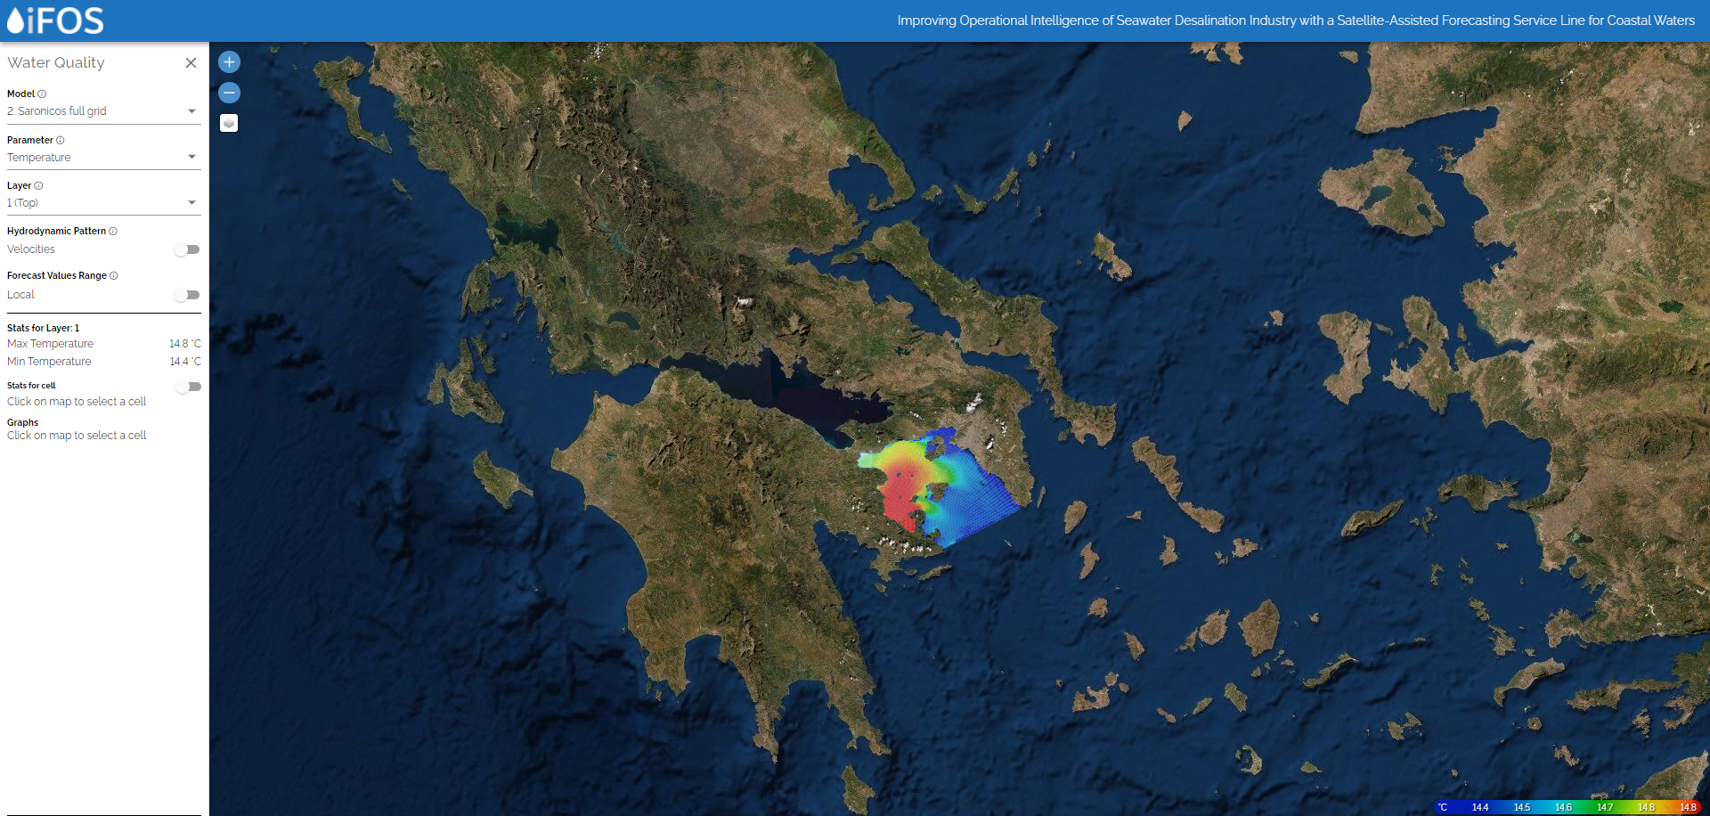
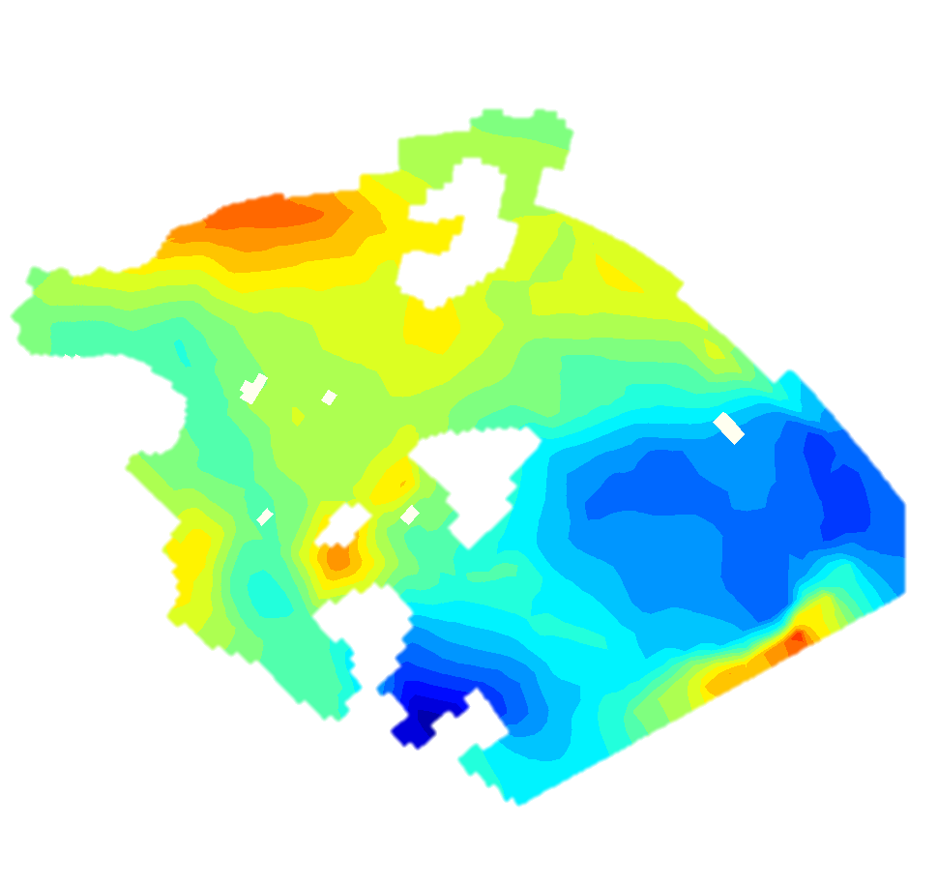
The physical component of the forecasting system ...
...is a coupled hydrodynamic-wave model implemented over Saronikos Gulf in Greece.
The model has been validated using medium-resolution satellite-derived data of sea temperature for a ten-month long period.
Validation (w/o assimilation) offered strong evidence supporting that the model captures the spatiotemporal variability of sea temperature sufficiently.
Mean absolute error (MAE) is below 1.6 ºC when temporally aggregated.
MAE is below 1.3 ºC in the area of interest.
Computational domain: Saronikos Gulf-GR
Curvilinear Structured Grid
Varying cell sizes: 100 m to 1000 m (average 600 m)
Area of interest (water abstraction of the desalination plant)
1.59 ºC
External forcings
Meteorology: Wind field, Temperature, Humidity, Cloud cover (ERA5)
Hydrodynamics: Water level, water TMP, salinity (CMEMS MED-Currents, EAS5 system)
Wave action: Wave Height, period, and direction (CMEMS MED-Currents, EAS5 system)
1.07 ºC
MAE, Feb 2018 – Dec 2018

Slide 5
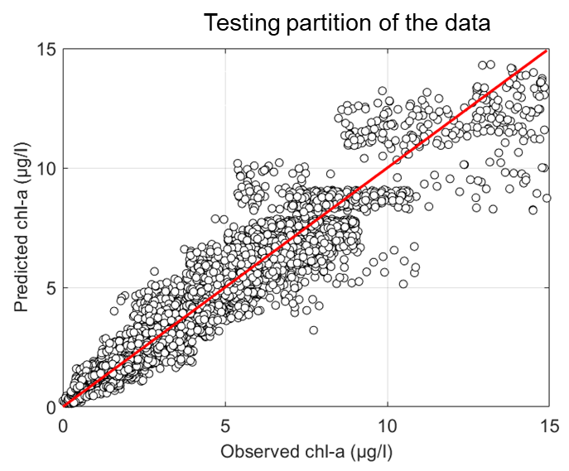

The water quality component of the forecasting system ...
… is a spatiotemporal Random Forest model that maps hydrometeorological predictors to chlorophyll-a.
Random Forests and Gaussian Process regression models were tested. RFs were preferable in terms of accuracy and interpretability.
The model has been trained, validated, and tested using medium-resolution satellite-derived chl-a over a two-year-long period.
MAE for the held-out data is below 1.0 μg/l; the model slightly underpredicts chl-a values that exceed 12 μg/l.
Water temperature
Sea Physics
Mixed layer thickness
NH₄
Sea Biogeochemistry
Target
NO₃
Chl-a concentration
Multi satellite and Sentinel-3 OLCI observations
PO₄
Air Temperature
Meteorology
Wind speed
Predictors
Radiation

Slide 6
The early warning system ...
... forecasts the probability of exceedance of a critical chl-a concentration up to five days in advance.
Reforecast experiments indicate that the forecasting system can replicate phytoplankton dynamics adequately up to five days ahead.
Skill performance drops slightly from day-ahead to five-day-ahead forecasts, mostly due to the impact of meteorological uncertainty.
The skill close to the shoreline is worse compared to the deeper parts of the domain.
Larger evaluation periods are required to enhance statistical significance of the skill evaluation.
Brier score –
Day-ahead forecast
0.06
0.05
0.04
0.03
0.02
0.01

Slide 7
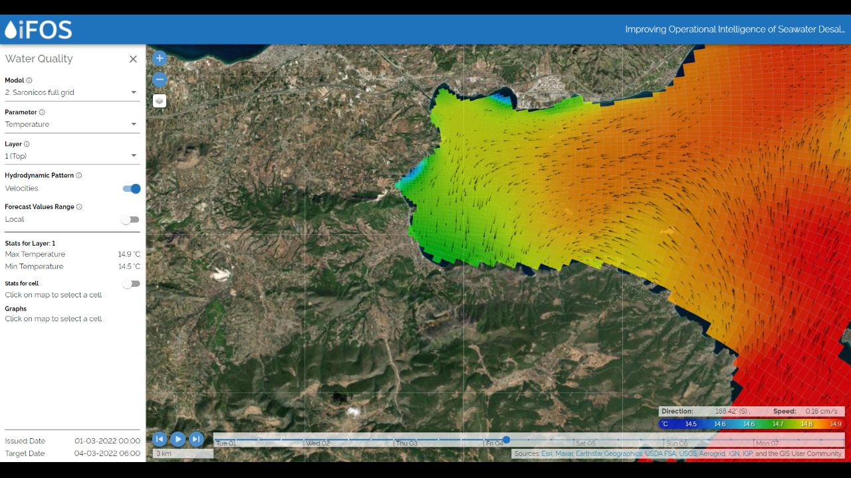
Concluding remarks
A multi-model chain has been developed to forecast phytoplankton dynamics in coastal environments.
The physical component of the modeling chain replicates water temperature variability in space and time adequately.
This is vital for the accurate representation of phytoplankton dynamics.
The adding value of near-real-time DA has not yet been evaluated.
The water quality component represented phytoplankton dynamics accurately, even under unseen conditions (low generalization errors).
A threshold-based EWS was also tested against its ability to forecast the probability of exceeding a critical chl-a value.
The EWS is trustworthy up to five days ahead.
Larger evaluation periods are required.
Benchmarking with alternative forecasting solutions will be performed to evaluate the adding value of the EWS.

Slide 8


Thank you for attending!
https://ifos.emvis.gr/
@iFOS_Project
kkandris@emvis.gr
iFOS project is supported by a grant from Iceland, Liechtenstein and Norway through the EEA Financial Mechanism 2014-2021, within the framework of the Programme "Business Innovation Greece".

