Slide 1



Isotopic characterisation of methane
Insights from clumped isotope measurements
Malavika Sivan¹, Anna Wallenius², Thomas Röckmann¹, Caroline P. Slomp³, Carina van der Veen¹, Maria Elena Popa¹
1Institute of Marine and Atmospheric Research, Utrecht University, Utrecht, Netherlands
2Department of Microbiology, Institute of Water and Wetland Research, Radboud University Nijmegen, Nijmegen, Netherlands
3Department of Earth Sciences, Faculty of Geosciences, Utrecht University, Utrecht, Netherlands

Slide 2
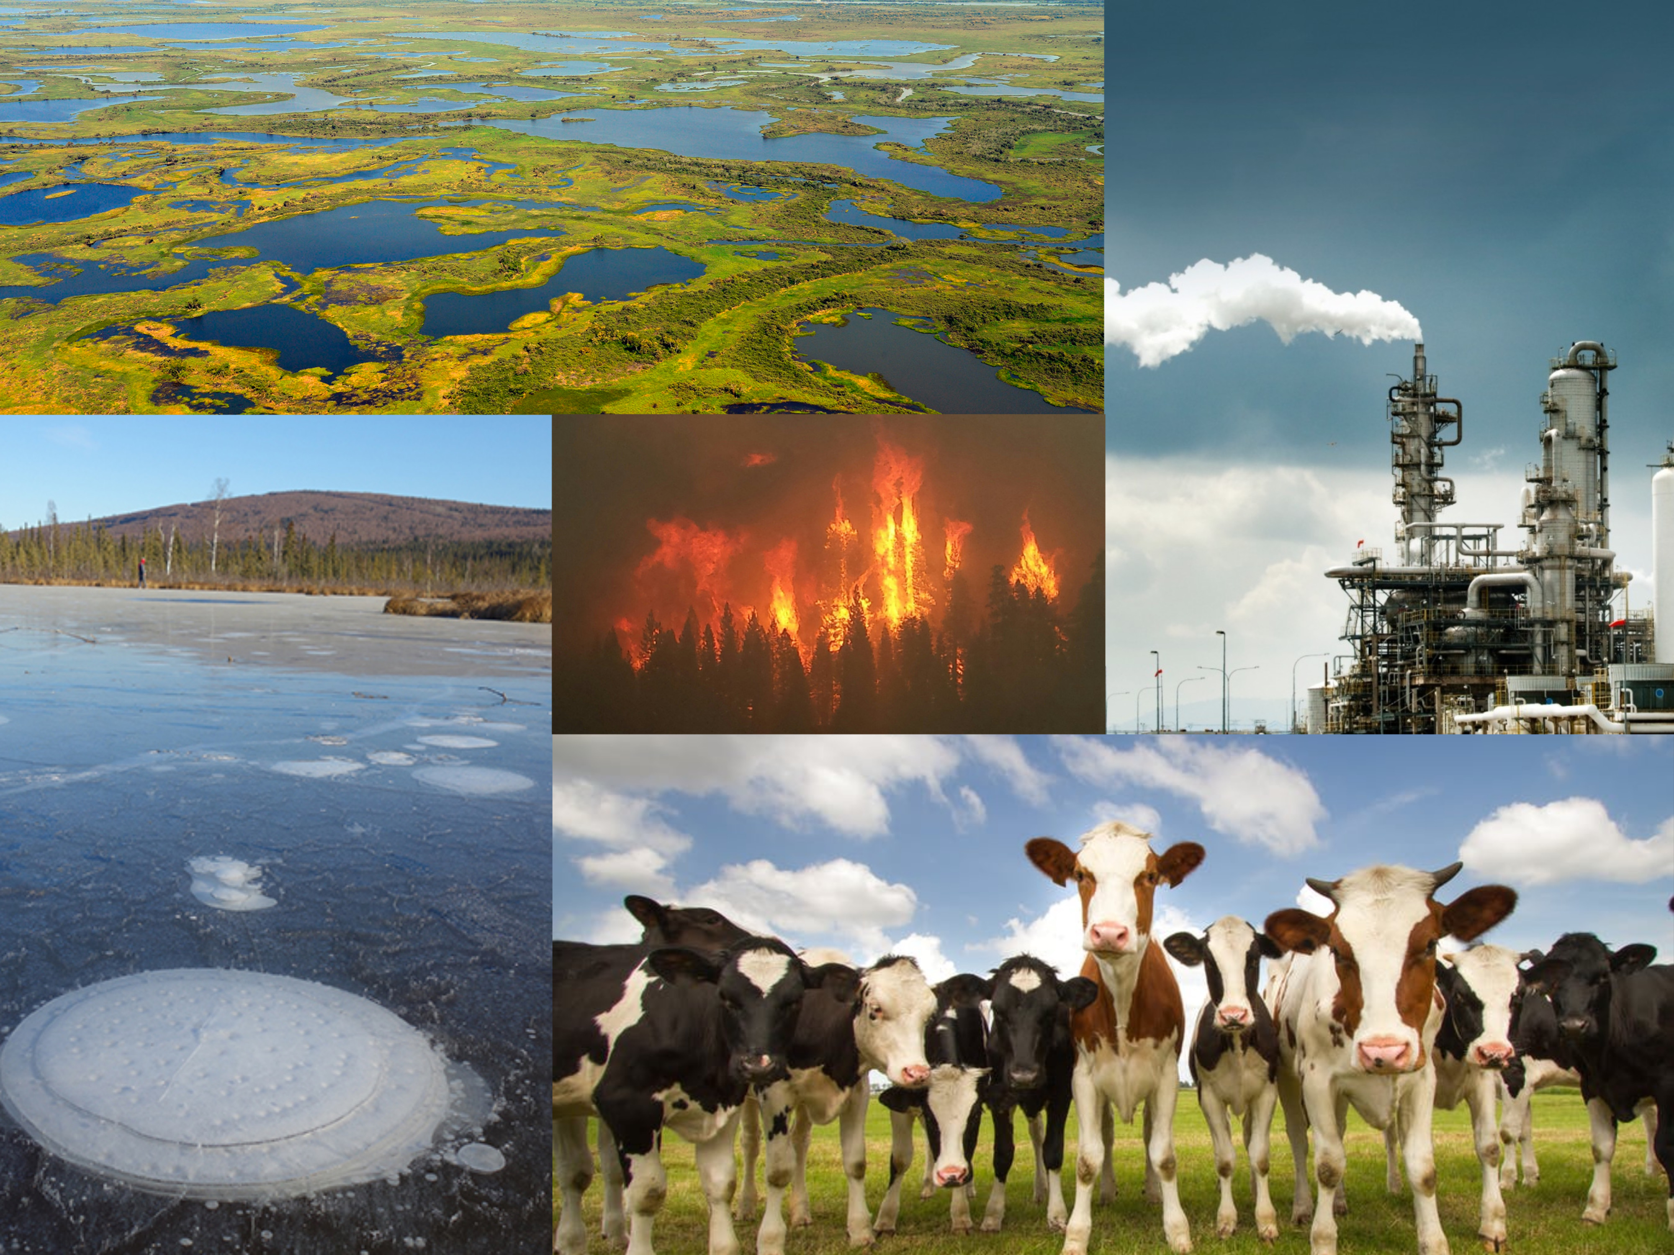
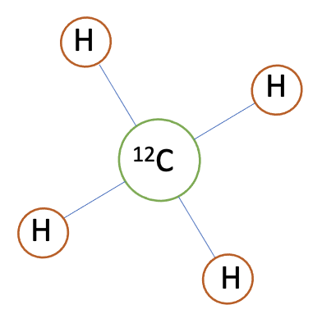
Introduction
Methane sources
Thermogenic Biogenic Pyrogenic

Slide 3
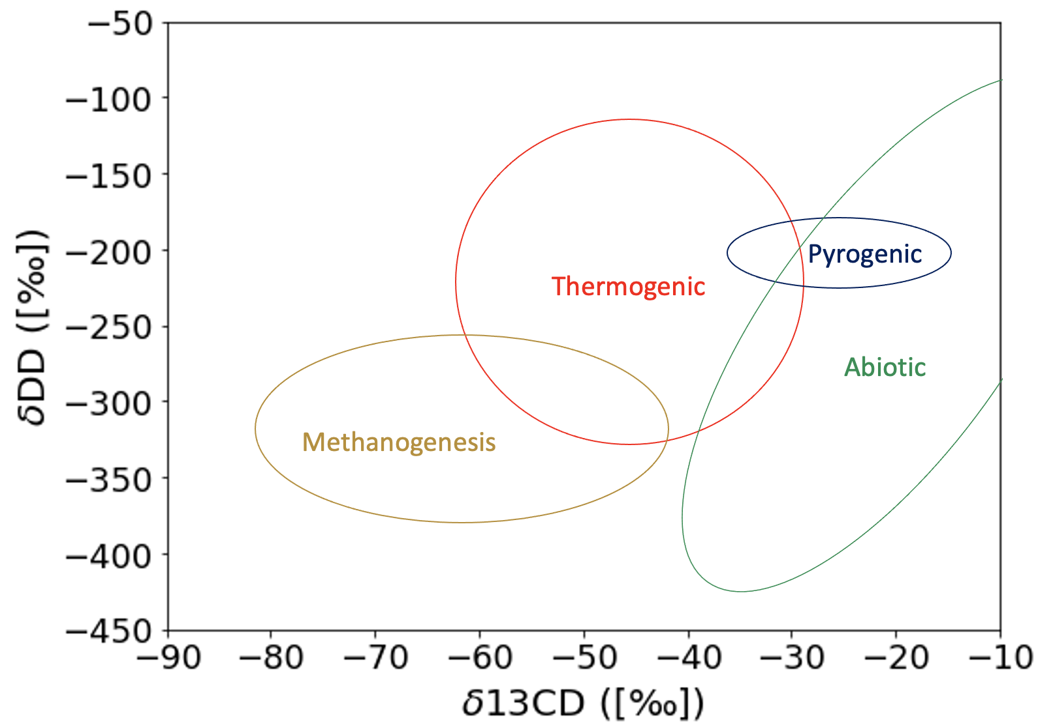
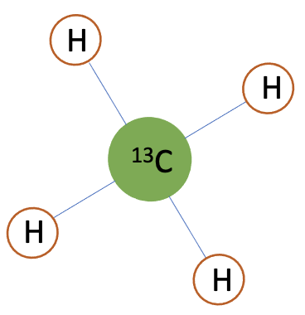
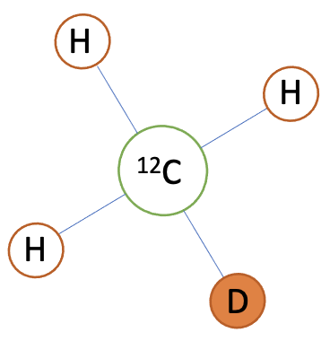
Introduction
Bulk Isotopologues
¹³CH4
CDH3

Slide 4
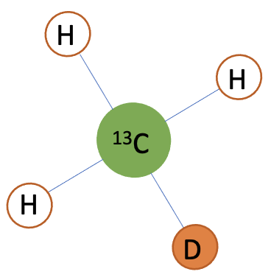
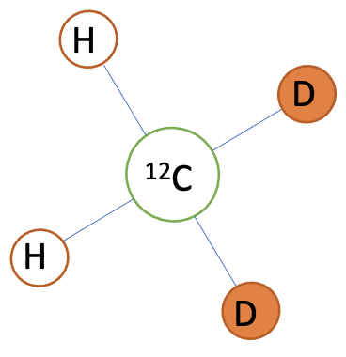
Introduction
Clumped Isotopologues
△ = Clumping anomaly
Temperature dependent!
¹³CDH3
CD2H2

Slide 5
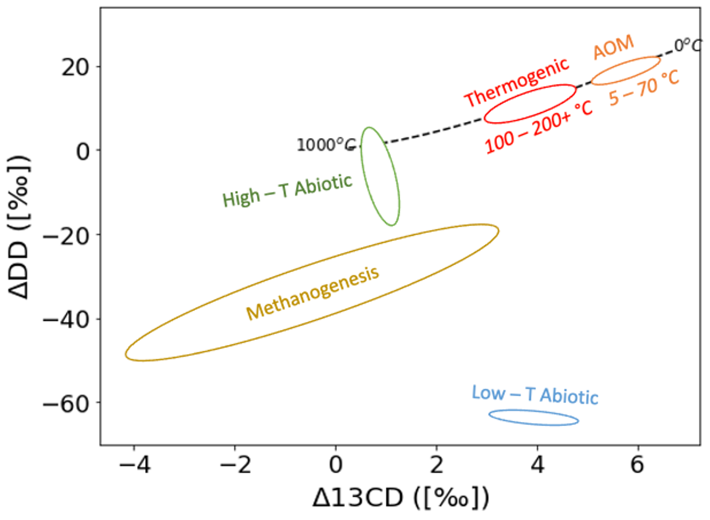

Introduction
Bulk vs Clumped Isotopologues
Ref: Malika Menoud
Ref: J. L. Ash et al., 2019

Slide 6
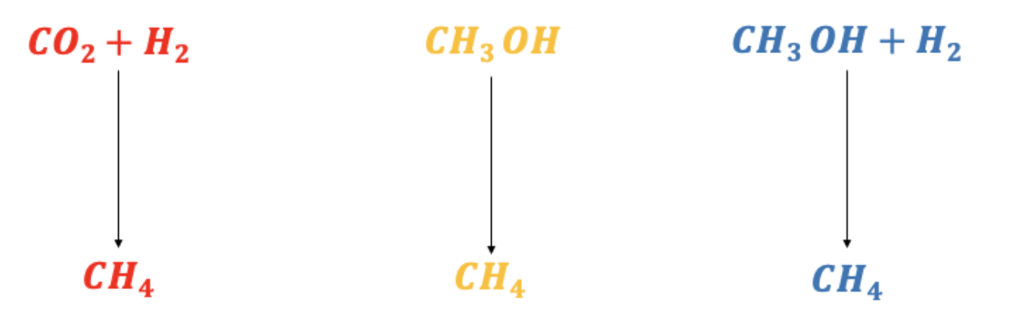
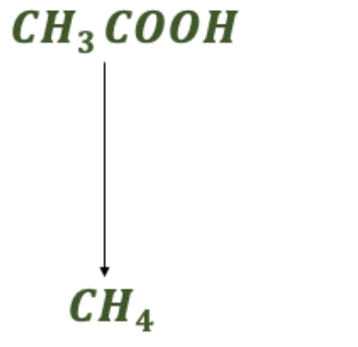
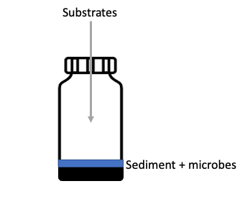
Results
Microbial methanogenesis pathways : Incubation experiments

Slide 7
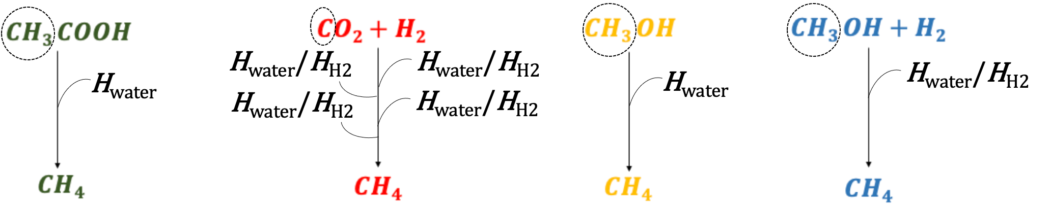
Results
Microbial methanogenesis pathways : Incubation experiments

Slide 8
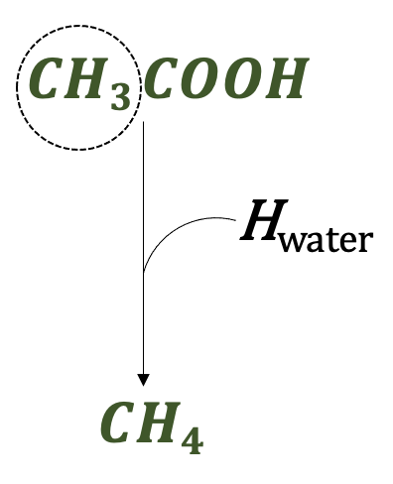
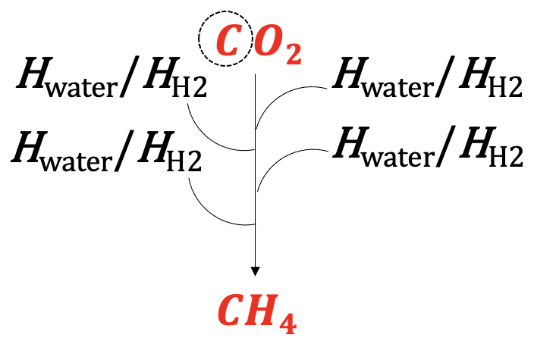
Results
Microbial methanogenesis pathways : Incubation experiments
Bulk isotopologues
Clumped isotopologues

Slide 9
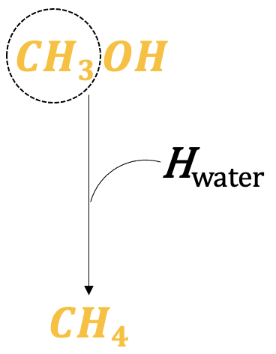
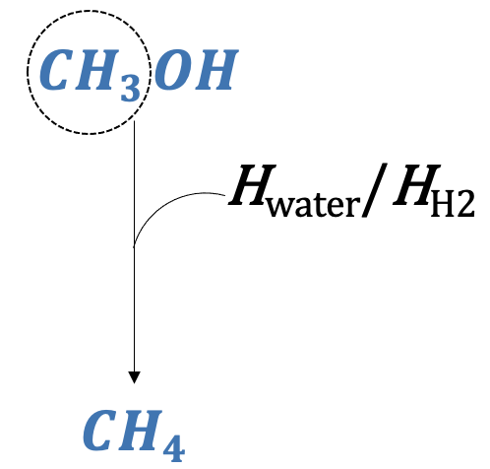
Results
Microbial methanogenesis pathways : Incubation experiments
40 ‰
VS
>10 ‰

Slide 10
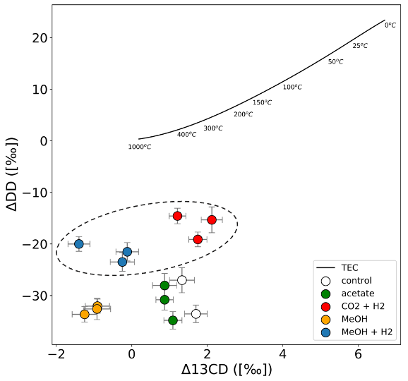
Results
Microbial methanogenesis pathways : Incubation experiments

Slide 11
Conclusion
Clumped isotopologues serve as an additional constraint to distinguish methane sources.
It can be used to calculate the formation temperature when methane is formed in equilibrium.
And in the case of disequilibrium, to study the different kinetic fractionation pathways.
Thank you…
Contact: m.sivan@uu.nl

