Slide 1
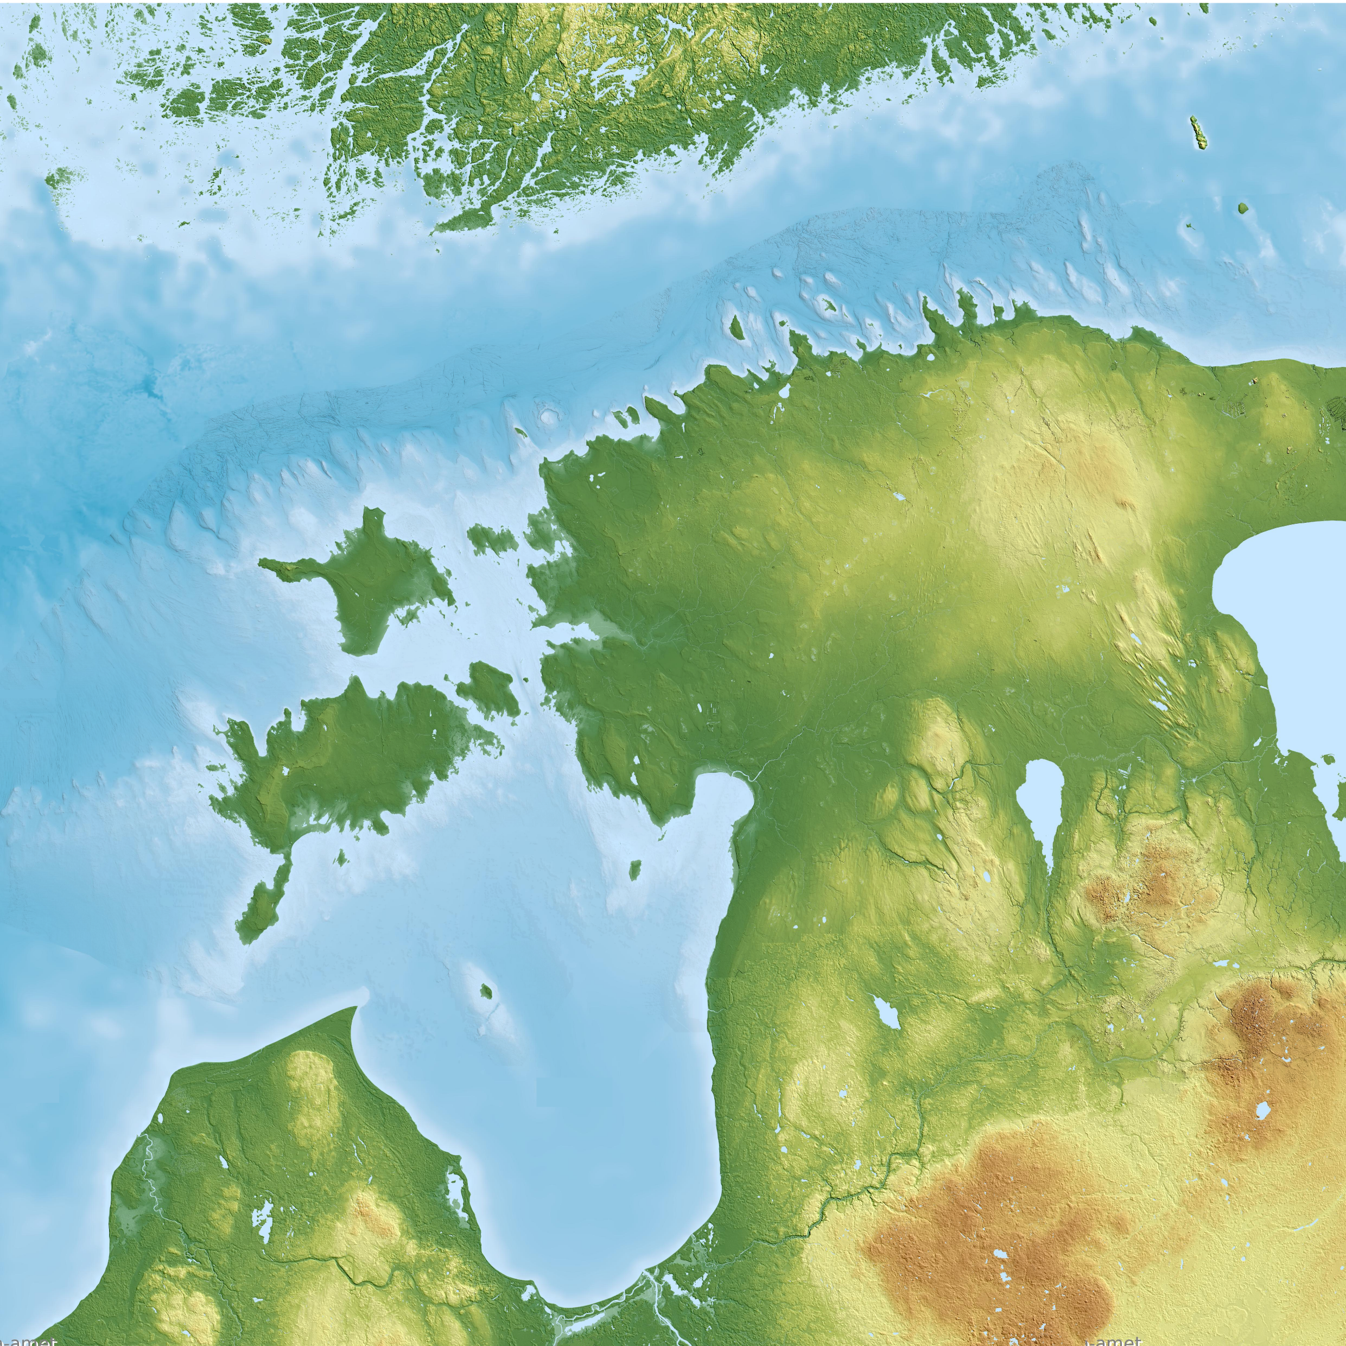
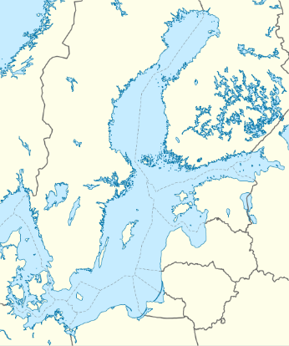




Submarine glacial landscapes of the Western Estonian Shelf and implications for ice-flow reconstructions
Vladimir Karpin, Atko Heinsalu and Joonas Virtasalo
FI
EE
SWE
RU
LV
LT
24.05.2022
Notes:
Geomorphological studies of the bottom of the Baltic Sea are still scarce and little is directly known about glacial bedforms and the palaeo-ice flow dynamics in the area.
However, recently collected high resolution multibeam bathymetric data from the Western Estonian territorial waters and Exclusive Economic Zone reveals direct geomorphological evidence of glacial bedforms, such as iceberg scours (ploughmarks), streamlined features like drumlins, and a recently discovered subglacial landform called murtoo, enabling the reconstruction of ice-flow patterns on the Western Estonian shelf as well as the better understanding of subglacial hydrology.

Slide 2
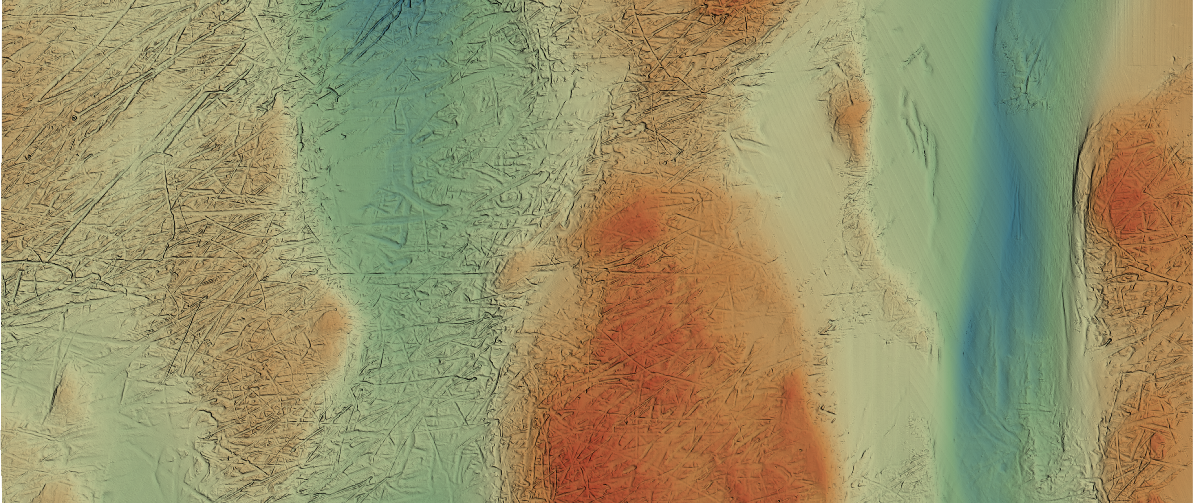
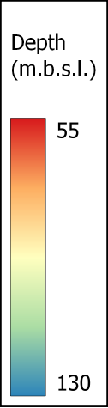
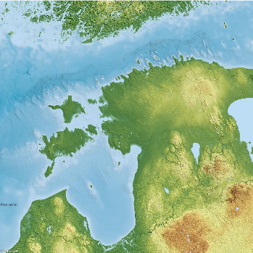
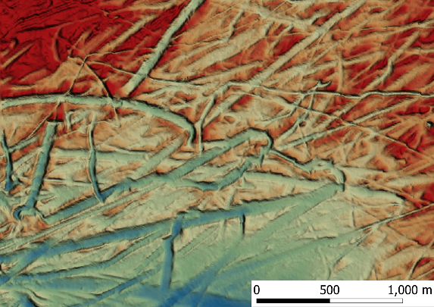
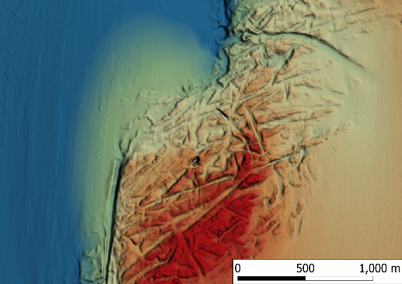
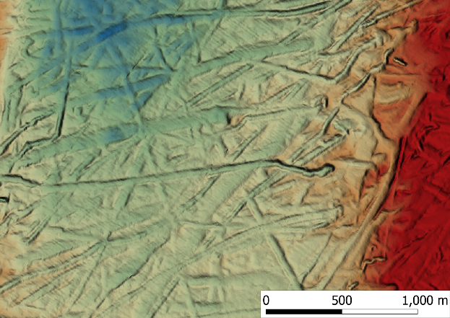

Iceberg scours (ploughmarks)
Notes:
High-resolution multibeam data reveal widespread linear and curved depressions, interpreted as iceberg scours, produced by ploughing and grounding icebergs during and soon after the final ice retreat from the area, approximately around 13.2 to 12.3 kyr BP (click).
Scours can be observed changing direction (click), leaving marks on a single impact (click), and running aground as it gets shallower.
We recognize two populations of scours. The first is formed on top of the coarse-grained glacial deposits with an average orientation of NE to SW. The second population is formed on top of the superimposed glaciolacustrine and post-glacial sediments exposed on the seafloor, with an average orientation of ENE-WSW. The scours of both populations are on average 780 m long, 54 m wide and 1.6 m deep.

Slide 3
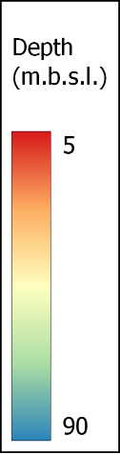
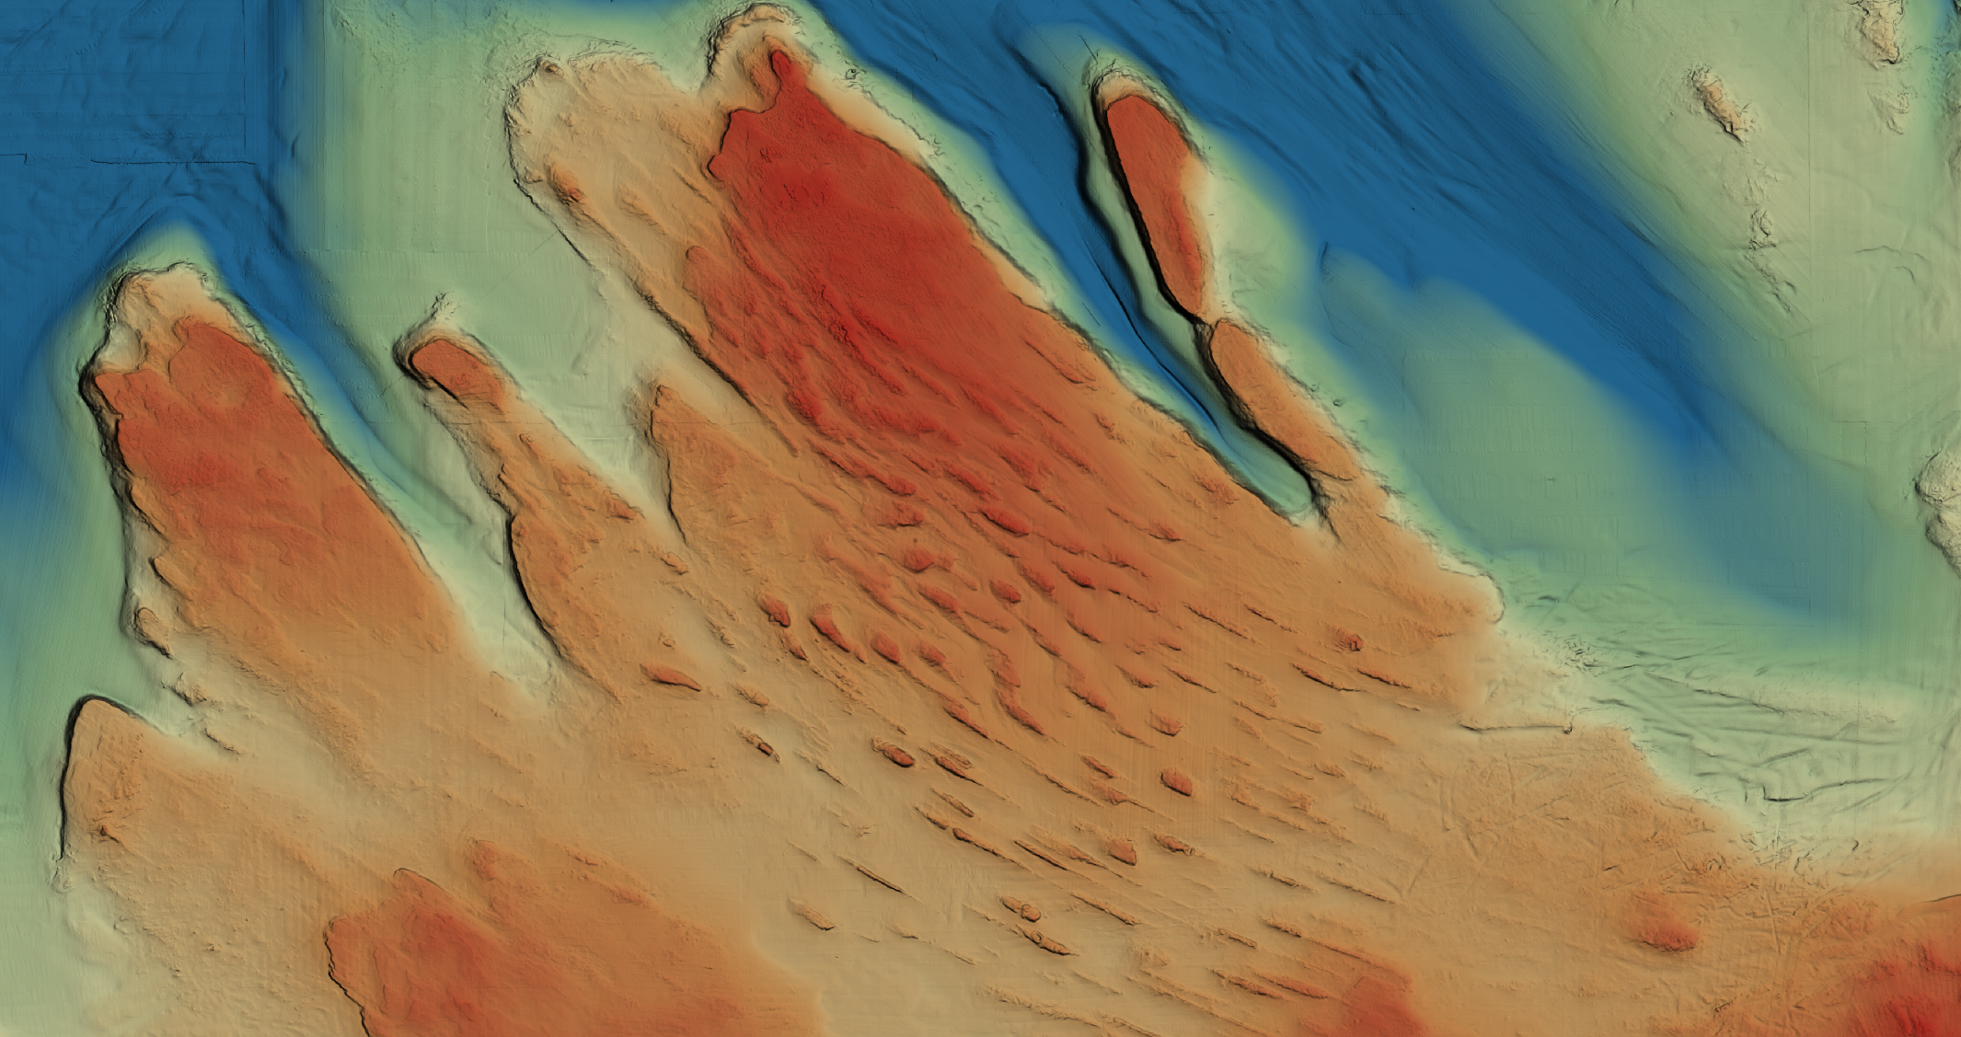

Streamlined features
Notes:
We also report a well-preserved geomorphological record of streamlined bedforms (mostly drumlins). We identify two diverging flow sets, consisting of 723 streamlined bedforms, partially continuing onshore, revealing ice sheet behaviour in the area before the time of Palivere stadial (13.2 kyr BP). This is one of those sets.

Slide 4
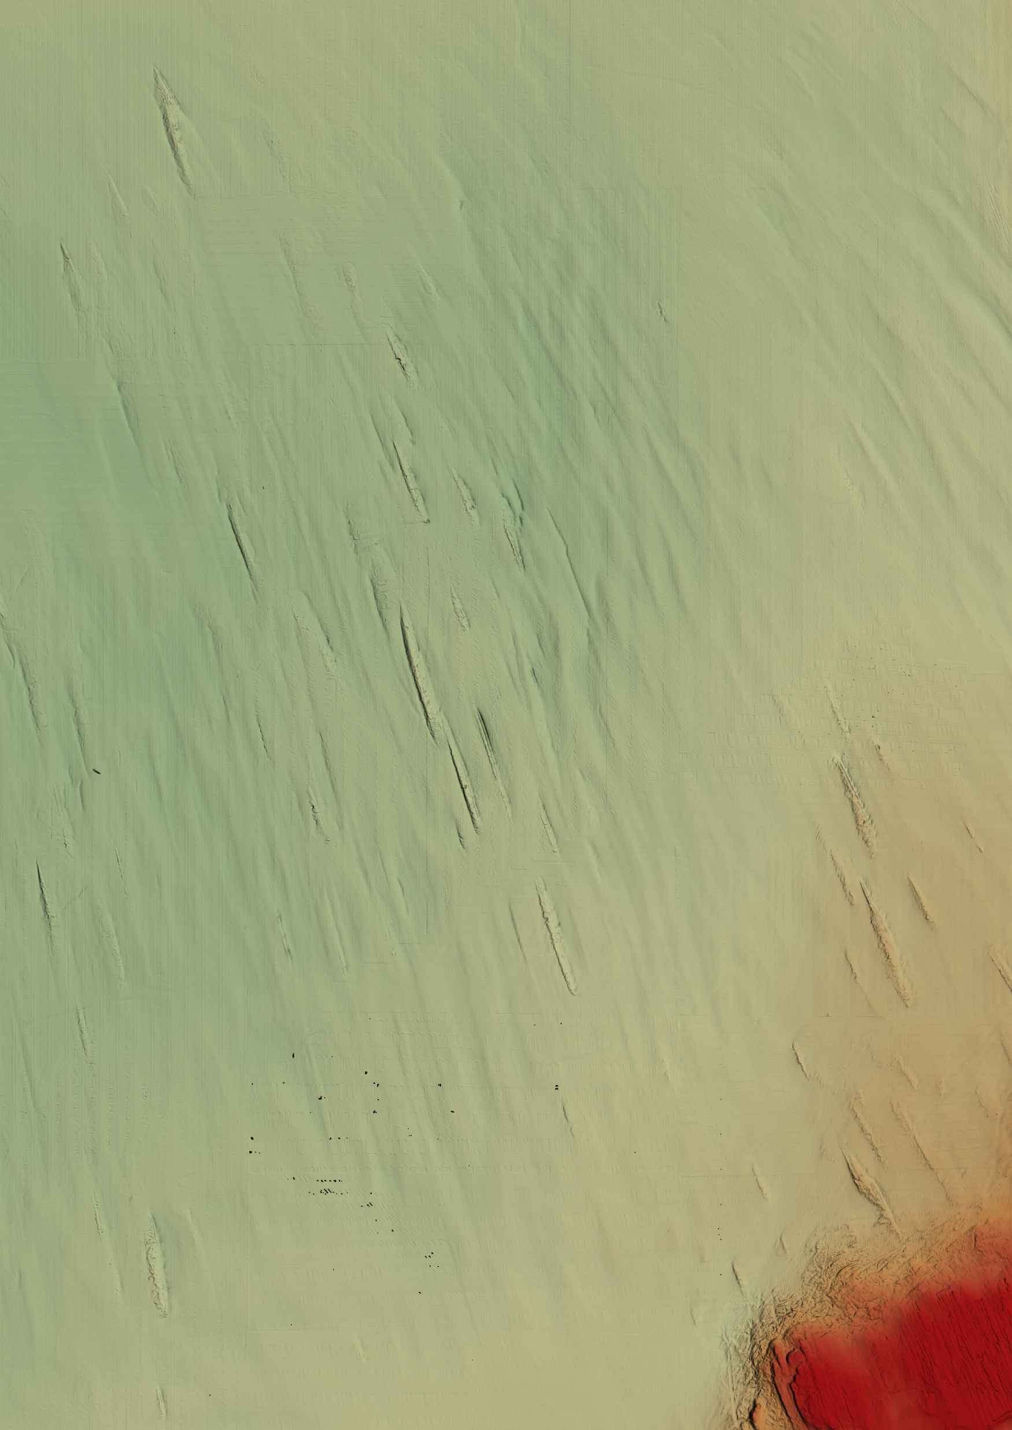

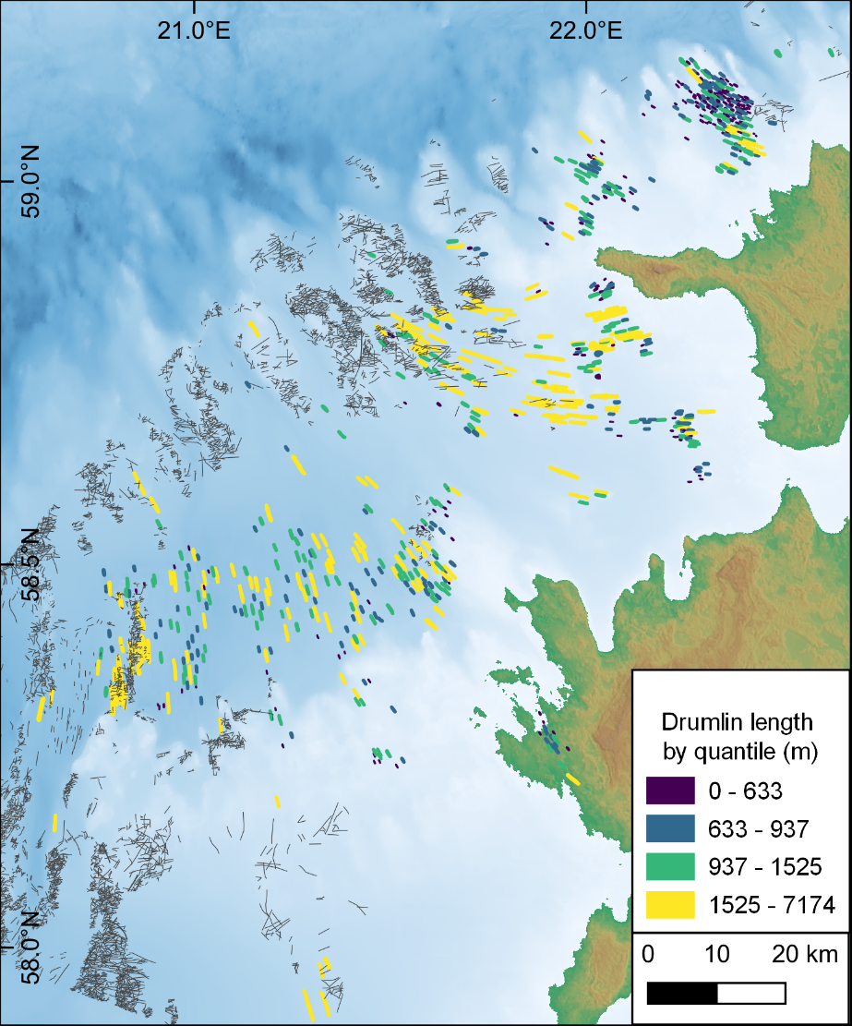
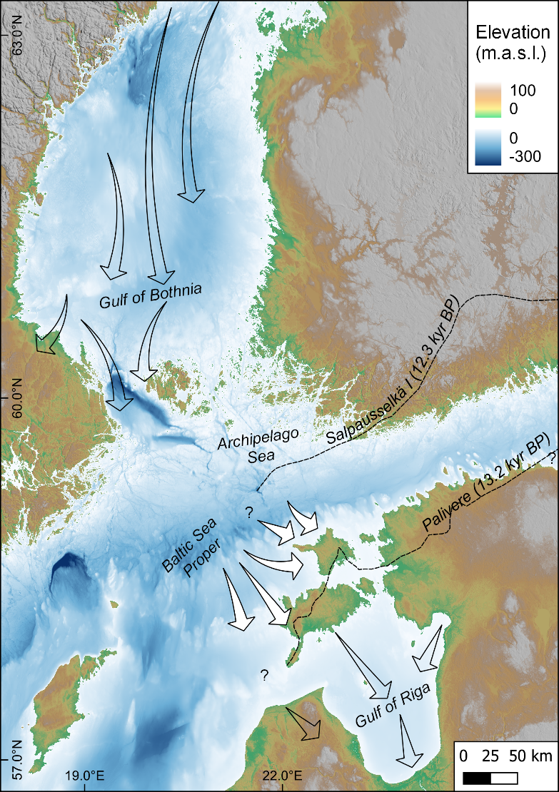
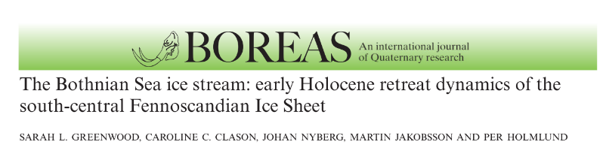
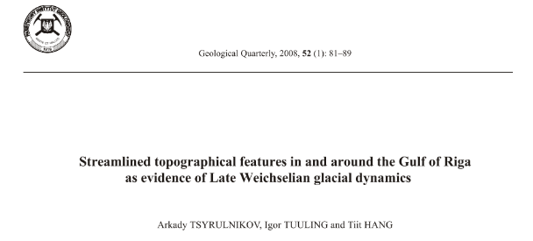
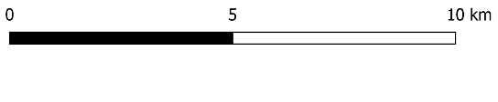
Streamlined features
Notes:
Here are the examples from another set, containing more elongated features, compared to those on the previous slide. It has a well-pronounced divergent pattern with a variation in feature orientation of 200○. (click)
Here are the mapping results for both iceberg scours and streamlined features. (click). Streamlined features are shown as coloured lines and scours are shown as black lines.
Reconstruction of ice retreat is shown with white arrows. Transparent arrows show previous ice flow reconstructions by other authors in the Gulfs of Bothnia (click) and Riga (click).
The observed ice-flow directions permit refining earlier reconstructions and conclude that there were no significant ice-margin standstills in the area. There is still a missing link remaining, an area in the Baltic sea proper, between the current study area and the Gulf of Bothnia.

Slide 5
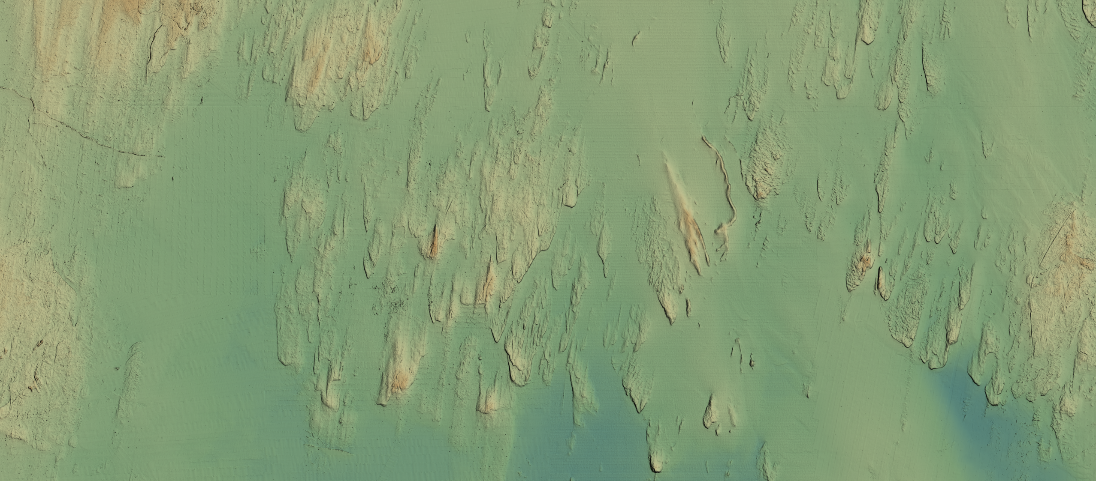

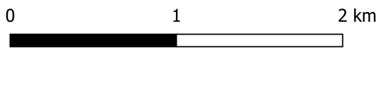
Murtoos
Ice flow
vladimir.karpin@ttu.ee
Notes:
A new morphologically distinct triangular-shaped subglacial landform known as “murtoo” discovered just 5 years ago in Finland and Sweden with the help of LIDAR was just discovered for the first time in high-resolution bathymetric multibeam data from the bottom of the northern Gulf of Riga.
Murtoos could potentially improve our understanding of subglacial hydrology and the dynamics of rapidly melting ice, as murtoos are thought to be formed by repeated flooding of ribbed bedforms along subglacial meltwater corridors followed by subsequent deformation by the ice sheet. Murtoos consist of heterogenous diamictic and sand-dominated sediments and come in a variety of sub-shapes, including classic “triangle”, “chevron” and “lobate” types, as well as diverse murtoo-related ridges, mounds, and escarpments.

