Slide 1



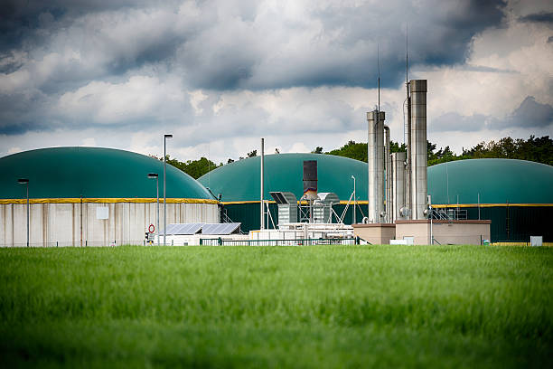
Effect of organic loading rate on biogas production and concentration of heavy metals and valuable elements in continuous anaerobic co-digestion of manure and reed canary grass Nazia Zaffar, Erik Ferchau, Hermann Heilmeier, and Oliver Wiche Technical University of Bergakademie Freiberg, Biosciences, Bio/Ecology, Freiberg, Germany (naziazaffarqau@gmail.com)
Zn
Ge
Cr
Ni
REEs
Nazia Zaffar
Ph.D Candidate
Technical University Bergakademie, Freiberg, Germany

Slide 2

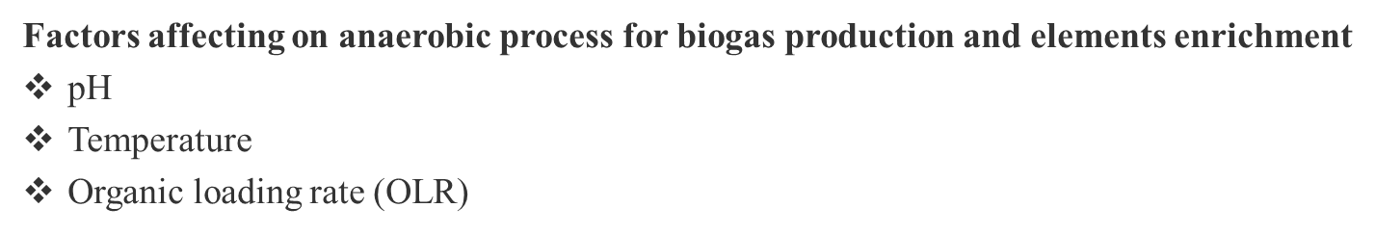
PURPOSE OF STUDY
Effect of organic loading rate on the biogas production
Concentration of heavy metal (Cu, Zn, Ni ) and valuable elements (Ge, Zn)

Slide 3
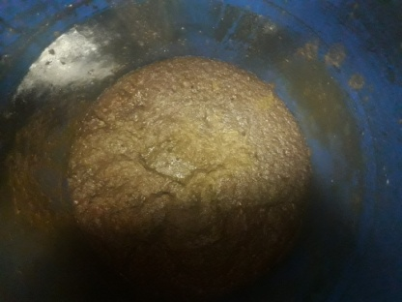
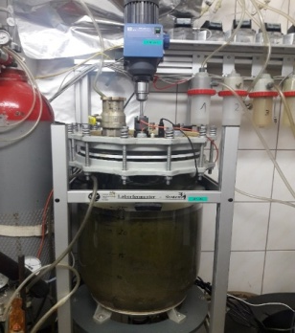
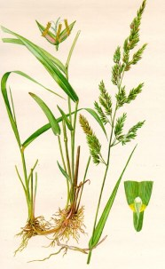
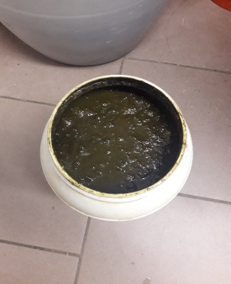
PROCESS CHAIN
Cr
Zn
REEs
Ni
Ge

Slide 4

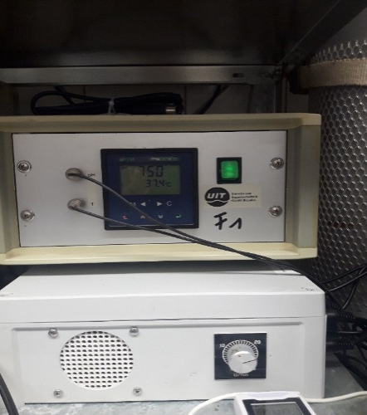
Continues reactor, pH and Temperature
Input Substrate
Propeller
Thermostat
Temp, pH
Gas composition
Gas meter
2.3 liter (Substrate)
Digestate outlet
TU Bergakademie Freiberg | Institut für Biosciences | Telefonnummer: 015901978931 | www.tu-freiberg.de | Vortragender: Nazia Zaffar | Veranstaltungstitel | 27.05.2022

Slide 5
Result 1 Effect of OLR ([kg VS/(m3 d)] on biogas production

Slide 6
Result 2 Effect of OLR on concentration of heavy metals (Zn, Cr, Ni) and valuable elements (Ge, REEs)

Slide 7
Conclusion
OLR fundamentally impacts gas production and mineral element concentrations in digestate
The effects depend initially on element concentrations in biomass and gas production which potentially offers novel perspectives for optimization of biogas process towards a phytomining of valuable elements and use of digestates as secondary raw materials.

