Slide 1
Defining and evaluating the effect of redundant isotopic tracers in the Bayesian unmixing model MixSIAR
Terry Cox & Environmental Geosciences Group
Basel University

Slide 2
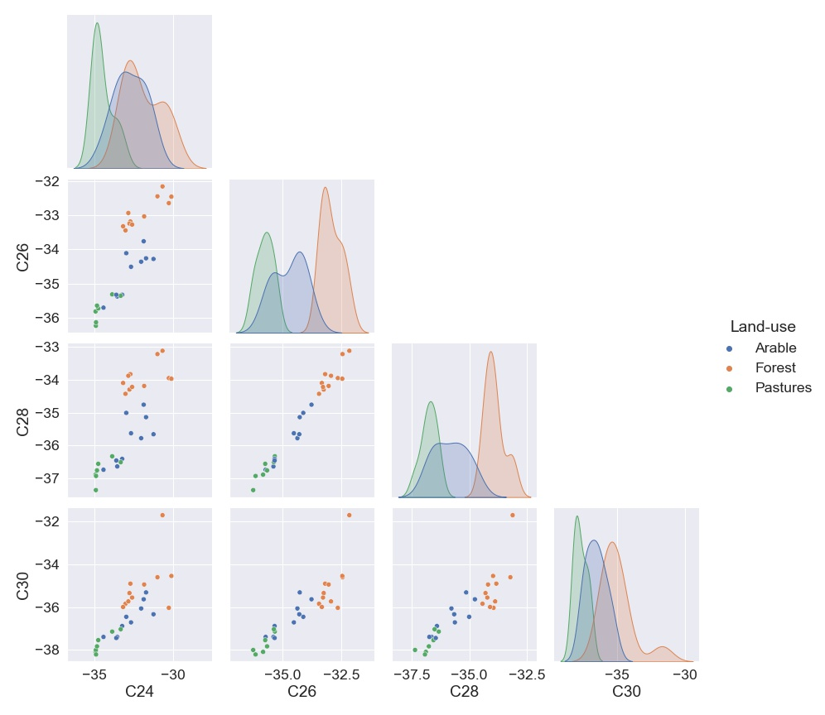
CSSI’s as tracers- current problem
Land-use specific source apportionment is achieved by the use of isotopic signature of bio tracers
However, linear mixing lines have occurred in multiple applications of d¹³C Fatty acid (FA) CSSI tracers
Linear mixing lines can cause highly inaccurate results
An additional land-use specific tracer is required

Slide 3
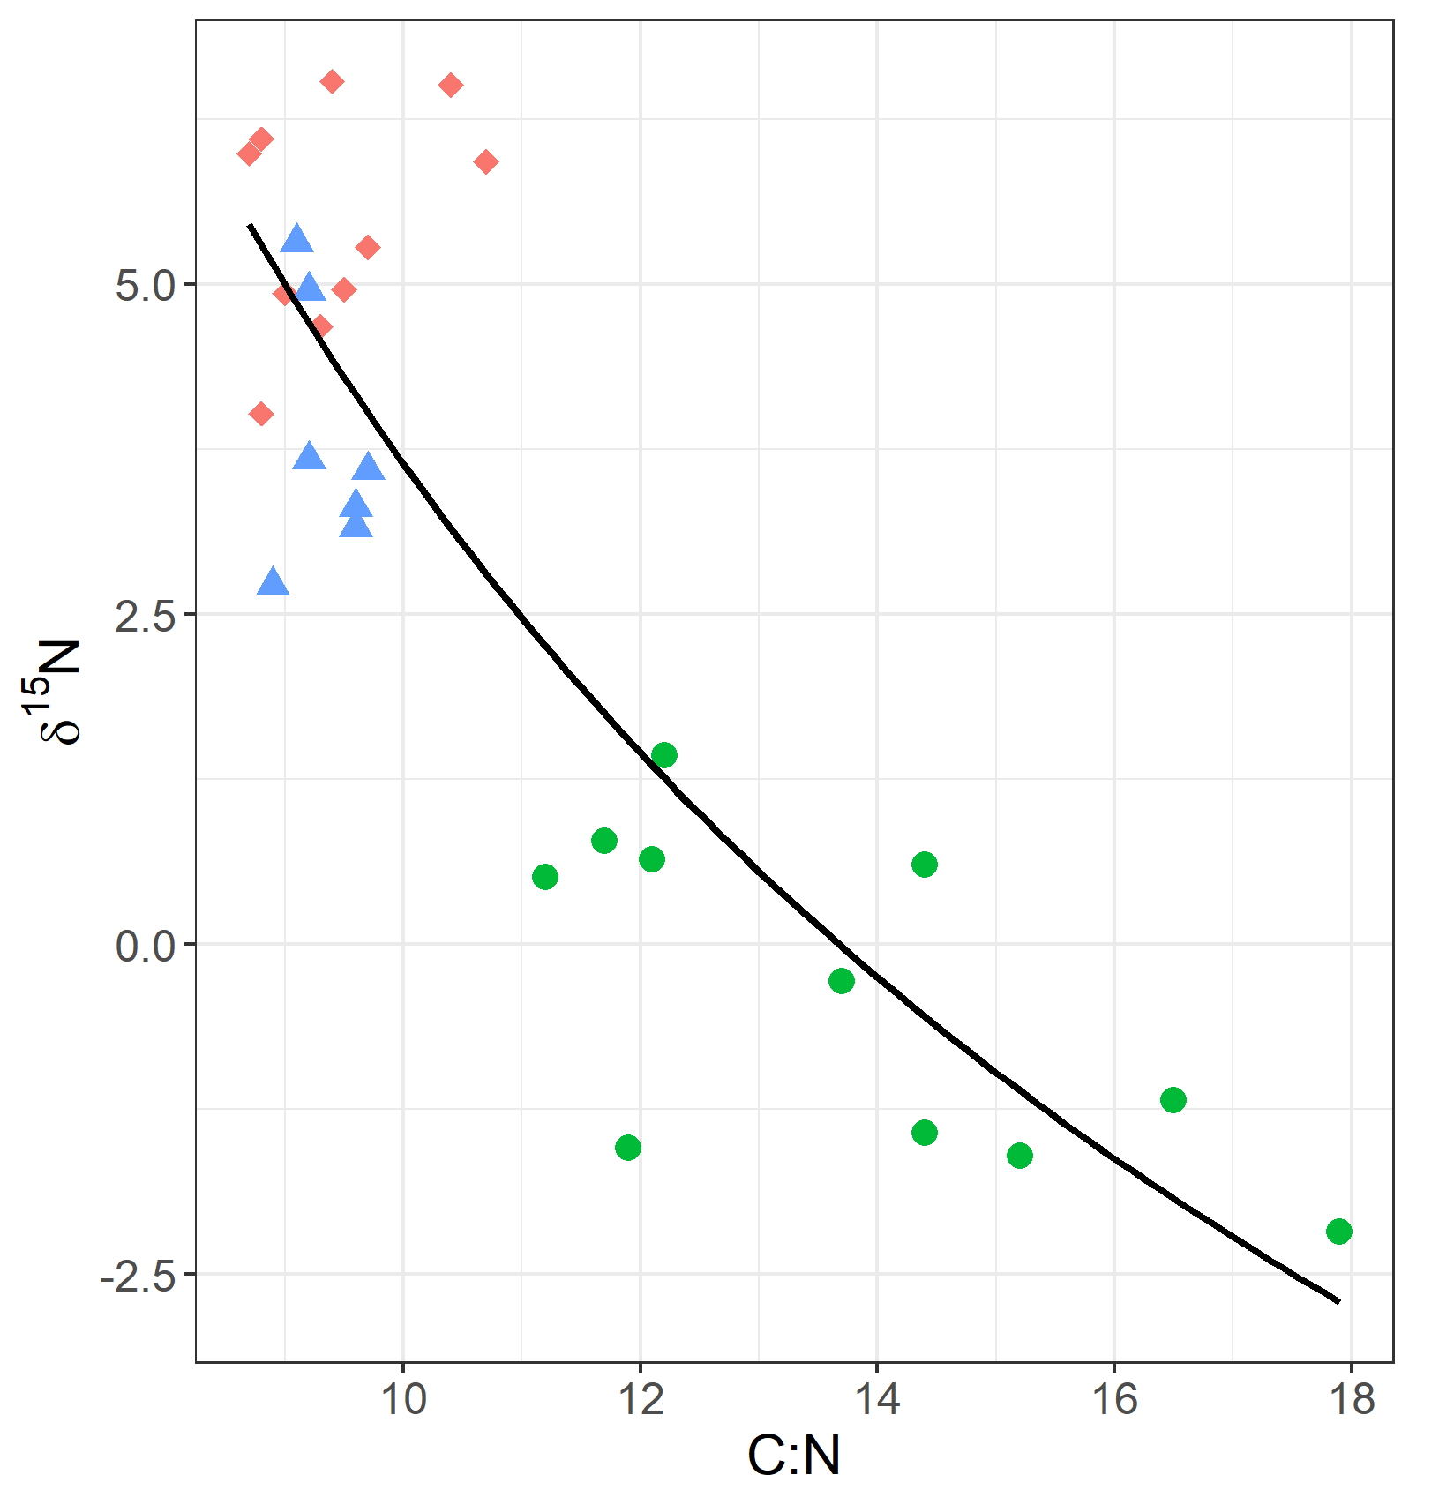
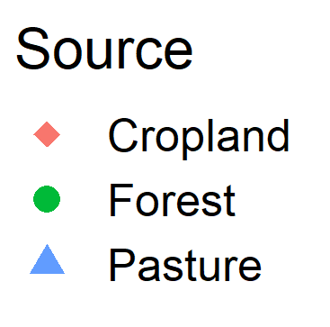
d¹⁵N offset as an additional tracer to Fatty acid CSSI
What is it? d ¹⁵N offset is a measure of the degree of nitrogen cycle perturbation
How ?
In non-nitrogen cycle perturbed areas, bulk ¹⁵N values have been shown to occur in a relatively narrow range for any particular C/N ratio
Deviation from this range suggest nitrogen perturbation
Accelerated nitrogen loss
Arable
Accelerated nitrogen accumulation

Slide 4
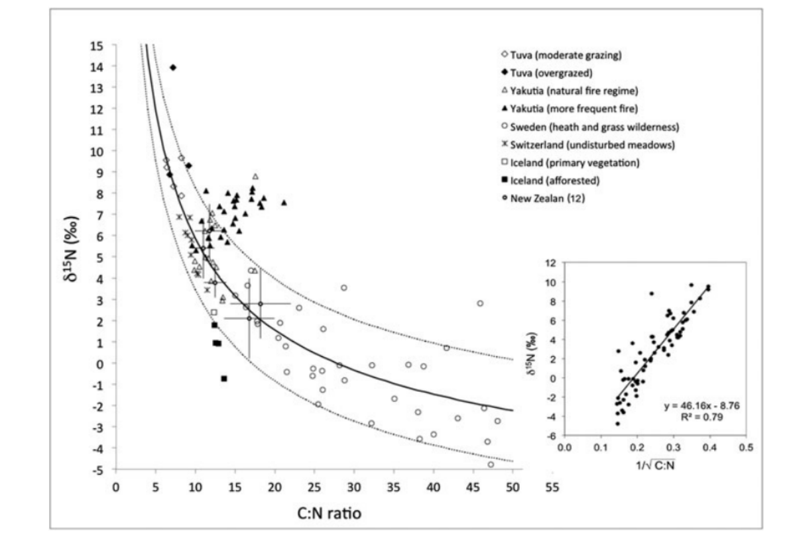
d¹⁵N offset as an additional tracer to Fatty acid CSSI
What is it? d ¹⁵N offset is a measure of the degree of nitrogen cycle perturbation
How ?
In non-nitrogen cycle perturbed areas, bulk ¹⁵N values have been shown to occur in a relatively narrow range for any particular C/N ratio
Deviation from this range suggest nitrogen perturbation
(Conen 2012)
Accelerated nitrogen loss
Arable
Accelerated nitrogen accumulation

Slide 5
Testing d¹⁵N offset and FA CSSI’S with virtual mixtures
Interpretation of the unmixing model performance with out laboratory / virtual mixtures can lead to incorrectly assuming reduced uncertainty equates to increased model performance output
Although commonly used in other fingerprinting methods, virtual mixtures with CSSI tracers are non existent
The only previous performance test of using CSSI tracers in unmixing models are time consuming laboratory mixtures.

Slide 6
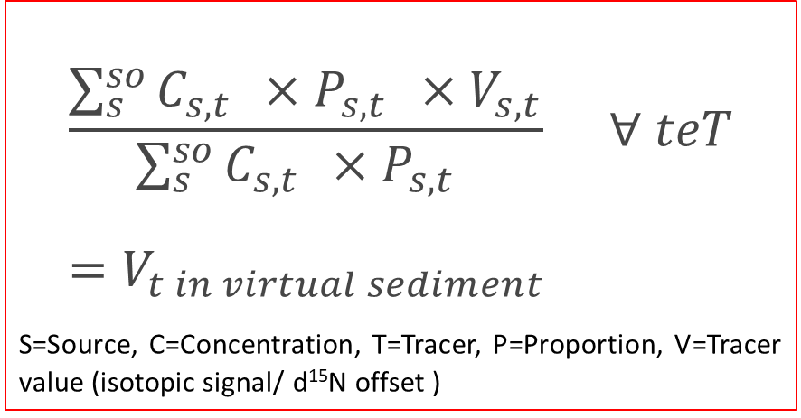
Virtual mixtures - Conditions
Virtual mixture conditions
FA concentration and d¹³C FA from Rhine catchment are used
Tracer values are weighted by the concentration of tracer
d¹⁵N offset concentration was set to 1
Mean isotopic signal and concentration values were used for each source
150 virtual sediments were generated and unmixed using the Bayesian unmixing model MixSIAR
Process error only error structure used
$$\frac{\sum_{s}^{so}{C_{s,t }} ×P_{s,t } ×V_{s,t}}{\sum_{s}^{so}{C_{s,t }} ×P_{s,t } } ∀ teT=V_{t in virtual sediment }$$
S=Source, C=Concentration, T=Tracer, P=Proportion, V=Tracer value (isotopic signal/ d¹⁵N offset )

Slide 7
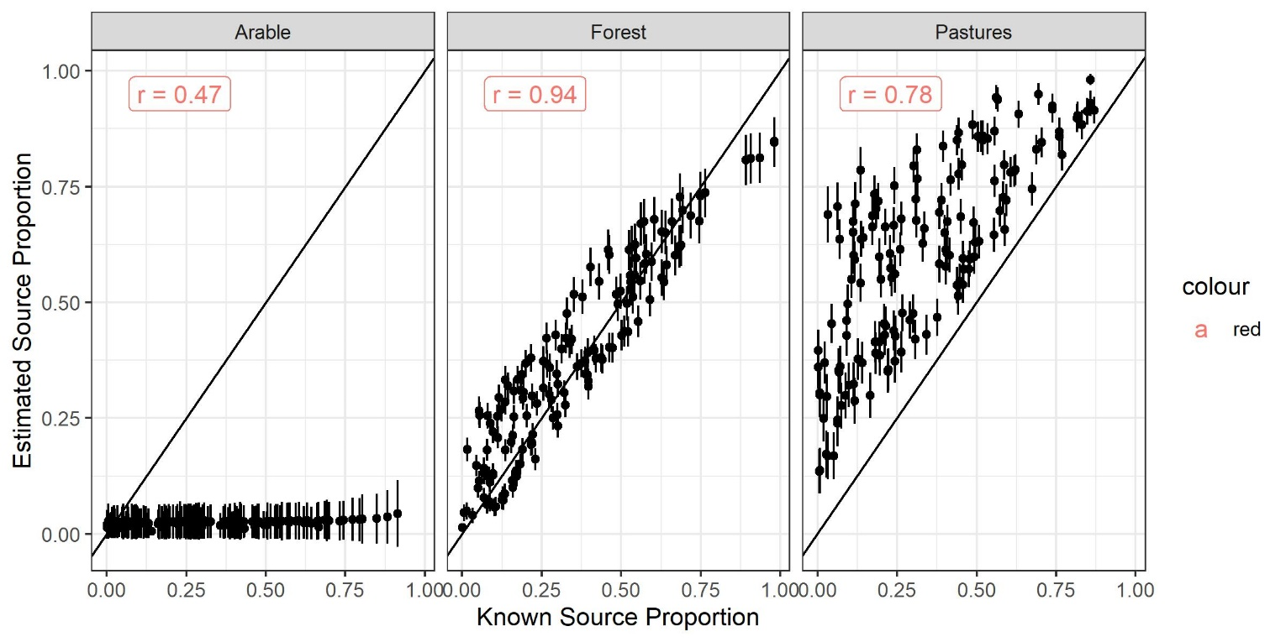
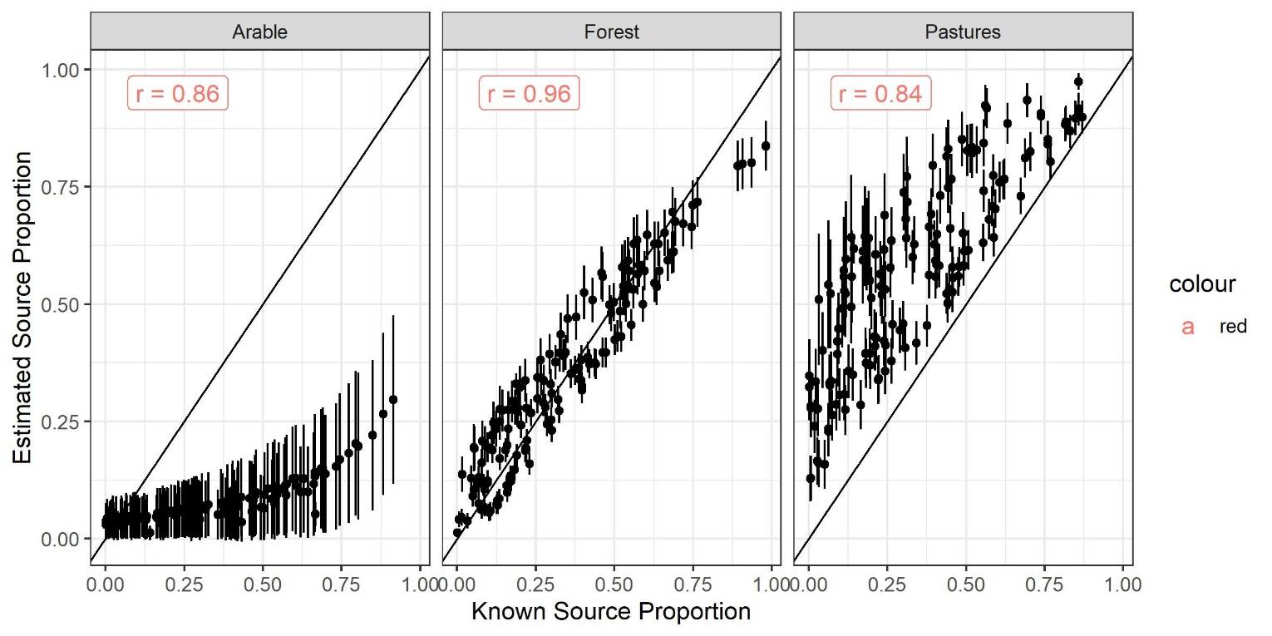
Virtual mixtures results- d¹⁵N offset + FA Scatterplots
Tracer set- ALL FA
Tracer set- d¹⁵N offset + FA

Slide 8
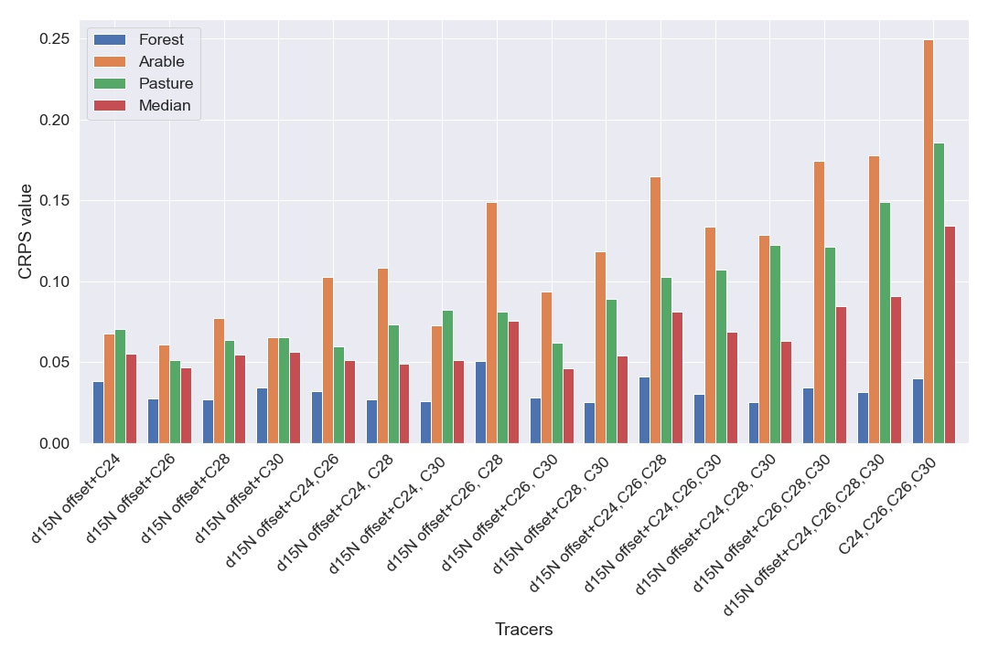
Less is more?
Just FA
Using virtual mixtures, all possible permutations of FA tracers were assayed in combination with d¹⁵N offset
Model performance increased as number of FA tracers decreased.
Thus contradicting the idea to maximise the number of conservative tracers
CRPS= Continuous ranking probability score
( lower the value= better model output)
d¹⁵N+ 4FA
d¹⁵N+ 3FA
d¹⁵N+ 2FA
d¹⁵N+ 1FA

Slide 9
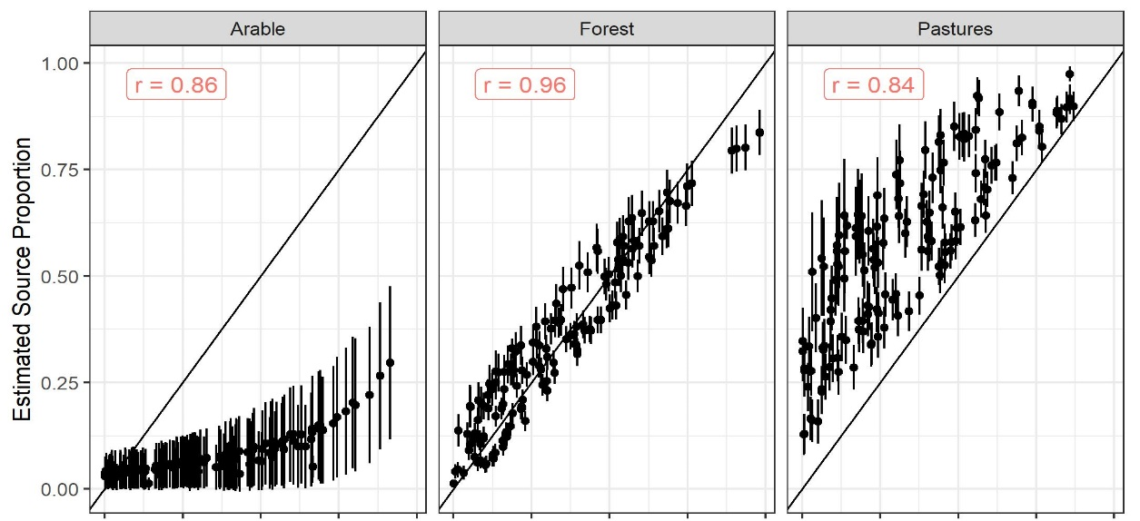
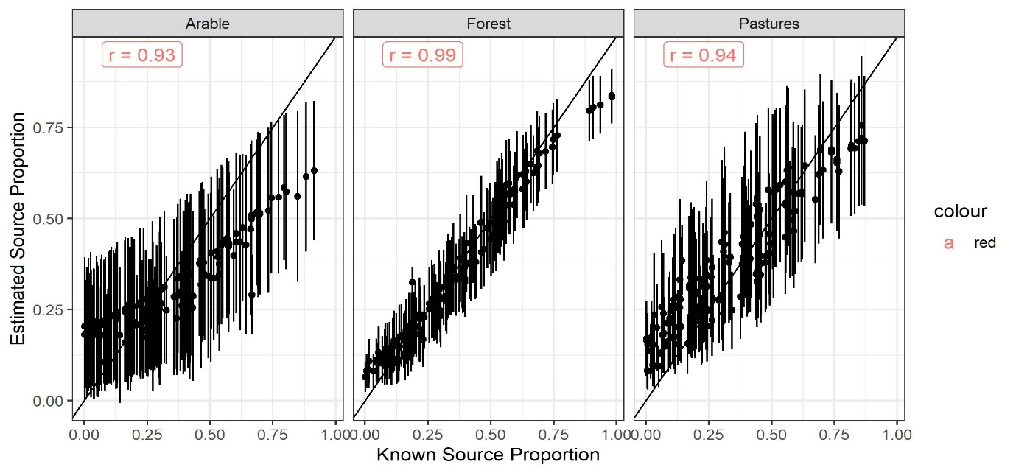
Virtual mixtures results- d¹⁵N offset + FA C26
Tracer set- d¹⁵N offset + ALL FA
Tracer set- d¹⁵N offset + FA C26

Slide 10
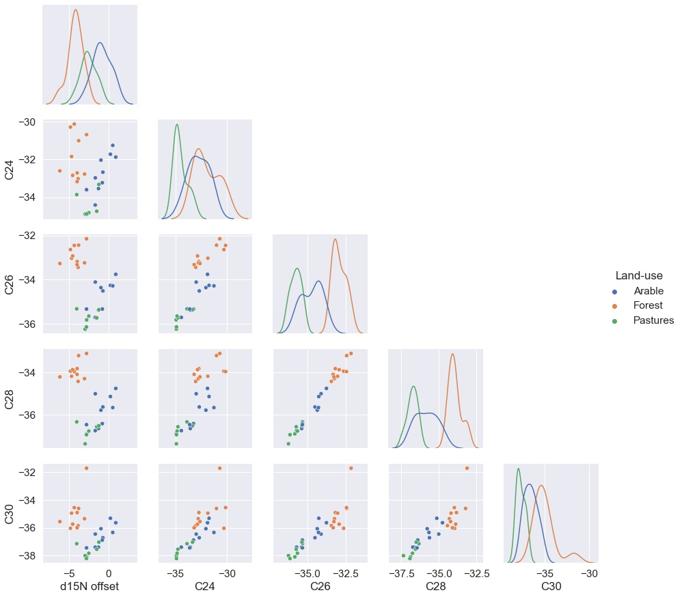
Less is more, but why?
F
P
A
Source apportionment depends on the relative difference between source values and not on absolute tracer values
By taking a closer look at the iso-plots we can see that..
The absolute value for each source is significantly different for each tracer
~ 1 ‰ d¹³C for each additional carbon
However, the relative position of each source is similar for each FA tracer.
Making additional FA tracer act as identical tracers
P
A
F
P
A
F
P
A
F
P
A
F

Slide 11
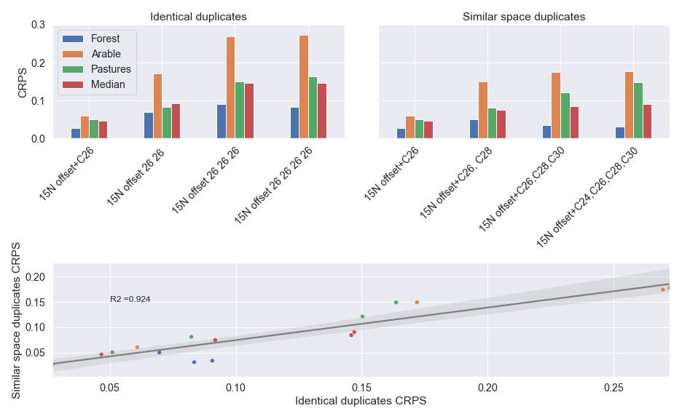
Testing the effect of using additional redundant tracers
d¹⁵N offset and additional different FA tracers were compared to d¹⁵N offset and additional identical FA tracers
Additional identical FA tracers
Additional different FA tracers
Additional different FA tracers
Additional different FA tracers
Additional identical FA tracers

Slide 12
Summary
Concentration dependent virtual mixtures allow for the evaluation of CSSI unmixing models
Using additional tracers which have a similar mixing space has a negative impact on model performance, and should be removed in tracer selection processes
Using C26 and d¹⁵N offset improves the model (compared to all FA) by 72%
Using virtual mixtures for all permutations and combinations is a definitive method for tracer selection.

Slide 13
Thank you for your attention.
And thank you to the Environmental Geosciences group at Basel for their on-going contribution to the Rhine project

